Slide 1
What Kind of Salt?
Linda Lundberg
March 19, 2022

Slide 2
I did a quick online inquiry into how many types of salt there are. Although there were varying responses, the following major types are table, kosher, sea, lake, pink, gray, fleur de sel salt flakes, Himalayan black, Hawaiian black lava, Hawaiian red, truffle, pickling, Celtic grey sea, smoked, and Cyprus black lava.
In his book, The Paradox of Choice: Why More is Less, Barry Schwartz writes about the abundance of choices Americans have now. Although having more choice should give us more freedom and autonomy, he says that psychologically that doesn’t seem to be the case.

Slide 3
Salt was one of the most important minerals in Bible times.
It was a necessity of life.
Salt could be mined from the earth or extracted from salt water. One of the ways salt was extracted was to dig saltpits and pour salt water into them. The water would evaporate, leaving salt.

Slide 4
Zephaniah 2:9
Therefore, as I live,”
Says the Lord of hosts, the God of Israel,
“Surely Moab shall be like Sodom,
And the people of Ammon like Gomorrah—
Overrun with weeds and saltpits, . . .

Slide 5
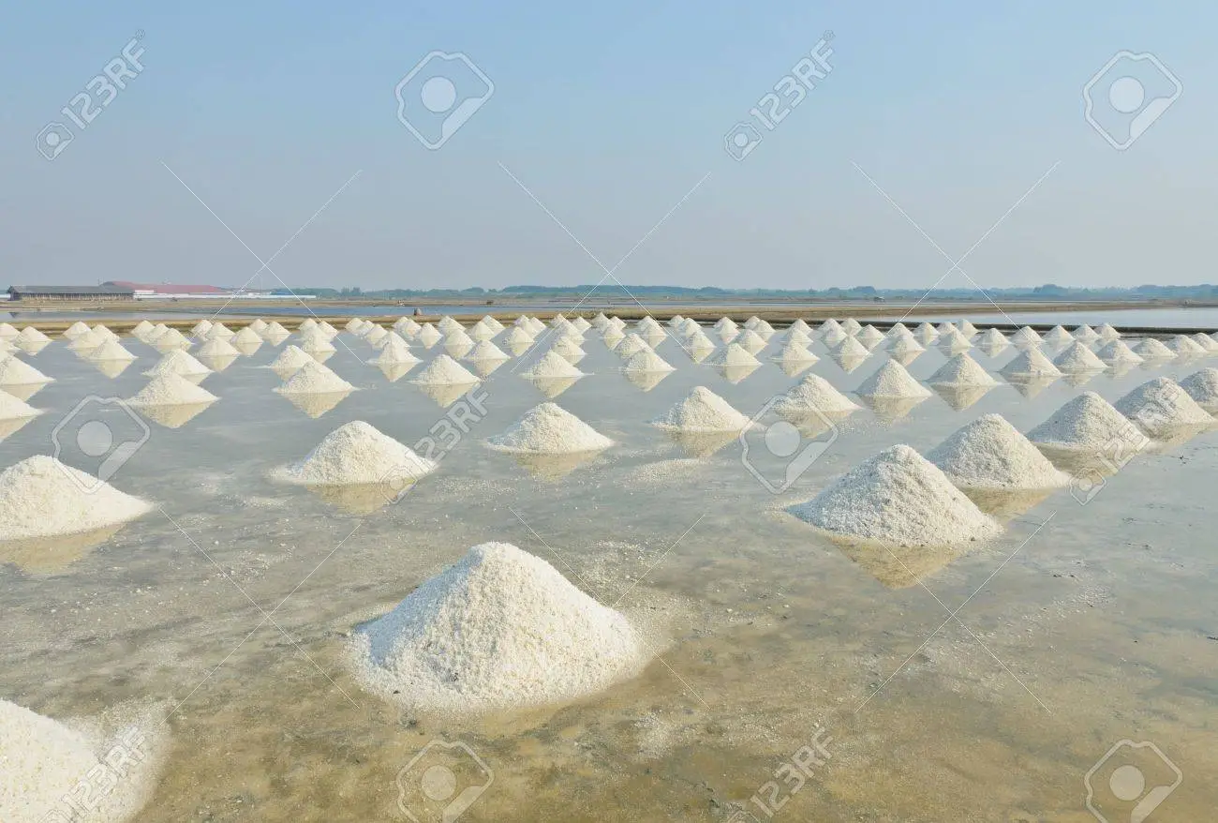
Example of Modern Salt Extraction
Notes:
Salt extraction in Thailand

Slide 6
Uses of Salt
Seasoning
Job 6:6
Can flavorless food be eaten without salt?
Or is there any taste in the white of an egg?

Slide 7
Uses of Salt
2. Trading
Salt was a valuable trade commodity.
Roman soldiers were partially paid in salt.
The Latin word for salt is sal, from which we get our word salary.

Slide 8
Uses of Salt
3. Healing
Ezekiel 16:4
As for your nativity, on the day you were born your navel cord was not cut, nor were you washed in water to cleanse you; you were not rubbed with salt nor wrapped in swaddling cloths.
Notes:
God told Ezekiel to tell Jerusalem about her abominations. The illustration is that Judah did not receive the usual care from God because she had left Him. When babies were born, they were washed and then rubbed with salt to remove any germs from their skin.

Slide 9
Uses of Salt
3. Healing
2 Kings 2:20, 21
And he said, “Bring me a new bowl, and put salt in it.” So they brought it to him.
Then he went out to the source of the water, and cast in the salt there, and said, “Thus says the Lord: ‘I have healed this water; from it there shall be no more death or barrenness.’ ”
Notes:
After Elijah was taken up to heaven, Elisha went to Jericho. The men of the city told him the city was pleasant but the water was bad and the ground was barren.

Slide 10
Uses of Salt
3. Healing
Prophets and Kings, p. 231
“…The salt mingling with the polluted spring purified its waters and brought life and blessing where before had been blighting and death. When God compares His children to salt, He would teach them that His purpose in making them subjects of His grace is that they may become agents in saving others….”

Slide 11
Uses of Salt
4. Breaking down nutrients in dung for fertilizer
Luke 14:35
“It is neither fit for the land nor for the dunghill, but men throw it out. He who has ears to hear, let him hear!”
While salt was still good, it was spread over dunghills to break down the nutrients faster so the dung could be used for fertilizer.

Slide 12
Uses of Salt
5. Preventing growth of grass and vegetation
Judges 9:45
So Abimelech fought against the city all that day; he took the city and killed the people who were in it; and he demolished the city and sowed it with salt.
Notes:
Abimelech turned against the city of Shechem.

Slide 13
Uses of Salt
5. Preventing growth of grass and vegetation
Jeremiah 17:6
For he shall be like a shrub in the desert,
And shall not see when good comes,
But shall inhabit the parched places in the wilderness,
In a salt land which is not inhabited.
Notes:
The Lord is telling Jeremiah about Judah’s sin and punishment.

Slide 14
Uses of Salt
5. Preventing growth of grass and vegetation
Conflict and Courage, p. 359
“There are many who, though striving to obey God’s commandments, have little peace or joy. This lack in their experience is the result of a failure to exercise faith. They walk as it were in a salt land, a parched wilderness. They claim little, when they might claim much; for there is no limit to the promises of God. Such ones do

Slide 15
Uses of Salt
5. Preventing growth of grass and vegetation
not correctly represent the sanctification that comes through obedience to the truth. The Lord would have all His sons and daughters happy, peaceful, and obedient. Through the exercise of faith the believer comes into possession of these blessings. Through faith, every deficiency of character may be supplied, every defilement cleansed, every fault corrected, every excellence developed.”

Slide 16
Uses of Salt
5. Preventing growth of grass and vegetation
Ezekiel 47:11
But its swamps and marshes will not be healed; they will be given over to salt.
Notes:
This verse is included in Ezekiel’s description from God of Israel’s return to the land. Some commentators think this verse indicates some land would not be healed so that the Israelites would have an adequate supply of salt.

Slide 17
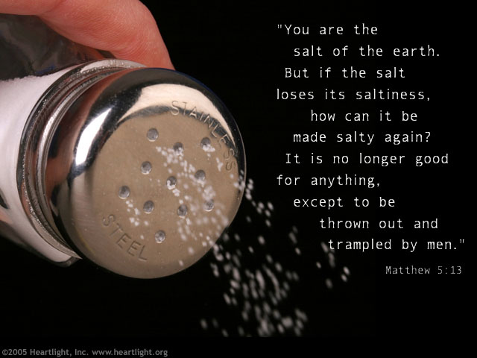
Uses of Salt
5. Preventing growth of grass and vegetation
Notes:
Ellen White in The Desire of Ages tells us that those listening to Jesus in what we know as the Sermon on the Mount could see the salt glistening on the pathways nearby, preventing grass from growing on the pathways.

Slide 18
Uses of Salt
6. Using it in worship
Leviticus 2:13
And every offering of your grain offering you shall season with salt; you shall not allow the salt of the covenant of your God to be lacking from your grain offering. With all your offerings you shall offer salt.

Slide 19
Uses of Salt
6. Using it in worship
Ezra 6:9, 10
And whatever they need—young bulls, rams, and lambs for the burnt offerings of the God of heaven, wheat, salt, wine, and oil, according to the request of the priests who are in Jerusalem—let it be given them day by day without fail,
that they may offer sacrifices of sweet aroma to the God of heaven, and pray for the life of the king and his sons.
Notes:
These verses were part of King Darius’ decree concerning rebuilding the house of God in Jerusalem.

Slide 20
Uses of Salt
6. Using it in worship
Ezra 7:21-23
²¹ And I, even I, Artaxerxes the king, issue a decree to all the treasurers who are in the region beyond the River, that whatever Ezra the priest, the scribe of the Law of the God of heaven, may require of you, let it be done diligently, ²² up to one hundred talents of silver, one hundred kors of wheat, one hundred baths of wine, one hundred baths of oil, and salt without prescribed limit.
Notes:
These verses were part of the letter from King Artaxerxes to Ezra concerning rebuilding the house of God in Jerusalem.

Slide 21
Uses of Salt
6. Using it in worship
Ezra 7:21-23
²³ Whatever is commanded by the God of heaven, let it diligently be done for the house of the God of heaven. For why should there be wrath against the realm of the king and his sons?

Slide 22
Uses of Salt
6. Using it in worship
Ezekiel 43:22-24
²² On the second day you shall offer a kid of the goats without blemish for a sin offering; and they shall cleanse the altar, as they cleansed it with the bull. ²³ When you have finished cleansing it, you shall offer a young bull without blemish, and a ram from the flock without blemish.

Slide 23
Uses of Salt
6. Using it in worship
²⁴ When you offer them before the Lord, the priests shall throw salt on them, and they will offer them up as a burnt offering to the Lord.

Slide 24
Uses of Salt
6. Using it in worship
In The Desire of Ages, p. 439, Ellen White writes that the salt used in the offerings represents Christ’s righteousness.

Slide 25
Salt of the Covenant
Leviticus 2:13
And every offering of your grain offering you shall season with salt; you shall not allow the salt of the covenant of your God to be lacking from your grain offering. With all your offerings you shall offer salt.
Notes:
Several Bible verses refer to the salt of the covenant.

Slide 26
Salt of the Covenant
Numbers 18:19
“All the heave offerings of the holy things, which the children of Israel offer to the Lord, I have given to you [Aaron] and your sons and daughters with you as an ordinance forever; it is a covenant of salt forever before the Lord with you and your descendants with you.”
Notes:
Numbers 18 describes the duties of priests and Levites, offerings to support the priests and tithes to support the Levites.

Slide 27
Salt of the Covenant
2 Chronicles 13:5
Should you not know that the Lord God of Israel gave the dominion over Israel to David forever, to him and his sons, by a covenant of salt?

Slide 28
Salt of the Covenant
The Seventh-day Adventist [SDA] Bible Commentary, Vol. 1, p. 721 indicates that “[a] covenant of salt is a perpetual covenant….”
On p. 884 a covenant of salt is described as “[a]n indissoluble covenant, one that never decays, a bond of sacred friendship….”
Nelson’s Illustrated Bible Dictionary adds that in the Middle East nomads still eat bread and salt as a sign or seal of an agreement and brotherhood.

Slide 29
Uses of Salt
7. Using it as a preservative

Slide 30
Uses of Salt
7. Using it as a preservative
The SDA Bible Commentary, Vol. 5, p. 329 describes this preserving aspect as applied to Jesus’ disciples in all ages:
“…[T]he Christian, by becoming an agent in saving others through the diffusion of the gospel, exerts a preserving and purifying influence in the world.

Slide 31
Uses of Salt
7. Using it as a preservative
The disciples were to recognize the salvation of their fellow men as their primary responsibility….”

Slide 32
Uses of Salt
7. Using it as a preservative
Thoughts From the Mount of Blessing, p. 36
“Salt must be mingled with the substance to which it is added; it must penetrate and infuse in order to preserve. So it is through personal contact and association that men are reached by the saving power of the gospel. They are not saved in masses, but as individuals. Personal influence is power. We must come close to those whom we desire to benefit.”

Slide 33
Uses of Salt
7. Using it as a preservative
Luke 14:34, 35
“Salt is good; but if the salt has lost its flavor, how shall it be seasoned?
It is neither fit for the land nor for the dunghill, but men throw it out. He who has ears to hear, let him hear!”
Notes:
One Sabbath Jesus and His disciples went to the house of one of the rulers of the Pharisees to eat. Great multitudes followed Him there, and after addressing those at the meal, he turned to the multitudes, talking to them about leaving all to follow Him.

Slide 34
Uses of Salt
7. Using it as a preservative
Counsels on Health, p. 592
“It is not God’s will that we should seclude ourselves from the world. But while in the world we should sanctify ourselves to God. We should not pattern after the world. We are to be in the world as a corrective influence, as salt that retains its savor. Among an unholy, impure idolatrous generation, we are to be pure and holy,

Slide 35
Uses of Salt
7. Using it as a preservative
showing that the grace of Christ has power to restore in man the divine likeness. We are to exert a saving influence upon the world.”

Slide 36
Uses of Salt
7. Using it as a preservative
Mark 9:49, 50
“For everyone will be seasoned with fire, and every sacrifice will be seasoned with salt.
Salt is good, but if the salt loses its flavor, how will you season it? Have salt in yourselves, and have peace with one another.”
Notes:
These words of Jesus were spoken to the disciples after the transfiguration. On their way to Capernaum the disciples had been disputing among themselves who would be the greatest. He was talking with the disciples in a house in Capernaum.

Slide 37
Uses of Salt
7. Using it as a preservative
Fire purifies and salt preserves.
The SDA Bible Commentary, Vol. 1, p. 722, states: “…Not only are they [God’s people] to become clean and holy, but they are to be kept so. The fire with which they are to be ‘salted’ does not destroy, but purifies. We are first to be cleansed, then we are to be kept….”

Slide 38
Uses of Salt
7. Using it as a preservative
Jesus’ admonition to have salt in yourselves I take as for us as well as for the disciples. If we have Jesus’ purifying influence in our lives, we will not be self-serving and have jealousies and disputes among ourselves.

Slide 39
Uses of Salt
7. Using it as a preservative
17 Letters and Manuscripts, Manuscript 117, 1902, par. 20
“The call to every one who knows the truth is to proclaim it to those who know it not, not in self-sufficiency, but in the power of Him who declares, ‘Without Me ye can do nothing.’ [John 15:5.] Truth that is not lived, that is not imparted to others, loses its life-giving power,

Slide 40
Uses of Salt
7. Using it as a preservative
its healing virtue. The truly converted are blessed by the Holy Spirit, that they may bless others. In the place of wounding and bruising the hearts of their fellow workers, men and women are to uplift and strengthen them. Thus they honor and glorify God. Not an unkind word is to pass their lips. All that they say is to heal and restore. When the workers in God’s cause

Slide 41
Uses of Salt
7. Using it as a preservative
know the truth as it is in Jesus, they will be as salt that has retained its savor. Filled with love for sinners, they will proclaim the message of present truth with such power that many will be converted.”

Slide 42
Uses of Salt
7. Using it as a preservative
Colossians 4:6
Let your speech always be with grace, seasoned with salt, that you may know how you ought to answer each one.

Slide 43
Retaining the savor
Our High Calling, p. 215
“No renewed heart can be kept in a condition of sweetness without the daily application of the salt of the Word. Divine grace must be received daily, or no man [or woman] will stay converted.”

Slide 44
Jesus makes it easy for us.
There are just two kinds of salt:
Salt that retains its savor and is a blessing to others and a powerful witness for Him in the world.
Salt that has lost its savor and is a detriment to themselves and to the world.

Slide 45
What kind of salt am I?
What kind of salt are you?
~

