Slide 1

Notes:
It is good to be here in the presence of the Lord worshipping with God’s children in His Holy Sanctuary. We are going to experience God’s presence and the manifestation of the Holy Spirit this morning. So let us prepare our hearts and minds as we look forward to the service.
I want to pause here and pray. Please pray with me and for me as wait upon the word of God.

Slide 2
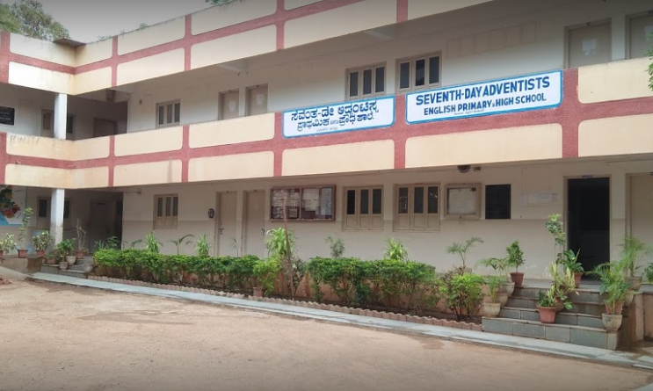
Notes:
In 1975, this is the first school where I joined as the church pastor and the principal. Valsa and I with my son Naveen worked three years before we were transferred to another school.

Slide 3

Notes:
The first biggest investment I made was in a sofa. That was the pride of my possessions. It cost me my whole month’s salary. I made Valsa and my mom to sit on that sofa. I was so happy to buy something that I still remember even today. Now this may not be a great thing for you, but some how this left an indelible impression on my mind. A new leather sofa, purchased by me for my own home. And I am the owner of that beautiful furniture that sat in my front room which was also the Principals office. I am sure you all had such an experience.

Slide 4
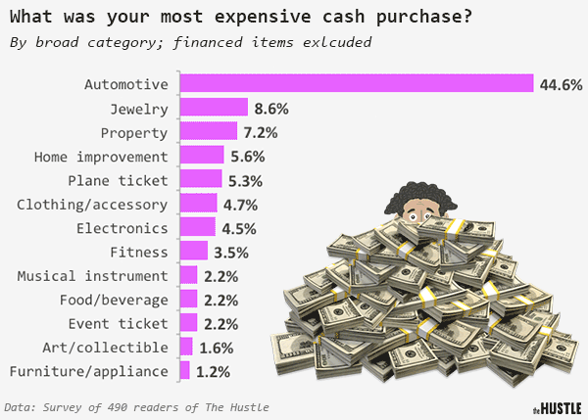
Notes:
So, let me ask you this question?
What was your most expensive cash purchase?

Slide 5

Matthew 13:45, 46 NKJV
“Again, the kingdom of heaven is like a merchant seeking beautiful pearls, who, when he had found…”
Notes:
Now compare that experience with the passage recorded in matthew. Jesus Christ spoke in parables and in Matthew 13th Chapter He compared the kingdom of God to many earthly things. One of which is a costliest, one of a kind pearl. Listen to what He says.
“Again, the kingdom of heaven is like a merchant seeking beautiful pearls, who, when he had found…”

Slide 6
Matthew 13:45, 46 NKJV
“…one pearl of great price, went and sold all that he had and bought it.”
Notes:
“…one pearl of great price, went and sold all that he had and bought it.” Matthew 13:45,46

Slide 7
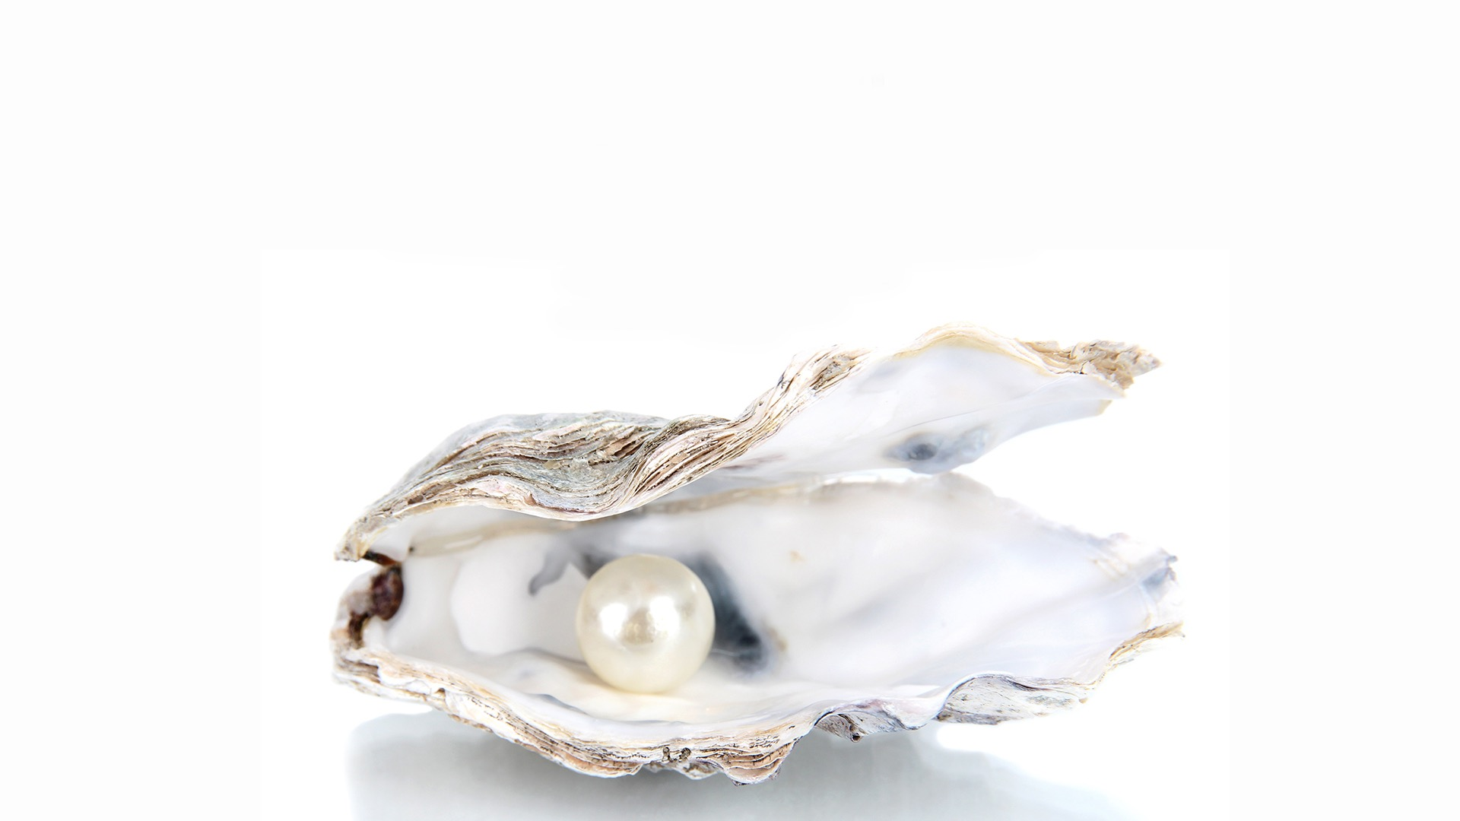
THE PEARL OF
GREAT PRICE
Notes:
THE PEARL OF GREAT PRICE
“The Lord said again, ‘The kingdom of heaven is like treasure hidden in a field which when a man hath found he hideth and for joy of it, goeth and selleth all that he hath and buyeth that field. Again the kingdom of heaven is like a merchant man, seeking fine pearls who when he had found one pearl of great price, went and sold all that he had and bought it.’
Now, if we were to sum up the meaning of these two parables, we could sum them up under the title “The Incomparable Value of the Kingdom.” The Incomparable Value of the Kingdom.

Slide 8
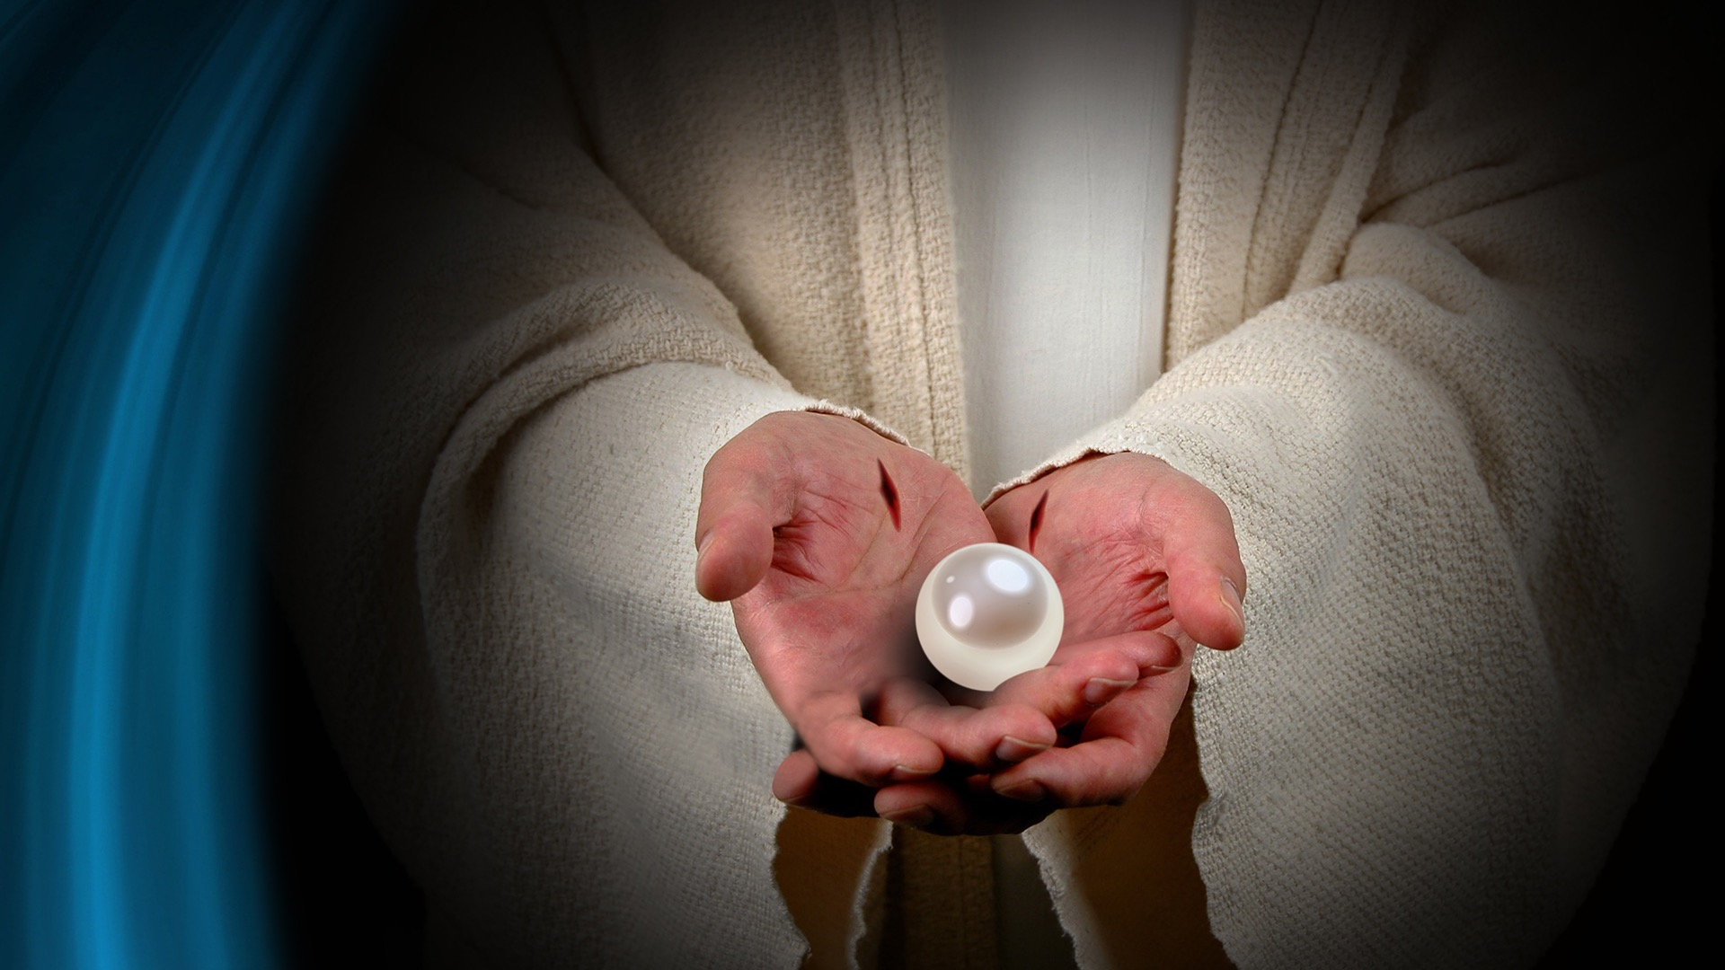
Notes:
Jesus was teaching, and He was seeking to make plain the value of salvation for the "kingdom of heaven” was the expression Jesus used here to refer to salvation. There was no accident involved in the comparison He chose to use. A pearl is not the product of human manufacture. Only God can make a pearl, for it grows in the body of an oyster and its color and shape are those that the environment brings about.

Slide 9
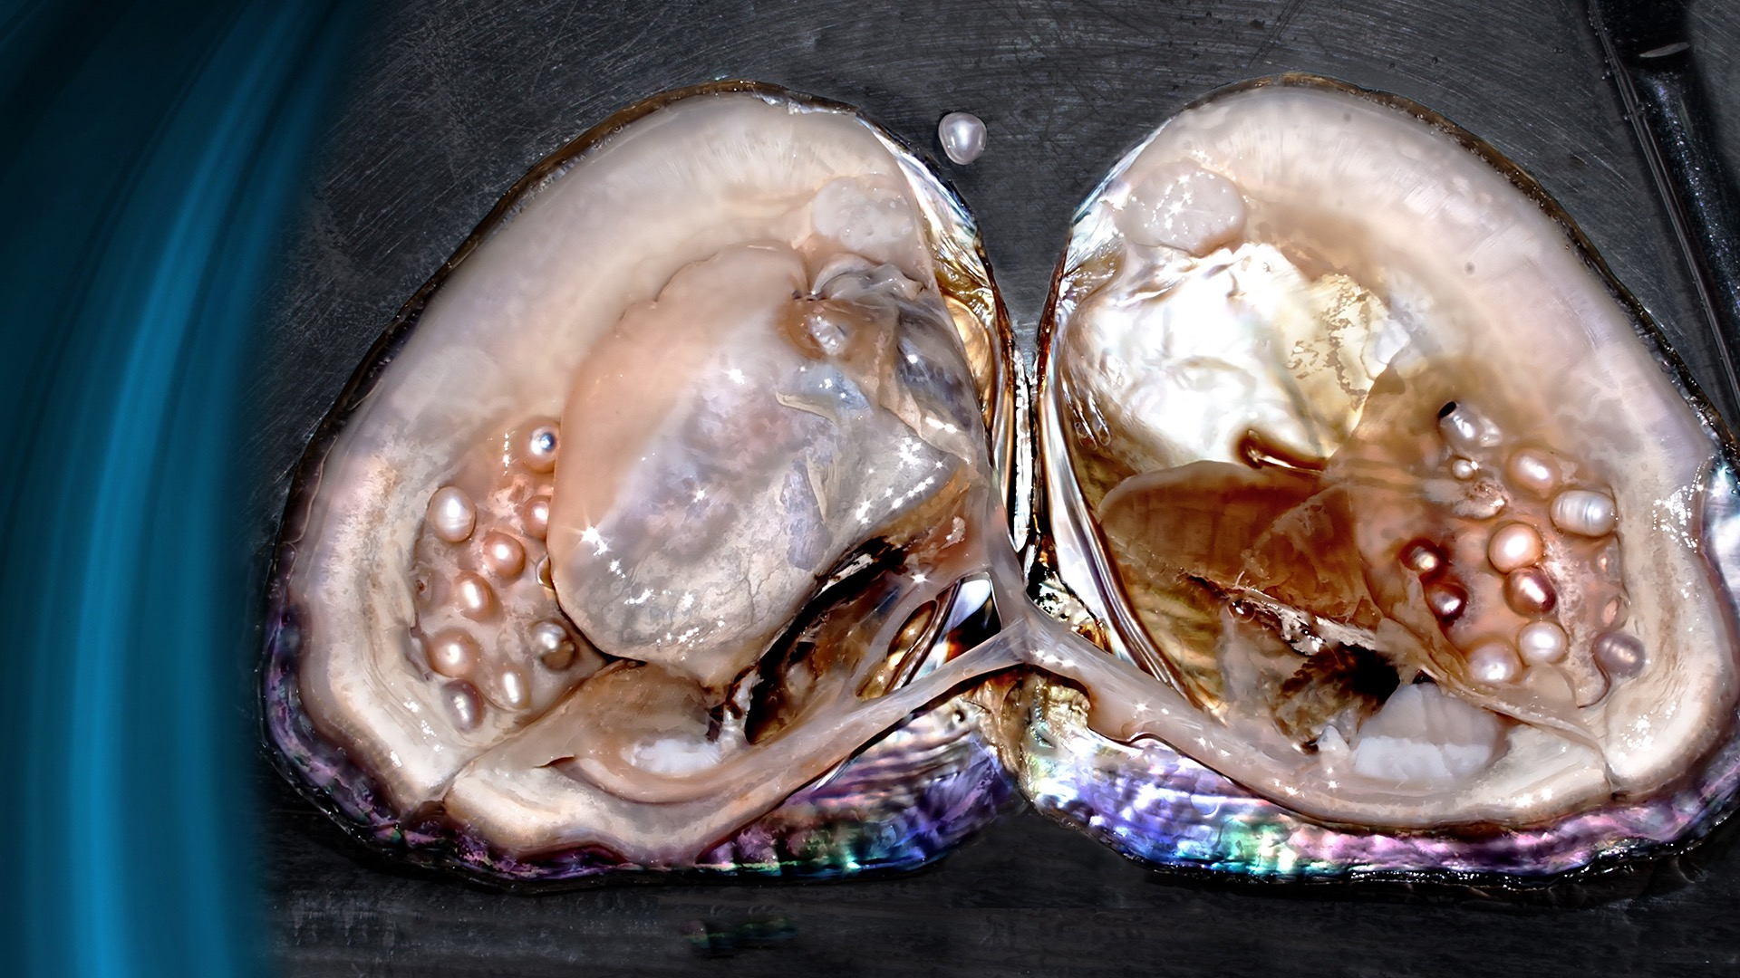
Notes:
It is true that today the Japanese produce "cultured" pearls by farming oysters in the sea and placing in their bodies grains of a foreign substance that cause the oyster to produce pearls. The process is still one of nature, and these pearls do not bring the price that natural pearls do.

Slide 10
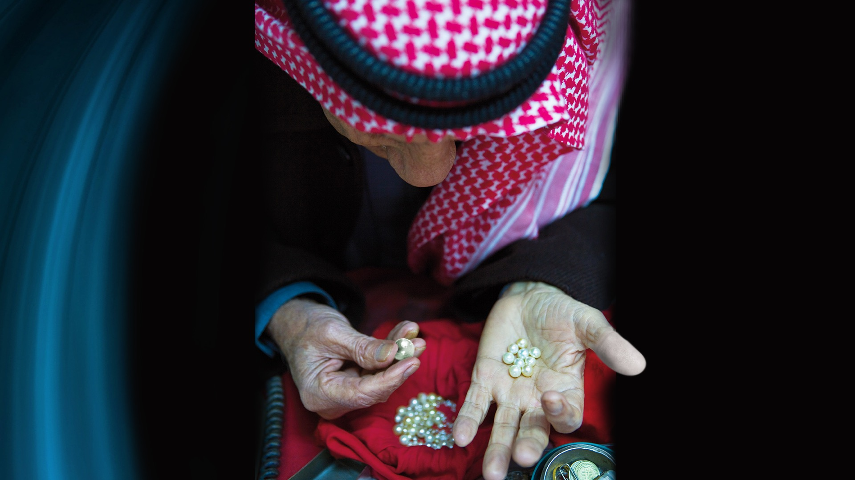
Notes:
The man in the parable must have loved gems, and in particular pearls, for it seemed to him that he must have this pearl; the finest he had ever seen—possibly the finest in existence.
Salvation is like that. There is NO substitute for it, and it can be obtained only by a willingness to surrender anything we possess.

Slide 11
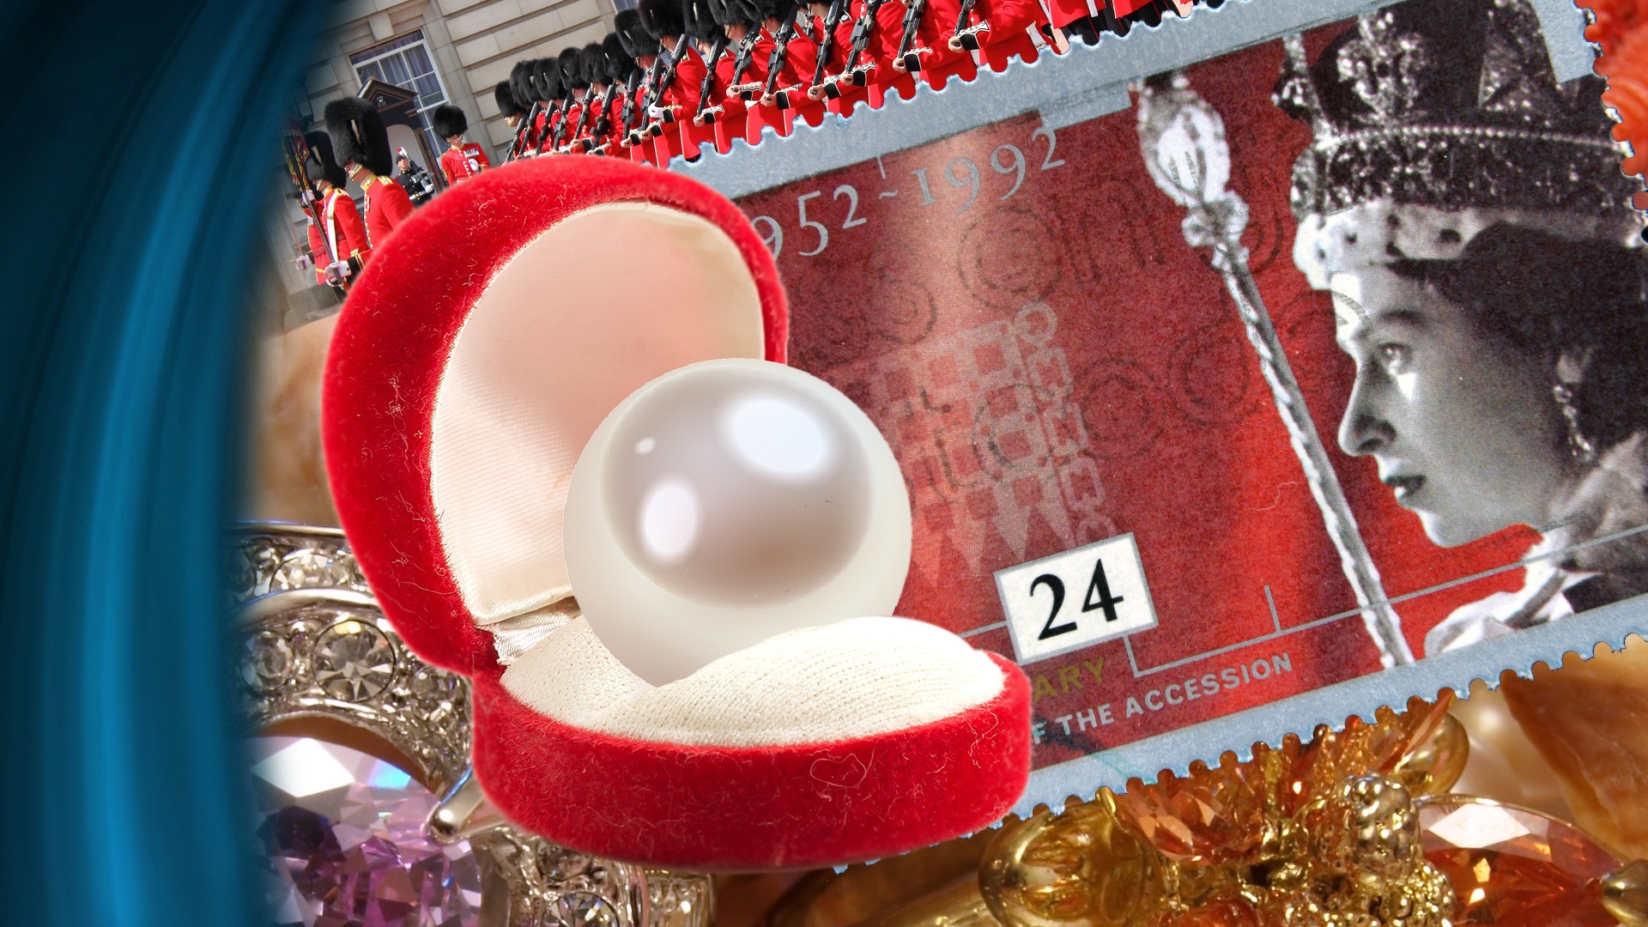
Notes:
It is odd that people will sacrifice almost anything for material possessions and yet deny themselves the priceless gift of salvation.
Among the crown jewels which belong to the reigning monarch of England, which are kept under tight security in the Tower of London, is such a pearl as this man must have bought.
It is an absolutely perfect pearl of staggering size, for it is about the size of a pigeon's egg. It is hard to say what its purchase price might be for it is not for sale, and probably never will be. But its value is far less than the value of salvation.

Slide 12
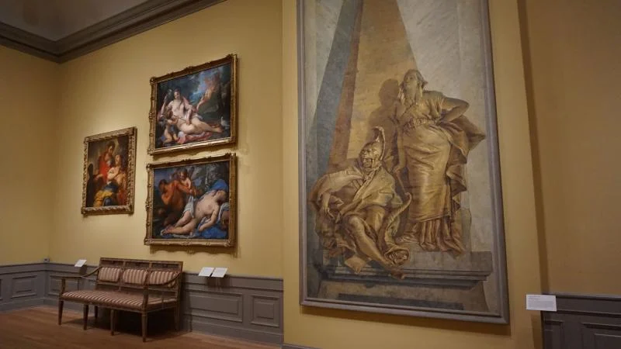
Notes:
People love collecting Art and owning it..

Slide 13

Notes:
"But," you say, "salvation is free, isn't it?"
Yes, salvation is free, but only in the sense that it cannot be bought and that it is available to anyone who has the price, and everyone has the price.
Let us put in contrast to this parable of Jesus, another that He also told.

Slide 14
Luke 12:16-21 NKJV
“Then He spoke a parable to them, saying: “The ground of a certain rich man yielded plentifully…”
Notes:
“Then He spoke a parable to them, saying: “The ground of a certain rich man yielded plentifully…”

Slide 15
Luke 12:16-21 NKJV
“…And he thought within himself, saying, ‘What shall I do, since I have no room to store my crops?’ So he said,…”
Notes:
“…And he thought within himself, saying, ‘What shall I do, since I have no room to store my crops?’ So he said,…”

Slide 16
Luke 12:16-21 NKJV
“…‘I will do this: I will pull down my barns and build greater, and there I will store all my crops and my goods…”
Notes:
“…‘I will do this: I will pull down my barns and build greater, and there I will store all my crops and my goods…”

Slide 17
Luke 12:16-21 NKJV
“…And I will say to my soul, “Soul, you have many goods laid up for many years; take your ease;
eat, drink, and be merry…”
Notes:
“…And I will say to my soul, “Soul, you have many goods laid up for many years; take your ease;
eat, drink, and be merry…”

Slide 18
Luke 12:16-21 NKJV
“…But God said to him, ‘Fool! This night your soul will be required of you; then whose will those things be which…”
Notes:
“…But God said to him, ‘Fool! This night your soul will be required of you; then whose will those things be which…”

Slide 19
Luke 12:16-21 NKJV
“…you have provided?’ “So is he who lays up treasure for himself, and is not rich toward God.”
Notes:
“…you have provided?’ “So is he who lays up treasure for himself, and is not rich toward God." Luke 12:16-21 NKJV.

Slide 20

Notes:
The contrast is plain. One man was willing to give up all his possessions to gain salvation. The other man was willing to give up nothing, and God calls him a fool, a term used very seldom by God in the Bible.
The question that God puts to every man is: "Will your salvation cost you all that you have; or will what you have cost you your salvation?"
If we only could sense the joy of salvation in this life, there would be fewer who would make the wrong choice.

Slide 21
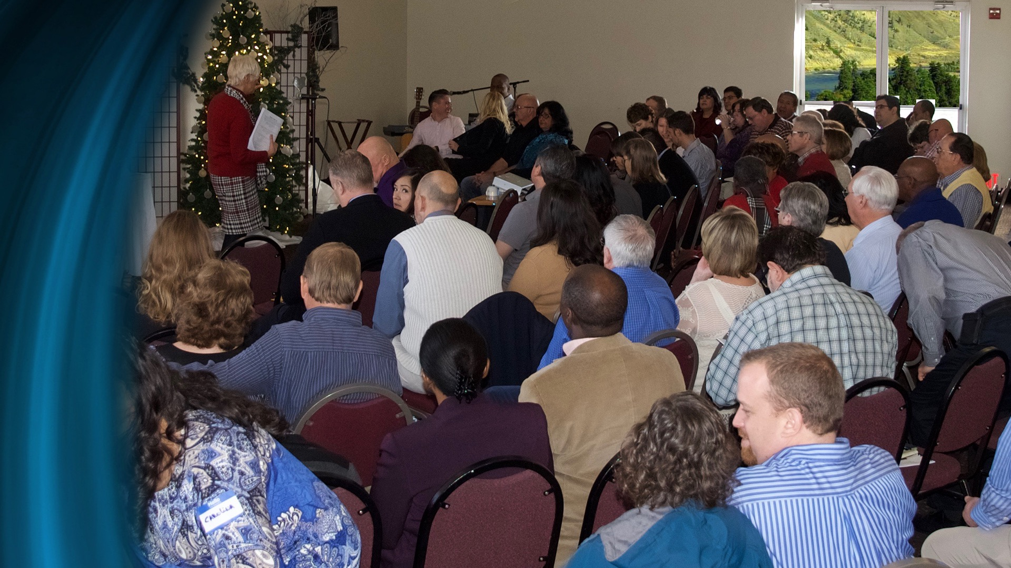
Notes:
A man and his wife attended a religious camp meeting in Canada a few years ago. The wife was there because she loved the Lord and wanted to fellowship with the people of God and listen to the instruction that would be given. The man came because his wife had told him that she wanted to attend, and he had told her that he would be glad to take her. But while he was attending the meetings he planned to take his fishing gear and go into the mountains to fish until the meetings were over.

Slide 22

Notes:
When they arrived at the campground and were unpacking, the wife asked her husband why he did not stay overnight as it was already late afternoon. This would give him time to rest a bit and get his gear ready, and he would still have plenty of time to fish during the next week, for the meetings would last that long. He good-naturedly agreed.
The next morning, he went to the meeting with his wife. During the large late-morning meeting an appealing evangelistic sermon was given and an altar call came at its end. The husband did not respond, perhaps thinking that this was not for him. But near the end of the altar call a minister left his seat in the congregation and walked over to the husband and personally appealed to him to yield his life to God. Both of them went together to the front of the auditorium.

Slide 23

Notes:
One of the pastors noticed that this man was present at every meeting. At the end of the camp meeting he asked the husband how the fishing had been.
"I never unpacked my fishing gear—I have not missed one of these meetings!" was the answer.

Slide 24

Notes:
There is a lovely sequel to this story. A year later the same couple was back at the annual camp meeting. During an altar call this husband was invited to come to the rostrum for an interview.
"Is there anything you would like to say to those here who may not have made a decision for Christ?" the speaker asked.
"Yes, there is. This last year has been the happiest year of our lives, for my wife and me. I would recommend everyone here who is not a Christian to do what I did a year ago!”
This good man had done what was necessary to gain the pearl of great price and had found with it a blessing that he had never even imagined before.

Slide 25

Christ’s Object Lessons, p. 116
“In the parable, the pearl is not represented as a gift. The merchantman bought it at the price of all that he had…”
Notes:
A renowned Christian writer has commented on this parable as follows:
"In the parable, the pearl is not represented as a gift.
The merchantman bought it at the price of all that he had…

Slide 26
Christ’s Object Lessons, p. 116
“…Many question the meaning of this, since Christ is represented in the Scriptures as a gift. He is a gift, but only to…”
Notes:
…Many question the meaning of this, since Christ is represented in the Scriptures as a gift. He is a gift, but only to…

Slide 27
Christ’s Object Lessons, p. 116
“…those who give themselves, soul, body, and spirit to Him without reserve. We are to give ourselves to Christ,…”
Notes:
…those who give themselves, soul, body, and spirit to Him without reserve. We are to give ourselves to Christ,…

Slide 28
Christ’s Object Lessons, p. 116
“…to live a life of willing obedience to all His requirements. All that we are, all the talents and capabilities we possess,…”
Notes:
…to live a life of willing obedience to all His requirements. All that we are, all the talents and capabilities we possess,…

Slide 29
Christ’s Object Lessons, p. 116
“…are the Lord's, to be consecrated to His service. When we thus give ourselves to Him, Christ,…”
Notes:
…are the Lord's, to be consecrated to His service. When we thus give ourselves to Him, Christ,…

Slide 30
Christ’s Object Lessons, p. 116
“…with all the treasures of heaven gives Himself to us. We obtain the Pearl of Great Price.”
Notes:
…with all the treasures of heaven gives Himself to us. We obtain the Pearl of Great Price." –Christ’s Object Lessons, p. 116.

Slide 31
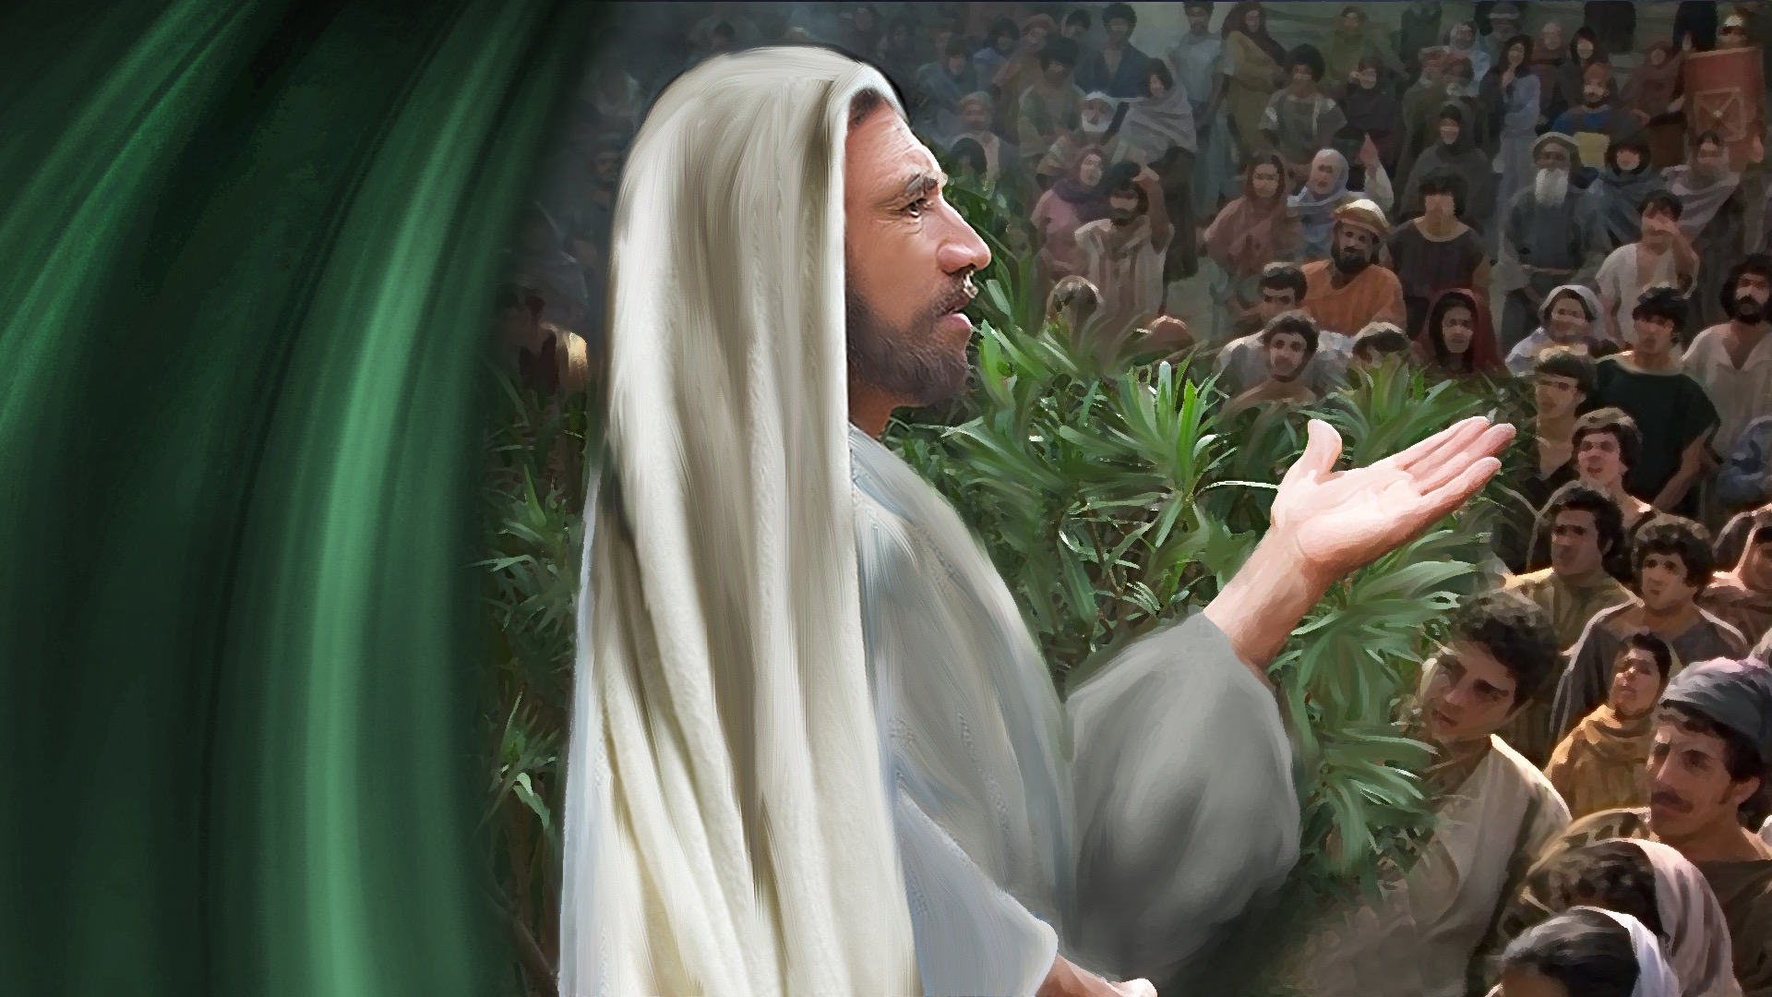
Notes:
Paul stated essentially the same thought in different language.

Slide 32
1 Corinthians 9:24, 25 NKJV
“Do you not know that those who run in a race all run, but one receives the prize? Run in such a way that you may obtain it…”
Notes:
“Do you not know that those who run in a race all run, but one receives the prize? Run in such a way that you may obtain it…”

Slide 33
1 Corinthians 9:24, 25 NKJV
“…And everyone who competes for the prize is temperate in all things…”
Notes:
“…And everyone who competes for the prize is temperate in all things…”

Slide 34
1 Corinthians 9:24, 25 NKJV
“…Now they do it to obtain a perishable crown, but we for an imperishable Crown.”
Notes:
“…Now they do it to obtain a perishable crown, but we for an imperishable Crown.” 1 Corinthians 9:24,25 NKJV.

Slide 35
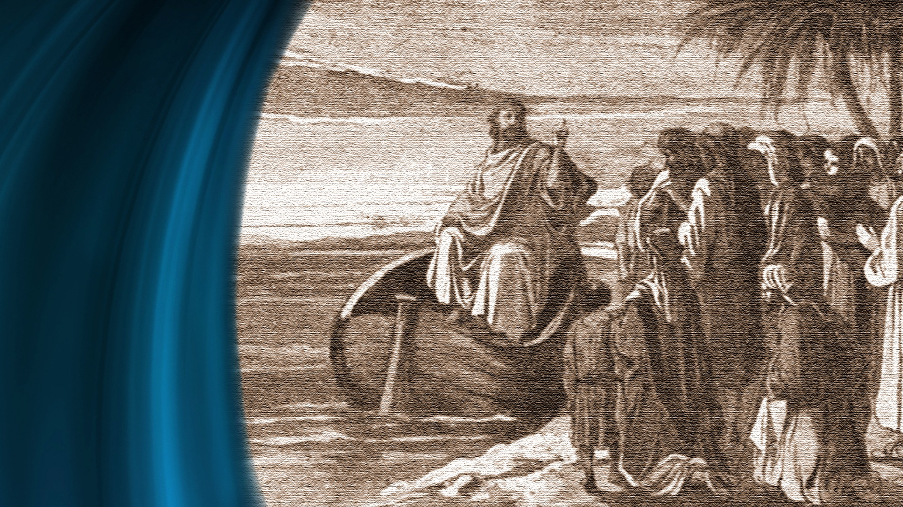
Notes:
Jesus said of the gem buyer, He…

Slide 36
Matthew 13:46 NKJV
“…went and sold all that he had, and bought it.”
Notes:
Going back to our parable, the merchant …"went and sold all that he had and bought it.”

Slide 37
Luke 5:27, 28 MKJV
“After these things He went out and saw a tax collector named Levi, sitting at the tax office…”
Notes:
What does it mean, to sell all the things and buy?
The calling of Matthew.
Jesus knew what He was talking about. It was exactly on this basis that He called His disciples.
“After these things He went out and saw a tax collector named Levi, sitting at the tax office…”

Slide 38
Luke 5:27, 28 MKJV
“…And He said to him, “Follow Me.” So he left all, rose up, and followed Him.”
Notes:
“…And He said to him, “Follow Me.” So he left all, rose up, and followed Him.” Luke 5:27, 28 NKJV

Slide 39
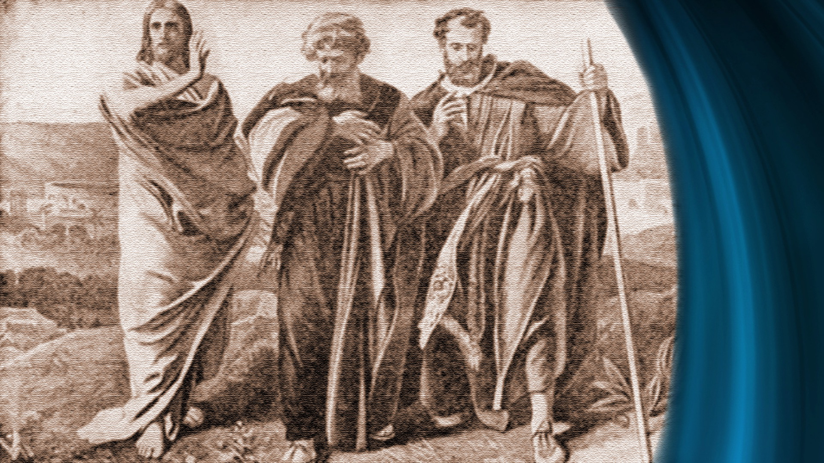
Notes:
This is the story of the calling of Matthew. Luke, in telling the story, knew that Matthew was a very wealthy man engaged in a most profitable profession.
So, Luke said, "He left all."
The calling of the fishermen. Some of the disciples did not have so much to leave, but they did exactly what Matthew did.
They left all.

Slide 40
Matthew 4:18-20 NKJV
“And Jesus, walking by the Sea of Galilee, saw two brothers; Simon called Peter, and Andrew his brother,…”
Notes:
“And Jesus, walking by the Sea of Galilee, saw two brothers; Simon called Peter, and Andrew his brother,…”

Slide 41
Matthew 4:18-20 NKJV
“…casting a net into the sea; for they were fishermen. Then He said to them, “Follow Me,…”
Notes:
“…casting a net into the sea; for they were fishermen. Then He said to them, “Follow Me,…”

Slide 42
Matthew 4:18-20 NKJV
“…and I will make you fishers of men.” They immediately left their nets and followed Him.”
Notes:
…and I will make you fishers of men.” They immediately left their nets and followed Him." Matthew 4:18-20 NKJV.

Slide 43
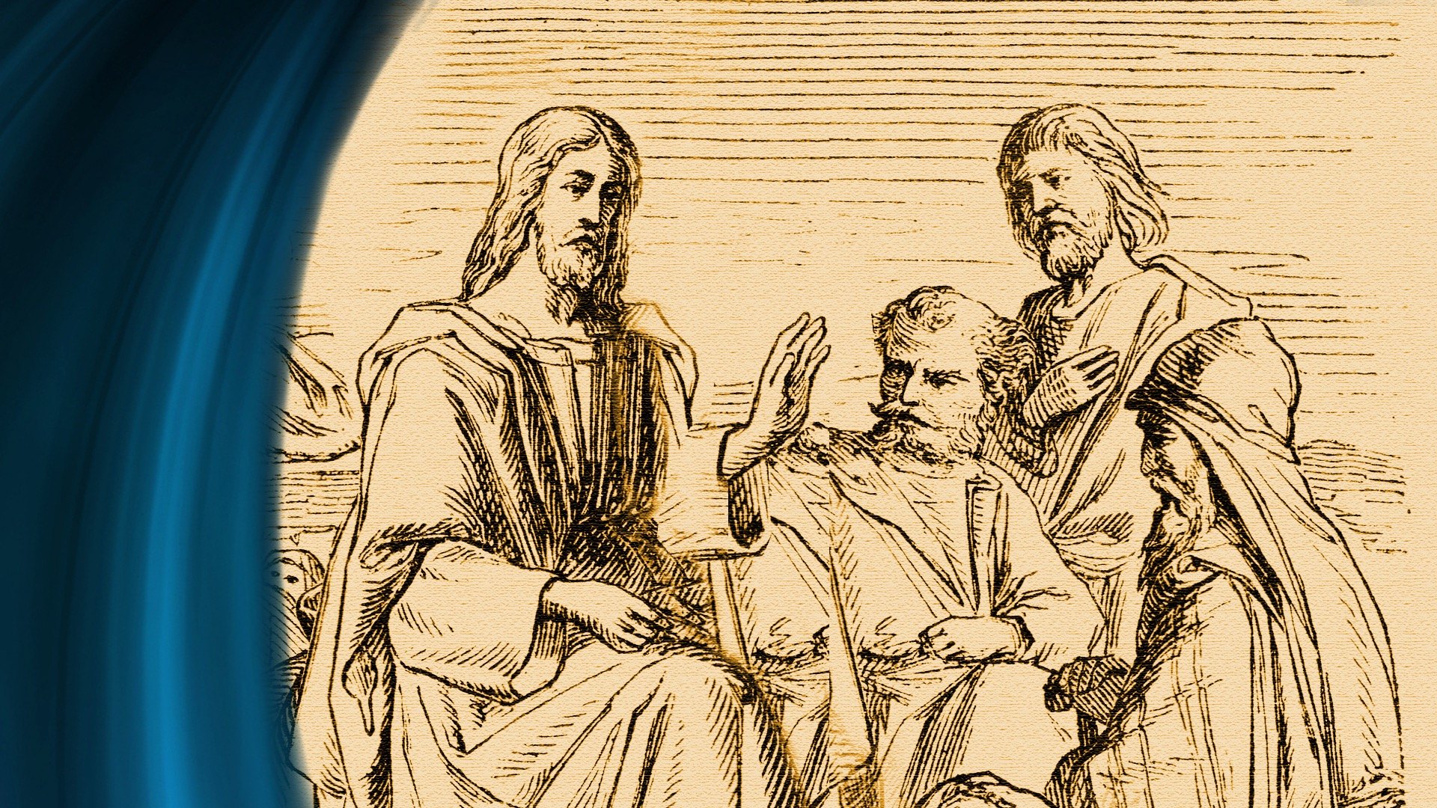
Notes:
Peter and Andrew had only the tools of fishermen, probably worth almost nothing in the eyes of a man as rich as Matthew; but it was all that they had, and they left it. In leaving all, they gained all.

Slide 44
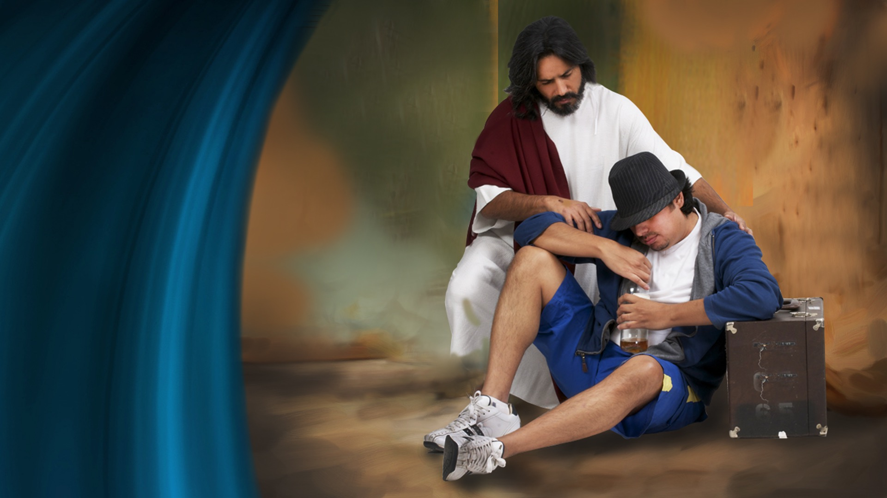
Notes:
Sadly, there are some who feel the call of the gospel and are not willing to answer the call.
They may finally come to Christ, but in the meantime, they will have paid a far higher price than God ever intended for them to pay.

Slide 45

Notes:
The lesson the truck driver learned.
A young husband and father had actually joined the church and had been faithful for a time when great temptation came to him. He was a truck driver and he was offered a seemingly lucrative contract. In order to get the contract he had to buy a new outfit; a truck with the equipment to go with it to make it possible for him to do the job. He took the job and bought the truck with very heavy payments to make on it.
When he started on the new job it soon became apparent to him, or at least it seemed so, that he would have to haul seven days a week to make enough money to meet his payments and support his family. Although he knew it was wrong, he worked on God's time, the Sabbath.

Slide 46

Notes:
This was during the depression of the 30's and times grew very hard. The company with whom this unfortunate man had the contract went bankrupt and his contract was worthless. Desperately, he sought more hauling jobs, but competition was fierce and he found few. He fell behind on his payments and could not even find day labor to earn money with which to meet his obligations. One day the sheriff came while he was away from home and took not only the truck but all the equipment with it. He was left empty-handed.
The awful day came when he had to appeal to the county for relief. His wife and his three small children wore second-hand clothing and ate very poorly.
It was when things were about as bad as they could get that he found his way back to the church. He confessed his folly and was reunited with the church by rebaptism.
Not long after this, he found good-paying employment at a trade that he enjoyed.

Slide 47

Notes:
One day he met his former pastor and joyfully told him about the new job. The pastor's heart was gladdened as he listened to the enthusiastic description of the new job. But he also thought of the past. "And what about the Sabbath?" he asked, almost afraid of what the answer might be.
"Don't ever worry about that," the happy narrator answered. "I learned my lesson once. I will never make that mistake again!"

Slide 48

Notes:
This is the happy ending of the story. But there is another factor that we must not forget. This young husband had suffered a great deal of remorse and anxiety; remorse for the mistake he had made and anxiety for the deprivations that his family had to endure.
Did God ever intend that this man's young wife should go through deprivation and humiliation? Not at all. Nor did God want the children to wear shabby clothes, donated by sympathetic friends who did not have much to spare themselves.
No, God does not enjoy anything that makes His created beings unhappy or causes them to suffer. Sometimes it is necessary for a person to suffer to appreciate the great value of salvation.

Slide 49

Notes:
Jesus was aware of the temptations of the wealthy. He astounded His disciples by warning them of the deceitfulness of riches, for they seemed to think that the rich were sure to be saved. He told the powerful parable that we referred to earlier to illustrate this.
Sometimes it is not great riches that deceive us but the lust for acquiring money that dries up our spiritual springs.

Slide 50
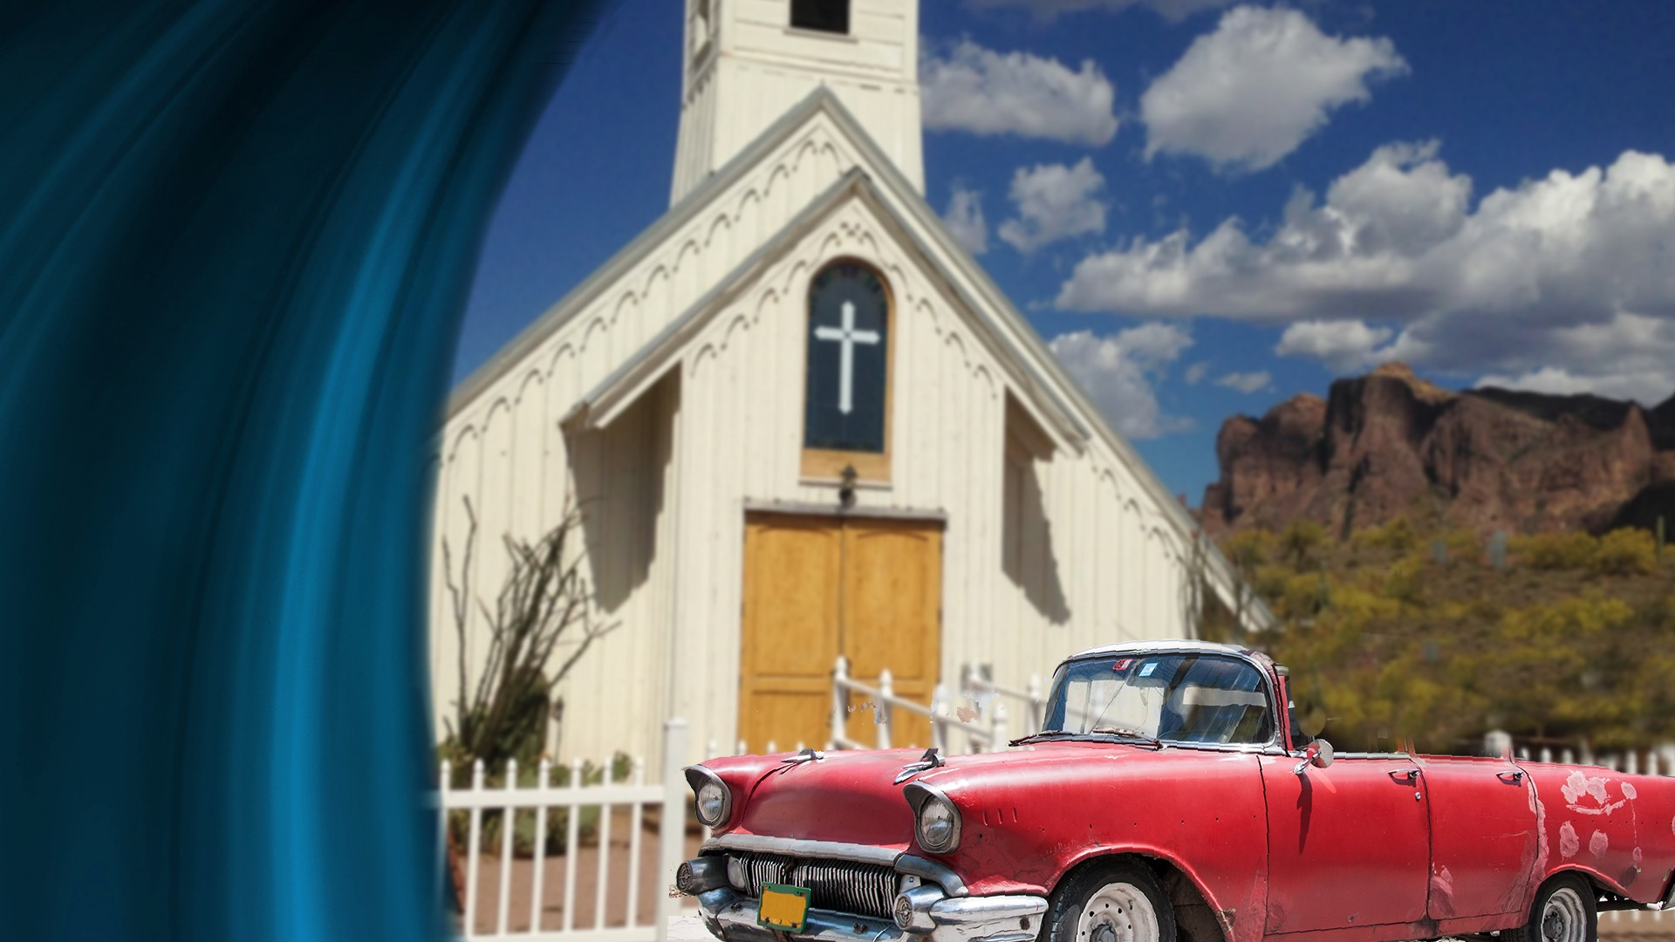
Notes:
In a small city in the West there was a little white church—an Adventist church to which came every Sabbath a mother and two growing girls. Each Sabbath they were brought by their father in a rickety old car. It had once been a "touring car"; what we could call today, a convertible. But it had long since lost its top. Its paint was almost gone, and the wooden spokes in the wheels were so shrunken that they rattled when the car moved.
The father was a farmer and if anyone had suggested that the car needed replacing he would have indignantly said that he could afford nothing better.
The girls' mother would have liked to send them to a Christian school, but that was financially impossible, the husband decided. He really had no interest in religion. Farming and making money were his life.

Slide 51

Notes:
And then it came to pass that one day his wife told him of some troublesome symptoms that she was having. He had noticed that she had not seemed well and strong as usual but thought it a passing thing. Since his wife was not one to complain, now that she had confided in him, he was alarmed and frightened, for his wife meant a great deal to him, although he probably did not express his regard very much.
He immediately took his wife to town and to the family doctor. After examining her, the doctor looked troubled. “I think you should have some tests made that I am not equipped to make. She will probably need to be in the hospital for a few days.”

Slide 52
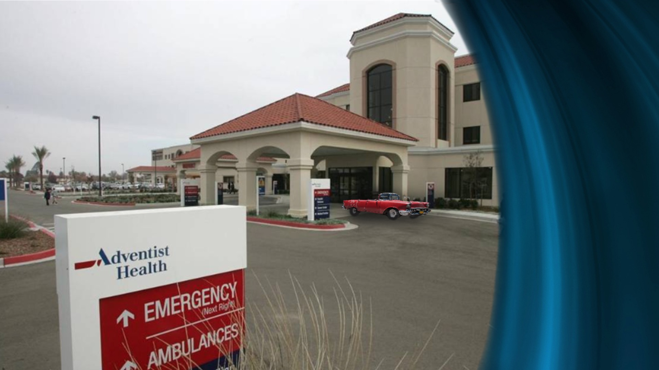
Notes:
The husband and wife left the office in a daze. Neither had expected anything serious. As they drove back home in the rickety old car, they discussed the future.
Where should they go? Timidly, the wife said that she would like to go to a Seventh day Adventist hospital, over a hundred miles away.
"If that is what you want, that is where we will go, tomorrow." said the husband, to his wife's considerable surprise. And tomorrow they went.

Slide 53

Notes:
The hospital's diagnosis was cancer and the recommendation was immediate surgery. There was no alternative, the hospital doctors said.
The world seemed to have collapsed around the farm couple, but the reality had to be faced and surgery was agreed upon and performed the next day.
The husband stayed by until the wife seemed out of immediate danger and then drove his lonely way home to see about his farm and his daughters.
He was not gone long. Only a couple of days or so and he was back, anxiously hoping to see his wife looking better. She did not seem to be much stronger, but she did her best to put on a brave front.

Slide 54

.
Notes:
"Dear, there's something I want you to see," said her husband. "I am going to move your bed over by the window so you can look out.”
The move was made and the wife looked out.
"Don't you see that car on the driveway?"
"Yes, I see it."
"That's our carl" the husband proudly exclaimed. "I drove it here myself. I decided that you deserved something decent to go home in when you are well, and I needed something dependable to come up here in so I could see you.”
If surprise could have cured the ailing wife, she would have been well almost instantly, for she did not know that her husband had money enough even for a good used car, and this one was sparkling new.

Slide 55

Notes:
That was not the end of her surprises, for a bit later her husband transferred the girls from the public school and enrolled them in a Seventh-day Adventist academy, to the great delight of both the girls and their mother.
Shortly after this he came to her room with a roll of blueprints which he told his wife were the drawings for a new house.
"But, Darling, we don't need a new house," the wife said. "Our house is good enough."
"Oh, yes, we do. The old shack is not really comfortable summer or winter and it takes a lot more work to keep clean than a modern house would.
So I'm going to build a new one. I want you to tell me how this suits you and if there are changes you want, we will have them made!”
All these things came to pass, but the wife never left the hospital alive, for her illness was terminal.

Slide 56

Notes:
A few months later there was a camp meeting in the state, and one evening a revival meeting was in progress. It concluded with an urgent call for surrender to those who had never been Christians.
Some in the congregation were startled to see this bereaved husband, with his two Christian daughters, make his way to the altar and kneel in surrender. There were those who wept with the husband. The tears were tears of joy, but at least in one mind there came the thought: "It isn’t quite fair that the Christian wife could not be here to see this. It just isn't fair!" But the wife, could she have known what was happening, would have said that the question of fairness did not matter at all. What mattered was the salvation of her family.
"Even your suffering?"
"Yes, even my suffering—and far more, if that is what it took," would have been the answer.

Slide 57

Notes:
The words of our Saviour never lose their import. They are just as true today as when He spoke them. We should heed them much more seriously than we do.

Slide 58
Matthew 16: 24-26 NKJV
“If anyone desires to come after Me, let him deny himself, and take up his cross, and follow Me…”
Notes:
Then Jesus said to the disciples: “If anyone desires to come after Me, let him deny himself, and take up his cross, and follow Me…”

Slide 59
Matthew 16: 24-26 NKJV
“…For whoever desires to save his life will lose it, but whoever loses his life for My sake will find it. For what profit is it to a…”
Notes:
“…For whoever desires to save his life will lose it, but whoever loses his life for My sake will find it. For what profit is it to a…”

Slide 60
Matthew 16: 24-26 NKJV
“man if he gains the whole world, and loses his own soul? Or what will a man give in exchange for his soul?”
Notes:
“man if he gains the whole world, and loses his own soul? Or what will a man give in exchange for his soul?” Matthew 16:24-26 NKJV

Slide 61
Notes:
Will you accept the pearl of great price today—the precious gift of salvation that Christ offers you? It is worth more than any other possession in all the world.

Slide 62
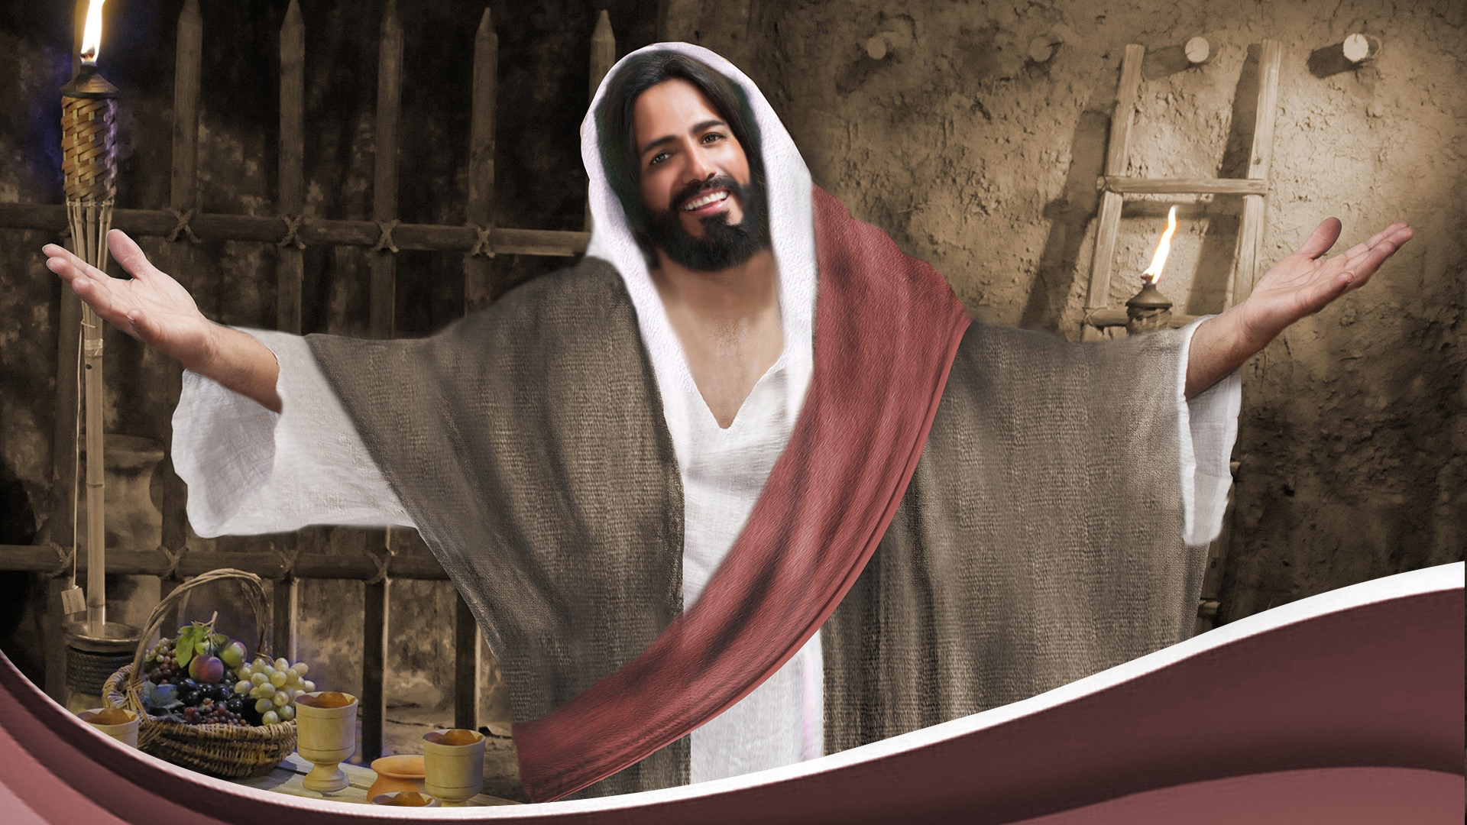
Notes:
Jesus is waiting with His open arms. Will you accept His sacrifice on calvary and come to Him this very moment? If you are please stand in affirmation as we sing this closing song. #318, “Wash me and I shall be whiter than snow.”

