Slide 1
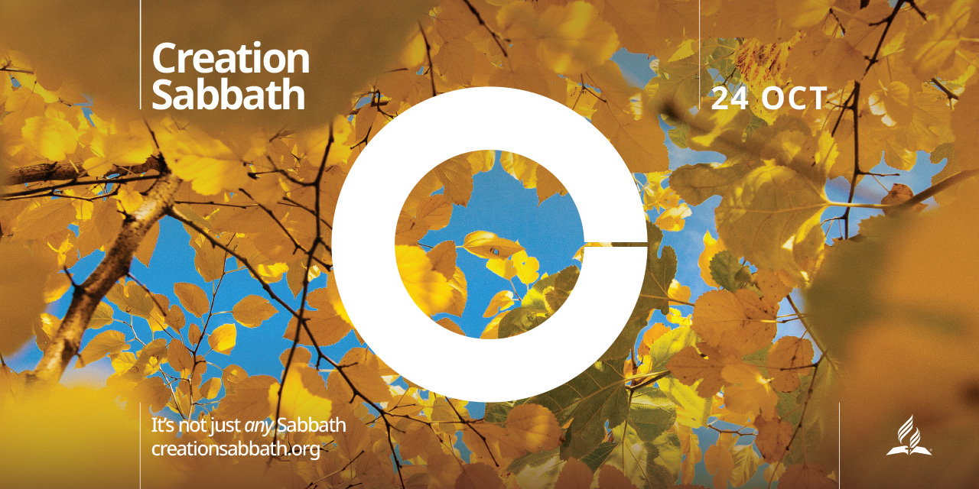
How It All Began?
Notes:
Good morning and Happy Sabbath to each one of you. Once again it is a joy to worship the Lord in the company of God’s faithful children. Today is celebrated as the Creation Sabbath across the globe. This morning it is our privilege and honor to be a part in this celebration. When was the last time you took time to specifically recognize God’s power and grace as Creator and Redeemer?
Creation Sabbath is a special time of celebration! A chance to rejoice, praise, and rest with God as we enjoy the creation He made.
The Seventh-day Adventist Church designated the fourth Sabbath in October as Creation Sabbath. This annual celebration is “acknowledging God as our Creator and the implications that this biblical teaching has for us . . . to create a worldwide sense of unity in promoting this belief in a positive light.”
You don't have to be a Seventh-day Adventist to celebrate, everyone is invited to join in celebrating Creation Sabbath. But before that I want to share with you a very important message.

Slide 2
Notes:
The story is told that a group of scientists had a meeting and decided that humans had come so far that they no longer needed God. After reaching their decision they appointed one in their number to go and explain to God that He was no longer needed.

Slide 3
THESE SCIENTISTS DIALOGUE WITH GOD
Notes:
The scientists said, “God, we’ve concluded that we no longer need you, because we are to the point that we can conceive life in a test tube and even clone people. We are so technologically advanced that we can do many things that at one time would have been thought of as miraculous. So we are asking you to leave the world in our hands.”
God listened until the man was finished. With great kindness in his voice, he said, “Very well then, but first, why don’t we have a man-making contest.” This sounded like a marvelous idea to the scientist, and he agreed to the challenge. But God said, “Now, you understand that we are going to have to do this just like I did back in the garden with Adam.” The self-assured man said, “That will be no problem,” and scientist bent down and grabbed a handful of dirt, realizing that he held in his hand all the building blocks of life. But God looked at him and said, “You don’t understand. You have to get your own dirt.”
YOUR NOTES
the garden with Adam.” The self-assured man said, “That will be no problem,” and scientist bent down and grabbed a handful of dirt, realizing that he held in his hand all the building blocks of life. But God looked at him and said, “You don’t understand. You have to get your own dirt.”

Slide 4
THEORY OF EVOLUTION IS A POPULAR BELIFE
Notes:
We as human beings have become so self- sufficient that we have forgotten where we have come from.
We have theories about everything, even how the world began. One theory is that it all happened by chance. But that doesn’t seem to measure up with the evidence we have.
We are all familiar with Darwin's Theory of Evolution which is the widely held notion that all life is related and has descended from a common ancestor: the birds and the bananas, the fishes and the flowers -- all related. Darwin's general theory presumes the development of life from non-life and stresses a purely naturalistic (undirected) "descent with modification".

Slide 5
The geologist Eduard Suess, in 1875 wrote a definition for the biosphere as 'the place on Earth's surface where life dwells.'
Notes:
We are told that that there are over 60 criteria that are necessary for life on earth.

Slide 6
Here is a partial list of what is needed for life:
Earth’s rotation was slower, or faster
We were 2% closer or further from the sun
Earth had a 1% change in sunlight
Earth was smaller or larger
The moon was smaller or larger
We had more than one moon
Earth’s crust was thinner or thicker
Oxygen/Nitrogen ratio was greater or less
Ozone layer was greater or less
Notes:
These are the necessary criteria for life to exist on earth. But the question is: "HOW DID THIS WORLD COME ABOUT?"

Slide 7
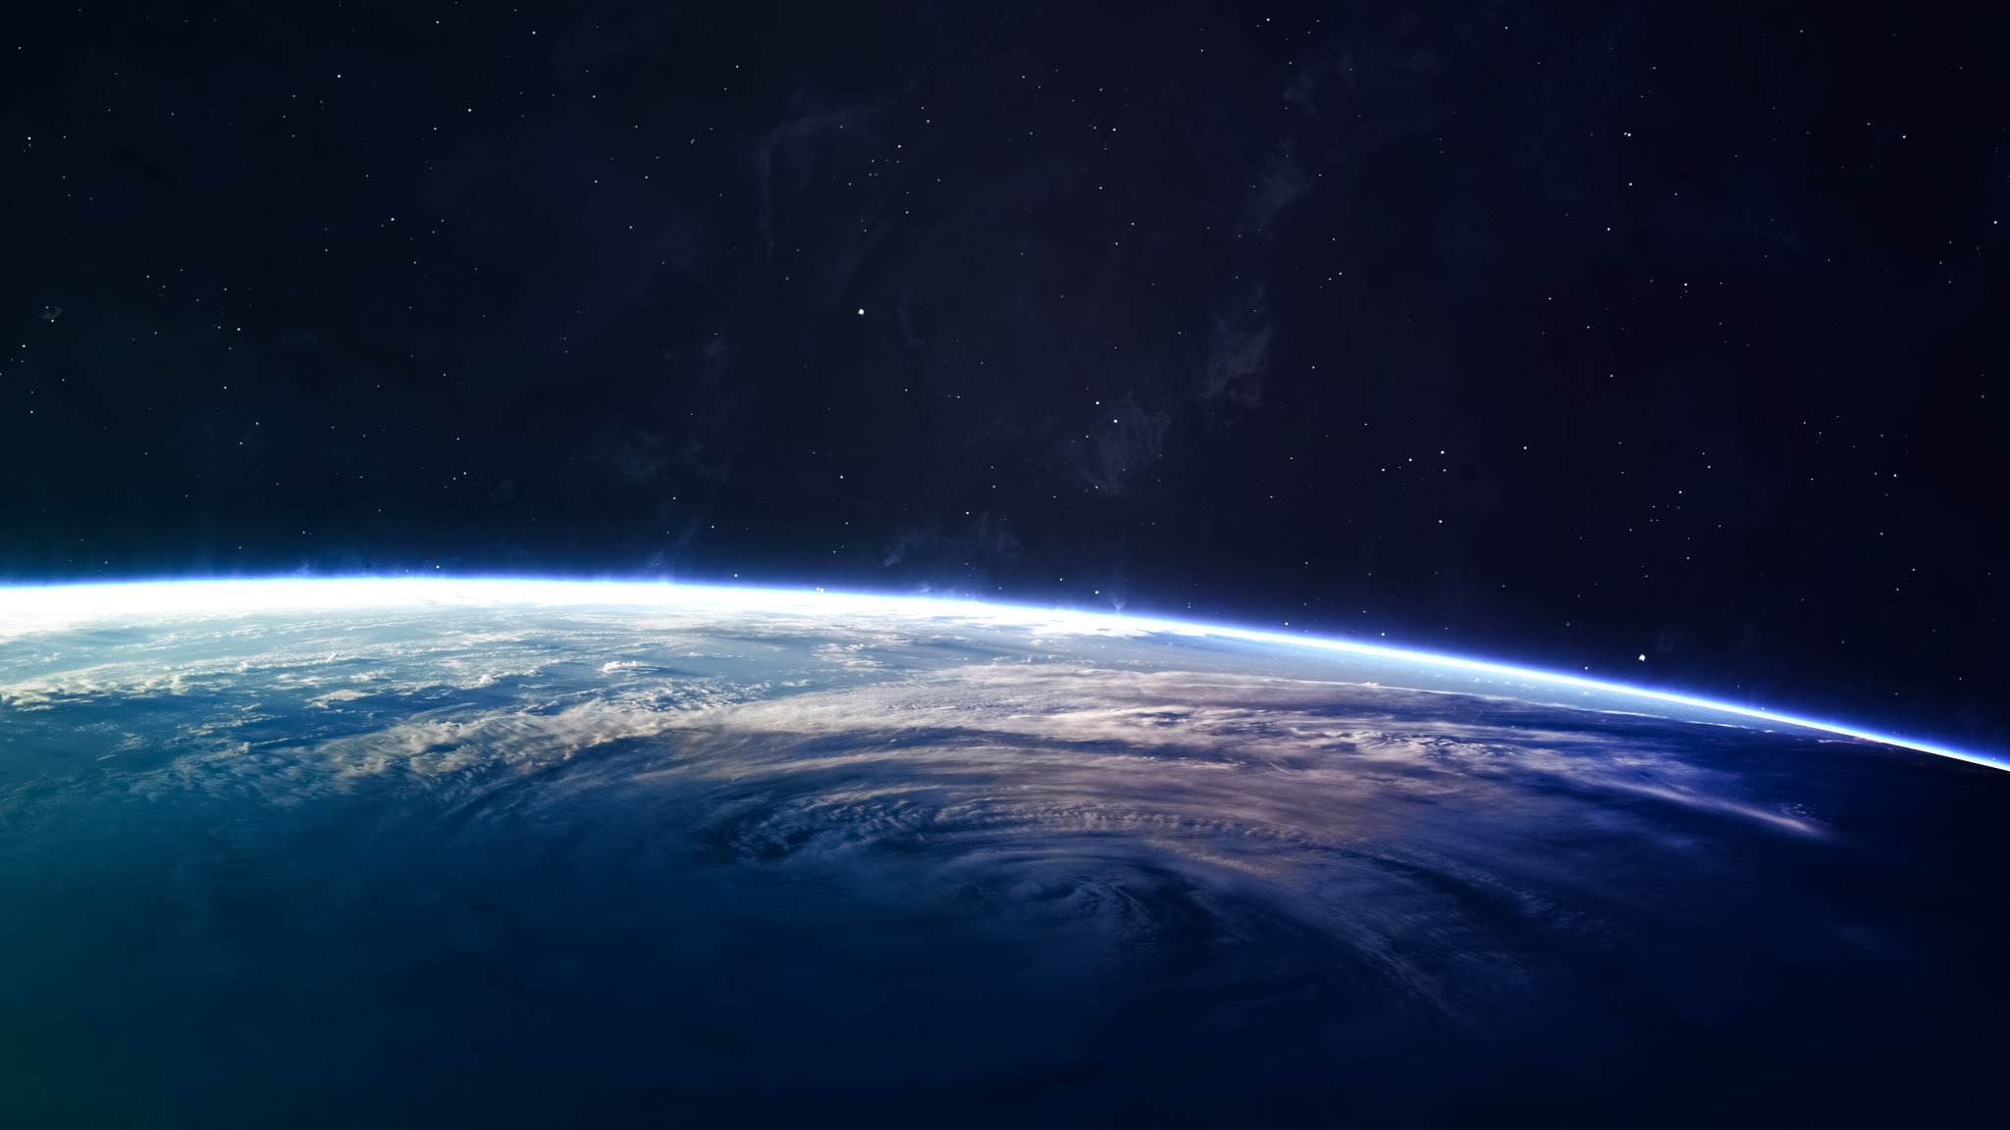
But how did this world come about?
Notes:
So, we can see that there was no way that this earth or this universe we enjoy could have come into being by chance.
But how did it come about? The Bible has an answer. Let’s look at one of the most familiar passages in Scripture that talks about how this all came to be, Genesis 1:1.

Slide 8
Genesis 1:1.
1 In the beginning God created the heavens and the earth.
Notes:
Here we see a summary of what is going to be recorded in the rest of Genesis 1 and 2. It is also the foundation of everything else that goes on in Scripture. So let’s look at it word by word.

Slide 9
GENESIS 1:1 “IN THE BEGINNIG...”
Scripture clearly shows us that there was a beginning. That life is not an endless cycle. That all of this began at a specific point in time.
There are some out there who look at the creation story as simply a myth, something that was made up by the ancients in order to simplify how evolution took place.
Notes:
The simple verse in the beginning has a deeper meaning. It is a true account. no myth. There is no room for evolution because there is a beginning.

Slide 10
The meaning of Hebrew word “Bereshith”
“Bereshith” says that there was indeed a beginning.
When was this beginning?
Some say that the beginning was millions of years ago, others says tens of thousands of years, and still others say just thousands of years ago.
Notes:
THE HEBREW WORD “BERESHITH” IS TRANSLATED AS – BEGINNING, DENOTES THE IDEA THAT THERE WAS INDEED A BENNING.

Slide 11
Hebrew, “bereshith”
When was this beginning?
But the Hebrew, “bereshith” says that there was indeed a beginning. When was this beginning? Some say that the beginning was millions of years ago, others says tens of thousands of years, and still others say just thousands of years ago.
Notes:
In some Bibles, in earlier manuscripts, when you open to Genesis 1, you will see the year 4004 BC. This is the date that Creation supposedly took place.
I have to tell you that this is not an inspired date.
It is a date the Anglican Bishop of Ireland, James Ussher, came up with in 1650 by studying the chronology of the Bible.

Slide 12
Actually, Bishop Ussher came up with the exact date of October 3, 4004 BC for creation.
Notes:
Actually Bishop Ussher came up with the exact date of October 3, 4004 BC for creation.
However, Ussher in his study made some assumptions that we are finding out doesn’t hold true, which takes Creation a little further back. However, what Ussher does do is help us see that the world is not billions of years old, or even millions of years old.

Slide 13
Genesis record tells us: In the beginning.
In the beginning” also tells us this world, including humans, is not an accident.
At some point in history an Infinite Being purposed and created this world.
This world, you and I, are not accidents.
We were purposefully created. You are not an accident.
Notes:
GENESIS CHAPTER 1 VERSE 1 EMPHATICALLY STATES THAT THERE WAS A BEGINNING.

Slide 14
Let’s look at the next word: In the beginning God
The word in Hebrew is “Elohim”, which is a very important word in the Bible.
There are two main words that are used in the Old Testament for God. The one that we might be most familiar with is Yahweh or Jehovah.
It is the personal name of God. The other, which is the word used in this passage is “Elohim.”
Notes:
An example of the differences between the uses of these two words is actually found here in the first two chapters of Genesis. The first chapter uses the word for God, Elohim, exclusively.

Slide 15
The first chapter uses the word Elohim, for God.
It talks about God speaking and there being light.
it talks about God speaking and there being the sun moon and the stars.
it talks about God speaking and all the animals appearing.
It even talks about God creating man but doesn’t say how it was done. But the next chapter does.
So, God, Elohim, is a powerful God who speaks and gets things done.
Notes:
In Genesis, the first chapter uses the word Elohim for God. You remember in Matthew 8th chapter a centurion approaches Jesus seeking healing for his servant He says just speak the word my servant will be healed. Now that is Elohim, a powerful God. He speaks and things are done. SO REMEMBER ELOHIM, GOD THE CREATOR.

Slide 16
Then we get the chapter 2.
There the word used for God changes from Elohim to Yahweh.
Suddenly, we see a much more personal God. A God who bends down in the dust and creates man, a God who created the Garden of Eden for man to live in, a God who sees that man is lonely and performs the first surgery to create a helpmate for Adam.
Notes:
YAHWEH OR JEHOVAH A DEFFERENT NATURE OF GOD. When I read this statement, it blew my mind. Yahweh, a God who bends down in the dust and creates man out of dust.

Slide 17
O, the fact that we see a powerful and personal God involved in the creation of the world immediately casts doubt on:
ATHEISM- Doctrine of: If there is a God, His existence can’t be proven.
PANTHEISM - Doctrine of: God is in everything. The danger of this is that the Creator is now subject to the whims of His creation.
POLYTHEISM - Teaching that there are many gods.
But the Bible tells us that an Infinite Being, God Himself, was the Creator.
Notes:
One God the creator God.

Slide 18
We have seen that indeed there was a beginning, that this is not a Universe of endless cycles and that this world was not an accident, we have seen that a powerful and personal God was responsible for the universe , and now let’s move onto the next word.
Notes:
JUST TO RECAP WHAT WE HAVE STUDIED SO FAR. We notice three things in this phrase. 1. There was a beginning. 2. This world was not an accident. 3. A powerful and personal God was responsible for the universe.

Slide 19
In the beginning God created
The word “bara” in the Hebrew is very telling. It is only used with God as the subject, which means that only God can create.
I will admit that it took me a little while to understand the implications of this.
Notes:
Only God can create. But what about the great masterpieces, great pieces of art, weren’t that created by the artist? What about the great culinary delights? Weren’t they created by the people who brought them? What about parents? Didn’t they create the child they call their own?

Slide 20
The words “create” and “make.”
You see many times we use the words “create” and “make” as interchangeable. But in reality, they aren’t, at least in the Bible.
The Bible makes it very clear that only God can “bara”, create.
But what is the difference?
Notes:
THERE IS A DIFFERENCE BETWEEN “CREATE” & “MAKE.”

Slide 21
Notice what God did?
He created something out of nothing. He spoke and there was light. He didn’t take a wire and hook it up to some great generator in the sky and then made light that way.
No, He created light where there was no light. He created it out of nothing. He spoke and the birds and the fish came into being. He didn’t have an incubator somewhere and transfer the eggs to make the fish and the birds.
He made something out of nothing.
Notes:
God created something out of nothing.

Slide 22
We saw in the story at the beginning of the sermon that we as humans can make all kinds of things with materials that already exist, but we can never create something out of nothing like God can.
What does that tell me? It tells me that the powerful and personal God deserves to be worshipped as the Creator.

Slide 23
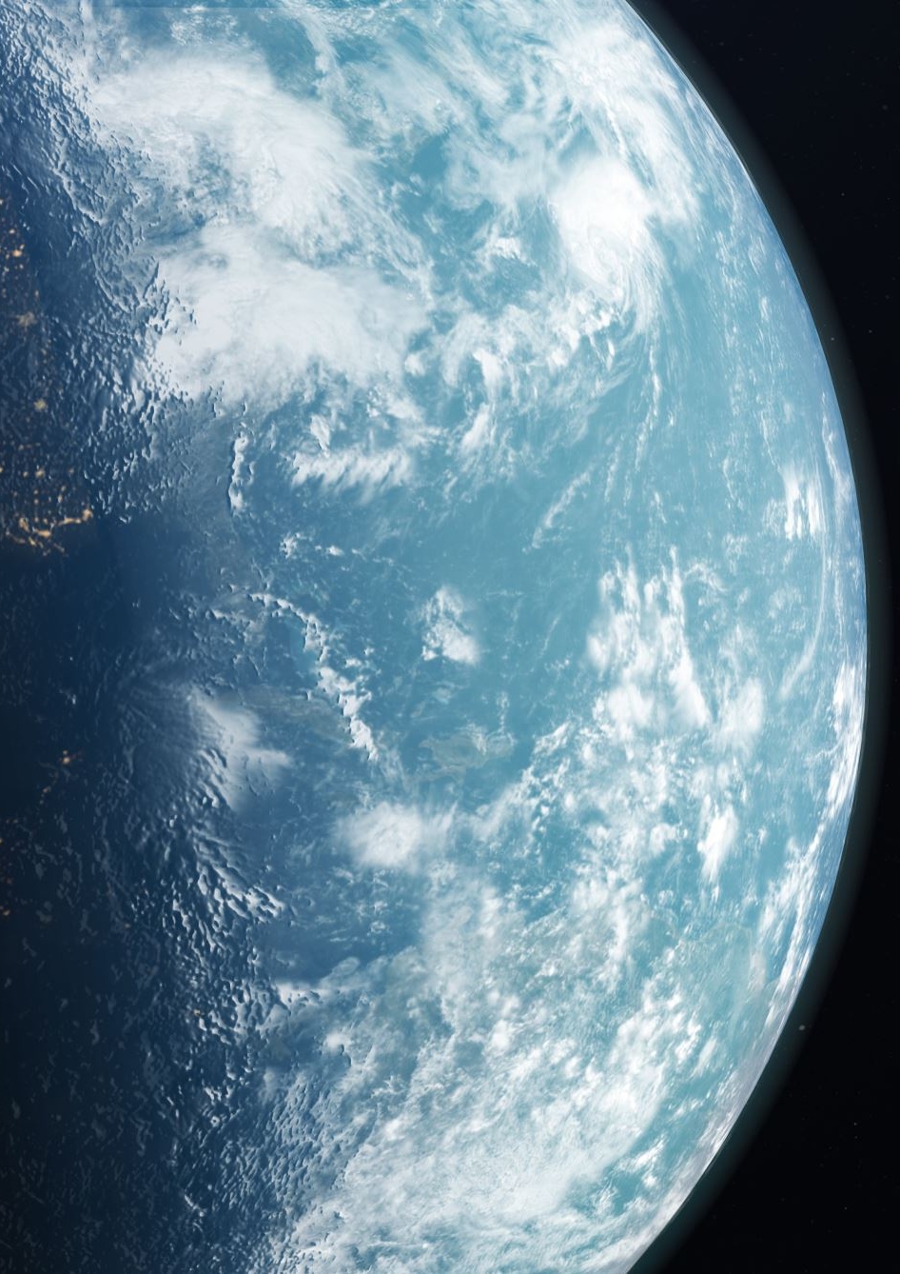
The only Being in the universe who can speak, and something comes into being.
The only Being who can make something out of nothing.
A Being who spoke and the trees appeared.
A Being who spoke and the water appeared
A Being who spoke and the sky appeared.
Now that kind of Being deserves worship because He is the one and only Creator.
Notes:
By observing the Sabbath we worship the creator God.

Slide 24
By the way, that is what the Sabbath is all about.
. Worshipping and being in awe of the One who is the Creator.
We as humans become like the scientists, we talked about at the beginning, who think we can live without God. That we don’t need God anymore.
But every 7th day, we are reminded that “All you have to do is look around and see that you are not a creator, but God in heaven is the Creator who deserves to be worshipped.”
Notes:
People who do not OBSERVE THE SABBATH MAY NOT UNDERSTAND THIS TRUTH.

Slide 25

We have seen a Universe that is not an endless cycle and this world was not an accident.
We have seen a powerful and personal God that was responsible for the Universe and now we have seen a Creator who, unlike any other being in the Universe, made this world out of nothing.

Slide 26
Let’s move to the final words of this verse: In the beginning, God created the heavens and the earth
There is a debate going on in religious circles as to whether this refers to the whole Universe or just the world in which we live.
Now, I am not going to get into that debate, because I think that the words “heavens and the earth” tell us very clearly that God is responsible for everything. Any time this phrase is used refers to everything that exists.

Slide 27
WHEN WE LOOK IN THE MICROSCOPE
Notes:
So, as we look in a microscope, every little thing we see, God created.

Slide 28
WHEN WE LOOK IN THE TELESCOPE.
Notes:
As we look up into the night sky with a telescope, every star and planet we see, God created.

Slide 29
PSALM 19:1
Notes:
THE PSALMIST IN PSALM 19:1 SPEAKS ABOUT THIS CREATION HOW IT DECLARES THE CREATOR GOD.

Slide 30
Notes:
As we look around us today, God created all of this. And He has given you and me, as humans, stewardship over what He has created. So, I think it is important, as we enjoy the world God created, we remember that God is also the One who has given us responsibility to take care of that which He created.

Slide 31
Notes:
It was all perfect. At the end of creating on the 6th day, as He prepared to rest, God said, “It is very good.”

Slide 32
He had created everything, even man and woman with whom He could now have a relationship.
But then something went wrong.
Notes:
Somewhere down the line, the man and woman sinned, and because of sin, His creation was marred. All of the sudden death came in and the things He created began to die, even the humans

Slide 33

God put a Plan into Action.
Notes:
But God would not allow this to go on unchallenged. He put a plan into action that He had made even before He started creating. He would come to earth Himself and save humanity by dying. It would be a big risk, but God was willing to pay the price to stop sin and death from going on forever

Slide 34
The apostle John describes it this way
Notes:
I WANT TO SHARE TWO VERSES FROM THE GOSPEL ACCORDING TO JOHN.

Slide 35
Notes:
God Himself came to this earth to put a stop to sin and death marring His creation. And so this “Word” that John describes, the Creator Himself, Jesus Christ, came lived among us and then died to stop the cycle of sin and death.
ut it isn’t over yet, God’s creation is still marred, but one day that will all change. The same apostle John who described Jesus as being the Creator in the beginning also describes these words that also echo the first words of the Bible:

Slide 36

REVELATION 22:12,13
12 “Look, I am coming soon! My reward is with me, and I will give to each person according to what they have done.
13 I am the Alpha and the Omega, the First and the Last, the Beginning and the End.
Notes:
Sabbath keeping helps us to understand the New Heaven and New Earth God has in place for us. Because Jesus came and stopped the cycle of sin and death, He can promise that one day it will all end. One day He will come back. One day sin, death, and suffering will end. And one day, God’s creation will be recreated, never again to be marred by sin or by death.

Slide 37
Listen to how John describes this recreation:
Then I saw “a new heaven and a new earth,”^{[a]} for the first heaven and the first earth had passed away, and there was no longer any sea. ² I saw the Holy City, the new Jerusalem, coming down out of heaven from God, prepared as a bride beautifully dressed for her husband. ³ And I heard a loud voice from the throne saying, “Look! God’s dwelling place is now among the people, and he will dwell with them. They will be his people, and God himself will be with them and be their God. ⁴ ‘He will wipe every tear from their eyes. There will be no more death’^{[b]} or mourning or crying or pain, for the old order of things has passed away.”⁵ He who was seated on the throne said, “I am making everything new!” Then he said, “Write this down, for these words are trustworthy and true.”
Notes:
JUST TO RECAP, GENESIS 1:1 SAYS IT ALL. IN THE BEBIINING, THERE WAS A BEGINNING, IT IS NOT A MYTH. THE NEXT WORD ‘GOD’ SPEAKS ABOUT A CREATOR NOT A CHANCE. CREATED HEAVEN AND EARTH. EVERYTHING THAT WE SEE AROUND US IS CRERATED BY GOD. HE IS THE CREATOR AND HE IS WORTHY OF OUR WORSHIP. EVRY SABBATH LET US COME TOGETHER TO WORSHIP HIM BECAUSE HE ALSO REDEEMED US WHEN SIN MARRED HIS CREATION. HE TOOK UPON HIMSELF ACCORDING TO THE PLAN OF SALVATION TO DIE FOR US. AND HE HAS A NEW HEAVEN AND EARTH PREPARED FOR US. I WANT US TO BE A PART OF THIS PLAN OF GOD. SO LET US RECONSECRATE OUR LIVES AS WE CELEBRTAE THIS CRAETION SABBATH.

Slide 38
Conclusion
We may be awe struck by the beauty that we see around us today, but very soon there will be a new heaven and a new earth recreated. We can’t even start to imagine how beautiful that is going to be.
Notes:
I want to invite us today, to begin planning to be a part of this earth made new. Tell our Creator that you are planning to be a part of this great recreation, where sin, death, and suffering will never again rear its ugly head. Amen.

Slide 39
ANIMALS LIVING IN HARMONEY
https://youtu.be/WIc8jGgzPrE
https://www.youtube.com/watch?v=WIc8jGgzPrE&authuser=0

