Slide 1

Notes:
Happy Sabbath. Happy Sabbath! Praise unto the Lord for He has been faithful to us. Happy Sabbath and heartfelt welcome to the worship services of the Hyattsville SDA Church. ►Despite the challenges of life, we still shout praises to our Lord and God because His blessings far outweigh our challenges ►As we brace ourselves for severe weather conditions let us keep on our knees in prayer.
What is one thing that bothered you this week? I think for many of us it is the Russian aggression on Ukraine.
Last Wednesday I was in the Bible study with (Allan) an young man from Discover Bible study guides. Lesson # 10 ”How soon will Jesus Return?”
A general feeling permeates many of our churches that, as long as you love the Lord, regularly attend church, pay your tithe, respect the Sabbath, assist from time to time with church work, and do not do anything really bad, Jesus will take care of you and you will be all right when He returns. Many go beyond this and reason that since we are saved by faith only, not by our works, what we do is not even important. Some feel that we ought not to worry about any special preparations for Jesus’ return, as long as we love Him. Jesus will come at His determined time, and we cannot do anything about it anyway.

Slide 2

Notes:
When we look around the world, we see many people are anxious.
They are worried as they look toward the future.
They wonder what is coming next.
BELIEF 25: THE SECOND COMING OF CHRIST
The second coming of Christ is the blessed hope of the church, the grand climax of the gospel.
INTRODUCTION
A. A young preacher decided to try preaching a sermon on the second coming of Christ without any notes. He memorized each point carefully, including a dramatic introduction. Stepping into the pulpit, he sounded forth the beginning words of Revelation 22:7 “Behold, I come!” But then he forgot what came next! Hoping to jog his memory, he quoted it again, a little louder and more dramatically: “Behold, I Come!” Still, he couldn’t remember what came next! In a last-ditch effort to salvage his sermon, he took a few steps back, then launched forward shouting, “BEHOLD, I COME!” His momentum carried him over the top of the lectern into the lap of a good old sister on the front row. “I’m so sorry, sister,” the preacher sputtered. “It’s all right, sonny,” the old sister replied. “You warned me three times you wuz a’ comin!”

Slide 3
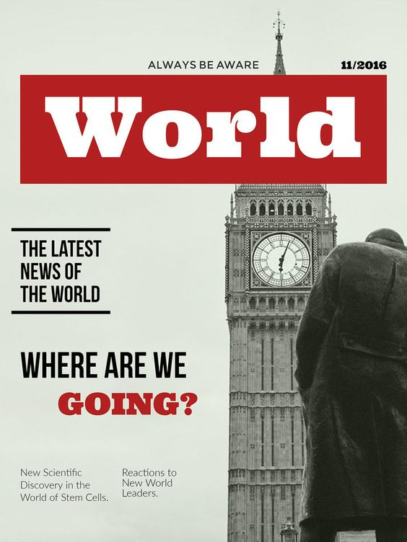
Notes:
There is always this lingering question in our minds, where are we going?

Slide 4
Notes:
Only God’s word has the promise and assurance of Hope beyond tomorrow.

Slide 5

Notes:
What is this Blessed Hope?

Slide 6
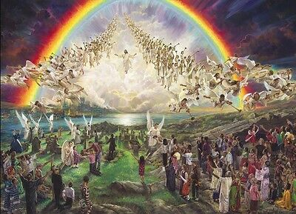
Notes:
Our Blessed hope is from the word of God.
We read about this Blessed Hope according to Titus 2:13 is “Looking for that blessed hope, and the glorious appearing of the great God and our Savior Jesus Christ.”

Slide 7
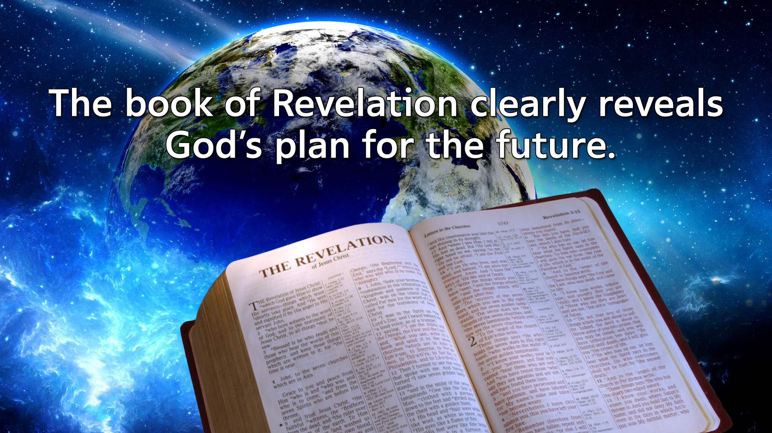
Notes:
The book of Revelation clearly reveals God’s plan for the future.

Slide 8
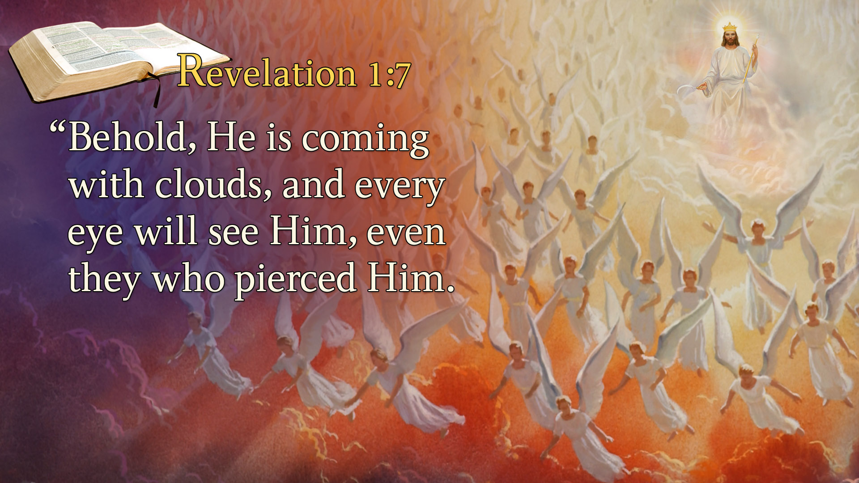
Notes:
Revelation 1:7
“Behold, He is coming with clouds, and every eye will see Him, even they who pierced Him.
Revelation leads us to lift our eyes from the earth below to heaven above.
It leads us to lift our eyes from the problems, trauma, and disappointments of life to the God who will send His Son to solve this world’s problems.
Revelation 1:7 states it clearly: “Behold, He is coming with clouds, and every eye will see Him.”
The last chapter of the book of Revelation confirms the nearness of the second coming of Jesus Christ.

Slide 9
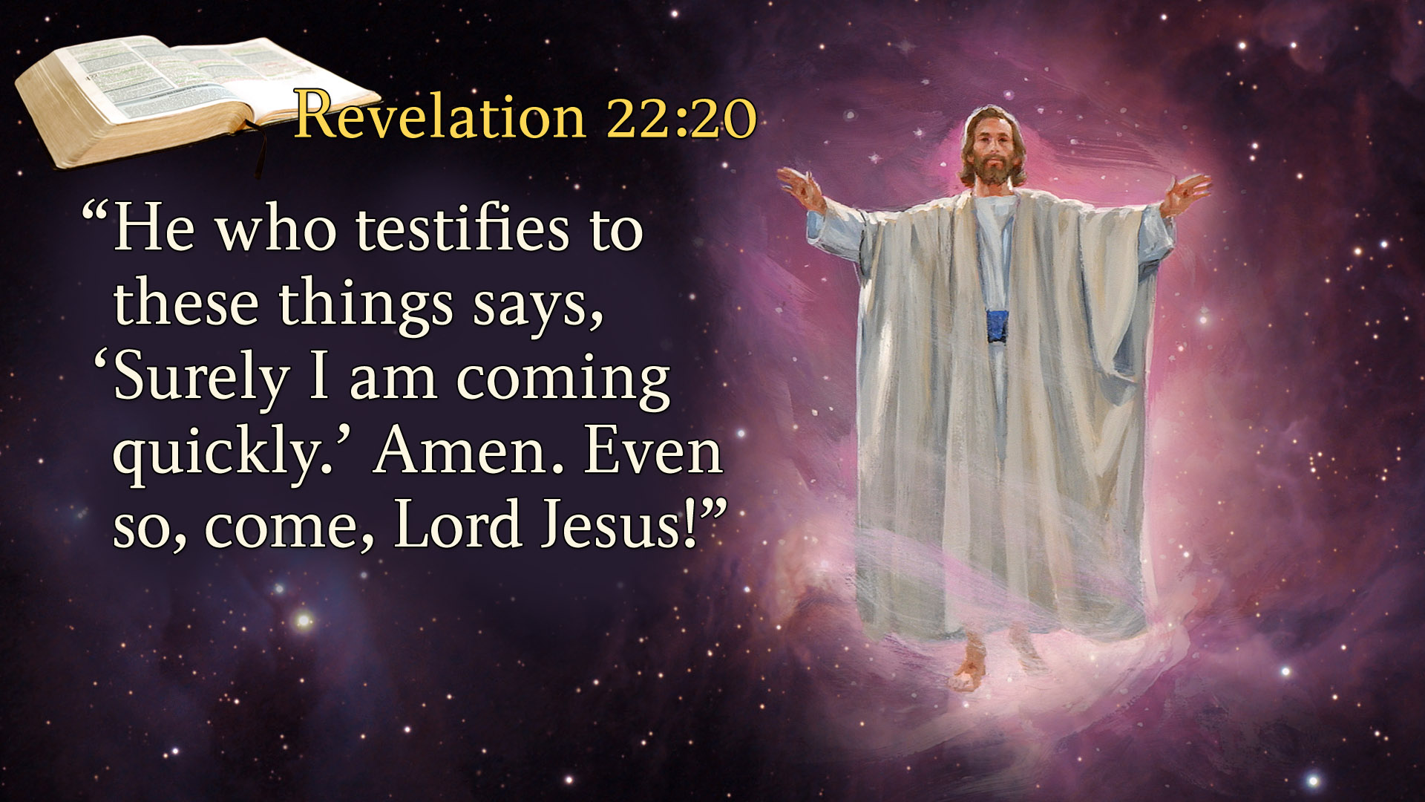
Notes:
Revelation 22:20
“He who testifies to these things says, ‘Surely, I am coming quickly.’
In Revelation 22 it says three times, “I am coming quickly.”
The book of Revelation is full of excitement, anticipating that soon all the promises of God will be fulfilled and Jesus will return.
But there is a question:

Slide 10

Notes:
How quickly is quickly? How soon is soon? And How near is near?
Haven’t Christians down through the ages believed His coming was near?
Haven’t they believed His coming was soon?
Are there any signs in the Bible – that say the coming of Jesus is near? that you and I might see the coming of Jesus personally?
What signs might there be?
We are not the first to ask that question.
Jesus’ disciples wondered what signs pointed to His coming.
They came to Jesus and asked,

Slide 11
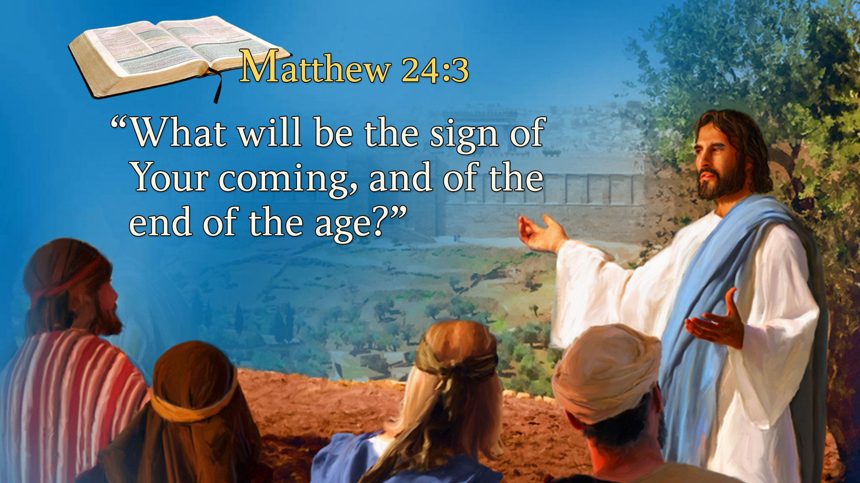
Notes:
Matthew 24:3
“What will be the sign of Your coming, and of the end of the age?”
In a masterful presentation, Jesus blended the events associated with the fall of Jerusalem in 70 AD with those that would take place at the end of the world.
He gave signs of His return that would be occurring in

Slide 12
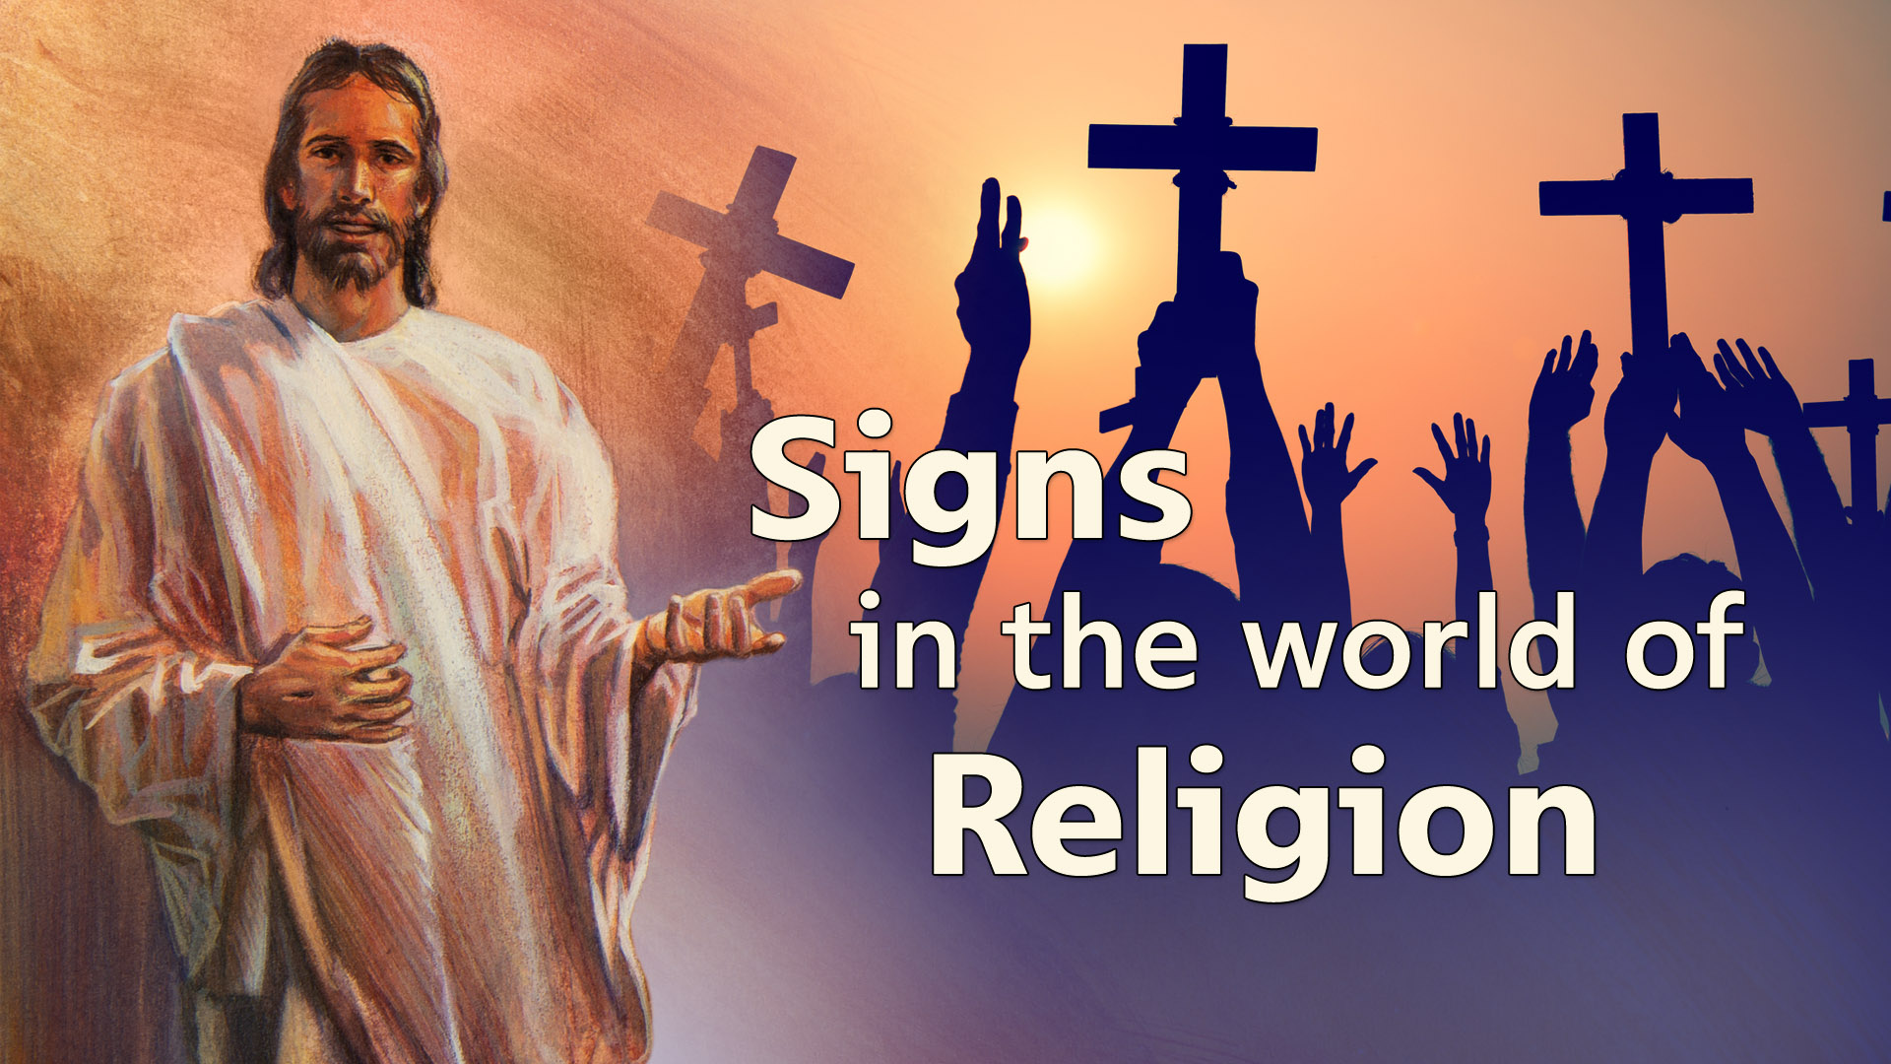
Notes:
the World of Religion;

Slide 13

Notes:
The World of Politics;

Slide 14
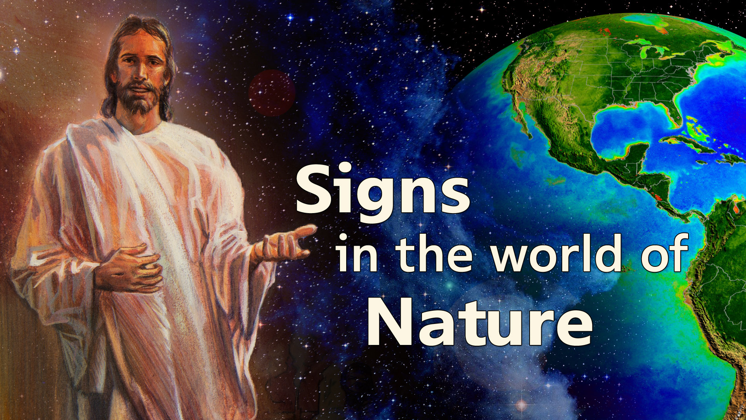
Notes:
The World of Nature;

Slide 15
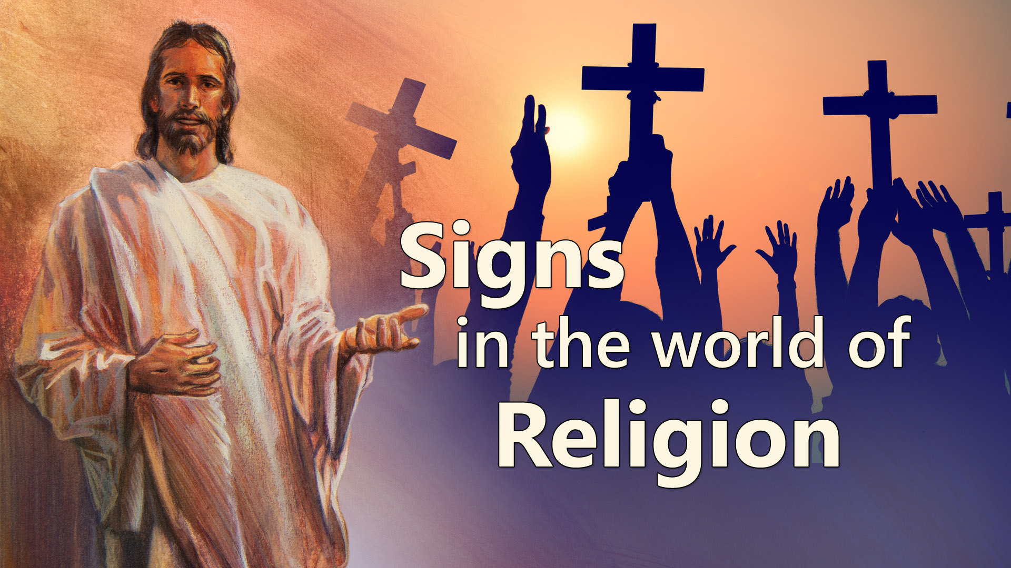
Notes:
The first of these signs is in the World of Religion.

Slide 16

Notes:
Matthew 24:24
“For false christs and false prophets will rise and show great signs and wonders.”
Before the coming of Christ, we should expect an increase in religious leaders, who are leading people from the word of God with false signs and miracles.
Merely because a miracle has been worked does not mean that the one who claims to have worked the miracle is from God.
There can be another source behind the miracle.
Did you know the Bible teaches that evil spirits can perform miracles?

Slide 17
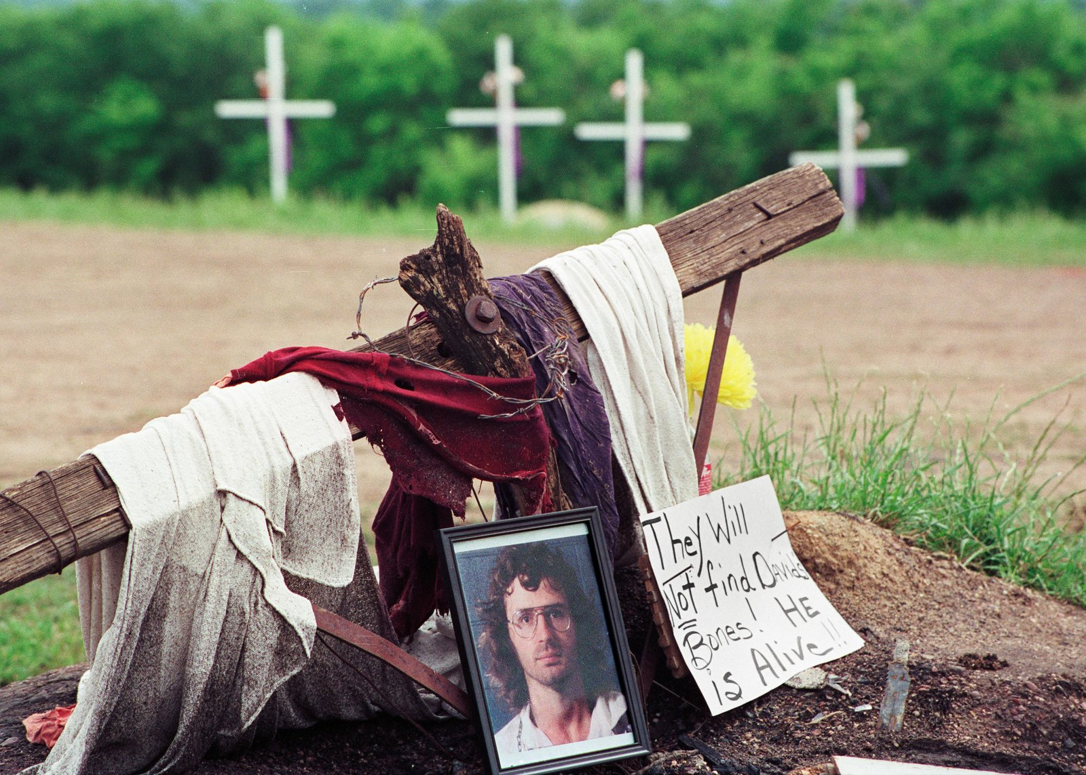

Slide 18
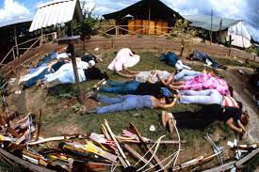


Slide 19

Notes:
On March 26, 1997, Applewhite and 38 other members of a cult called Heaven’s Gate were found dead in a mass suicide at a rented mansion in Rancho Santa Fe, California. The group members, who killed themselves by eating applesauce and pudding mixed with drugs, believed that a spaceship following the Hale-Bopp comet (which made its closest approach to Earth on March 22, 1997) would pick them up and take them to a higher plane of existence.

Slide 20
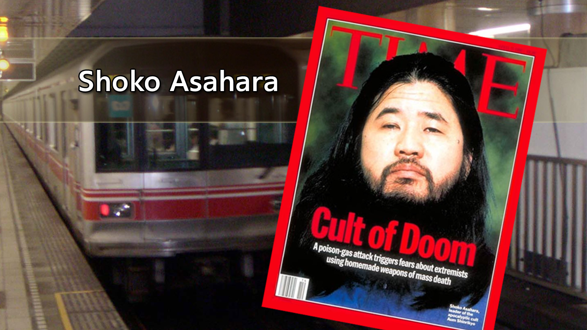
Notes:
In the last 50 years, there has been a rapid increase in those claiming to be divine spiritual leaders.
On the continent of Africa, there are at least two cult leaders that have led their followers to a fiery death.

Slide 21
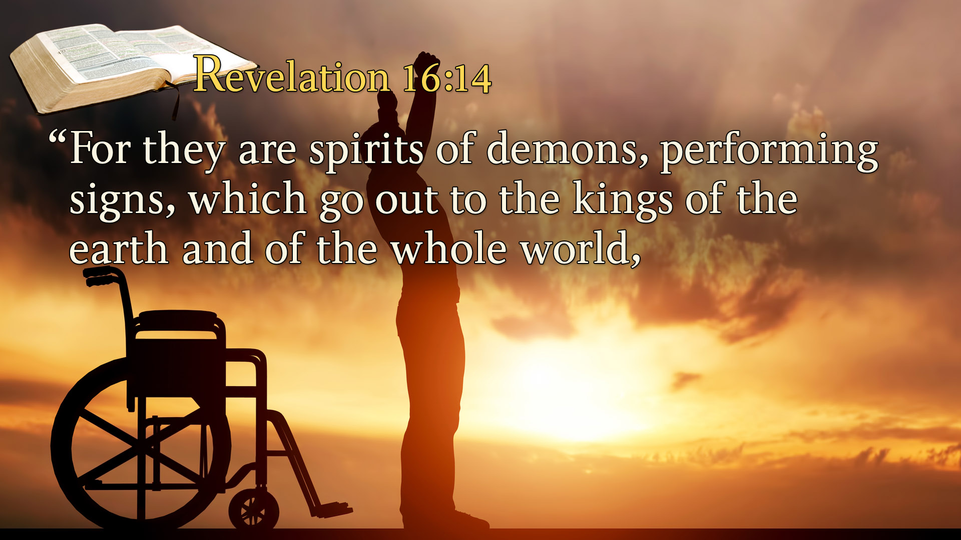
Notes:
Revelation 16:14
“For they are spirits of demons, performing signs, which go out to the kings of the earth and of the whole world,

Slide 22
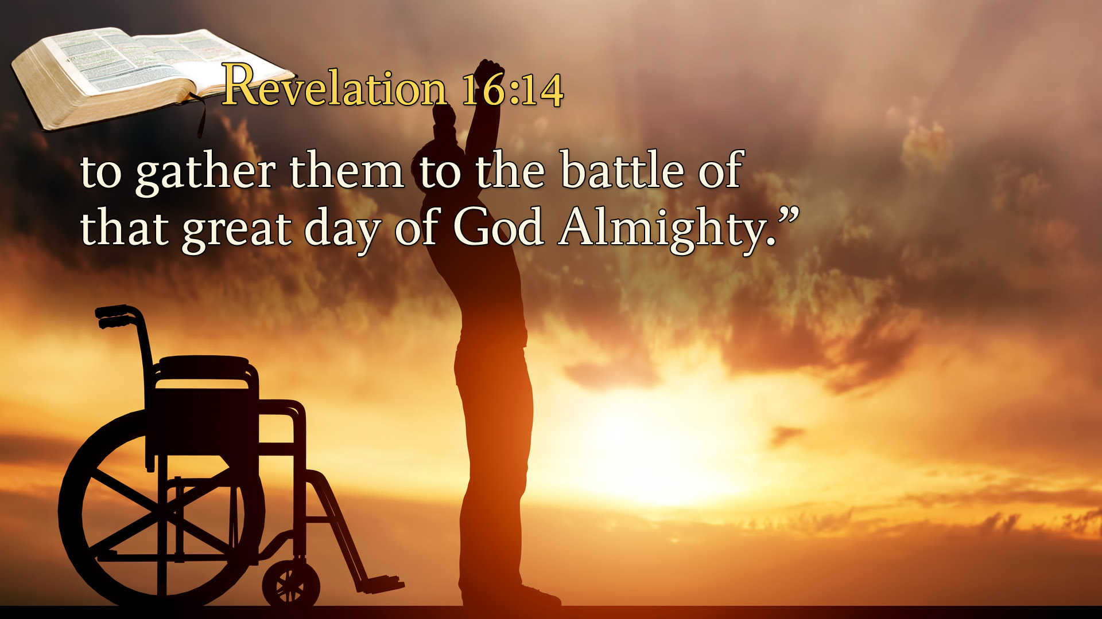
Notes:
to gather them to the battle of that great day of God Almighty.”
These false teachers point to the miracles and signs they are doing as evidence that what they are saying is true.
But these false signs are demon inspired to deceive men and women. They are counterfeits. The closer they get to the original, the more credible the counterfeit appears.

Slide 23

Notes:
If anyone comes to you even if they claim miraculous signs and they can heal the sick. If they disregard the plain teachings of the Bible, beware!

Slide 24
Notes:
The Savior then moves to the area of politics.

Slide 25

Notes:
He discusses international conflict—War
Jesus predicts the very events we see occurring around us today.
Matthew 24:6 says, “And you will hear of wars and rumors of wars.”
Haven’t we always had wars down through history?
If we’ve had conflict throughout the centuries what sense does it make to say war is a sign of the end of the world?
Let’s notice carefully what Jesus said, “You will hear of wars and rumors of wars.”
“Wars” is in the plural.
Rumor of War?
Though Putin has claimed that he will not invade Ukraine, the 100,000 troops he has amassed on the Ukrainian border send another message. It signals, too, just how serious he is about Ukraine and NATO, even if he has ulterior motives, such as possession of Ukraine’s major ports on the Black Sea, as well as tightening his grip on the flow of oil to Western Europe, with a major pipeline running through Ukraine.
Look up and lift up your heads, because your redemption draws near

Slide 26

Notes:
Matthew 24:7
“For nation will rise against nation, and kingdom against kingdom.”

Slide 27
Over the last several days, increasing tensions and aggressive actions taken by the Russian government against Ukraine have created an onslaught of trauma for tens of thousands of innocent people, with possible repercussions for millions more. At the time of this writing, people are fleeing for their lives and sheltering
with their families as a result of this senseless violence. These attacks are coordinated, intentional, and aimed at\ dominance over others while spreading disinformation online and abroad.
Notes:
Since our founding in 2001, the core of Adventist Peace Fellowship’s mission has been to follow the call of Jesus to promote peace and justice among and for all of God’s children. We believe in following Christ’s example of living counter-culture to the world’s inclination towards violence. Today, more than ever, this message and mission are essential.

Slide 28
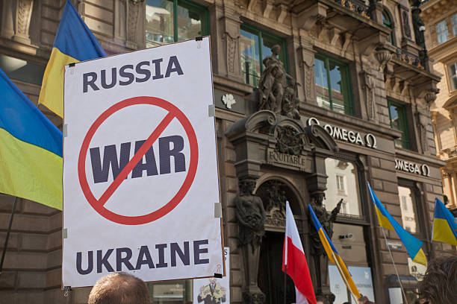
Notes:
We are looking at the inception and the progress of the war initiated by Russia. Over night it resulted in million refuges.

Slide 29

Notes:
However much the West wants a diplomatic solution, they refuse to concede to the demand that Ukraine never join NATO. Thus, Putin sees “little ground for optimism.” Though some experts claim that Russia would never invade and that all this saber-rattling is designed merely to wring concessions from the West, plans are being made in case he does, including “brutal” economic sanctions. That would be bad enough, but there are serious concerns that such actions could quickly escalate into wider armed conflict, with both sides possessing nuclear weapons.
Almost two thousand years ago, Jesus signaled that before His return, “nation shall rise against nation” (Matthew 24:7) and that we would hear of “wars and rumors of wars” (Matthew 24:6). This latest crisis is yet another fulfillment of that warning. However much people have predicted that human progress, science, and reason would usher in an era of utopia and peace, it has never happened and, according to the Bible—which predicts “a time of trouble, such as never was since there was a nation even to that same time” (Daniel 12:1)—it never will. Instead, things will get only worse before Christ returns.
Yet, amid these signs, Jesus also said, “Look up and lift up your heads, because your redemption draws near” (Luke 21:28). In other words, however bad things get, we have hope because Jesus will return, and all these wars, rumors of wars, and troubles will be over forever.

Slide 30
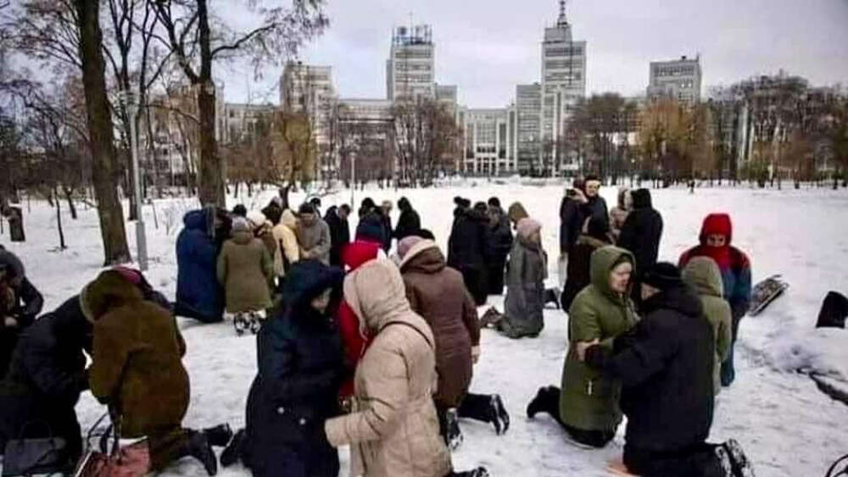
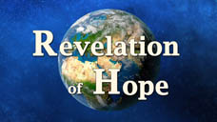
Notes:
UKRAINIANS TURN TO GOD UNDER THREAT OF WAR - Local Christians gather at 7.30am every morning to pray for protection and peace in the central square of Kharkiv (30 km/19 miles to the Eastern border).

Slide 31
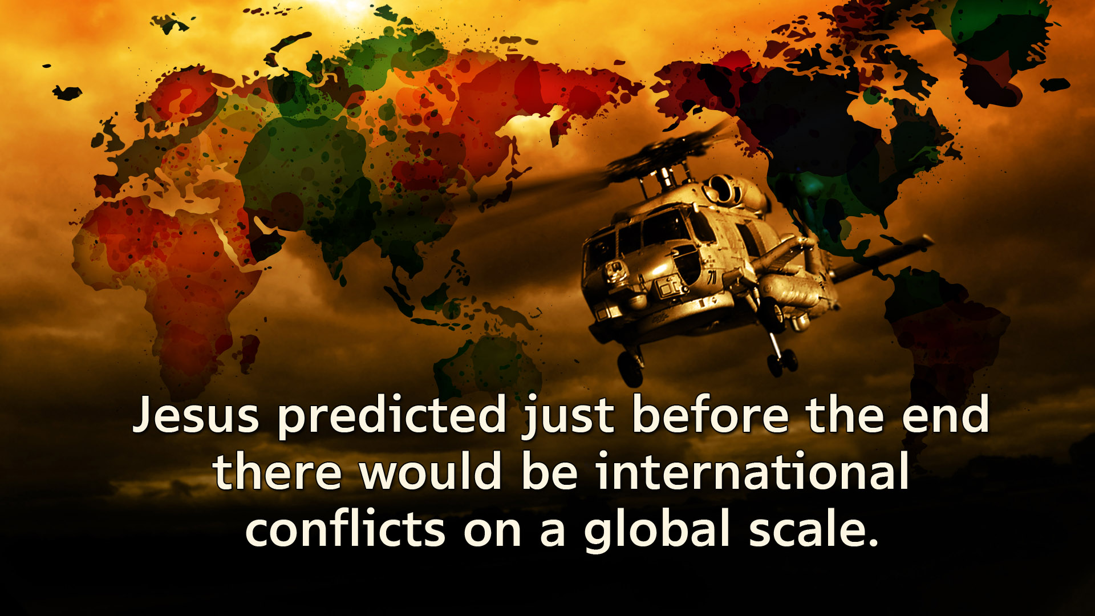
Notes:
Jesus predicted just before the end there would be international conflicts on a global scale.
In other words, there would be world wars.

Slide 32
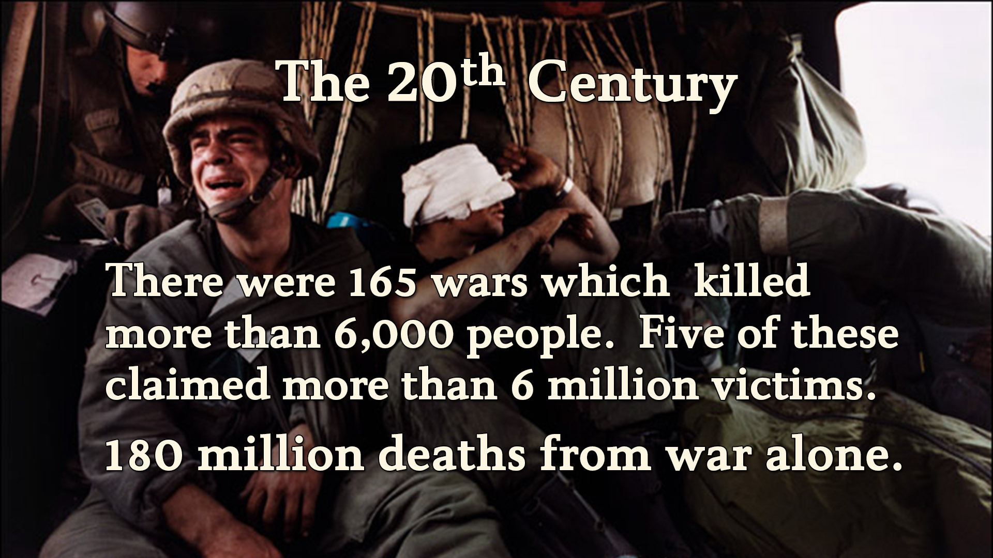
Notes:
Having launched into the 21st century we look back on the 20th century as the bloodiest of all. Some estimated in the 20th century there were 180 million deaths from war alone.
The 20th and 21st centuries have been engulfed in the flames of war.
Think about the devastation in Sudan as war rages on, and what about the uncertainty in so many of the African nations and the devastation that is taking place in Libya. Of course, the Middle East is a hotspot of conflict. Iraq and Syria have been divested by war. Jesus’ words are being rapidly fulfilled.

Slide 33

Notes:
World peace is very fragile.
The Bible predicts that all human attempts to achieve world peace will fail.
The apostle Paul describes it this way:
Failed peace talks. Failed negations.

Slide 34
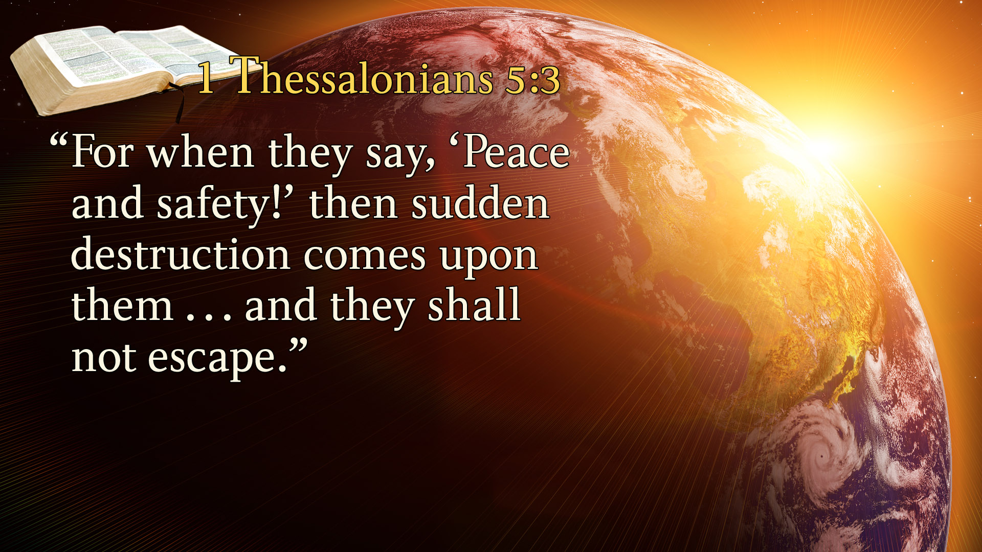
Notes:
1 Thessalonians 5:3
“For when they say, ‘Peace and safety!’ then sudden destruction comes upon them . . . and they shall not escape.”
A classic example of a peace treaty that was supposed to end all war is the:

Slide 35
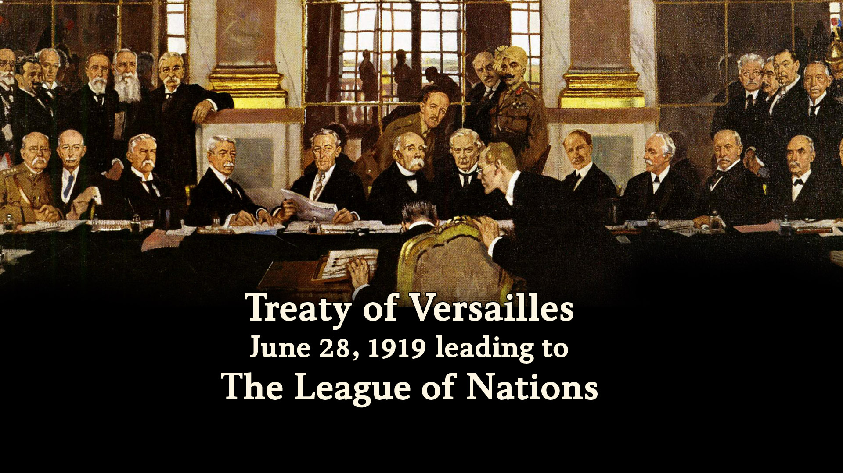
Notes:
Treaty of Versailles
June 28, 1919 leading to The League of Nations
Of course, it wasn’t long until the worst world war in history, World War II, broke out.
This led to the formation of:

Slide 36
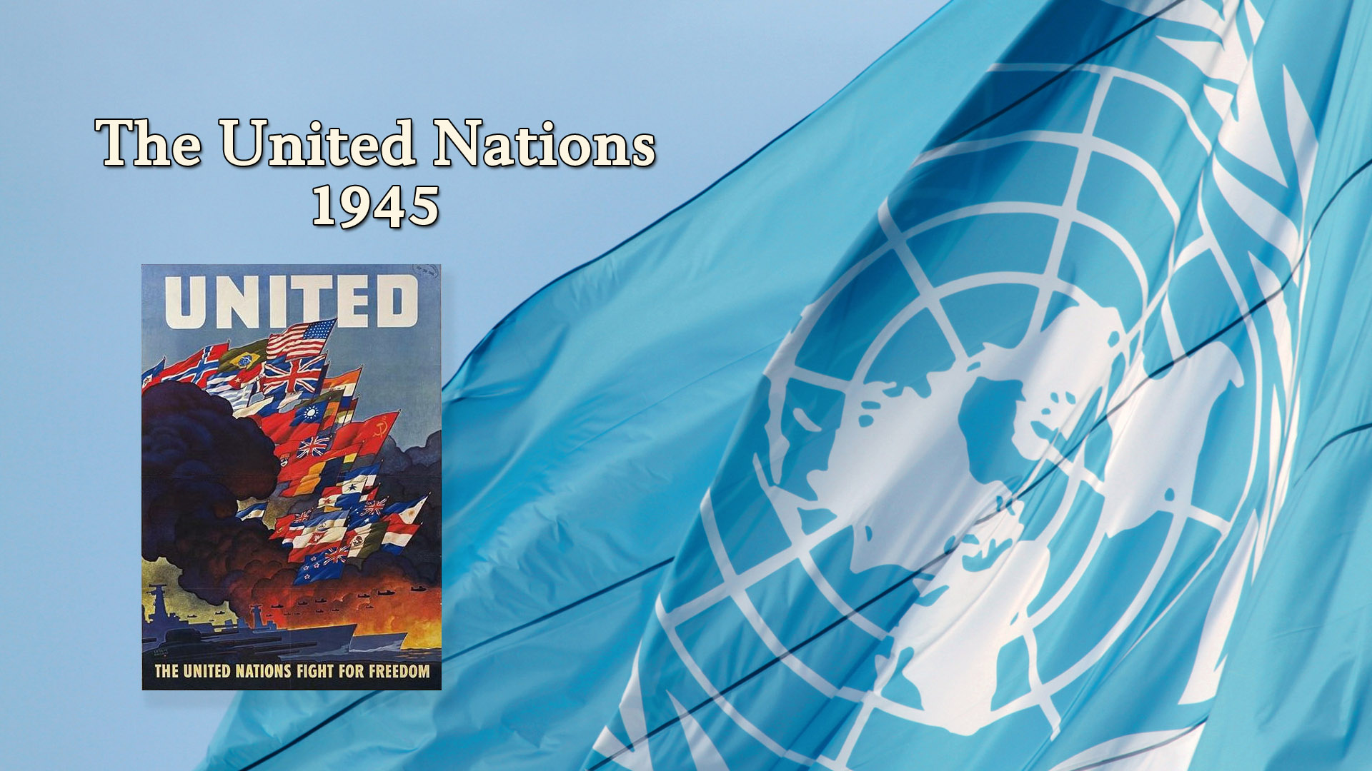
Notes:
The United Nations, 1945
For all of its best efforts the United Nations has failed to achieve world peace. War has continued to engulf the planet.
The Bible says, “When they say peace and safety, then sudden destruction comes upon them.”
We are seeing these prophecies being fulfilled today.
The Bible is so accurate. It speaks of our day.
The Bible says Jesus would come at a time when the human race has the

Slide 37
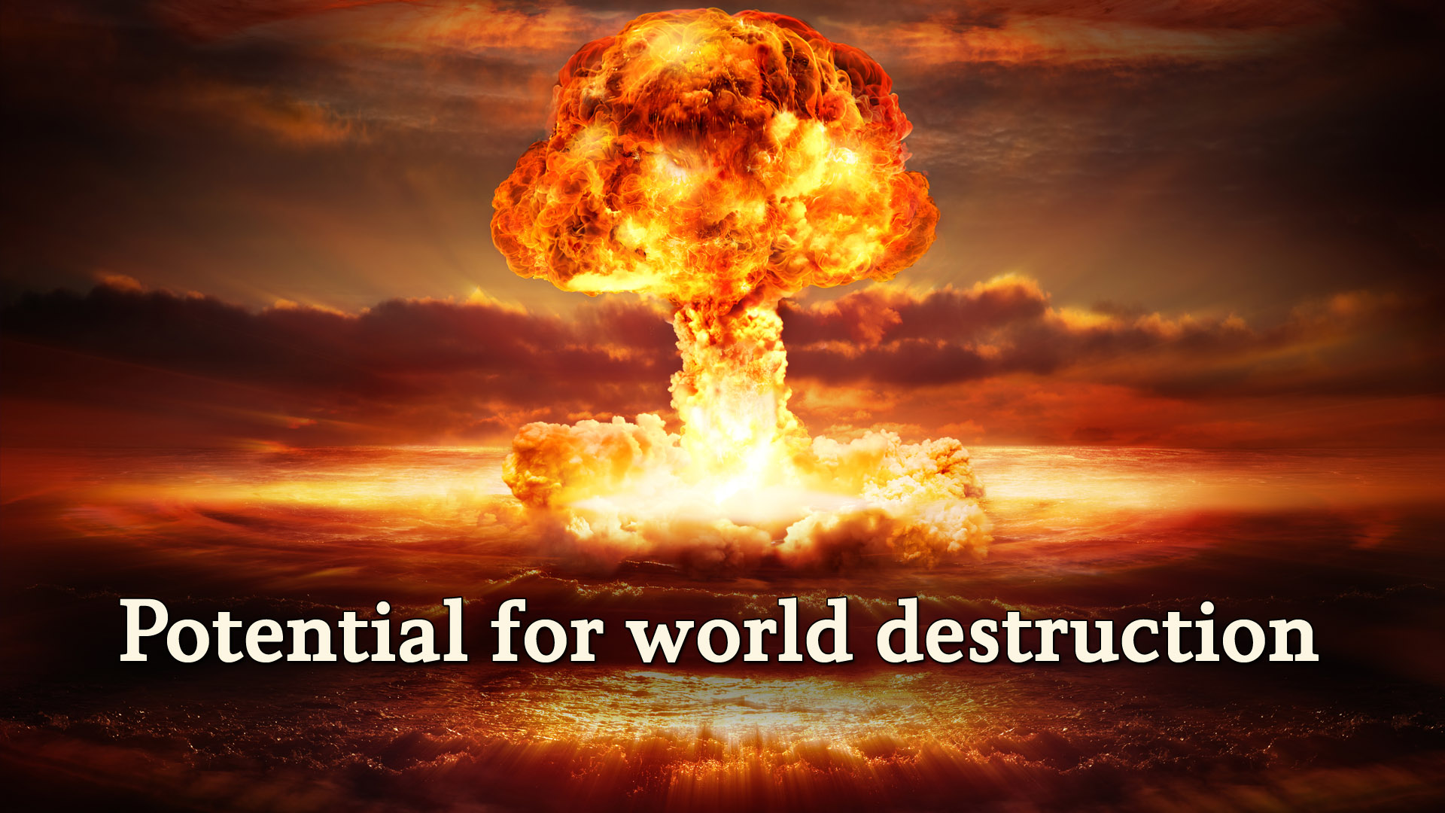
Notes:
Potential for world destruction.
Never before in history has the human race had the ability or the capacity to destroy itself.
Revelation describes it this way:
The North Atlantic Treaty Organization, also called the North Atlantic Alliance, is an intergovernmental military alliance among 28 European countries and 2 North American countries. Established in the aftermath of World War II, the organization implements the North Atlantic Treaty, signed 4 April 1949. Wikipedia
Headquarters: Brussels, Belgium
Founded: April 4, 1949, Washington, D.C.
Founders: United States, United Kingdom, France, Italy, Norway

Slide 38
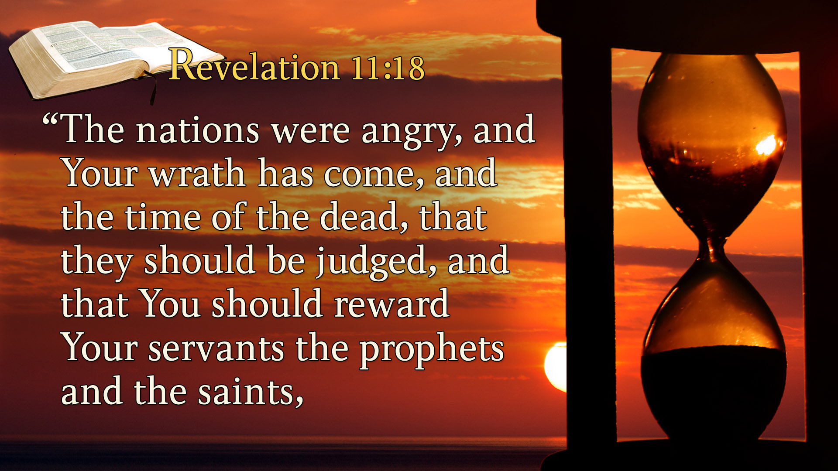
Notes:
Revelation 11:18
“The nations were angry, and Your wrath has come, and the time of the dead, that they should be judged, and that You should reward Your servants the prophets and the saints,

Slide 39
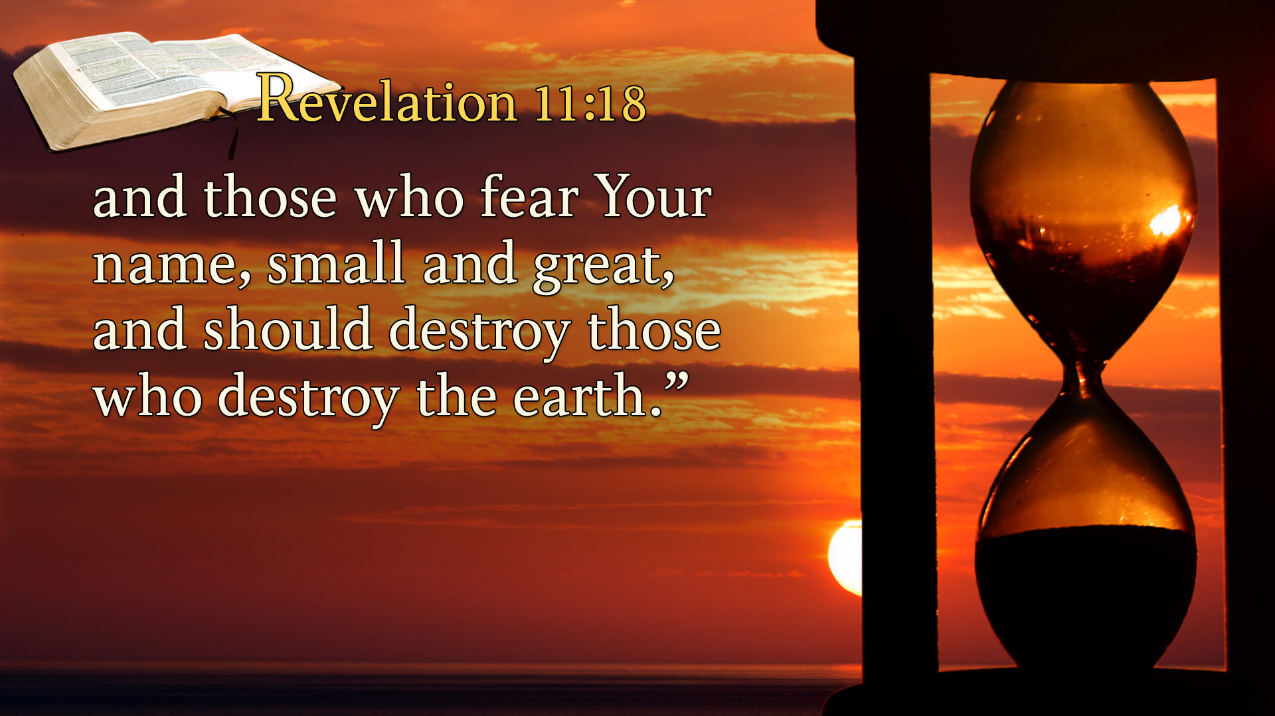
Notes:
and those who fear Your name, small and great, and should destroy those who destroy the earth.”
So, when Jesus comes to give out His reward He comes at a time when humans has the capacity to destroy the earth.
Did the human race have the ability to destroy the earth 100 years ago? Certainly not.
Today we have nuclear weaponry enough to destroy the earth multiple times over.
Jesus said that when the world would be gripped with fear, He would step across the threshold of eternity into time.
He will come to deliver us.

Slide 40
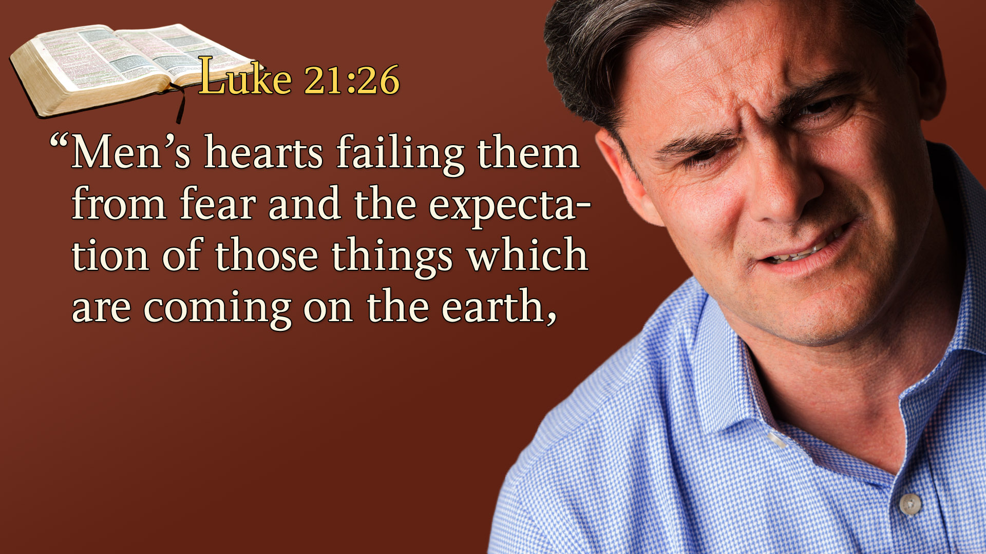
Notes:
Luke 21:26
“Men’s hearts failing them from fear and the expectation of those things which are coming on the earth,

Slide 41
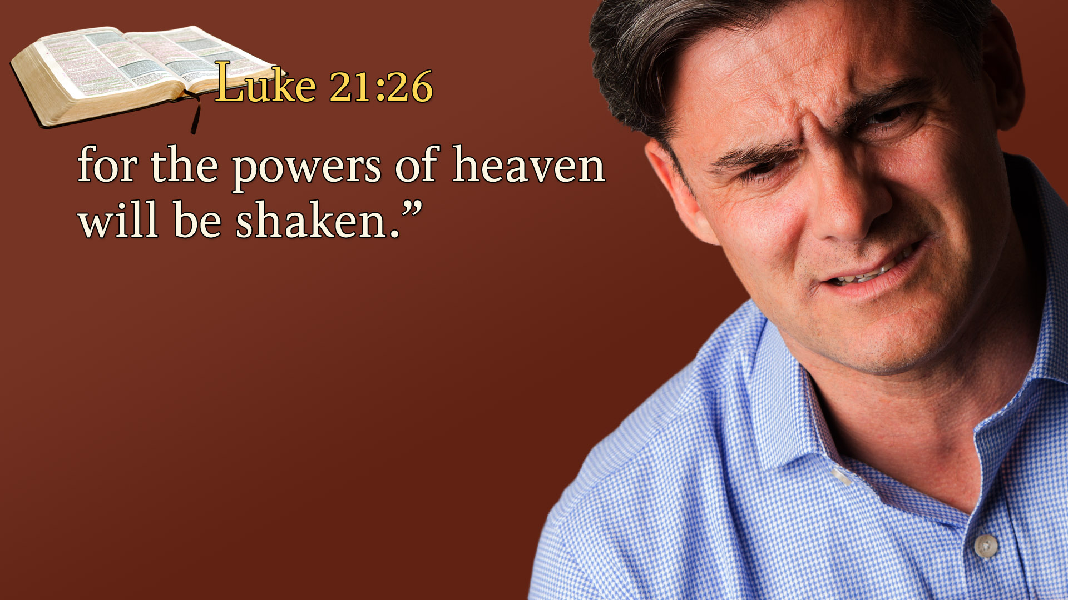
Notes:
for the powers of heaven will be shaken.”
When you are fearful, don't look around you.
Look up for the coming of the Lord draws nigh.
I think I hear the footsteps of the coming of Jesus.
All of history is moving to a grand climax.
Jesus says lift your eyes off the earth and focus them on divine reality. “I am about to return.”
Revelation reveals there is hope. There are signs in the world of religion, signs in the world of politics, and

Slide 42
Notes:
Signs in the world of nature.
The Bible predicts that all nature will be out of control just before the coming of Jesus.
We should expect tornadoes, fires, floods, hurricanes, and an epidemic of destruction that we can hardly imagine.

Slide 43
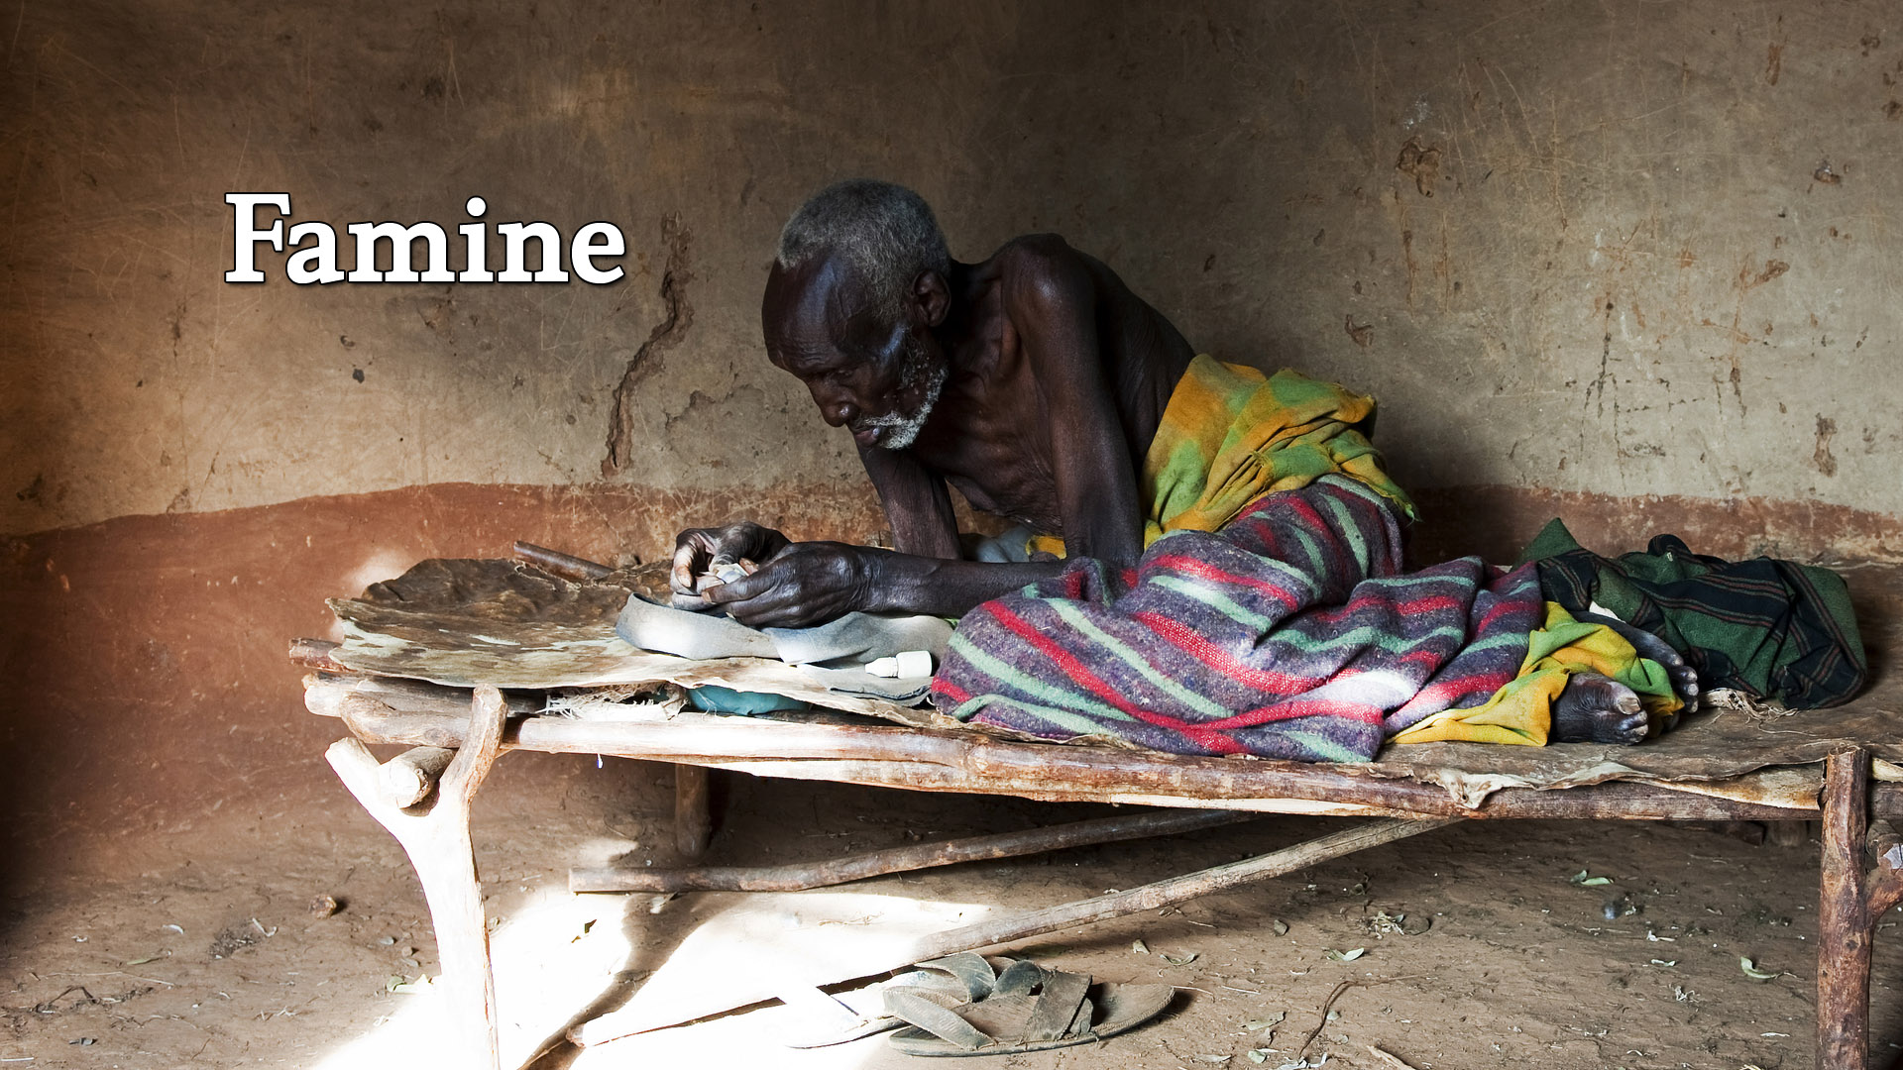
Notes:
Among these natural disasters is the Bible’s prediction for world-wide hunger and famine.

Slide 44
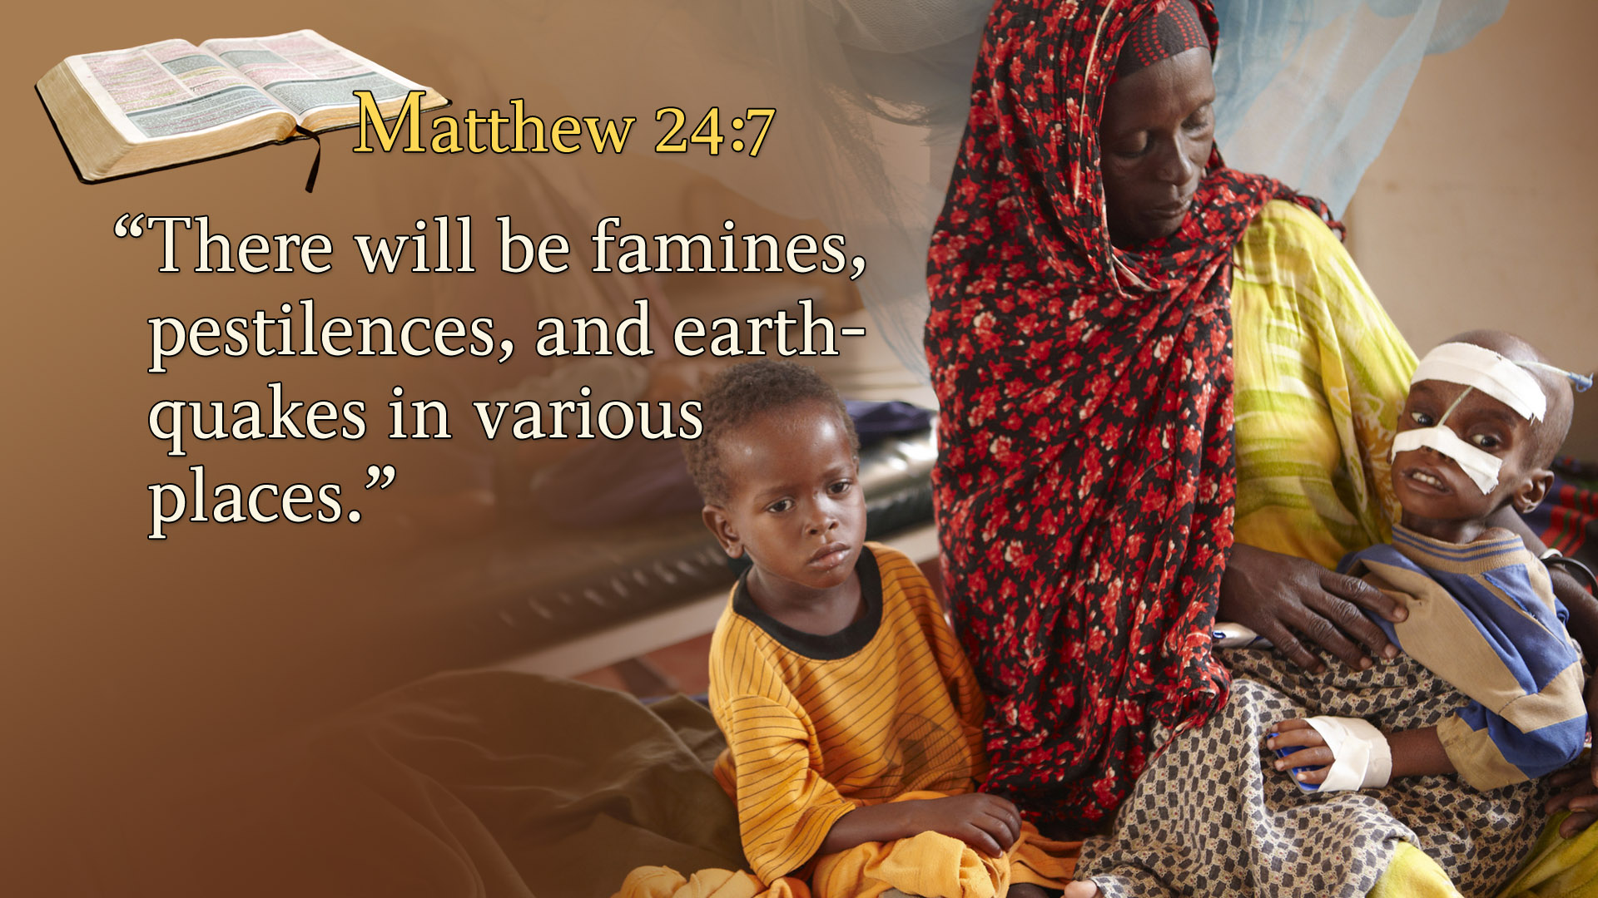
Notes:
Matthew 24:7
“There will be famines, pestilences, and earthquakes in various places.”
Haven’t we always had famines?
Haven’t there always been hungry children?
Yes, we have, but here is the difference.
Jesus didn’t predict a famine but He said there would be famines –plural – famines on an international scale; hunger on an unprecedented scale just before the coming of Jesus.
As we look out over our world, indeed, this prophecy as others is being fulfilled.

Slide 45
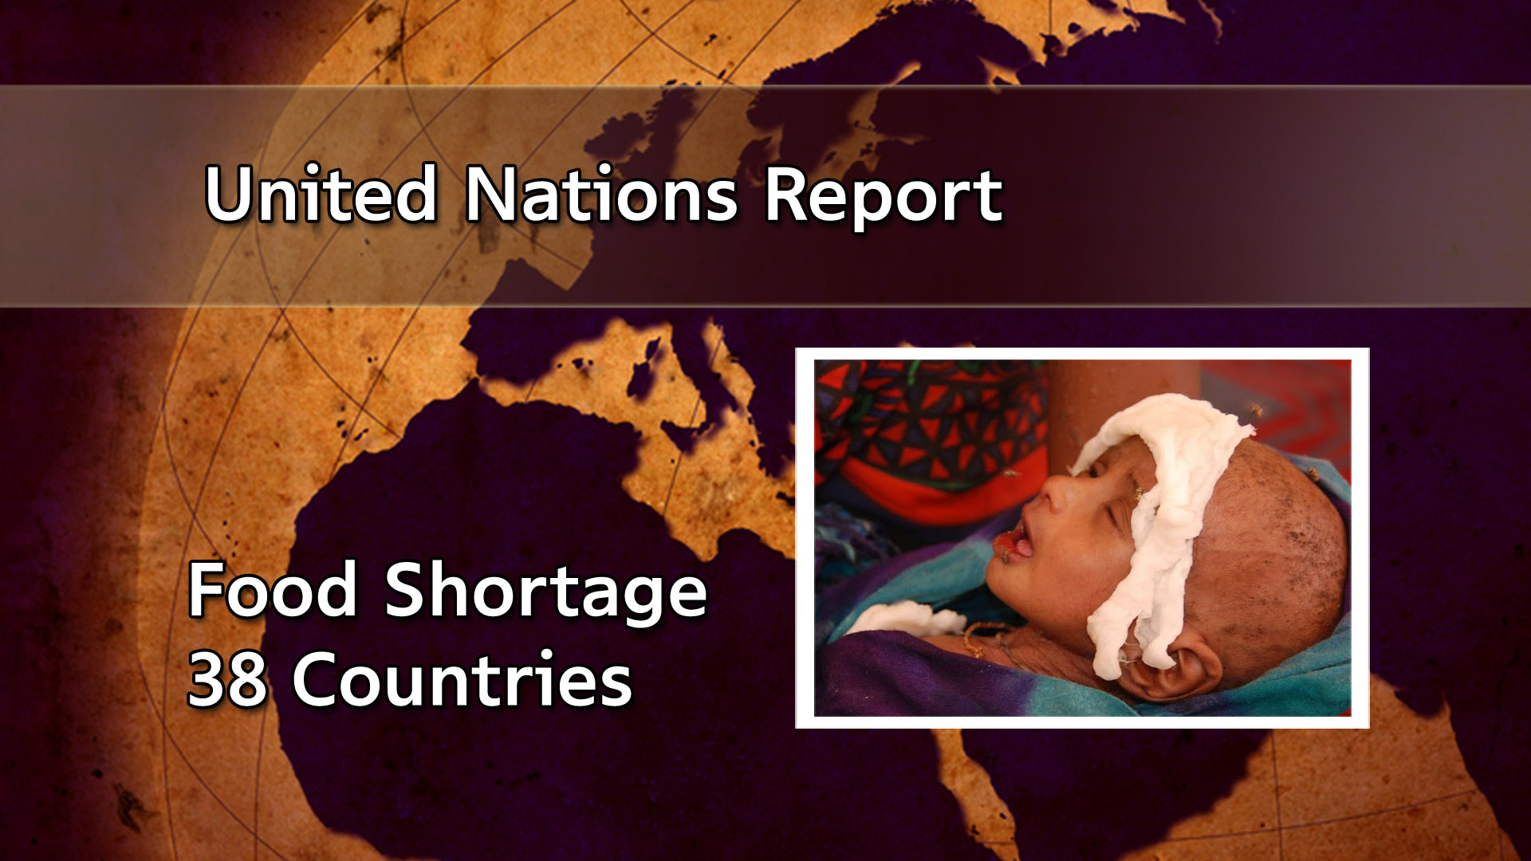
Notes:
The United Nations reported recently there is a severe food shortage in 38 of the major countries of the world.
WHERE IS EXTREME POVERTY?
Sub-Saharan Africa is the region with the largest number of people living in extreme poverty. See below for a breakdown of where people living with less than $1.90 per day are located.
413.3 million in Sub-Saharan Africa
216.4 million in South Asia
47.2 million in East Asia and Pacific
25.9 million in Latin America and the Caribbean
18.6 million in the Middle East and North Africa
7.1 million in Europe and Central Asia
Around the world, more than enough food is produced to feed the global population—but as many as 811 million people still go hungry.[4] After steadily declining for a decade, world hunger is on the rise, affecting 9.9 percent of people globally. From 2019 to 2020, the number of undernourished people grew by as many as 161 million, a crisis driven largely by conflict, climate change, and the COVID-19 pandemic.⁵

Slide 46
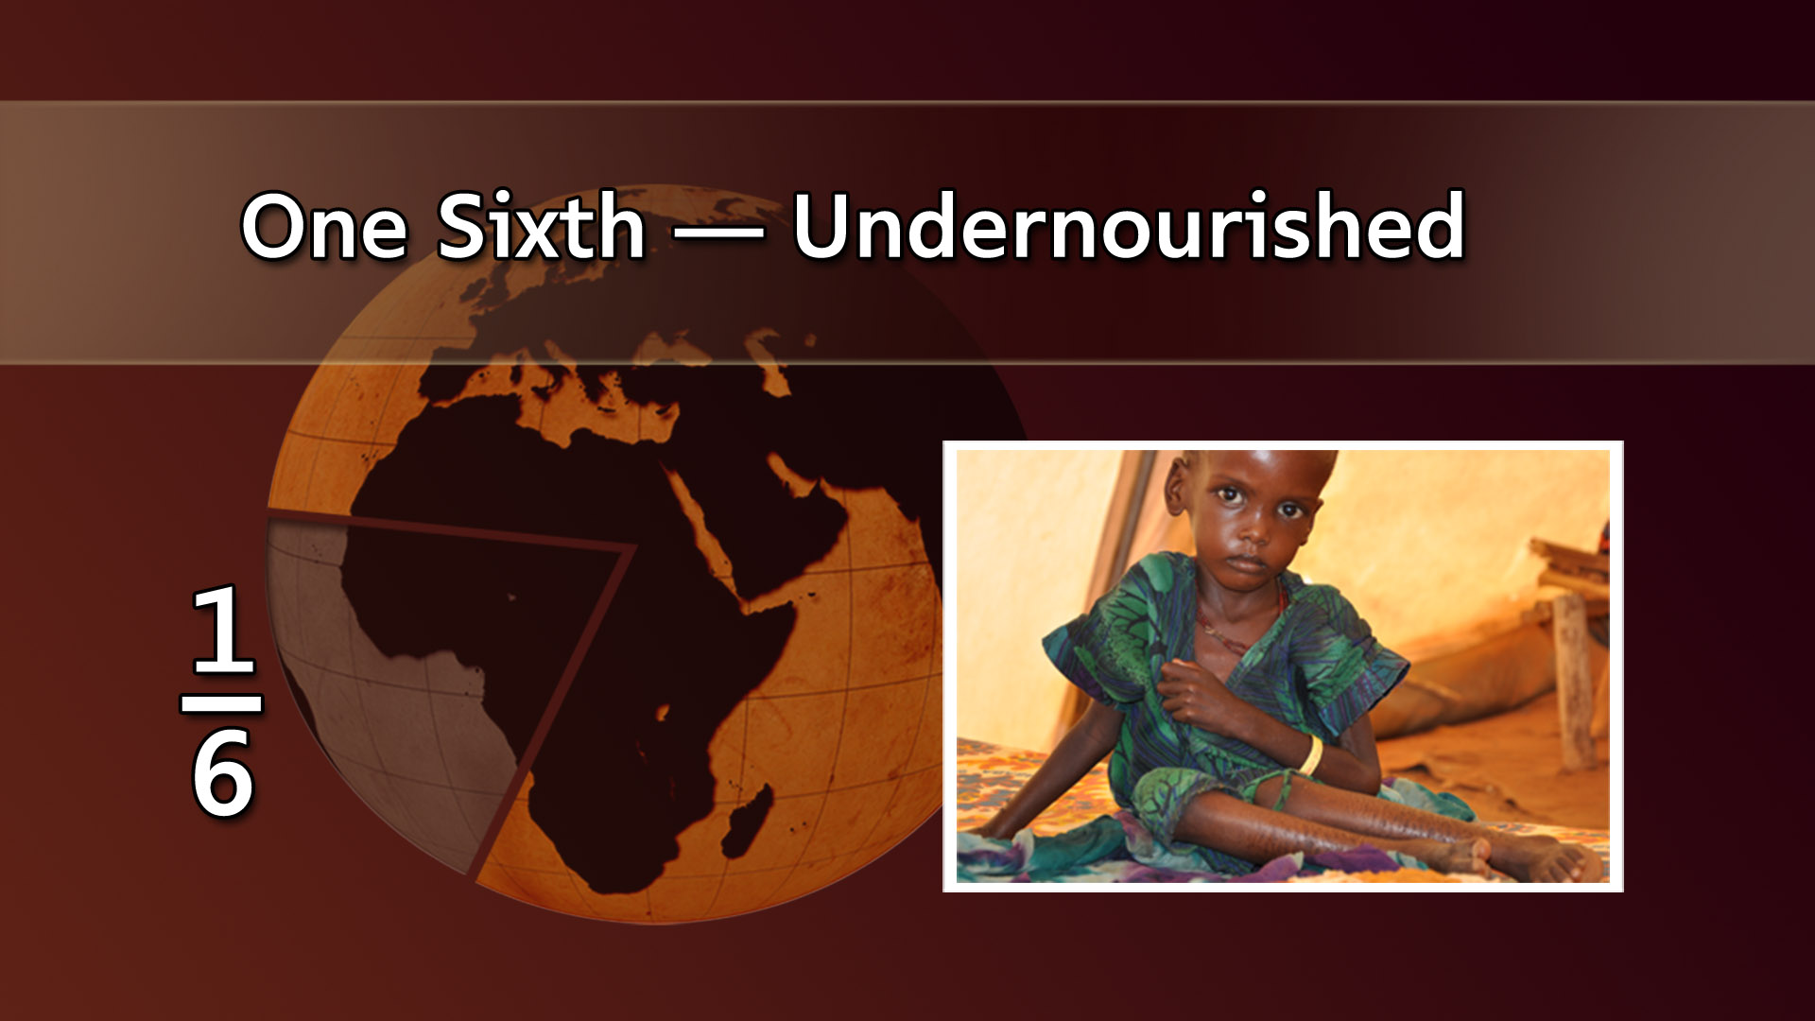
Notes:
One-sixth of the world’s population will go hungry tonight.
It is staggering when you look at the immensity of world famine.
Experts estimate that for two billion people in the world today – nearly one third of the world’s population – chronic hunger is an ever-present part of daily life.
Jesus’ prediction regarding famine is coming true with uncanny accuracy.

Slide 47
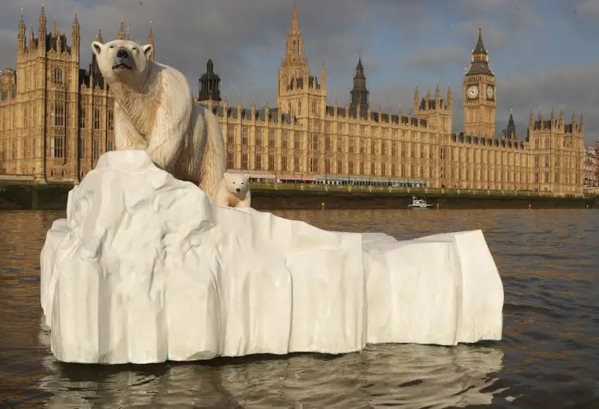
Notes:
Global warming.

Slide 48
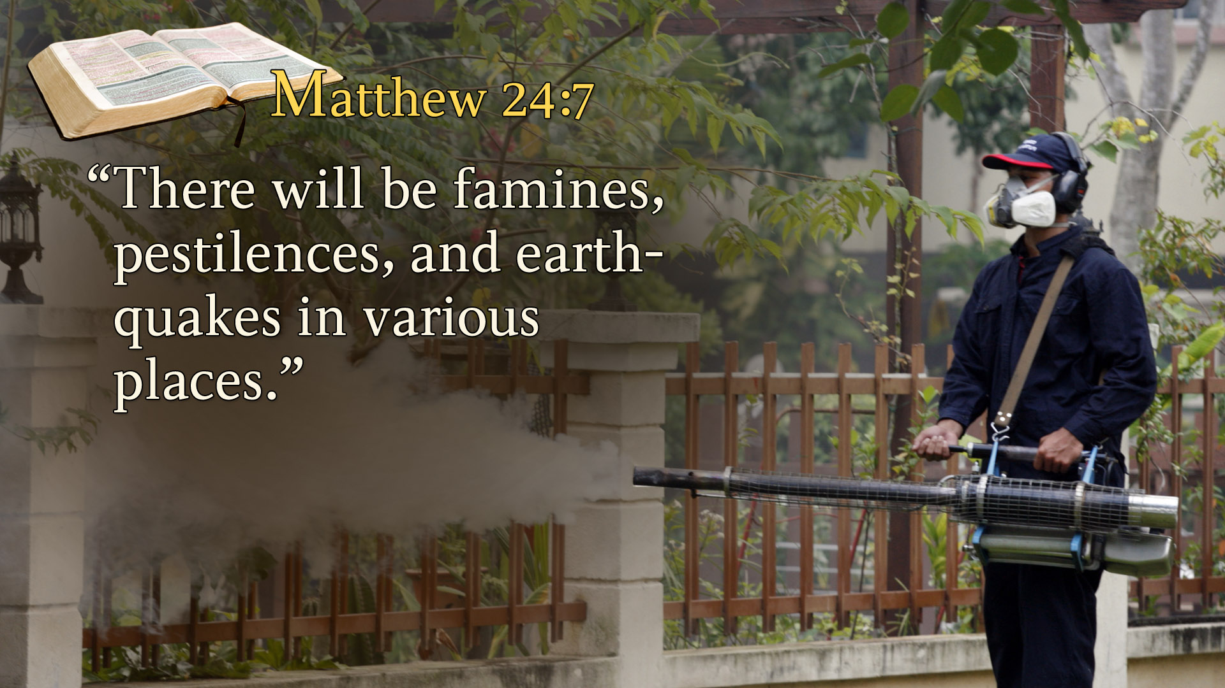
Notes:
Then He said there would also be pestilences.
What is a pestilence?

Slide 49
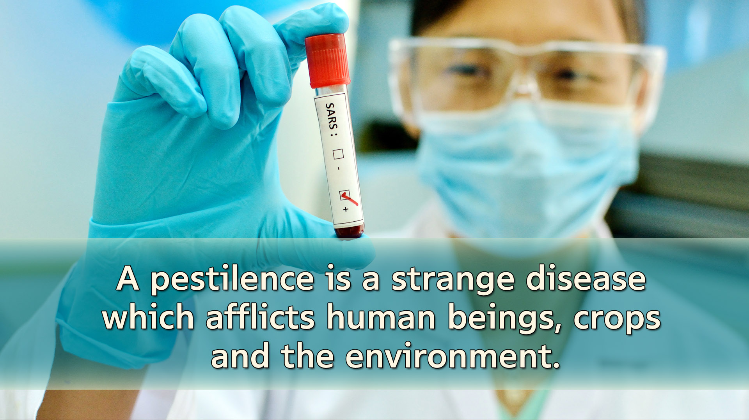
Notes:
A pestilence is a strange disease which afflicts human beings, crops and the environment.
You’ve heard of pesticides on crops. The reason farmers put pesticide on crops is because these diseases are destroying them.
Pestilences are rapidly spreading in various parts of the world.

Slide 50
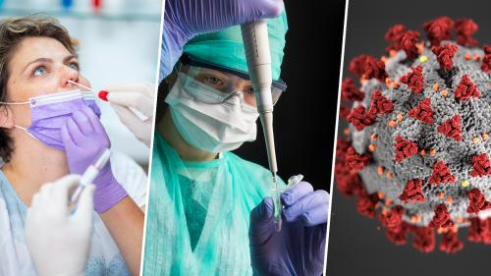

Slide 51
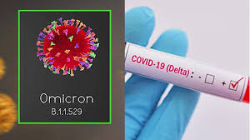
Notes:
Variants of Covid – 19. We went through all these variants.

Slide 52
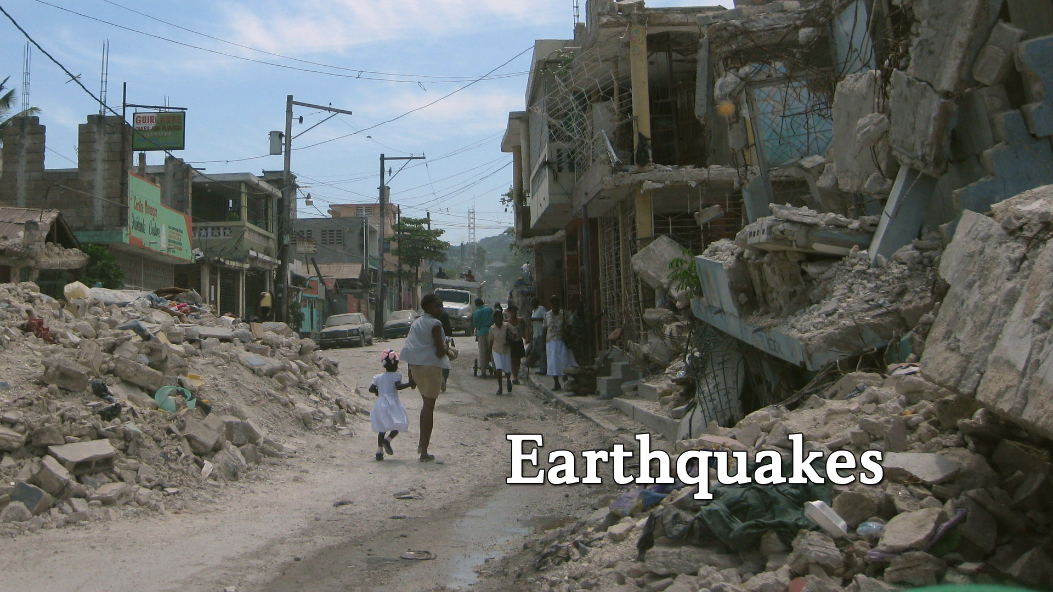
Notes:
Jesus also said there would be earthquakes.

Slide 53
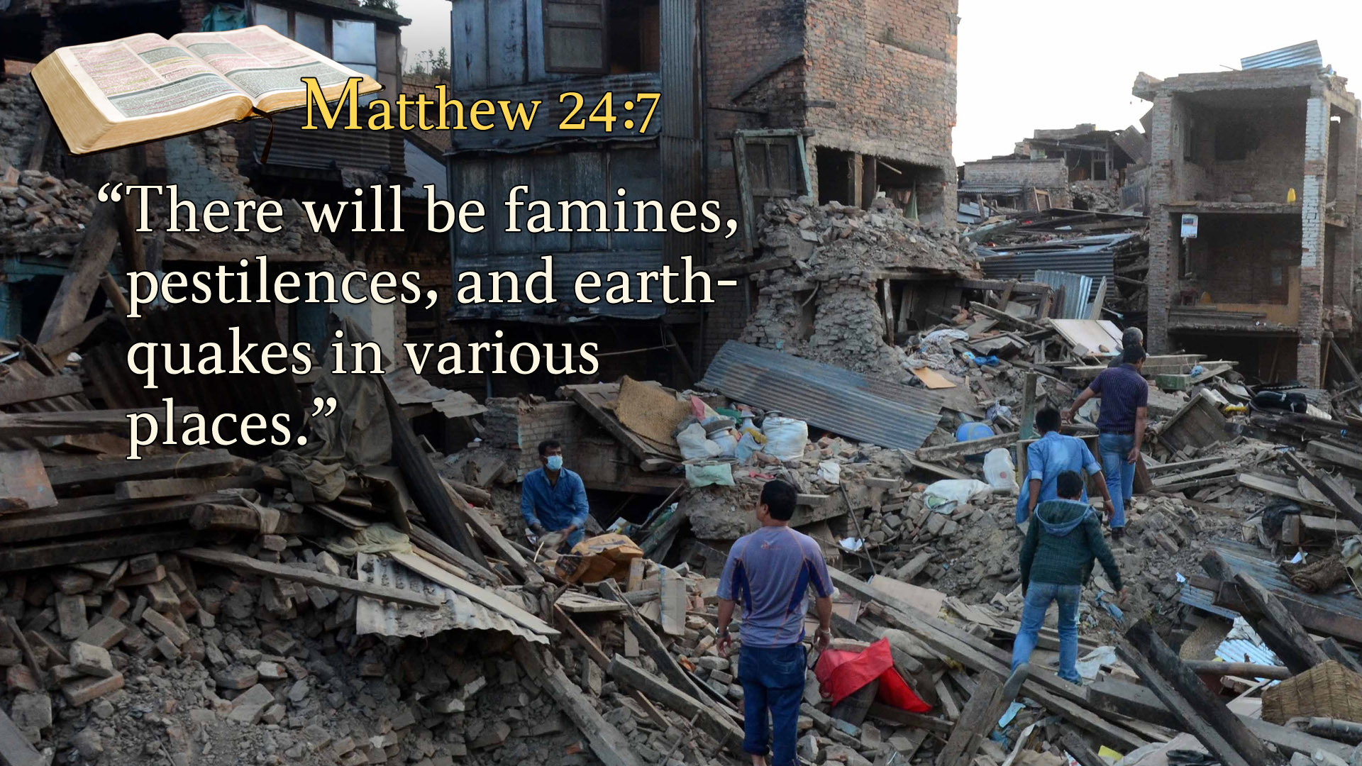
Notes:
Matthew 24:7
“There will be famines, pestilences, and earthquakes in various places.”

Slide 54
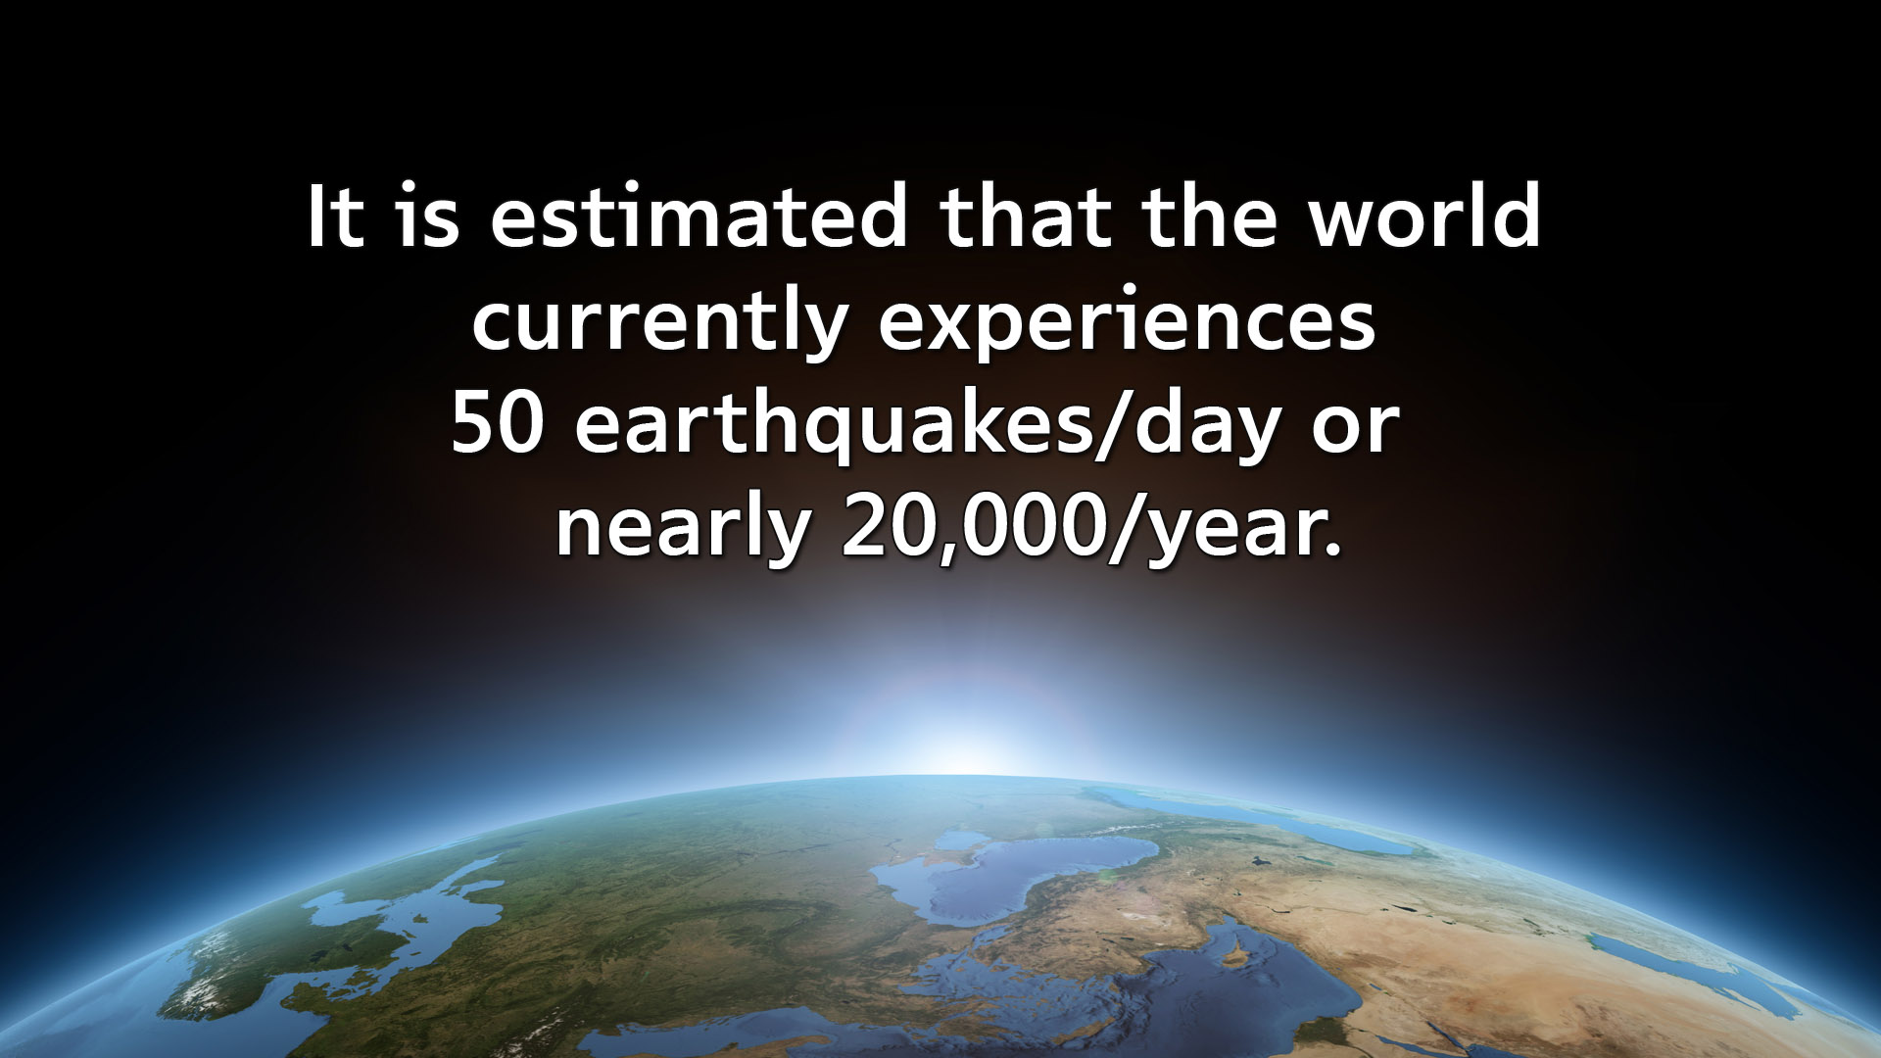
Notes:
It is estimated that the world currently experiences 50 earthquakes/day or nearly 20,000/year

Slide 55
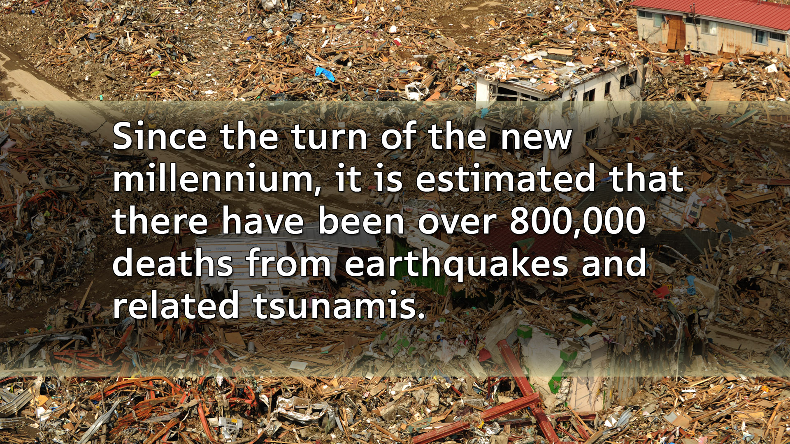
Notes:
Since the turn of the new millennium, it is estimated that there have been over 800,000 deaths from earthquakes and related tsunamis.
Jesus continues:

Slide 56

Notes:
Sep 21, 2021
Tens of thousands of people across five Australian states and territories have reported feeling a strong earthquake on Wednesday morning. Geoscience Australi...

Slide 57
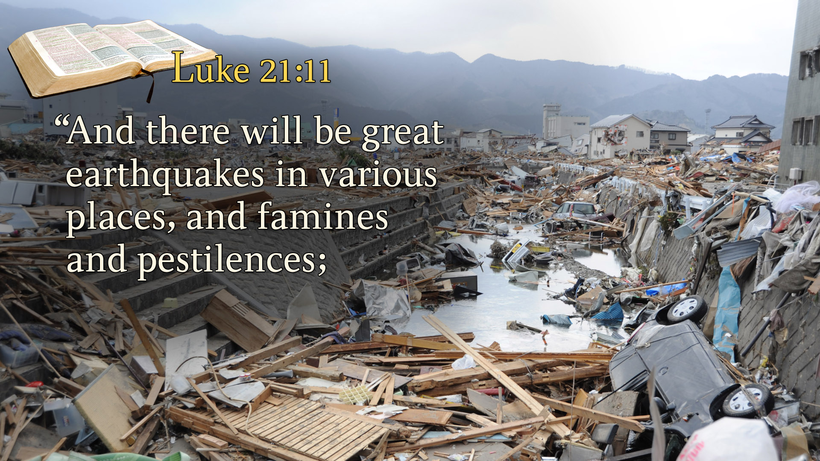
Notes:
Luke 21:11
“And there will be great earthquakes in various places, and famines and pestilences;

Slide 58
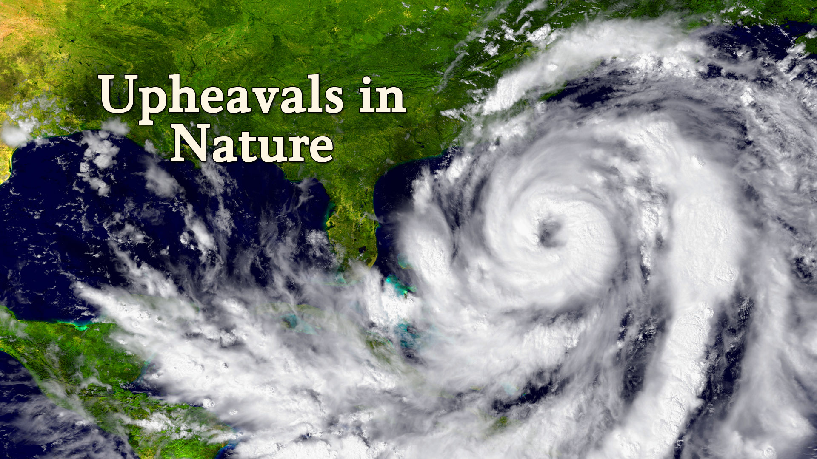
Notes:
This upheaval in nature would reveal itself in various ways.
Hurricanes, typhoons, tornadoes, floods, and fires would manifest themselves in rapid succession.
The news is full of disasters affecting millions. there have been countless thousands more killed, injured, displaced or financially disrupted by fires, floods, heatwaves, volcanic eruptions, hurricanes and typhoons, tornadoes, or drought.

Slide 59
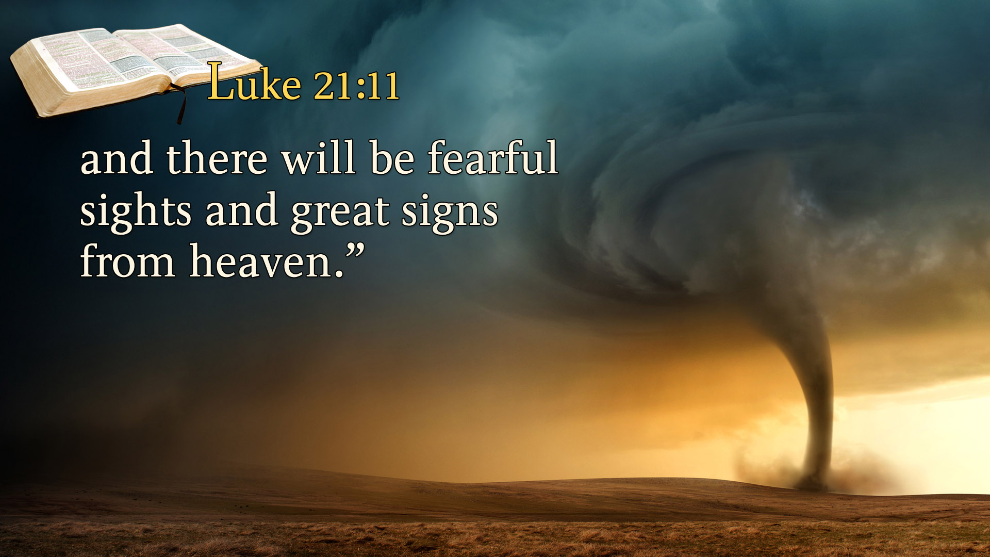
Notes:
and there will be fearful sights and great signs from heaven.”

Slide 60
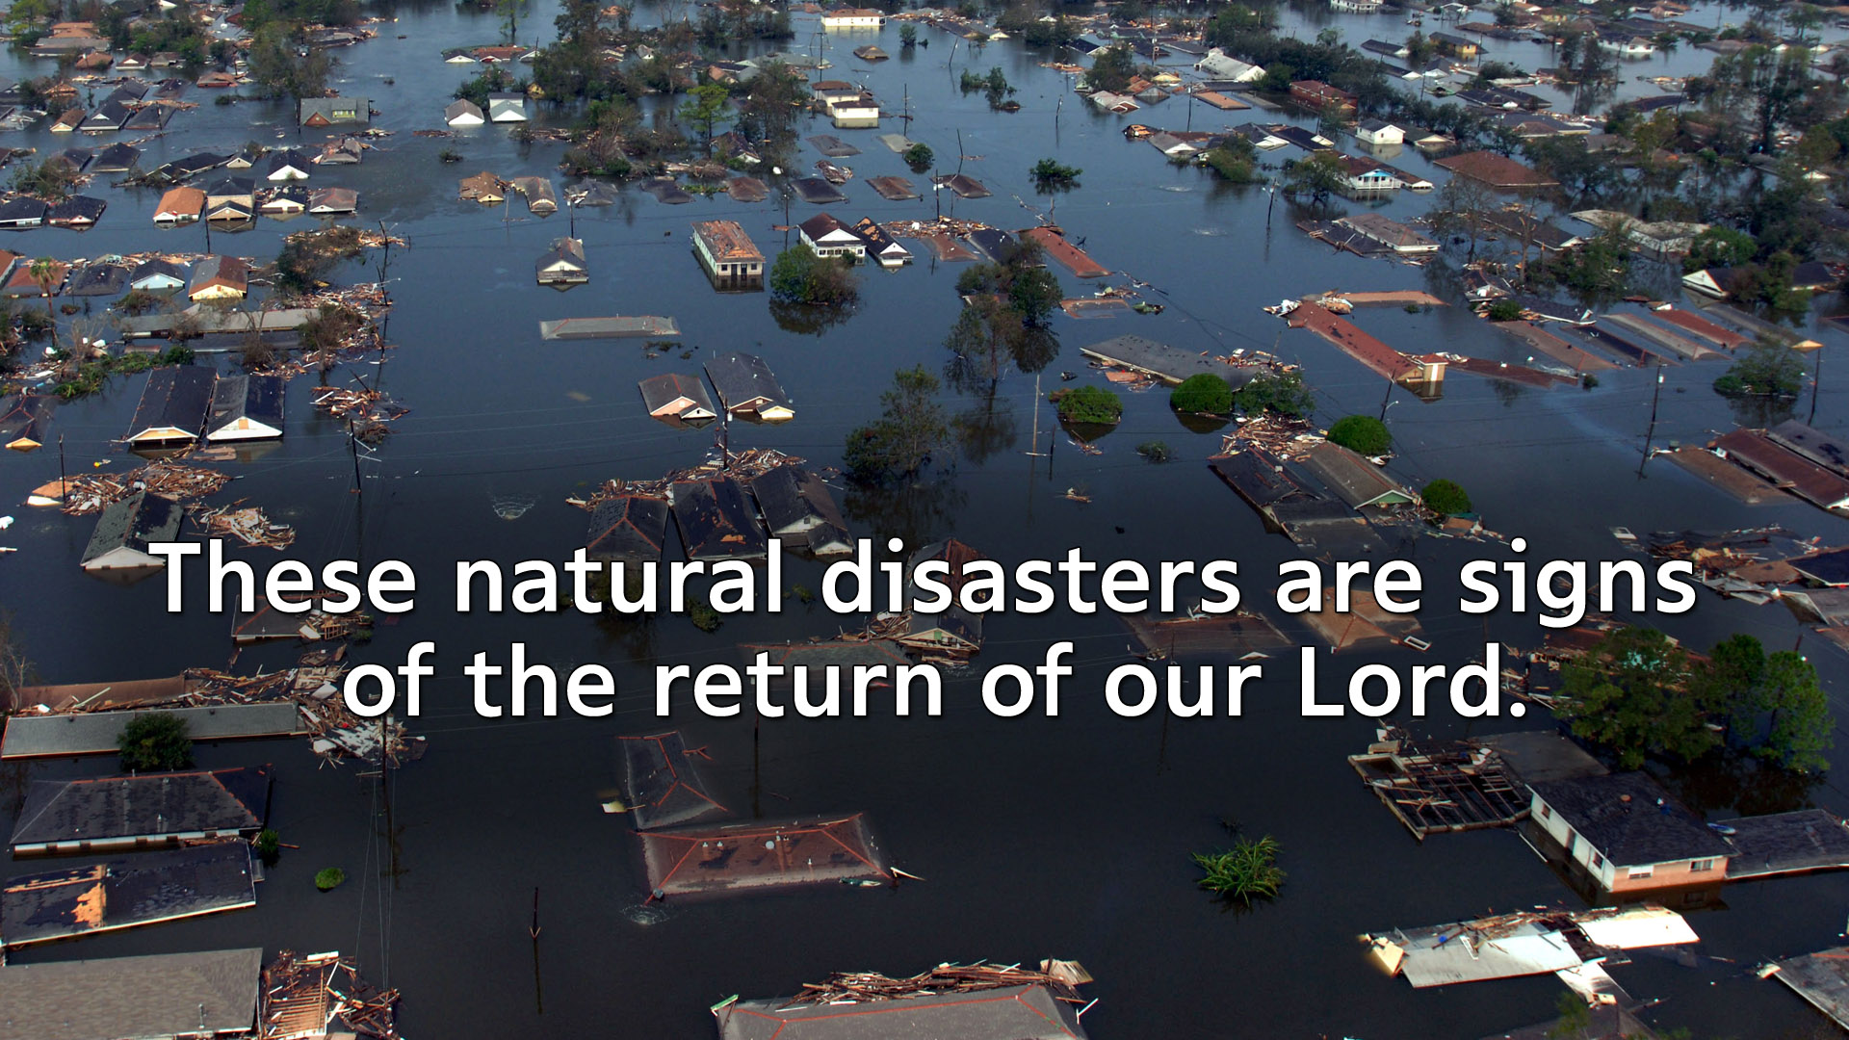
Notes:
These natural disasters are signs of the return of our Lord.
All of earth is crying out – “Oh Jesus, Come quickly.” Hearts are indeed failing for fear and for expectations of those things that are coming on the earth.
We’ve seen an increase in the signs that Jesus foretold all around us. When you look at our world today it does seem that all nature is out of control.
But those of us who have confidence in the Bible believe these are signposts on the way pointing to Jesus’ soon coming.
We’ve seen what the Bible says regarding the signs of Jesus coming in the world of religion, world of politics and the world of nature

Slide 61
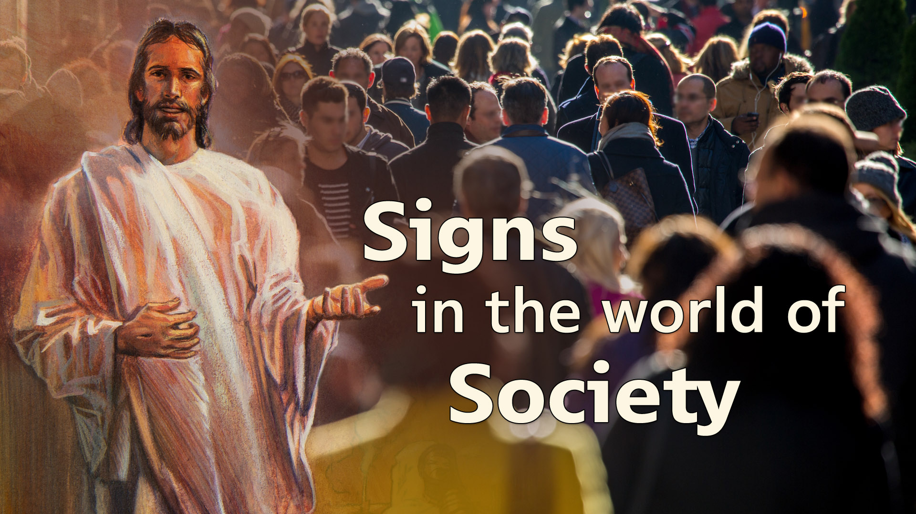
Notes:
Now let’s look at His predictions regarding the social life around us.

Slide 62

Notes:
Our Lord predicted the moral fabric of society would fall apart just before the return of our Lord.
Moral decay and corruption would be prevalent everywhere.

Slide 63
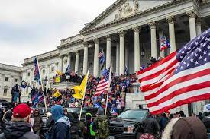
Notes:
Civil disorder in January 6, 2021, Capitol riot.

Slide 64
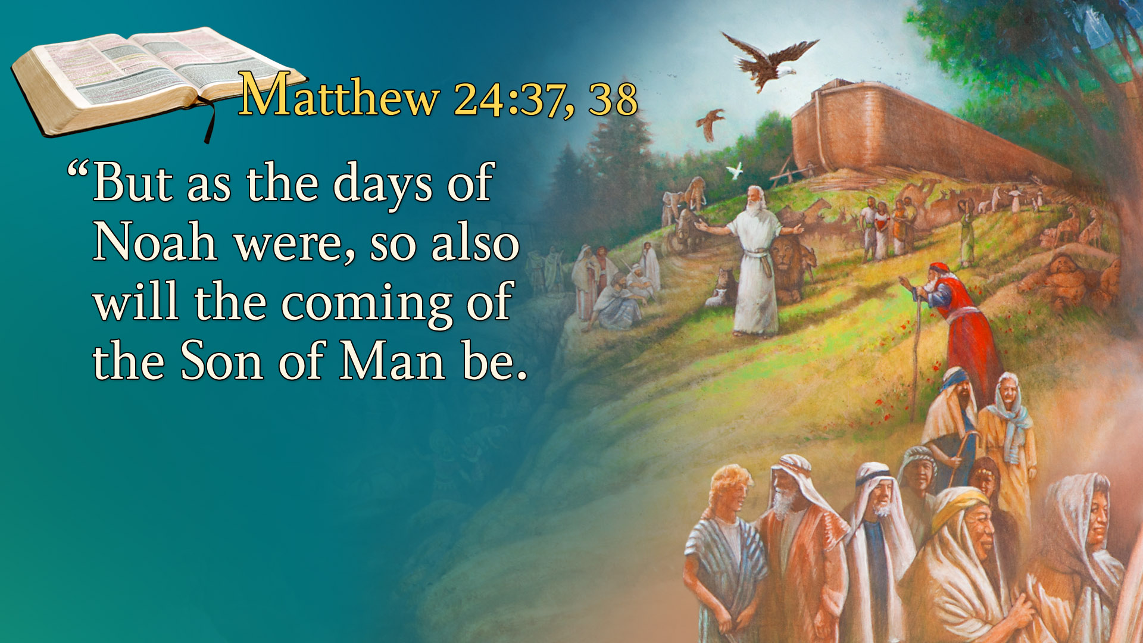
Notes:
Matthew 24:37, 38
“But as the days of Noah were, so also will the coming of the Son of Man be.
Jesus said, “As it was in the days of Noah.”
Many are familiar with the story of Noah’s ark full of animals that escaped the flood waters that destroyed the earth.
But what was society like in Noah’s day, before the flood?
Jesus gives a glimpse as He continues…

Slide 65
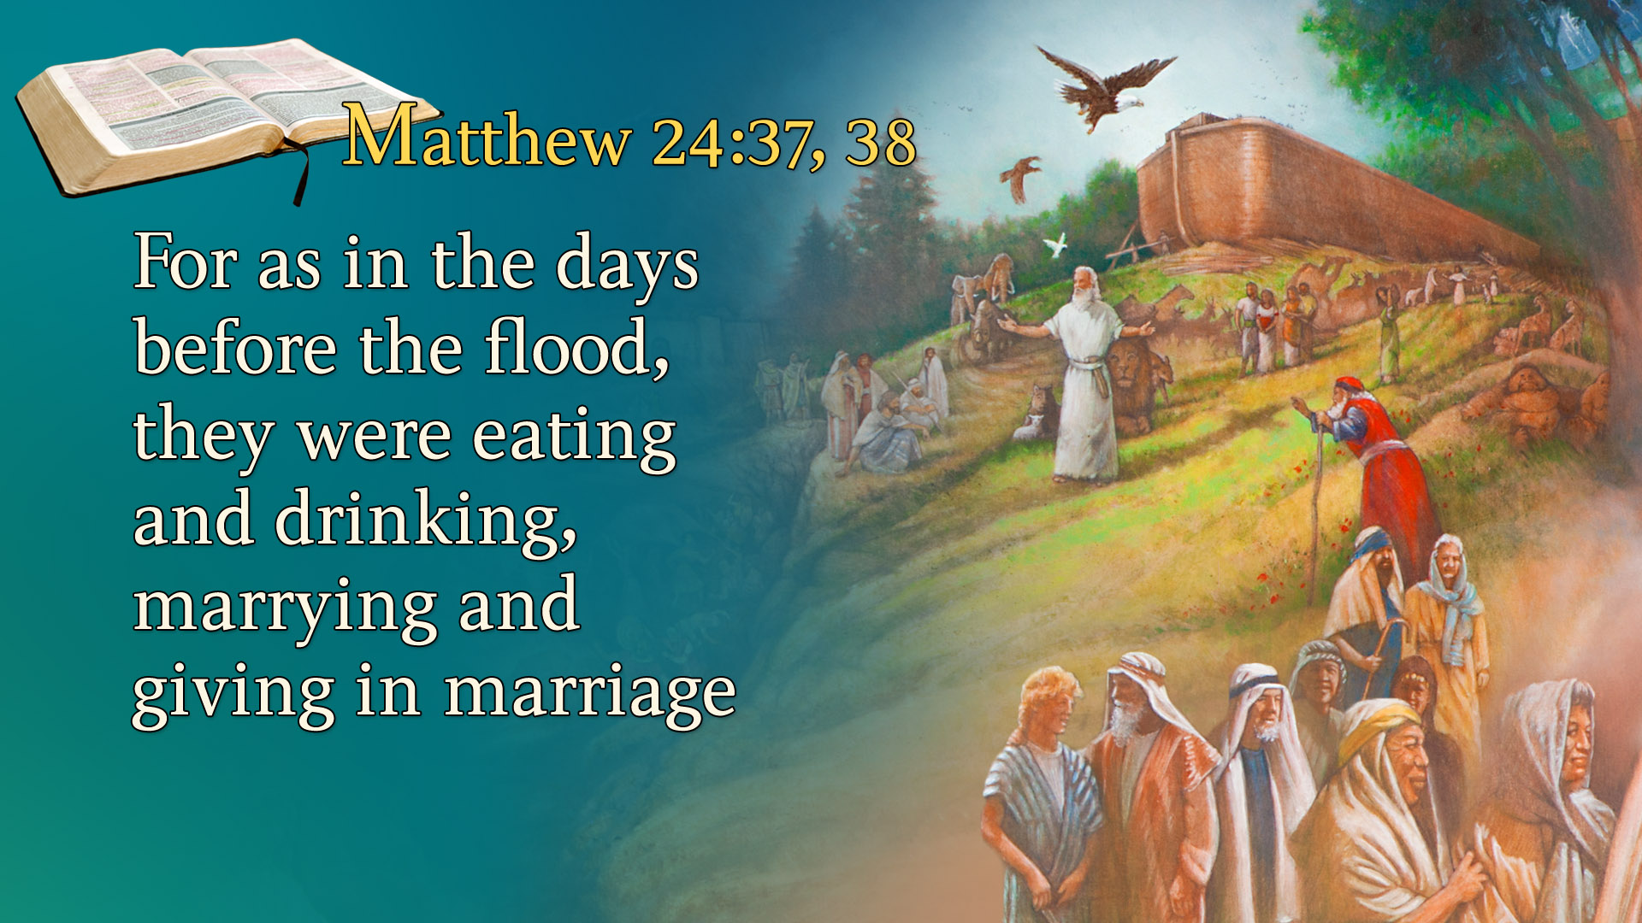
Notes:
For as in the days before the flood, they were eating and drinking, marrying and giving in marriage,

Slide 66
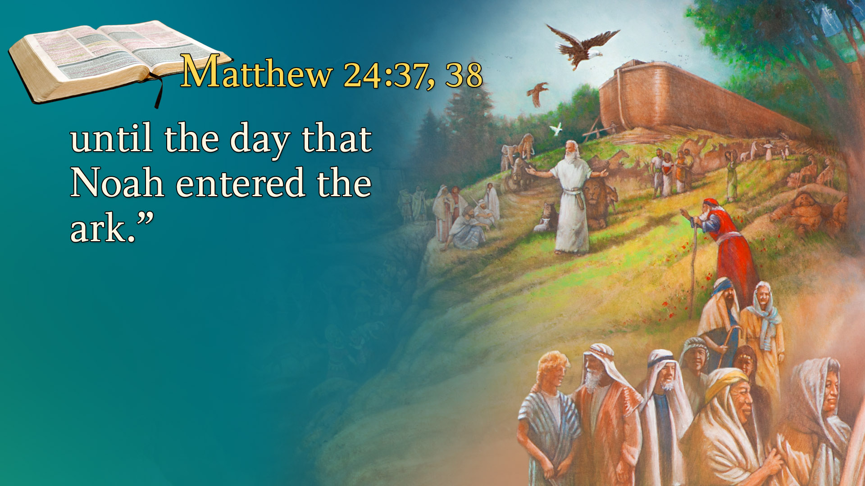
Notes:
until the day that Noah entered the ark.”
What’s wrong with eating and drinking? Nothing!
What’s wrong with marrying and giving in marriage? Nothing!
This passage describes a people who continued living self-centered godless lives.
They took eating and drinking to excess.
Pleasure dominated their lives.
And they ignored the signs of the times.

Slide 67
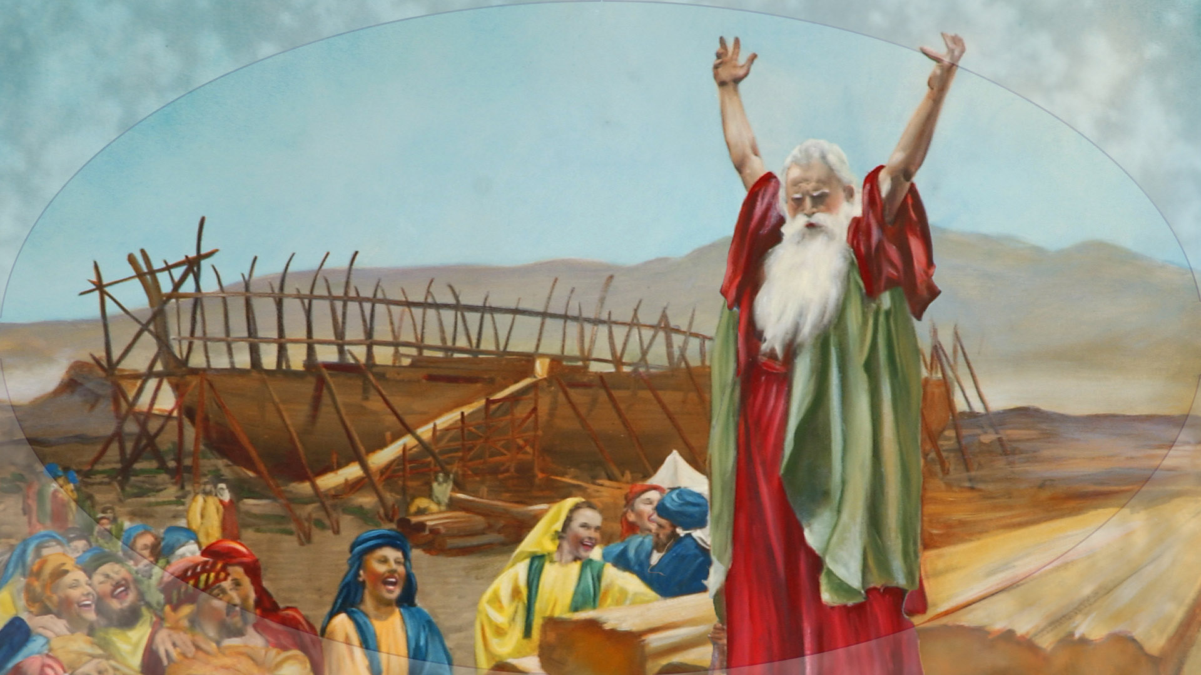
Notes:
Noah proclaimed, “A flood is coming.”
Noah pointed out the decay of morality.
He indicated that a flood was coming and yet people of his day continued to live their self-centered lives.
They were not spiritually moved.
They did not repent of their sins.
Their minds were too occupied.
They were enchanted with the here and now.
Eternity was crowded out of their thinking.
What about today? Jesus predicted there would be loose morality at the end of time, just like it was in the days of Noah.
When Jesus uses the phrase, “marrying and giving in marriage” He was predicting:

Slide 68

Notes:
1) The break-up of the family unit.
2) Complacent attitude toward spiritual things and moral living.
Do we see that happening today?

Slide 69

Notes:
The family unit which has been so secure for so many years is beginning to crack and crumble.
The Biblical model for the family is being shattered in modern society.
These prophecies are being fulfilled before our very eyes tonight.
But what a tragedy that love has degenerated into sexual immorality in so many cases.
What a tragedy that homes are breaking up.

Slide 70

Notes:
We live in a world of rising crime and violence, similar to Noah’s day

Slide 71

Notes:
Genesis 6:11, 12 state it this way:
“The earth also was corrupt before God, and the earth was filled with violence.

Slide 72

Notes:
So, God looked upon the earth, and indeed it was corrupt; for all flesh had corrupted their way on the earth.”
In Noah’s day God destroyed the world with a flood because it was filled with violence.
Is our earth filled with violence? Is it a global concern?
Are world governments concerned about violence?
Yes, governments are concerned.

Slide 73

Notes:
In 2014 the World Health Organization reported a shocking summary of the problems of global violence and the efforts to address them.
475,000 homicide deaths per year, 1 in 4 children has been physically abused, 1 in 3 women has been a victim of abuse, and 1 in 17 older people has been abused in past month.

Slide 74

Notes:
Current data on US crime rates is difficult to come by. Most data from the US Federal Bureau of Investigation (FBI) is only available through 2018, a few exceptions such as offense clearance statistics go through 2019, and for 2020, the year of COVID, you have to either reference preliminary figures published in September that cover January-July or bounce from metro area to metro area to find the statistics you're looking for. So, we did both!

Slide 75

Notes:
The Bible also predicts economic uncertainty as a sign of the last days.

Slide 76

Notes:
I am sure we are following the stock market because for many our retirement fund is invested.

Slide 77
World Economic Forum surveys people every year about the biggest problems facing the world.
Climate change is the millennial generation's top concern for the third year in a row.
Millennials are also concerned about large scale conflict, wars, and inequality.

Slide 78


Notes:
For the third year in a row, millennials who participated in the World Economic Forum's Global Shapers Survey 2017 believe climate change is the most serious issue affecting the world today.Millennials protest

Slide 79

Notes:
James 5:1-3 describes it this way:
“Come now, you rich, weep and howl for your miseries that are coming upon you! Your riches are corrupted, and your garments are moth-eaten. . ..

Slide 80

Notes:
Your gold and silver are corroded, and their corrosion will be a witness against you and will eat your flesh like fire. You have heaped up treasure in the last days.”

Slide 81

Notes:
Revelation 18:17
“For in one hour such great riches came to nothing . . .”
Wars have caused millions to flee their homes and become destitute living in refugee camps. Stock markets have crashed, earthquakes, tsunami’s, hurricanes, typhoons, floods, fires, and tornadoes have destroyed homes, businesses, causing tens of millions of people to struggle to survive on very, very little. Natural disasters
My Friends Jesus is coming!
These prophecies are being fulfilled before our very eyes.

Slide 82


Slide 83

Notes:
Think about it. God warns every generation. This is our warning.

Slide 84

Notes:
Signs are being fulfilled:

Slide 85

Notes:
1. False christs and prophets
2. Wars and rumors of wars
3. Cries of peace, but no peace
4. Famines
5. Pestilences

Slide 86

Notes:
6. Earthquakes
7. Sexual immorality
8. Homes falling apart
9. Violence filling our lands
10. Economic uncertainty All these signs are fulfilled.
But there is one more sign which will prove beyond any shadow of a doubt that indeed we are living in the very last days of this world’s history.

Slide 87

Notes:
The final sign that Jesus gives of His soon return in Matthew 24 is the gospel being proclaimed to the entire world.

Slide 88

Notes:
Matthew 24:14
“And this gospel of the kingdom will be preached in all the world as a witness to all the nations, and then the end will come.”

Slide 89


Notes:
I Will Go is the official strategic plan website of. the Seventh-day Adventist World Church.

Slide 90

Notes:
Revelation 14:6 also echoes this thought:
“Then I saw another angel flying in the midst of heaven, having the everlasting gospel

Slide 91

Notes:
to preach to those who dwell on the earth—to every nation, tribe, tongue, and people.”
In Revelation Jesus says you will know we have come to the end by the final sign.

Slide 92

Notes:
When you see the gospel going quickly around the world.
This prophecy is rapidly being fulfilled today.
Today the Gospel leaps across all barriers through radio, television, and the Internet. How many of you have a cell phone? Many people can receive text messages and Biblical presentations right on their cell phones today. God is reaching people in every way possible.
In a mountain village of Southeast Asia, a remote tribe received a transistor radio. They began listening to the Short-Wave signal of Adventist World Radio, a Christian radio network, broadcasting truth filled Gospel presentations. As they listened to the Word of God, the whole village was transformed by God’s grace and became Christians.
In a wealthy Middle Eastern home, a Muslim family began watching Christian Television, their lives were changed and they too now are committed to walk with Jesus.
In a Siberian Prison, a hardened criminal heard the message of Christ through a satellite transmission and now is a consecrated believer.
In a crowded European city, a desperate young man picked up a brochure advertising a series of meetings on Revelation’s prophecies just like the one you are attending.
New hope flooded in to his heart and his life was changed.
From remote villages to barren deserts, to wealthy homes in gated communities, prisons and the cities with their teeming masses, the Gospel is going forth in these last days in remarkable ways.
God is working miracles around the world today.
Millions are being stirred as never before with a sense of the urgency of the times.
Millions are turning from the uncertainty of this world to seek for a better world to come.
Many have sacrificed all to take the gospel to the far regions of the world.

Slide 93

Notes:
God is on the move. Prophecy is being fulfilled.
Around the World, God is doing something special.
He is fulfilling His word.
We are on the verge of the kingdom of God.
The signs that our Lord gave are being fulfilled.
It is the midnight hour. And God is appealing to men and women, He is appealing to you and me, to be ready for His return.

Slide 94

Notes:
Would you like to raise your hand and say “Yes, Jesus, I believe you are coming soon.”
How many of you would want to say, “Lord, I want to be ready for your coming?”
Is there anything in your life that would keep you from being ready for Christ’s coming? Would you like to raise your hand right now and surrender that thing to Jesus as we pray?

Slide 95

Notes:
F. E. Belden wrote many hymn tunes, gospel songs, and related texts in the early years of the Seventh-day Adventist Church. Belden was able to rapidly write both music and poetry together which enabled him to write a song to fit a sermon while it was still being delivered. He also wrote songs for evang­el­ist Bil­ly Sun­day. Though Belden’s later years were marred by misunderstandings with the church leadership over his royal he did donate his papers and manuscripts to the church’s seminary at his death. He died on December 2, 1945 in Battle Creek, Michigan.
Omens generally get a bad rap — that's probably because a lot of them predict bad stuff, at least according to superstition. But the interpretation of omens really depends on the country and culture. What's considered an ominous sign in one place might mean a lifetime of good luck somewhere else. Oscar Wilde once wrote that, “There is no such thing as an omen. Destiny does not send us heralds. She is too wise or too cruel for that.”
Because we do not know which hour Jesus is coming. So be ready.

