Slide 1
HERBS OF THE BIBLE

Slide 2
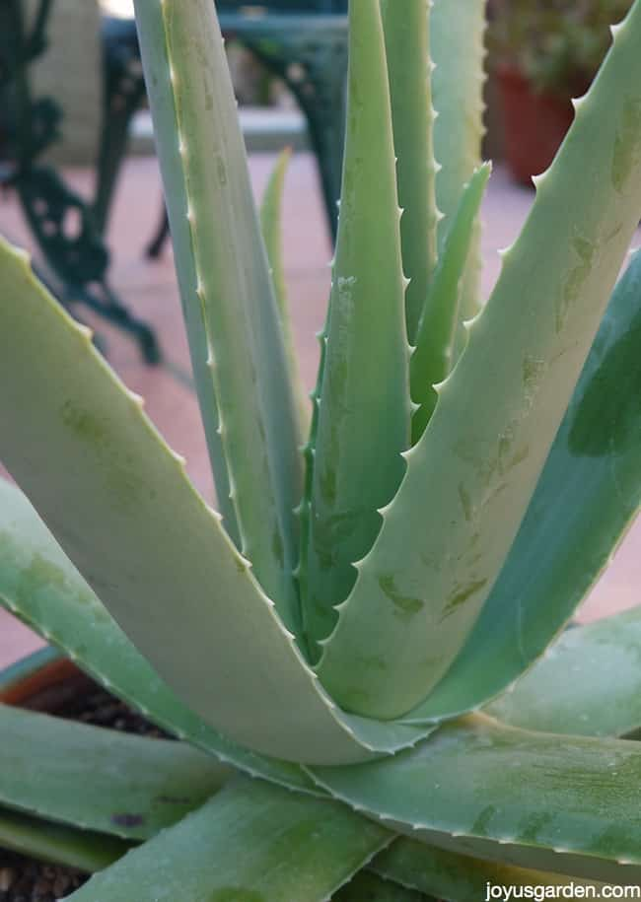
ALOE (ALOE VERA)
JOHN 19: 39-40
ALOES ARE USED IN VARIOUS TREATMENTS. ALOE JUICE WAS USED FOR ENBALMING IN ANCIENT EGYPT AND ITS JUICE WAS INCLUDED IN INCENSE, PERFUMES,LOTIONS AND POWDERS
ALOES CAN BE TAKEN INTERNALLY AND IT AIDS IN HEALING AND INCREASING BLOOD FLOW

Slide 3
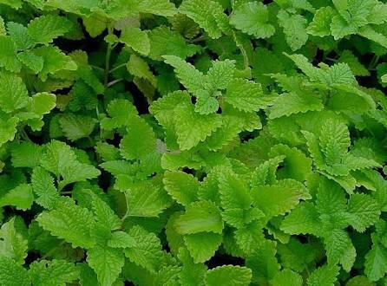
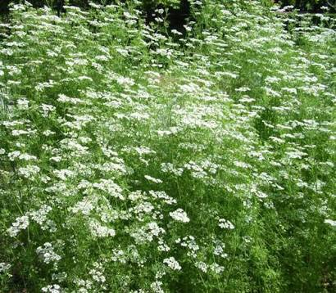
ANISE
MATHEW23:23
ALL PARTS OF ANISE PLANT WERE USED IN BIBLICAL TIMES
ANISE IS USED TO HELP DIGESTION AND FLATULENCE
A RELIEF AID FOR COLDS &COUGHS
ANISE HELPS IN INSOMNIA

Slide 4
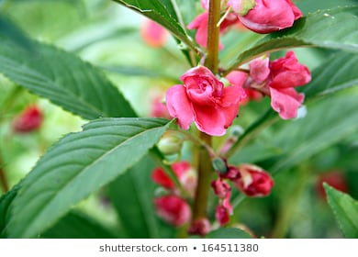
BALM
JEREMIAH 8:22
BALM IS A FRAGRANT SUBSTANCE EXTRACTED FROM THE BALSAM TREE
IN BIBLICAL TIMES IT WAS CONSIDERED EXTREMELY VALUABLE
IT WAS USED AS INCENSE & MEDICINE TO TREAT MANY AILMENTS

Slide 5
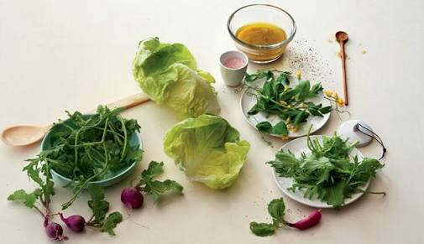
BITTER HERBS ( LETTUCE, HOREHOUND, TANSY, HORSERADISH, ENDIVE & CORIANDER )
EXODUS 12:8
BITTERHERBS WERE USED AS FOOD AND THE PEOPLE OF ISREAL WERE COMMANDED TO EAT IT WITH THEIR PASSOVER MEAL
BITTER HERBS HELP IN URINARY TRACT INFECTIONS, KIDNEY STONES, FLUID RETENTION, ACHY JOINTS & GOUT

Slide 6
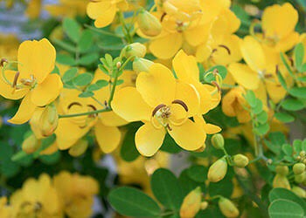
CASSIA
EZEKIEL 27:19
CASSIA HAS AROMATIC PROPERTIES SIMILAR TO CINNAMON & WAS USED IN ANOINTING OILS
CASSIA CAN BE USED AS NATURAL HAIRCARE, COLORING & CONDITIONING

Slide 7
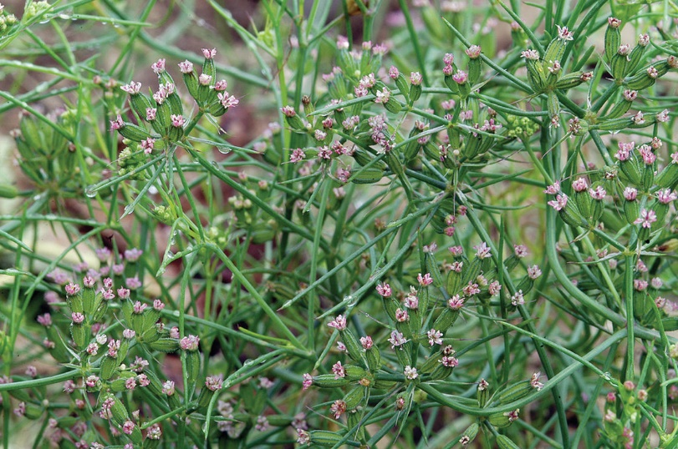
CUMIN
ISAIAH28:25
ANCIENT ISRAELITES USED CUMIN TO FLAVOR THEIR FOOD
IT IS STILL USED IN FOOD & IT HELPS IN DIGESTION, CARDIOVASCULAR DISEASE, URINARY DISORDERS & FEVER

Slide 8
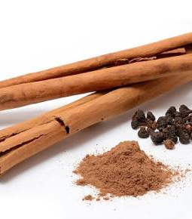
CINNAMON
EXODUS 30:23
CINNAMON HAS AMAZING MEDICINAL PROPERTIES AND USED TO TREAT MANY AILMENTS
CINNAMON OIL & CINNAMON BARKS ARE USED IN ANOINTING OILS & PERFUMES

Slide 9
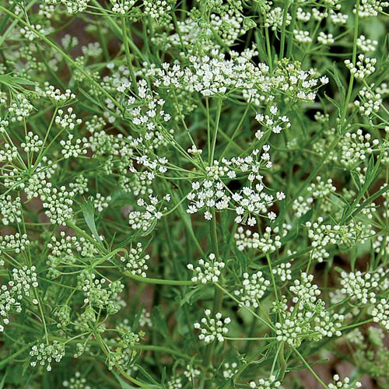
ANISE
Mathew 23:23
ALL PARTS OF ANISE WERE USED DURING BIBLICAL TIMES
ANISE HEPS IN DIGESTION & FLATULENCE
ANISE IS A RELIEF AID FOR COUGHS & COLDS ALSO HELPS TO SLEEP BETTER

Slide 10
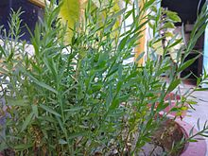
FLAX
LEVITICUS 6:10
FLAX WAS USED TO MAKE THE FINE LINEN IN THE TEXTILES. FLAX SEED OIL WAS USED IN THE ENBALMING PROCESS
FLAX SEED PRODUCES LINSEED OILWHICH IS EDIBLE AND IT IS USED AS DEMULCENT, EMOLLIENT AND LAXATIVE. FLAX SEEDS SLOWS BLOOD CLOTTING PREVENTS INFLAMMATION , RELIEVES COLITIS AND PREVENTS TUMOR GROWTH. VERY USEFUL IN PREVENTING BREAST AND COLON CANCERS

Slide 11
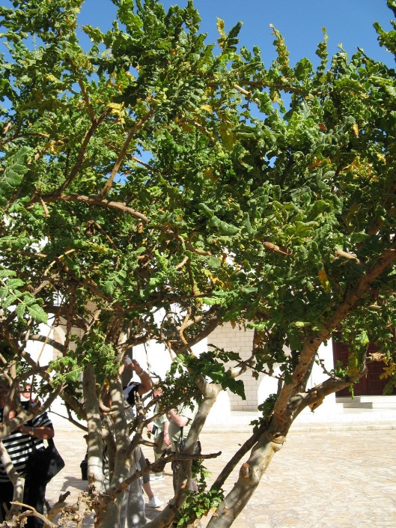
FRANKINCENSE
EXODUS: 30:34
THE MAGI BROUGHT THE NEWBORN JESUS 3 GIFTS: 1. GOLD TO RECOGNIZE HIS KINGSHIP 2. FRANKINCENSE TO ACKNOWLEDGE HIS HOLINESS & DIVINITY AND 3. MYRRH TO SYMBOLIZE THE HARDSHIP AND SUFFERING THAT HE WOULD ENDURE
FRANKINCENSE IS AN IMPORTANT INGREDIENT FOR INCENSE, PERFUMES & HOLY OINTMENTS.

Slide 12
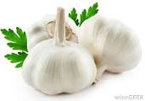
GARLIC
NUMBERS 11: 5-6
GARLIC IS A POWERFUL ANTIBIOTIC, INHIBITS PLATLET AGGREGATION, ANTIFUNGAL & ANTICANCEROUS
IT WAS BELIEVED THAT GARLIC GAVE STRENGTH TO 100000 PYRAMID BUILDERS THEIR STRENGTH FOR 30 YEARS

Slide 13
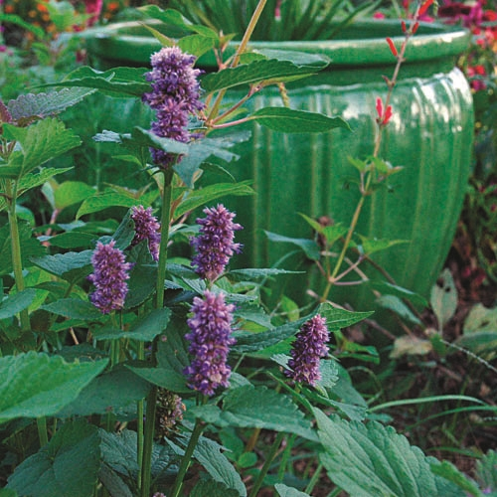
HYSSOP
1 KINGS 4:33
HYSSOP IS A SWEET SMELLING PLANT FROM THE MINT FAMILY
HYSSOP WAS USED IN CEREMONIAL RITUALS OF THE ISRAELITES
HYSSOP TYPICALLY MEANT FOR INNER CLEANING

Slide 14
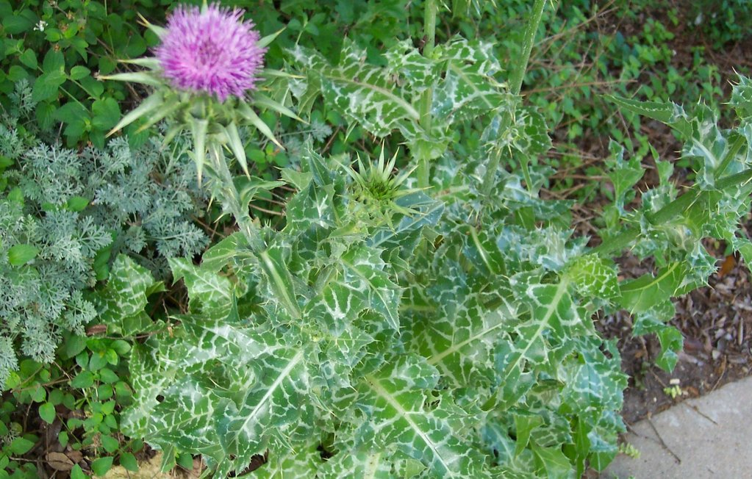
MILK THISTLE
GENESIS 3:18
MILK THISTLES ARE USED IN THE EFFECTS OF ALCOHOLISM, ASTHMA, & CIRRHOSIS
MILK THISTLE CAN REGENERATE DAMAGED LIVER CELLS
MILK THISTLE ALSO HELPS IN LOWERING BLOOD SUGARS AND DIABETES

Slide 15
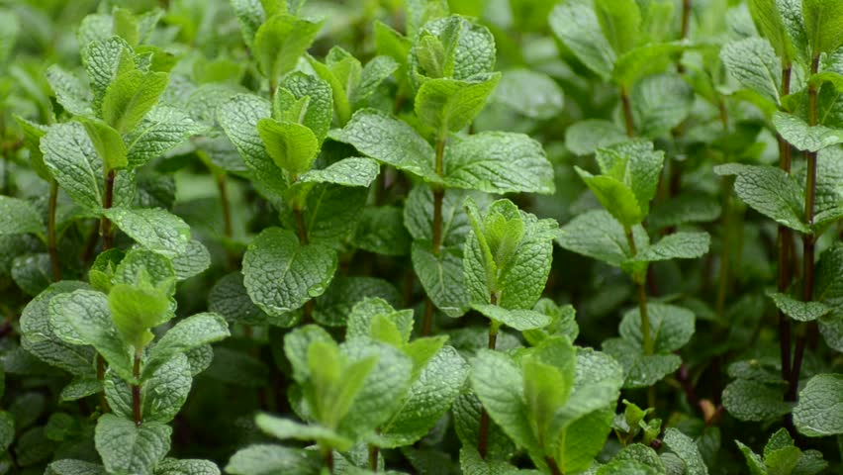
MINT
LUKE 11:42
MINT IS WIDELY USED BY ALL AS A CULINARY HERB
MINT HELPS WITH STOMACH ACHES, DIGESTION, FEVER, HICCUPS, EAR ACHES & SINUS TROUBLES

Slide 16
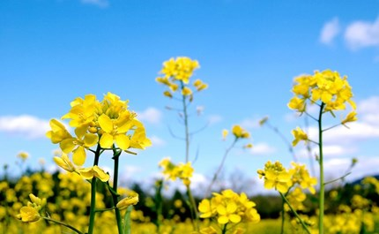
MUSTARD
LUKE 17:6
MUSTARD GREW ABUNDANTLY IN PALESTINE
MUSTARD IS USED IN COOKING
MUSTARD IS USED FOR SORE THROATS, MUSCLE & BACK PAIN & IS USED TO TREAT DAMAGED HAIR

Slide 17
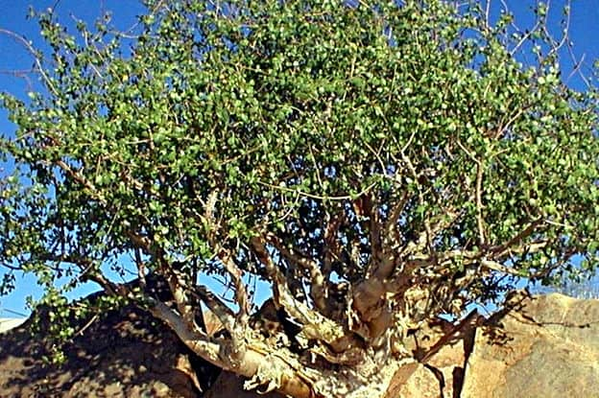
MYRRH
ESTHER 2:12
MYRRH IS USED AS AN ANALGESIC, ASTRINGENT, BRONCHITIS AND HIGH CHOLESTEROL
THERE ARE 135 SPECIES OF MYRRH FOUND IN AFRICA AND ARABIA AND MAINLY GROWS IN ARID REGIONS

Slide 18
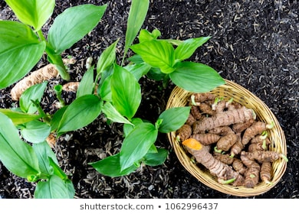
TURMERIC
SONGS OF SOLOMON : 4: 14-15
TURMERIC IS USED FOR INFLAMMATION, FLATULENCE, ARTHRITIS, BRONCHITIS, LARYNGITIS, LYMPHOMA, & RHEUMATISM
TURMERIC IS A MAIN CONSTITUANT OF CURRY POWDER
TURMERIC IS A POWERFUL ANTIOXIDANT

