Slide 1

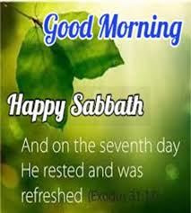
Notes:
Good morning and happy sabbath. once again it is with great joy and HUMILITY, I approach this pulpit and thank god for his mercy and goodness. god has been good to all of us. we enter his presence with thanksgiving. i am happy to see everyone. let us tune our hearts and minds heavenward. To day we celebrate communion and also Baptisms.
please pray with me and pray for me as we listen to the word of god – prayer.

Slide 2
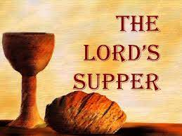
Notes:
This morning, after the meditation on the love and sacrifice of Jesus we will enter into a very solemn service celebrating the Lord’s Supper.
The Lord’s Supper is a participation in the emblems of the body and blood of Jesus as an expression of faith in Him, our Lord and Savior. In this experience of communion, Christ is present to meet and strengthen His people.
As we partake, we joyfully proclaim the Lord’s death until He comes again. Preparation for the Supper includes self-examination, repentance, and confession.

Slide 3
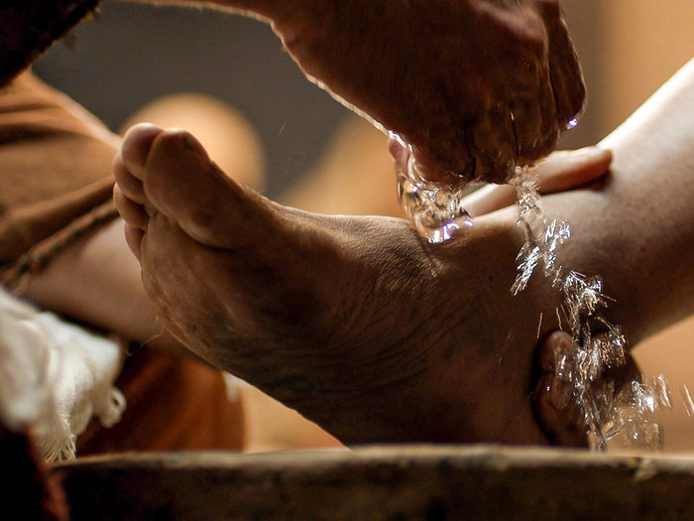
Notes:
The Master ordained the service of foot-washing to signify renewed cleansing, to express a willingness to serve one another in Christlike humility and to unite our hearts in love. The communion service is open to all believing Christians.

Slide 4
Notes:
Unfortunately, the practice seems to be having the opposite effect on others these days. Some of my fellow ministers lament that it actually drives members away from celebrating the Lord’s Supper.
They note that many who attend Sabbath services on communion day choose to leave right after the sermon, while others avoid going to church altogether! And even for those who stay, the amount of time and energy invested in washing feet seems to overshadow the sharing of bread and wine.

Slide 5
What is the significance of the practice of foot-washing?
Is it merely a lingering trace of a past culture?
No. There is the possibility of a deeper and more meaningful lesson than simply one of humility, important as that may be.
Notes:
Please think about these questions.

Slide 6
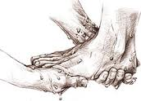
The incident is recorded in John 13. Jesus' time was becoming very short, and there were strivings among the disciples.
In 24 hours, He would be on the cross. How could He prepare them for what was coming? How could He lead their thoughts away from selfish interests?

Slide 7

Notes:
True greatness is to follow Jesus in the path of service and humility. For many, greatness consists in the accumulation of wealth, fame, and power. To such, the opportunity to “wash feet” represents the ultimate humiliation. Jesus here does the opposite of what seems natural to human experience.

Slide 8

Notes:
It hardly seems possible that perhaps only 20% of Americans are genuinely happy.
It is because many people seek it through money, people, events etc. All of this is only temporary at best and can’t bring lasting happiness.
It is only by having a relationship with Jesus Christ and obedience to God’s Word that can bring me real happiness.

Slide 9
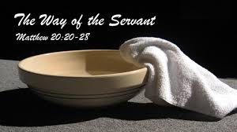
To convey His feelings and teach a truth that would never be forgotten, Jesus used an illustration-enacted a parable to convey His thoughts.
Notes:
.

Slide 10
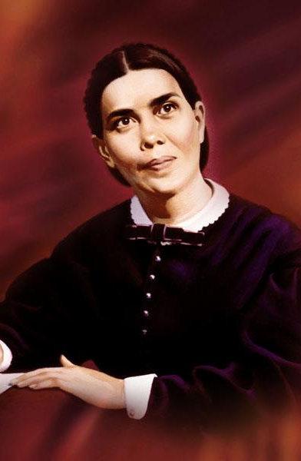
"The whole life of Christ had been a life of unselfish service.
In Matt. 20:28 He said, 'Not to be ministered unto, but to minister' had been the lesson of His every act.
But not yet had the disciples learned the lesson.
At this last Passover supper, Jesus repeated His teaching by an illustration that impressed it forever on their minds and hearts"
(Ellen G. White, The Desire of Ages, p. 642).

Slide 11
More Than One Lesson
So, was it a lesson in humility?
Yes, there is no doubt about it, but there is more.
If we look deeper into this part of the service, we see it was more than a simple conforming to standard practice-and more than a lesson in being humble.

Slide 12
The key to the whole passage is verse 1: "When Jesus knew that his hour was come, having loved his own which were in the world, he loved them unto the end."
Two thoughts here set the stage for what is to follow.
First, Jesus' self-consciousness in knowing that His hour has come, and
Second, His love for His disciples.

Slide 13
It is significant that John should begin this chapter with an expression of love.
It must be that what follows is an unfolding in the form of a parabolic act, a dramatization of what love is.
Here were circumstances for which words would have been totally inadequate, since they would soon be forgotten, but not so with actions.
Notes:
What was to take place would remain with them for the rest of their lives.
It was His last act of dedication to these men whom He had known for three and a half years and upon whose shoulders the responsibility of the preaching of the gospel would now rest.

Slide 14
Foot washing, on the other hand, represents the Christian’s ongoing need to deal with the soiling that comes from daily contact with the sinful world and its contamination.
The foot is the part of the body that in ancient times came in regular contact with the earth and, therefore, needed continual cleansing.
The beautiful lesson that comes through in Jesus’ action is that our daily shortcomings as Christians do not call our original cleansing into question. It is not necessary to be rebaptized or to start all over every time we make a mistake. One who has bathed needs only to wash the feet again!
Notes:
Going back to our meditation, the full-body bath represents the complete cleansing that a person receives at the beginning of the Christian life (baptism).
In the ancient Eastern part of the world either they wore open sandals or walked barefoot. And the feet always become dirty and dusty. Therefore, needed continual cleansing.

Slide 15
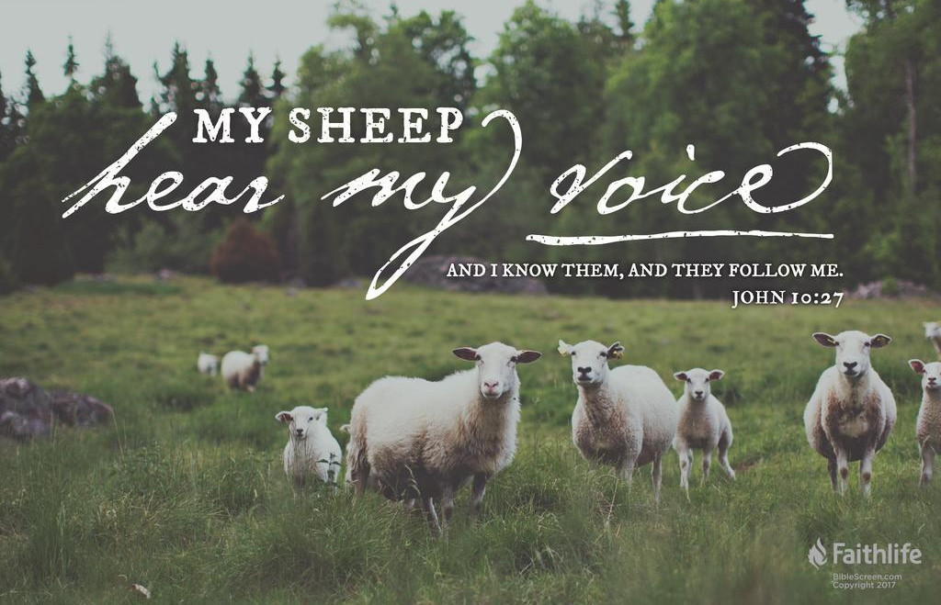
According to Jesus promise in John 10:27-29. We are
secure if we do not choose to turn away.
o
Notes:
27 ^{n}My sheep hear my voice, and I knowthem, and they follow me. 28 ºI give themeternal life, and ^{p}they will never perish, and^{q}no one will snatch them out of my hand. 29 My Father, ^{r}who has given them to me,¹ ^{s}isgreater than all, and no one is able to snatchthem out of ^{t}the Father’s hand.

Slide 16
Notes:
The image of Jesus washing the feet of His disciples represents His forgiveness of sins committed after baptism. The image of the disciples washing one another’s feet signifies our willingness to forgive those daily irritations and transgressions that threaten the unity in love that Jesus purposed for His disciples.

Slide 17
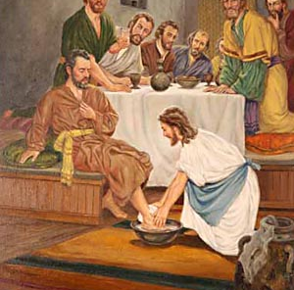
Notes:
How better could He demonstrate His love for and confidence in them at this point than to take the place of a servant and wash their feet?
They were totally unprepared for what took place. "He riseth from supper, and laid aside his garments
And took a towel and girded himself. After that he poureth water into a basin, and began to wash the disciples' feet, and to wipe them with the towel wherewith he was girded" (John 13:4, 5).

Slide 18
Notes:
True greatness is the King of the universe walking over to the corner of a room, picking up a towel and a basin of water, and stooping down to wash the feet of an unstable disciple such as Peter and a traitor such as Judas. True greatness does not need to brag or assert itself. It takes true greatness to exercise self-control or to act the role of a slave. It takes true greatness to do the right thing when everyone laughs at you or despises you in his or her heart.

Slide 19
Philippians 2:5-11
5 Let this mind be in you,
which was also in
Christ Jesus: 6 Who, being in the form of God, thought it not robbery to be equal with God: 7 But made himself of no reputation, and took upon him the form of a servant, and was made in the likeness of men: 8 And being found in fashion as a man, he humbled himself, and became obedient unto death, even the death of the cross.
Notes:
True greatness is to have the same attitude as Jesus (Phil. 2:5), who was “in very nature God” (vs. 6, NIV) yet took “the very nature of a servant” (vs. 7) and “humbled himself ” (vs. 8). True greatness is to “consider others better than yourselves” (vs. 3). True greatness is to follow Jesus in the path of service and humility.

Slide 20
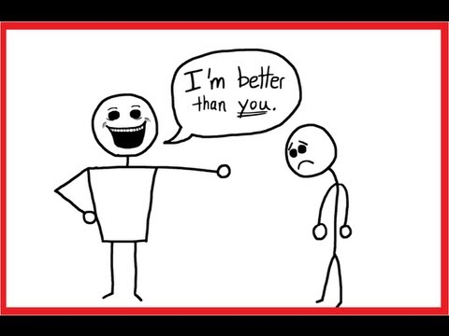
Notes:
In contrast, if our first thought in any situation is of our own advantage and self-interest, we are pursuing a false greatness. If our first reaction to any situation is to nag, belittle, criticize, and complain, we are exhibiting the opposite of humility and true greatness. Putting other people down says “I am better than you.” Considering others as better than yourself causes you to uplift, encourage, and praise.

Slide 21
Luke 22:24
And there was also a strife among them, which of them should be accounted the greatest.

Slide 22
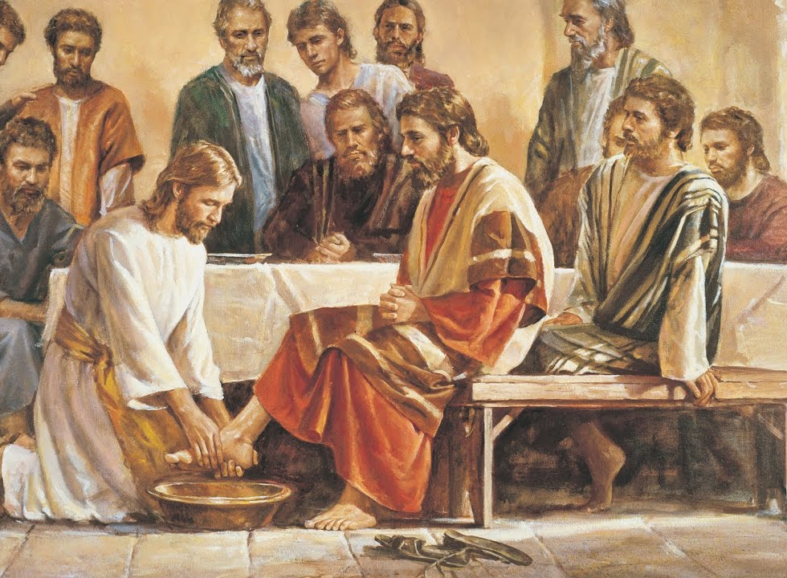
Notes:
Jesus starts with Judas, His betrayer, and moves around the circle before the wondering eyes of the disciples. The text says, "Having loved his own which were in the world, he loved them unto the end." The Greek word for "end" means "perfectly, wholly, completely." It seems, therefore, that here we find the highest expression of Jesus' love for His disciples thus far.

Slide 23
What He seemed to be saying to each one was,
"I love you so much that you can count on Me to do anything for you, even to the point of washing your feet and, if necessary, dying for you." It was an act of complete love and dedication.

Slide 24
This seems to be the meaning of the ordinance, the meaning of which the disciples failed to see, as implied in Jesus' question to them, "Know ye what I have done to you?"
This is what Jesus meant for us to continue when He said, "If I then, your Lord and Master, have washed your feet; ye also ought to wash one another's feet" (verse 14).
Notes:
The washing of one another's feet is an act of loving dedication to one's partner, who is also a representative of all humanity, of our willingness to do for that one whatever may be necessary, even to the point of death.

Slide 25
When we take the feet of our brother or sister in our hands and wash them, we are saying to him or her, "I love you as a brother or sister in Christ, and you can count on me to be of service to you, however humble it may be, even to the point of giving my life for you." Unless one enters into it in this spirit, prepared to make this commitment, it cannot be said that one has truly taken part in the service and has "washed one another's feet."
Notes:
When we take the feet of our brother or sister in our hands and wash them, we are saying to him or her, "I love you as a brother or sister in Christ, and you can count on me to be of service to you, however humble it may be, even to the point of giving my life for you." Unless one enters into it in this spirit, prepared to make this commitment, it cannot be said that one has truly taken part in the service and has "washed one another's feet."

Slide 26
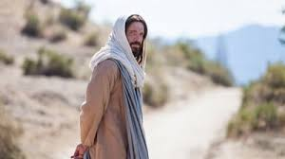
Notes:
The key point of this lesson is that true greatness is not found in power, wealth, or fame; it is found in following Jesus along the path of service and humility. Jesus demonstrated this path when, in full awareness of the Cross He was about to experience, He never- the less was more concerned for the impact of the coming events on His disciples than He was for Himself.

Slide 27
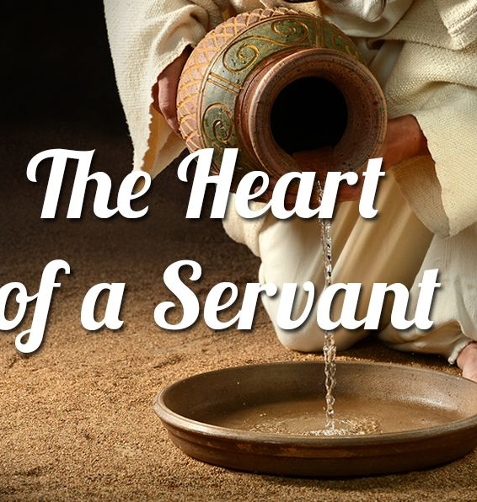
The key to this ordinance is in verse 17 - “If ye know these things, happy are ye if ye do them.” The sequence is important, which is humbleness, holiness and then happiness.
Happiness is the by- product of a life that is lived in humbleness and holiness (vv. 12-17).
The world thinks that happiness is the result of others serving us, but real joy comes when we serve others.

Slide 28
In washing the feet of His disciples and in praying for them, as well as for us, Jesus did the opposite of what comes naturally to the human spirit. In so doing, He set for us an example of true greatness.

Slide 29
Notes:
Next time when you wash one another’s feet remember it is more than a lesson. It is Love in Action. It is this service God wants us to show in our lives.

Slide 30
We will now separate for foot-washing.
Please come back and join us in the sanctuary when we are all done.

