Slide 1

HAPPY SABBATH
Notes:
Good morning and Happy Sabbath. It is good to be in the Sanctuary of God and worshipping with the saints of God. How are you all doing? How was your week? If you are like me you will thank for the Sabbath day otherwise, we all will be restless. So here we are, we have come to worship, fellowship and commune with God. I am happy you are here and I want to assure you that you are in the right place. I want to welcome you to the service this morning and later on the Lord’s Supper.
Seventh-day Adventist Christians take part in the Lord’s Supper, or communion service, as a commemoration of Jesus’ sacrificial death on the cross. It’s a time to reflect upon what Jesus has done for us, and to respectfully express this gratitude as a church family.
We’ll look at:
What the Lord’s Supper is and what it means
The “emblems” and “ordinances,” and their symbolism
Bread
Wine
Footwashing
Preparing for the Lord’s Supper communion service
The Lord’s Supper is a simple celebration of Jesus’ sacrifice and promise, but its significance is profound. It is a unifying act of worship, joy, and remembrance of our Savior’s unmatchable love.
Seventh-day Adventists practice open communion. All believers who claim Jesus is their Lord are welcome to take part in the service.

Slide 2
FINDING YOUR SPACE
Notes:
This morning I want you to come with me to the upper room. Luke 22:8-23 NLT
Jesus sent Peter and John ahead and said, “Go and prepare the Passover meal, so we can eat it together.” “Where do you want us to prepare it?” they asked him. He replied, “As soon as you enter Jerusalem, a man carrying a pitcher of water will meet you. Follow him. At the house he enters, say to the owner, ‘The Teacher asks: Where is the guest room where I can eat the Passover meal with my disciples?’ He will take you upstairs to a large room that is already set up. That is where you should prepare our meal.” They went off to the city and found everything just as Jesus had said, and they prepared the Passover meal there. When the time came, Jesus and the apostles sat down together at the table.

Slide 3
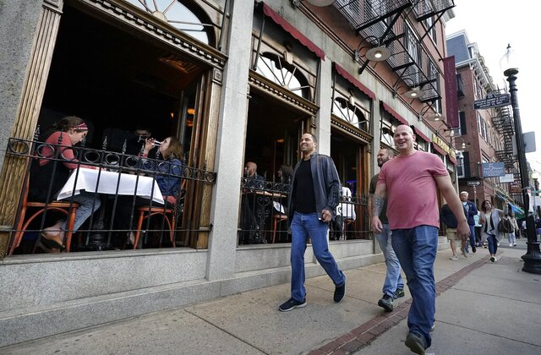
Americans Are Coming Out of Their COVID-19 Pandemic Shells
Notes:
Which is goo news but still we are finding our space in the new normal. Two years after the coronavirus outbreak upended life in the United States, Americans find themselves in an environment that is at once greatly improved and frustratingly familiar.

Slide 4
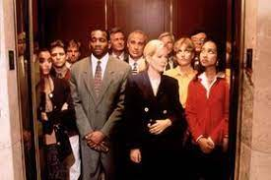
WHEN YOU ARE IN A CROWDED ELEVATOR
Notes:
When you are in a crowded elevator of strangers, what do you look at?
Do you become fascinated with the digital floor indicator above the door?
Chances are you are looking either at that or at the buttons and lights, nervously fidgeting, hoping to get to your floor quickly. I
t can be an awkward social experience, especially if the elevator is full of people.

Slide 5
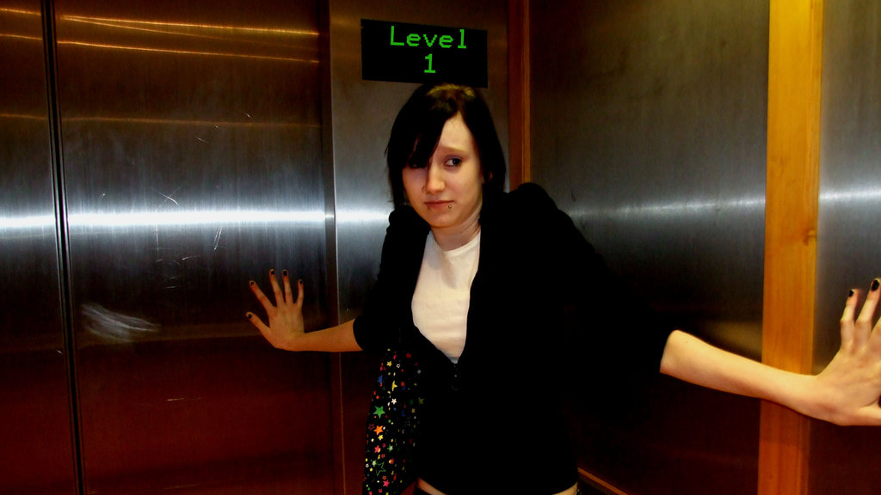
Notes:
Some suffer from claustrophobia, which is a very real condition.
But even for those who don’t fear enclosed places, there is still the matter of personal space.
How large is your personal space?

Slide 6

Notes:
Social scientists have researched this topic and have determined that personal space, defined for an American culture, is about two feet. Which means that as individuals, we protect two feet around us.
Think of it as a bubble of security. This is a psychological zone, of course—something that cannot be seen, but certainly can be felt. When someone gets too close or enters our comfort zone of personal space we can feel somewhat threatened or intimidated.

Slide 7
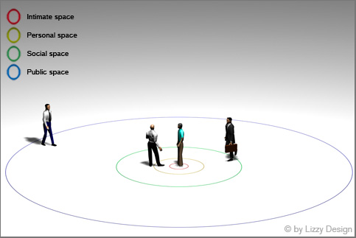
How large is your personal space?
Notes:
These invisible yet real circles range from the “public ring,” which ranges from 12 to 24 feet from a person, to the closer social ring, which reaches within four feet of one’s body, to the personal ring, coming in even closer to two feet.
Finally, there is the ring of intimacy, which extends approximately one and a half to two feet away from your body.
Usually, we don’t like people invading this space, unless they are related, of course.
If it is our husband or wife, we want them in our personal space every now and then! And we sometimes want our children in our personal space as well.
But if a stranger comes too close, in American culture, we feel uncomfortable and maybe even a little intimidated.

Slide 8
Edward Hall wrote a book entitled The Hidden Dimension.
There he identifies four American spatial distances/zones:
Intimate distance: 0-18 inches
Personal distance: 18 inches to 4 feet
Social distance: 4 to 10 feet
Public distance: 10 feet to infinity.
Group size is impacted by spatial distance. Reversing the list above:
Public: 35 people and more
Social: 8 to 35 people
Personal: 3 to 7 people
Intimate: 2 people.
Notes:
You stay away from me.

Slide 9

Even in cultures in which people hug and touch, there are times a person just want to be alone.
Notes:
But there are some cultures in which people hug and touch and are quite comfortable living in close proximity to each other.
To a large degree culture determines where one’s personal space is, but even in those cultures in which physical closeness is a way of life, there are times a person just wants to be alone.

Slide 10

THE THEORY OF PERSONAL SPACE.
Notes:
The theory of personal space was first noted by Heini Hediger, a Swiss zoologist who studied proxemics in zoo animals.
Prior to 1966, when Hall first suggested the concept of personal space, he consulted with Hediger, who noted that these invisible concentric circles also exist around animals.
He observed that some animals are very protective of their personal space, and if it is encroached upon, the claws and teeth come out.
Actually, I have known some people to behave that way too!

Slide 11
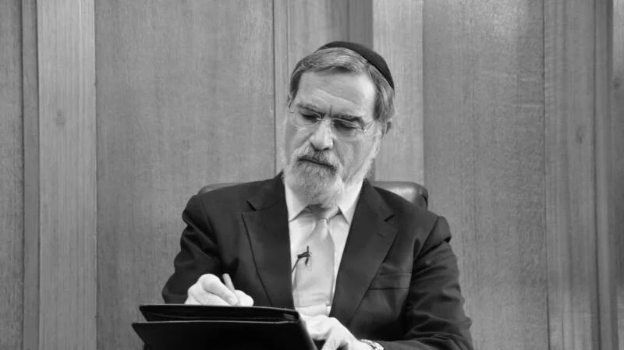
Notes:
The idea of personal space is not new. Even in the Talmud, the codified rabbinic commentary on the law written centuries ago, there is reference to one’s personal space.
Within the Jewish tradition, there is an understanding of the concept of personal space and even a description of its dimensions.

Slide 12

SOCIAL DISTANCING
Notes:
The personal space extends to approximately six to eight feet around the person, and there are certain circumstances in which it is inappropriate for someone to come within that space.

Slide 13
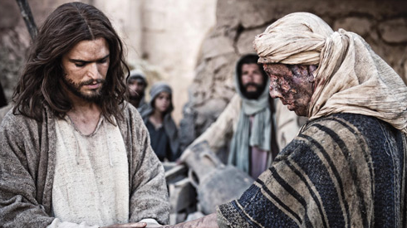
Jesus and Personal Space
Notes:
Have you noticed as you read the Gospels that Jesus often came within the personal space of people who were in need and that He made no apologies for this?
He would reach out and touch them—even those who had diseases that rendered them “untouchable” in their society.
There were people who said, “Look, these lepers are unclean. Do not go near them.
Do not touch them. If You do, You surely will get sick and die a miserable death.”

Slide 14
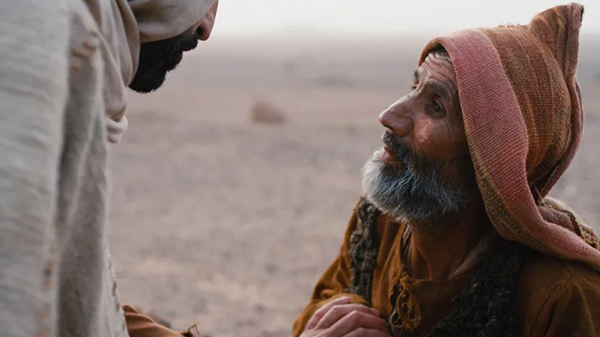
Notes:
Of course, Jesus, the Great Physician, ignored these prohibitions. These people were poor and pitiable.
They needed to feel the touch of someone who cared. These were social outcasts who were assigned to live in quarantined villages outside the boundaries of “healthy” society. They were forced to live in isolation, hidden away from family and friends. Unless they were healed, they would never again experience the touch of a “clean” human being. They would die alone. Imagine what that would be like.

Slide 15
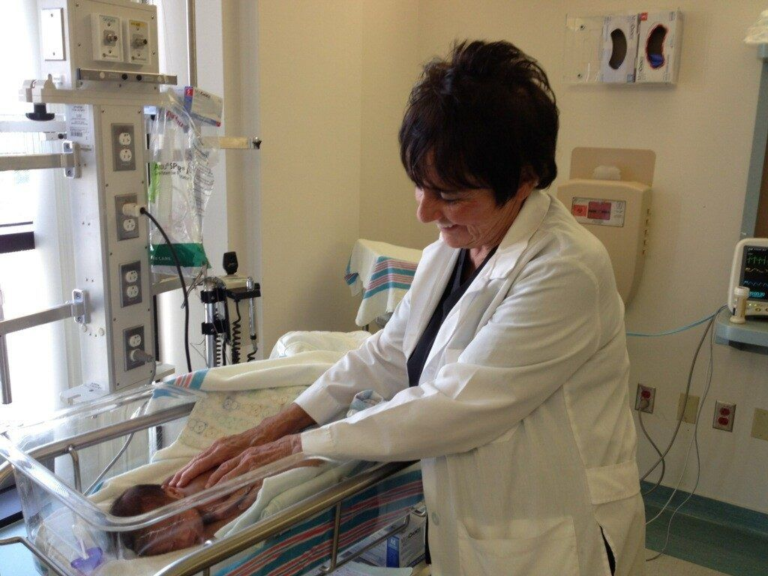

THE IMPORTANCE OF TOUCH
Notes:
Many studies have been conducted regarding the value and benefits of physical touch and its application in science and medicine. The Touch Research Institute (TRI), a part of the Miller School of Medicine at the University of Miami, Florida, has carried out more than 100 studies concerning touch and found very significant evidence, including: faster growth in premature babies, reduced pain, decreased autoimmune disease symptoms, lowered glucose levels in children with diabetes, and improved immune systems with people with cancer.

Slide 16
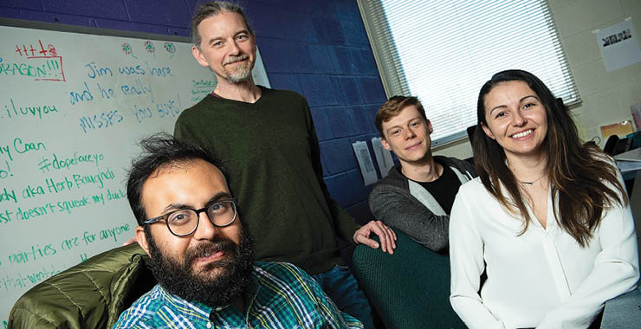
Notes:
Another interesting study done by James A. Coan, an assistant research professor of psychology at the University of Virginia in Charlottesville, reveals the power of touch in diminishing pain levels. His study involved analyzing brain scans of married women who were experiencing physical pain.

Slide 17
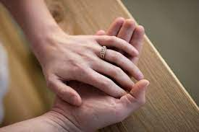
Notes:
“We spotted changes that may help to shed light on an age-old mystery,” Coan says. Here’s what he discovered: As soon as the women touched the hands of their husbands there was an instant drop in activity in the areas of the brain involved in fear, danger, and threat. The women, he goes on, who had been exposed to experimental pain while they were scanned, were calmer and less stressed. A similar but smaller effect was triggered by the touch of strangers.

Slide 18

TOUCH THERAPY – HUMAN TOUCH
Notes:
Touch therapy is what it is called—human touch. A sympathetic touch, a hug, that “knowing” pat on the shoulder can make a world of difference, especially in the life of someone who is suffering and in need of comfort.

Slide 19
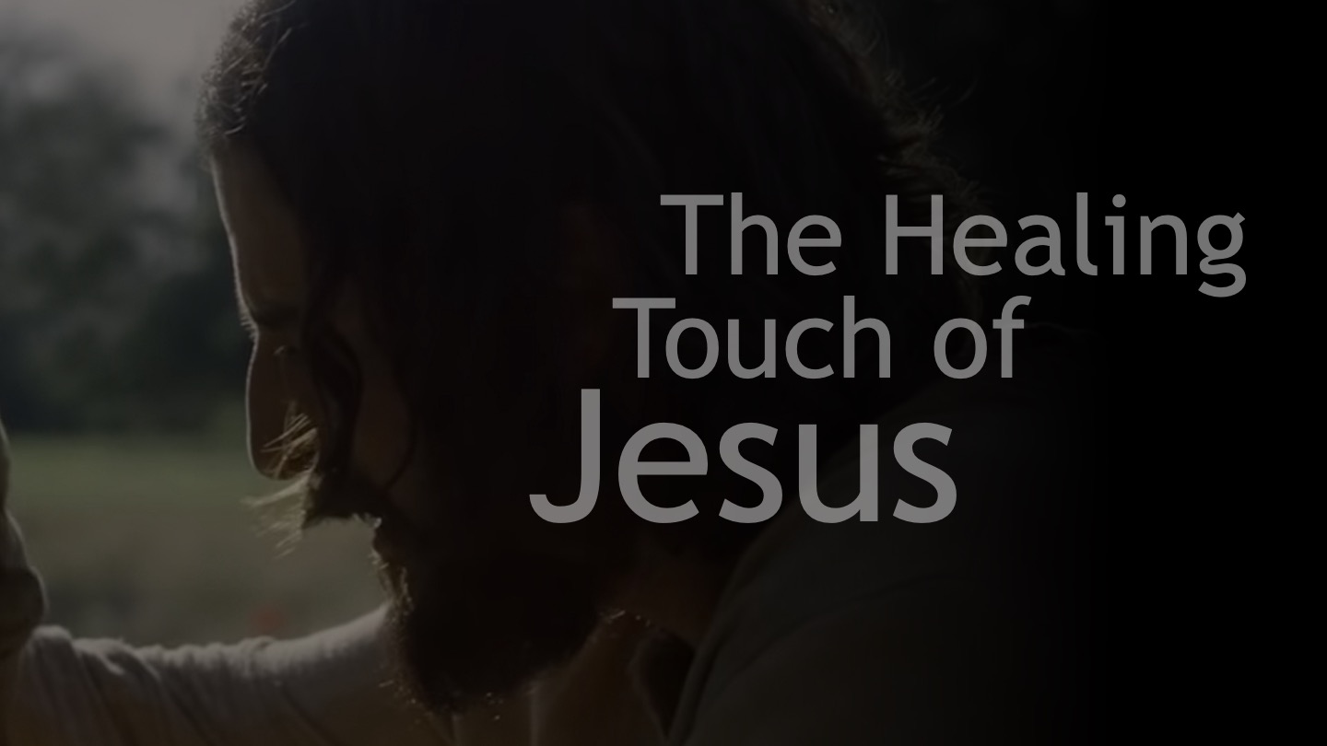
Notes:
Now, of course, when it comes to Jesus’ interactions with people there was something beyond just His physical touch. There was a redemptive element, a supernatural, miraculous cleansing of disease and pain by the healing power of God. The Holy Spirit was working through Jesus as He touched the sick. But the human factor of Jesus’ touch should not be discounted. These people, whether they were sick or not, needed to feel the physical touch of someone who cared.

Slide 20

Communion Service is An Important Service
Notes:
Now place this within the context of celebrating the Communion service. As you know, a part of a Seventh-day Adventist Communion service is what we call the ordinance of humility, or the foot-washing service. It is also an age-old practice—one that has been in the Christian church for generations.

Slide 21
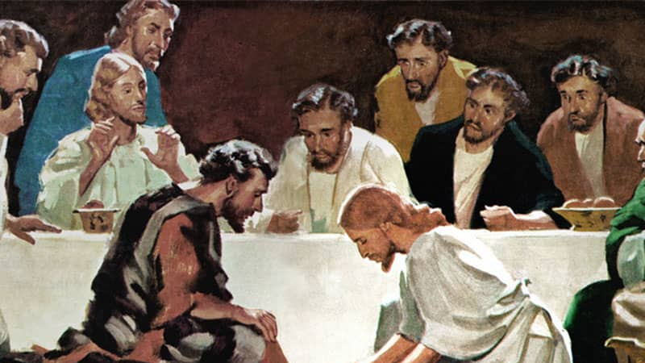
ORDINANCE OF HUMILITY
Notes:
Unfortunately, this important service has somehow fallen by the wayside among many faith communions and churches. Some think it is only the symbolism of service that really matters, so it is not necessary to perform the actual act of washing feet. But think how much is missed by those who do not kneel down, when you don’t kneel down and touch the naked feet of another human being—especially when that human being may be somewhat of a stranger to you. There is a special spiritual connection and bond that is formed there at that moment.

Slide 22
The Example of Jesus
Notes:
This is what Jesus did for His disciples. We are told in John 13 that on the night before He was to be crucified He took a towel and a basin and washed His disciples’ feet—something rabbis just did not do for their students.

Slide 23
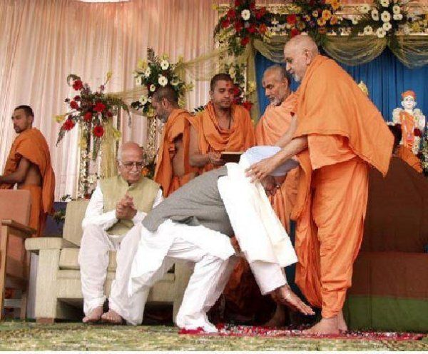
INDIAN CULTURE: TOUCHING THE FEET OF THE MASTER

Slide 24
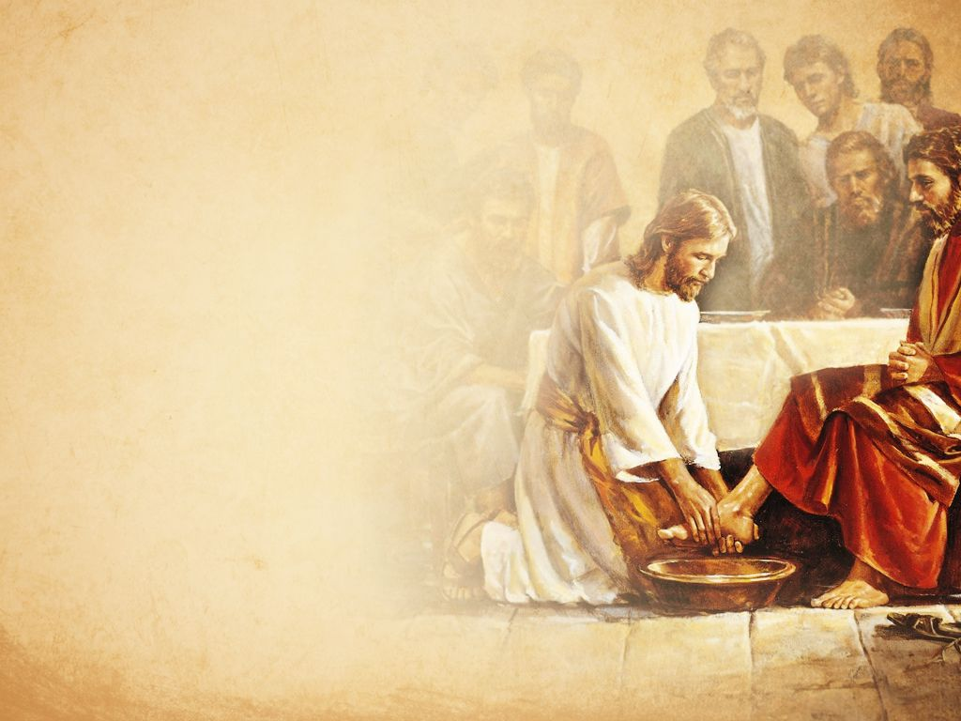
It was in fact an unthinkable act as far as the students were concerned. One would never allow his teacher to do this.
But Jesus took on the role of a servant—a servant leader.
He girded Himself in a towel and stooped to wash the feet of His students.
He touched them in a way they had never been touched by Him before.

Slide 25
No wonder Peter recoiled when it was his turn!
He said, “Lord, no! You cannot do this. You are the teacher! I am a student. I am Your disciple. You cannot do this for me!”
“ ‘If I do not wash your feet,’ Jesus answered, ‘you will no longer be My disciple’ ” (John 13:8, TEV).
Peter responded, “Lord, do not wash only my feet, then! Wash my hands and head, too!” (verse 9, TEV).

Slide 26
They didn’t completely understand what they had just experienced.
We know this because after Jesus was finished, He stood up and asked,
“Do you understand what I have just done to you?” (verse 12, TEV).
Because there must have been some blank looks around the circle,

Slide 27
Jesus explained it to them.
“I, your Lord and Teacher, have just washed your feet. You, then, should wash one another’s feet.
I have set an example for you, so that you will do just what I have done for you” (verses 14, 15, TEV).
And the implication is yes, do this even for perfect strangers who are seeking salvation and cleansing.

Slide 28
Understanding Grace and Dispensing Mercy
What kind of leader, what kind of king, does this?
The one who understands grace; the one who dispenses mercy.
The one who knows that His subjects can be cleansed in no other way than by His healing touch; by coming close and laying hands on them.

Slide 29
Jesus sets this as an example for us.
And so, in our faith communion, we follow His example.
We wash one another’s feet. But too often we do it in a kind of septic way.
This is a polite society, and we want to make sure we aren’t encroaching a little too closely into someone’s personal space, and we want to do it properly and in the right way.

Slide 30
But let’s not allow the lesson of the upper room to get lost in informality.
Let’s think about what we are doing, and let’s pray about it.
And then participate in a spirit of service, in the same way, Jesus did when He knelt at the feet of His disciples.

Slide 31
Something else happened when Jesus touched those men and bathed their feet.
It was a symbol of the cleansing they needed even though they had been baptized already.
That was revealed in the encounter with Peter once again
when he said, “Wash me all over,” and Jesus responded,
“I don’t need to do that—you’ve already been washed.
You’ve been baptized.
But you’ve picked up a little dirt along the way since your baptism.
That has to be taken care of.
That has to be washed away.

Slide 32
You don’t have to go back down to the Jordan River and go through that ceremony, as wonderful and as beautiful as that is.
But now, something has to be cleansed here and now in this place.
Peter, I’m here to do it.
Do you want this? Unless I wash you, you have no part with Me”

Slide 33
An Invitation
This is an invitation extended to us today.
Do we want the cleansing, healing touch of Jesus Christ?
Have you picked up a little dirt between now and the last time you participated in a foot-washing service?
Perhaps you need this cleansing, this reminder of what your baptism means.
If you are a committed disciple of Jesus Christ, do you want to have a part with Jesus today?

Slide 34
It is important to note that the Communion service involves such personal, tactile experiences.
Not only do we bathe one another’s feet in a spiritual act; we ingest emblems of His broken body and shed blood.
We take them into ourselves, thereby saying that we want Christ “in us,” for He is the only source of our salvation. Powerful, simple, lessons that teach what nothing else can teach.
It is a life-changing experience.

Slide 35
I know there are places of worship in which people show a lot of emotion in their worship.
They wave their hands, stand, clap, shout and praise, and we can debate the appropriateness of it or not.

Slide 36
But what I am suggesting today is if you are looking for a tactile, hands-on experience,
if you are one of those kinesthetic learners that has to “feel” the Spirit move,
then you have come to the right place.

Slide 37


Slide 38
Here you have the physical symbols.
You have the physical experience of the upper room.
We have Jesus reaching out to touch us.
Will you receive it?
It is for your healing.

