Slide 1
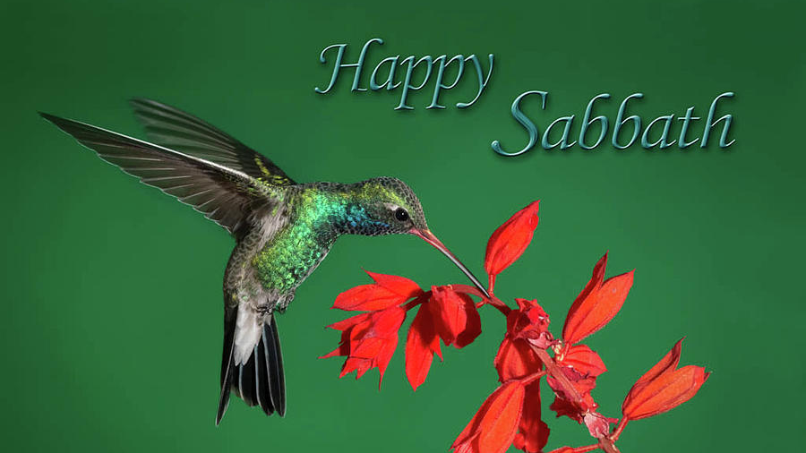
Notes:
Good Morning and Happy Sabbath. Once again it a blessing to celebrate the Sabbath with the church family. We have come to celebrate the creator and appreciate the beauty in God’s creation.
Even when we see ugliness that devil creates and throws at us a curve ball, God’s love overshadows it. I want to welcome each one of you for the divine service. Thank you for being here in person and for those who are joining us on zoom.
Let us pause here and ask the Holy Spirit to speak through me.
Prayer.

Slide 2
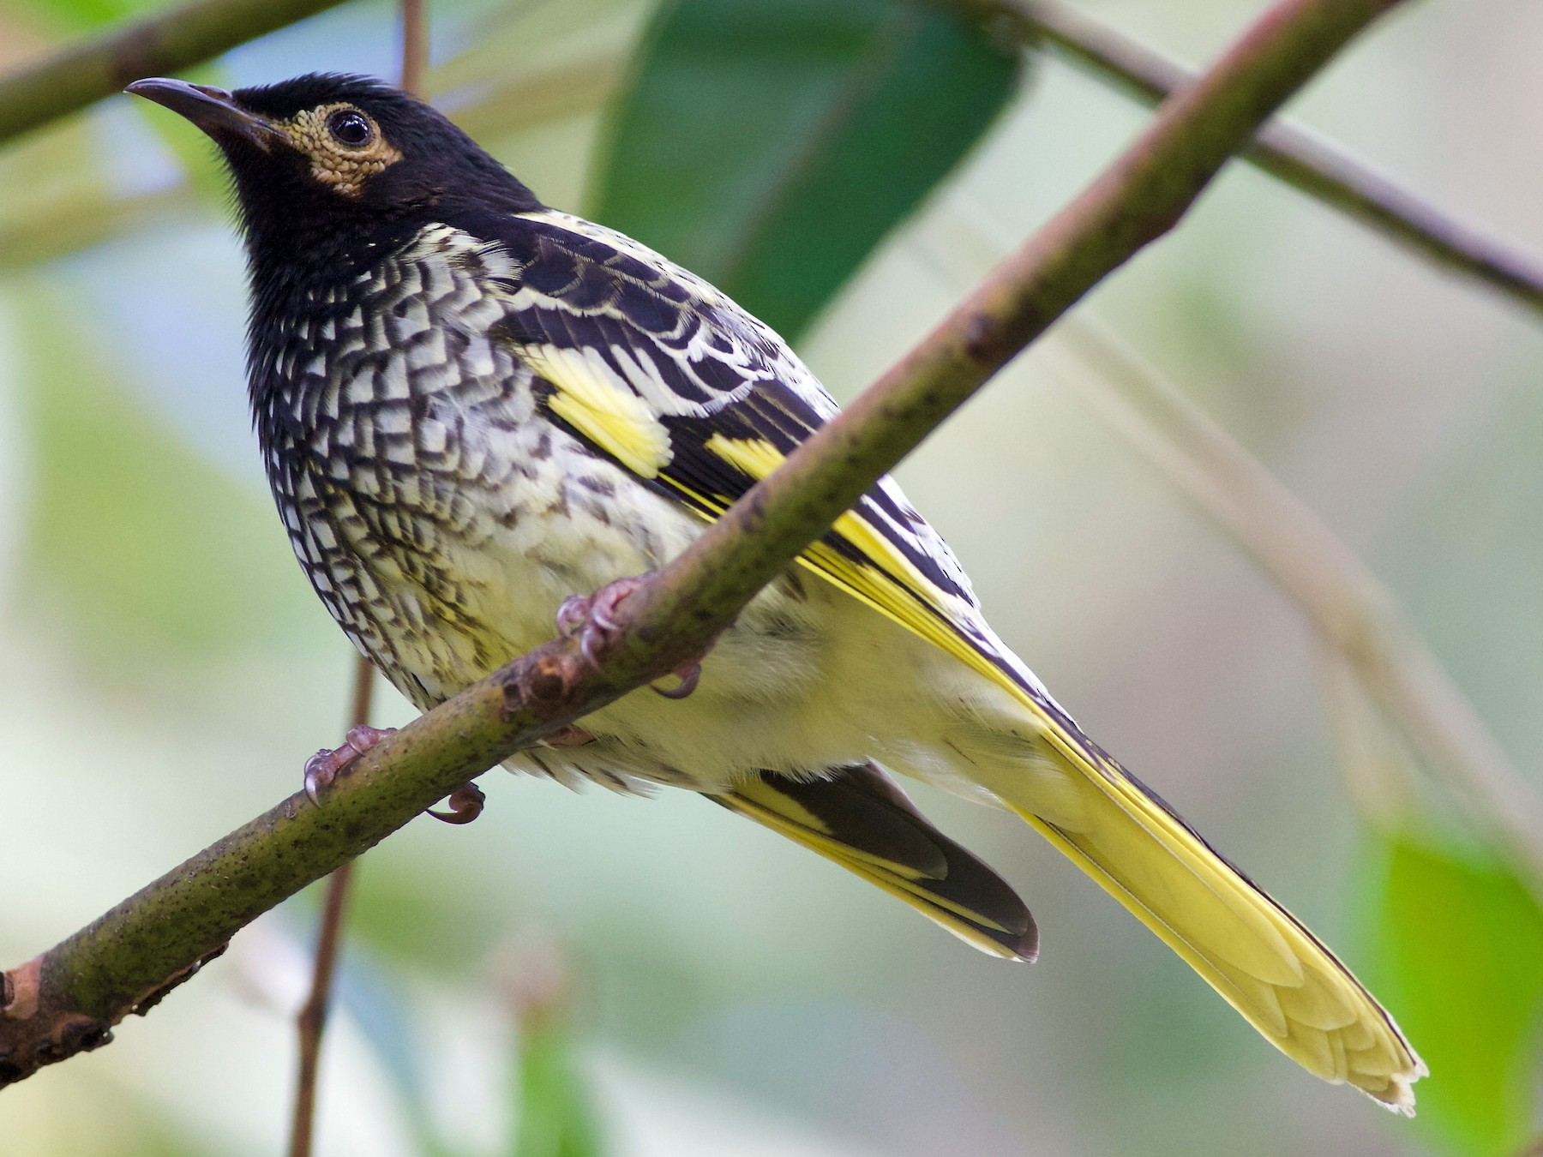
"I Love You, Lord"
I love you, Lord
And I lift my voice
To worship You
Oh, my soul, rejoice!
Take joy my King
In what You hear
Let it be a sweet, sweet sound
In Your ear
SING AGAIN

Slide 3
CHIPPIE THE PARAKEET CAN’T SING ANYMORE
Notes:
“CHIPPIE THE PARAKEET NEVER saw it coming. As Max Lucade tells the story, One, second, he was peacefully perched in his cage, the next moment his life changed forever.
The problems began when Chippie’s owner decided to clean Chippie’s cage with a vacuum cleaner. She removed the attachment from the end of the hose and stuck it in the cage to pick up the seeds and the feathers from the cage. The phone rang, and she turned to pick it up. She’d barely said ‘hello’ when ‘sssopp!’ Chippie got sucked in.

Slide 4
CHIPPIE THE PARAKEET CAN’T SING ANYMORE
Notes:
“The bird's owner gasped, put down the phone, turned off the vacuum, and opened the bag. There was Chippie– still alive but stunned. Since the bird was covered with dust and soot, she grabbed him and raced to the bathroom, turned on the faucet, and held Chippie under the running water. Then, realizing that Chippie was soaked and shivering, she did what any compassionate bird owner would do . . she reached for the hair dryer and blasted the pet with hot air.
“Poor Chippie never knew what hit him.
‘Chippie doesn’t sing much any more he just sits and stares.’

Slide 5
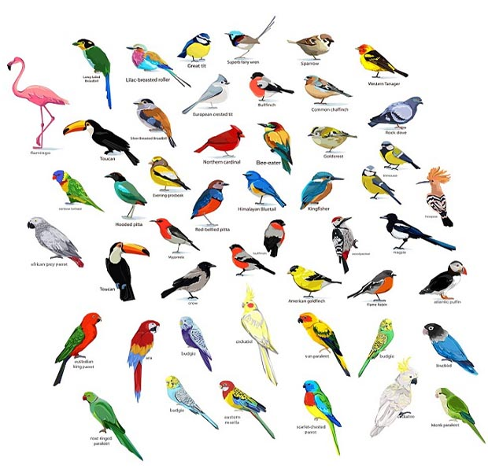
GOD CREATED BIRDS OF THE AIR
Notes:
God’s creation is full of beauty.
Do I have bird watchers in the congregation.
Thank you. It is good hobby to pursue.

Slide 6
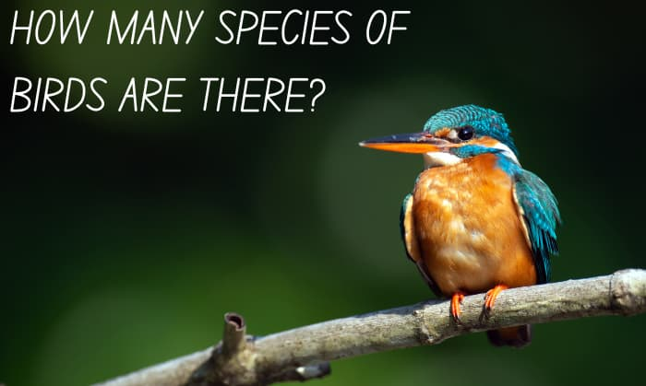
Notes:
Ever wondered how many species of birds are there?
Ever wondered how many species of birds are there worldwide? There are billions of birds that belong to around 11,160 species of avians. The research done to come up with this number was not an easy feat, but technology and curiosity combined, so the task was completed.
But of course, no one can truly say exactly how many birds are there. Unfortunately, many avian species have gone extinct, and others are declining in population.

Slide 7
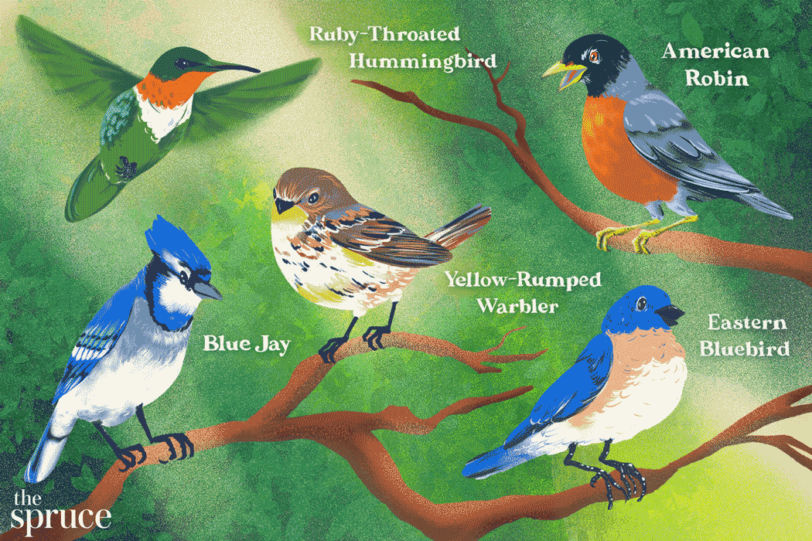
THE BIRDS THEIR CAROLS RAISE
Notes:
In Hymn number 91 the second stanza says, This is my Father’s world, The birds their carols raise; The morning light the Lilly white, Declare their Makers’s praise.
Next time you see a bird think about the creator who beautifies the earth with the presence of these beauties all around us.

Slide 8
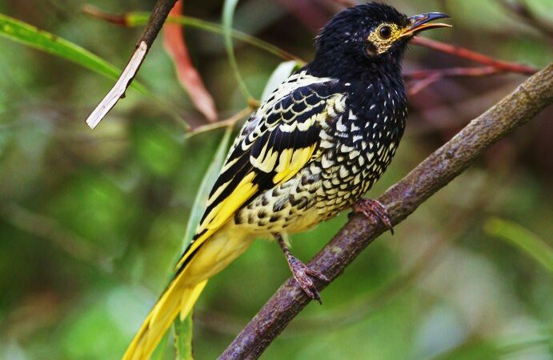
Losing Your Song
Notes:
However, there are some birds they lose their sing. They can’t sing any more.
Australia’s regent honeyeater bird is in trouble—it’s losing its song.
Though once an abundant species, just three hundred birds now remain; and with so few others to learn from, the males are forgetting their unique song and failing to attract mates.

Slide 9
SING AGAIN
Australia’s regent honeyeater
Notes:
If the singing is lost, it might result in loosing a whole Generation.

Slide 10
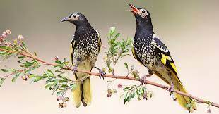
MALE BIRD SERINADES THE FEMALE
Notes:
HOWEVER, SOME BIRDS LOSING THEIR SONG.

Slide 11
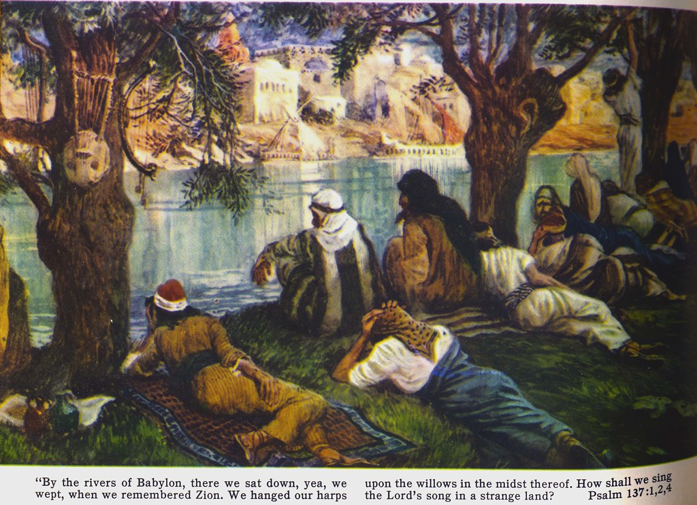
SING AGAIN
Notes:
Have you lost your song? In Psalm 137 we read. By the rivers of Babylon we sat and wept
when we remembered Zion.
² There on the poplars
we hung our harps,
³ for there our captors asked us for songs,
our tormentors demanded songs of joy;
they said, “Sing us one of the songs of Zion!”⁴ How can we sing the songs of the Lord
while in a foreign land?

Slide 12
1 By the rivers of Babylon we sat and wept when we remembered Zion.
2 There on the poplars we hung our harps,
3 for there our captors asked us for songs, our tormentors demanded songs of joy; they said, “Sing us one of the songs of Zion!”
4 How can we sing the songs of the LORD while in a foreign land?
SING AGAIN
Notes:
There are times we might not want to sing. Have you ever been in such circumstances? I have times I could not sing nor pray.

Slide 13
Singing can be done as an expression of sorrow. But when we find singing in the Scripture it is usually pointing to times of rejoicing. It is also connected with our worship toward God. The problem in our text was that the Lord's people had been carried away into captivity. As a result, they had lost their song. Many of God's people today have lost their song. They do not have the joy, the excitement, and the devotion toward God that they should have.
SING AGAIN

Slide 14
This morning, I would like to ask you, 'Have you lost your song?’
If so, 'What took your song?' For David, it was his disobedience toward God.
For Israel, it was their pride and rebellion.
SING AGAIN
Notes:
Following David's repentance, he prayed and asked God to restore unto him the 'joy' of his salvation. It wasn't that he had lost his relationship with God, but due to sin in his life, he had lost the 'joy' that should accompany a right relationship.

Slide 15
Get Ready to Sing Again!
The Lord Is My Strength and My Song
12 You will say in that day:
“I will give thanks to you, O LORD,
for though you were angry with me,
your anger turned away,
that you might comfort me.
² “Behold, God is my salvation;
I will trust, and will not be afraid;
for the LORD GOD is my strength and
my song, and he has become my salvation.”
SING AGAIN
Notes:
This is the second song recorded in the book of Isaiah. The first song was, When God sings the blues! God asked the question what more could I have done for my beloved? Now, Isaiah encourages Israel by sharing what lies ahead. Isaiah chooses words from Moses’ sister Miriam after Israel came safely through the Red Sea. Miriam sang a praise song to God and about God and His great deliverance.

Slide 16
In that wonderful day you will sing:
“Thank the Lord! Praise his name! Tell the nations what he has done.
Let them know how mighty he is!
Sing to the Lord, for he has done wonderful things.
Make known his praise around the world. Let all the people of Jerusalem shout his praise with joy!
For great is the Holy One of Israel who lives among you.”
SING AGAIN
Notes:
To repeat what Isaiah is saying.

Slide 17
⁵ “Sing praises to the LORD, for he has done gloriously;
let this be made known. in all the earth.
⁶ Shout, and sing for joy, O inhabitant of Zion,
for great in your midst is the Holy One of Israel.”
SING AGAIN
Notes:
Isaiah pens a new song of praise for salvation of Israel! When Isaiah sees a glimpse of God’s salvation plan, Israel’s complete deliverance and restoration, this is a fitting song. When God blesses anyone with deliverance and fruitfulness, praise is a suitable response. The song may be hard to hear in this generation, especially during this season of ingratitude. Today, criticism is more common than a compliment. It seems easier for people to complain than it is for them to express gratitude. God is worthy to be praised and praise is always in order.

Slide 18
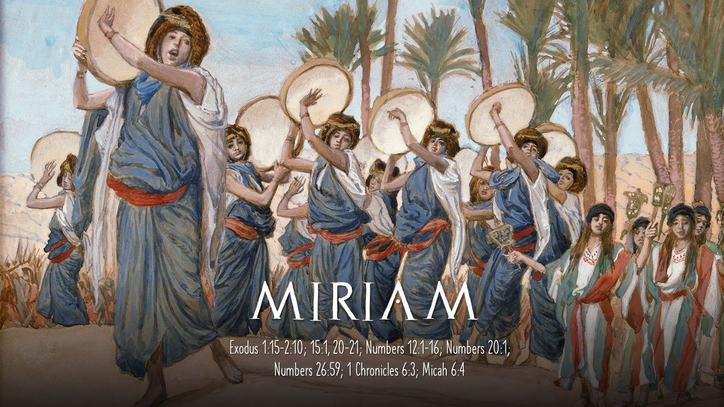
SING AGAIN
Notes:
After Israel was released from Egyptian bondage, and walk through the Red sea on dry ground, Miriam could not contain her praise. With her tambourine in hand, she led the congregation in song.

Slide 19
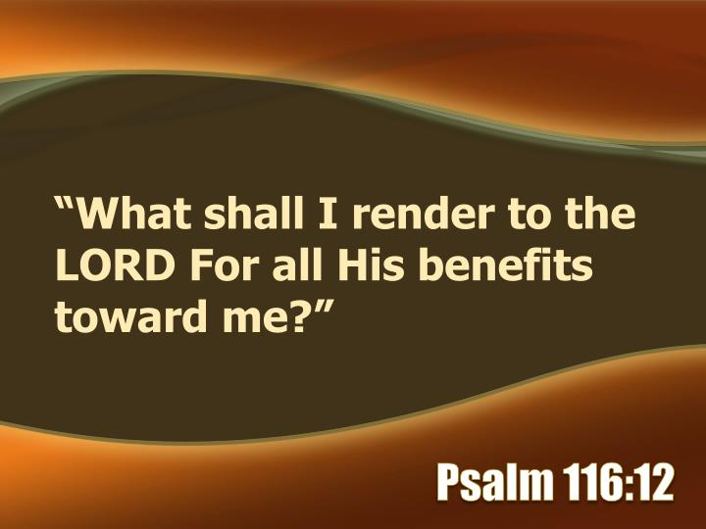
SING AGAIN
Notes:
After David had subdued all his enemies, and sat on the throne of Israel, Ps 116:12-14, “What shall I render unto the LORD for all his benefits toward me? I will take the cup of salvation and call upon the name of the LORD. I will pay my vows unto the LORD now in the presence of all his people.” David sang a song of praise, gave special offerings to God, and testified in the presence of God’s people.

Slide 20
The Book of Revelation is, quite literally, hymn-laden.
Fifteen hymns or hymn fragments are commonly recognized
(4:8;
4:9–11;
5:9–10;
5:12;
5:13;
7:10;
7:11–12;
11:15;
11:16–18;
12:10–12;
15:2–4;
16:5–7;
19:1–4;
19:5;
19:6–8),
and some scholars have identified even more.
SING AGAIN
Notes:
So, what does all this mean for Revelation’s songs and what might it tell us about their importance?
It is noteworthy that the heavenly worship scenes, and the hymns that are so central to them, “always occur at critical junctures in the book and provide commentary on the significance of the action.”
They thus perform the function of interpreting the events that unfold in the narrative sections of the prophecy.
Consequently, “all the major events of the book are accompanied by heavenly hymns.”

Slide 21
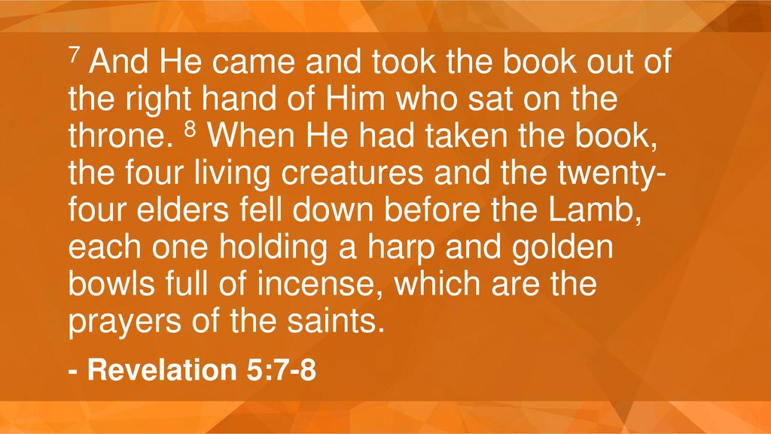
SING AGAIN
Notes:
You remember 5 Then I saw in the right hand of him who sat on the throne a scroll with writing on both sides and sealed with seven seals.² And I saw a mighty angel proclaiming in a loud voice, “Who is worthy to break the seals and open the scroll?” ³ But no one in heaven or on earth or under the earth could open the scroll or even look inside it. ⁴ I wept and wept because no one was found who was worthy to open the scroll or look inside. ⁵ Then one of the elders said to me, “Do not weep! See, the Lion of the tribe of Judah, the Root of David, has triumphed. He is able to open the scroll and its seven seals.”

Slide 22
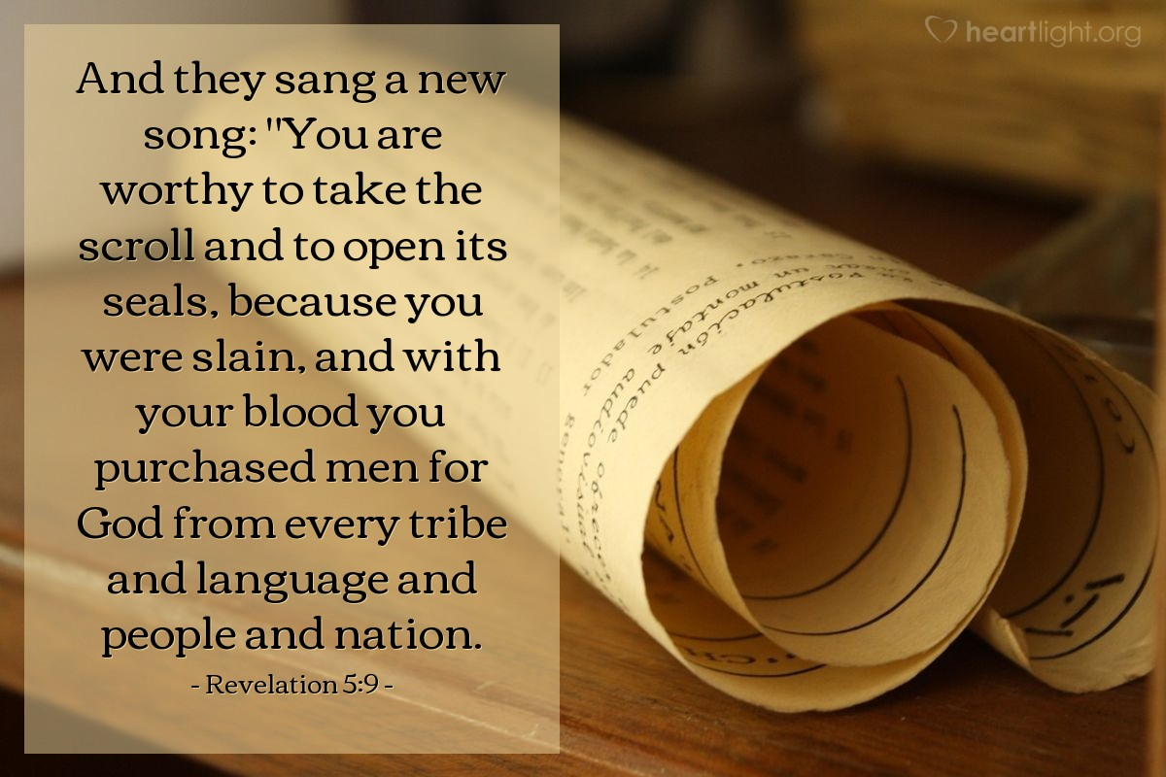
SING AGAIN
Notes:
This happening in heaven and before the throne of God.

Slide 23
While most of Revelation’s hymns are sung by heavenly beings (either the four living creatures, the twenty-four elders, the angels, or some combination of the three), at various points we see a progression toward the entire universe, most especially the redeemed, being drawn into the praise (e.g., 5:13; 7:9–10).
SING AGAIN
Notes:
Revelation 5:13 — King James Version (KJV 1900)
¹³ And every creature which is in heaven, and on the earth, and under the earth, and such as are in the sea, and all that are in them, heard I saying, Blessing, and honour, and glory, and power, be unto him that sitteth upon the throne, and unto the Lamb for ever and ever.
⁹ After this I looked, and there before me was a great multitude that no one could count, from every nation, tribe, people and language, standing before the throne and before the Lamb. They were wearing white robes and were holding palm branches in their hands. ¹⁰ And they cried out in a loud voice:
“Salvation belongs to our God,
who sits on the throne,
and to the Lamb.”¹¹ All the angels were standing around the throne and around the elders and the four living creatures. They fell down on their facesbefore the throne and worshiped God,

Slide 24
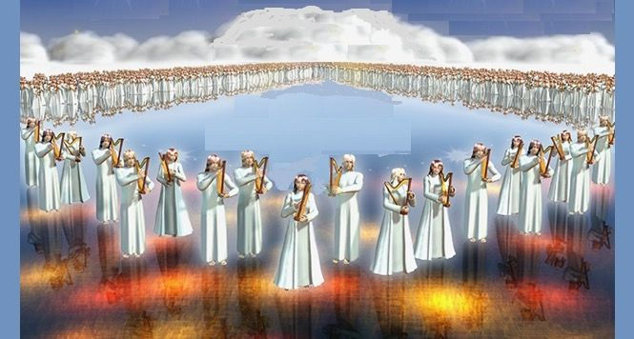
“They sing the song of Moses, the servant of God, and the song of the Lamb, saying: ‘Great and marvelous are Your works, Lord God Almighty! Just and true are Your ways, O King of the nations!’” Revelation 15:3
SING AGAIN

Slide 25

SING AGAIN
Notes:
In Revelation 2:17 I will also give that person a white stone with a new name written on it, known only to the one who receives it. Only you know the name given to you so, you introduce yourself, Hello, my name is . . . .

Slide 26
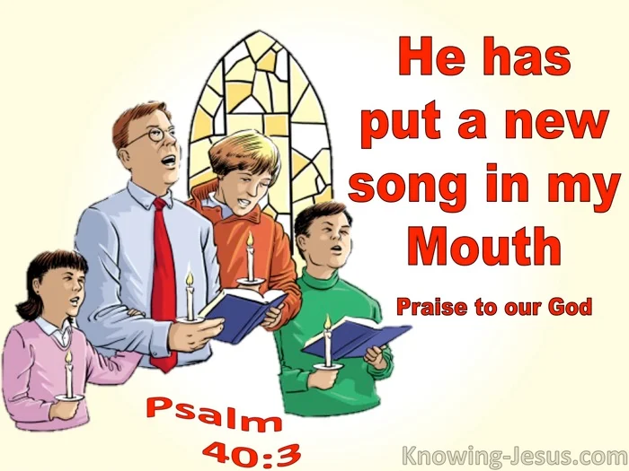
SING AGAIN
Notes:
And according to Psalm 40:3 “He has put a new song in my mouth.” What a wonderful promise,

Slide 27
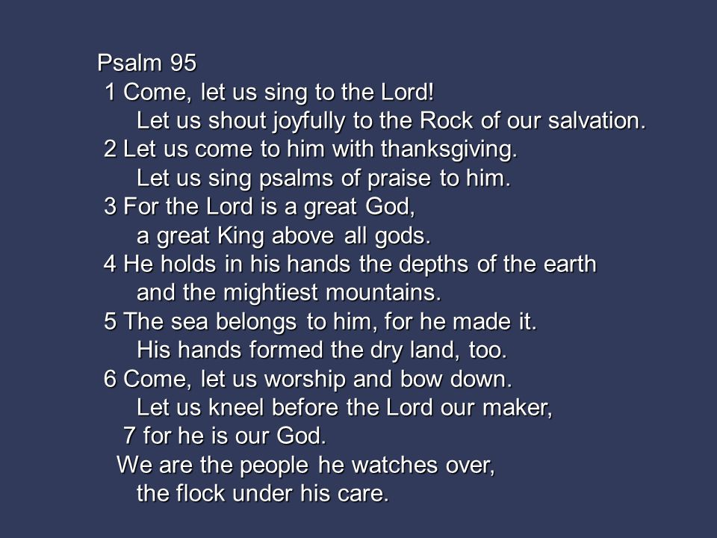
SING AGAIN
Notes:
We come here every Sabbath to worship Him with songs of joy.

Slide 28

For almost two thousand years, Christians have used music as a way to worship. In the Bible the Apostle Paul writes: “Speak to one another with psalms, hymns and spiritual songs.”
For almost two thousand years, Christians have used music psalms, hymns and spiritual songs.” For almost two thousand years, Christians have used music For almost two thousand years, Christians have used music and spiritual songs.”
SING AGAIN
Notes:
For almost two thousand years, Christians have used music as a way to worship. In the Bible the Apostle Paul writes: “Speak to one another with psalms, hymns and spiritual songs.”
The word “hymn" comes from the Greek word “hymnos” which means “a song of praise”. Originally these would have been written in honour of the Gods. Hymnody (the singing or composition of hymns) has evolved and changed over the centuries and been affected by new thinking and developing religious beliefs: throughout the history of the church, whenever there has been renewal, revival or restoration, new songs of worship have appeared.

Slide 29
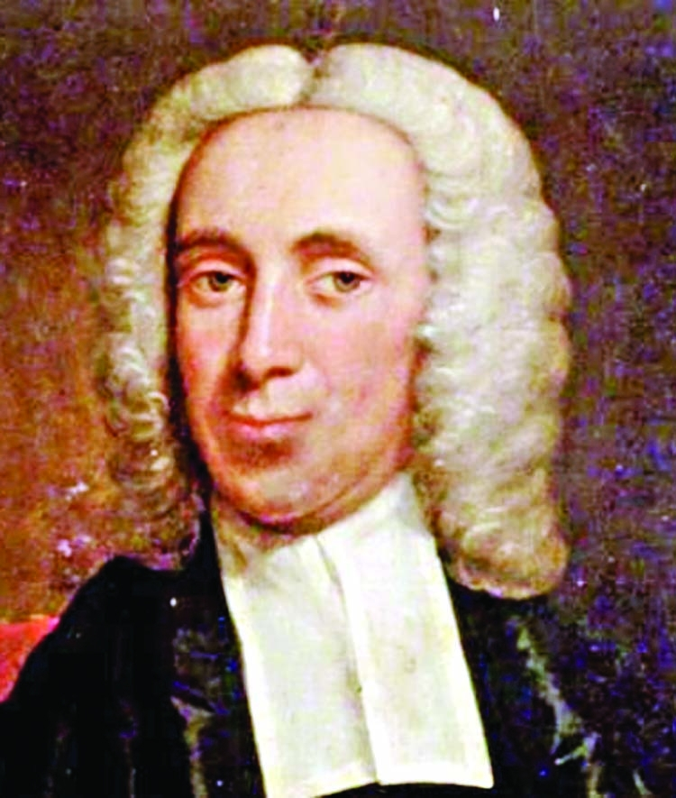
SING AGAIN
Notes:
In England the non-conformist minister Isaac Watts (1674-1748) began a transformation of congregational singing. Isaac Watts was an English Congregational minister, hymn writer, theologian, and logician. He was a prolific and popular hymn writer and is credited with some 750 hymns. His works include "When I Survey the Wondrous Cross", "Joy to the World", and "Our God, Our Help in Ages Past".

Slide 30
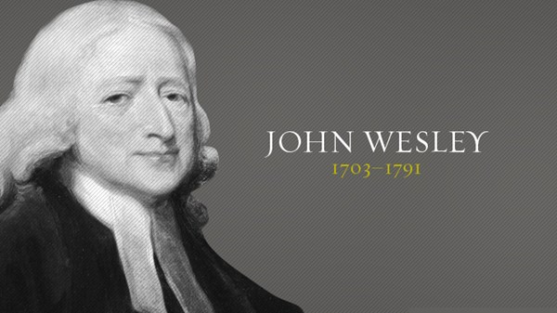
SING AGAIN
Notes:
He wrote over 6,000 hymns and preached 40,000 sermons.

Slide 31
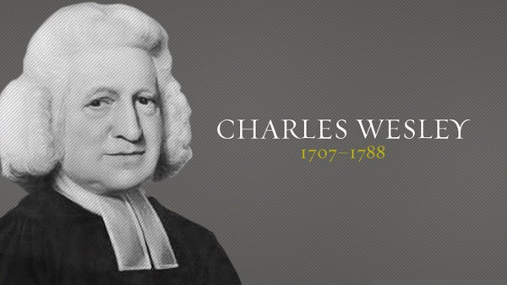
SING AGAIN
Notes:
His work as an evangelist and hymn writer for Methodism, however, had already made its permanent mark. He published more than 4,500 hymns and left some 3,000 in manuscript; George Frideric Handelwrote music specifically for some of them. Among Wesley’s best-known hymns are “Love Divine, All Loves Excelling,” “Hark, the Herald Angels Sing,” “Christ the Lord Is Ris’n Today,” “Soldiers of Christ, Arise,” “Rejoice, the Lord Is King,” and “Jesu, Lover of My Soul.”

Slide 32
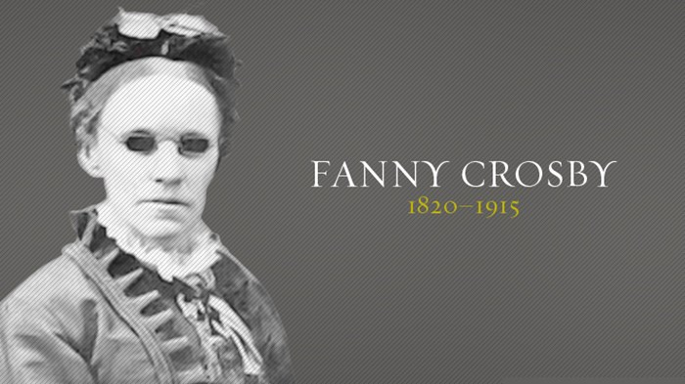
SING AGAIN
Notes:
Frances Jane van Alstyne, more commonly known as Fanny J. Crosby, was an American mission worker, poet, lyricist, and composer. She was a prolific hymnist, writing more than 8,000 hymns and gospel songs, with more than 100 million copies printed. She is also known for her teaching and her rescue mission work

Slide 33
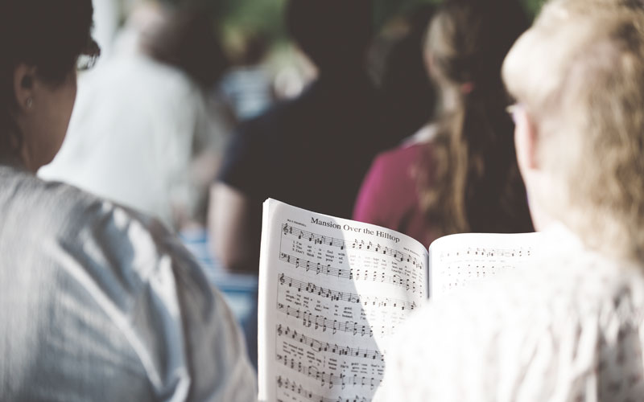
SING AGAIN

Slide 34
God Put a Song in Your Heart
He put a new song in my mouth, a song of praise to our God. Many will see and fear, and put their trust in the LORD. (Psalm 40:3)
There is a song in your heart.
Did you know that?
SING AGAIN
Notes:
There is another song that celebrates true soul satisfaction. The “new” song put in the heart by God’s grace is one that celebrates him, not our worth or the quality of our praise. The psalmist sings, “He put a new song in my mouth.”
This new song celebrates God! It rejoices in God! It sings about God! The psalmist waited patiently for the Lord! The Lord inclined to his cry! The Lord drew him up from the pit of destruction, out of the miry bog, set his feet upon a solid rock, and made his steps secure!
This song celebrates God for who he is and for what he has done. This is the “new song.”

Slide 35
Matt Redman and Jonas Myrin
Composed this song under the title 10,000 Reasons.
Bless the Lord, O my soul, O my soul
Worship His holy name
Sing like never before, O my soul
I'll worship Your holy name
Yes, I will worship Your holy name
Lord, I'll worship Your holy name
SING AGAIN
Notes:
How often we learn our sweetest songs when the blackness of trial closes in around us. This was David's experience. Cast down and almost despairing of life, he said,"...in the night His song shall be with me."
Elihu spoke of God giving "songs in the night" (Job 35:10).
Oh, friend, let's not despair when the darkness of trouble descends upon us. God is with us; God will help us; God will give us a song.

Slide 36
Do you have one reason to sing?
Life can be so unpredictable—joys and sorrows, beautiful blessings and distressing difficulties can come unexpectedly.
Our life’s dreams and plans can change in an instant. We all know this to be true. So how can we find peace amid such turbulence?
SING AGAIN

Slide 37
When peace like a river, attendeth my way,
When sorrows like sea billows roll
—Whatever my lot, thou hast taught me to know
It is well, it is well with my soul.²
SING AGAIN
Notes:
Thank you Hlible for that beautiful song. I am sure we all know the story behind that song.
Horatio Spafford knew something about life’s unexpected challenges. He was a successful attorney and real estate investor who lost a fortune in the great Chicago fire of 1871. Around the same time, his beloved four-year-old son died of scarlet fever.Thinking a vacation would do his family some good, he sent his wife and four daughters on a ship to England, planning to join them after he finished some pressing business at home. However, while crossing the Atlantic Ocean, the ship was involved in a terrible collision and sunk. More than 200 people lost their lives, including all four of Horatio Spafford’s precious daughters. His wife, Anna, survived the tragedy. Upon arriving in England, she sent a telegram to her husband that began: “Saved alone. What shall I do?”Horatio immediately set sail for England. At one point during his voyage, the captain of the ship, aware of the tragedy that had struck the Spafford family, summoned Horatio to tell him that they were now passing over the spot where the shipwreck had occurred.¹As Horatio thought about his daughters, words of comfort and hope filled his heart and mind. He wrote them down, and they have since become a well-beloved hymn:

Slide 38
Perhaps we cannot always say that everything is well in all aspects of our lives.
There will always be storms to face, and sometimes there will be tragedies.
But with faith in a loving God and with trust in His divine help,
we can confidently say, “It is well, it is well with my soul.”
SING AGAIN

Slide 39
THE BIRDS THEIR CAROLS RAISE
Notes:
This morning my prayer for each one of us is that God put a song in your mouth, so sing again.
Next time you see a bird think about the creator who beautifies the earth with the presence of these beauties all around us.

Slide 40
SING AGAIN

