Slide 1
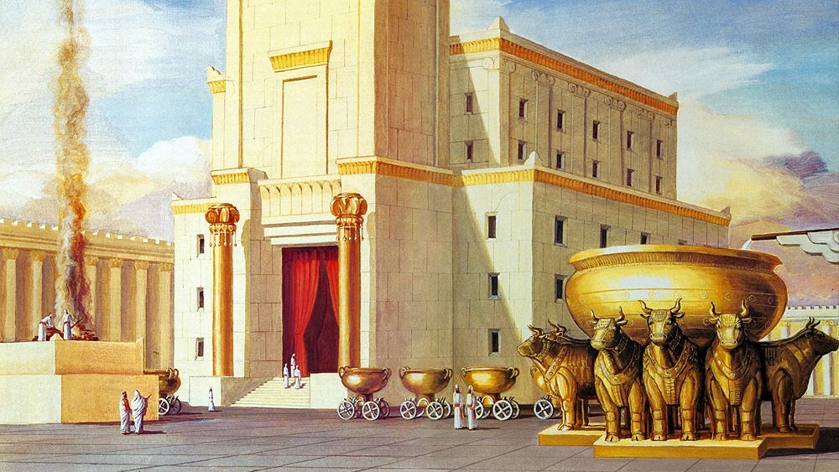
Is There A God In Israel?
2 Kings 1:1-18
By: Thomas Felder

Slide 2
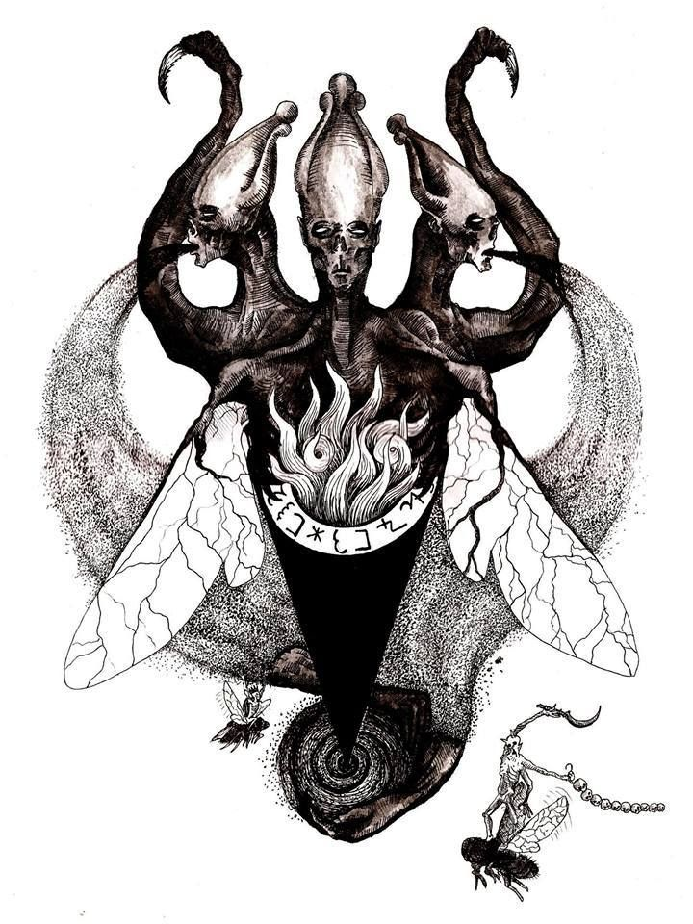
Ahaziah seeks Baal-Zebub
2 Kings 1:1-2
Moab rebelled against Israel after the death of Ahab. Now Ahaziah fell through the lattice of his upper room in Samaria, and was injured; so he sent messengers and said to them, “Go, inquire of Baal-Zebub, the god of Ekron, whether I shall recover from this injury.” (1-2)
Notes:
Ahaziah – God has Grasped- God has grabbed your attention… God is reaching out for you… Son of Ahab and Jezebel
“Their land was immediately east of the Dead Sea and shared an indefinite border with Israel to the north at approximately the point where the Jordan River enters the Dead Sea.” (Dilday)
ii. Moab had been under Israelite domination since the days of David (2Sa 8:2; 2Sa 8:11-12). This rebellion of Moab in the days of Ahaziah was a sign of the decline of Israel’s power and of the judgment of God.
b. Ahaziah fell through the lattice of his upper room in Samaria: This was surely an unexpected crisis. Such accidents happen to kings and peasants both.
“The king apparently leaned against the wooden screen and fell through from the second-floor balcony to the ground below.” (Dilday)
c. Go, inquire of Baal-Zebub, the god of Ekron, whether I shall recover from this injury: Ahaziah showed that he was a true worshipper of the pagan god Baal-Zebub because he turned to this god in his time of trouble.
“This could suggest that Baal-Zebub was a god who warded off plagues that were brought on by flies. There are numerous references to ‘fly gods’ in classical literature.” (Dilday)
ii. “He was the local god of Ekron, and probably was used at first to drive away flies. Afterwards, he became a very respectable devil, and was supposed to have great power and influence. In the New Testament, Beelzebub is a common name for Satan himself, or the prince of devils.” (Adam Clarke)
iii. “Men love the gods that are most like unto themselves, so it is not surprising to see Ahaziah sending to this miserable Philistine god.” (Knapp)

Slide 3
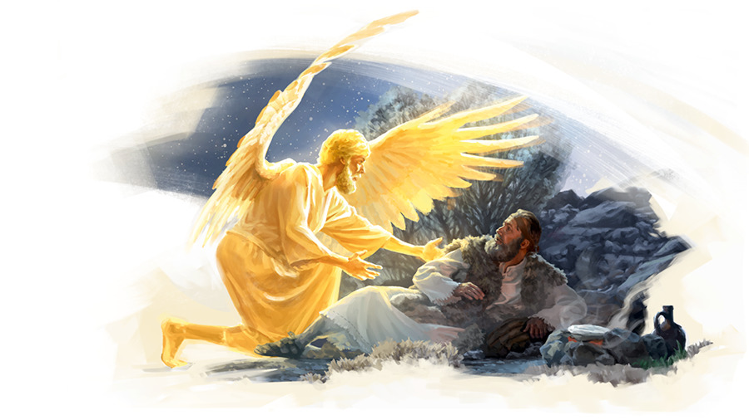
Elijah’s Message to Ahaziah
2 Kings 1: 3-4
But the angel of the LORD said to Elijah the Tishbite, “Arise, go up to meet the messengers of the king of Samaria, and say to them, ‘Is it because there is no God in Israel that you are going to inquire of Baal-Zebub, the god of Ekron?’ Now therefore, thus says the LORD: ‘You shall not come down from the bed to which you have gone up, but you shall surely die.’” So Elijah departed. (3-4)
Notes:
a. Is it because there is no God in Israel: There is little doubt that King Ahaziah believed that Yahweh lived, but he lived as if there were no God in Israel. He was a practical atheist, and the way he sought Baal-Zebub instead of the LORD demonstrated this.
b. You shall not come down from the bed to which you have gone up, but you shall surely die: Ahaziah did not seek help from the real God; therefore he will get no real help. Instead this will be an occasion for the real God to send a message of judgment to King Ahaziah.
According to Wiseman, when ancients sought their gods about medical issues, “The result was usually given in medical prognostic texts as ‘he will live/die’ as in verses 6, 16 (you will certainly die).” This means that Elijah’s words but you shall surely die were phrased as a medical diagnosis. It was as if Elijah said, “Here’s your diagnosis, Ahaziah: Your condition is fatal and irreversible.”
ii. In fact, this was a mercy to Ahaziah. God told him something that few people know. His death was imminent, and he had time to repent and prepare to meet God.
iii. This prophetic announcement might also explain why Ahaziah did not want to seek an answer from the LORD: He knew what the answer would be. In seeking Baal-Zebub for an answer, Ahaziah may have wanted to find a god to tell him what he wanted to hear.

Slide 4
The messengers return to Ahaziah
When the messengers returned … he said to them, “Why have you come back?” …“A man came up to meet us, and said to us, ‘Go, return to the king who sent you, and say to him, “Thus says the LORD: ‘Is it because there is no God in Israel that you are sending to inquire of Baal-Zebub, the god of Ekron? Therefore, you shall not come down from the bed to which you have gone up, but you shall surely die.’” (5-6)
2 Kings 1: 5-6
Notes:
a. A man came up to meet us: Though they were sent to seek a word from the pagan priests of Baal-Zebub, the word from Elijah persuaded them so much that they didn’t follow through on their original mission.
“This official delegation from the king would certainly not have turned back from their royal assignment just because some anonymous wayfarer asked them to. There must have been an irresistible quality to Elijah’s personality, a forceful spiritual presence, that compelled them to obey this stranger even though they didn’t know who he was.” (Dilday)

Slide 5
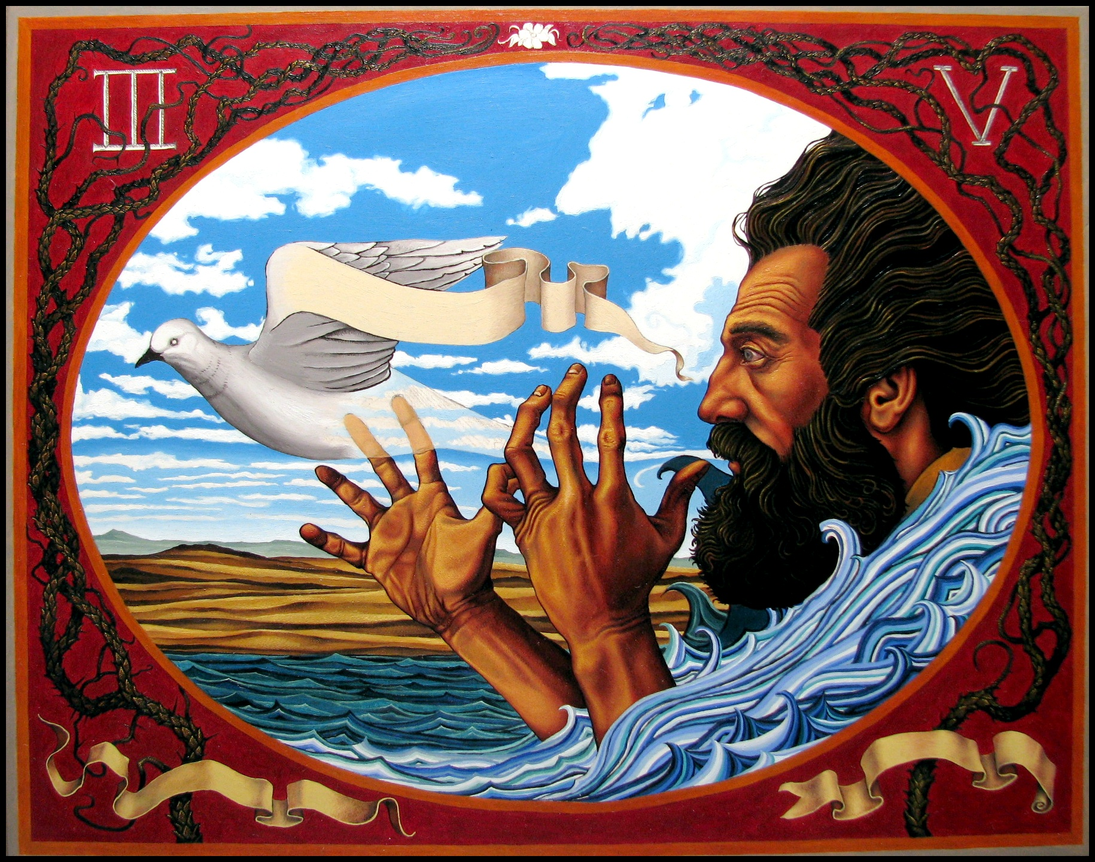
The messengers return to Ahaziah
2 Kings 1: 7-8
Then he said to them, “What kind of man was it who came up to meet you and told you these words?” So they answered him, “A hairy man wearing a leather belt around his waist.” And he said, “It is Elijah the Tishbite.” (7-8)
Notes:
b. What kind of man was it who came up to meet you: Ahaziah clearly suspected it was the Prophet Elijah who spoke this word. His suspicion was confirmed when the man was described as a hairy man wearing a leather belt around his waist.
The Hebrew words translated hairy man literally mean, “possessor of hair.” “This description more than likely refers to the hairy animal skins he wore clinched around his waist with a leather belt.” (Dilday)
ii. Identifying Elijah by his clothes also connected him to the ministry of John the Baptist, who dressed in hairy skins from animals (Mat 3:4). When the priests and Levites saw him they asked, “Are you Elijah?” (Joh 1:19-21)
iii. “Either because Elijah had much hair on his head and face, or because, as a prophet, he wore a rough garment (Zec 13:4), as a pattern of repentance.” (Trapp)

Slide 6
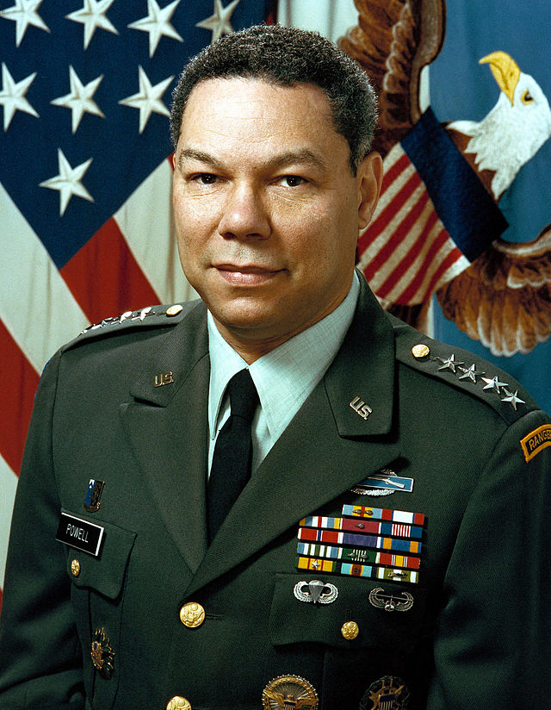
Elijah before Ahaziah
Then the king sent to him a captain of fifty with his fifty men. So he went up to him; and there he was, sitting on the top of a hill. And he spoke to him: “Man of God, the king has said, ‘Come down!” So Elijah answered and said to the captain of fifty, “If I am a man of God, then let fire come down from heaven and consume you and your fifty men.” And fire came down from heaven and consumed him and his fifty. (9-10)
2 Kings 1: 9-10
Notes:
a. The king sent to him a captain of fifty with his fifty men: This should have been plenty of men to capture one prophet. Clearly, Ahaziah sent more men than were normally required.
b. Man of God, the king has said, “Come down”: The captain here admitted the righteousness of Elijah when he called him “Man of God.” Therefore they were wrong in doing this, even though they were on orders from their king.
The Bible clearly teaches that we owe submission to the government and governing authorities (Rom 13:1-2). Rom 13:1 Let every person be subject to the governing authorities. For there is no authority except from God, and those that exist have been instituted by God.
Rom 13:2 Therefore whoever resists the authorities resists what God has appointed, and those who resist will incur judgment.
Yet in the human sphere, the Biblical command to submit is never absolute, but always conditioned by the greater responsibility to submit to God (Act 5:29). Act 5:29 But Peter and the apostles answered, “We must obey God rather than men. This commander should have resisted the ungodly and immoral command from King Ahaziah and obeyed God instead. His fifty men should have refused to obey the ungodly and immoral command of their captain.
c. If I am a man of God, then let fire come down from heaven: Elijah put the issue in stark contrast. If he really were a man of God, then the captain and his men were on an ungodly and immoral mission. Since Elijah could not bring down fire from heaven without Divine approval, he asked God to evaluate these men and the rightness of their actions against God’s prophet.
“Either they did not hold him to be a prophet, or they gloried in putting the power of their master above that of Jehovah. In any case, the insult was less against Elijah than Elijah’s God.” (Meyer)
ii. Elijah did not say, “You bet I am a man of God.” Instead, he answered If I am a man of God.
Essentially Elijah said, “You say I am a man of God even though you are not acting like it. Maybe I am and maybe I am not. Let’s let God decide by fire.”
iii. “Some have blamed the prophet for destroying these men, by bringing down fire from heaven upon them. But they do not consider that it was no more possible for Elijah to bring down fire from heaven, than for them to do it. God alone could send the fire; and as he is just and good, he would not have destroyed these men had there not been a sufficient cause to justify the act.” (Clarke)
d. Fire came down from heaven and consumed him and his fifty: God brought judgment on these men who acted as if Yahweh was not a real God and as if Elijah was not truly His servant.
The captain commanded Elijah to “Come down!” The man of God didn’t come down, but the fire of God did.
ii. “It must be noted that the demands made of Elijah were wrong. A king had no right to ask such allegiance and his actions should always be subordinate to God’s word. God was protecting his word and his servant.” (Wiseman)

Slide 7
Submission to Gov’t vs. Submission to God
Romans 13:1-2
The Bible clearly teaches that we owe submission to the government and governing authorities
Rom 13:1-2 Let every person be subject to the governing authorities…Therefore whoever resists the authorities resists what God has appointed, and those who resist will incur judgment.
Notes:
a. The king sent to him a captain of fifty with his fifty men: This should have been plenty of men to capture one prophet. Clearly, Ahaziah sent more men than were normally required.
b. Man of God, the king has said, “Come down”: The captain here admitted the righteousness of Elijah when he called him “Man of God.” Therefore they were wrong in doing this, even though they were on orders from their king.
The Bible clearly teaches that we owe submission to the government and governing authorities (Rom 13:1-2). Rom 13:1 Let every person be subject to the governing authorities. For there is no authority except from God, and those that exist have been instituted by God.
Rom 13:2 Therefore whoever resists the authorities resists what God has appointed, and those who resist will incur judgment.
Yet in the human sphere, the Biblical command to submit is never absolute, but always conditioned by the greater responsibility to submit to God (Act 5:29). Act 5:29 But Peter and the apostles answered, “We must obey God rather than men. This commander should have resisted the ungodly and immoral command from King Ahaziah and obeyed God instead. His fifty men should have refused to obey the ungodly and immoral command of their captain.
c. If I am a man of God, then let fire come down from heaven: Elijah put the issue in stark contrast. If he really were a man of God, then the captain and his men were on an ungodly and immoral mission. Since Elijah could not bring down fire from heaven without Divine approval, he asked God to evaluate these men and the rightness of their actions against God’s prophet.
“Either they did not hold him to be a prophet, or they gloried in putting the power of their master above that of Jehovah. In any case, the insult was less against Elijah than Elijah’s God.” (Meyer)
ii. Elijah did not say, “You bet I am a man of God.” Instead, he answered If I am a man of God.
Essentially Elijah said, “You say I am a man of God even though you are not acting like it. Maybe I am and maybe I am not. Let’s let God decide by fire.”
iii. “Some have blamed the prophet for destroying these men, by bringing down fire from heaven upon them. But they do not consider that it was no more possible for Elijah to bring down fire from heaven, than for them to do it. God alone could send the fire; and as he is just and good, he would not have destroyed these men had there not been a sufficient cause to justify the act.” (Clarke)
d. Fire came down from heaven and consumed him and his fifty: God brought judgment on these men who acted as if Yahweh was not a real God and as if Elijah was not truly His servant.
The captain commanded Elijah to “Come down!” The man of God didn’t come down, but the fire of God did.
ii. “It must be noted that the demands made of Elijah were wrong. A king had no right to ask such allegiance and his actions should always be subordinate to God’s word. God was protecting his word and his servant.” (Wiseman)

Slide 8
Submission to Gov’t vs. Submission to God
Any submission is always conditioned by the greater responsibility to submit to God
Act 5:29 But Peter and the apostles answered, “We must obey God rather than men.”
This commander should have resisted the ungodly and immoral command from King Ahaziah and obeyed God instead. His fifty men should have refused to obey the ungodly and immoral command of their captain.
Acts 5:29
Notes:
a. The king sent to him a captain of fifty with his fifty men: This should have been plenty of men to capture one prophet. Clearly, Ahaziah sent more men than were normally required.
b. Man of God, the king has said, “Come down”: The captain here admitted the righteousness of Elijah when he called him “Man of God.” Therefore they were wrong in doing this, even though they were on orders from their king.
The Bible clearly teaches that we owe submission to the government and governing authorities (Rom 13:1-2). Rom 13:1 Let every person be subject to the governing authorities. For there is no authority except from God, and those that exist have been instituted by God.
Rom 13:2 Therefore whoever resists the authorities resists what God has appointed, and those who resist will incur judgment.
Yet in the human sphere, the Biblical command to submit is never absolute, but always conditioned by the greater responsibility to submit to God (Act 5:29). Act 5:29 But Peter and the apostles answered, “We must obey God rather than men. This commander should have resisted the ungodly and immoral command from King Ahaziah and obeyed God instead. His fifty men should have refused to obey the ungodly and immoral command of their captain.
c. If I am a man of God, then let fire come down from heaven: Elijah put the issue in stark contrast. If he really were a man of God, then the captain and his men were on an ungodly and immoral mission. Since Elijah could not bring down fire from heaven without Divine approval, he asked God to evaluate these men and the rightness of their actions against God’s prophet.
“Either they did not hold him to be a prophet, or they gloried in putting the power of their master above that of Jehovah. In any case, the insult was less against Elijah than Elijah’s God.” (Meyer)
ii. Elijah did not say, “You bet I am a man of God.” Instead, he answered If I am a man of God.
Essentially Elijah said, “You say I am a man of God even though you are not acting like it. Maybe I am and maybe I am not. Let’s let God decide by fire.”
iii. “Some have blamed the prophet for destroying these men, by bringing down fire from heaven upon them. But they do not consider that it was no more possible for Elijah to bring down fire from heaven, than for them to do it. God alone could send the fire; and as he is just and good, he would not have destroyed these men had there not been a sufficient cause to justify the act.” (Clarke)
d. Fire came down from heaven and consumed him and his fifty: God brought judgment on these men who acted as if Yahweh was not a real God and as if Elijah was not truly His servant.
The captain commanded Elijah to “Come down!” The man of God didn’t come down, but the fire of God did.
ii. “It must be noted that the demands made of Elijah were wrong. A king had no right to ask such allegiance and his actions should always be subordinate to God’s word. God was protecting his word and his servant.” (Wiseman)

Slide 9
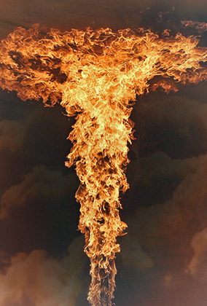
Judgment also comes upon a second captain
Then he sent to him another captain of fifty with his fifty men. And he answered and said to him: “Man of God, thus has the king said, ‘Come down quickly!’ ” So Elijah answered and said to them, “If I am a man of God, let fire come down from heaven and consume you and your fifty men.” And the fire of God came down from heaven and consumed him and his fifty. (11-12)
2 Kings 1:11-12
Notes:
a. Man of God, thus has the king said: The second captain repeated the same error as the first captain, but with even more guilt because he knew what happened to the first captain. The judgment upon the first group should have warned this second captain and his fifty men.
The specific request of the second captain (Come down quickly!) shows that the second captain made his request even more bold and demanding.
ii. The people and leaders of Israel had gone after pagan gods so long that they could not distinguish between the imaginary, impotent gods of the pagan world and Yahweh, the LORD God of Israel. They thought that Yahweh was just as powerless as their own useless gods.
b. If I am a man of God, let fire come down from heaven and consume you and your fifty men: Elijah left the matter in God’s hands, and God again responded in dramatic judgment.

Slide 10
The Third Captain Comes In Humility And Elijah Goes With Him.
Again, he sent a third captain of fifty with his fifty men… (he) fell on his knees before Elijah, and pleaded with him…: “Man of God, please let my life and the life of these fifty servants of yours be precious in your sight. Look, fire has come down from heaven and burned up the first two captains of fifties with their fifties. But let my life now be precious in your sight.” And the angel of the LORD said to Elijah, “Go down with him; do not be afraid of him.” So he arose and went down with him to the king. (13-15)
2 kings 1: 13-15
Notes:
a. Fell on his knees before Elijah, and pleaded with him: The third captain approached his mission in a completely different manner. He came to Elijah humbly, recognizing that he really was a Man of God. Perhaps the third captain looked at the two blackened spots of scorched earth nearby before he spoke to Elijah.
b. Go down with him; do not be afraid of him: It wasn’t that God did not want Elijah to go to King Ahaziah; it was that Ahaziah, his captains, and their soldiers all acted as if there were no God in Israel. When the request was made wisely and humbly, Elijah went.
i. There were many reasons why Ahaziah wanted to arrest Elijah, even though he already heard the prophecy through Elijah. Perhaps he wanted Elijah to reverse his word of doom and would use force to compel him to do it. Perhaps he just wanted to show his rage against this prophet who had troubled him and his father Ahab for so long. Perhaps he wanted to dramatically silence Elijah to discourage future prophets from speaking boldly against the king of Israel. God assured Elijah that he had nothing to fear from Ahaziah.

Slide 11
ELIJAH DELIVERS THE SAME MESSAGE TO AHAZIAH
2 Kings 1:16
Then he said to him, “Thus says the LORD: ‘Because you have sent messengers to inquire of Baal-Zebub, the god of Ekron, is it because there is no God in Israel to inquire of His word? Therefore you shall not come down from the bed to which you have gone up, but you shall surely die.’” (16)
Notes:
a. Is it because there is no God in Israel to inquire of His word: This was the same message Elijah gave to the men Ahaziah sent to inquire of Baal-Zebub. The message from God did not change just because Ahaziah didn’t want to hear it the first time.

Slide 12
Ahaziah dies and leaves no successor
So Ahaziah died according to the word of the LORD which Elijah had spoken. Because he had no son, Jehoram became king in his place. (17-18)
King Ahaziah
R.I.P.
852 BCE
2 Kings 1:17-18
Notes:
a. So Ahaziah died according to the word of the LORD which Elijah had spoken: The proof was in the result. Elijah was demonstrated to be a man of God because his prophecy was fulfilled just as spoken. Ahaziah did not recover from his fall through the lattice.
“Everything he did was weak, faithless, and miserable; he achieved nothing but ruin and failure. He let Moab rebel. He hurt himself in a clumsy accident. He foolishly attempted to use military force against Elijah. And worse, he sought help in the wrong place – in Philistia at the altar of a pagan god.” (Dilday)
b. Because he had no son, Jehoram became king: This Jehoram was also the son of Ahab (2Ki 3:1) and therefore the brother of Ahaziah. Ahaziah had no descendant to pass the kingdom to, so the throne went to his brother after the brief reign of Ahaziah.
i. The account becomes a little confusing here, because the king of Judah at that time was also named Jehoram (the son of Jehoshaphat).

Slide 13
Is There A God In the Church Today ?

Slide 14


Slide 15
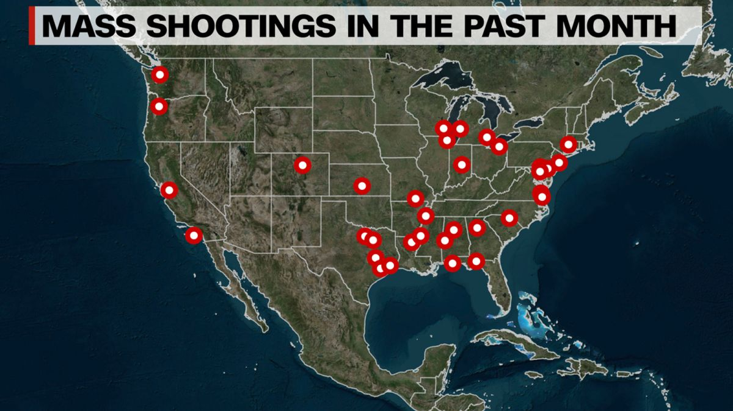

Slide 16


Slide 17


Slide 18




Slide 19
Famine
According to the World Health Organization, more than 820 million people across the world are hungry. This, is 9 million more than 2018.

Slide 21
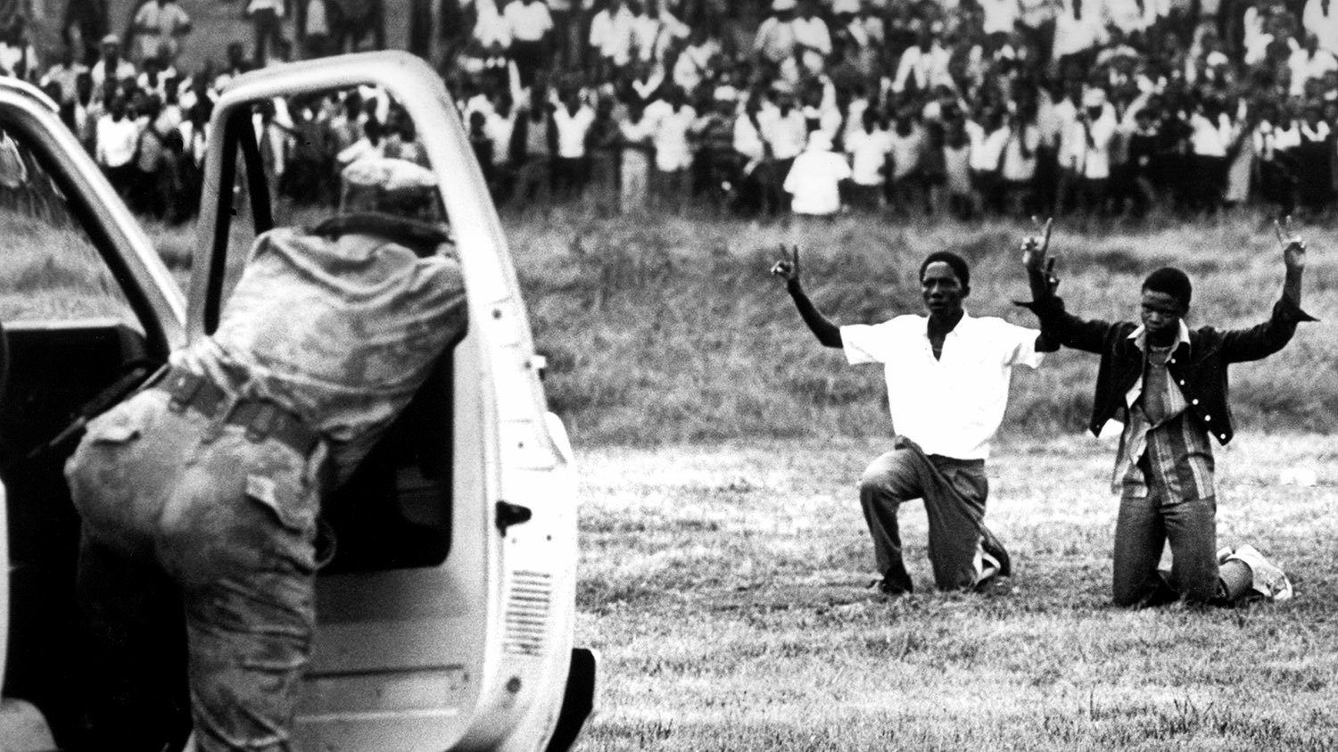
Notes:
Nation: Ethnos :
Thayer’s Greek Lexicon: race, nation

Slide 22
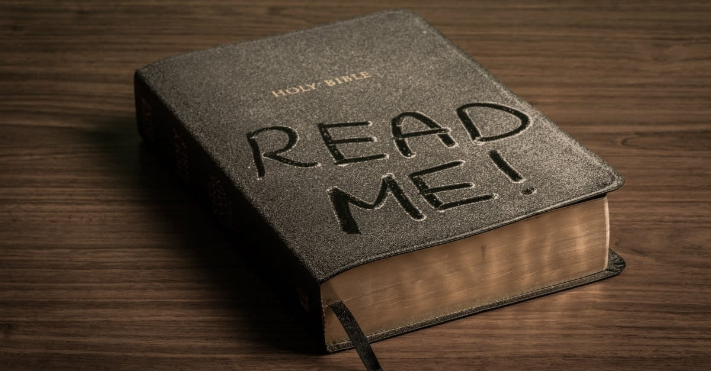

Slide 23

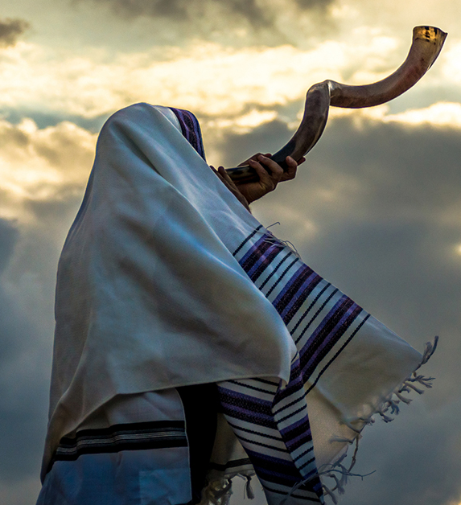
Notes:
Sound the Alarm & Blow the Trumpet

Slide 24
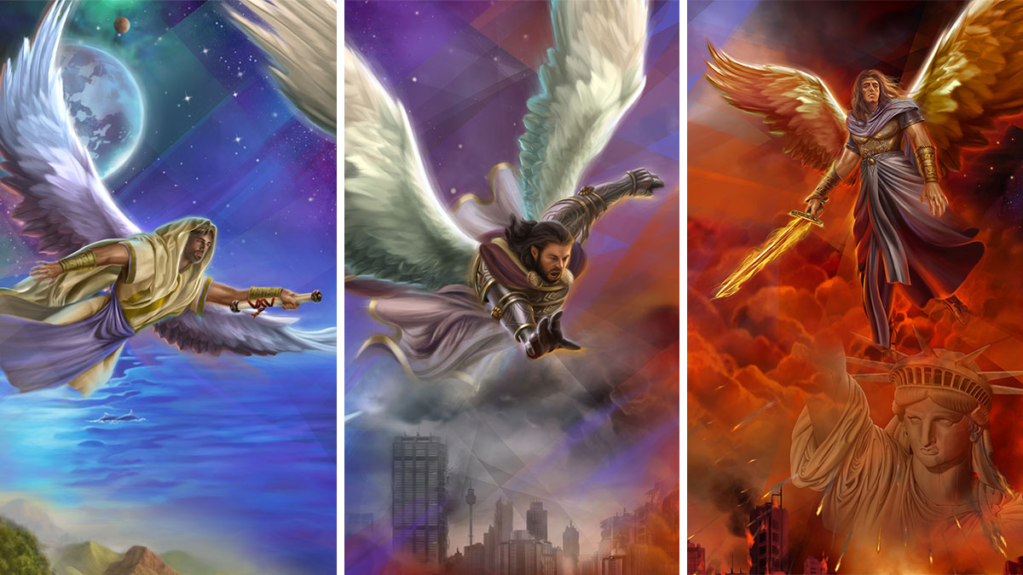
Wrath of God Poured Out
On those that worship the Beast
Fear God & Give
Glory to Him
Babylon the great
is Fallen
Notes:
Rev 14:6 Then I saw another angel flying directly overhead, with an eternal gospel to proclaim to those who dwell on earth, to every nation and tribe and language and people.
Rev 14:7 And he said with a loud voice, “Fear God and give him glory, because the hour of his judgment has come, and worship him who made heaven and earth, the sea and the springs of water.”
Rev 14:8 Another angel, a second, followed, saying, “Fallen, fallen is Babylon the great, she who made all nations drink the wine of the passion of her sexual immorality.”
Rev 14:9 And another angel, a third, followed them, saying with a loud voice, “If anyone worships the beast and its image and receives a mark on his forehead or on his hand,
Rev 14:10 he also will drink the wine of God's wrath, poured full strength into the cup of his anger, and he will be tormented with fire and sulfur in the presence of the holy angels and in the presence of the Lamb.

Slide 25
In a special sense Seventh-day Adventists have been set in the world as watchmen and light bearers. To them has been entrusted the last warning for a perishing world. On them is shining wonderful light from the Word of God. They have been given a work of the most solemn import—the proclamation of the first, second, and third angels’ messages. There is no other work of so great importance. They are to allow nothing else to absorb their attention. 9T 19.1

Slide 26
“Son of man, I have set thee a watchman unto the house of Israel; therefore thou shalt hear the word at My mouth, and warn them from Me. When I say unto the wicked, O wicked man, thou shalt surely die; if thou dost not speak to warn the wicked from his way, that wicked man shall die in his iniquity; but his blood will I require at thine hand.” Ezekiel 33:7-8.
Notes:
Everyone who has received the light of truth is under the same responsibility as was the prophet of Israel:

Slide 27
Are we to wait until the fulfillment of the prophecies of the end before we say anything concerning them? Of what value will our words be then? Shall we wait until God's judgments fall upon the transgressor before we tell him how to avoid them? Where is our faith in the word of God? Must we see things foretold come to pass before we will believe what He has said? In clear, distinct rays light has come to us, showing us that the great day of the Lord is near at hand, “even at the doors.” Let us read and understand before it is too late. 9T 20.1

