Slide 1
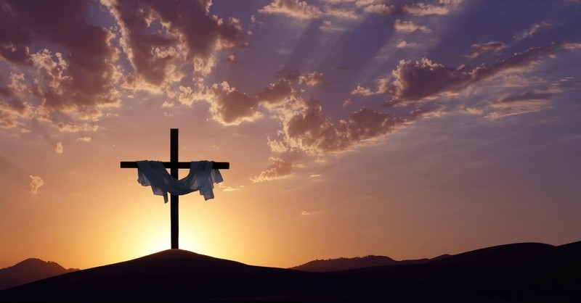
Tetelestai –It is Finished
Elder Segaran Sigamoney

Slide 2

Great Controversy p. 327,328
“In A.D. 31, three and a half years after His baptism, our Lord was crucified. With the great sacrifice offered upon Calvary, ended that system of offerings which for four thousand years had pointed forward to the Lamb of God. Type had met antitype, and all the sacrifices and oblations of the ceremonial system were there to cease.”

Slide 3
Great Controversy p. 518
“The great controversy between Christ and Satan, that has been carried forward for nearly six thousand years, is soon to close; and the wicked one redoubles his efforts to defeat the work of Christ in man’s behalf and to fasten souls in his snares. To hold the people in darkness and impenitence till the Savior’s mediation is ended, and there is no longer a sacrifice for sin, is the object which he seeks to accomplish.”

