Slide 1
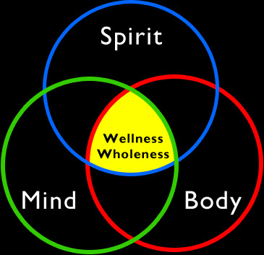
BODY MIND SPIRIT
Three definite entities --- separate, distinct, unified

Slide 2

A powerful force who’s limits are not known
Each part plays a vital, integrated part.

Slide 3

We are interconnected to everything in the world… sharing genes

Slide 4

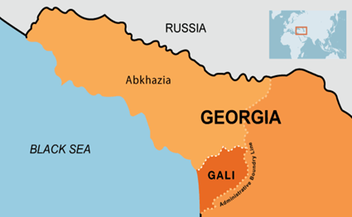
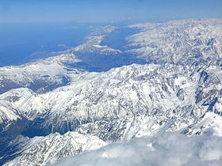
LONG LIFE - in the Blue Zones
1. Abkhazia, Republic of Georgia
2. Caucus Mountains,
Eurasia
(Aerial view)

Slide 5
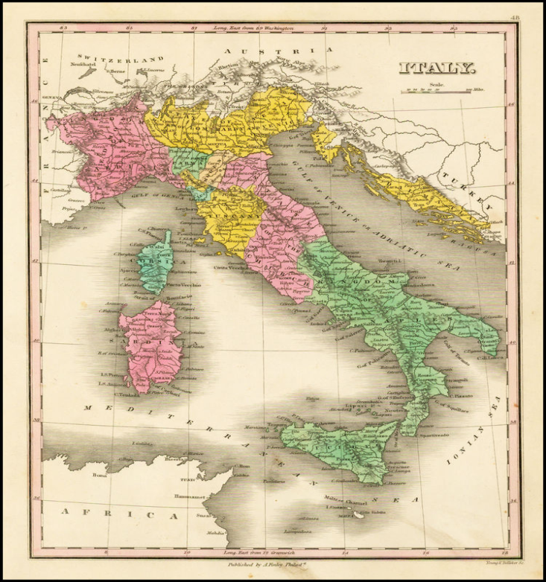
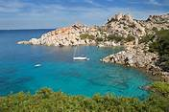
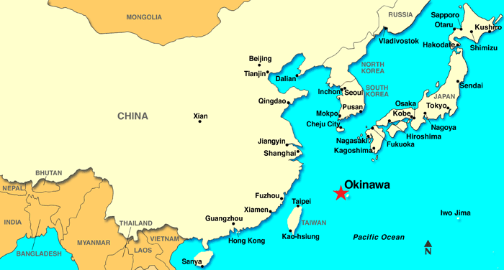

3. Sardinia, Italy
4. Okinawa, Japan

Slide 6
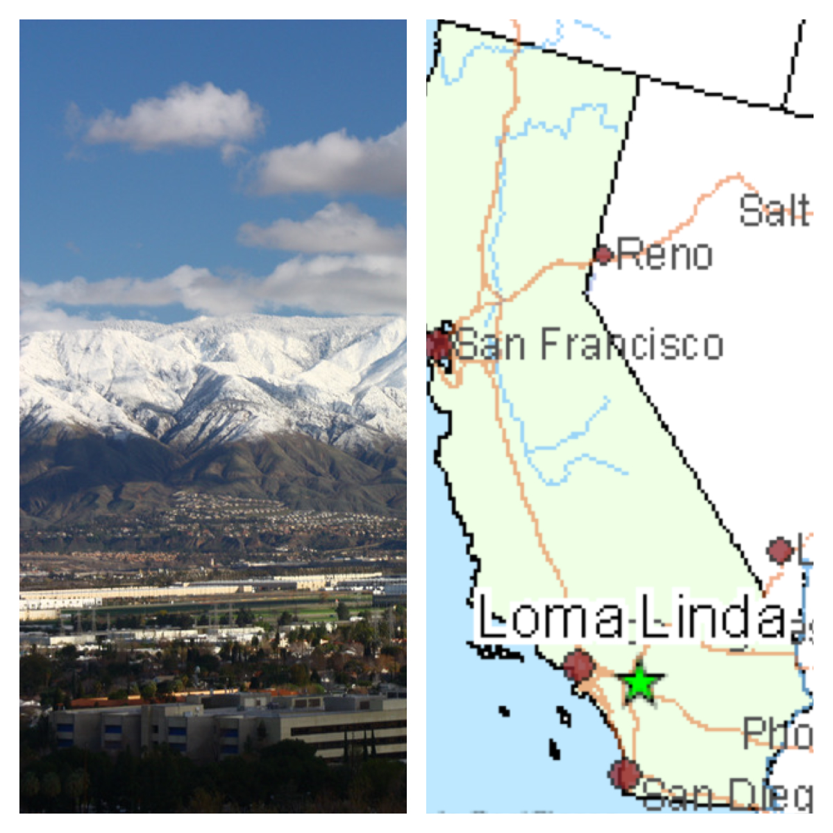
5. Loma Linda, California

Slide 7
PLATO:
“Fear old age, for it does not come alone”.
It comes with arthritis, heart disease, diabetes, hypertension, and cancer.
Chronological age is fixed.

Slide 8
PLATO:
“Fear old age, for it does not come alone”.
Biological age: Fluid, change, accelerate, slow down, even reverse.
Psychological age

Slide 9
THE EFFECTS OF AGING are preventable or at least delayed
THE BIOMARKER OF AGING -----
  Blood Pressure
  Bone Density
  Temperature Regulation
  Muscle Mass and Strength
  The ability to control metabolism
  Sex Hormone, &
  The immune function

Slide 10
Can all be improved or reversed. So biological age and chronological age need not be parallel
THE EFFECTS OF AGING
are preventable or at least delayed

Slide 11
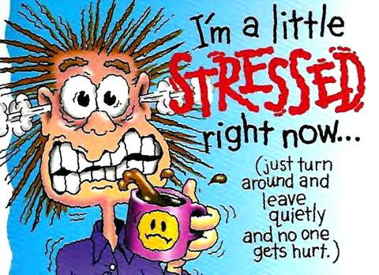
STRESS produces cortisol (the death hormone)
F
Fish – salmon just before dying
Adrenaline, nor adrenaline
Regulated by DNA’s active twin, RNA

Slide 12
THE EFFECTS OF AGING are preventable or at least delayed
B. AGING ----- entropy (decay) due to toxins: in environment, food, water, toxic relationships, toxic emotions.
All –ve emotions are toxic to the body, eg- fear, anger, jealously, envy, hatred, anxiety. An axe left in the open will rust.
This is due to Entropy or aging mechanism.

Slide 13
THE EFFECTS OF AGING are preventable or at least delayed
C. FREE RADICALS:
Unstable oxygen molecules that indiscriminately bind with the vital molecules in the body --- including the DNA, ie: they have an extra charge that must join with another molecule to become stable. They damage the body. They go up with- exercise, exposure to sun, air , food digestion.

Slide 14
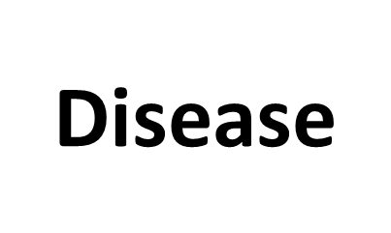
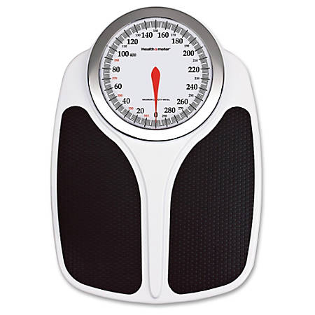


Wellness

Slide 15


Slide 16


Slide 17




Antidote: Prayer, meditation, yoga, & reading the scriptures reduces these DNE influenced by every thought.

Slide 18
Environment
External Internal Signals
Perception
Behavior Gene Activit

Slide 19
MIND
Environment
External, Internal, Signals
Perception
Behavior Gene Activity

Slide 20
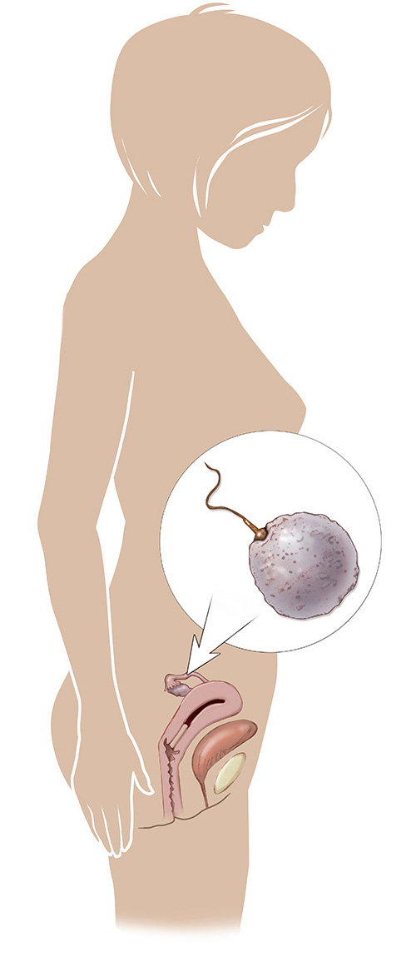
Mother’s Environment=Fetal Environment

Slide 21
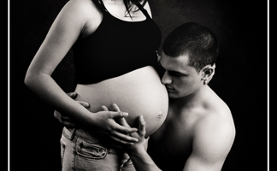

Slide 22
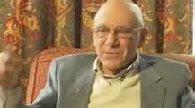
MIND & BODY
A. Our ability to see beauty in the mundane & take delight in the ordinary way contribute to agelessness, timelessness.
Bernie Siegel “THE POWER OF THE POSITIVE THINKING has not been understood or finally measured yet.”

Slide 23
MIND & BODY
B. The biological clock is influenced by and is a reflection of your awareness to time, space, & gravity so if I can transcend that in my mind my biological clock will respond accordingly.
So don’t let life be dictated by limitations of the time clock, self or egocentricity. Rather, Focus on what is REAL that is the reality of the eternal: ETERNAL GOD, ETERNAL PLACE, ETERNAL LIFE, ETERNAL YOUTH
Such a journey connects life to agelessness & timelessness

Slide 24
FREE YOURSELF from what’s controlling you. The past & the future---- both beyond your control. Be open only to the present ---- new experiences --- daily---- this is where you enjoy your ageless body.& timeless mind……… NOT TOMORROW, not next year,..
AND what happens to you is a result of how you see yourself in the present: Amazingly healthy, happy & wise.
Which is called “transcendant awareness of yourself” --- body, mind & soul.
Eg: Siddhartha & Vasudeva “Watching the river”

Slide 25
PHILLIPIANS 4:8
Finally, brethren, whatsover things are true, whatsoever things are honest, whatsoever things are just, whatsoever things are pure, whatsoever things are lovely, whatsoever things are of good report; if there be any virtue, and if there be any praise, think on these things.

Slide 26
That’s why the most vulnerable for a heart attack is soon after you retire.
The negative perception of life or negative emotions hurt us at the cellular level.
Each cell mirrors the damage ----- Depression, Sadness often leads to heart attacks & cancer.
POSITIVE emotions ------ healing, rejuvenation. In a sense our thought control our health.
“As a man thinketh, so is he” Proverbs 23:7
“Let this mind be in you which was also in Christ Jesus” Philipians 2:5
Hence the power of intentional living.

Slide 27
“AGE IS A MATTER OF THE MIND. IF YOU DON’T MIND, IT DON’T MATTER”!!
SO the mind influences every cell. Aging is fluid --- it can speed up, slow down, even reverse, depending on how you think.
ie: Perception becomes a reality.
That’s what quantum physics taught us.
“The accepted way of viewing the physical world was not accurate & there is no proof of reality, apart from the observer.

Slide 28
The “Heisenberg Principle” & “Schrodinger’s Cat”
So the Quantum theory smashed the old time space-solid mass model: You are not one big mass of tissue but there is immense space between each cell through which an enormous amount of communication and energy transfer occur.
Nutrino are bundles of energy which move between atoms which appear to be miles apart to the neutrino. Each atom is 99.999% empty space ---- all this goes on independent of the observation but controlled by your perception of life & the world.

Slide 29
THE NEXT FRONTIER
Quantum physics (quantum life) & mind - body medicine --- may destroy aging & take us closer to the Fountain of youth.
CONCEPTS: neither time or space is absolute or static, but are dynamic both without & within our bodies. So what influences this dynamic aspect in every organ, every cell?
What we Eat ---- drink ---- breathe --- and think.
“EVERY CELL changes to every thought”
Depressed immune function takes a hit
HAPPY ------------(fall in love) --------rejuvenated
DESPAIR , HOPELESSNES ------------ Heart attack, Cancer
FULFILLMENT: Health & Longevity

Slide 30
THE NEXT FRONTIER
2. MEMORY: Just remembering a stressful event - brings an outpouring of stress hormones as though you are living the same event all over again. So psychology & Biology are interconnected.
HYPNOSIS of SOCIAL CONDITIONING vs INTENTIONAL LIVING
“WE all grow old & die” “My life is almost over”
“ A few more years & I wont be around” Conditioning--- as opposed to

Slide 31
THE NEXT FRONTIER
“I am just getting started” (at retirement)
“You are only as old as you THINK you are”
Q: “How old do you think you are?”
“What is a thought -----? “

Slide 32
YOU HAVE TWO HEMISPERES
LEFT BRAIN
LOGIC
WORDS
PARTS
ORDER/CONTROL
RIGHT BRAIN
EMOTIONS
PICTURES
WHOLE
SPONTANEOUS/ FREE

Slide 33
THE MIND IS NOT THE BRAIN
Mind is energy that interpenetrates the brain and bodyk i.e. photons of light held in an electromagnetic field
The brain is the gray matter inside your cranium. It’s like the CPU chip in a computer.

Slide 34
Beliefs are filters for Reality you see the world NOT as IT IS..
But as you ARE!

Slide 35
Beliefs are conclusions, derived from formulation and/or experience. Beliefs can be both conscious and subconscious.

Slide 36
Your beliefs determine
Your biological and Behavioral Reality

Slide 37
Epigenetic Control
1 Gene = >30,000 Different Protein

Slide 38
Conscious Mind
Volitional – Sets Goals and Judges
Results…Likes to Try New things
Subconscious Mind
Habitual – Monitors Operation of the Body…e.g. Motor Functions, Heart Rate, Digestion, etc… It Prefers the Familiar

Slide 39
Have you ever tried to change your mind only to find out that your mind has a mind of it’s own?
The last ime:
…you promised yourself you’d get in shape
…you made a New Year’s resolution
…you tried to quit smoking
…you swore you’d never get involved with another person
Add your personal favorites here!

Slide 40
Beliefs “control” perception
Rewrite beliefs and you rewrite perception
Rewrite perception and you rewrite genes and behavior!
Perception is Awareness
Shaped by Belief

Slide 41
Beliefs create perception that affect your….
Self-Esteem
Relationships
Prosperity
Job Performance
Mental Health
Physical Health
Spiritual Outlook
And More……

Slide 42
“I CAN’T” Messages
You’ll never amount to anything
You’re worthless
You’re not smart enough
No matter how hard you try it’s never good enough
Money is hard to come by and hard to keep
You don’t deserve to succeed
No one will ever love you
You’re going to get cancer, because it’s genetic

Slide 43
“I CAN” Messages
I can accomplish anything I choose
I am a worthy and valuable person
I am intelligent and capable
I do my best and my best is good enouth
I easily attract money into my life and use it wisely
I deserve happiness and success in my life
I love myself and I am loved by others
My beliefs control my genes and I control my belief

Slide 44
MYTHS & FACTS ABOUT CHANGING BELIEFS
Myth #1
I you’ve had a limiting belief for a long time it will take a long time to change it.
Fact: Most of the time, changing subconscious beliefs is lke changing a document in a computer. It doesn’t take any longer to change a document that has been in your computer for 30 years thatn it does one that has been there for 30 minutes

Slide 45
Myths & Facts about changing Beliefs
Myth #2
Changing old behaviors and thought patterns is difficult and often painful
Fact:
Thought patterns and behaviors are caused by perception (beliefs). Beliefs are represented by specific configurations or photons of light held in an electromagnetic field. Change the field and you change the belief. Change the belief and you change the behavior or thought pattern

Slide 46

THE MOST POTENT FORCE IN THE UNIVERSE IS LOVE!

