Slide 1
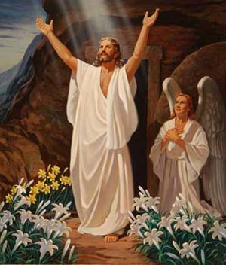
RESURRECTION OF JESUS
BASED ON DESIRE OF AGES CHAPTER 81
Notes:
Good morning and Happy Sabbath. The Christian world celebrated Easter last Sunday commemorating the resurrection of Jesus Christ. So, in the spirit of Easter, I chose my message to meditate on the resurrection of Jesus Christ and what it means to us. I want us to turn our hearts and minds heavenward and thank God for everything that we have endured thus far. So please join me IN PRAYER.
Dear Heavenly Father in the name of Jesus, our risen savior we come to you this Sabbath morning realizing that you are the giver of life, life eternal. Our redeemer who conquered death and rose from the grave. We worship you and adore you as we come before the throne. Please accept our worship and come close to us. Bless each one of us who has gathered here. May your name be glorified in everything we say.
In Jesus' precious name. Amen.

Slide 2
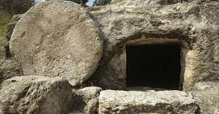
HE IS NOT HERE, HE IS RISEN
Notes:
Five-year-old Brian had a pivotal verse to recite in an Easter program:
“He is not here, he is risen” (Luke 24:6). Unfortunately, he could not remember what to say, and the director had to quietly remind him of his line. He then confidently grabbed the microphone and triumphantly shouted, “He’s not here; He’s in prison!”
we laugh it off for a child's forgetfulness. Come to think of it, Satan thought he had him in prison when Christ died on the cross and was put in the grave.

Slide 3
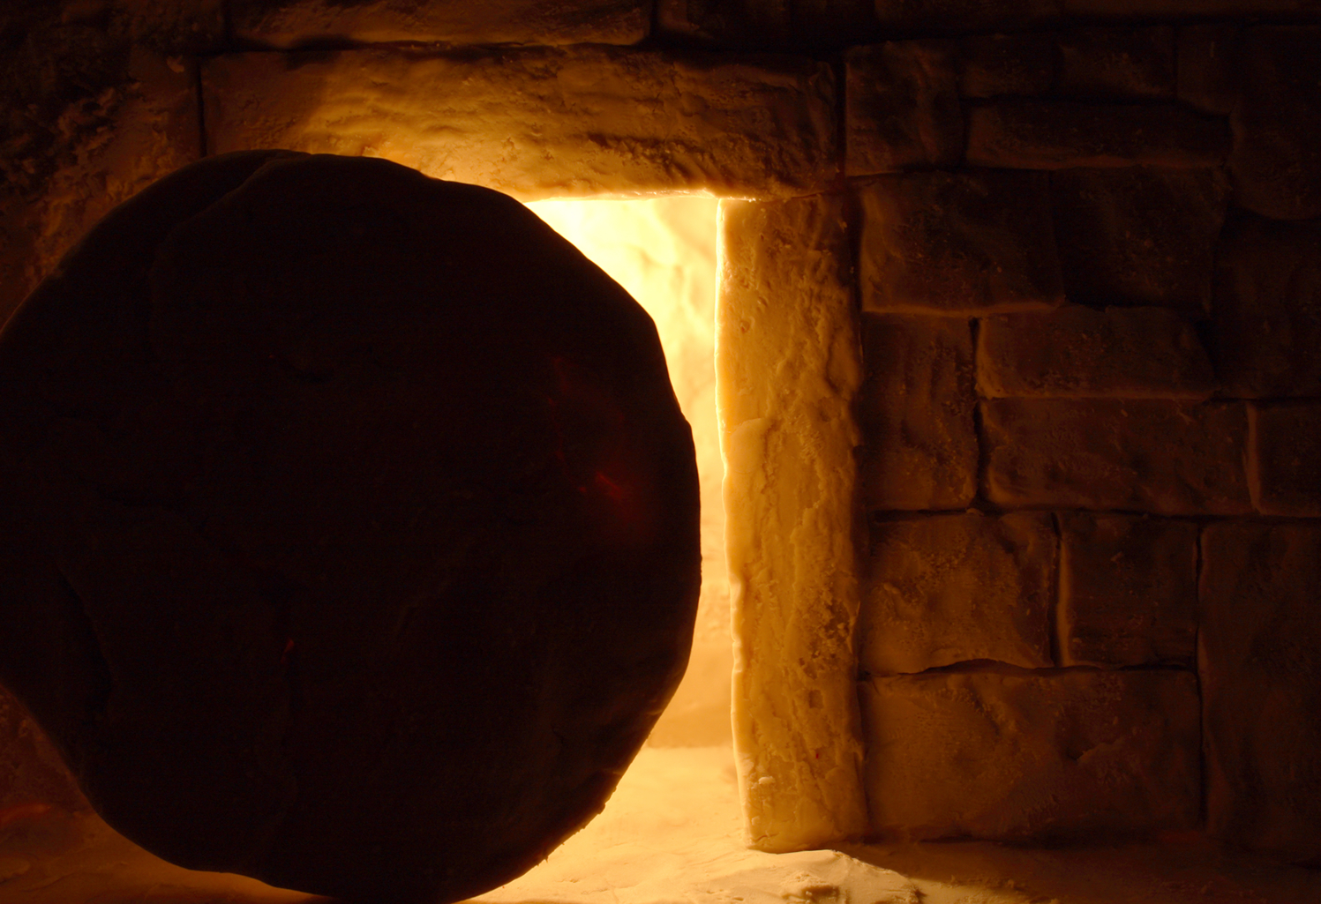
Notes:
Ellen White says in Desire of Ages.
The night of the first day of the week had worn slowly away. The darkest hour, just before daybreak, had come. Christ was still a prisoner in His narrow tomb.
The great stone was in its place; the Roman seal was unbroken; the Roman guards were keeping their watch.
And there were unseen watchers. Hosts of evil angels were gathered about the place.
Had it been possible, the prince of darkness with his apostate army would have kept forever sealed the tomb that held the Son of God. But a heavenly host surrounded the sepulcher. Angels that excel in strength were guarding the tomb and waiting to welcome the Prince of life.

Slide 4
RESURRECTION OF JESUS
Notes:
Christ came forth from the tomb glorified, and the Roman guard beheld Him.
Their eyes were riveted upon the face of Him whom they had so recently mocked and derided. In this glorified Being, they beheld the prisoner whom they had seen in the judgment hall, the one for whom they had plaited a crown of thorns.
This was the One who had stood unresisting before Pilate and Herod, His form lacerated by the cruel scourge. This was He who had been nailed to the cross, at whom the priests and rulers, full of self-satisfaction, had wagged their heads, saying, "He saved others; Himself He cannot save." Matthew 27:42.
This was He who had been laid in Joseph's new tomb. The decree of heaven had [781] loosed the captive. Mountains piled upon mountains over His sepulcher could not have prevented Him from coming forth.

Slide 5

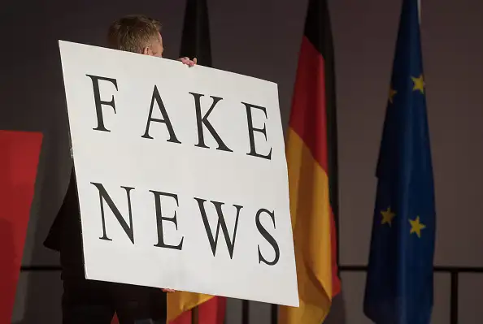
FAKE NEWS
Notes:
A lying report was then given to the soldiers. "Say ye," said the priests, "His disciples came by night, and stole Him away while we slept." Here the priests overreached themselves.
How could the soldiers say that the disciples had stolen the body while they slept? If they were asleep, how could they know?
And if the disciples had been proved guilty of stealing Christ's body, would not the priests have been first to condemn them?
Or if the sentinels had slept at the tomb, would not the priests have been foremost in accusing them of Pilate?

Slide 6
When Jesus was laid in the grave, Satan triumphed. He dared to hope that the Savior would not take up His life again.
He claimed the Lord's body, and set his guard about the tomb, seeking to hold Christ a prisoner. He was bitterly angry when his angels fled at the approach of the heavenly messenger.
When he saw Christ come forth in triumph, he knew that his kingdom would have an end, and that he must finally die.

Slide 7

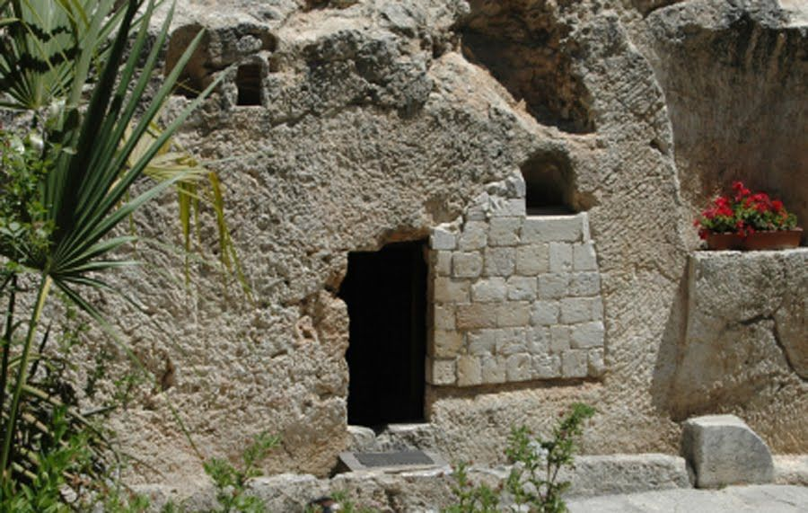
Notes:
There are two primary sites in Jerusalem that are identified as possible locations where Jesus was buried. They are the Church of the Holy Sepulcher and the Garden (also known as Gordon's) tomb.
The church is believed to have been consecrated and built in 335 A.D., demolished in 1009, and rebuilt in 1048.
In 1842 A.D. a man by the name of Otto Thenius proposed that the place where the Lord was crucified, called Calvary (Golgotha) in Scripture, was the same as the place called the 'place of the skull.' In 1867 A.D., the discovery of a garden tomb (shown in the picture above) occurred near the place of the skull.

Slide 8
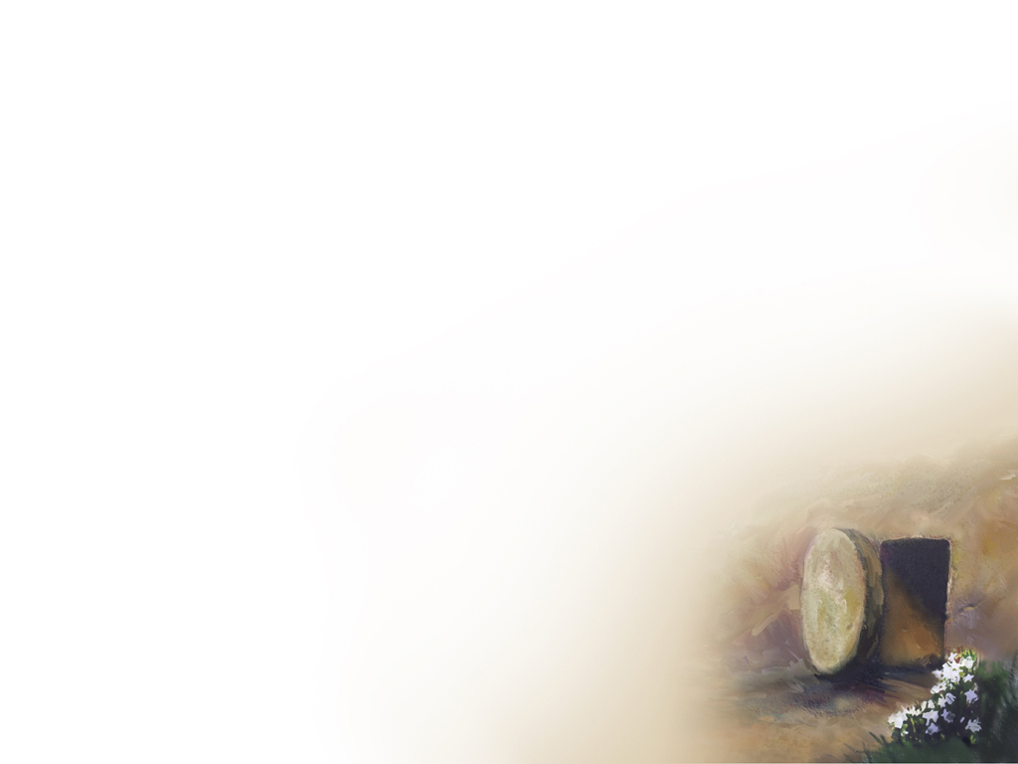
A lot of people say, "I believe in the resurrection; I just don't understand it." George Gallup did a poll that said 84 percent of people who never
go to church believe Jesus rose from the dead. It is historical fact; it wasn't done in
secret.
Notes:
According to the survey,

Slide 9
The proclamation of what happened on Resurrection morning is the pivotal point in human history, but it's often not as well known as the Christmas story.
Let us turn to Mark 16: 1- 8

Slide 10
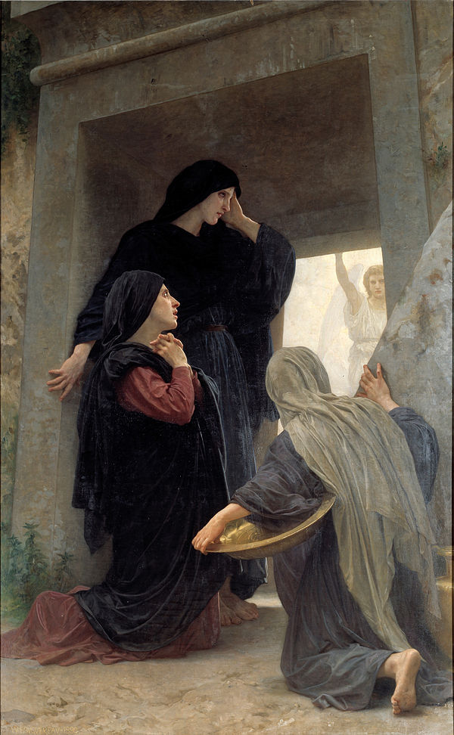
Notes:
All the four Gospels record the story of the resurrection. We see Mary Magdalene, Mary the mother of James, and Salome bought spices so that they might go to anoint Jesus’ body.
Let us read the full account in Mark 16: 1 - 8

Slide 11
When the Sabbath was over, Mary Magdalene, Mary the mother of James, and Salome bought spices so that they might go to anoint Jesus’ body. 2 Very early on the first day of the week, just after sunrise, they were on their way to the tomb 3 and they asked each other, “Who will roll the stone away from the entrance of the tomb?”
4 But when they looked up, they saw that the stone, which was very large, had been rolled away.
Notes:
Please follow this passage in your Bibles.
V. 4 ". . . . . . the stone which was (what) large had been rolled away."
When you face large stones on your way to worship the Lord. You will have some obstacles. They are not small but large stones. You will be worried, Who will roll away the stone? Then when you take the journey of faith. When you walk in faith. And when you reach there, you will find that the stone is not there.
The stone is rolled away. Evidence, you will see the Angels in person,

Slide 12
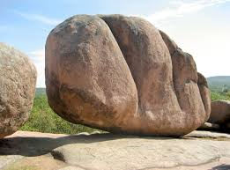
THE STONES THAT ARE OBSTRUCTING YOUR LIFE.
Notes:
WHAT ARE THE STONES ARE YOU FACING?
1. FEAR
2. DOUBT
3. STRESS
4. CROWD
5. IDENTITY
4. SICKNESS
5. FINANCE
6. ACCEPTANCE
MAYBE YOU HAVE A LONGER LIST. OR NONE THAT IS MENTIONED HERE.

Slide 13
5 As they entered the tomb, they saw a young man dressed in a white robe sitting on the right side, and they were alarmed. 6 “Don’t be alarmed,” he said. “You are looking for Jesus the Nazarene, who was crucified. He has risen! He is not here. See the place where they laid him. 7 But go, tell his disciples and Peter, ‘He is going ahead of you into Galilee. There you will see him, just as he told you.” 8 Trembling and bewildered, the women went out and fled from the tomb. They said nothing to anyone, because they were afraid.

Slide 14
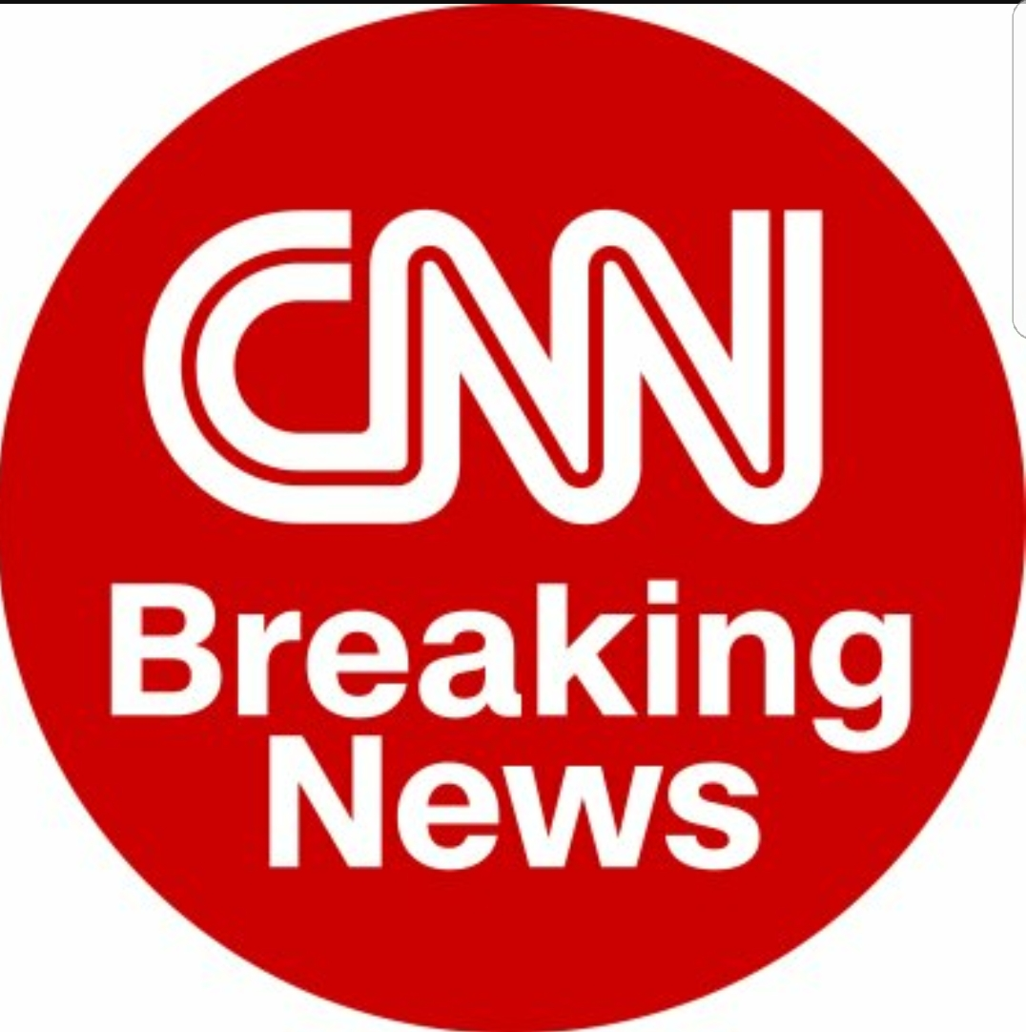
It was big news. If CNN had been there, they would have had it live
Notes:
They would have broadcast on CNN every hour. Body missing from the grave even with the tight security around it.
But the women were afraid to say that Jesus was alive. He rose from the grave. But they did follow the instruction of the angels and shared it with the eleven disciples and others.

Slide 15
There are at least 15 historical references to Jesus meeting people, touching people, and talking with people after he had been crucified. One time he cooked breakfast for some people. One time he talked to about 500 people after he had risen from the dead. A lot of people saw him.
Notes:
He had one on one conversation with couple of people on Emmaus Road.

Slide 16
But what does the resurrection mean?
It means three things:
(1) Jesus is who he claimed to be;
(2) Jesus has the power he claimed to have; and
(3) Jesus did what he promised to do.
Notes:
We are going to go more deeper into understanding these three things.

Slide 17
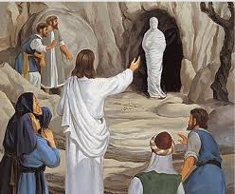
1. The resurrection means Jesus is who he claimed to be
Notes:
You remember at the tomb of Lazarus, Jesus said John 11:25 says, "I am the resurrection and the life. He who believes in me will live, even though he dies."

Slide 18
The resurrection means Jesus is who he claimed to be
John 11:25 says, "I am the resurrection and the life. He who believes in me will live, even though he dies."
Jesus made some outrageous claims when he was here on earth. He said things like, "I'm God. I'm perfect. I'm the only way to heaven. I'm the savior of the world."
Notes:
I could teach you good moral truths, and you might say, "If I am a good teacher."
But if I started calling myself God, you wouldn't think I was a good teacher anymore.
Jesus was either who he said he was, or he was the biggest liar who ever lived.

Slide 19
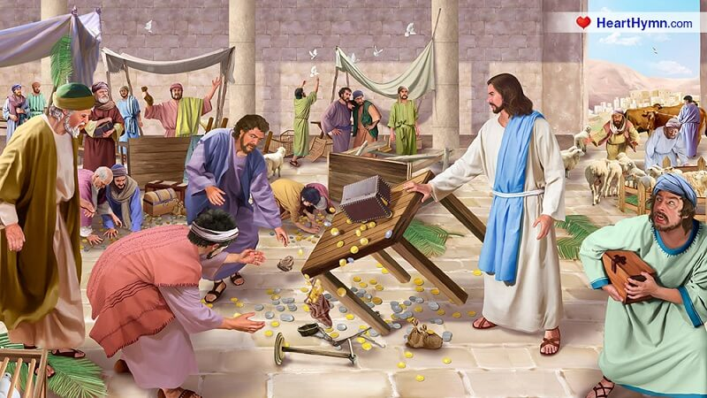
One day Jesus cleared the money changers out of the temple
Notes:
Do you remember the day Jesus cleared the moneychangers out of the temple.
They had turned the temple into something like a flea market, so he drove them all out.

Slide 20
They said, "What right do you have to do this?" He said, "Because I'm God." They said, "Prove it!"
He said, "I will. Three days after you kill me, I'm going to come back to life."
He claimed to be God, and his resurrection backs up what he claimed to be.
Notes:
Remember that encounter in the temple?

Slide 21
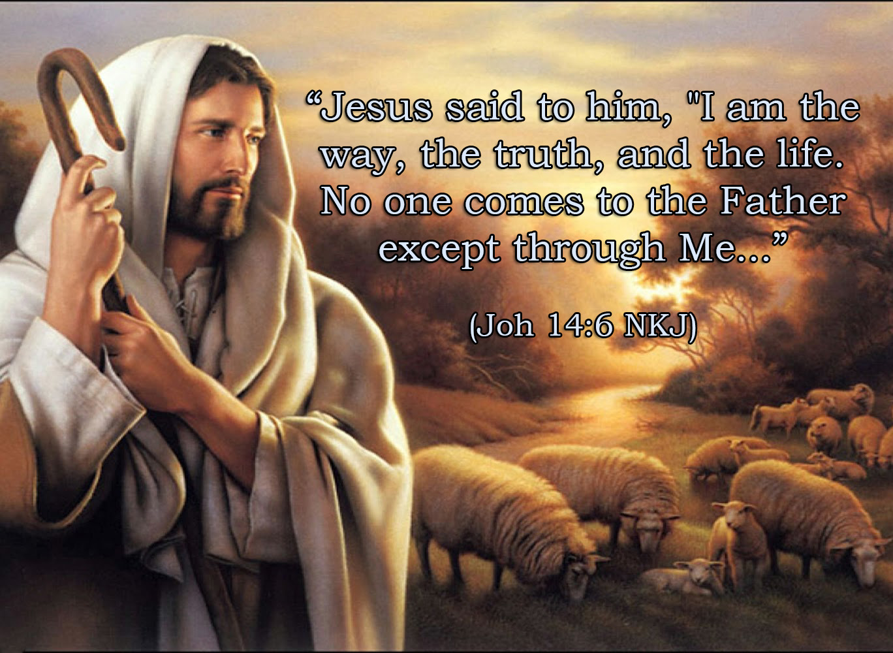
Notes:
Not only that, Jesus said, That's a strong claim.
He said, "I'm the way." He didn't say, I'm one way, I'm a good way, or I'm one of the ways.
Saying "all roads get to heaven" is stupid.
That's like saying I can dial any phone number and get home

Slide 22
There's only one number that will get me home.
Jesus said, "I am the truth." That means any other way is not the truth. He claimed to be God. He said, "No one can get to God the Father except by me."

Slide 23
Even if you don't believe Jesus Christ is one who he said he was, you still use him as a reference point. God came to earth in the form of a man so we could know what God is like.
His name was Jesus Christ. He split all of history into A.D. and B.C. Every time you write a date, Jesus is the reference point. He is who he claimed to be.

Slide 24
The focal point of time itself is centered on the birth of Christ and is the dividing point of time in world history.
Notes:
All the people in the world celebrate Jesus by acknowledging the timeline.

Slide 25
2. The resurrection means Jesus has the power he claimed to have
Jesus said, "All power on earth and in heaven is given to me." Because he is God, he can do everything God can do.
In John 10:18 he says: "Nobody takes my life from me. I have the power to lay
it down, and I have the power
to take it up again."
Notes:
The next power of resurrection. What is it, The resurrection means Jesus has the power he claimed to have.

Slide 26
3. The resurrection means Jesus did what he promised to do
In Mark 10:34 Jesus says: "They will mock and flog and kill me, but after three days I will come back to life.”
The cross was no surprise to Jesus. It was all part of God's plan.
Notes:
No force could keep Jesus in the tomb. The Romans killed him, put him in a tomb, put a big stone in front, sealed it with the Roman seal, and posted a 24-hour guard.
They were only trying to prevent the inevitable. Jesus said: They can't stop me. I can give my life away, and I can take it up again.
Maybe that's where they get the phrase, "you can't keep a good man down"!

Slide 27
He did what he promised. When God makes a promise, you can count on it
That's what Easter means. Because Jesus did rise, he is who he said he was, he has the power he said he had, and he keeps the promises he makes.
Why does the resurrection matter? What difference does it make?
It matters for three reasons.
1. Jesus is who he claimed to be,
2. Jesus has the power he claimed to have and does.
3. Jesus did what he promises to do.
Notes:
The angel said: "Don't be frightened. I know you're looking for Jesus, who was crucified. But he isn't here. He's come back to life again, just as he said he would.” He did what he promised. When God makes a promise, you can count on it. That's what Easter means. Because Jesus did rise, he is who he said he was, he has the power he said he had, and he keeps the promises he makes.

Slide 28
The resurrection matters because my past can be forgiven
Here's the good news. Colossians 2:14 says: "He has forgiven all our sins and canceled every debt we owe. Christ has done away with it by nailing it to the cross.”
That means I don't have to pay for it. He was hung for my hang-ups. Jesus Christ was nailed to the cross, so I can quit nailing myself to the cross. He wants to forgive your past. He wants to cancel every debt you owe—emotional debts, relational debts, sins. All canceled.
Notes:
Can you say Amen to that? Here's the good news. Colossians 2:14 says: "He has forgiven all our sins and canceled every debt we owe. Christ has done away with it by nailing it to the cross.”

Slide 29
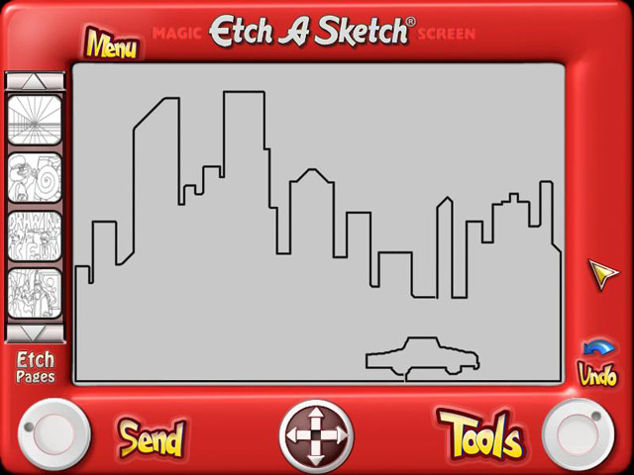
Notes:
Are you familiar with this toy. An Etch A Sketch has a thick, flat gray screen in a red plastic frame. There are two white knobs on the front of the frame in the lower corners. Twisting the knobs moves a stylus that displaces aluminum powder on the back of the screen, leaving a solid line. The knobs create lineographic images. The left control moves the stylus horizontally, and the right one moves it vertically.

Slide 30
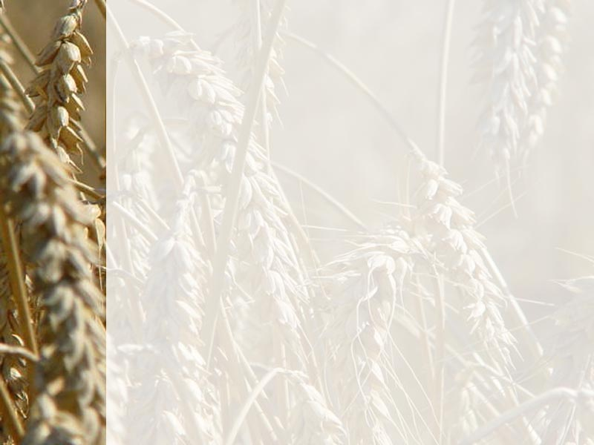
Etch-A-Sketch?
Those of you who are baby boomers, do you remember having an Etch-A-Sketch? What happens if you mess up the picture? You flip it, shake it, turn it back over, and there's a clean slate. This is God's Etch-A-Sketch verse in the Bible. He wants to wipe our slate clean.
Notes:
You get back a clean slate. All the mess is gone. The resurrection matters because my past can be forgiven. That's good news. Have you ever been halfway through a project and wished you could start over? A lot of times people feel that way about life. They get halfway through life and wish they could start over. We have all done things we wish we hadn't done, said things we wish we hadn't said, and thought things we wish we hadn't thought. We all have regrets. We all feel bad about things. We all have guilt.
You can walk out of here today, knowing that every single thing you've ever done wrong until this point is completely forgiven. That is good news. That is news I can use. No condemnation, Jesus Christ did not come to rub it in; he came to rub it out. He said: "I didn't come to condemn the world; I came to save it. I want to change you, I want to help you, I want to give you a new beginning, I want to give you a clear conscience."

Slide 31
The resurrection matters because my present problems can be managed
Charlie Shedd, an author, wrote: "Before we had kids, I used to travel across the country giving a lecture I called, 'The Ten Commandments for Raising Perfect Kids.'" After he and his wife had their first child, he changed the title to "Ten Hints for Parents." After their second child, he relabeled the lecture, "A Few Tentative Suggestions for Fellow Strugglers." He said after the arrival
of their third child, he gave up speaking
on the topic altogether.
Notes:
Maturity is when you figure out you can't have it all figured out. Maturity is when you realize you can't manage all life is going to send you. But God can. And that's good news. I can't control everything in my life, but God can. So I want to hook up with him and let him control it and ask him for help.

Slide 32
I talk to many people, and the number one complaint I hear from people today is this: "My life is out of control." I hear it a thousand times: "I feel powerless to change the situation.
I feel powerless to break a bad habit.
I feel powerless to save a relationship.
I feel powerless to get out of debt.
I feel powerless to manage my time and my schedule.

Slide 33
What you need is a power greater than yourself. You were never meant to live this life in your own power. God wants to have a relationship with you. And here's the good news:
Ephesians 1:19-20 says: "How incredibly great is his power to help those who believe him, the same mighty power that raised Christ from the dead."

Slide 34
In an article written a year before The Desire of Ages Sister White wrote: “In him was life, and the life was the light of men” (John 1:4). It is not physical life that is here specified, but immortality, the life which is exclusively the property of God.
The Word, who was with God, and who was God, had this life. Physical life is something that each individual receives. It is not eternal or immortal; for God, the Life-giver, takes it again. Man has no control over his life. But the life of Christ was unborrowed. No one can take this life from Him. “ I lay it down of myself” (John 10: 18),

Slide 35
She said, In Him was life, original, unborrowed, underived. This life is not inherent in man. He can possess it only through Christ. He cannot earn it; it is given him as a free gift if he will believe in Christ as His personal Savior. “This is life eternal, that they might know thee the only true God, and Jesus Christ, whom thou hast sent” (John 17:3). This is the open fountain of life for the world.” {The Signs of the Times, April 8,1897 quoted in Selected Messages Book 1, pp. 296, 297}
Notes:
What kind of life was in Jesus Christ in His incarnation? Un- Borrowed, underived, original.

Slide 36
The same power that enabled Jesus to rise from death will help you rise above your problems. The same power God used at the resurrection 2,000 years ago can be used in your life right now. You don't know what the future holds. I don't either.
I don't know what's going to happen next year, next month, next week. I don't know what's going to happen tomorrow, and neither do you. But it doesn't matter, because even though it's out of my control, it's not out of God's. He will give me the power to face it.
Notes:
Please listen to me carefully. Here is the message of the Resurrection of Christ.
The Power of Resurrection will help you rise above your problems.

Slide 37
Finally, The resurrection matters because my future can be secure
One of the universal problems we've all got is death. Let's face it—everybody dies. I'm going to die someday, and so are you. Only a fool would go all through life unprepared for something he knows is inevitable. That doesn't make sense. But sometimes we get so busy in the here and now, we don’t
stop to think about what's going to come.

Slide 38
The fact is everybody has a deep internal longing to know, "What's going to happen after I die?" It's obvious we're going to spend more time on that side of eternity than on this side. Here we only spend 60, 70, maybe 80 years. This is just the first inch of the yardstick. This is preschool for what's going to happen in eternity. It is interesting to me that as 78 million baby boomers move into middle age, all of a sudden they're becoming more interested in the hereafter.
Notes:
As a Pastor, I have conducted scores of funeral services. Every time I conduct a graveside service, every time I commit a body to the ground earth to earth, ashes to ashes, and dust to dust, I commit that person to the ground in the sure and certain hope of a joyful resurrection when our Lord shall return in glory.
Paul Writes in 1 Corinthians 15:14
¹⁴ And if Christ be not risen, then is our preaching vain, and your faith is also vain.

Slide 39
U.S. News & World Report ran a cover article called, "The Rekindling of Hell."
It says more people believe in heaven and hell than ever before in American history. Why? Because people are wondering, "What's going to happen?”
There are a lot of misconceptions about heaven. Most of them come from movies with bad theology: Heaven Can Wait; Oh, God; All Dogs Go To Heaven. These are cute little ideas of what somebody thinks heaven is going to be like.

Slide 40
What is it really going to be like? Let's check it out with the source. When you go to the Bible, what does God say it's really going to be like in heaven and hell?
Number one, heaven is a perfect place. Total love, total peace, total joy, total perfection. No sin, no mistakes, no evil, no bad, no errors. It's perfect in every area.

Slide 41
The story of the resurrection is not just good news; it's true news. And when Jesus says, "Whoever lives and believes in me will never die," that is not a metaphor or some vague hope. It means that death has no power to take you from the arms of the Father. Guilt cannot separate you from God. Whatever bad news you face, if you have crossed that line, if you have trusted Jesus, you have a resurrection coming.

Slide 42
To the elderly person whose health is frail, almost gone, you don't have to live in fear. You have a resurrection coming.
To the devastated husband whose wife has left you, and you feel betrayed and alone, you don't have to live like a loser. You have a resurrection coming.
To the frightened parents of a depressed child, you don't have to live burdened by this weight of blame. You have a resurrection coming.

Slide 43
To the anxious worker who has lost their job, you have a resurrection coming.
To the guilt-ridden addict hiding in the shadows, you have a resurrection coming.
To the lonely young person longing to be loved, you have a resurrection coming.

Slide 44
Jesus Christ's resurrection can transform the way I live and the way I die
Whoever you are, if you have taken the all-important step of faith, you are living in a new reality. The Father's arms are plenty strong. They have not lost any of their power, and they will pick you up. Resurrection is coming.

Slide 45

      A story is told of an African Muslim who became a Christian. His friends asked, “Why have you become a Christian?”
He answered, “Well, it’s like this. Suppose you were going down the road and suddenly the road forked in two directions, and you didn’t know which way to go. There at the fork were two men, one dead and one alive—who would you ask which way to go?”

Slide 47

Notes:
I want us to meditate on these words before we sing the closing song. #526 "Because He Lives." That is the message of Resurrection.

