Slide 1

Are You
A MONOMANIAC?

Slide 2
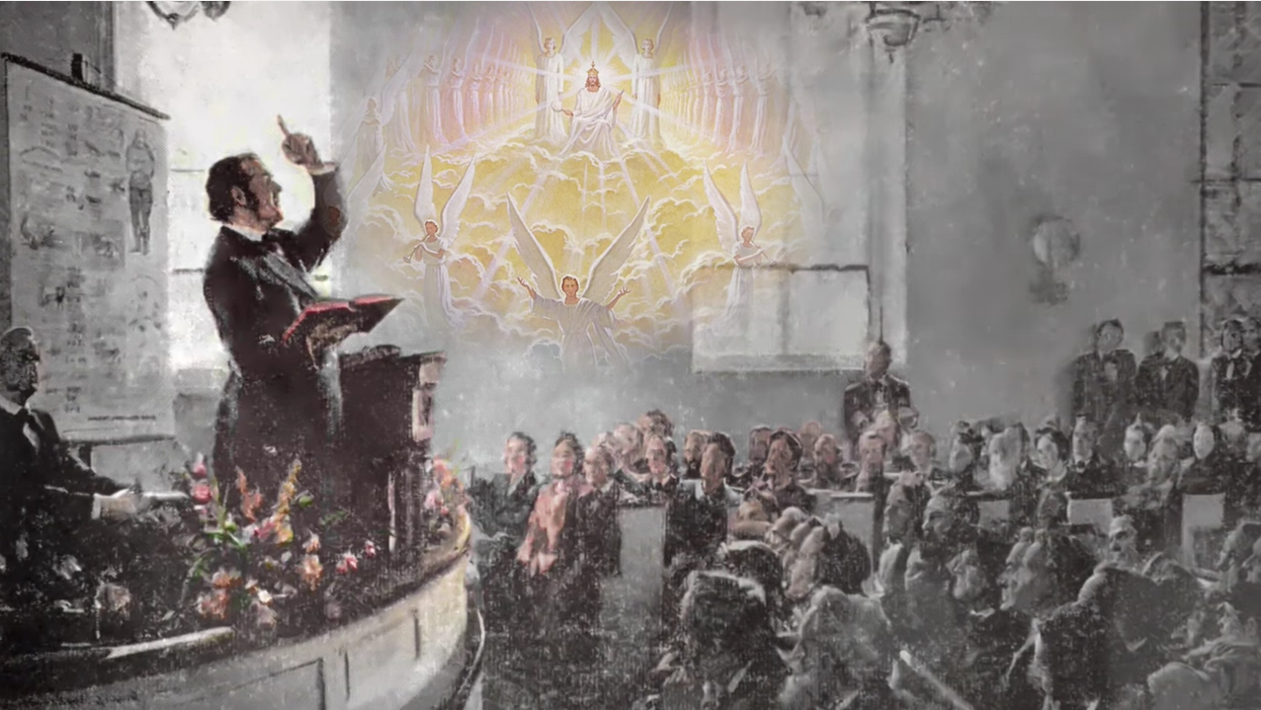

Slide 3
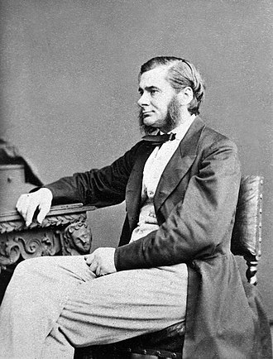
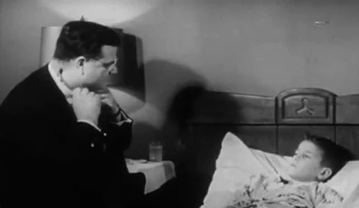
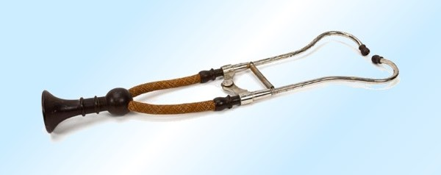

Slide 4
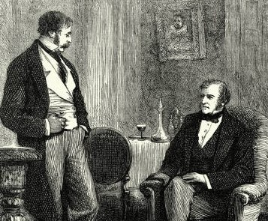


Slide 5
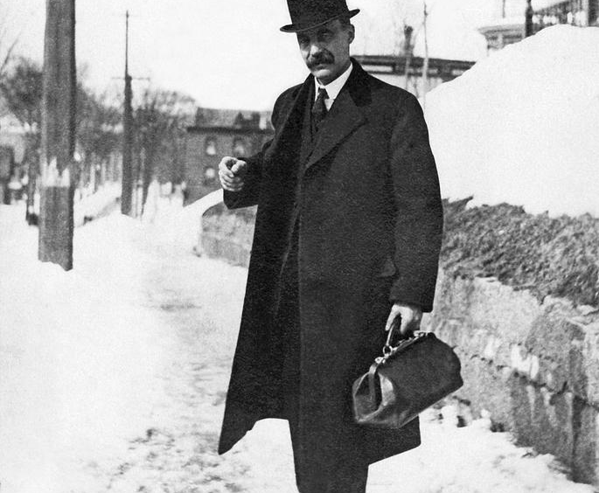

Slide 6

William Miller
Manuel Lacunza
Advent Pioneers
Fulfilled--Timing
Preached
Leviticus 23:23-25
Daniel 8:14
Fulfilled--Message
Revelation 14:6,7

Slide 7
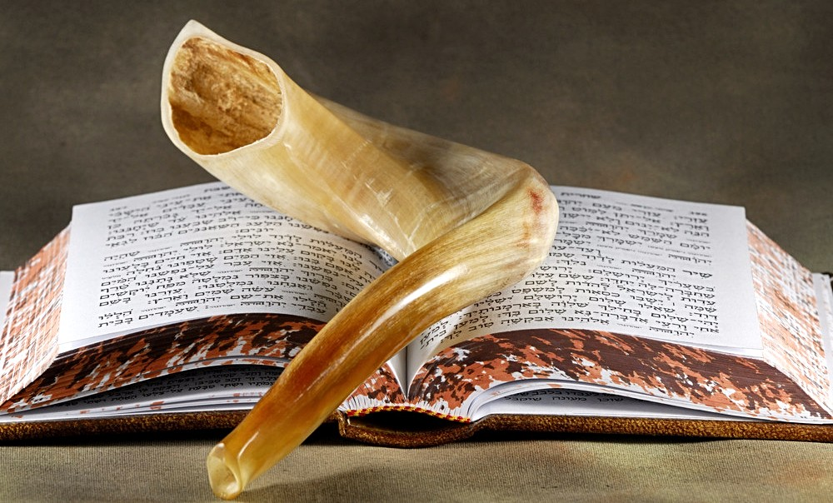
And the LORD spake unto Moses, saying,
Speak unto the children of Israel, saying, In the seventh month, in the first day of the month, shall ye have a sabbath, a memorial of blowing of trumpets, an holy convocation.
Ye shall do no servile work therein: but ye shall offer an offering made by fire unto the LORD.
Leviticus 23:23-25

Slide 8
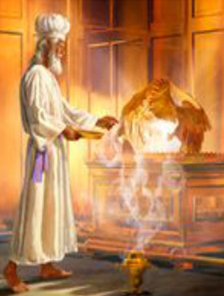
And he said unto me, Unto two thousand and three hundred days; then, shall the sanctuary be cleansed.
Daniel 8:14

Slide 9
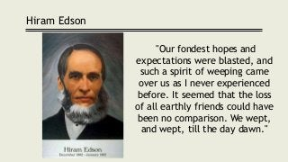

Slide 10
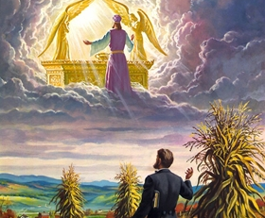
100,000
50 (.05%)

Slide 11
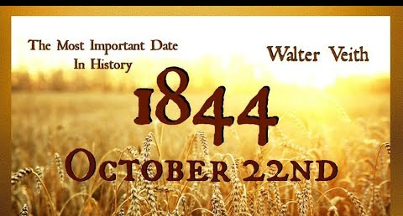

Slide 12
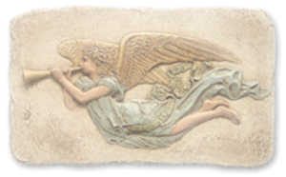
And I saw another angel fly in the midst of heaven, having the everlasting gospel to preach unto them that dwell on the earth, and to every nation, and kindred, and tongue, and people, Saying with a loud voice, Fear God, and give glory to him; for the hour of his judgment is come: and worship him that made heaven, and earth, and the sea, and the fountains of waters.
Revelation 14:6-7

Slide 13

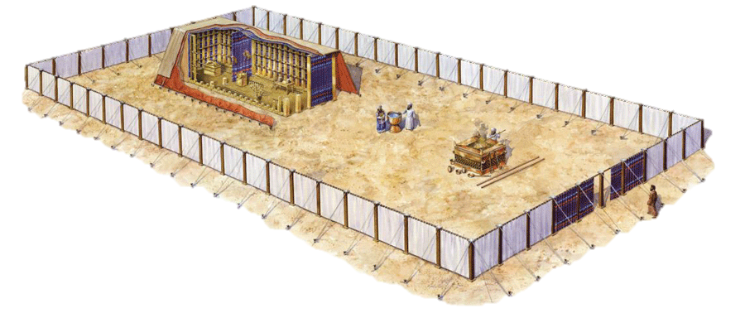
God’s Salvation Plan Illustrated

Slide 14
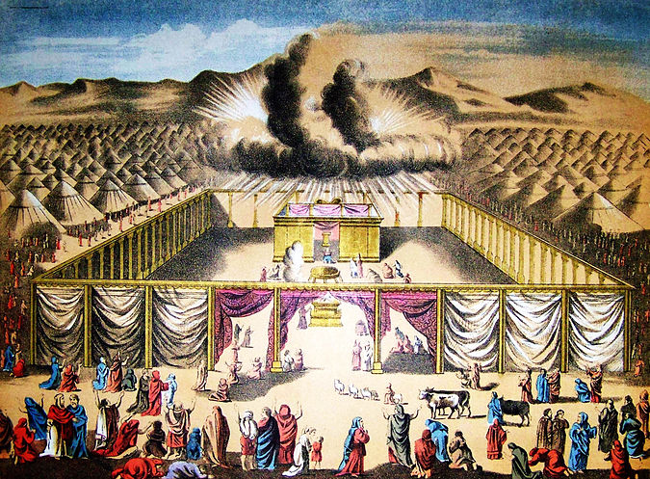
350 days of asking forgiveness for inadvertent and unknown sins
nine days of preparing for the atonement day, but still asking forgiveness daily
one day of agonizing, fasting, prayer, afflicting of soul, and still asking forgiveness

Slide 15

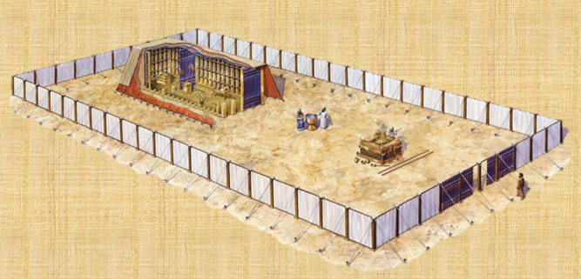

By denomination: Protestantism in the United States according to the Pew Research Center (2014)[7]
Affiliation | % of U.S. population
Protestant | 46.5
Other denomination | 25.2
Southern Baptist Convention | 5.3
United Methodist Church | 3.6
American Baptist Churches USA | 1.5
Churches of Christ | 1.5
Evangelical Lutheran Church in America | 1.4
National Baptist Convention, USA, Inc. | 1.4
Assemblies of God USA | 1.4
Lutheran Church-Missouri Synod | 1.1
Presbyterian Church (USA) | 0.9
Episcopal Church | 0.9
Church of God in Christ | 0.6
Seventh-day Adventist Church | 0.5
United Church of Christ | 0.4
Presbyterian Church in America | 0.4
Church of God (Cleveland, Tennessee) | 0.4

Slide 16
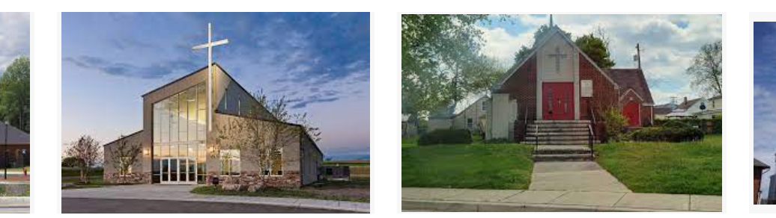
The enemy will bring in false theories, such as the doctrine that there is no sanctuary. This is one of the points on which there will be a departing from the faith. Where shall we find safety unless it be in the truths that the Lord has been giving for the last fifty years?-- Review and Herald, May 25, 1905. {CW 53.2}
Satan is striving continually to bring in fanciful suppositions in regard to the sanctuary, degrading the wonderful representations of God and the ministry of Christ for our salvation into something that suits the carnal mind. He removes its presiding power from the hearts of believers, and supplies its place with fantastic theories invented to make void the truths of the atonement, and destroy our confidence in the doctrines which we have held sacred since the third angel's message was first given. Thus he would rob us of our faith in the very message that has made us a separate people, and has given character and power to our work.--Special Testimonies, Series B, No. 7, p. 17. (1905.) {CW 53.3}

Slide 17
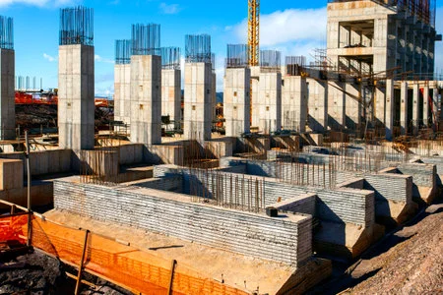
The correct understanding of the ministration in the heavenly sanctuary is the foundation of our faith.--Letter 208, 1906.
The subject of the sanctuary and the investigative judgment should be clearly understood by the people of God. All need a knowledge for themselves of the position and work of their great High Priest. Otherwise, it will be impossible for them to exercise the faith which is essential at this time, or to occupy the position which God designs them to fill. {Ev 221.3}

Slide 18
Those who have a hold of the truth theoretically, with their fingertips as it were, who have not brought its principles into the inner sanctuary of the soul, but have kept the vital truth in the outer court, will see nothing sacred in the past history of this people which has made them what they are...They will accept that which pleases their ideas and will begin to manufacture another foundation than that which is laid. 2SM 388-89

Slide 19
Every position of truth taken by our people will bear the criticism of the greatest minds; the highest of the world's great men will be brought in contact with truth, and therefore every position we take should be critically examined and tested by the Scriptures. Now we seem to be unnoticed, but this will not always be. Movements are at work to bring us to the front, and if our theories of truth can be picked to pieces by historians or the world's greatest men, it will be done. {Mar 217.4}

Slide 20
As soon as Satan can separate the soul from God, the only Source strength, he will seek to arouse the unholy desires of man's carnal nature. The work of the enemy is not abrupt; it is not, at the outset, sudden and startling; it is a secret undermining of the strongholds of principle. It begins in apparently small things—the neglect to be true to God and to rely upon Him wholly, the disposition to follow customs and practices of the world. PP 717.2

Slide 21

Eve really believed the words of Satan, but her belief did not save her from the penalty of sin. She disbelieved the words of God, and this was what led to her fall…
…In the judgment men will not be condemned because they conscientiously believed a lie, but because they did not believe the truth, because they neglected the opportunity of learning what is truth. {CC 15.7}

Slide 22
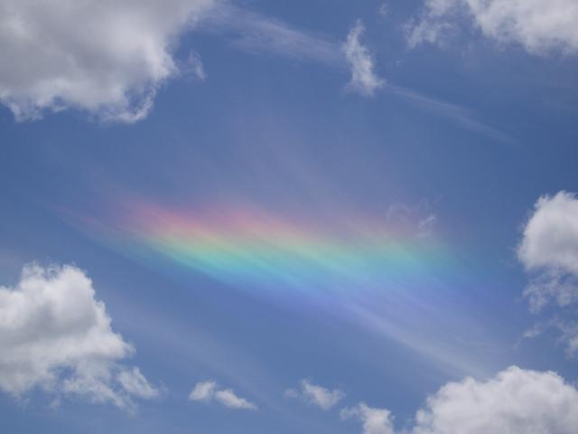
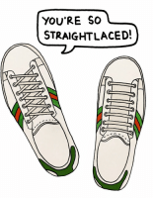
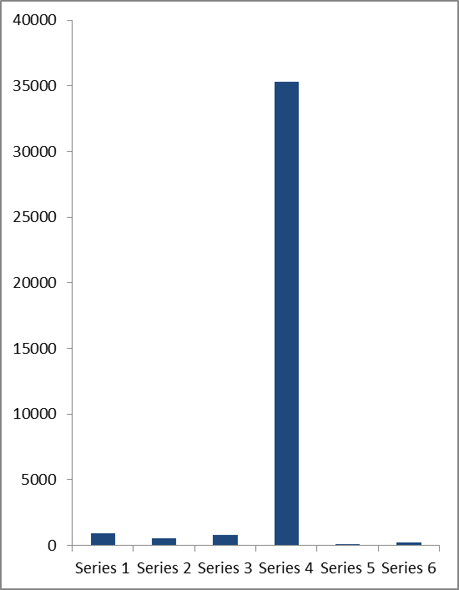
When we reach the standard that the Lord would have us reach, worldlings will regard Seventh-Day Adventists as odd, singular, strait-laced extremists.
—FCE 289

Slide 23

The seal of the living God will be placed upon those only who bear a likeness to Christ in character. Mar 241.3
Many will not receive the seal of God because they do not keep His commandments or bear the fruits of righteousness. Mar 241.5
The great mass of professing Christians will meet with bitter disappointment in the day of God. They have not upon their foreheads the seal of the living God. Lukewarm and halfhearted, they dishonor God far more than the avowed unbeliever.... Mar 241.6

Slide 24

Those whom the Lamb shall lead by the fountains of living waters, and from whose eyes He shall wipe away all tears, will be those now receiving the knowledge and understanding revealed in the Bible, the Word of God.... Mar 241.7

Slide 25
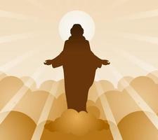
We are to copy no human being. There is no human being wise enough to be our criterion. We are to look to the man Christ Jesus, who is complete in the perfection of righteousness and holiness. He is the author and finisher of our faith. He is the pattern man. His experience is the measure of the experience that we are to gain. His character is our model. Let us, then, take our minds off the perplexities and the difficulties of this life, and fix them on Him, that by beholding we may be changed into His likeness. We may behold Christ to good purpose. We may safely look to Him; for He is all-wise. As we look to Him and think of Him, He will be formed within, the hope of glory. Mar 241.8
Let us strive with all the power that God has given us to be among the hundred and forty-four thousand.
SDA Bible Commentary 7:970. Mar 241.9

Slide 27
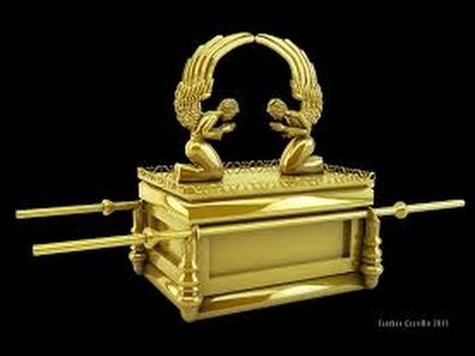
Now unto him that is able to keep you from falling, and to present you faultless before the presence of his glory with exceeding joy, to the only wise God our Saviour, be glory and majesty, dominion and power, both now and ever. Amen.
Jude 1:25

Slide 28
Are You
A MONOMANIAC?

Slide 30
Another Angel…
Revelation 14:6-7

Slide 31
Salvation
What does salvation mean? Matthew 1:21 (deliverance from sin)
[COMPARE Matthew 9:21-22 (make whole); 16:25(preserve); Luke 23:35 (deliver) WITH Genesis 12:12, 45:7, 50:20 (allow to live)]
By what means primarily is the knowledge of salvation brought to the human family? Romans 10:14 (preaching of the gospel)
What is the gospel? Romans 1:16 (the power of God, through Christ, to save from sin)

Slide 32
First Angel’s Message
Are the angels of Revelation literal? (an angel represents a movement; e.g. mighty angel=great, strong movement; swift angel=fast-paced movement)
What is the First Angel’s mission? Revelation 14:6 (preaching the everlasting gospel)
To whom is this gospel to be preached? Revelation 14:6 (everyone on the earth)

Slide 33
What is the text of this angel’s message? Revelation 14:7 (fear God; give glory to Him; His judgment hour has come; worship Him; He made heaven, earth, sea, and the fountains of waters)
What does it mean to fear God? Job 28:20, 28; Psalm 111:10 (depart from evil and do his commandments; see Deuteronomy 4:5-6; Proverbs 2; 4:7)
What does it mean to give glory to God? (heap dignity, honor, and praise on Him; live a godly life)
What does it mean to worship the Creator? (bow to and reverence Him; to obey Him, including His command to keep holy the seventh day, which He blessed and rested on to commemorate His creation)

Slide 34
The Fear of God and Salvation Meet in the Judgment
What judgment does the First Angel announce? 1Peter 4:17 (the first judgment; the one that begins at the church) (see Daniel 7:9-10; 2Corinthians 5:10, Ecclesiastes 11:9-10)
When did the First Angel begin to sound? Leviticus 23:23-25 (using the day=year principle, ten years before antitypical judgment day, i.e. Day of Atonement)
The typical Day of Atonement fell on the 10th day of the seventh month (Leviticus 23:26-27). When did the antitypical Day of Atonement begin? Daniel 8:14 (October 22, 1844—2,300 years from A.D.457)

Slide 35
Is salvation instantaneous and once-and-for-all? Numbers 28:24; Ezekiel 33:13
The High Priest’s work is continual [see Numbers 4:16, 29:6 (daily=regular, continual, perpetual); Hebrews 7:25 (lives to intercede at all times)] so that He is always available to mediate for us the merits of His blood. Therefore, we should be ever availing ourselves of these benefits.
Simply put, salvation is the Divine process by which God accomplishes three things:
1) He rescues us from death by paying the price to buy us back from Satan;
2) He empowers us to resist temptation, thus eradicating sinful habits from our lives; and
3) He grants us a glorified body to complement the character that we have allowed Him to develop in us.

Slide 36
Keep=be on guard, preserve, avoid, save
Present=bring, establish, hold up
Faultless=without blame, blemish, fault, spot
Before the presence=directly in front of, in the sight of
Savior=deliverer

Slide 37
The Really Good News
The EVERLASTING GOSPEL = The Creator God is exercising creative power to save from sin

Slide 38
MONOMANICS WANTED!

