Slide 1
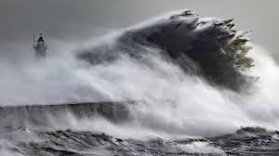
AT YOUR WITS’ END

Slide 2


Slide 3
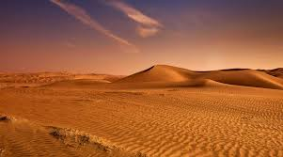
Painting#1 THE DESERT

Slide 4

Psalm 107:4-5
4 They wandered in the wilderness in a solitary way; they found no city to dwell in.

Slide 5
Psalm 107:4-5
5 Hungry and thirsty
their soul fainted
in them.

Slide 6
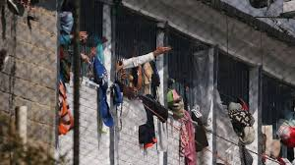
Painting#2 THE PRISON

Slide 7
Psalm 107:10
10 Such as sit in darknes and the shadow of death, being bound in affliction and iron.

Slide 8

Painting #3

Slide 9
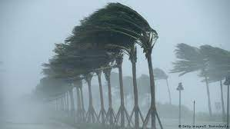
Painting#4 THE STORM

Slide 10
PSALM 107:23-32
23 They that go down to the sea in ships, that do business in great waters;

Slide 11
PSALM 107:23-32
24 These see the works
of the Lord, and His
wonders in the deep.

Slide 12
PSALM 107:23-32
25 For He commandeth and raiseth the stormy wind, which lifteth up the waves thereof.

Slide 13
PSALM 107:23-32
26 They mount up to the heavens, they go down
again to the depths; their soul is melted because of trouble.

Slide 14
PSALM 107:23-32
27 They reel to and fro, and stagger like a
drunken man, and are at their wits’ end.

Slide 15
PSALM 107:23-32
28 Then they cry unto the Lord in their trouble, and He bringeth them out of their distresses.

Slide 16
PSALM 107:23-32
29 He maketh the storm
a calm, so that the waves thereof are still.

Slide 17
PSALM 107:23-32
30 Then are they glad because they be quiet; so He bringeth them unto their desired haven.

Slide 18
PSALM 107:23-32
31 Oh that men would
praise the Lord for His goodness, and for His wonderful works to the children of men!

Slide 19
PSALM 107:23-32
32 Let them exalt Him also in the congregation of the people, and praise Him in the assembly of the elders.

Slide 20
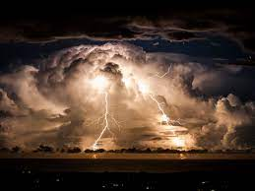
A.THE PLACE OF THE STORM

Slide 21
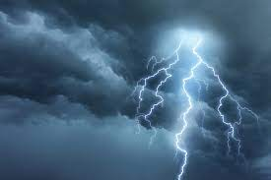
B.THE PRODUCER OF THE STORM

Slide 22
PSALM 107:25
25 For He commandeth and raiseth the stormy wind, which lifteth up the waves thereof.

Slide 23
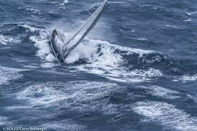
C.THE PERIL OF THE STORM

Slide 24
PSALM 107:26,27
26 They mount up to the heavens, they go down
again to the depths; their soul is melted because of trouble.

Slide 25
PSALM 107:26,27
27 They reel to and fro, and stagger like a
drunken man, and are at their wits’ end.

Slide 26
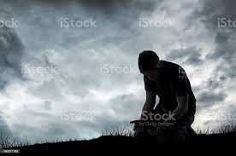
D.THE PRAYER IN THE STORM

Slide 27
PSALM 107:28
28 Then they cry unto the Lord in their trouble, and he bringeth them out of their distresses.

Slide 28
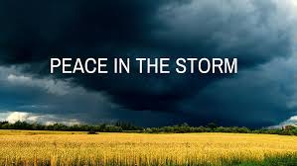
E.

Slide 29
PSALM 107:29,30
29 He maketh the storm
a calm, so that the waves thereof are still.

Slide 30
PSALM 107:29,30
30 Then are they glad because they be quiet; so He bringeth them unto their desired haven.

Slide 31
PSALM 107:14
14 He brought them out of darkness and the shadow of death, and brake their bands in sunder.

Slide 32
PSALM 107:20
20 He sent His word, and healed them, and delivered them from their destructions.

Slide 33
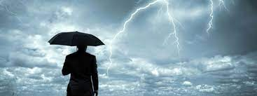
F.THE PURPOSE OF THE STORM

Slide 34
PSALM 107:30
30 Then are they glad because they be quiet; so He bringeth them unto their desired haven.

Slide 35
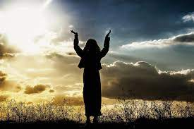
G. THE PRAISE AFTER THE STORM

Slide 36
PSALM 107:31,32
31 Oh that men would
praise the Lord for His goodness, and for His wonderful works to the children of men!

Slide 37
PSALM 107:31,32
32 Let them exalt Him also in the congregation of the people, and praise Him in the assembly of the elders

Slide 38
PSALM 107:15,16
15 Oh that men would
praise the Lord for His goodness, and for His wonderful works to the children of men!

Slide 39
PSALM 107:15.16
16 For he had broken the gates of brass, and cut the bars of iron in sunder.

Slide 40
PSALM 107:21, 22
21 Oh that men would
praise the Lord for His goodness, and for His wonderful works to the children of men!

Slide 41
PSALM 107:21,22
22 And let them sacrifice the sacrifices of thanksgiving, and declare his works with rejoicing.

Slide 42
PSALM 107:31,32
31 Oh that men would
praise the Lord for His goodness, and for His wonderful works to the children of men!

Slide 43
PSALM 107:31,32
32 Let them exalt Him also in the congregation of the people, and praise Him in the assembly of the elders

Slide 44
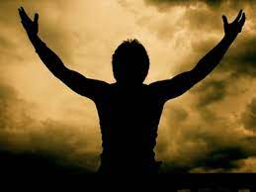
HELP!

Slide 45


