Slide 1
How It All Began?
Notes:
Good morning and Happy Sabbath to each one of you. Once again it is a joy to worship the Lord in the company of God’s faithful children.
I trust and pray that God is keeping all of us safe and we are constantly in His care and protection. However, it is still recommended that we take all safety precautions. Personally, I recommend that we continue to wear the mask as we come together to worship. It is to create a safety atmosphere for everyone. And we follow the protocols. God is still in control and we rely on Him for wisdom in these circumstances.
Please bow down with me before the King of Kings as I share a message about trusting God.
Let us Pray:

Slide 2

Notes:
Most of us don’t like waiting.
We are annoyed with lengthy checkout lines at the store, frustrated by long red lights, waiting in Doctor's office.
But we especially don’t like waiting on God. Of all the commands of Scripture, perhaps this is one of the hardest to obey.

Slide 3
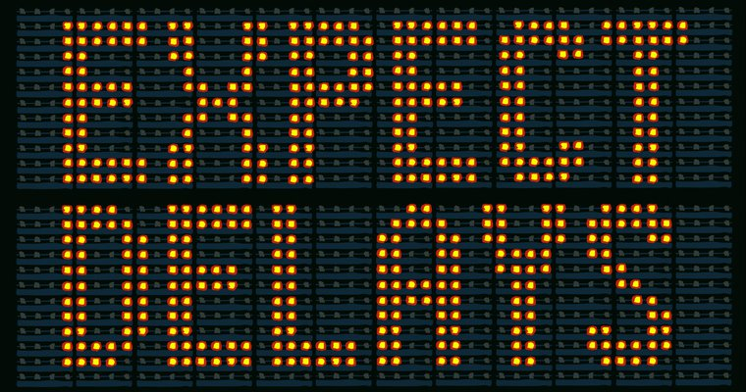
Notes:
We are forewarned certain times in our daily lives about delays.
Two refrains accompany one another in the pages of the Bible.
God's message to individuals and groups alike is often, "Wait."
Individuals and groups, likewise, often ask, "How long, O LORD?”
I want to remind you this morning that there is a place we can trust while we wait. Let me repeat, there is a place we can trust while we wait.

Slide 4

Notes:
Who do we trust while we are waiting?
I find it sort of fascinating, especially beginning in 2020 and even now presently, to think about whose word do we trust?
Who do you trust?

Slide 5
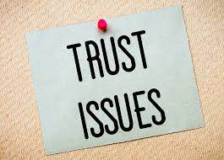
Notes:
We all agree that there are Trust Issues.
Trust issues are characterized by fears of betrayal, abandonment, and manipulation.
Many of us have these feelings—whether we have trouble trusting our boyfriends and girlfriends, or our parental figures, or even our doctors.

Slide 6
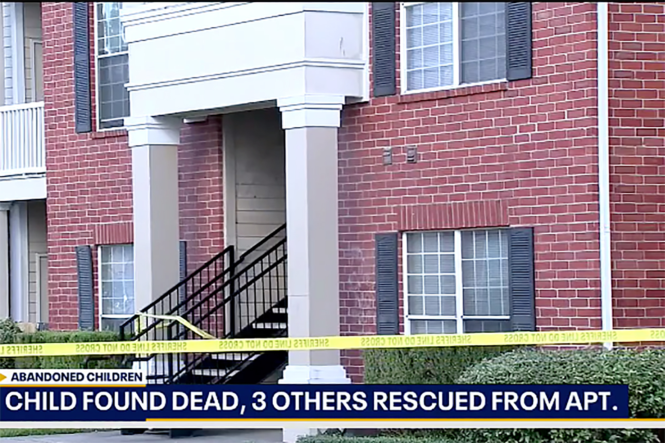
Notes:
Remains found in Texas apartment believed to be abandon children’s brother
October 25, 2021
The three abandoned children fending for themselves in a deplorable Texas apartment were living with the body of their 9-year-old brother — who may have been rotting there for a year, authorities said Monday.
The oldest of the children — a 15-year-old boy — called 911 around 4 p.m. Sunday to report that his brother had been dead for a year in the Houston apartment that he shared with his siblings, Harris County Sheriff Ed Gonzalez said.
“They were in there while the body was deteriorating,” Gonzalez told the Houston Chronicle.
When deputies arrived Sunday, they discovered the remains of a “small child” consistent with the description that the teen provided, Gonzalez said.
Deputies located the 15-year-old, as well as his brothers, ages 10 and 7.
The younger brothers “appeared malnourished and showed signs of physical injury,” Gonzalez said.
“All three were transported to a hospital to be assessed and treated for their injuries,” he tweeted.
The apartment where cops believe they have found the skeletal remains of a 9-year-old boy in Houston.FOX4The sheriff said it appeared that the remains and the brothers had been abandoned for an “extended” period of time.
“And I emphasize extended,” Gonzalez said.
The brothers are now in Child Protective Services’ custody.
Gonzalez said it’s believed that the children had been living without their parents for several months, forcing the eldest son to step up as the caretaker.
“Our hearts break for those three. They are still children,” the sheriff said.
For at least a couple of weeks, the children had not had power in the apartment, the Chronicle reported.
A neighbor had been helping the boys, bringing them food and charging their cell phone, the outlet reported.
It’s unclear whether they attended school.
The mother and her boyfriend were brought in for questioning, but have since been released and no charges have been filed, authorities said.

Slide 7
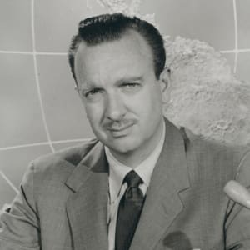

Born: November 4, 1916.
Died: July 17, 2009.
Born: David McClure Brinkley; July 10,
Died: June 11, 2003 (aged 82.)
Notes:
I used to think that Walter Cronkite, and Chet Huntly and David Brinkley the news casters of the yester years were worthy of my trust.

Slide 8
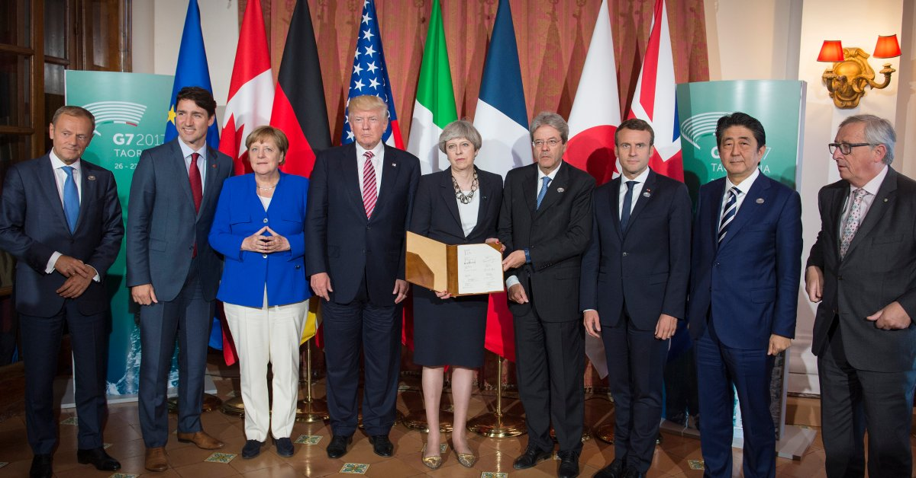
Notes:
There was a time when it felt sort of okay to trust our political leaders...but we’ve all reduced our level of trust in 2020!

Slide 9
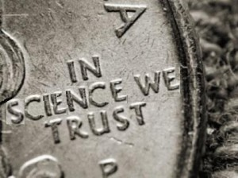
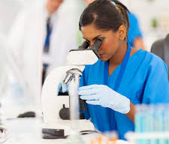
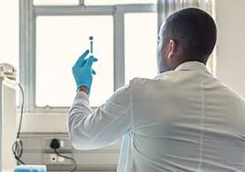
Notes:
Some feel safe in trusting scientists but then, being true to their science, they make a new scientific discovery that blows their old scientific conclusion out of the water.
And the result of too much broken or disappointed or mistaken trust turns us all a little skeptical.

Slide 10
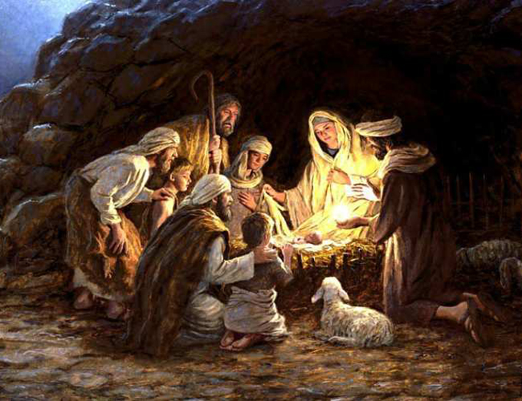
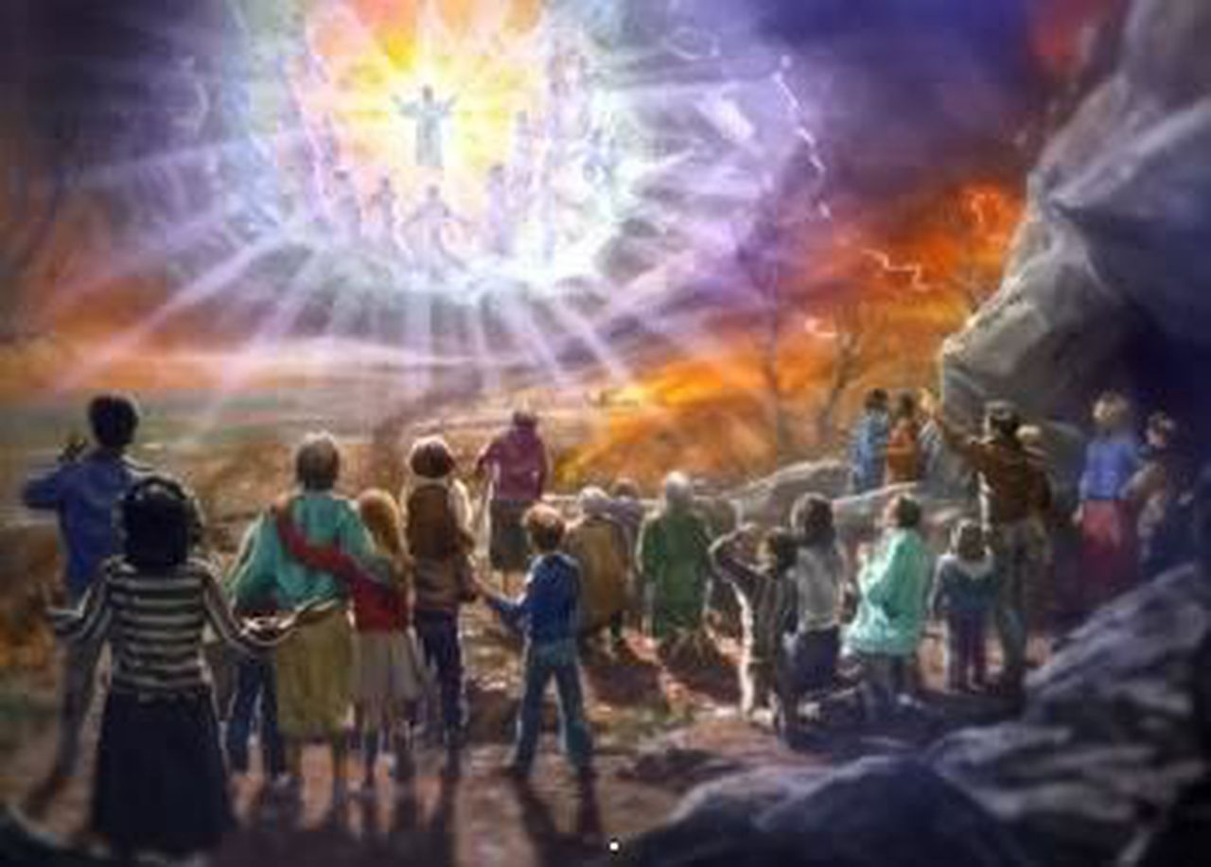

FIRST ADVENT
SECOND ADVENT
Notes:
I want to remind you in the story of the first Advent, when Jesus came to our earth and in the promise of the second Advent when Jesus will return,
that there is a place we can trust while we wait.

Slide 11
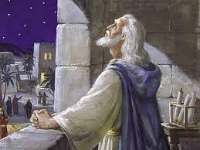
DANIEL PRAYING DURING THE 70 YEAR CAPTIVITY.
Notes:
While Daniel was waiting for the 70 years of captivity to end, he trusted in the writings of Jeremiah the prophet.
He knew when the captivity began, and he trusted God’s word through Jeremiah that their captivity would last for 70 years.
By his best calculations he realized that they were only 3 - 4 years away from returning to Jerusalem.

Slide 12
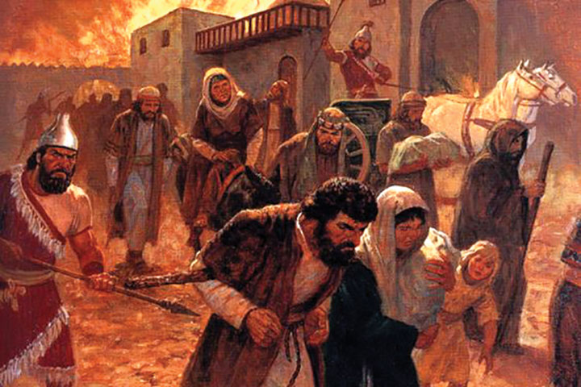
BABYLONIAN CAPTIVITY
Notes:
Until he read about the reasons for the captivity. If he could trust God’s word,
the captivity happened because of the people turning away from God and
not trusting God and
not confessing their sins.

Slide 13
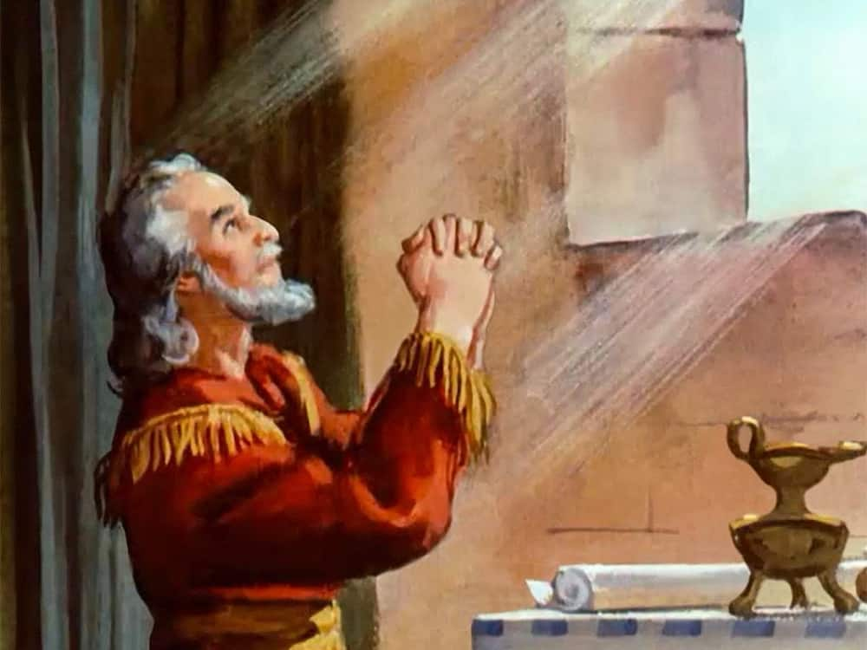
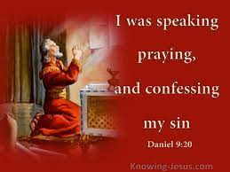
Notes:
^{Daniel 9:3} So I turned to the Lord God and pleaded with him in prayer and petition, in fasting, and in sackcloth and ashes.
So, Daniel prayed, pleaded, petitioned God.
Daniel wanted things right between him and God and between the people of Israel and God.
So, he confessed: 1. We have sinned and done wrong. 2. We have been wicked and have rebelled.
3. We have turned from your commands and laws.
4. We have not listened to your prophets.
5. All Israel has transgressed your law and turned away, refusing to obey you.
Daniel owns the reality that they deserved the captivity.
Finally, Daniel prays telling God that for God’s sake restore the city that bears his name.

Slide 14
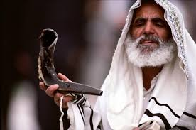
WE HAVE NOT LISTEN TO YOUR PROPHETS
Notes:
Daniel's prayer was a confession.
We have not listened to your prophets.
All Israel has transgressed your law and turned away, refusing to obey you.
Daniel owns the reality that they deserved the captivity.
Finally, Daniel prays telling God that for God’s sake restore the city that bears his name.

Slide 15
AN UNSELFISH PRAYER OF DANIEL
It is, in the end a very unselfish prayer. “We do not make requests of you because we are righteous, but because of your great mercy.
O Lord listen!
O Lord, forgive! O Lord, hear and act for your sake!
Notes:
It was an unselfish prayer, in the end of that unselfish prayer Daniel says.
“We do not make requests of you because we are righteous, but because of your great mercy.
O Lord listen! O Lord, forgive! O Lord, hear and act for your sake!

Slide 16
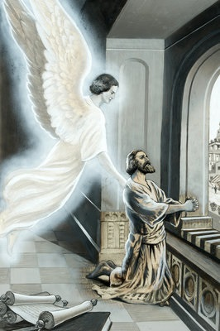
Notes:
While Daniel is praying Gabriel shows up and reveals a prophecy that creates great specificity of when Messiah will come.
When we decipher the prophecy, we discover that it runs from the command to rebuild Jerusalem to the coming of Messiah to the sacrifice of Messiah to the destruction of Jerusalem.
A prophecy of hope and desolation, but ultimate hope because the Anointed One will confirm the covenant.

Slide 17
BACKGROUND SCENES OF AN ANSWERED PRAYER
^{DANIEL 10: 12 - 14}
¹² Then he continued, “Do not be afraid, Daniel.
Since the first day that you set your mind to gain understanding and to humble yourself before your God, your words were heard, and I have come in response to them.
Notes:
I want to take a little detour from our message.
What happens when you pray? Read that verse again, ..... “since the first day that you set your mind to gain understanding and to humble yourself before your God, your words were heard”
What I understand here is that when we pray, the moment you ask God according to His will, the heavenly forces are directed in working out an answer for you.
Right Counsel Versus Evil Counsel—[Daniel 10:12, 13 quoted.] By this we see that heavenly agencies have to contend with hindrances before the purpose of God is fulfilled in its time. The king of Persia was controlled by the highest of all evil angels. He refused, as did Pharaoh, to obey the word of the Lord. Gabriel declared, He withstood me twenty-one days by his representations against the Jews. But Michael came to his help, and then he remained with the kings of Persia, holding the powers in check, giving right counsel against evil counsel. Good and evil angels are taking a part in the planning of God in His earthly kingdom. It is God's purpose to carry forward His work in correct lines, in ways that will advance His glory. But Satan is ever trying to counterwork God's purpose. Only by humbling themselves before God can God's servants advance His work. Never are they to depend on their own efforts or on outward display for success (Letter 201,1899).

Slide 18
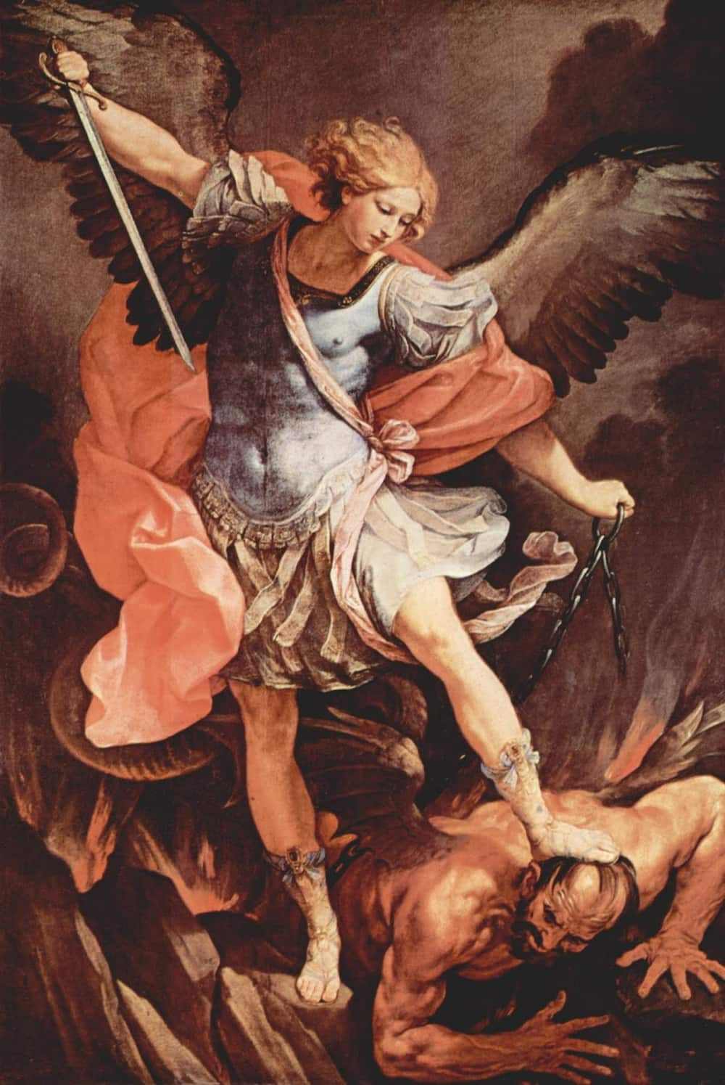
CONTINUE ........
¹³ But the prince of the Persian kingdom resisted me twenty-one days.
Then Michael, one of the chief princes, came to help me, because I was detained there with the king of Persia.
Notes:
13. An Invisible Struggle—We have before us in the Word of God instances of heavenly agencies working on the minds of kings and rulers, while at the same time satanic agencies were also at work on their minds.
No human eloquence, in strongly set forth human opinions, can change the working of satanic agencies.
Satan seeks continually to block the way, so that the truth shall be bound about by human devising; and those who have light and knowledge are in the greatest danger unless they constantly consecrate themselves to God, humiliating self, and realizing the peril of the times.

Slide 19
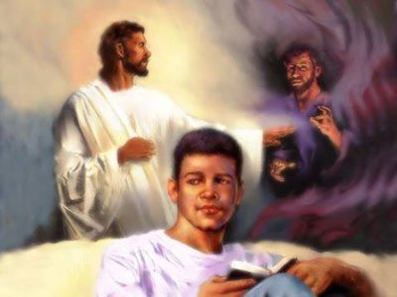
BACKGROUND SCENES OF AN ANSWERED PRAYER
Notes:
Heavenly beings are appointed to answer the prayers of those who are working unselfishly for the interests of the cause of God. The very highest angels in the heavenly courts are appointed to work out the prayers which ascend to God for the advancement of the cause of God. Each angel has his particular post of duty, which he is not permitted to leave for any other place. If he should leave, the powers of darkness would gain an advantage....
Day by day the conflict between good and evil is going on. Why is it that those who have had many opportunities and advantages do not realize the intensity of this work? They should be intelligent in regard to this.
God is the Ruler. By His supreme power He holds in check and controls earthly potentates. Through His agencies He does the work which was ordained before the foundation of the world.

Slide 20
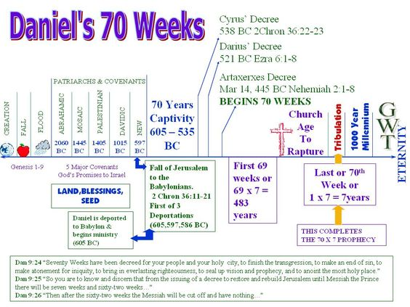
GOING BACK TO OUR MESSAGE:
Notes:
There was ample information to be “ready” for Jesus’ coming.
Born of Virgin. Near the end of the prophecy in Daniel 9.
Birthed in Bethlehem. In the line of David.
Testified to by Anna and Simeon Angels singing to shepherds.

Slide 21
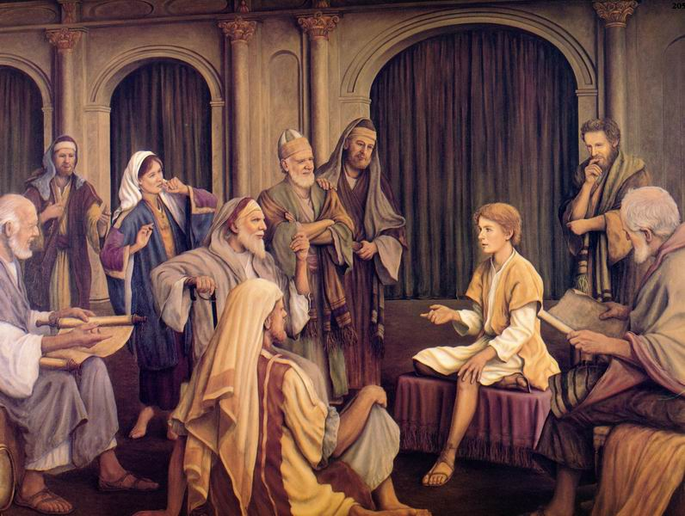
MISSING THE ARRIVAL OF MESSIAH
Notes:
But at least part of the “Chosen” people missing the arrival of and ministry of, and belief in Messiah, Jesus the Christ because of their failure to Trust His Word while they waited.
Instead, Satan was successful in getting the Chosen people of God to rely on themselves. To imagine themselves to be just a little bit better than others because they had the “truth”. But instead of digging into truth they aggrandized themselves and they bought into the demonic principle that we humans can save ourselves by our own works.

Slide 22
Failure to trust God’s word.
The first Advent of our Savior was missed, by the vast majority of those commissioned to trumpet his arrival, because of a failure to trust God’s word.
Self-interest, self-reliance, self-trust stole the place of trusting God’s word.
Notes:
So, even though missed by many, Jesus came. God incarnate.
Born of woman, born under sin, to redeem those under sin and bring them out free in him to be united with God.
The plan, risky and yet picture perfect and unequivocally clear in its countering Satan’s claim that God was totally selfish.
Jesus demonstrates in his incarnation, life, death, resurrection and ascension that rather than selfish God is self-giving, self-sacrificing, and generous beyond belief.

Slide 23

THE FIRST ADVENT OF JESUS
Notes:
In less than two months the Christian world celebrates the First Advent. It is the happiest time of the year because Jesus came and reversed our destiny.
Jesus came and showed us how off our perceptions were of the Father, Son and Holy Spirit.
The cross and the celebration of the resurrection are grand but the condescension of God.
For God to become man; for Jesus to open the circle of the Trinity to the creation, to human. Wow. Christmas is amazing.

Slide 24
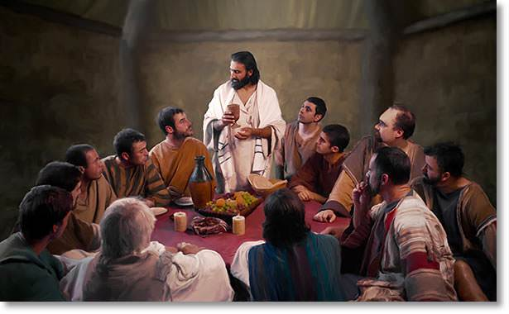
JESUS CHRIST AT THE PASSOVER
Notes:
It was the night before the crucifixion that Jesus made explicitly clear in the teaching of his word, that we can choose to trust while we wait.
Jesus knew what was on the horizon. He knew that in just hours all of his disciples would run. Peter would deny. He knew they would be overwhelmed by their loss of him. In less than 24 hours he would be lying in Joseph of Arimathea’s tomb.

Slide 25
The words Jesus shared that night gave them hope.
What would be most helpful for his disciples to hear? He’d tried to warn them of tough things that were coming.
But what foundational truth should he share in which they could put their trust when the bottom would drop out?
What word best prepares them for facing hard times?
Notes:
The words Jesus shared that night are words that gave them hope,
challenged them, but gave them hope and when we trust God’s words, they still give us hope today.

Slide 26
WORDS OF HOPE AND TRUST.
Let not your hearts be troubled. You believe in God, believe also in Me.
In my Father’s house are many mansions: if it were not so, I would have told you.
I go to prepare a place for you. And if I go and prepare a place for you, I will come again and receive you unto myself that where I am, there you may be also.
Notes:
John 14: 1-3, Those words that Jesus spoke in the upper room are the same words the comfort the generations.

Slide 27
“I WILL COME AGAIN.”
There it is.
Just four words. Four words that are a promise to which we cling. Jesus said it. When we look at everything Jesus said it was true, it happened, it started, it stopped at his word, disease fled, eyes opened, crutches were thrown away and dead came back to life at his word.
Jesus is true and kind and good, and he said –
“I WILL COME AGAIN.”

Slide 28
He continues,
And, where I go you know, and the way you know.
Thomas obviously didn’t get it. He questioned, “Lord we don’t know where you are going, and how can we know the way?”
Jesus’ reply is part of God’s word we can trust while we wait.
He said, “I am the way, the truth, and the life: no one comes to the Father but by me.”
Notes:
Later writers of the New Testament will talk about our ability to be with God, to be part of his kingdom as a gift. There will be clear teaching that we can’t climb or work or achieve or buy our way to the Father, access is something that is provided for us in Jesus Christ. All of our hope is in him.

Slide 29
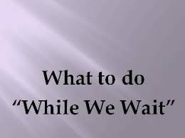
Notes:
While We Wait, we can trust his word. That same night Jesus said that he was the vine, and we are the branches. The branch can do nothing except it abide in the vine.
We can do nothing except abide in the vine and when we do the life of Jesus, the life of the vine flows through the branch and bears fruit.

Slide 30
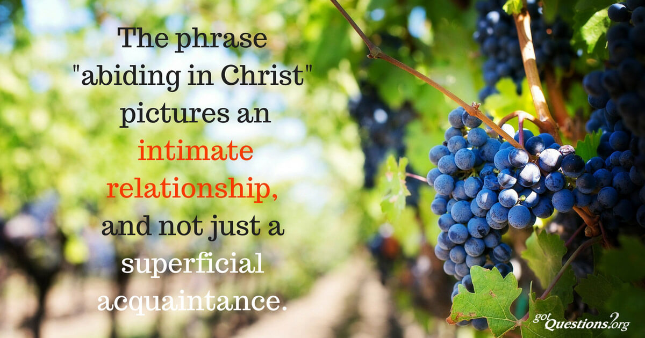
Abiding in Jesus,
Notes:
Abiding in Jesus, trusting God’s word mean constant surrender to Jesus’ service, and the strength and character of the vine flow into the branch that abides in the vine.
Jesus says the Father is glorified when we bear much fruit, but we bear fruit not by straining and stressing and attempting to produce it, we bear the fruit the Father desires by abiding, clinging, resting in Jesus and then his love flows in and through us and we love because he first loved us.

Slide 31
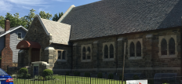
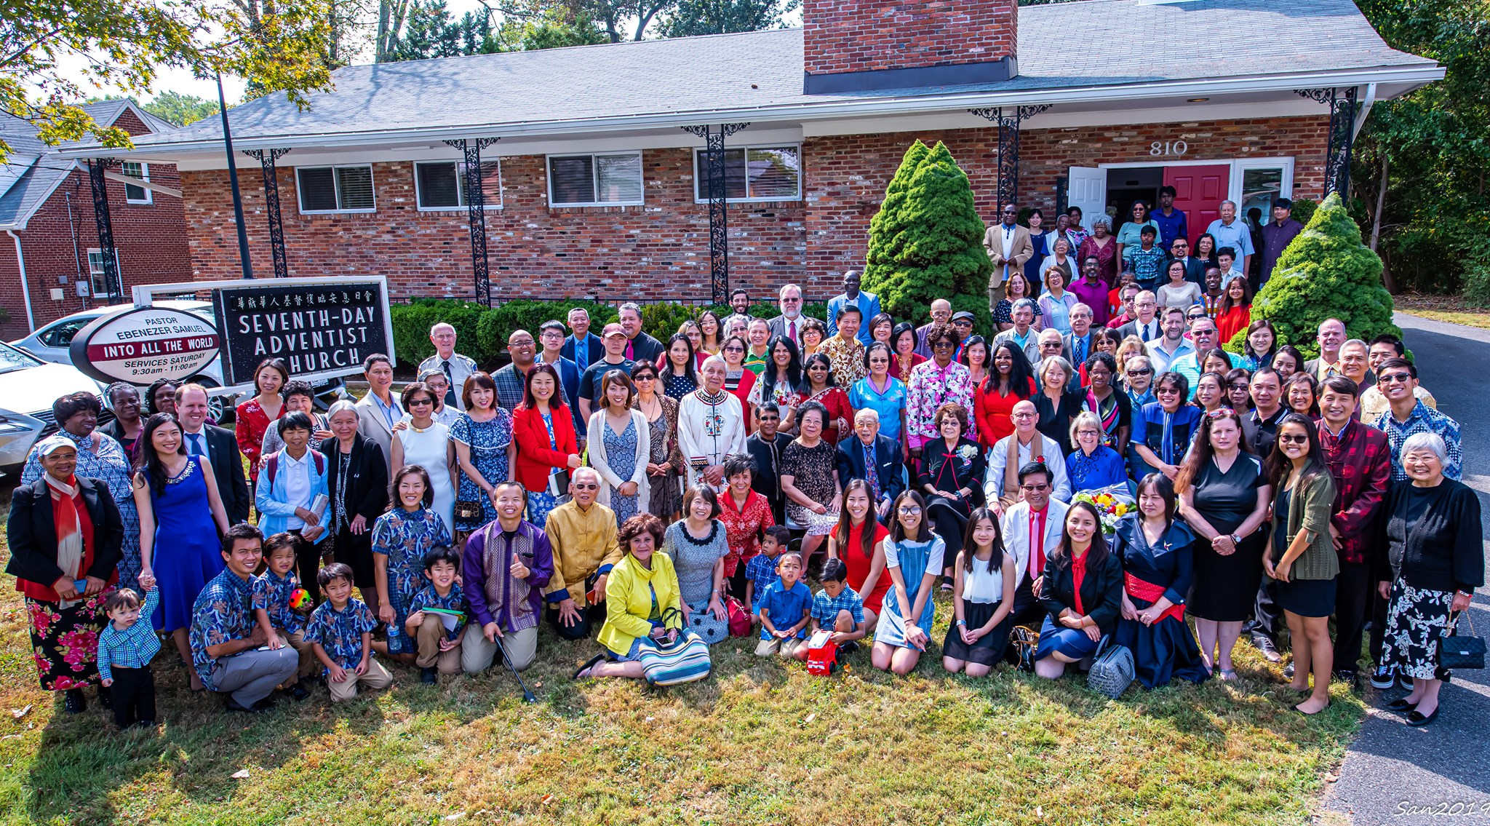
OUR CIRCLE OF INFLUENCE LOVING PEOPLE
Notes:
We go about our life in our circle of influence loving people. We hope to love them so well that they will want to abide in the vine, anchored in a lifelong friendship with God.

Slide 32
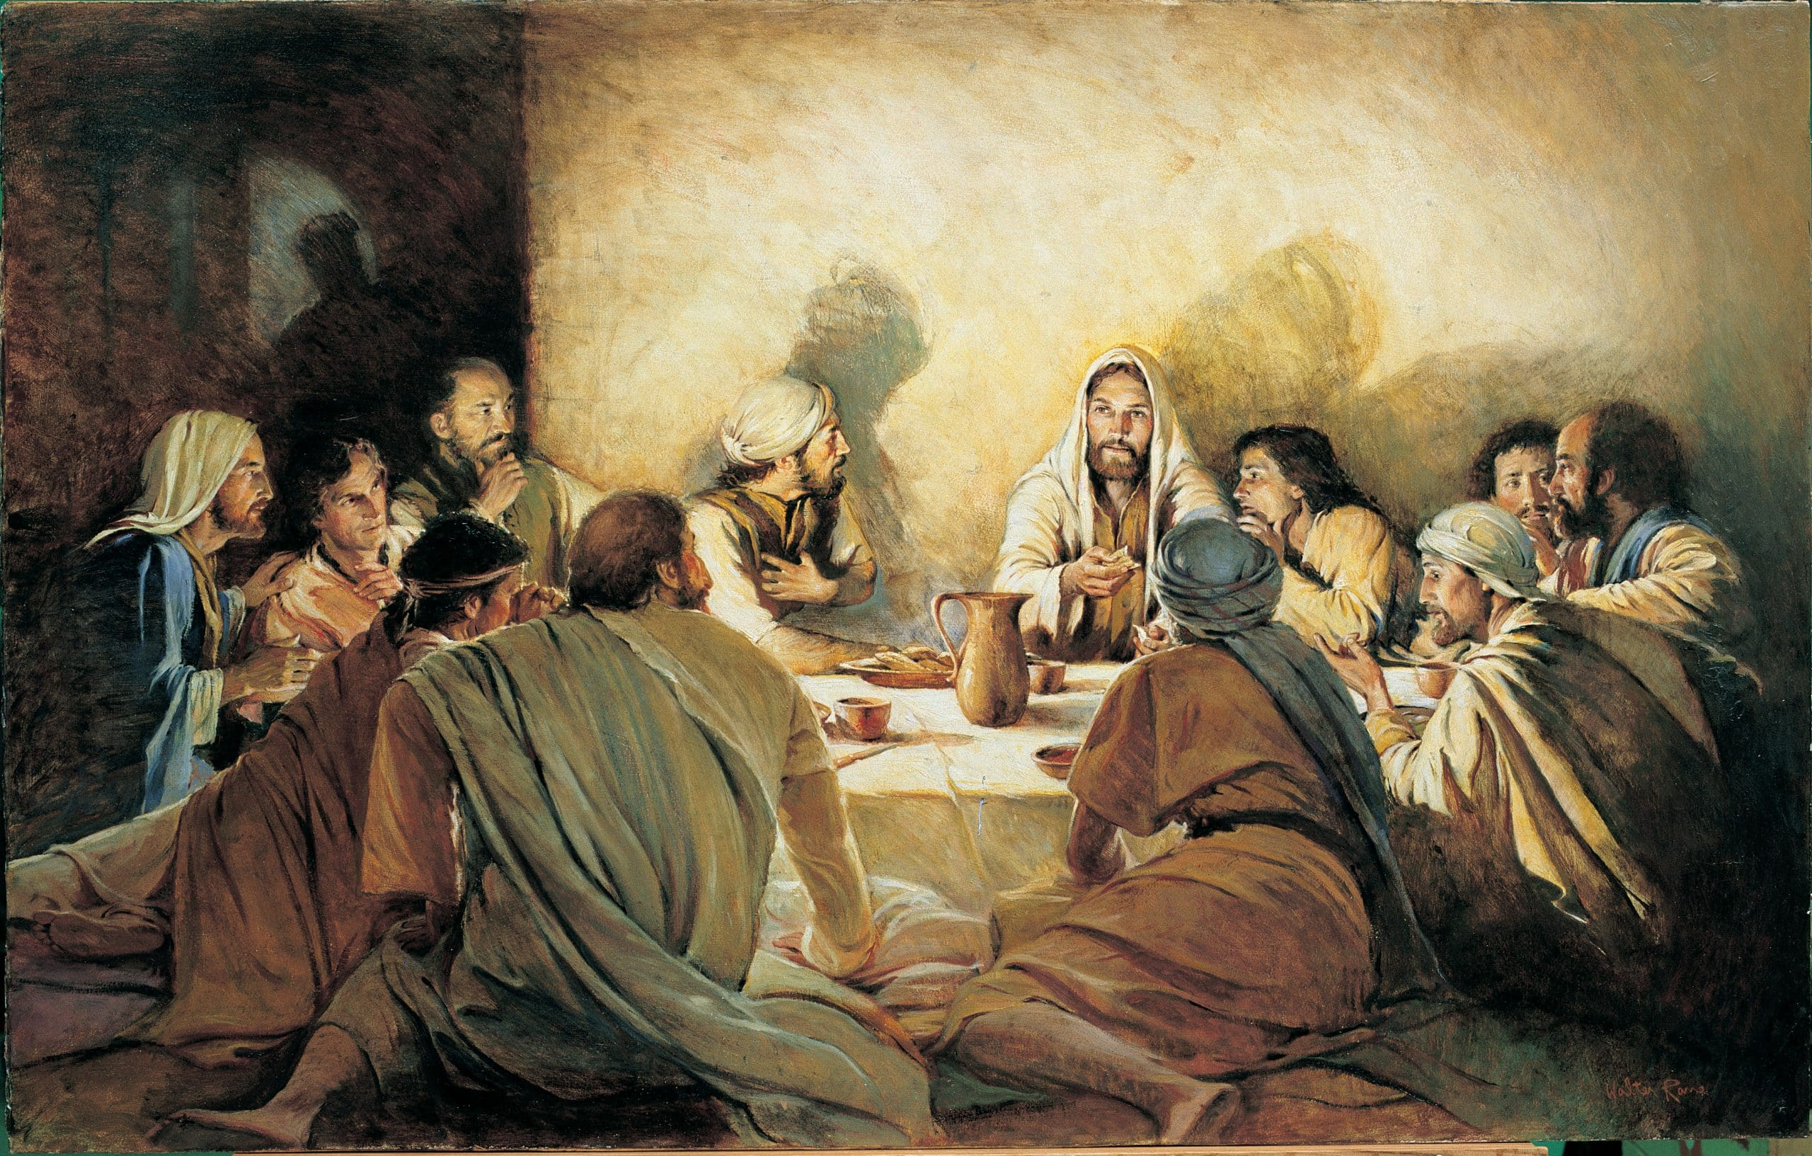
Notes:
That same night that he said I Will Come Again, he also said, by this will everyone know that you are my disciples, if you have love one to another.

Slide 33
OUR CIRCLE OF INFLUENCE LOVING PEOPLE
Notes:
Think about us as a church.
From various corners of our country and from corners of other countries around the world. Some with little formal schooling and others with advanced degrees. Various languages. Multiple ethnicities. Opposite political positions. Different ways of seeing scripture. All socio-economic levels. Singles, Married, With Children without, young and old, different skin colors.

Slide 34
OUR CIRCLE OF INFLUENCE LOVING PEOPLE
Notes:
We go about our life in our circle of influence loving people. We hope to love them so well that they will want to abide in the vine, anchored in a lifelong friendship with God.

Slide 35
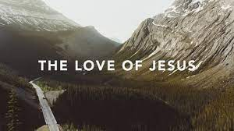
THERE IS NO SINGLE THING BUT THE LOVE OF JESUS
Notes:
There is no single thing but the love of Jesus that pulls us together and nothing holds us together but the love of Jesus and that unity of love is a huge testimony to the world of the love of Jesus in us.

Slide 36
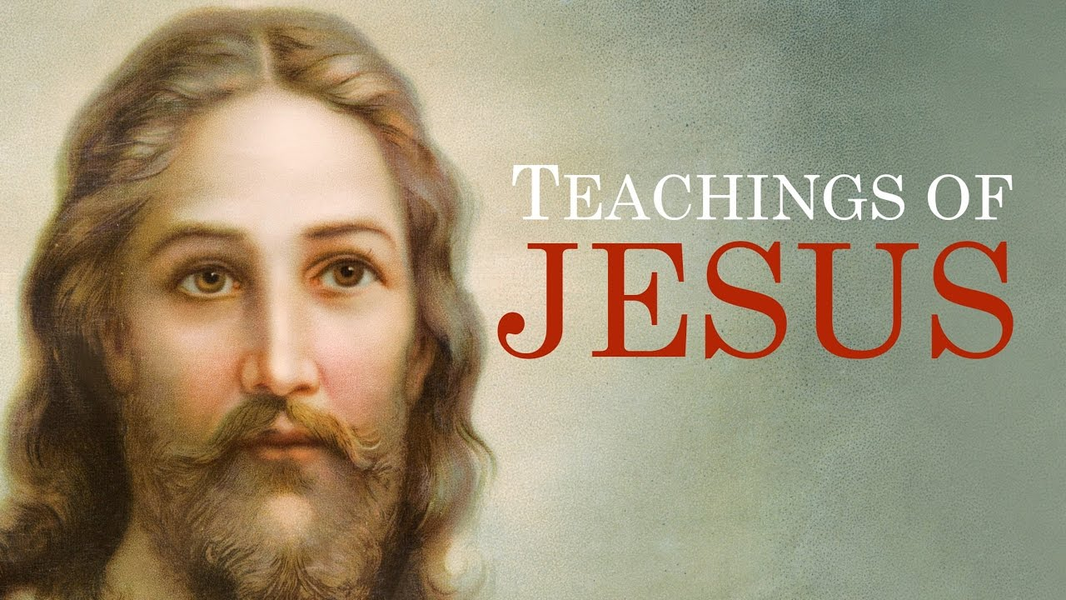
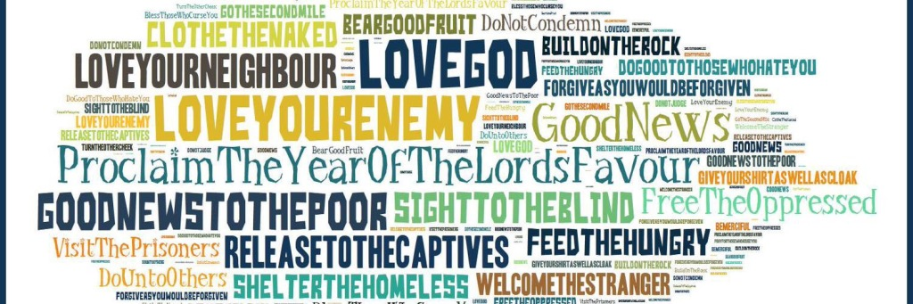
Notes:
Jesus words are ones we can trust while we wait.
Do unto others as you would have them do unto you. Love your enemies, Do good to those who persecute you. Go the extra mile. Listen to my teaching and follow it and be like the house on the rock, Be the Light of the world illumine that which might be hidden in the dark and bring it into the light. Be salt, preserve, purify, add zest to life. Give yourself away in service. Don’t worry. Ask and you will receive. All this and so much more.

Slide 37
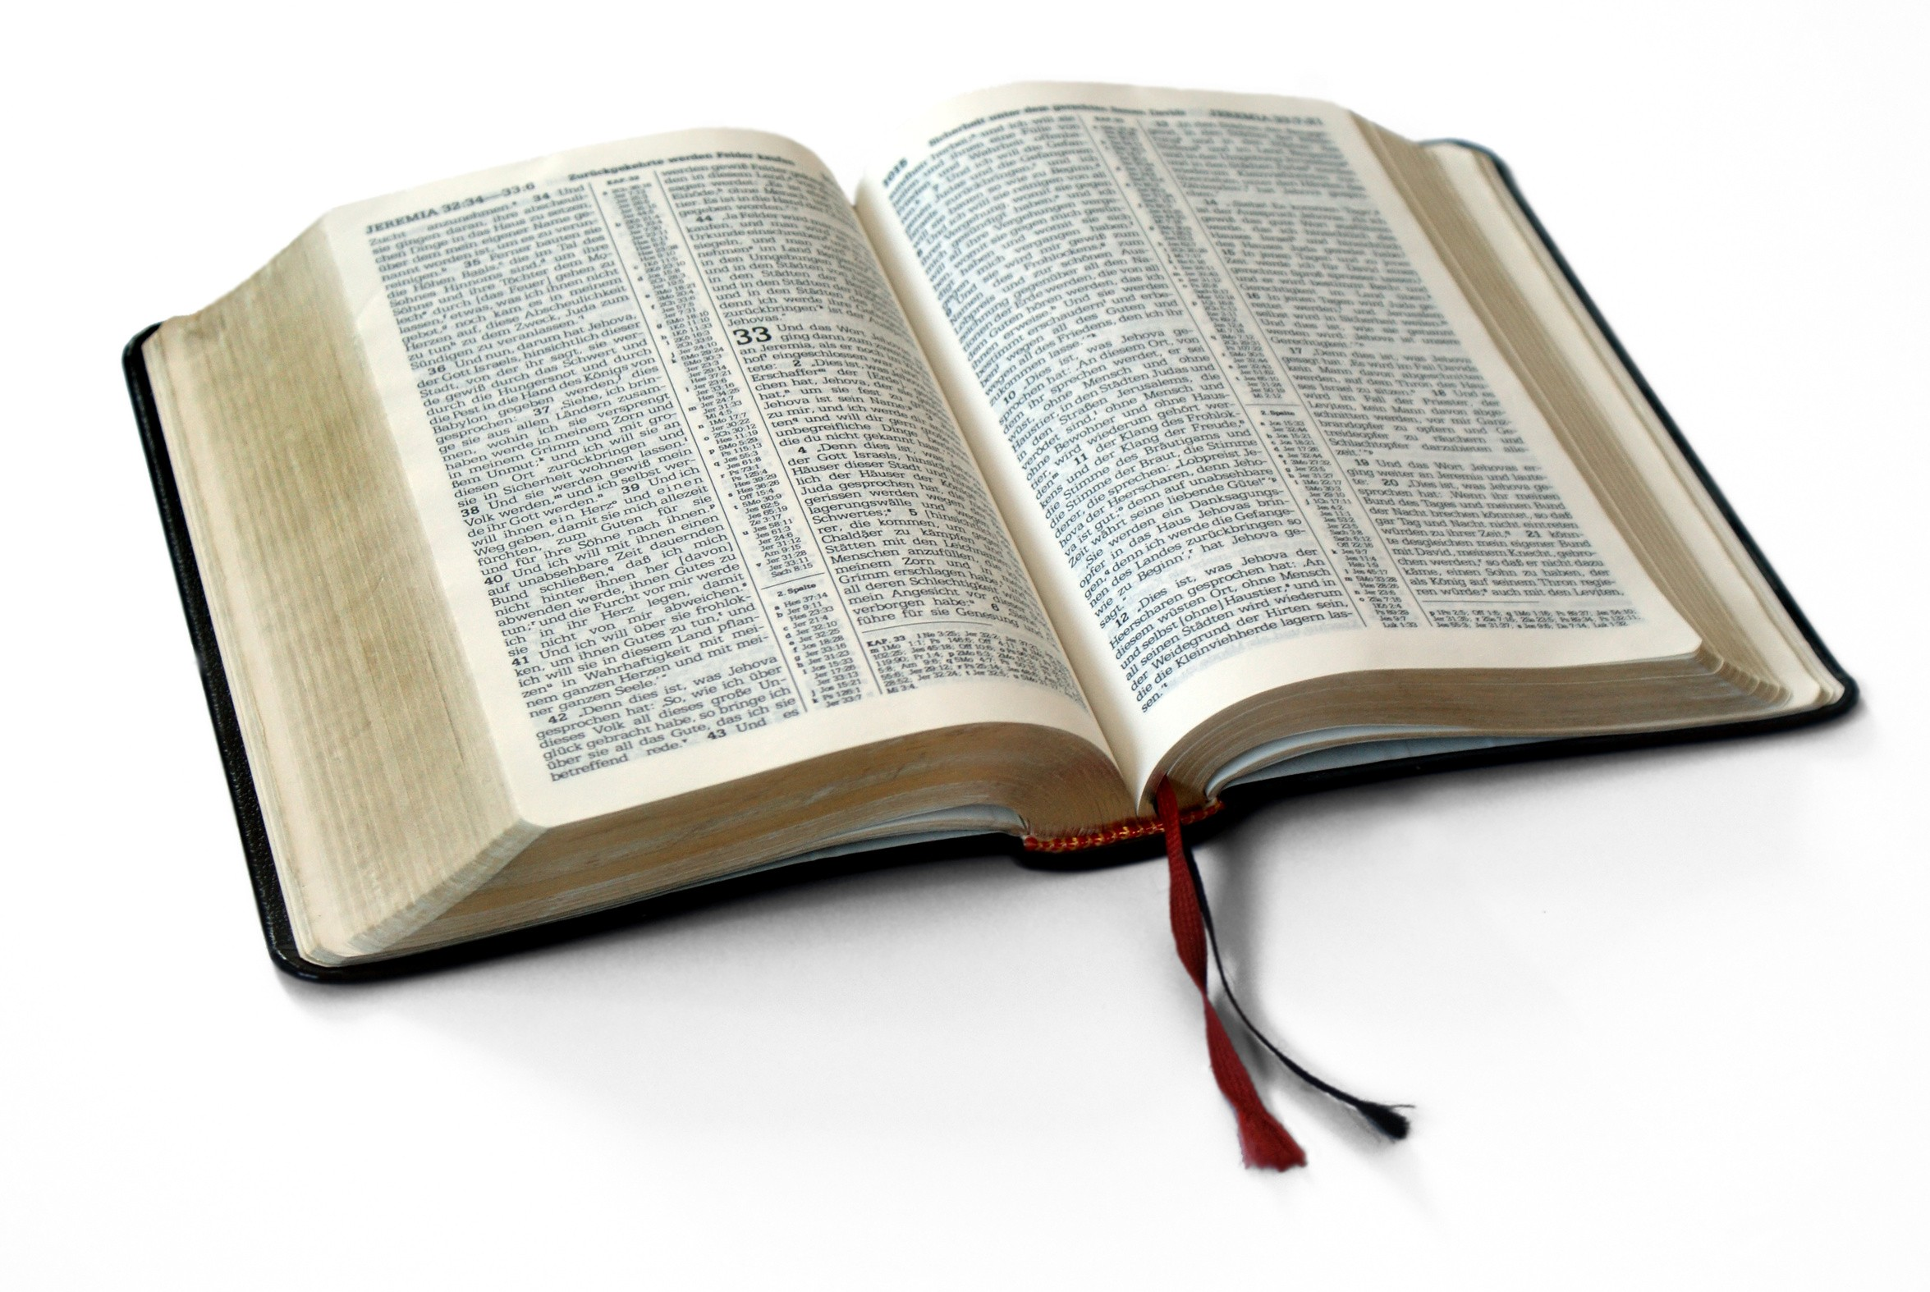
While we wait, we Trust in God’s word.

Slide 38
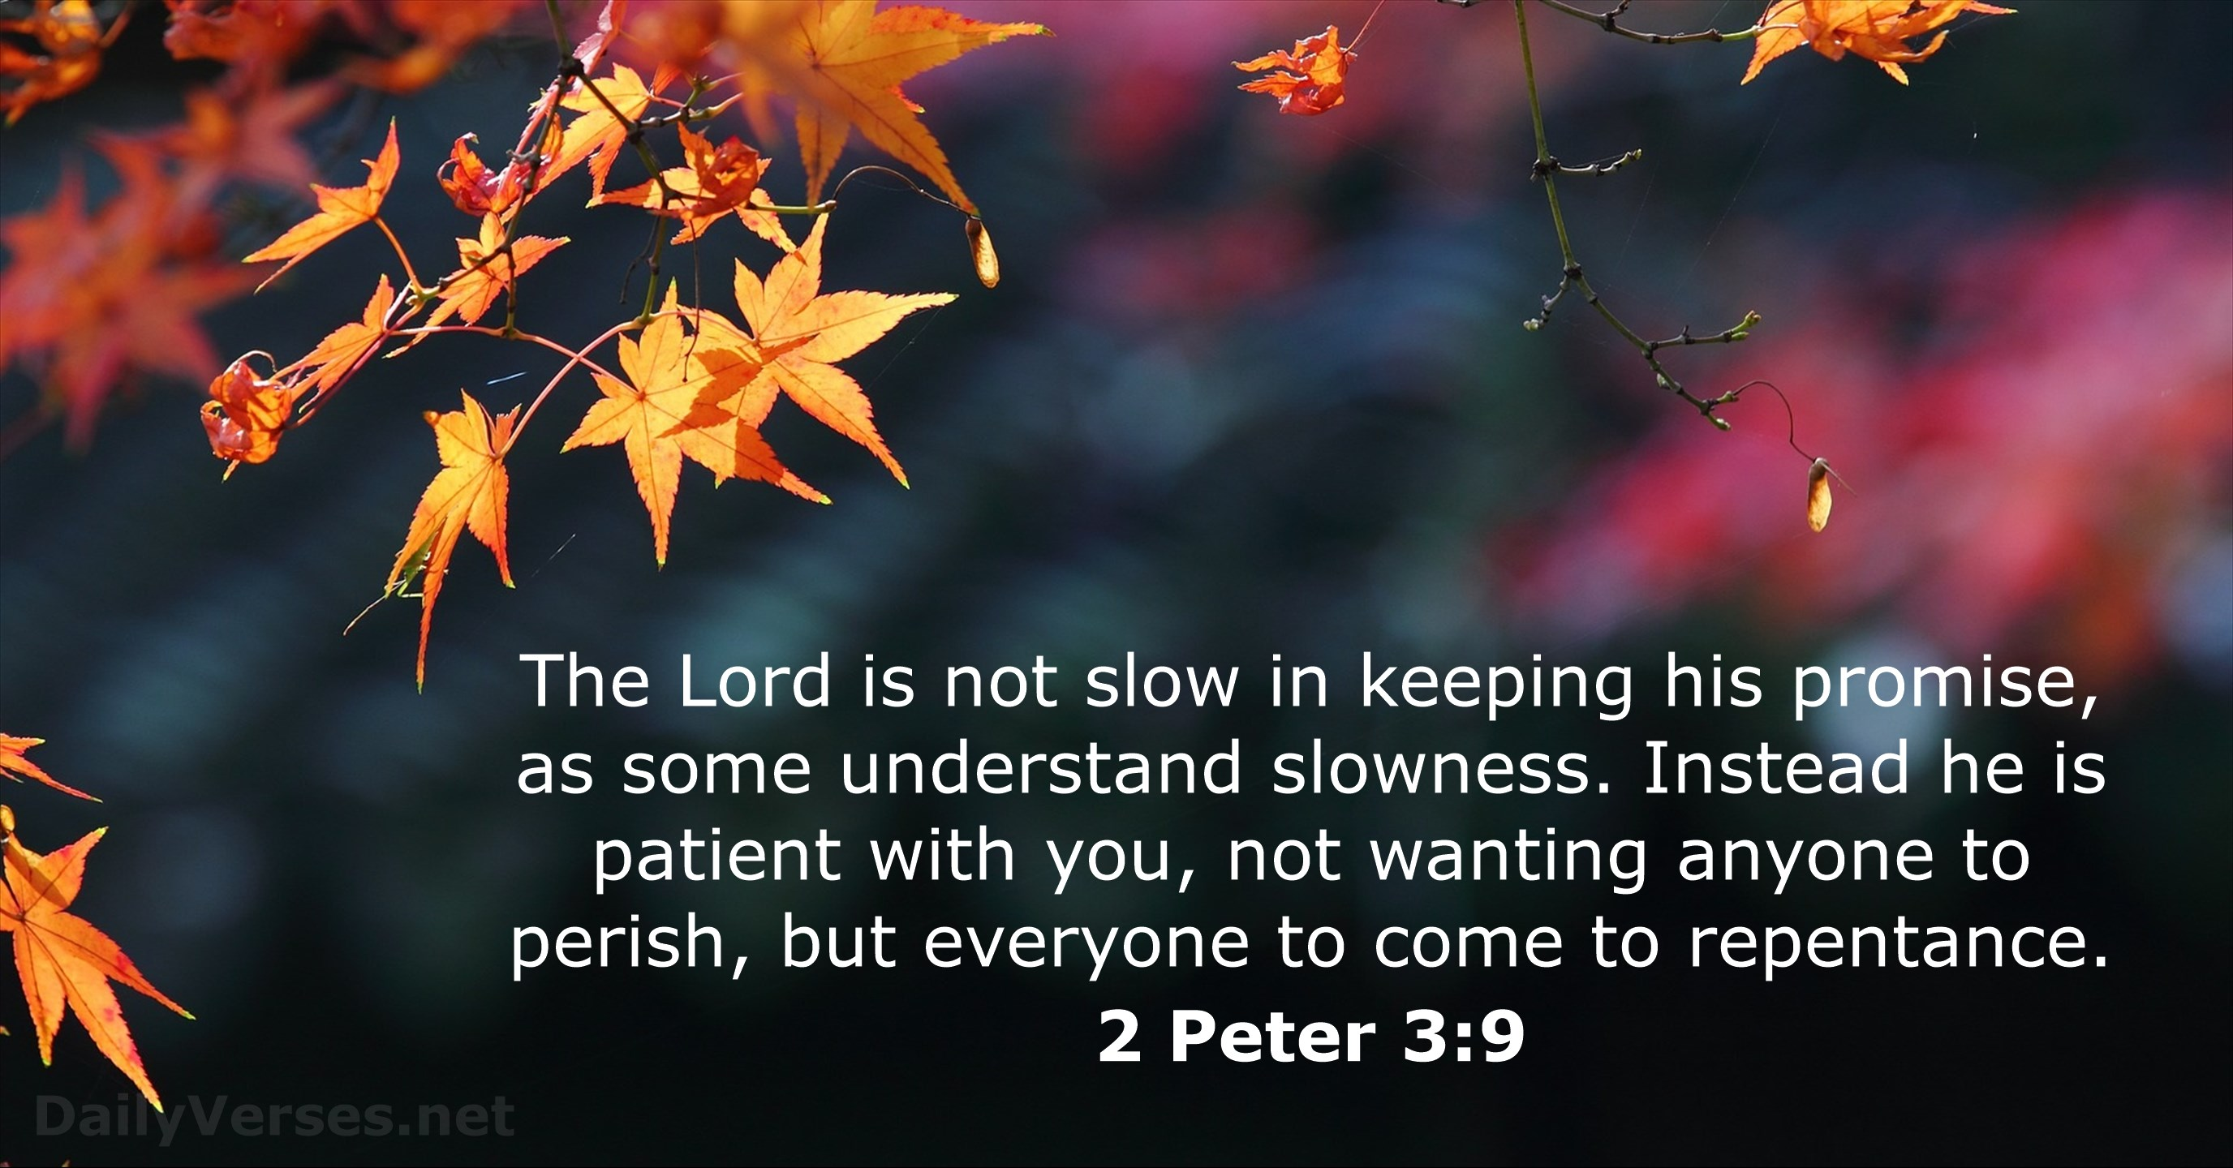
Where is this coming, he promised?
Notes:
It may get harder. He said, I will come again, but we find ourselves still waiting. In 2 Peter 3 he writes about a temptation to ask “Where is this coming he promised.
Everything just keeps rocking along. How can you be so sure?
Peter writes: But do not forget this one thing, dear friends, with the Lord a day is like a thousand years and a thousand years are like a day. The Lord is not slow in keeping his promisee as some understand slowness. He is patient with you, not wanting anyone to perish , but everyone to come to repentance. The day of the lord will come like a thief (surprise)

Slide 39
While we wait, we Trust in God’s word.
So, as we step into this holiday Season, first Thanksgiving and Christmas.
We remember and recall, sing about and read the stories of that first Advent, lets remind ourselves that it happened right on time.
When the fullness of time was come God sent Jesus. God’s word can be trusted.

Slide 40
While we wait, we Trust in God’s word.
And now as we wait, God’s word can be trusted.
Let’s adopt God’s thinking and be patient not wanting anyone to miss it but for everyone to come to admit and own their failures and accept the undeserved, unearned gift of Jesus reconciliation.
And while we wait let’s trust God’s word and love as he loved us.
Notes:
Let me remind again, while we wait, we trust in God’s word.

Slide 41

Notes:
A young lady busied herself getting ready for a blind date. This was not just dinner and a movie; her date had planned dinner at an exclusive downtown restaurant with live music and dancing. Wanting to make a good first impression she had taken the day off work. She cleaned her apartment; she went out that afternoon to have her hair done and get a manicure. When she got home she did her makeup, put on her best dress and was ready for her date’s arrival. His expected arrival came and went, but she continued to wait patiently. Finally after waiting over an hour she decided she had been stood up, so she took off her dress, let down her hair put on her pajamas, gathered all her favorite junk food and sat down to watch TV with her dog. Sometime later there was a knock at the door; it was her date. He looked at her surprised and said, “What I gave you an extra two hours and you’re still not ready to go!”
Jesus is coming again. Will you be ready for His return, or will He catch you unprepared?
A young lady busied herself getting ready for a blind date. This was not just dinner and a movie; her date had planned dinner at an exclusive downtown restaurant with live music and dancing. Wanting to make a good first impression she had taken the day off work. She cleaned her apartment; she went out that afternoon to have her hair done and get a manicure. When she got home she did her makeup, put on her best dress and was ready for her date’s arrival. His expected arrival came and went, but she continued to wait patiently. Finally after waiting over an hour she decided she had been stood up, so she took off her dress, let down her hair put on her pajamas, gathered all her favorite junk food and sat down to watch TV with her dog. Sometime later there was a knock at the door; it was her date. He looked at her surprised and said, “What I gave you an extra two hours and you’re still not ready to go!”
Jesus is coming again. Will you be ready for His return, or will He catch you unprepared?

