Slide 1

Notes:
Good morning and Happy Sabbath. I want to welcome each one who are present here in the sanctuary and those joining via zoom. Today we are celebrating the Lord’s Supper followed by the Fasting and Prayer. So let us prepare our hearts and minds as we wait up on the Lord’s Table.
For those familiar with the Lord's Supper, celebrating the Eucharist, sharing in the Lord's Table, engaging in Holy Communion, you may wonder why we need to talk about the Communion Service?

Slide 2
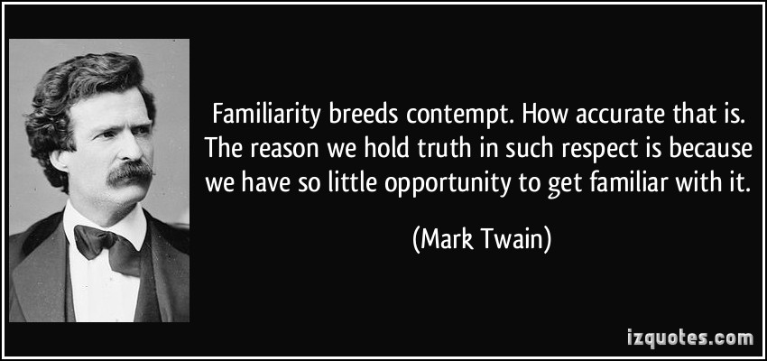
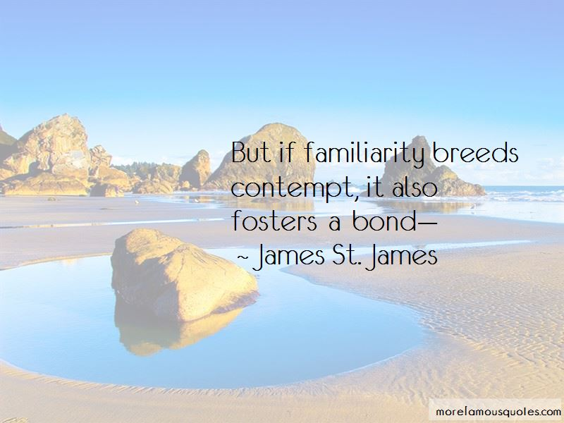
Why we need to talk about the Communion Service?
Notes:
Quote slide 1. It is because, on the one hand, our familiarity with it may not have moved us to contempt.
Still, sometimes familiarity may cause some sleepiness, some lethargy, some simply closing our eyes to fresh understandings so that we offhandedly respond to the experience with,
"Oh yea, I know. I know. I know." When in actuality, it is an experience which, with thought, with prayer, with enlarged understandings can be both ancient and fresh, historical and current. Where new, angles can help us see and experience it as if for the first time!

Slide 3
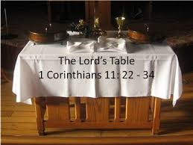
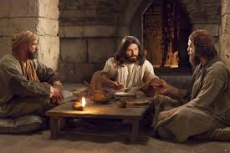
THE TABLE OF THE LORD
Notes:
In many if not most Christian traditions, the focus is almost exclusively on what we call the table of the Lord.
We will talk about the table, the bread, and the wine, but true to the practice in the Seventh-day Adventist Denomination of Christendom, let's first focus on what preceded the table and the transition of Passover to the Lord's Supper, Holy Communion.

Slide 4
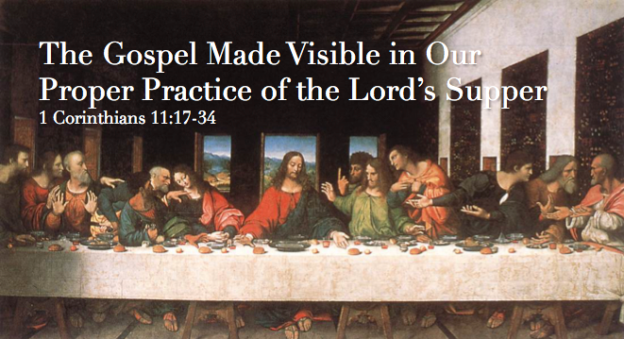
Notes:
What happened in that upper room, the teaching by demonstration, using bread and wine is echoed in Jesus' prayer in John 17.

Slide 5
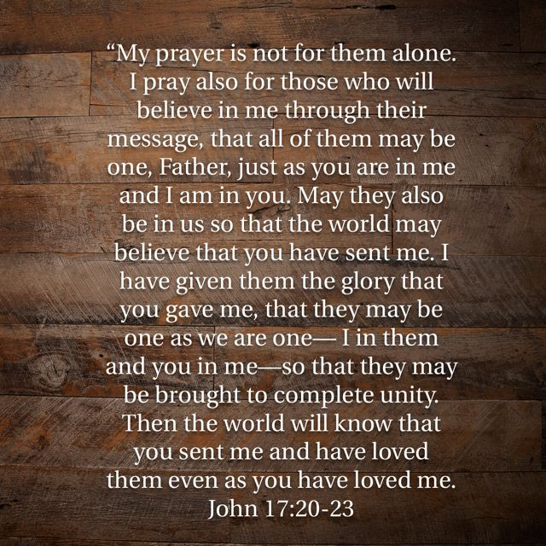
Notes:
It was a prayer that night two millenniums ago, and, looking at Christ's body in the church today, it must be a prayer he continues to pray.
That night as they entered the upper room, I imagine the same old contentions, rivalries, jealousies for the best highest positions in Christ's coming new kingdom were still on their minds.

Slide 6
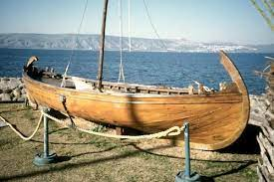
They have cashed in their lives and gone all-in with Jesus.
Notes:
For several years they've been following Jesus.
They have cashed in their lives and gone all-in with Jesus.
They assume themselves to have made a wise investment, and they are looking for the payoff.

Slide 7

Notes:
Part of the same old song was the clarity that each disciple saw themselves as deserving the first place.
And their compatriots as deserving some lesser post.

Slide 8
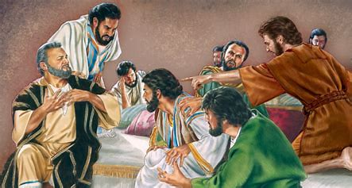
Notes:
No spirit of unselfishness filled the air.
Each was out to have the first place, the best seat, to be served!
The only unity was in their shared self-interest!

Slide 9
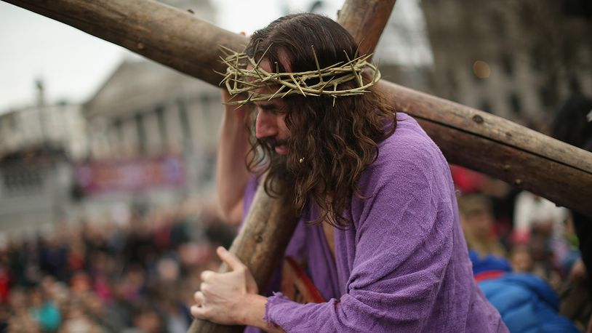
Notes:
Jesus knew what was coming.
His suffering and humiliation and death.
One last time, he took the opportunity to act out the very essence of his kingdom in a very tangible illustration.
He sought to cement what it means to do kingdom work and live free of the spiraling down the drain of a self-serving, self-focused, selfish life.

Slide 10
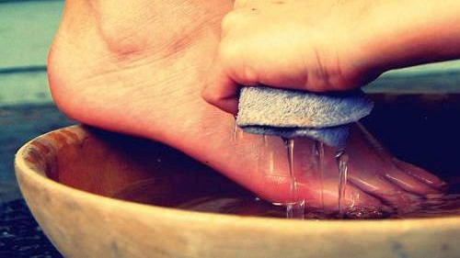
Notes:
In that culture, the most humble of services offered by a low-level humble servant would be washing the feet of guests gathered for a meal.
No one had arranged for a servant.
There grew an awkward silence in that upper room as each one around the table recognized the oops - no one had arranged for a servant to be there!

Slide 11
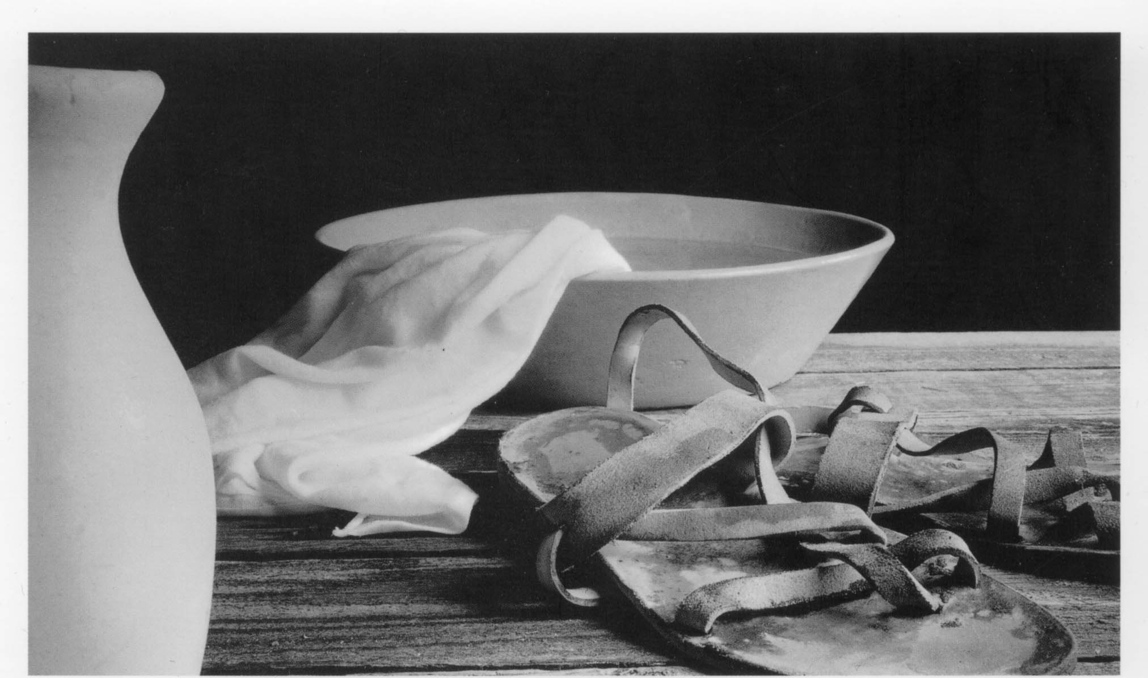
Notes:
As the reality dawned on each one, so did the sad determination of each that they would never take that role. The role of a servant to wash the feet.
No way.
They would not give service to another and voluntarily place themselves "beneath" one or all of the others.

Slide 12
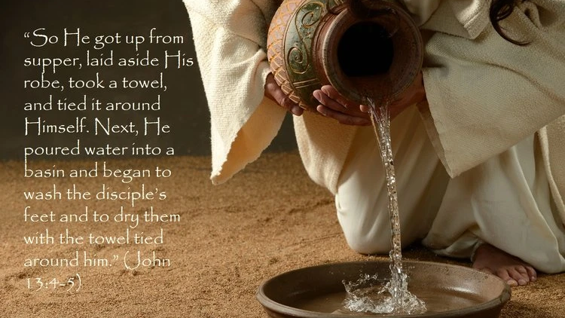
Notes:
The awkward silence is getting more and more uncomfortable.
And just before the silence is broken by an argument over who dropped the ball, who to blame.....
A question arose among the disciples, "who was great"?
Jesus "got up from the meal, took off his outer clothing, and wrapped a towel around his waist.
After that he poured water into a basin and began to wash his disciples' feet drying them with the towel that was wrapped around him."

Slide 13
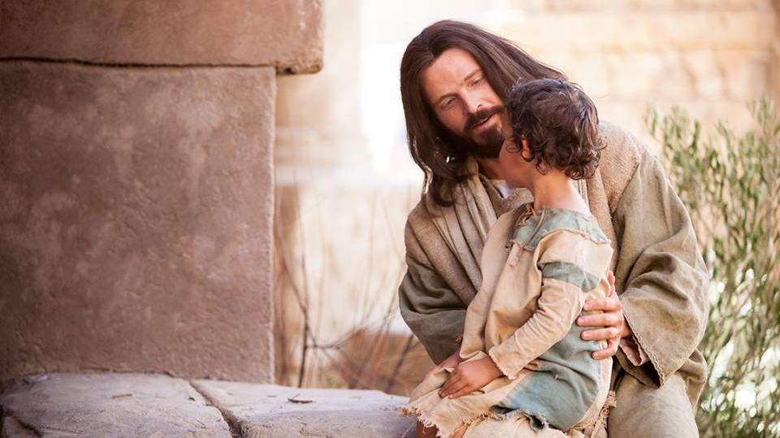
Notes:
The contrast between his heart and theirs was painted for them in this living mural. He had taught it.
He had invited a little child to stand in their midst and said, except you become as a little child...
He had said it and lived it, "the first shall be last and the last first."
He couldn't have used clearer words. "Whoever wishes to be great but be the servant of all."
He had declared that he came like no other leader, no other CEO, no other manager or boss because he came not to be served but to serve and to give his life as a ransom for many.

Slide 14
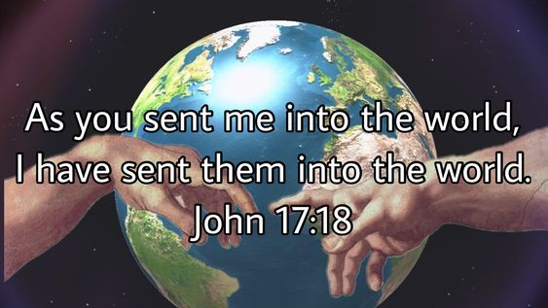
Notes:
Christ was an example of such a servant leader.
Make the leap from then to now.
Remember the words of Jesus prayer before they left that upper room. Jesus was clear that he had been sent by the Father into the world to serve it, to serve it's people, to lay down his life as a ransom for many.
And in John 17:18 Jesus prays these words: "As you sent me into the world, I have sent them into the world."

Slide 15

The path of serving rather than being served
Notes:
Here is where the body of Christ in a local congregation and in the universal body of Christ comprised of all his followers, here is one of the opportunities for absolute unity.
Regardless of your interpretation of truth differently from another fellow Christian, no matter your understanding of prophecy or end time events, or what happens to a person when they die, or how the millennium works, or the proper understanding of three angels messages, before and above and more centrist to Jesus intention for his church,
and where there can be unity in place of so much arguing is he calls us to follow him on the path of serving rather than being served.

Slide 16

Notes:
In the kingdom of God, the way up is down.
To think of others as better than ourselves.
To resist thinking of ourselves more highly than we ought, to recognize the upside-down nature of the kingdom of God that the highest, the very highest place in his kingdom is to be a servant.
The upside-down way of the kingdom of God.
This is what he taught in his personal demonstration just hours before he would serve the entire universe by dying on the cross.

Slide 17
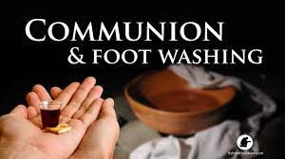
Notes:
This, this is why when we celebrate the Lord's Table in our denomination, we normally precede it by serving each other in the washing of feet.
We must be careful to not worship the tradition of washing of feet.
That service is just an illustrative practice to remind us of our calling in life 24/7 to be servants and servants serve.

Slide 18

Notes:
And when we unite in serving people we are fulfilling, answering Jesus prayer that we are one with him and the Father and the Holy Spirit and we are one with every other of his children who serve.
Because God is love and to love is to serve.
That's how we bring meaning to our testimony of love.

Slide 19
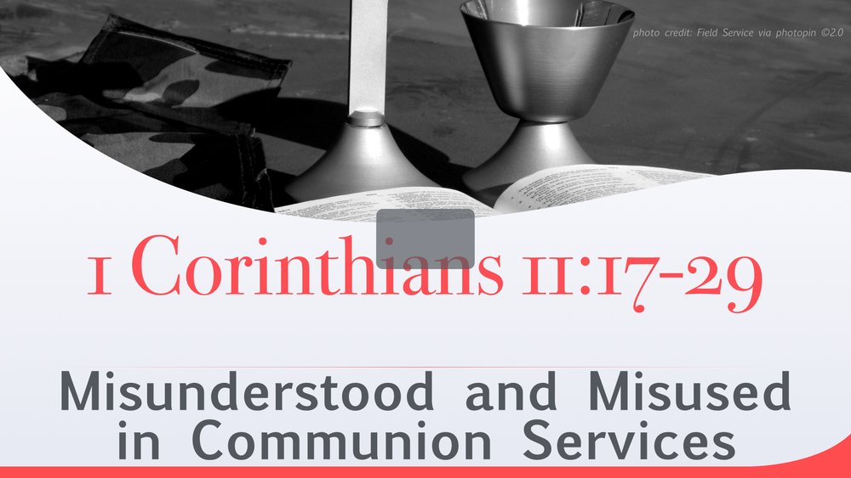
Notes:
When it comes to sharing the bread and wine at the table Paul's words to the Corinthians have scared too many people from participation.
The fear of eating the bread or drinking the cup in an unworthy manner.
What is Paul talking about, because it is a pretty stern warning?

Slide 20
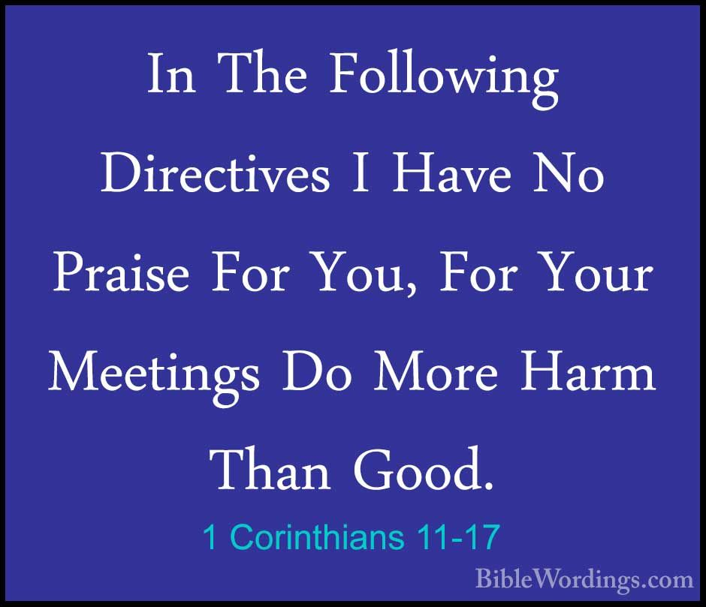
Notes:
I believe what Paul is talking about is coming to the table to be served rather than to serve.
If we look at the context, we read 1 Corinthians 11 we find the abuse that was taking place.
In vs 17 he writes, "...for your meetings do more harm than good."
The first problem he identifies is that "when you come together there are divisions among you."

Slide 21
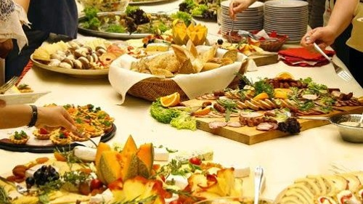
Notes:
What was happening in their communion service agape feast is that those with resources would bring their food and eat a lavish meal without regard for anyone else.
They would go ahead and stuff themselves while other believers were going hungry.
More picnic than potluck.
Instead of a shared cup some would drink to drunkenness.
Now we don't do this in our communion services but that was happening in Corinthian Communion services.

Slide 22
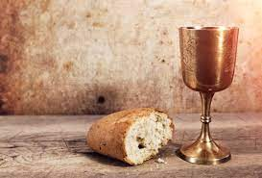

Listen carefully what makes a person unworthy in their participation is to not recognize what the bread and wine represent. And to participate without consideration of serving others.
Notes:
A simple act of serving one another is not followed.

Slide 23
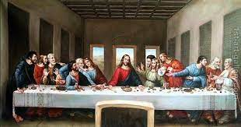
Notes:
It is hard to imagine any group more unworthy than the crowd around the table at the first Lord's supper.
James and John were there, seekers of the two best assignments in the coming kingdom.
Peter had a seat at the table, talk about unworthy, in just hours he will three times deny that he even knows Jesus.
All the disciples will abandon Jesus and run.
And who could have a more unworthy status than Judas who will leave the meal and betray Jesus to his enemies?

Slide 24

The Lord's Table, the Communion Service is something shared by followers of Jesus everywhere on the planet.
Why? Because it centers us, it reminds, it brings to our recollection the reality of where our salvation lies.
Not in our distinct understandings of scripture or prophecy. Not in our conforming to all the rules of whatever branch of Christianity to which we adhere.
Not in anything we do but simply in what he has done.

Slide 25

Today in our culture locally and globally there are plenty of issues that divide.
We are pulled, recruited to be loyal to certain camps, and to find unity there.
Politics and Religion and Race seem to top the list in polarizing and creating division and disunity.
Now more than ever, as followers of Jesus we must seek common ground.

Slide 26
Just the very oppositional stance regarding whether scripture affirms or denies. One group says if scripture doesn't condemn than it is Ok, and another group says unless scripture affirms than it is wrong!
Some are willing to look at just one verse and authoritatively declare, "The Bible says!" While others can't agree with a single verse of evidence but must only see that verse in relation to what the Bible as a whole says.
Notes:
Taking things out of context to prove one's point.

Slide 27
Where can there be unity?
How can we imagine Jesus getting his prayer answered that we all be one?
Put almost any two followers of Jesus in the same room, have them study some Biblical passages, and invariably there will be disagreement on what they mean.
Does this disagreement mean disunity?
And are there some understandings where there can be amazing unity?

Slide 28
I believe there are. Scripture clearly teaches them.
I believe that while followers of Jesus may hold a bunch of other things, they believe are important and true, and which might actually be both important and true, the larger the circle of what we insist as both important and true the harder unity becomes.

Slide 29
Maybe we like longer lists of what is important and true and worrying about getting everyone to understand how important and true those things are, because it is a great diversion, a distraction to the centrist call of Christ, to fulfill that to which he calls us.

Slide 30

I came not to be served but to serve and to give my life as a ransom for many.
And his prayer in John 17:18 "As you sent me into the world, I have sent them into the world.
" To love = to serve.
Notes:
Jesus said on several occasions, I came not to be served but to serve.

Slide 31
There is even in our divisive world, a place where all followers of Christ can gather in unity.
Jesus is the Savior
He calls us to love (that is to serve)
There is a glorious future
Notes:
The unity comes when we believe in this centrist doctrine.
Jesus is the Savior.
He calls to love (that is to serve)
There is a glorious future in this unity.

Slide 32
This we celebrate as we come to the table of the Lord. Jesus took the bread, gave thanks, broke it, and gave it to them saying,
This is my body, given for you, do this in remembrance of me.
In the same way he took the cup and said,
"This cup is the new covenant in my blood, which is poured out for you."

Slide 33
He is the Savior.
Before the meal after washing their feet, he said, "I have set you an example that you should do as I have done for you." To serve to love with skin on it not just words.
And with the cup he said, "For I tell you I will not drink again of the fruit of the vine until the kingdom of God comes."
Notes:
Service in action. Not just in words.

Slide 34
It was still there in the upper room that Jesus said these comforting words:
"Do not let your hearts be trouble. Trust in God, trust also in me. In my Father's house are many rooms; if it were not so, I would have told you. I am going there to prepare a place for you.
And if I go and prepare a place for you, I will come back and take you to be with me that you also may be where I am."
John 14:1-3

Slide 35
There is a glorious future.
Maybe all the other stuff is of greater and lesser importance at different times but Jesus' prayer for unity for oneness is a call to humility about our beliefs.
Share unity, oneness with him and the father is a call worthy of following and in this shared table there is unity that
Jesus is the savior,
he calls us to love and serve
there is a glorious future.

Slide 36
This service makes me wish for us to be physically present with one another, to serve and to share in the table.
To practice open communion that all are welcomed to the table of the Lord.
So separated physically we join together to share the Lord's table in the unity of Jesus our savior who has called us to love and serve and who is preparing for our glorious future with him.
Welcome to the table.

Slide 37
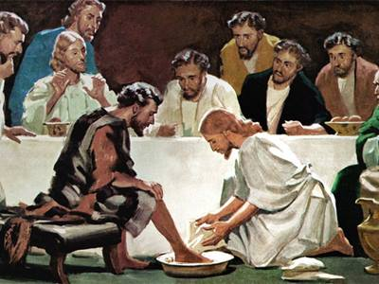
Notes:
Those of you who are joining on zoom can now participate in foot washing. At present we are not observing this ordinance in sanctuary, in person service. We will remain in our seats spend time in mediation while we listen to some music.

Slide 38
