Slide 1


Slide 2
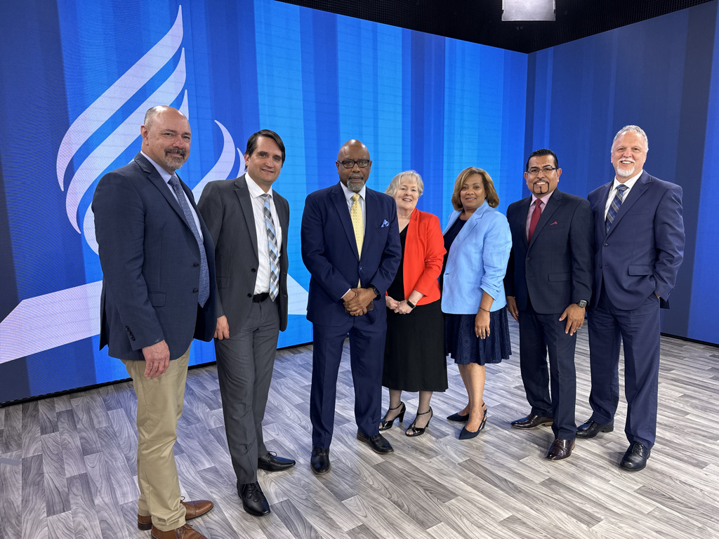
Potomac Conference Administration
Steve Laing
VP for Education
Rafael Soto
Director Hispanic Ministries
Charles Tapp
President
Karen Senecal
VP for Finance
Debra Anderson
Assistant to the President for Communication
Jose Vazquez
VP for Administration
Rick Labate
VP for Pastoral Ministries

Slide 3
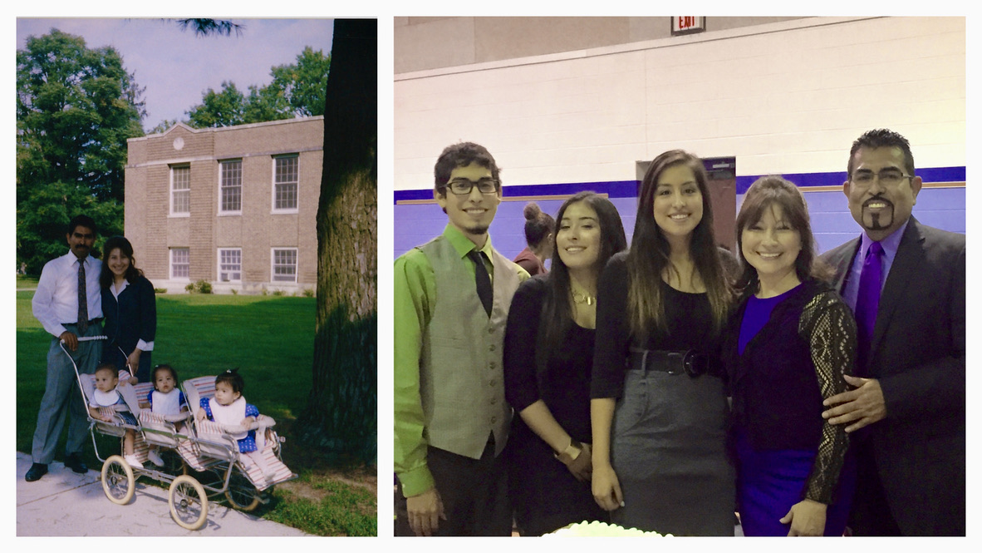
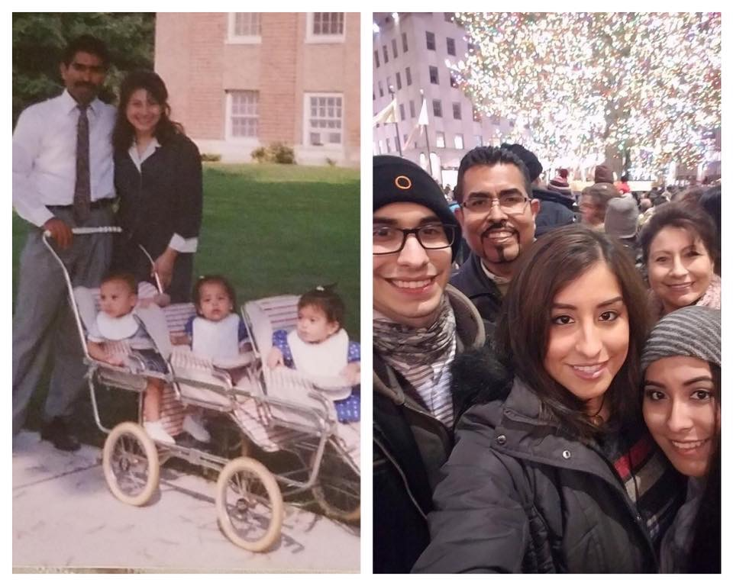

Slide 4
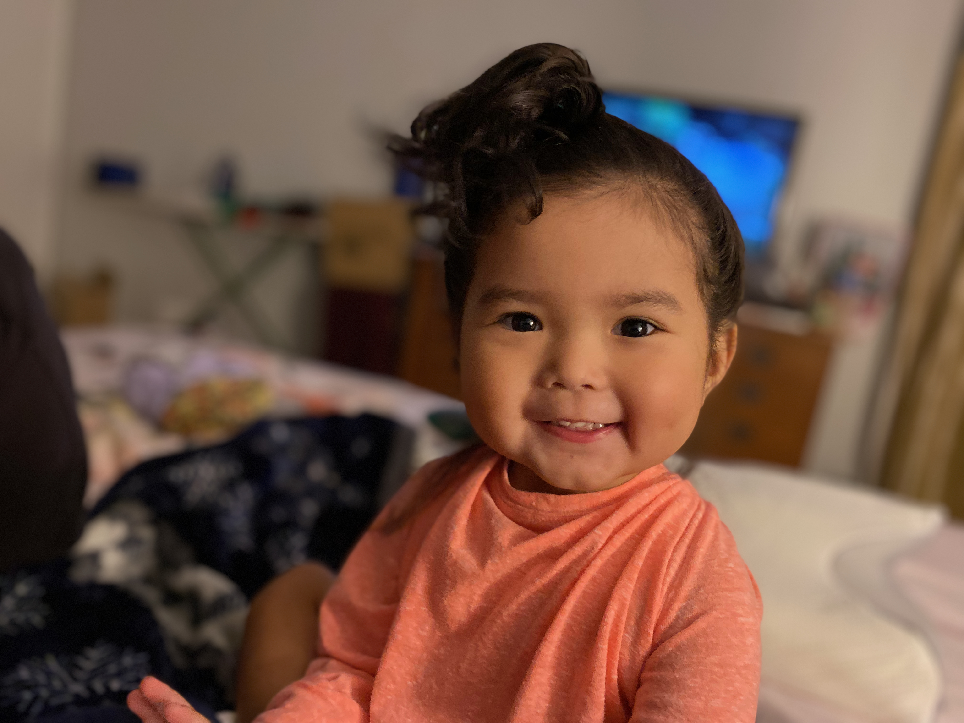
Mila Marie

Slide 5


Slide 6
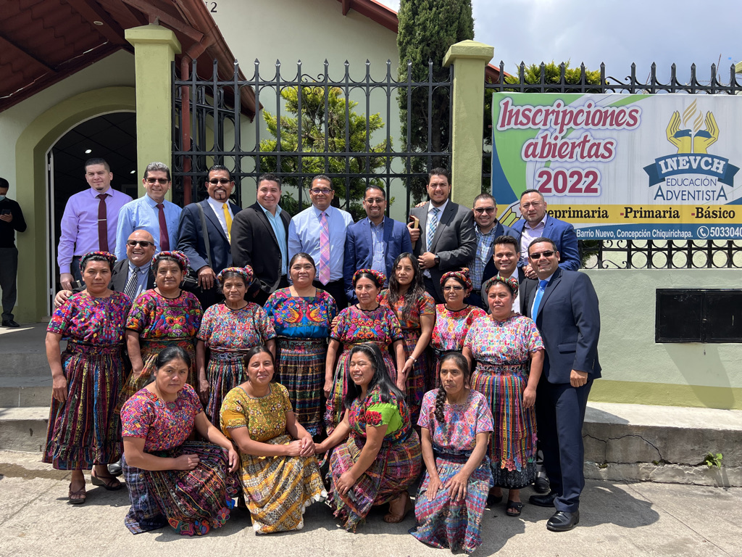
Quetzaltenango
Concepcion de Chiquirichapa

Slide 7
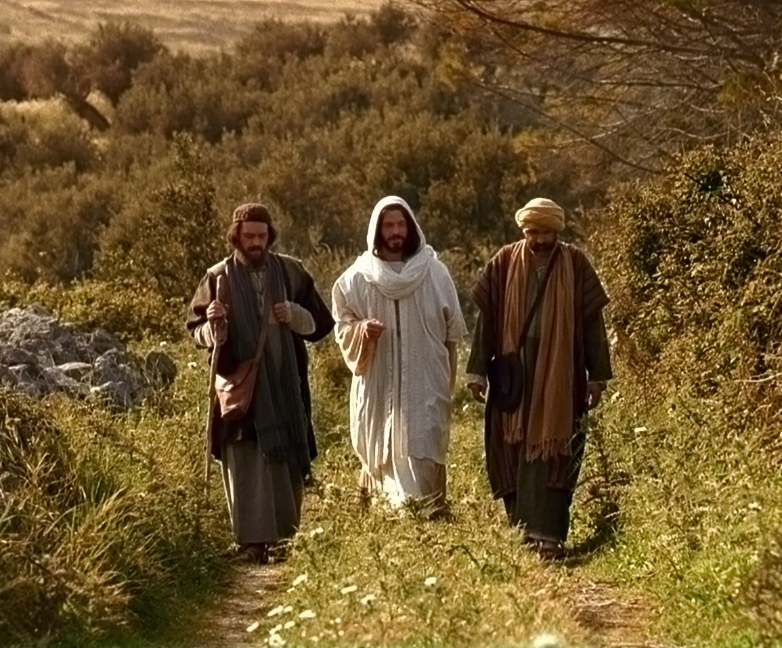
Abide With Us
Quédate Con Nosotros

Slide 8
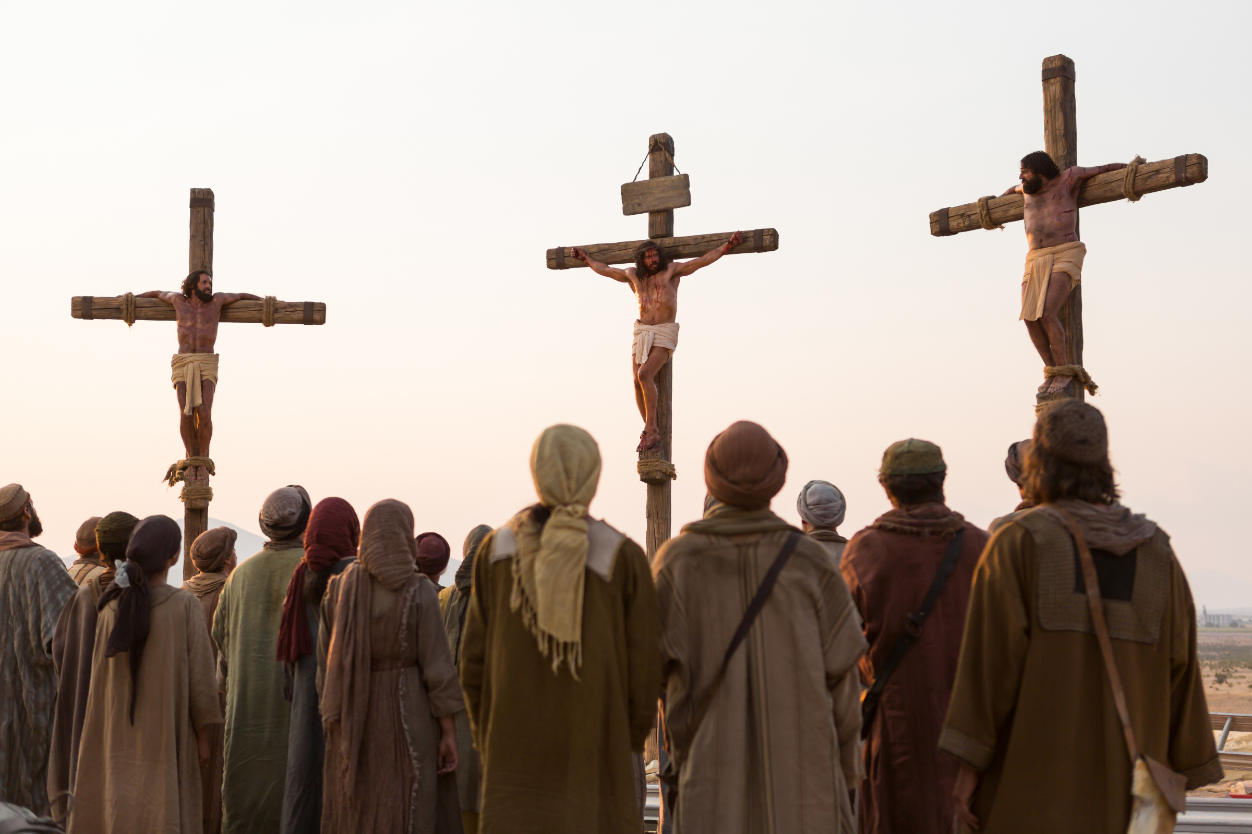

Slide 9
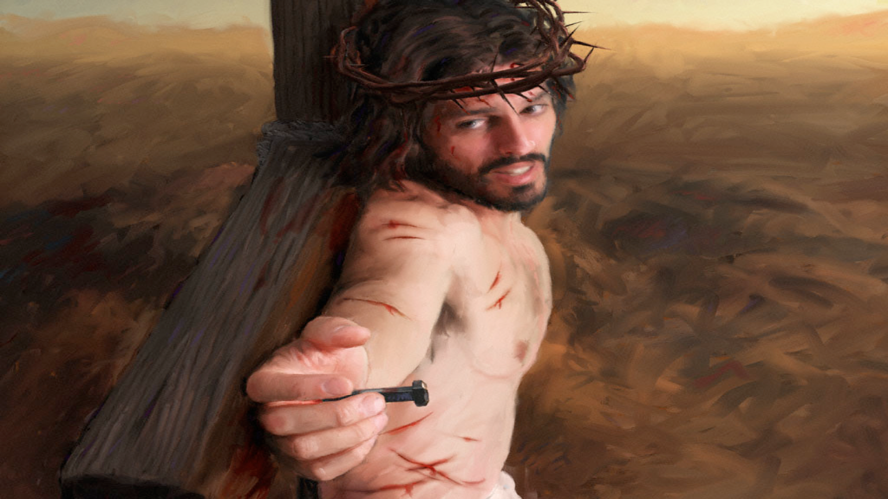

Slide 10
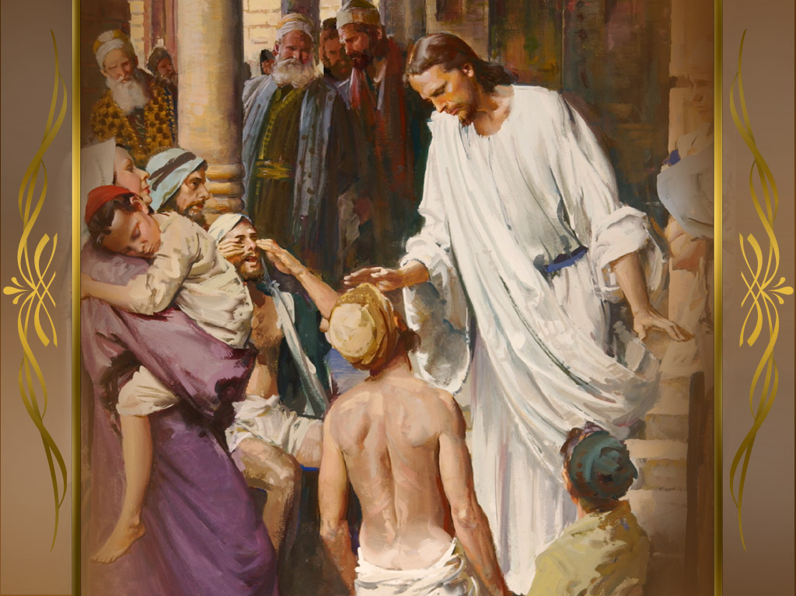

Slide 11
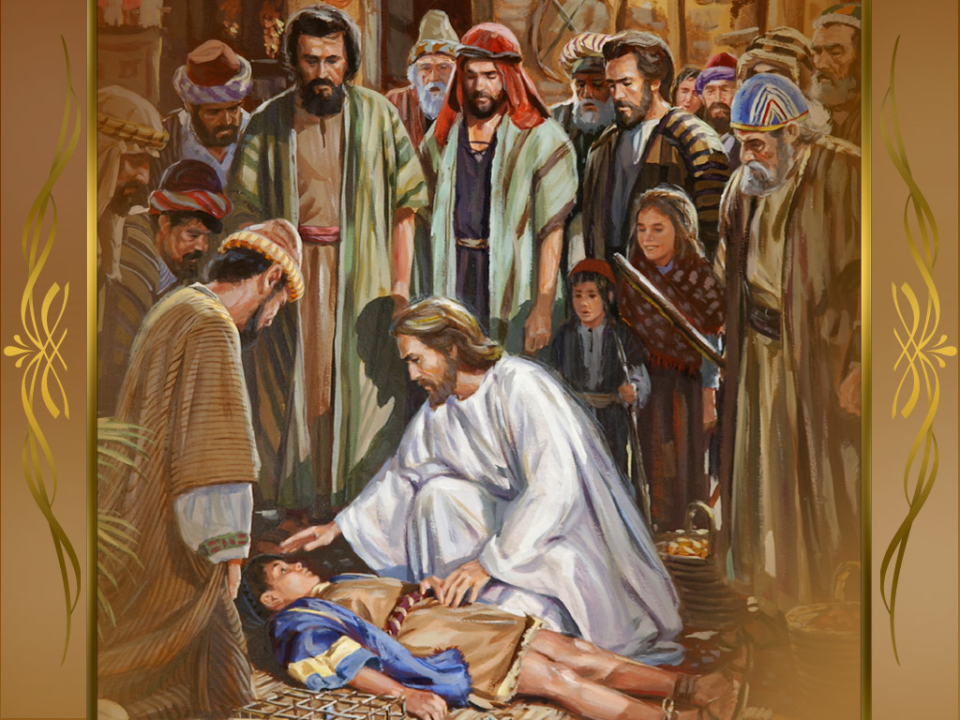

Slide 12
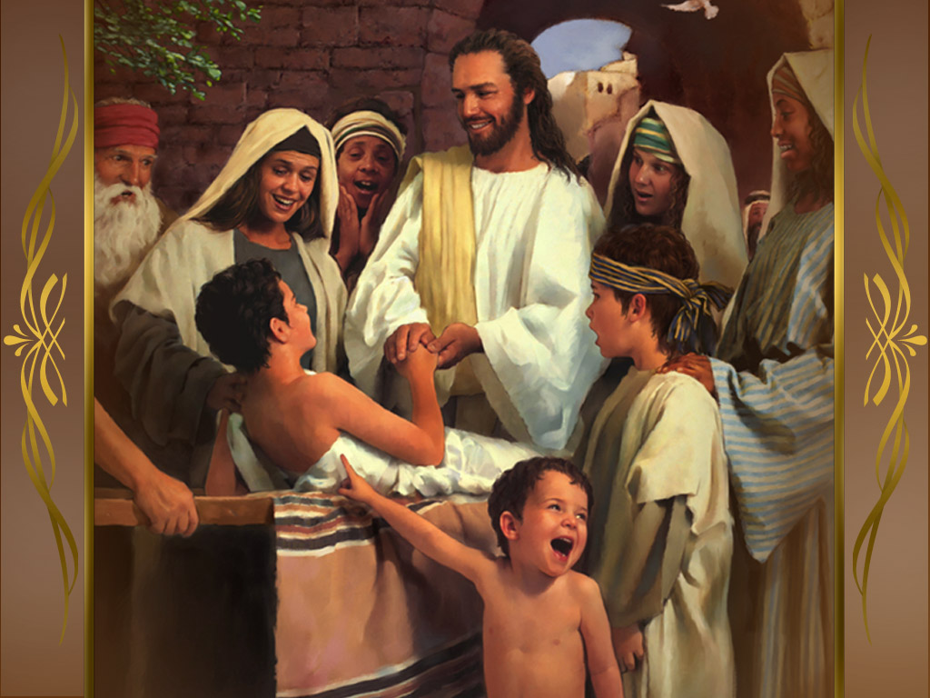

Slide 14
Luke 24:13
Lucas 24:13

Slide 15
Emmaus

Slide 16
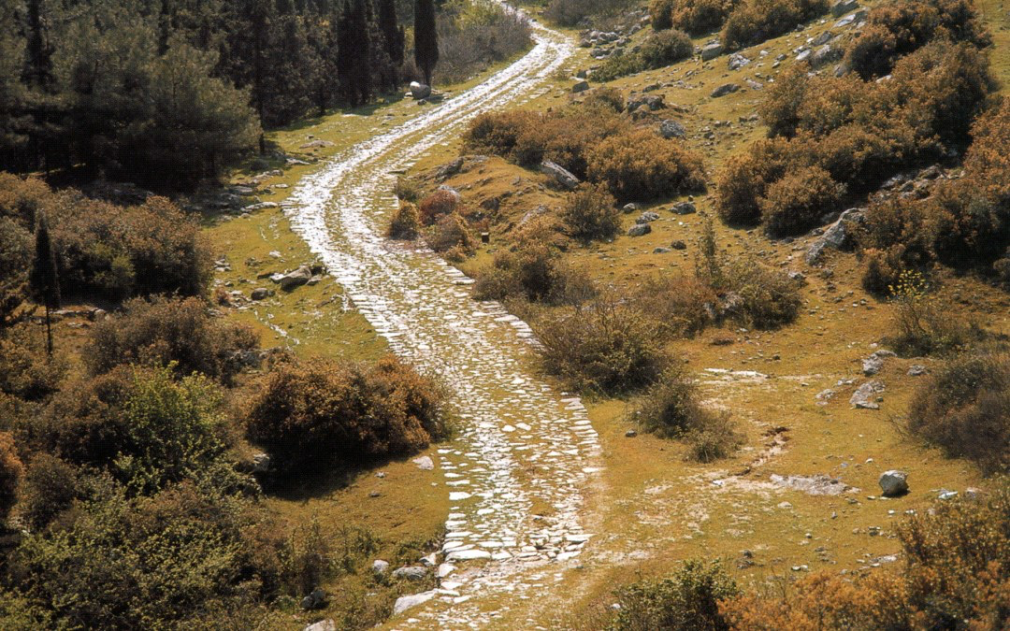
Emmaus= “Hot Baths”
Emaús= “Baños Calientes”

Slide 17
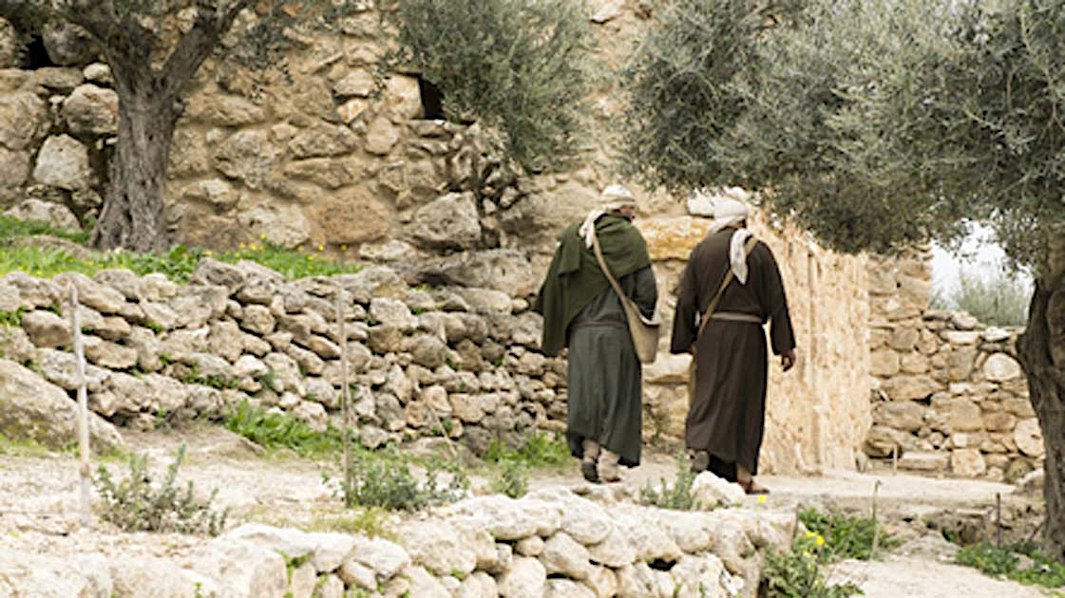

Slide 20
Jesus walks with us.
Jesús camina con nosotros.

Slide 21
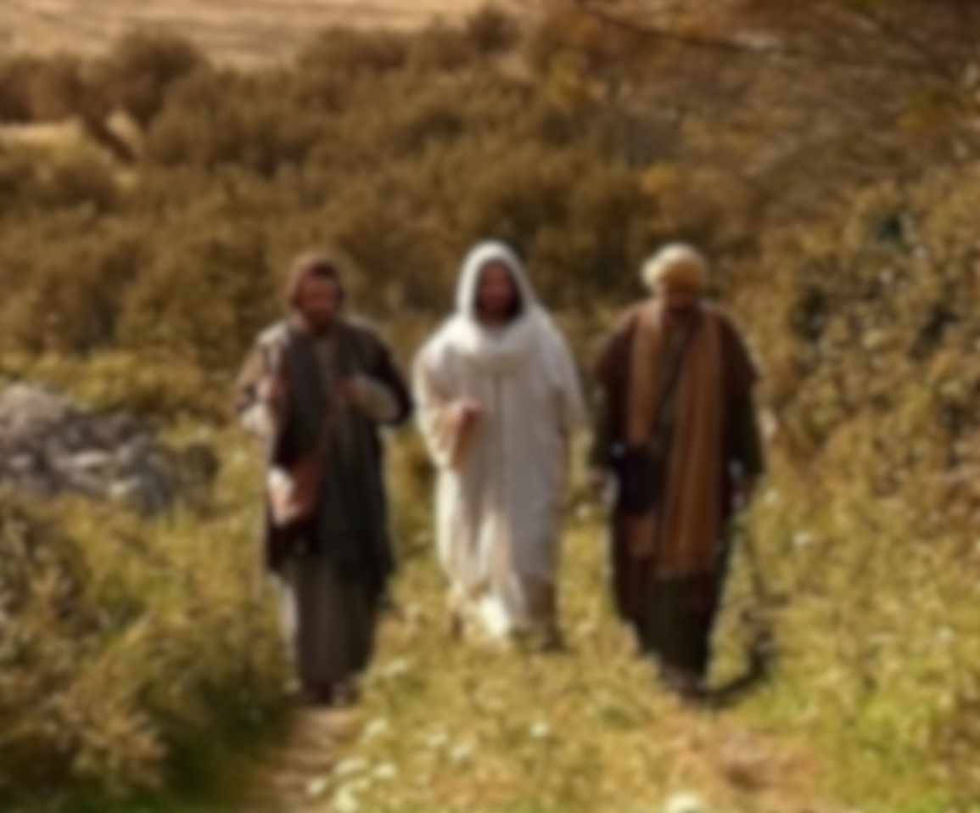
Sorrow
Tristeza
Joy
Felicidad
Fear
Temor
Faith
Fe
Cowardness
Cobardía
Confidence
Confianza

Slide 22
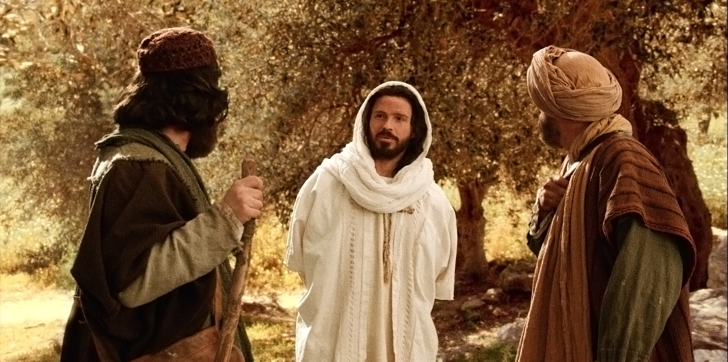
Jesus talks with us.
Jesús habla con nosotros.

Slide 25
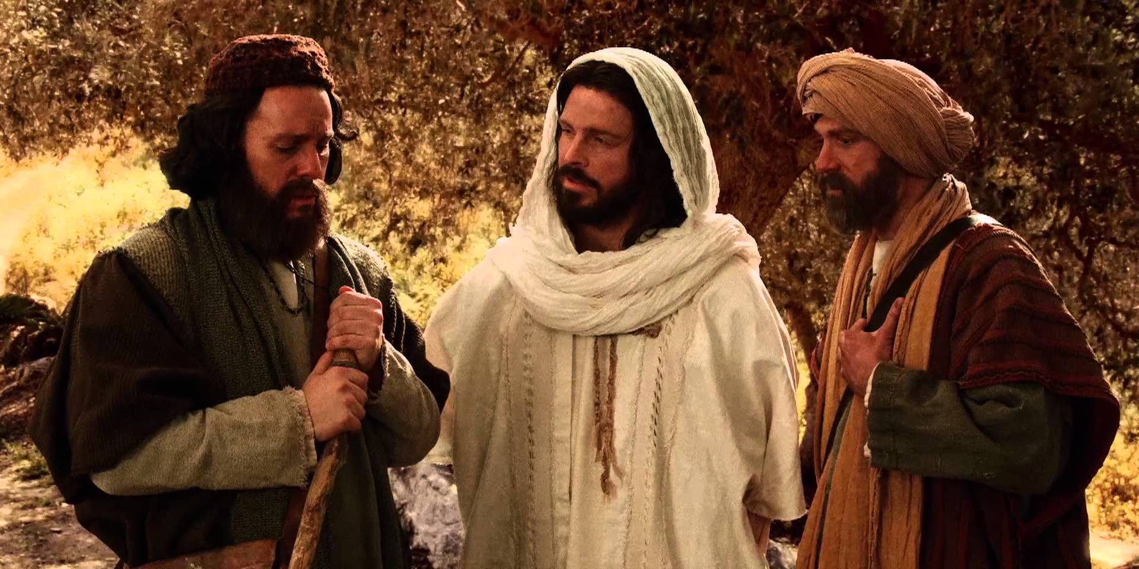
Jesus wants us to talk with Him.
Jesús quiere que hablemos con Él.

Slide 26
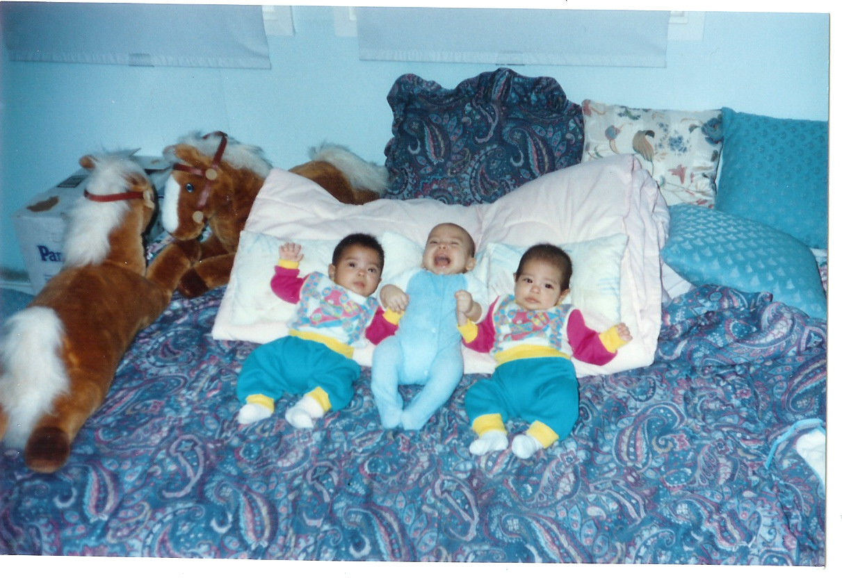


Slide 27
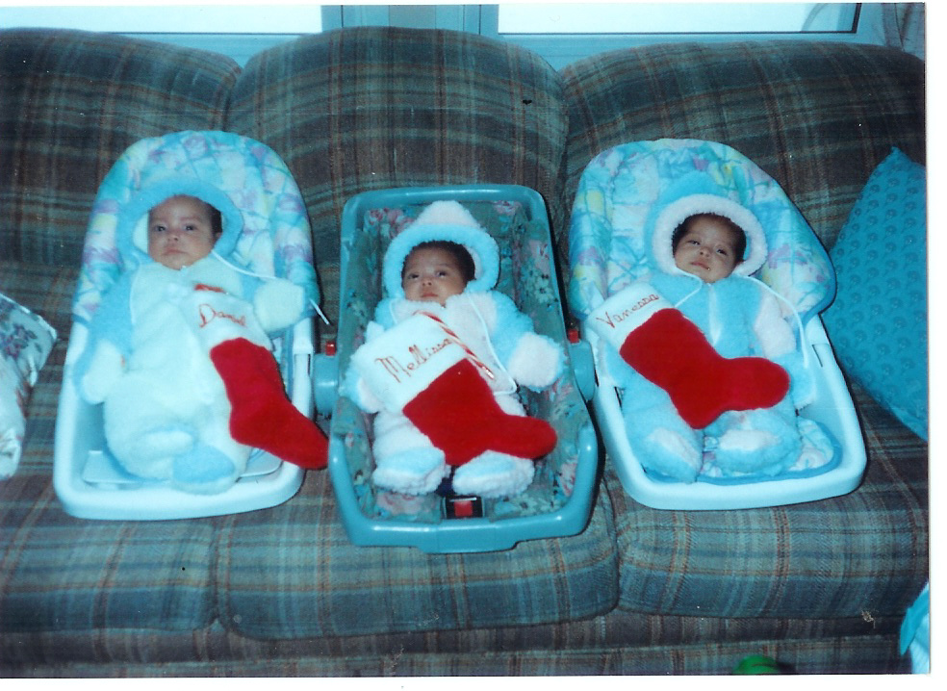

Slide 28
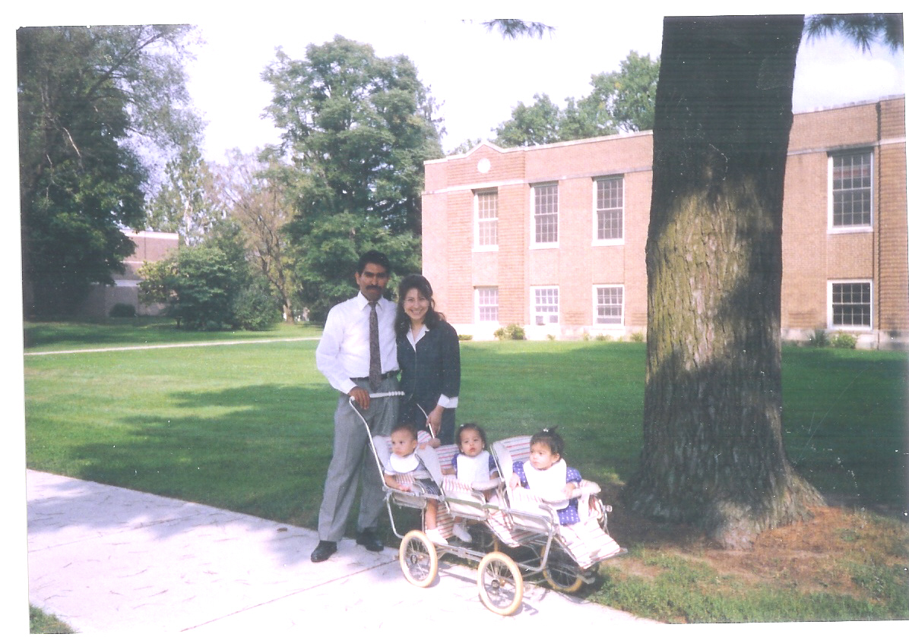

Slide 29
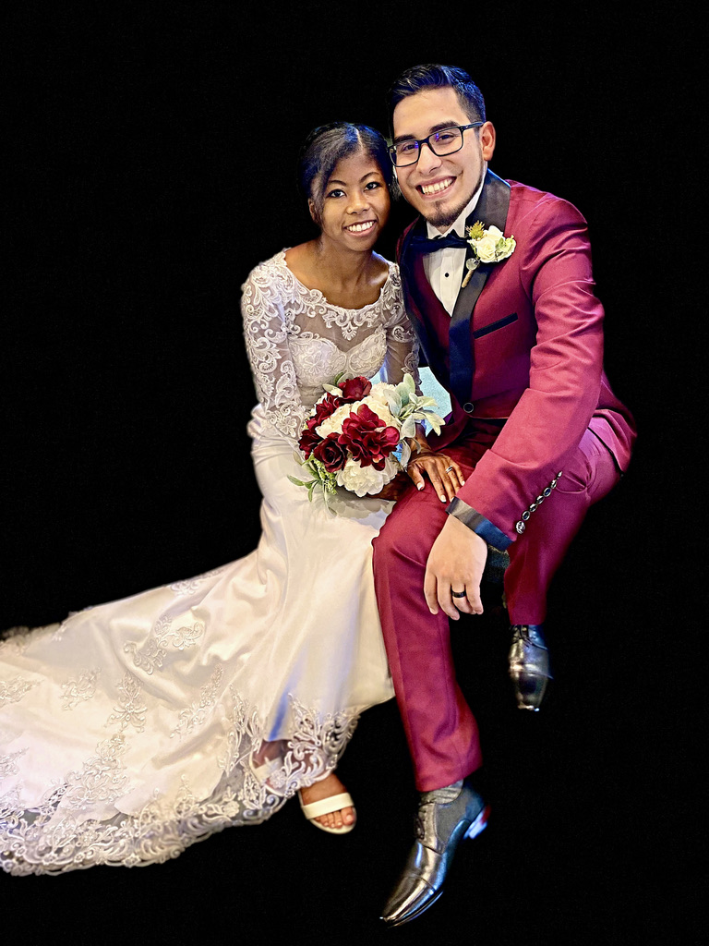

Slide 32
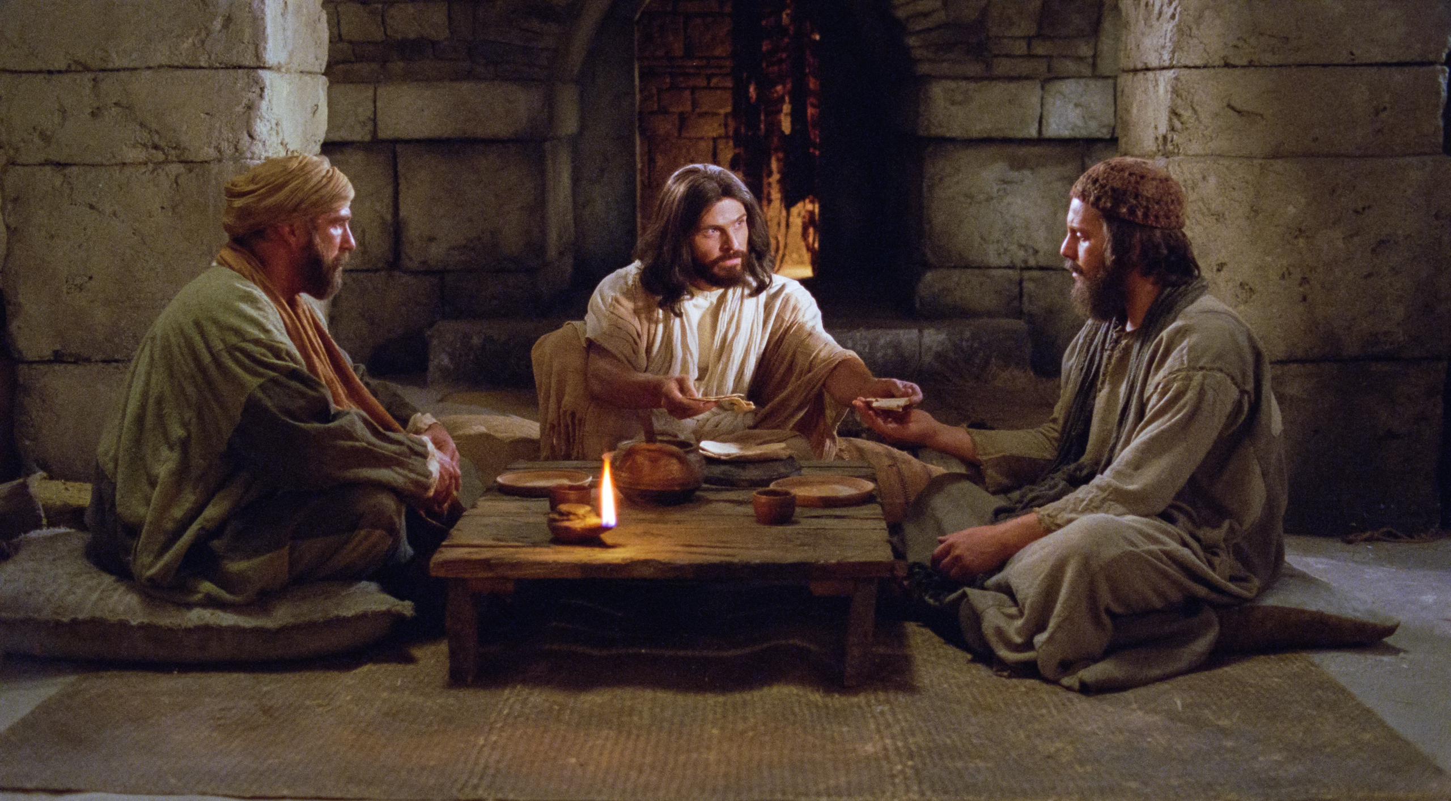
Jesus wants to stay with us.
Jesús quiere quedarse con nosotros.

Slide 34
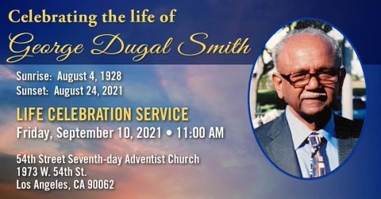

Slide 35
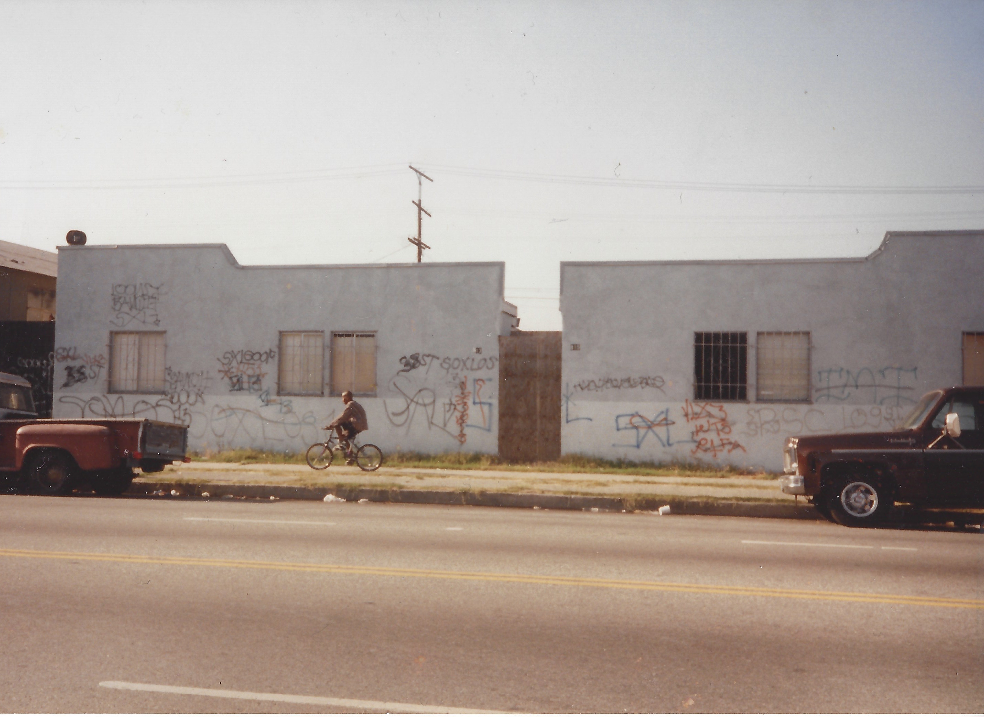

Slide 36


Slide 37
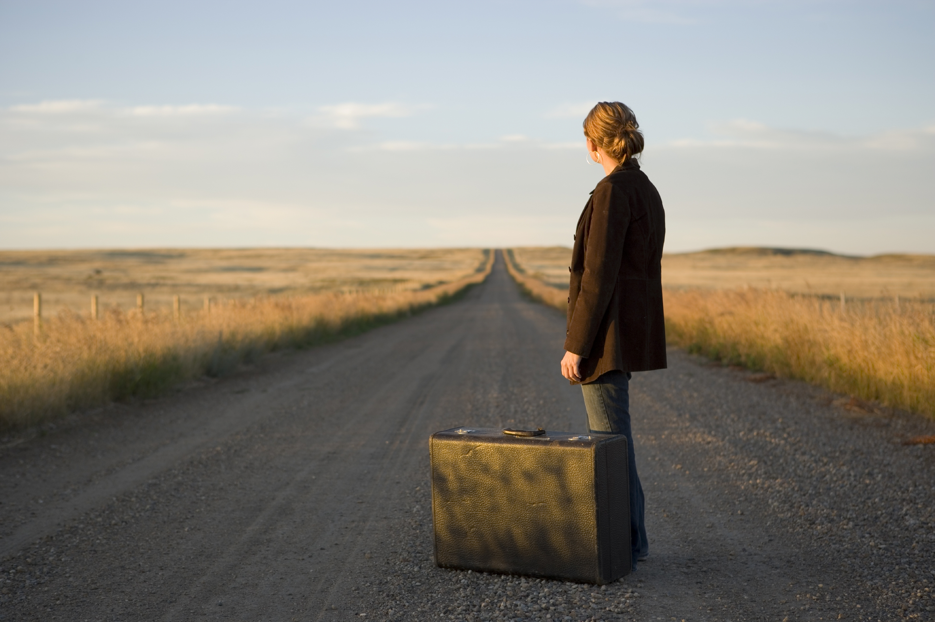

Slide 38

Where are you going?
¿A dónde vas?

Slide 40
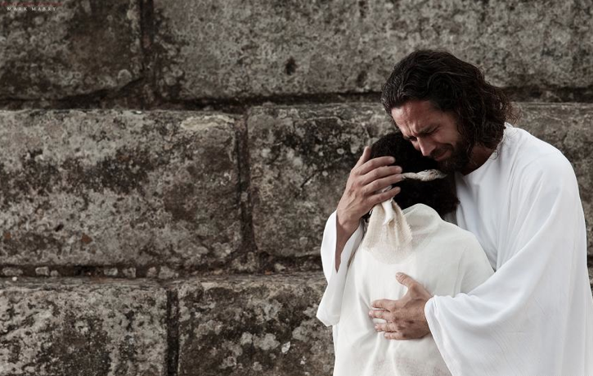

Slide 41


