Slide 1
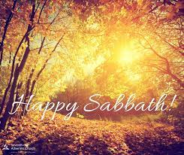
Notes:
Good morning. Happy Sabbath children of the the Most High!
What a joy to congregate this sabbath morning,
Let us thank our heavenly father for keeping us in the perfect since we left here last Sabbath, His goodness has been with us in our various activities through the week.
Let us thank our Lord always and may we increase in the knowledge of the Lord during this Sabbath celebration that are enriching and helpful in our Spiritual life.
May God be with you until we finish. Stay blessed in the Lord

Slide 2
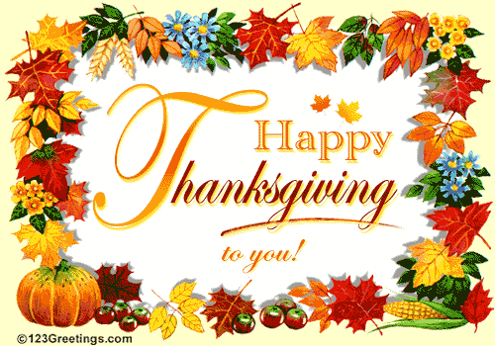
Notes:
This week, we will be celebrating the national holiday of Thanksgiving.
The first Thanksgiving celebrated in the United States is dated in October of 1621 when the Pilgrims and the Native Americans shared the harvest feast.
“We are so thankful for all the members who are present here in the church and those who are tuning in to watch us online today!
Although we have a particular Thanksgiving day that we celebrate as a nation, throughout history, peoples and nations and families have celebrated days of remembrance and thanksgiving, as well as day of corporate repentance and renewal. Thanksgiving should not be a yearly event but everyday we have to give Thanks to God our creator.
Happy Thanksgiving.
Let us pray.

Slide 3

Notes:
A few years ago, I was invited for a house-warming ceremony through a friend who was working in the house as a nanny. The owner was a Jewish gentleman and was a film producer. I was asked to bless the house as they just moved into this beautiful big house. I was humbled at this honor at the same time perplexed as to what would I say to a Jewish family on an occasion like that. The Holy Spirit gave me a passage from the book of Deuteronomy.
I want to thank Jessica for reading the scripture this morning. It is an appropriate passage for us as we contemplate on God’s goodness during this Thanksgiving season.
In this morning’s text, Moses urges the people of Israel to remember the Lord – as they enter the Promised Land with all its beauty and bounty – they are to remember the Lord – to be obedient and thankful.
“Deuteronomy” means “the second giving of the Law.”
After four hundred years of slavery in Egypt, God delivers Israel. God frees them and brings them through the Red Sea and into the wilderness of Sinai, where, due to their sin, they wander for forty years – until all of the adults – except for Joshua and Caleb – die – and then, with Moses’ death, Joshua and Caleb lead the children into the Promised Land.

Slide 4

BEGINS WITH A CAUTION
Notes:
In verse #1. Moses says Be Careful.
Read Deuteronomy 8:1 - Be careful to follow every command I am giving you today, so that you may live and increase and may enter and possess the land the Lord promised on oath to your ancestors.
The instructions of Moses begins with a word of caution, “Be Careful.”
The message is loud and clear: be careful to obey every and all commands of God.
Some would consider these many statements as mindless repetition. Why this “overkill”? Over emphasis.
Because humanity has proven since the beginning that it is nearly unfailingly not careful. Were Adam and Eve careful to obey all that God commanded? No, and their progeny, all humanity, has followed in their footsteps ever since.

Slide 5
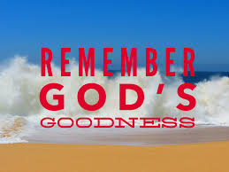
REMEMBER:
Notes:
,
^{#2, Moses says,}
² Remember how the Lord your God led you all the way in the wilderness these forty years, to humble and test you in order to know what was in your heart, whether or not you would keep his commands.
“You shall remember all the way which Yahweh your God has led you these forty years in the wilderness” (v. 2a).
Remembering is important, and God modeled that for us. God remembered his covenant with Israel, and that led him save Noah and the other inhabitants of the ark (Genesis 8:1)—and to promise never again to destroy all flesh by floods (Genesis 9:15)—and to redeem his people from slavery in Egypt (Exodus 2:24; 6:5)—and to show compassion (Psalm 106:45)—and to provide food (Psalm 111:5; see also Psalm 105:8ff.; 115:12). In other words, remembrance goes beyond bringing something from the past to mind. Remembrance leads to action—to response. The 4th command begins with this reminder to remember the Sabbath.
Remembrance solidifies relationships.

Slide 6
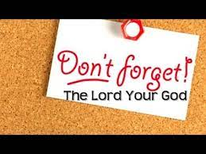
Remember how the Lord your God led you all the way in the wilderness these forty years, to humble and test you in order to know what was in your heart, whether or not you would keep his commands
Notes:
God called the Israelites to wear a fringe on their garments “so that when you see it, you will remember all the commandments of the Lord and do them, and not follow the lust of your own heart and your own eyes” (Numbers 15:40).
In other words, remembrance goes beyond bringing something from the past to mind. It leads to action—to response.

Slide 7
REMEMBER:
Notes:
² Remember how the Lord your God led you all the way in the wilderness these forty years, to humble and test you in order to know what was in your heart, whether or not you would keep his commands.

Slide 8
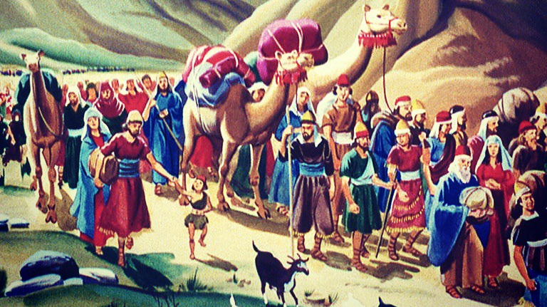
Notes:
³ He humbled you, causing you to hunger and then feeding you with manna, which neither you nor your ancestors had known, to teach you that man does not live on bread alone but on every word that comes from the mouth of the Lord.
⁴ Your clothes did not wear out and your feet did not swell during these forty years.
⁵ Know then in your heart that as a man disciplines his son, so the Lord your God disciplines you.

Slide 9
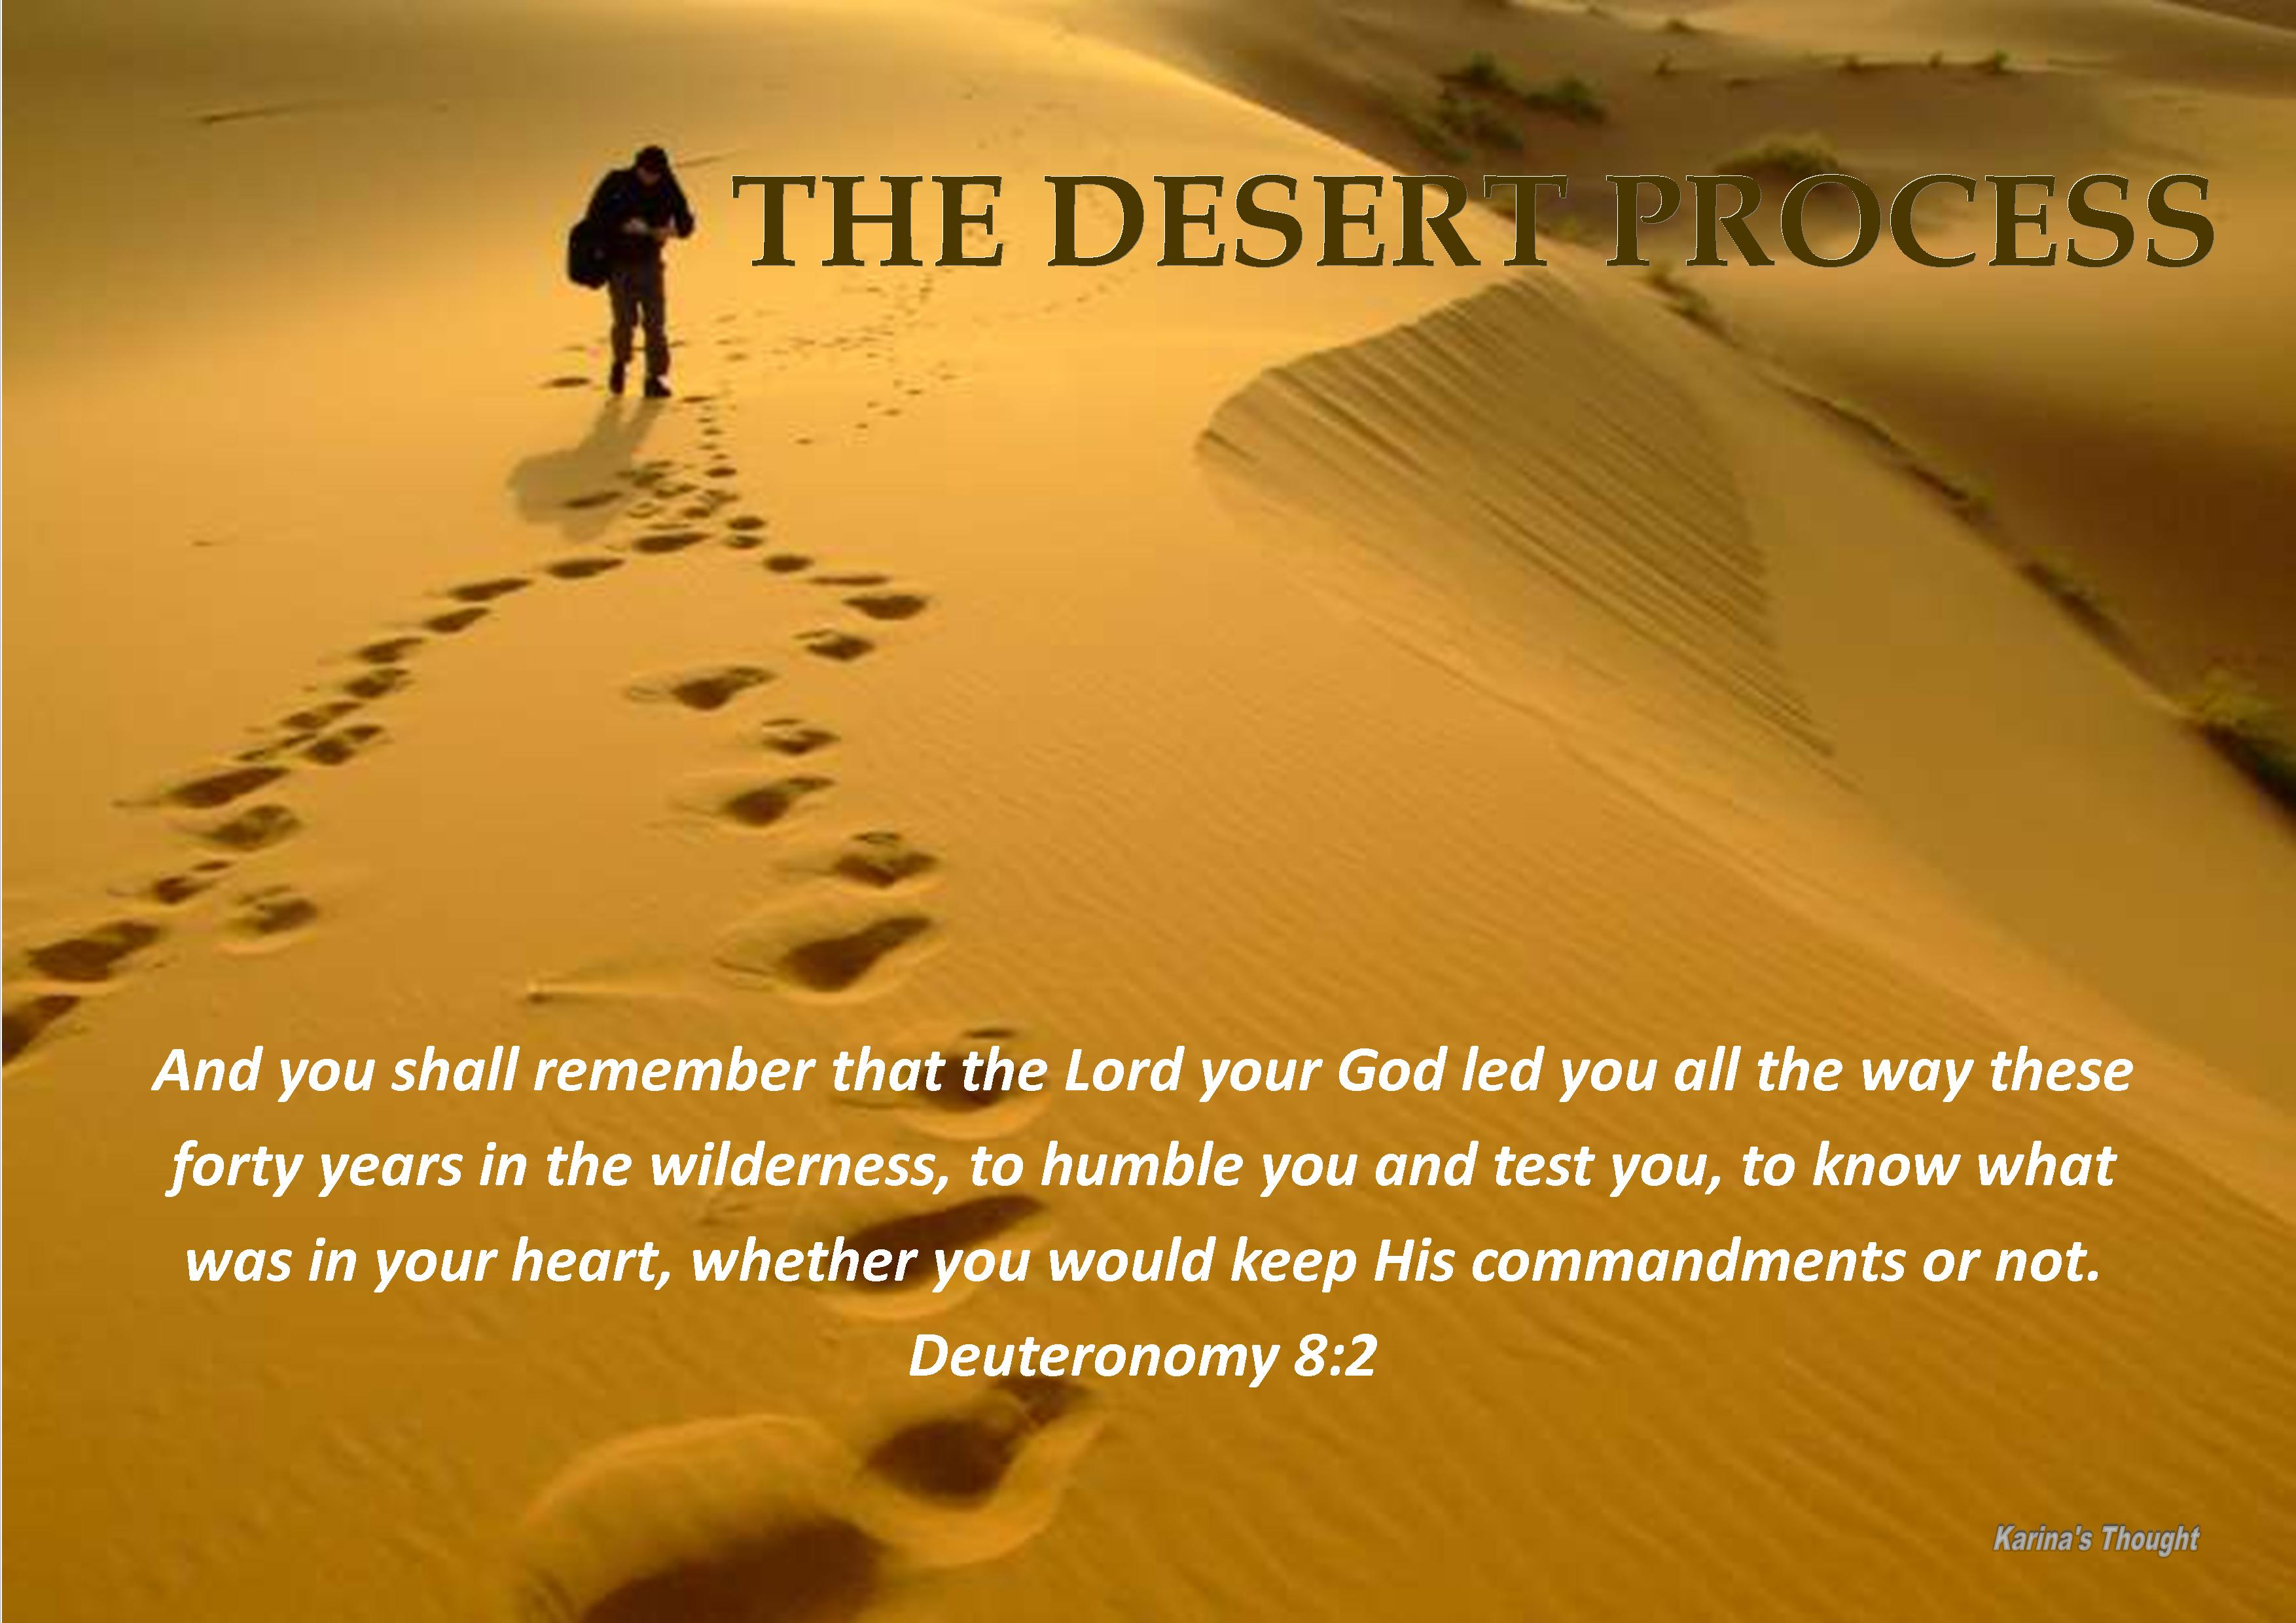
Notes:
We need to speak about the desert. We all go through these desert experiences. Bible calls it wilderness.
Wilderness is a place of lack, a place of difficulty, a place of want and danger. But we find it that the experience that different people have of this wilderness varies greatly and sometimes it's almost contradictory.
Like just two totally different things.

Slide 10
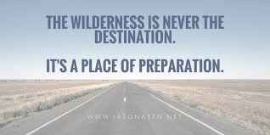
Notes:
I want you to note that the wilderness is not the destination. God does not want it to be. But he wants you to pass throgh it.
IT IS A PLACE OF PREPARATION.

Slide 11
If we think of the story of Israel, they were led into this being a place of vulnerability.
A place of danger and yet it's also the place of God's protection place where God shepherded over them.
It's even a place that later in the stories of King David, he ran into the wilderness for refuge for safety.

Slide 12
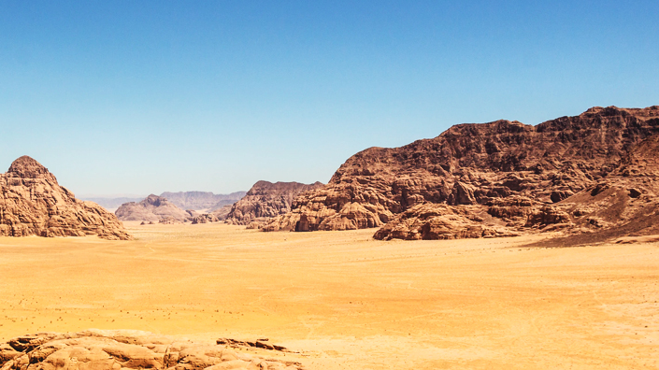
If we look at the wilderness in general, it's a desert so by definition it's a place of lack, a place of need. But it's also the place in the story of Israel where God provided. It's the story of place of provision.

Slide 13
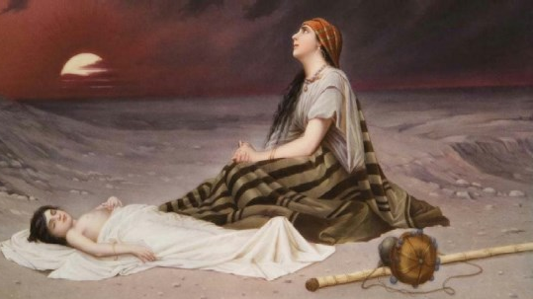
Notes:
If we're thinking about the wilderness in general a lot of the stories it becomes a place where people are cast off to.
Like the story of Hagar or Elijah.
They are sent out into the wilderness almost in a sort of personal exile and yet it's there in that place where they are alone that we find God comes to them that God speaks to them, appears to them

Slide 14
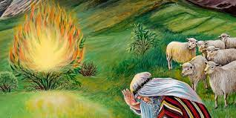
Notes:
Moses saw God in the wilderness. He lived 40 years in the wilderness before God sent him on that rescue mission.

Slide 15
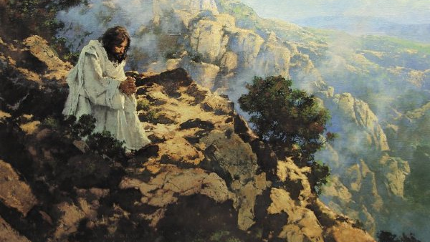
Notes:
In the story of Jesus we find that the wilderness is a place of trial and is a place of temptation but it's also the place of preparation.
God was preparing Israel for the land that they would come into, He is preparing Jesus for his public ministry.

Slide 16
Notes:
If we look at the wilderness in general it's a desert so by definition it's a place of lack, a place of need.
But it's also the place in the story of Israel where God provided.
It's the story of place of provision.

Slide 17
The wilderness is not a neutral place. It is a very formative place. God knows that the way in which it forms us depends upon how we respond to it and how we react to that. What we're going through and when we think about that description, I think it fits so well. This past year for some they took it as a time to really focus on some very important things of life. We all go through wilderness experience it is a place of preparation.

Slide 18

Notes:
Good parents know the importance of discipline—of setting clear limits and enforcing them faithfully. I have seen more than one child ruined by permissive parenting.
The military knows the value of taking people to the limits of their endurance—and of requiring strict compliance with orders and standards. Lives hang in the balance.
God’s effort to humble his chosen people was an act of love. It made it possible to keep them from destroying themselves—and their relationship with God.

Slide 19
^{1.} Observe the commands of the Lord your God,
2. walking in obedience to him and
3.revering him.
Notes:
Moses gives them simple instruction.
For the Lord your God is bringing you into a good land—a land with brooks, streams, and deep springs gushing out into the valleys and hills; ⁸ a land with wheat and barley, vines and fig trees, pomegranates, olive oil and honey; ⁹ a land where bread will not be scarce and you will lack nothing; a land where the rocks are iron and you can dig copper out of the hills.

Slide 20
Moses tells them, first, God is to be obeyed in thanks
for His blessings.
“For the LORD your God is bringing you into a good
land, a land of brooks of water, of fountains and
springs, flowing out in the valleys and hills, a land of
wheat and barley, of vines and fig trees and
pomegranates, a land of olive trees and honey, a land in
which you will eat bread without scarcity, in
which you will lack nothing, a land whose stones are
iron, and out of whose hills you can dig copper.
And you shall eat and be full, and you shall bless the
LORD your God for the good land he has given
you.”

Slide 21
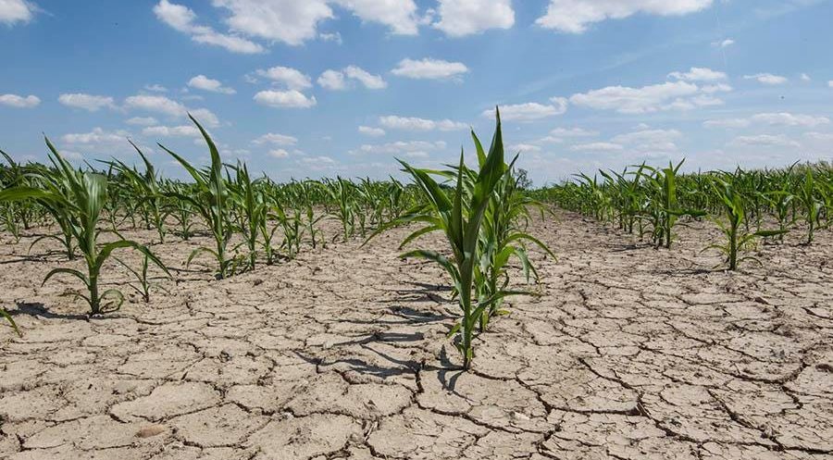
Notes:
A land wherein thou shall eat bread without scarceness,.... That is, should have plenty of all sorts of provisions, which bread is often put for: thou shall not lack anything in it; for necessity and convenience, and for delight and pleasure:
Moses tells these young men and women that they are entering the Promised Land that God is giving them, so they should thank God and obey Him.
They are entering a land where they will not have to go without water or strive to find it – it is a land full of brooks and fountains and springs.
It is not a wilderness, but a land of valleys and hills.
It is a land filled with wheat and barley and vines and fig trees and pomegranates and olive trees and honey and bread without end, not a wilderness of scarcity.
It is a land filled with minerals – iron and copper – that they can build and create with, rather than being without resources.

Slide 22
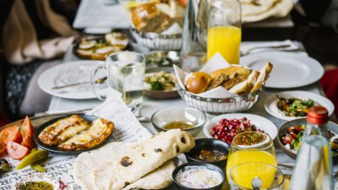
Notes:
Therefore you shall keep the commandments of the LORD your God, to walk in His ways and to fear Him. For the LORD your God is bringing you into a good land, a land of brooks of water, of fountains and springs, that flow out of valleys and hills; a land of wheat and barley, of vines and fig trees and pomegranates, a land of olive oil and honey; a land in which you will eat bread without scarcity, in which you will lack nothing; a land whose stones are iron and out of whose hills you can dig copper. When you have eaten and are full, then you shall bless the LORD your God for the good land which He has given you.

Slide 23
¹⁰ When you have eaten and are satisfied, praise the Lord your God for the good land he has given you.
Notes:
Why do we need to be reminded to obey and be thankful? We don’t have to be reminded to disobey and not give thanks – we don’t need to be reminded to complain, do we?
We have a standard – even before God – of what we think we deserve. And we won’t be satisfied until God and everyone else fulfills what we believe we should have.
We ought to thank other people for their service in appreciation of their doing their job well. We are more than just “consumers;” we are human beings who are to love one another – who are to consider each other better than ourselves – to do everything we can to better each other’s lives.
And then there is God. What has God done for us?
God has caused us to live in the United States. God has given us this church building and each other. God has allowed us to have housing, food, and enjoyments, as well. God has given us His Only Son to live and die that we would be made right with God and be received into His Kingdom.
Do we have any reason to obey God? Do we have any reason to thank Him?
Moses looks back at the history of Israel and tells them that God overflows blessings upon them – as seen in His Providence and Grace – and the right response is to joyfully serve and trust Him.
As we look back over our history – as a church – as individuals – do we have reasons to be thankful and obey? Are we surprised that we’re here – as a church – and as individuals? Can any of us look back and say, “I never thought I would be here. I never thought things would be this good. I never thought this church would still be open. I never thought God would do so much to get me to this point”?

Slide 24
Second, God is to be obeyed and not forgotten.
¹¹ Be careful that you do not forget the Lord your God, failing to observe his commands, his laws and his decrees that I am giving you this day.
Notes:
“Take care lest you forget the LORD your God by not keeping his commandments and his rules and his statutes, which I command you today, lest, when you have eaten and are full and have built good houses and live in them, and when your herds and flocks multiply and your silver and gold is multiplied and all that you have is multiplied, then your heart be lifted up, and you forget the LORD your God, who brought you out of the land of Egypt, out of the house of slavery, who led you through the great and terrifying wilderness, with its fiery serpents and scorpions and thirsty ground where there was no water, who brought you water out of the flinty rock, who fed you in the wilderness with manna that your fathers did not know, that he might humble you and test you, to do you good in the end. “

Slide 25
We see in our passage is this command to remember. It’s a command that appears 19 times in the book of Deuteronomy and another four times he says do not forget. Oftentimes they're put right together remember and do not forget.
Notes:
Is it harder for you to maintain a proper relationship with God in prosperity or in hardship?
Why?
Moses doesn’t want Israel to forget God and be proud of their own attainments once they get in the promised land (v. 1).
Moses warns them that prosperity may cause them to stop depending on God. The one thing that will help them to not forget God is to not stop praising Him. Failure to praise Him will lead to forgetting Him and the next step will be to start worshiping other gods.

Slide 26
WHEN AND HOW PRIDE GETS INTO ONES LIFE?
¹² Otherwise, when you eat and are satisfied, when you build fine houses and settle down,
¹³ and when your herds and flocks grow large and your silver and gold increase and all you have is multiplied,
Forgetfulness
Notes:
The wilderness taught Israel how to live in adversity. In the wilderness, they had just enough food and water for the day. They had to keep on the move, in part, to provide forage for their sheep and goats and, in part, because they had no homeland to call their own. The wilderness, for Israel, was like the refiner’s fire, purging the dross and purifying the whole.
Now Israel must begin to learn how to live in prosperity, a condition that they have not enjoyed for many centuries—not since Joseph died and a new pharaoh who knew not Joseph came to the throne.
But that is now due to change. For the first time as a nation, Israel is now to experience real prosperity—fine houses, generous herds and flocks—silver and gold in abundance. That sounds like a wonderful future, and it has the potential to be just that—but it also has the potential to be their undoing. As Thomas Burton put it, “If adversity has killed his thousands, prosperity has killed his ten thousands.”

Slide 27
The Dangers of Forgetting God
Moses spells out the dangers of forgetting that God is the source of every blessing that we enjoy (v. 11). These Jews had been slaves in Egypt, having nothing, and soon they would be living in nice houses, taking care of their large flocks and accumulating their silver and gold (vv. 12-13). This kind of success has a way of making us proud (v. 14), and we can soon forget God and what we were before God called us.
Notes:
There’s a story about a man from the city who was visiting relatives on a farm. He was out walking around with the farmer when the farmer gave a whistle and his dog herded the cattle into the corral, and then latched the gate with her paw. “Wow, that’s some dog. What’s her name?” The forgetful farmer thought a minute, and then asked, “What do you call that red flower that smells good and has thorns on the stem?” “A rose?” “That? it!” The farmer turned and called out to his wife. “Hey Rose, what do we call this dog?” (Source Unknown).

Slide 28
“then your heart be lifted up, and you forget Yahweh your God, who brought you forth out of the land of Egypt, out of the house of bondage“ (v. 14).
For the Israelites, the greatest temptation of prosperity is that they will become focused on material things and forget Yahweh, who made their prosperity possible.
Forgetfulness
Notes:
They will be tempted to forget their centuries of slavery in Egypt—and their miraculous deliverance in the Exodus. They will be tempted to forget the plagues that caused such suffering in Egypt that pharaoh finally allowed them to leave. They will be tempted to forget that, when they were trapped between the waters of the Red Sea at their front and the Egyptian chariots at their back, Yahweh saved them. They will be tempted to forget that, at Yahweh’s command, Moses stretched out his staff over the sea and divided it so that they Israelites might pass through the sea on dry ground. They will be tempted to forget that, once they had passed through the sea, at Yahweh’s command, Moses stretched out his hand over the sea so that the waters returned to their natural state, drowning the Egyptian army. They will be tempted to forget, not only their history with Yahweh, but Yahweh himself.

Slide 29
“then your heart be lifted up, and you forget Yahweh your God” (v. 14a).
The epitome of forgetfulness would be for the Israelites to remember their own victories—and to forget Yahweh’s role. They will be tempted to remember their military exploits—and the work they did to subdue the land itself—and to forget the hand of God that brought about their success.
Forgetfulness
Notes:
When that happens, they will begin to believe that they are a nation of giants, rather than a nation led by a wondrous God.
Then they will be poised to take a fall, because God will need to discipline them once again to bring them back to their spiritual senses.

Slide 30
“who led you through the great and terrible wilderness, with fiery serpents and scorpions, and thirsty ground where there was no water; who brought you forth water out of the rock of flint“ (v. 15).
Once settled in their good land—the land into which Yahweh is leading them—Israel will dwell in fine houses amidst many possessions, and their memories of the wilderness will quickly fade.
Forgetfulness
Notes:
In their comfort, they will be tempted to forget their uncomfortable years. They will be tempted to forget the poisonous snakes and their ever-pressing need for water. They will be tempted to forget that Yahweh provided water from a rock.
Moses tells them that he knows how it is – humans forget. We remember when she slights us or he insults us. But once we have lived awhile and things are good, we tend to forget the difficult past, once we get to the blessings of the day – we are pleased with where we are and we forget – we forget what happened, we forget to be thankful, we forget to obey God.

Slide 31
Moses tells them that he knows how it is – humans
forget.
We remember when she slights us or he insults us.
But once we have lived awhile and things are good,
we tend to forget the difficult past, once we get to
the blessings of the day – we are pleased with
where we are and we forget – we forget what
happened, we forget to be thankful, we forget to
obey God.
Forgetfulness

Slide 32
Moses tells them to be careful once they enter the land, Moses tells them to make sure they keep the Word of God before them and give thanks for all that God does.
Moses tells them in the present day of their bounty in the land, they must remember all that came before it: slavery, an expansive, terrifying wilderness, snakes, scorpions, and the lack of water.
Forgetfulness

Slide 33
Moses tells them not to forget God, but to remember that God chose to give the gifts of water out of the rock, of manna every night – and this preservation was given so that they would be humbled and do what is good – that they would obey everything God says in His Word and thank Him.
Forgetfulness

Slide 34
Do we remember where we were compared to where we are now?
Aren’t we all in a pretty good place, in a pretty good land?
Yes, things could be better, but couldn’t they also be so much worse.
Would any of us prefer to live in Iran or Iraq or Afghanistan or North Korea or before modern medicine?
Forgetfulness

Slide 35
Luke records for us nine people who forgot God almost immediately after receiving their blessing:
“On the way to Jerusalem [Jesus] was passing along between Samaria and Galilee. And as he entered a village, he was met by ten lepers, who stood at a distance and lifted up their voices, saying, ‘Jesus, Master, have mercy on us.’ When he saw them he said to them, ‘Go and show yourselves to the priests.’ And as they went they were cleansed. Then one of them, when he saw that he was healed, turned back, praising God with a loud voice; and he fell on his face at Jesus' feet, giving him thanks. Now he was a Samaritan. Then Jesus answered, ‘Were not ten cleansed? Where are the nine? Was no one found to return and give praise to God except this foreigner?’ And he said to him, ‘Rise and go your way; your faith has made you well’” (Luke 17:11-19, ESV).
Forgetfulness

Slide 36
Third, Remember the Lord and give Him thanks.
“Beware lest you say in your heart, ‘My power and the might of my hand have gotten me this wealth.’ You shall remember the LORD your God, for it is he who gives you power to get wealth, that he may confirm his covenant that he swore to your fathers, as it is this day.”
Notes:
Moses looks towards the future and tells them not to lose sight of Who has blessed them. “Remember it is God Who has blessed you and enabled you to get to this point. God gave your parents who followed God and brought you out of Egypt before you were conceived and went through the suffering in the wilderness, and they shared with you so you would live until the day that the Promised Land was opened to you.”

Slide 37
Moses looks towards the future and tells them not to lose sight of Who has blessed them. “Remember it is God Who has blessed you and enabled you to get to this point. God gave your parents who followed God and brought you out of Egypt before you were conceived and went through the suffering in the wilderness, and they shared with you so you would live until the day that the Promised Land was opened to you.”
Notes:
I’ve mentioned a former friend of mine who became more and more bitter, and one day I tried to encourage him by showing him how thankful he should be for all he has, and he angrily responded, “No one has ever helped me. Everything I have I earned myself. I have no one to be thankful to but myself.”
You gave birth to yourself? You gave yourself your body and caused it to function well? You raised yourself? You gave yourself an education? You made yourself right with God?

Slide 38
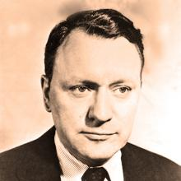
James James Reston – American
James Reston – American Journalist
James Reston was a syndicate
Columnist for the New York Times for more than 30 years. was a syndicated columnist for the New York Times for more than thirty years.
d columnist for the New York Times for more than thirty years.

Slide 39
He wrote
In America, we have learned something about how to deal with adversity since the great Depression, but not much about how to deal with prosperity.
We are very rich, but we are not having a very good time. We are producing so much food that we don’t know what to do with the garbage, while half of the human race goes to bed hungry night.

Slide 40
Jesus tells a parable:
“And he told them a parable, saying, ‘The land of a rich man produced plentifully, and he thought to himself, “What shall I do, for I have nowhere to store my crops?” And he said, “I will do this: I will tear down my barns and build larger ones, and there I will store all my grain and my goods. And I will say to my soul, ‘Soul, you have ample goods laid up for many years; relax, eat, drink, be merry.’” But God said to him, “Fool! This night your soul is required of you, and the things you have prepared, whose will they be?” So is the one who lays up treasure for himself and is not rich toward God’” (Luke 12:16-21, ESV).

Slide 41
Peter puts it this way:
“[Jesus’] divine power has granted to us all things that pertain to life and godliness, through the knowledge of him who called us to his own glory and excellence, by which he has granted to us his precious and very great promises, so that through them you may become partakers of the divine nature, having escaped from the corruption that is in the world because of sinful desire” (2 Peter 1:3-4, ESV).
Notes:
Do you recognize God in your prosperity? Listen to what Peter says,

Slide 42
HOW YOU DEAL WITH PROSPERITY?
Remember the Lord.
Give thanks to the Lord.
Obey the Lord.
Show your love of the Lord.
Notes:
Moses offers a solution in verse 18. ¹⁸ But remember the Lord your God, for it is he who gives you the ability to produce wealth, and so confirms his covenant, which he swore to your ancestors, as it is today.

Slide 43
^{THE WARNING}
¹⁹ If you ever forget the Lord your God and follow other gods and worship and bow down to them, I testify against you today that you will surely be destroyed.
Notes:
It is a warning for all of us. This Thanksgiving as you sit with your family, think about the goodness of God. And Remember, Don’t forget.

Slide 44
Application
It is so easy for me to forget to give God thanks, or credit, for the many things He does for me in this life.
He is the one who has given me the promise of an abundant life, and He never fails to fulfill His promises.
I just need to stop every once in a while and give Him praise for all He does.

Slide 45
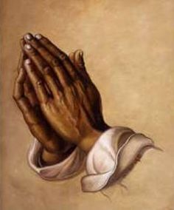
Let us pray:
Notes:
Let us pray:
Almighty God, all things are Yours – created by You and for You – and You chose to give us life and living and salvation through Your Son. We are quick to forget where You have brought us from and quick to forget You altogether. Help us to regularly consider where we have been and where we are now and what You have given us out of Your Amazing Grace. Humble us. Help us to remember You at all times and in all things. Keep any prosperity from making us forgetful. Send the Holy Spirit to keep us alert and knowledgeable of all You have done and continue to do out of love, and cause us to respond in obedience and thanks. Lord, make us thankful. May we be thankful to You. In Jesus’ Name, Amen.

