Slide 1
Can we learn from the past?
Twenty-Seventh Westford Symposium on Building Science

Slide 2
What am I here to talk about?
With our eyes on the prize of ultimate sustainability, carbon emission reduction, are we too often focusing on the tree rather than the forest. We always think we can do it better than our predecessors, but sometimes we forget what they did, why and how they did it.
Notes:
Tell them about the invitation to speak – Flatered but a little bit anxious
Coming up with something quickly and sending it off not to change my mind
Then opening the agenda and reading what I sent!!
Who do I think I am? I don’t have those answers
The whole thing led to a lot of thinking
Also had the opportunity to talk with a few people, about things we don’t stop and think about very often.
The more I thought and talked with those people , the more something started to take shape,
So if you allow me to wonder a little, I am hoping I can bring it back to a few take aways

Slide 3
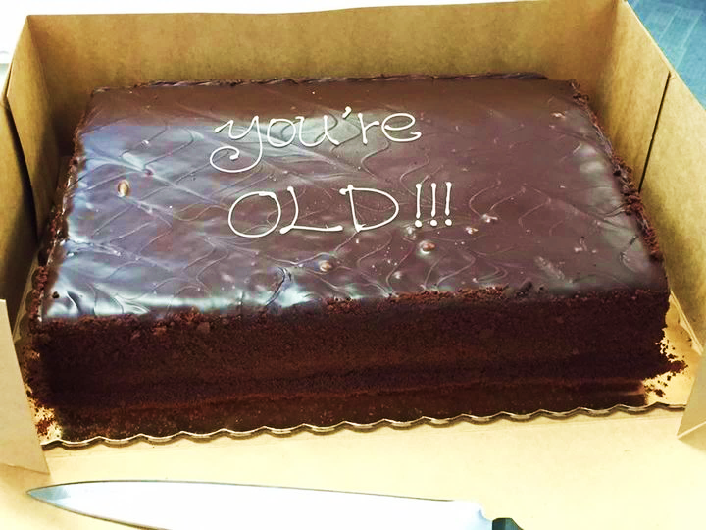

Don’t we all like to think we are 35?
Notes:
So I am starting that reflection , and the first thing that comes to mind is I am not that old!
I am only like what 35 or something around that! Would that be nice
I have a good friend that likes to remind me otherwise, for every big milestone birthday he sends me a cake…
A few years ago it was …
Then more recently …
Jokes aside an experience that stuck with me more recently is when
I attended a speed mentorship event and introducing myself and how I came about doing what I do and I mentioned the leaky condo crisis in Vancouver, and after someone came to me and said… Yeah I read about that
There is nothing to make you feel older than being part of the history books!

Slide 4

Who am I anyway?
Building Envelope Specialist
27 years experience, 22 of which were with a multi-disciplinary North American firm.
Managed the west coast building science department, from Edmonton to San Francisco
But only practiced engineering in Vancouver and lower mainland
Worked on all types of buildings, although now mostly institutional and multi residential NC
About 5 years ago, I started Evoke Buildings with a few other mischiefs –that has allowed me to be more involved in project work again
Vancouver
Climate zone 4
Lots of Rain November to April
Notes:
Since this conference brings together a rather wide spectrum of people, I think it is important for me to set the stage by telling you a little more about who I am professionally.

Slide 5
Things I was told that still ring through today!
Some only have a little to do with building science:
1
Hire for attitude, you can teach the rest
2
You can make a mistake, but don’t make it again
3
We are both advisors and gate keepers
4
It doesn’t matter so much what you know if you cannot communicate it
But something that is more relevant to today’s presentation
5
We have done that before.
Notes:
I would say I had 2 mentors that marked my career – Pierrer Gallant and Mark Lawton
Of course I learned from many more people, but those 2 they were part of my day to day for so many years, for sure they had an impact on my day to day and where is am at today
The tid-bits that pop in my mind, are like ….

Slide 6
The drainage cavity
Notes:
So let’s start with this one!

Slide 7
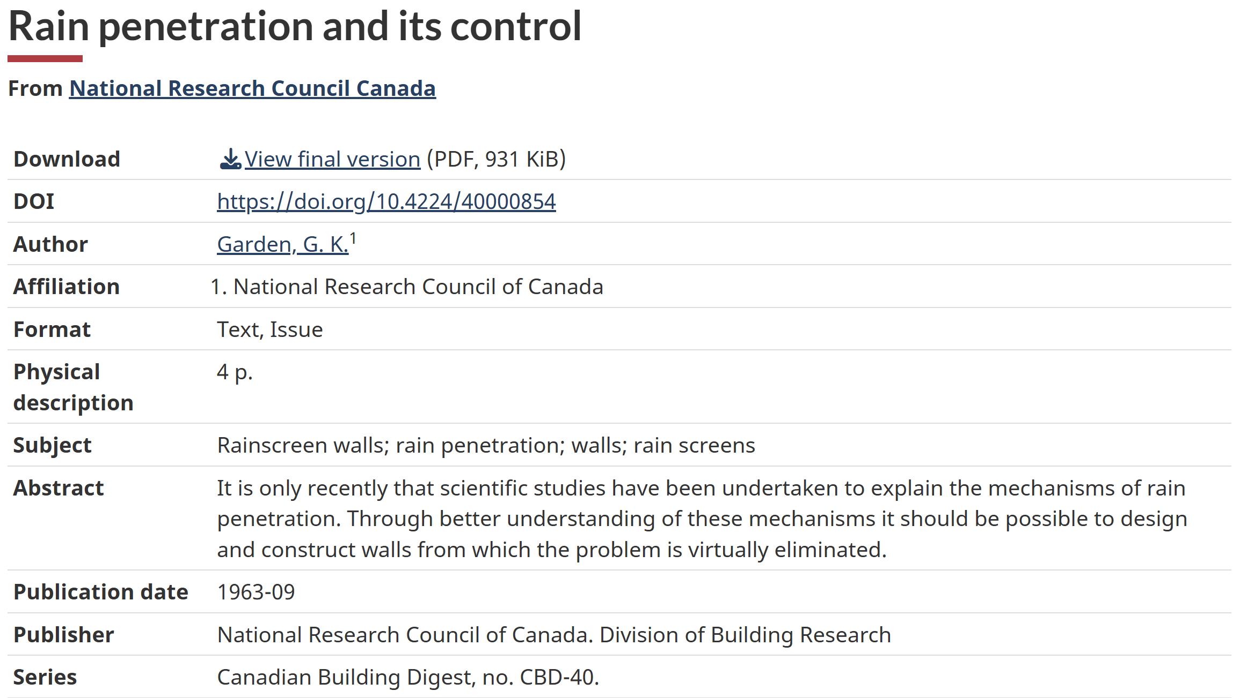
Early publications
Notes:
Joe BSI and CBD
Some of the early publication happen in the 1960 in Canada,
They were published through the National building Council under the Canadian Building Digest
CBD-40 was not the only publication talking about the cavity but perhaps the most comprehensive one, and it a lofty goal.
Read the abstract

Slide 8
The drainage cavity
“As with capillary suction and gravity, water entry resulting from an air pressure difference can be controlled by the introduction of an air space in the joint or wall.”
[JS: Summary. While much of the article remains correct and relevant, the most jarring omission in the document is any mentioned of what today is as the fundamental concept of drained rain penetration control strategies: that is a “second-line of defense” or drainage plane / water resistant barrier integrated with flashing and weep holes…
Notes:
I won't read you the entire publication, although CBD were quite short and to the point, but one sentence that probably summarize this one fairly well is this…
It was interesting, because when I was looking for it on the web it came up first in
[JS: Remarkably, the importance of a WRB1 was not singled out in the literature until the 1990s (although building paper and tar coatings had long been used in many buildings), and not integrated into North American building codes until the mid-2000’s.

Slide 9


The drainage cavity timeline
Rainscreen cladding can be traced back hundreds of years in some form or another.
1998 – Barrett Commission
Commission of Inquiry into the Quality of Condominium Construction in B.C.
Building Codes
Building Envelope Professionals (BEP)
1950’s
One of the US’ first rainscreen buildings, Alcoa Building
1963 – The rain penetration and its controls (CBD-40)
Published and begins adoption
2000’s
Rainscreen Principle brought to U.S. West Coast
1950
1960
1970
1980
1990
2000
2010
2020
1950’s
Became more widely used in UK and Ireland
1960’s
Research of rainwater penetration and adoption begins
1970’s
Cavity in facades starts to be more widely used in Canada
1980’s – 1990’s
People forget about it…
Notes:
After the publication of the CBD, adoption started in Canada.
I remember as a younger engineer fixing leaky face-sealed condo, of being in Awe at some point when taking apart the cladding of an older building NOT because it was leaking but because the cladding was tiles and they were falling off and finding out there was a cavity behind the tiles and the thick set,
But somewhere in the early 80’s, People forget about it
And that led to a pretty big disaster in BC, in particular in the lower coastal region
Barrett commission report published in 1998
Code implement in VBBL and BCBC

Slide 10
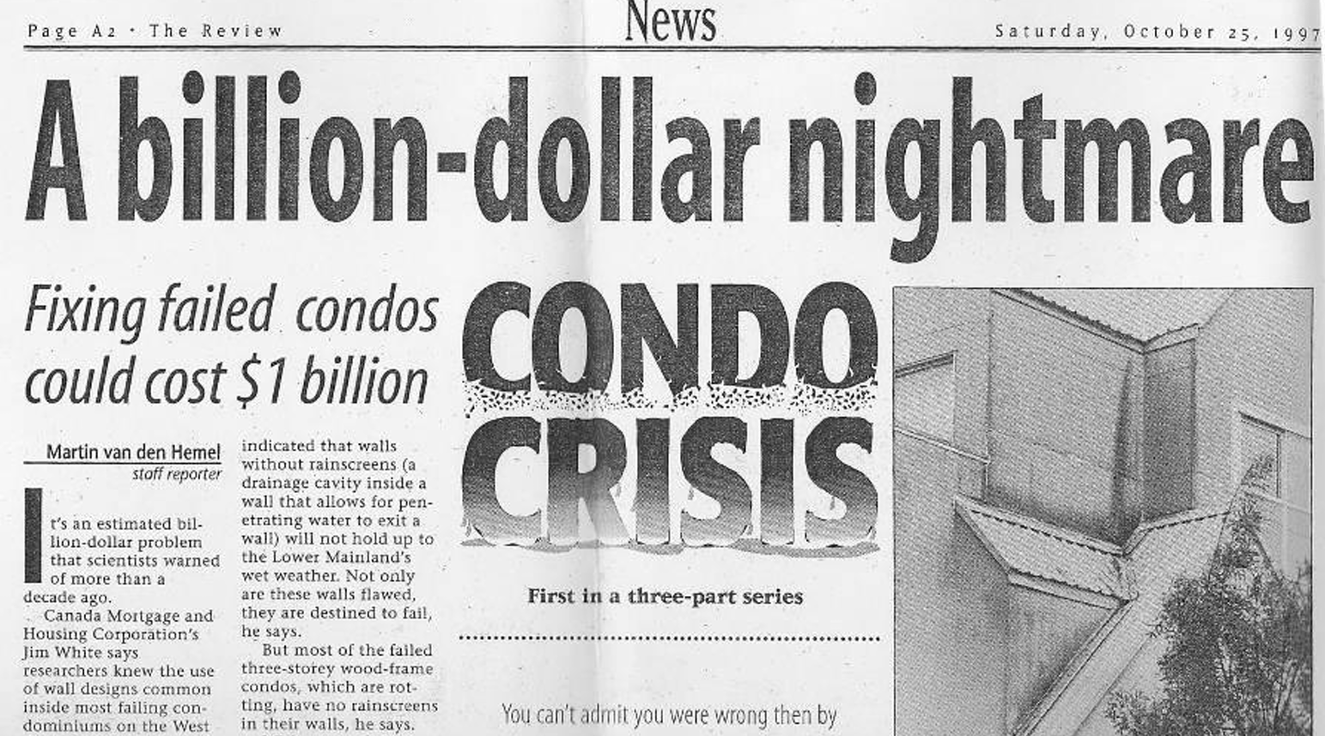
The leaky condo crisis
In B.C. alone an estimated $4 billion in damage has occurred to over 900 buildings and 31,000 individual housing units built between the late 1980s and early 2000s, establishing it as the most extensive and most costly reconstruction of housing stock in Canadian history.^{[1]}
Similar infiltration problems have been reported in highrise buildings and schools, as well as in other climatic zones in Ontario and Nova Scotia,^{[2]} in the United States,^{[3]} and New Zealand.^{[4]}
Not my photos, from RDH Presentation
Notes:
So let’s talk about what was the leaky Condo Crisis?
End up being an expensive mistake that affected a lot of people
The numbers on Wikipedia indicate that it around $4B and over 30,000 condos were affected
Some of those buildings are still being repaired today, some by court order, as people have been putting their head in the snd for a long time.
And while the lower west coast of BC was the epicenter, the problem is not limited to BC
It has appeared in other locations, Some with different climate as well.

Slide 11
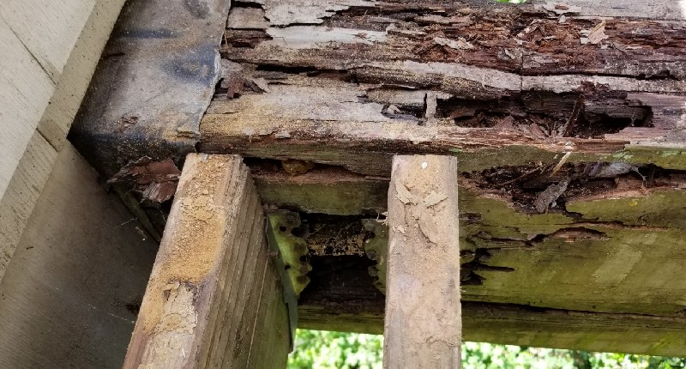
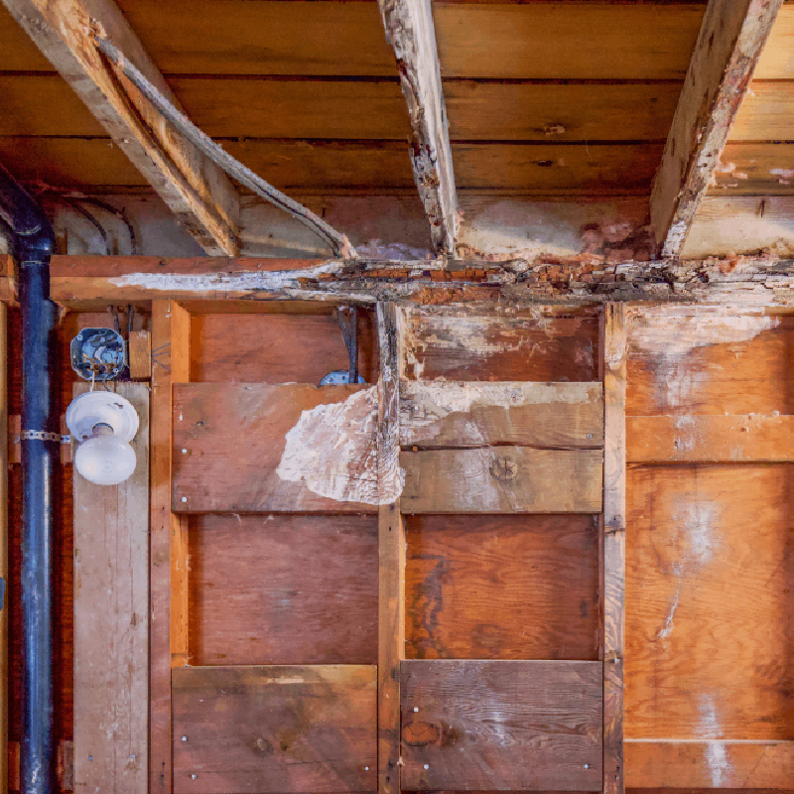
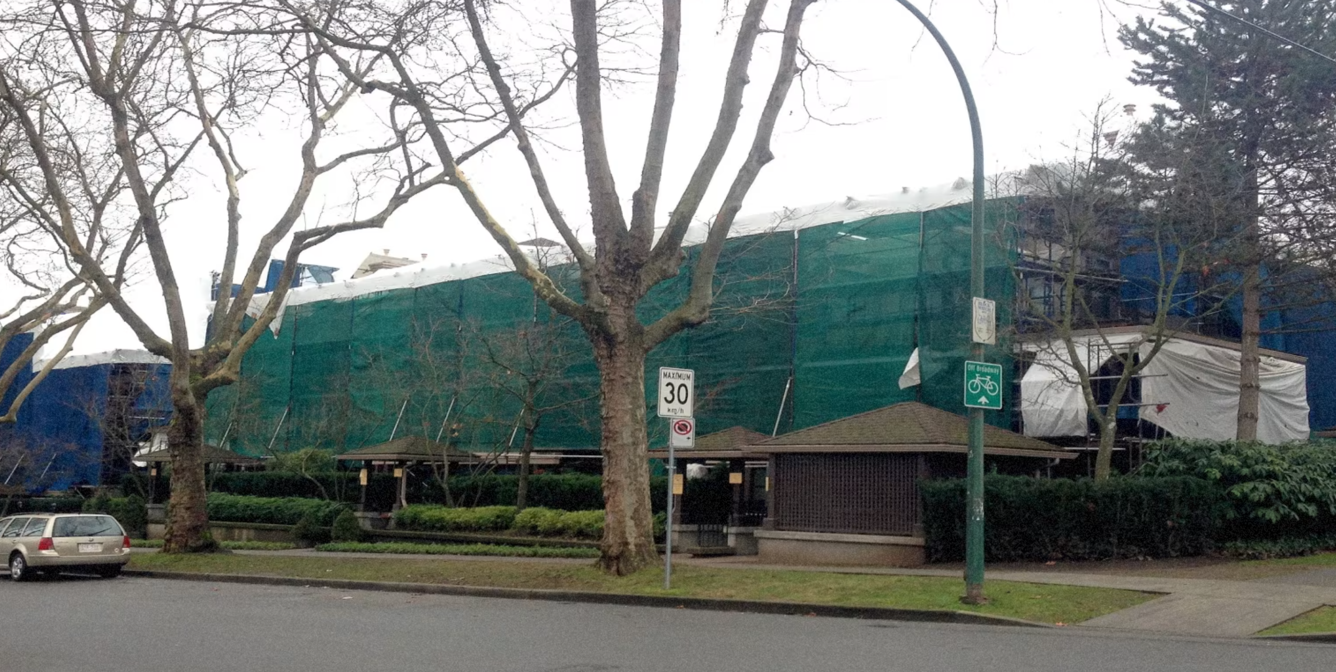
Contributing factors
The evidence suggests that significant building envelope failures in British Columbia since the early 1980s ... is a result of numerous factors, including
design features inappropriate for our climate
a reliance on face-sealed wall systems
a fundamental lack of awareness regarding the principles of enclosure design suitable for our climate;
a lack of meaningful inspection at critical stages of construction;
and a regulatory system which was unable to understand that failures were occurring and to redress them.
Not my photos, from image search
Notes:
Everybody that experienced the leaky condo crisis from up close, and not even so close, have an opinion on why it happen
The list here is the one published in the inquiry report
Building scientist were few before the leaky condo crisis, there was also a big construction boom (population growth after Expo 86) which led to hiring of inexperience trades, and new products on the market that were not really used before
Prior to 1993 in B.C., architects and engineers were not required to certify that the design met the requirements of the building codes, review the quality of construction, or certify that the construction had been performed in accordance with the codes, permitted drawings, and specifications
AND those were big failures, I mean have you ever hear of structural stucco?

Slide 12
History repeating itself?
Trades appear to be losing collective knowledge – many old timer retired during Covid, less mentorship and lots of turnover.
More construction needed than people to build it
VE being necessary for project to go ahead
Many new material flooding the market, new assemblies being used
That buildable space and its exemption still pushing design in the wrong direction
Notes:
Today it is not so much that the use of a cavity is being questioned, at least not in the lower mainland,
but that many of the contributing factors identified in the Barrett Inquiry report are showing their nose again:
Read the points
So it is begging the question, are we seeing history repeating itself
So I hope not but it sure is not reassuring.

Slide 13
Better Insulation
Notes:
This next one is more a demonstration of how things can evolve based by building on what was done previously

Slide 14

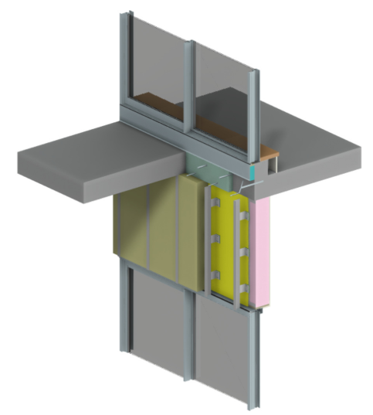
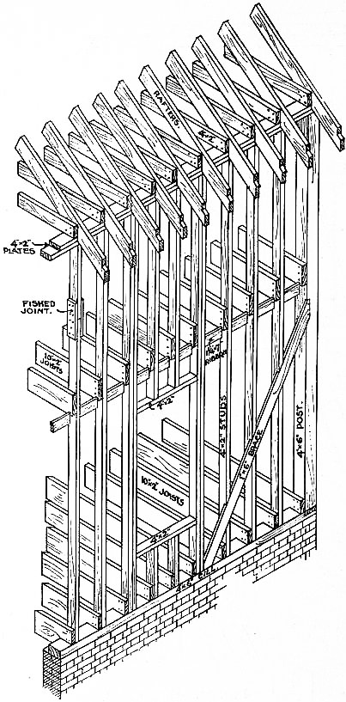
Evolution of Insulation
1950
1950’s
Framing cavity filled with news paper, animal wool or sawdust
1960
1970
1970’s
The Oil Crisis of 1973 led to improvement in both material and technics
1980’s – 1990’s
Increase in insulation thickness without much consideration for thermal bridges
1980
1990
2000
2000’s - 2010’s
Development of tool to better evaluate thermal bridging
2010
Notes:
For a long time, buildings were built of stone, without any insulation
With the change in construction technics to light framing, cavity started to filled with material of convenience, like straw or news paper.
Eventually insulation materials evolved, especially through the Oil crisis fo the 70s, and we got better performing insulation that not only provided better insualting value per inch but was also resistant to moisture.
And that where things stagnated for a bit, mostly considering nominal value or limited amount of thermal bridging and ignoring the rest because it was too complicated to calculate.
The more recent developments in terms of insulation effectiveness, I am more familiar with not so much because I intensively participated in their development but because I have been sitting beside the guy who has from close to 20years – Patrick Roppel
And somehow it rubbed on me!

Slide 15
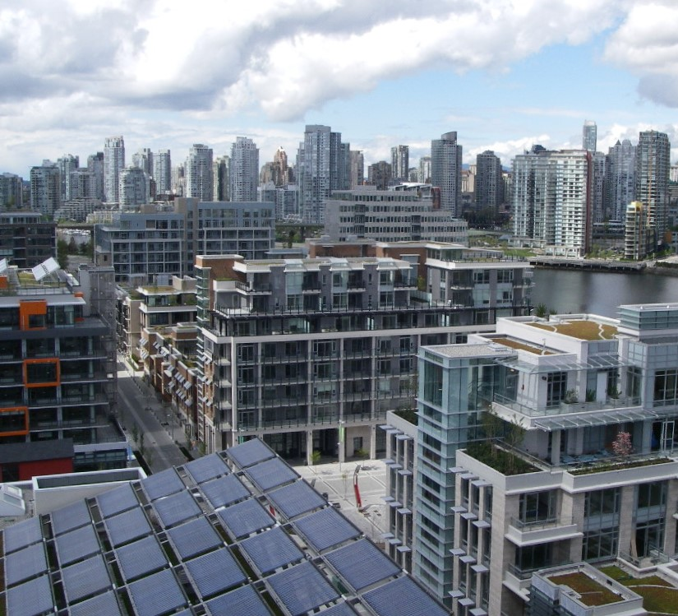


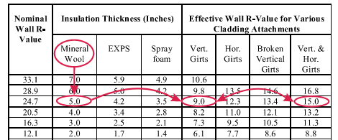
The beginning
Before 2010 Winter Olympics
Notes:
When it comes with understanding insulation effectiveness.
For me, the story starts just before the 2010 Vancouver Winter Olympics. This was a start of a big push for sustainability.
The challenge of the day was LEED Platinum and how to meet the effective R-values using wall assemblies that were not common at the time.
Up to then All buildings were ASHRAE 90.1 prescriptive. Energy modelling and exterior insulated walls for non-cobustible buildings were not as prevalent as they are today and we did not have proprietary cladding attachment systems with performance backed up with data.
During this era, My Colleague and business partner Patrick Roppel was doing the 2D (THERM) thermal analysis to determine how to meet the specified effective R-values. We did not have tables to look up solutions. Every change to the energy model and round of value engineering resulted in many new models, a lot of iteration, lots of effort, clients waiting for answers, and more meetings. There needed to be a better way.
That left the question “how can we provide information to the design team, so the team is empowered to make decisions without a fragmented design approach?”. This led to us developing generic solutions, in advance of meetings, for various cladding attachments and insulation levels. We presented the results in a way that aided decision making and reduced the need for project specific analysis.

Slide 16

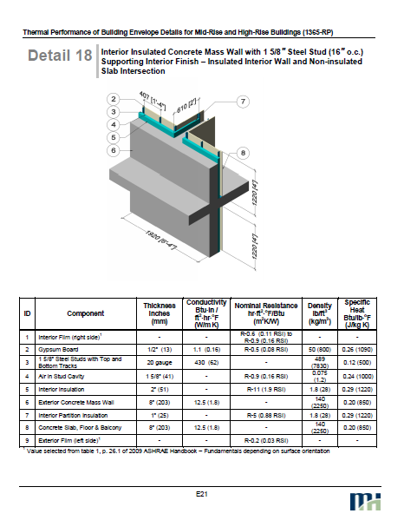
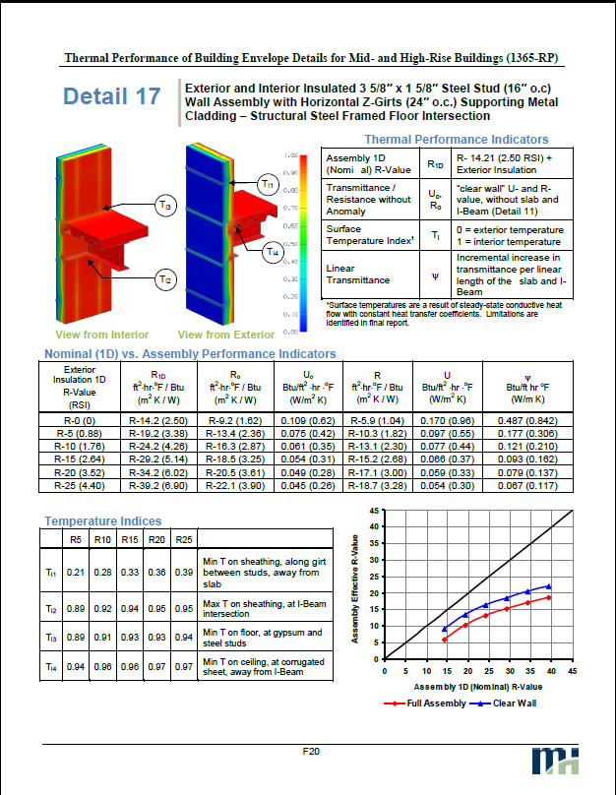
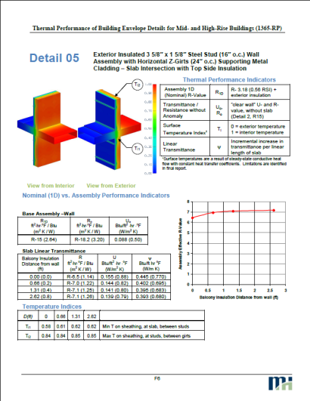
ASHRAE 1365 (2011)
Bedrock of the BETB Guide
Validation of procedures and software to measured data
Borrowed a methodology from Europe and applied to North American Practice
Raised awareness in North American of the impact of thermal bridging
Demonstrated the value of 3D detail database for interface details
Notes:
On the footstep of the olympic village, The team at Morrison Hershfield wrote a paper about the innovation at Olympic village. This work helped us secure a research project ASHRAE 1365-RP that explored the impact of thermal bridging using 3D Thermal modeling.
ASHRAE 1365-RP was the beginning of something a bit more serious than a spread sheet
validating the modelling procedures
and clearly explaining why North America needed to adopt the concept of linear transmittance.
The work done for ASHRAE 1365-RP and subsequent efforts to increase awareness led to the first BETB Guide, which had a BC focus.
Mind set at that time for Patrick “I don’t plan to make this my career”!!

Slide 17
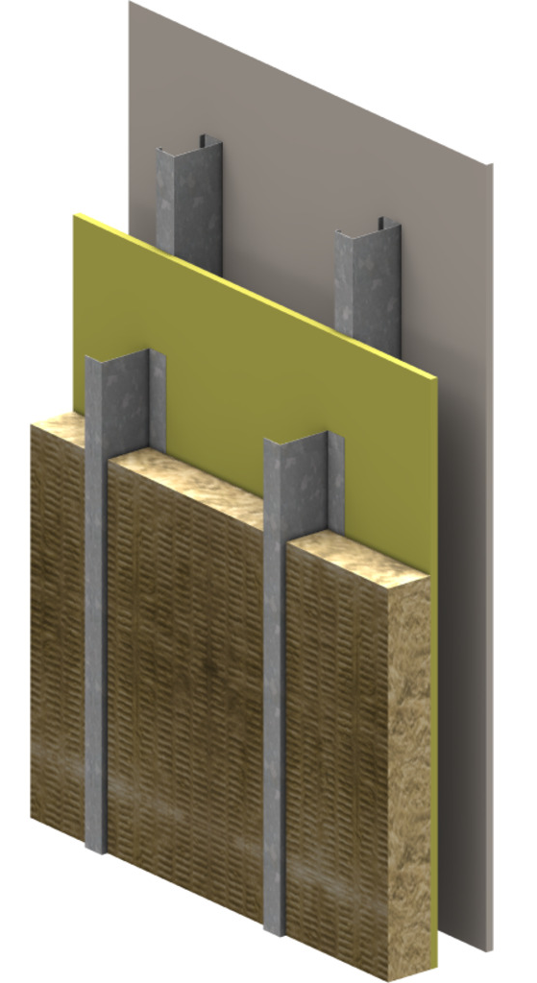
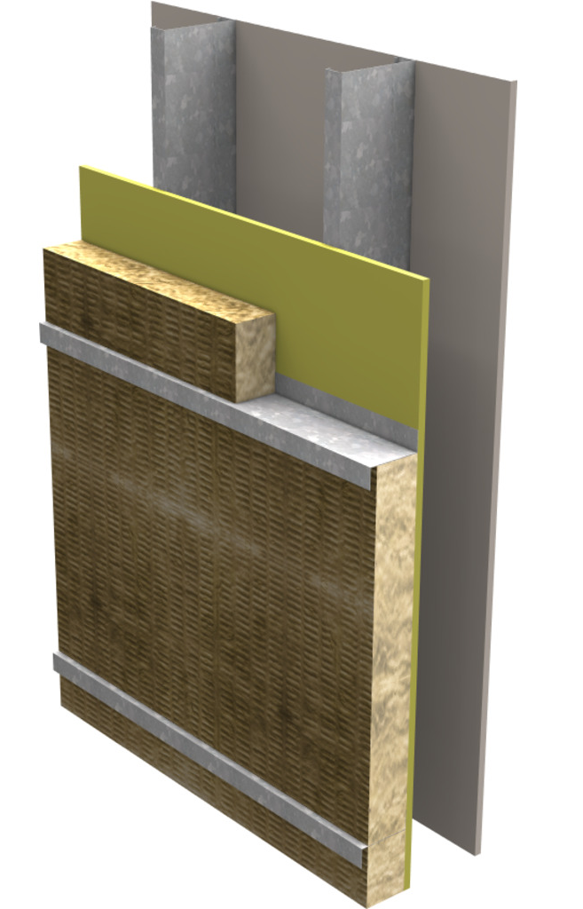
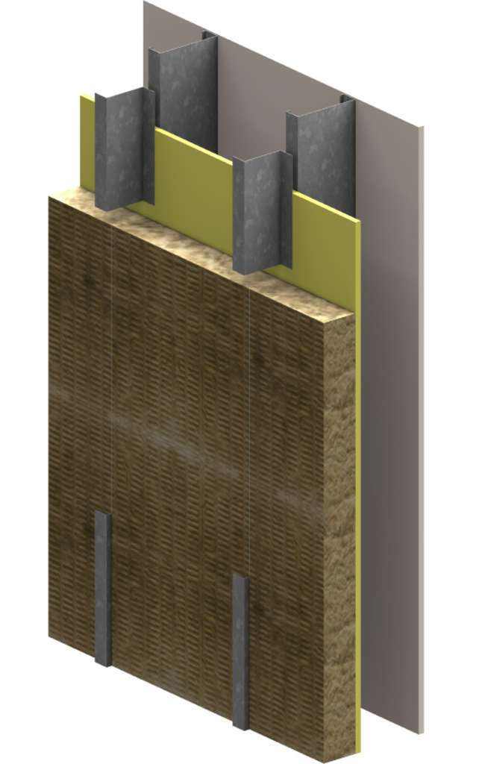
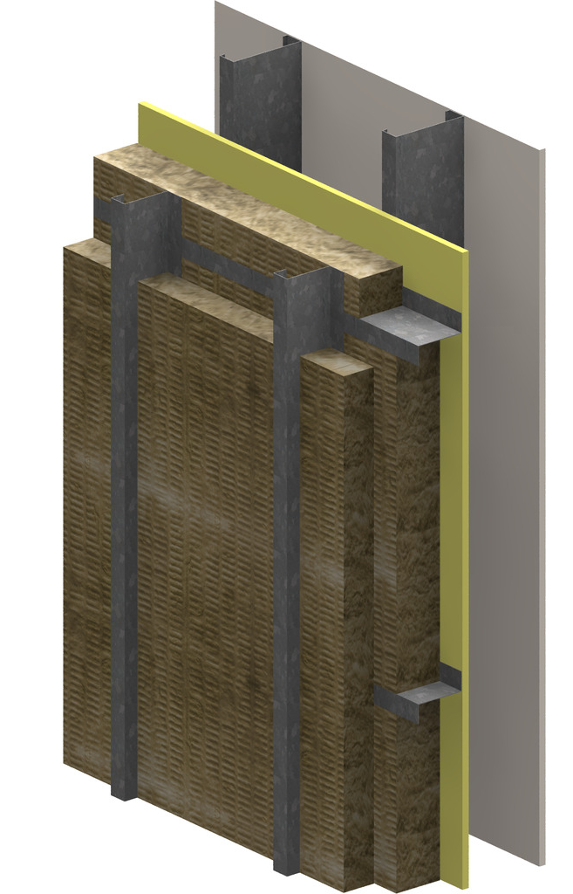
From concept to practice
Notes:
While trying to gather funding for a bigger body of work like the BETBG,
The ASHRAE 1365 research project was followed up with some key documents that was breaking down the work in smaller packets
Those publications provided information as to the performance expected of more complicated assemblies.
2 of them prove to be quite well received:
Cladding attachment
Curtain wall backpan

Slide 18

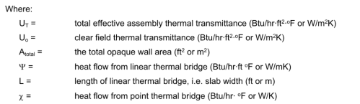
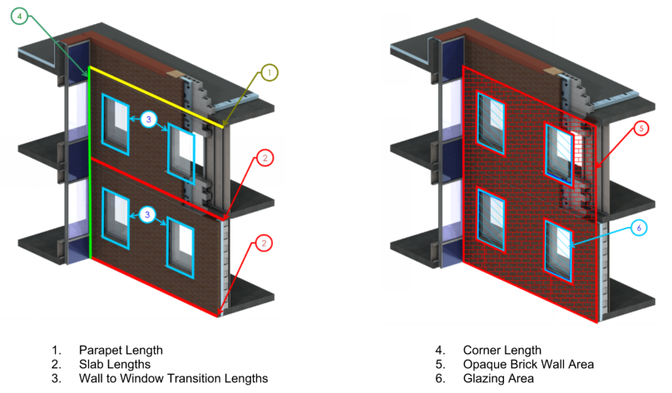
The thermal bridging guide
Notes:
So those publications helped paved the way to the BETBG, And that was a game changer for the local market
It was the tool that we needed to help everybody accept that things were going to change
First it change the way envelope thermal performance was calculated – now we were looking at considering not only clear field value but linear and point transmittances of the details in the overall U value…
It also provided hundreds of different assemblies and details with the associated transmittances, and it made it easier to account for interface details
The first edition was like 600pages mostly because of all those detail pages.
Having that information available was critical to the success of the methodology and it soon was incorporated in codes as a compliance requirement

Slide 19
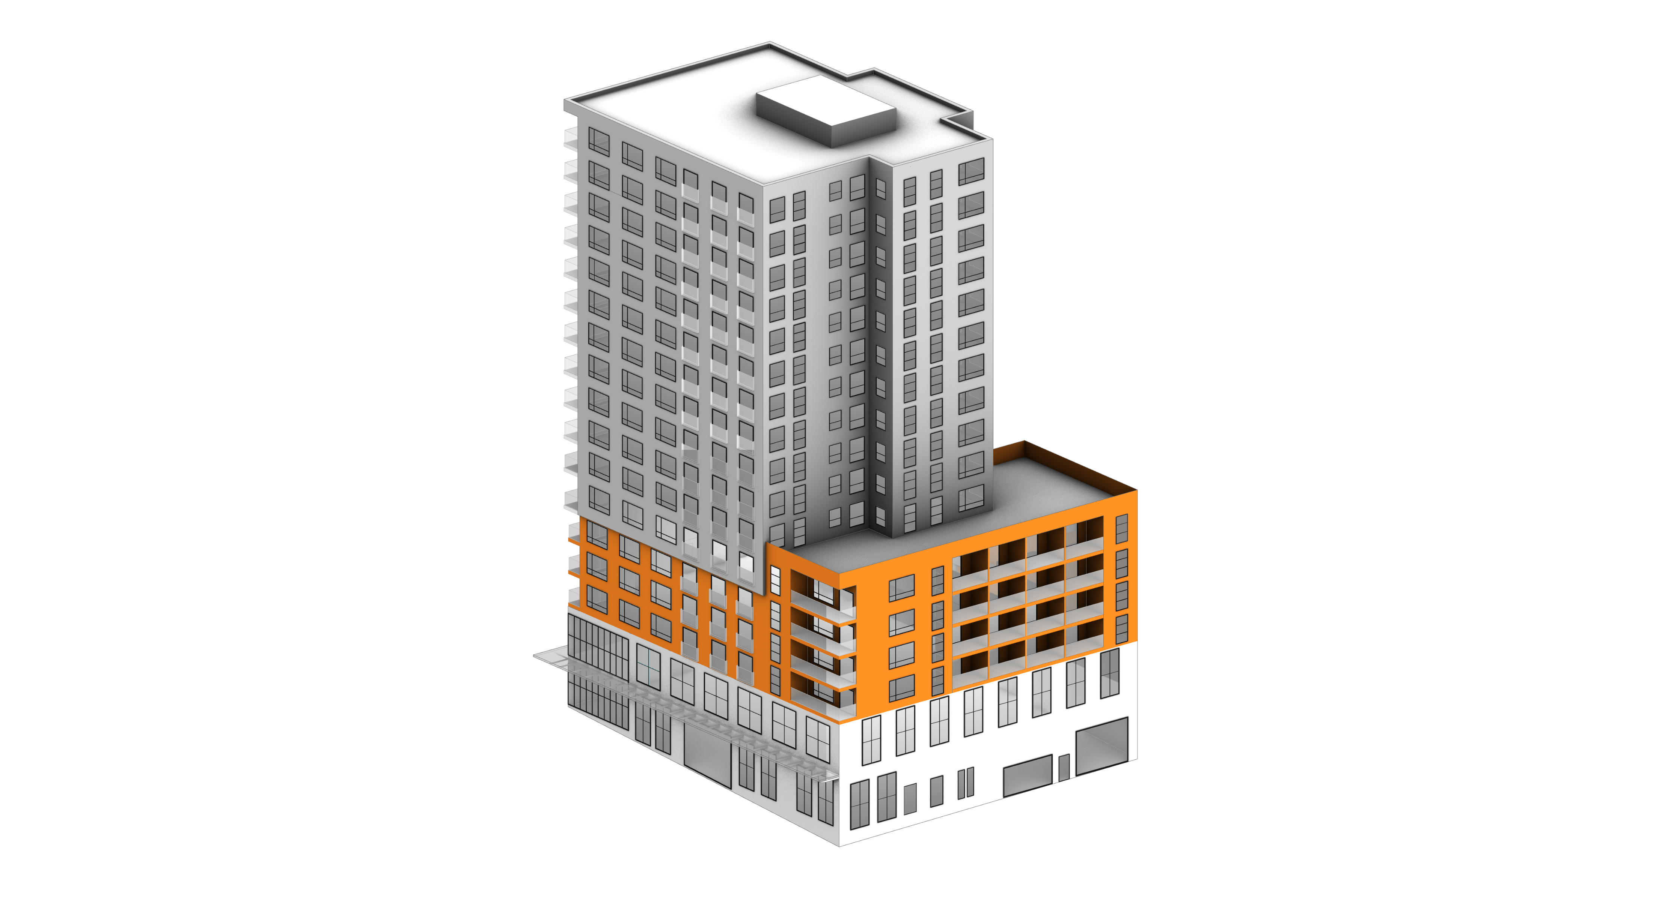
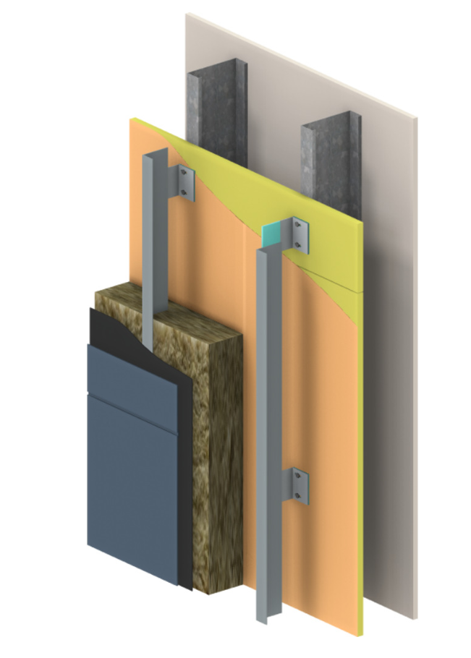
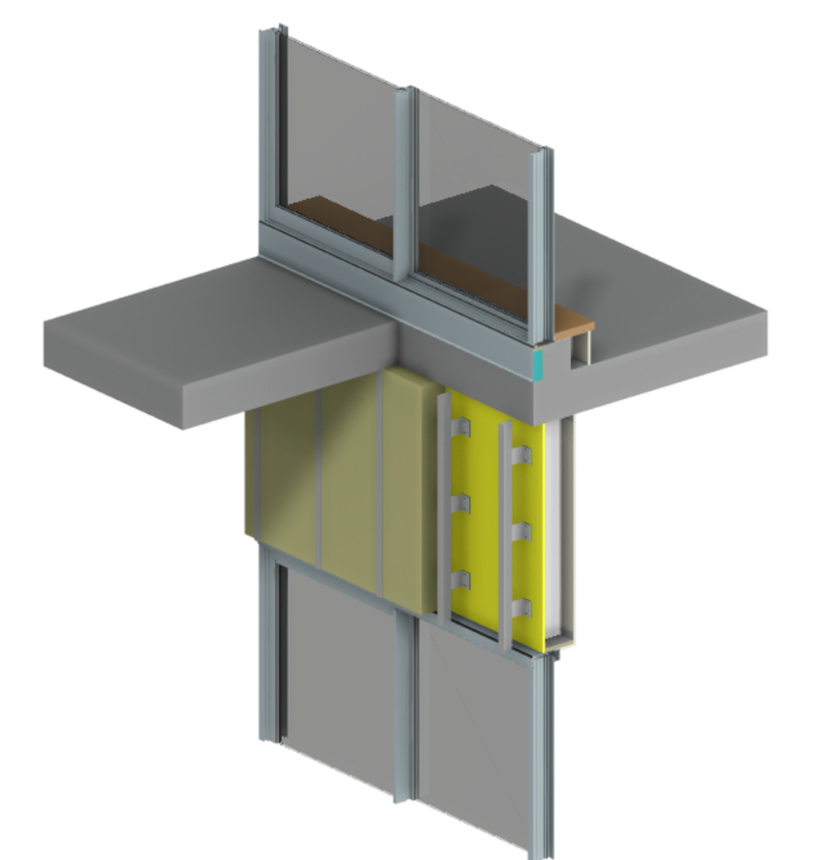
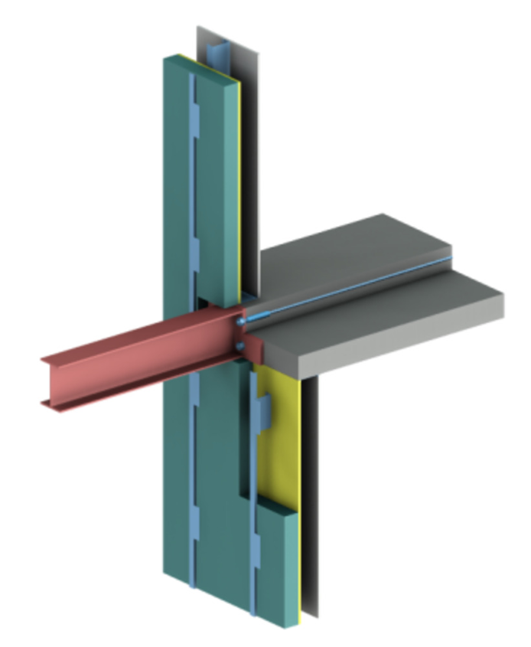
BETB Guide and Thermal Bridging
Details 30-70 % of Total heat loss
Clear Field
Assembly
Interface Details
Window perimeter is often the largest contributor to heat loss
Roof-to-Wall
Balcony
Window-to-Wall
Intermediate Floor
Canopy Outriggers
Wall-to-Grade
Notes:
So what exactly goes into calculating an overall thermal performance and how much does it matter?
For the opaque wall as an example,
What quickly become evident is that a lot of the heat lost was happening at the details.
For the overall opaque wall value…CLICK the details could represent from 30% in the best scenario to 70% of the heat lost if the TB was not mitigated. It showed how the interface details made a big impact if unmitigated
CLICK
And we also quickly realized that the window perimeter was a huge part of that heat lost, something that was rarely considered until then

Slide 20
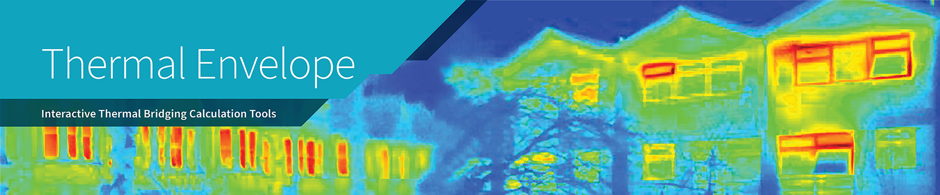
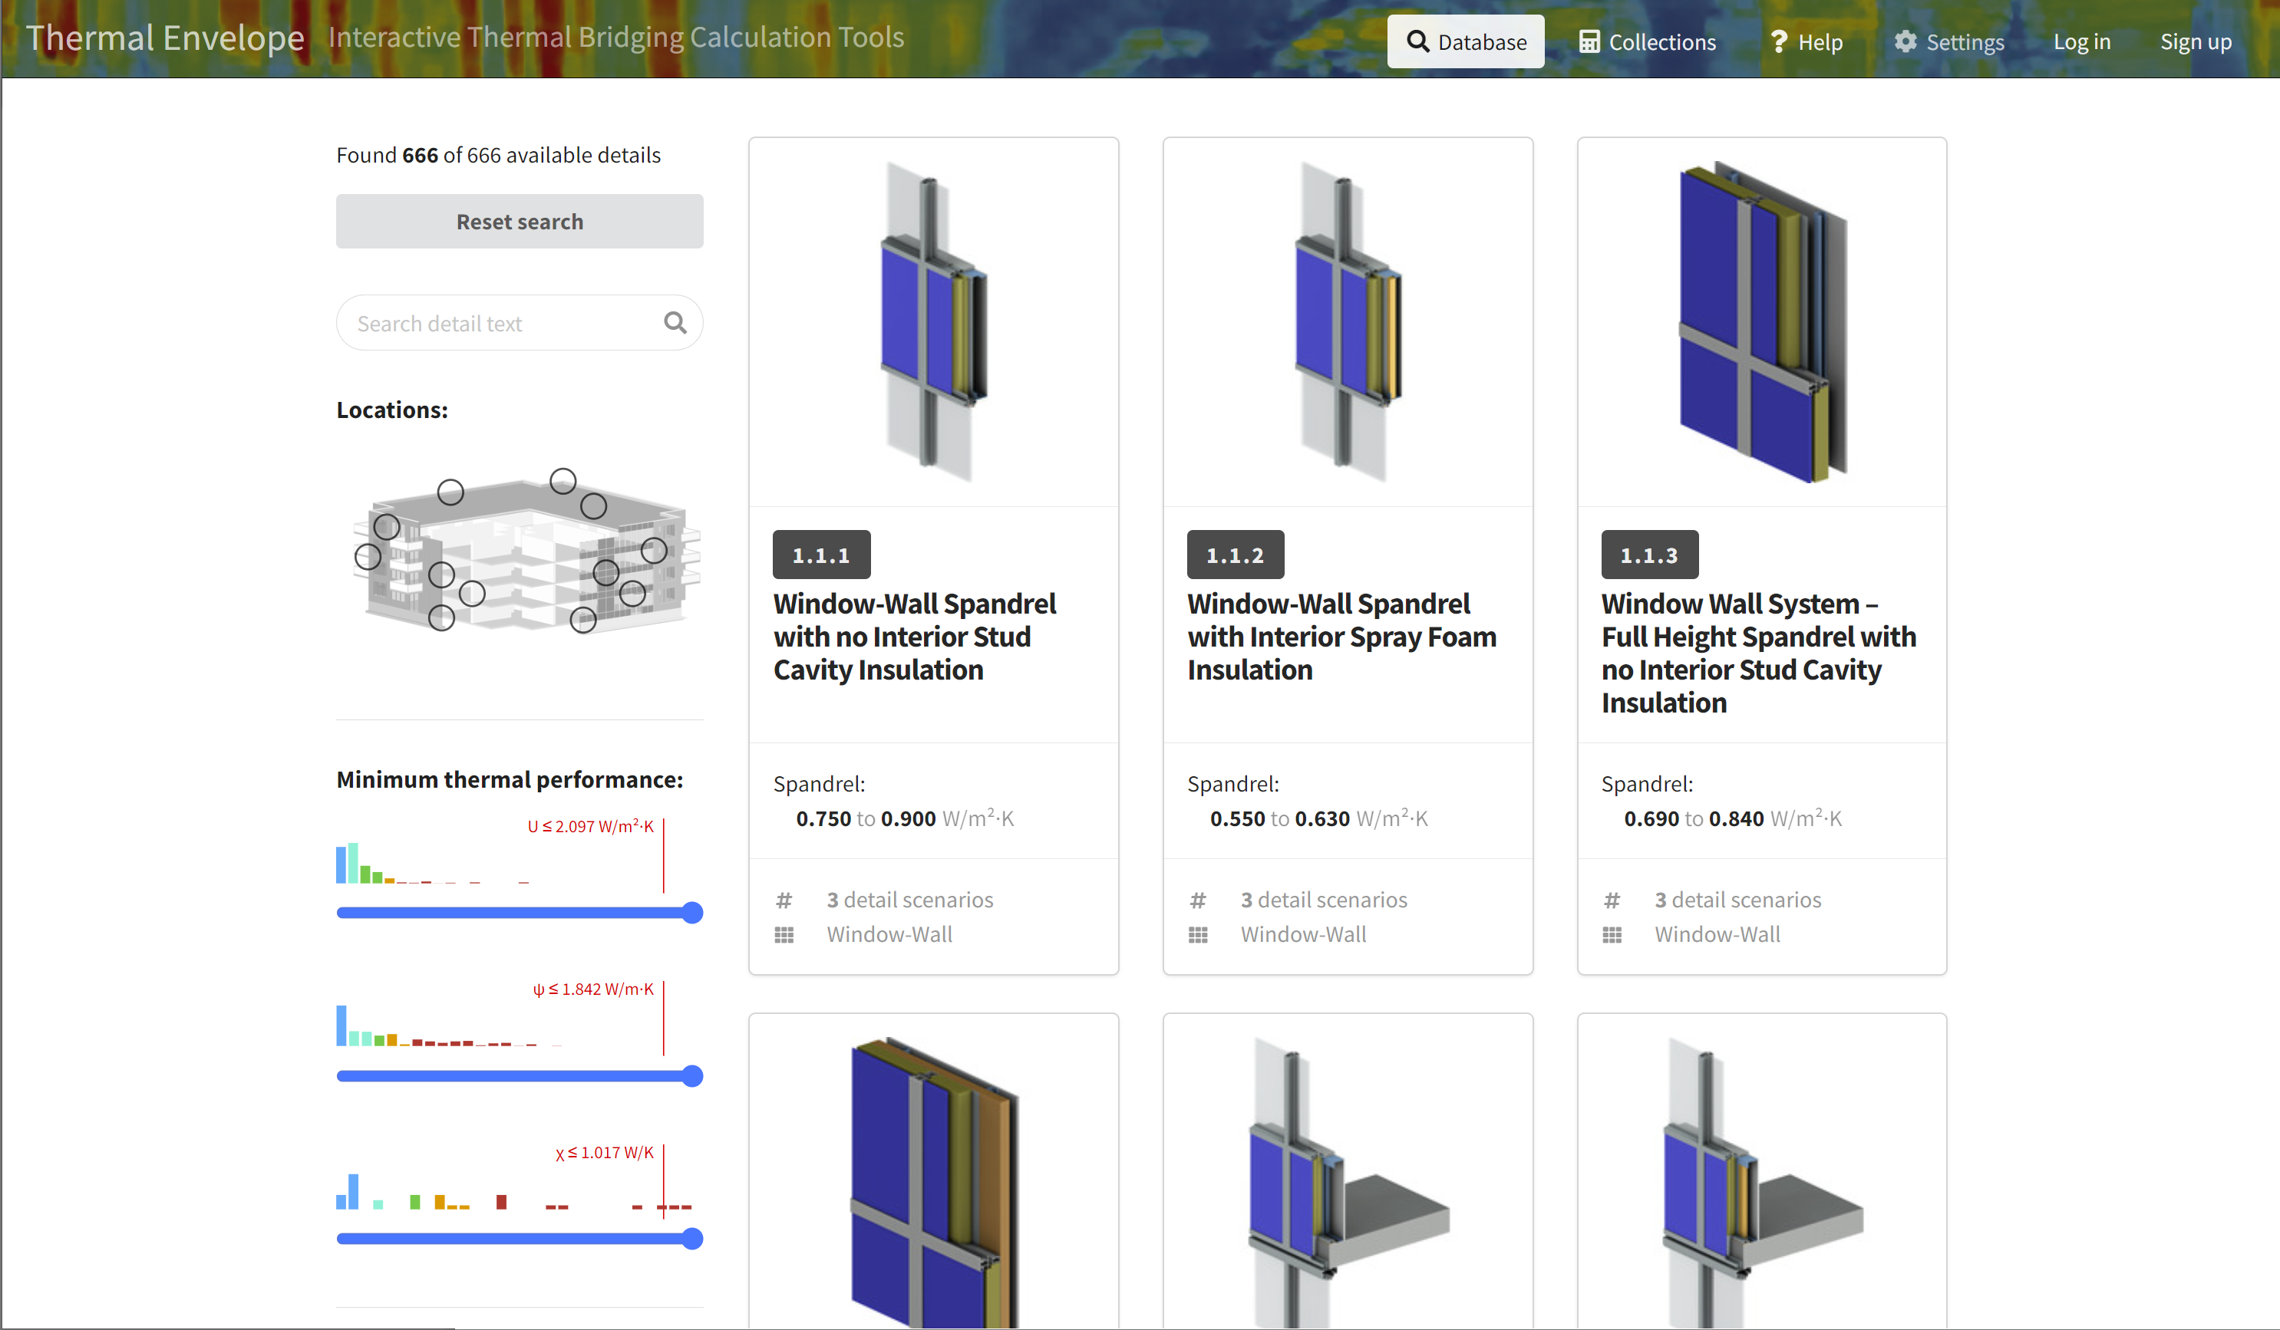
Significant database of thermal data
Integrated thermal calculator
Reports and collaboration tools
Educational resources
www.thermalenvelope.ca
Notes:
Success and many more details lead to the need to find a new platform.
Make the information accessible and have the technical background available if someone wants to really dig into the numbers.
Thermal Envelope has outgrown the PDF version of the BETB Guide.
Increased expectations for data and inclusion in database

Slide 21
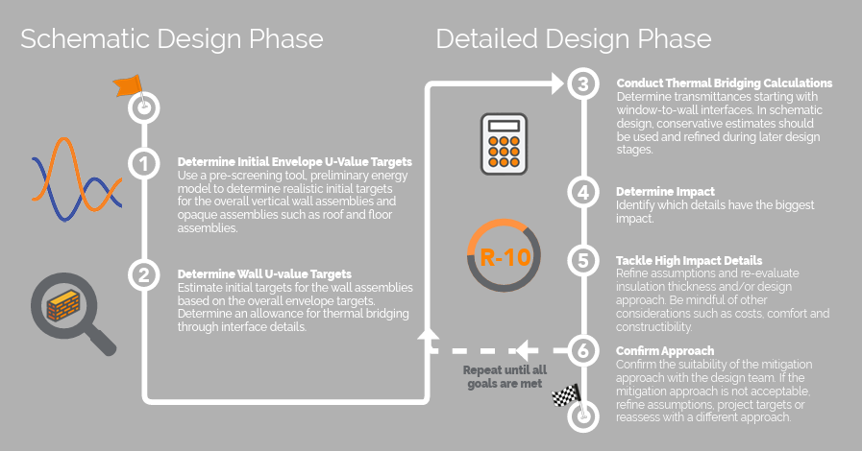
Better tools, Better results
Notes:
A database like Thermalenvelope.ca is useful not just when you are trying to evaluates the performance of a design building
But also at an early stage to understand what details or design approach could be better to the overall performance of the envelope
and making good decision early on is better than having to redesign late

Slide 22
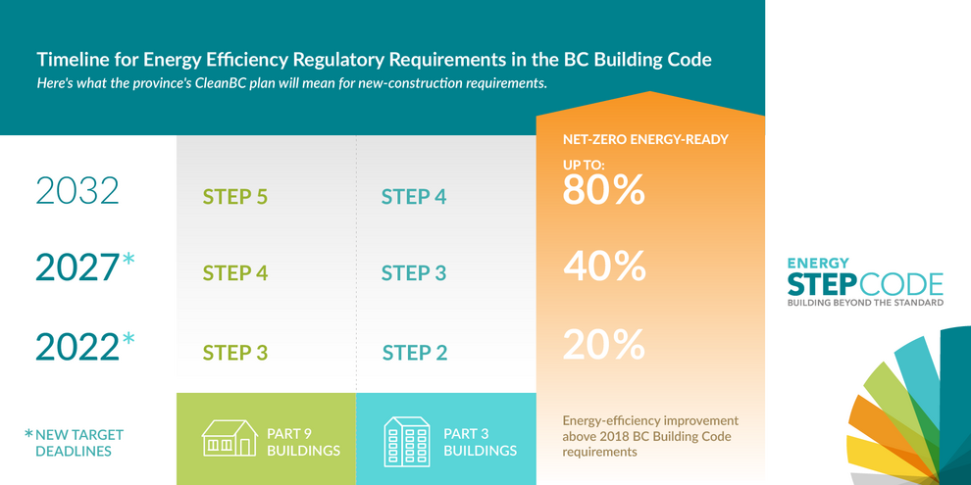
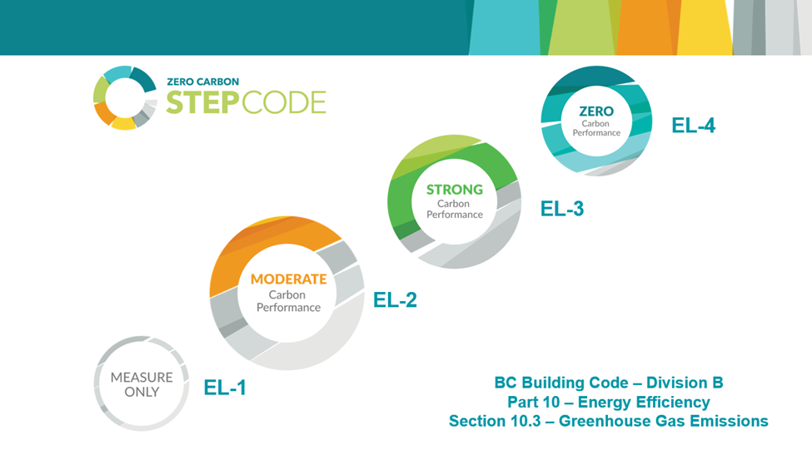
All in the same boat, no surprise
Charting the path ahead
TEUI - Total Energy Use Intensity
All energy uses in the building
TEDI - Thermal Energy Demand Intensity Annual heating load in the building
Building envelope performance
Ventilation system performance
GHGI - Greenhouse Gas Emissions Intensity From operations
Notes:
With good tools and method to evaluate thermal performance,
there was one less obstacle to acceptance of new compliance method
Getting people to understand where things are going and why, and that everyone will be in the same boat but can plan was I think one of the element to reduced opposition.
The idea was to present an incremental approach to improving buildings.
now from the get go, different municipally could adopt different level of the step Code and many chose to jump right in often allowing a lower step, like step 2 if a LCES was part of the equation, otherwise they would require step 3.
But the first few step are somewhat easy
Put in a good HRV and you are at step 2
Reduce your window wall ratio to something reasonable and Improve your envelope a bit and you are at step3
But the last step, to net zero ready or 80% better to where we were in 2018, is a big step, I would venture to say expodentially more difficult and seeing that even with step 3 some projects are struggling and find that the cost added (wrongly or rightly) are putting pressure on slowing down the process. it will be interesting to see the time frame in which the last step will be implemented.

Slide 23
That leaves the question…
Is net zero ready an achievable target for an entire industry?
Notes:
That brings the question?
Or ultimately is it a lofty goal that still serve a purpose to inch towards it?
Wheter it is one or the other, don’t they both serve a goal – Getting better and not stopping to improving

Slide 24
Whole Building Air Tightness
Notes:
Here is another I think we should talk about a little…

Slide 25
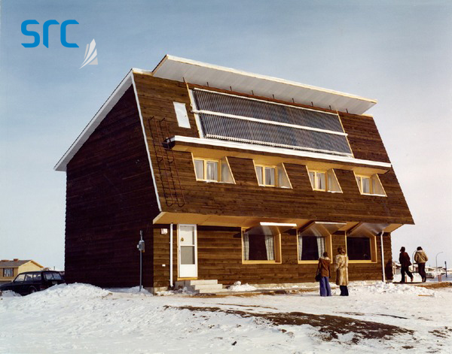
Building air tightness
1950
1960
1970
1970’s
The Oil Crisis of 1973 led to more efficient homes, including air leakage testing
1980’s
R2000 home start being built
1980
1986
First north American Code adoption
1990
1990-2000’s
Status quo
2000
2010
2010’s
New code requiring whole building air tightness testing
Image : Saskatchewan Research Council
Notes:
The history of air barriers can be traced to the early 70's during the energy crisis.
Building professionals were looking for ways to make buildings more energy efficient and eventually realized this could be achieved by stopping uncontrolled air leakage through the building envelope. The term "air barrier" was quickly adopted.
Air Barriers were first incorporated into the National Building Code of Canada in 1986. In the United States, It come a little bit later, with the first state adopting in 2001.

Slide 26
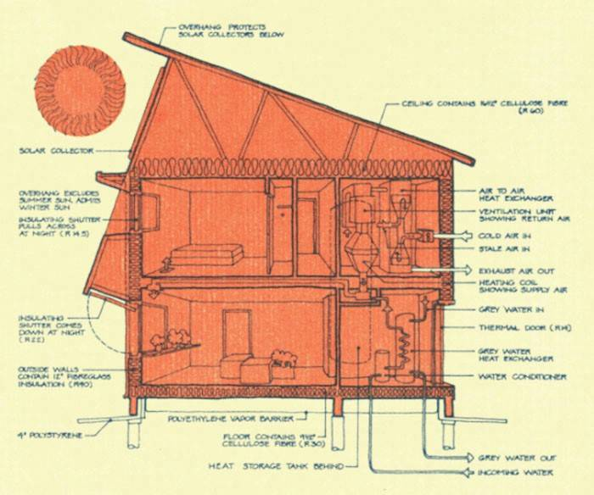
The Saskatchewan Conservation House
There were four main stages to the process:
STAGE 1
Finding a way to measure where the leakages of energy happen in houses.
STAGE 2
Finding a way to minimize the waste of energy (and the building of the Saskatchewan Conservation House).
STAGE 3
Going out and teaching others how to build and retrofit houses to an acceptable energy standard.
STAGE 4
Developing software to design energy-efficient homes (and the development of the HOTCAN computer model).
Image : Passipedia
Notes:
Canada was certainly at the forefront of the air barrier implementation and the Saskatchewan Conservation house was first in line. There was of course more to it than air tightness but in an article I found
Harold Orr, one of the lead engineers on the committee that pioneered the Saskatchewan Conservation House was asked to reflect on the different stages of the development of energy-efficient housing in Canada. And these are the 4 stages he identified
Read the stages Stage 1
- The first stage, measuring air leakage, was problematic. Prior to this time, there were no accurate methods of measuring air leakage in homes. Mr. Orr’s professor, Dr. George Green, suggested to Harold that he should design and build an instrument to measure infiltration in buildings for his master’s thesis. Harold started by injecting into houses tracer gases (helium and sulphur hexafluoride) and, with the aid of some expensive gas detectors, he began measuring how quickly the air was changing in the house.
Not practical to implement at large scale and expensive.
Looking for a more cost-effective method to measure air leakage, Mr. Orr, working with the National Research Council in Ottawa, built and developed the very first blower door system.
It was a piece of plywood with a fan mounted in the centre of it and a device to measure the airflow through the fan.

Slide 27
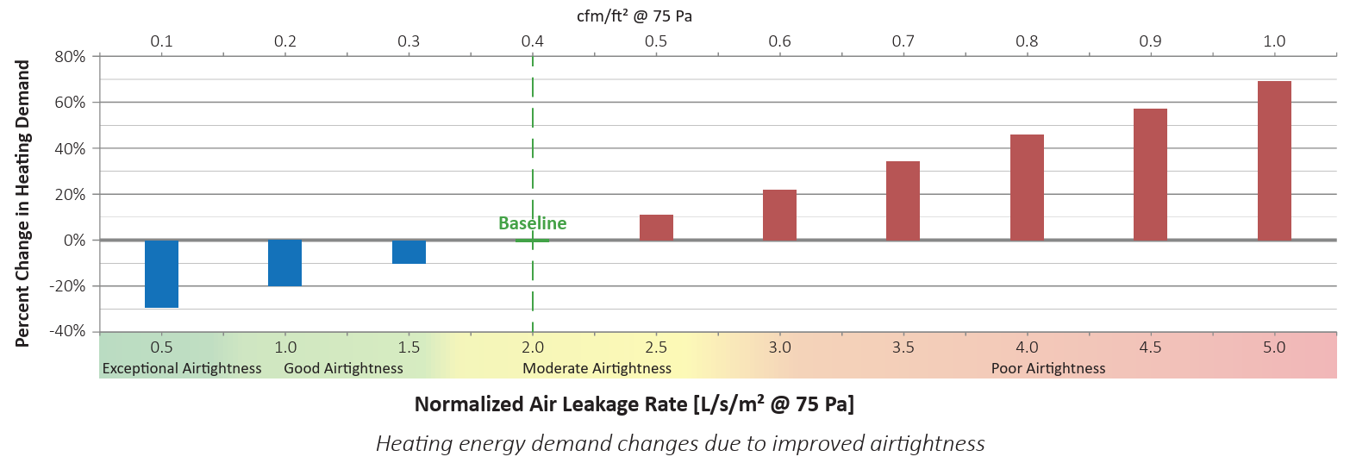
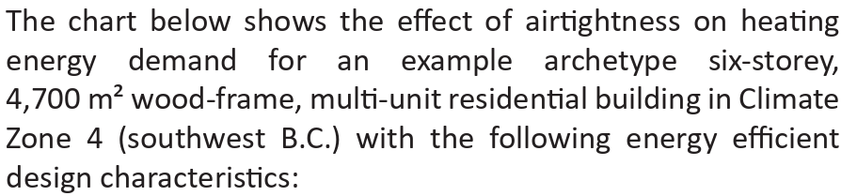
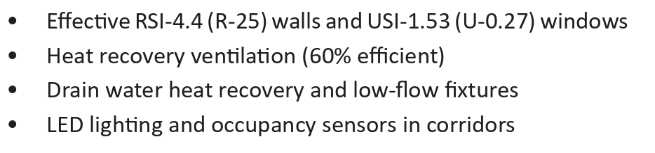
Getting an idea of performance
Notes:
But how important is air tightness in the whole energy performance of the building
This graph shows the %change in heating demand as the air leakage increases or decreases compared to the base line
The introduction of an air barrier was certainly a big improvement, IN THEORY reducing up to 70% the heating demand assuming the base lien was achieved
And there is still room for significant improvements, as you can see from the blue bars

Slide 28
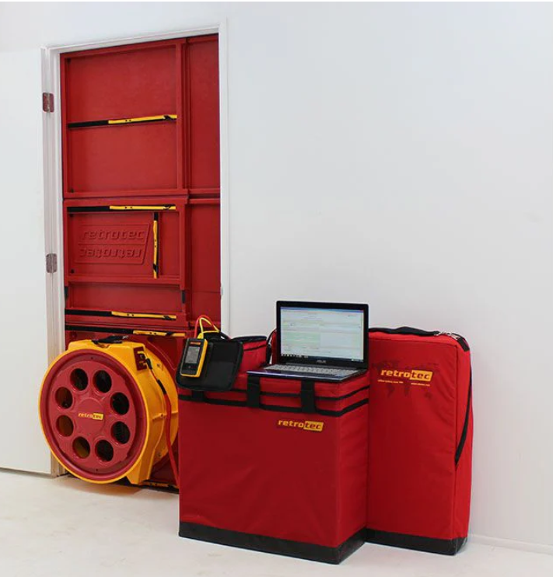
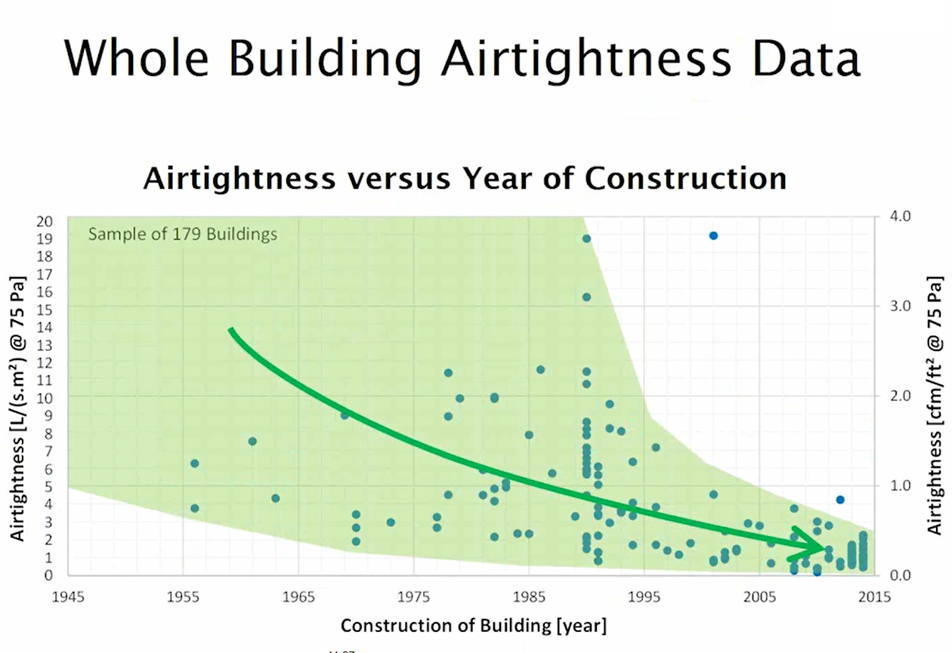
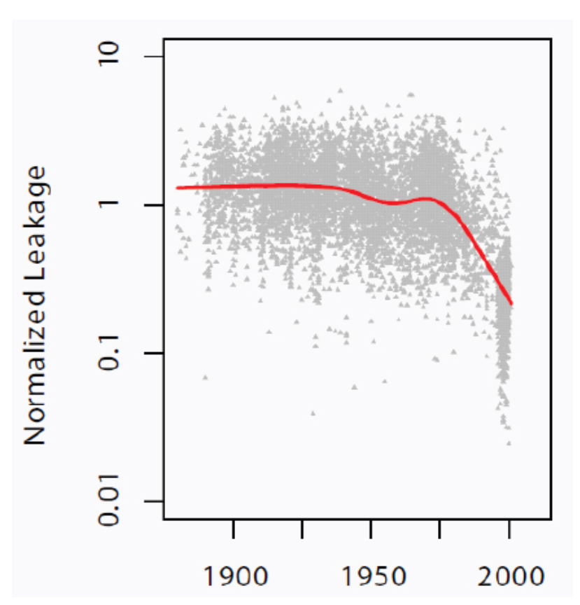
Air tightness over time
Image : RDH presentation
Image : RDH presentation
Image : Retrotech website
Tested buildings
Notes:
Of course, the awareness that air leakage and the introduction of an air barrier, even though it might not be well implemented, helped contributes to energy loss and improving the performance of building early afterwards.
Go over the graphs
But air barrier are tricky, and can we get good installation with testing Without testing???

Slide 29
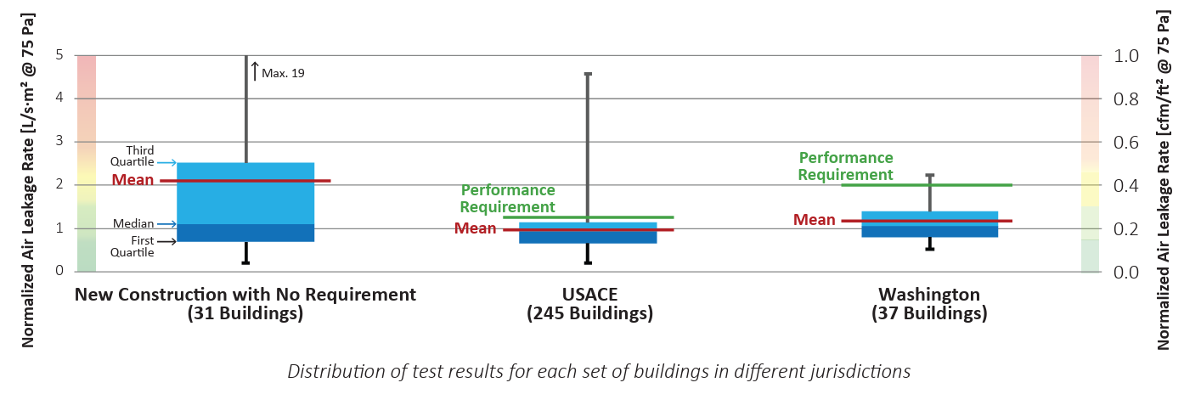
Impact of mandatory testing
Notes:
BC housing has good Guide that touches on this. They present the results from the data that RDH accumulated (, and aside from the general trend of building improving over the years, like in the previous slide , they also categorize performance
Research (done for a multitude of reasons)
US army core
Seattle, early adopter of air testing
There is a clear distinction not only in the median results being better where mandatory requirements exist, but also in the range of what is tested is much tighter when the requirement includes testing.
Two thing, testing and requirement

Slide 30
That brings yet another question
If you are not testing, are you really getting what you are expecting?
Notes:
While codes and regulations get you a good part of the way to make things better,
I just demonstrated that we could not count on reliable results in terms of air tightness if testing was not part of the equation
Are we going to face the same thing with Thermal and energy performance?

Slide 31
The first 5 takeaways
1
Legislation or codification is important to affect long lasting change
Need for tools and training, and a define path to implementation
Patience is in order, it can take a long time for a concept to become practice
History has a tendency to repeat itself, let’s not let it
Measurement and verification is key to obtaining the desired results
2
3
4
5
Notes:
Changes don’t happen fast, we have seen it with the examples I have put forward, it sometimes goes on over decades. Demonstration, testing, training, etc.
Ideology is great and important but for a long-lasting implementation, legislation or codification is critical
While legislation goes a long way, it is not sufficient on its own we have to
chart the path and
provide tools to allow widespread adoption, to make it easy
Perhaps also throw in A few demonstration projects also goes a long way
And let’s not forget to measure where it matters at least.
But at the end of the day, we cannot be complaisant, we need to work at getting better as an industry every day through training, teaching, and mentoring and not let the collective forget how we got here

Slide 32
Present day

Slide 33
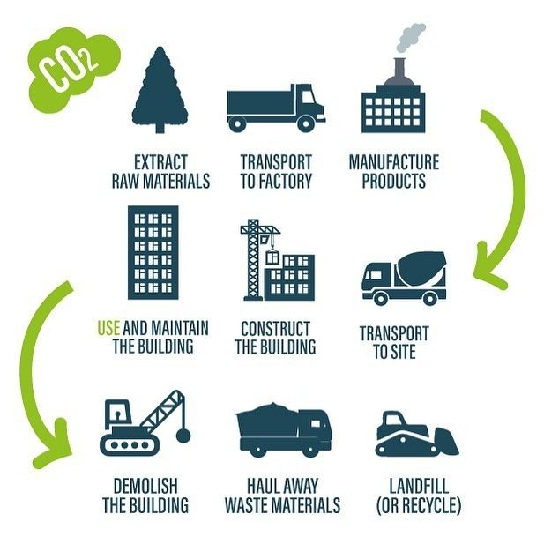
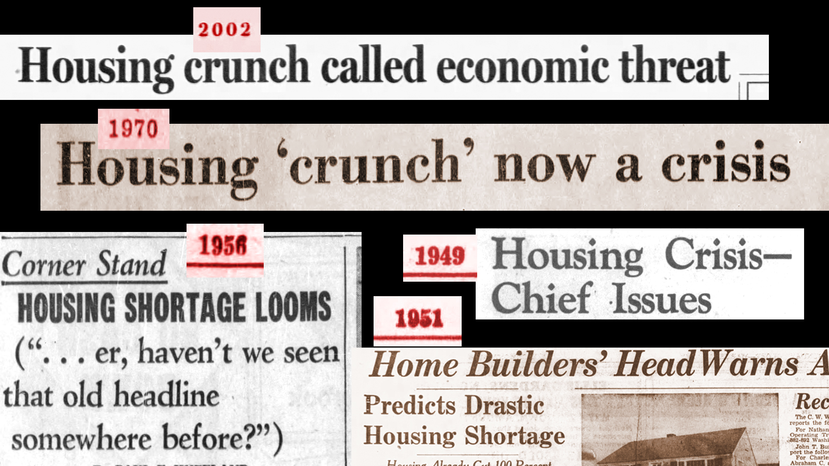
Where are we standing today?
Image : Nested Living
Image : Boston Globe
Notes:
OK that was a bit of looking back, learning from it
Now looking at where we are today, what do we think are the issues of the day that we need to tackle and get better at:
My take:
First you have Green house gases emission, not just from operational emissions, but also looking at embodied carbon
And then you have housing affordability – oops this one is not new but probably more relevant today then ever!
There is no doubt that adding requirement to housing construction will increase the price of construction, especially if it is not well done.
Do we save a word that many cannot afford to leave in or is there a way to achieve both?
So if we want to balance sustainability with affordability

Slide 34
There’s already a lot to Think and Talk About!
What are the drawbacks of greater heat recovery efficiency?
What is our maximum glazing ratio?
What SHGC do we need for comfort versus energy?
What is a TEDI?
Do we really need triple glazing?
TEUI?
What is our building shape?
What effective R-value do we need for the opaque?
How will the building be heated?
Can you just tell me the answer?
Can we achieve that level of air-tightness and take credit?
How can they still build like this?
Can I delete the exterior insulation to reduce embodied carbon?
Notes:
When it comes to designing a new construction projects, Leaving aside the structure, since my focus in on envelope
There are a lot of questions that come up when we are trying to address GHGI emission.
I get some version of them on almost every project I am involved with.
The sentiment is certainly: Can you just tell me what I need?
The answers are not so straightforward.
And I would argue that it is an architectural decision first, envelope second kind of discussion,

Slide 35
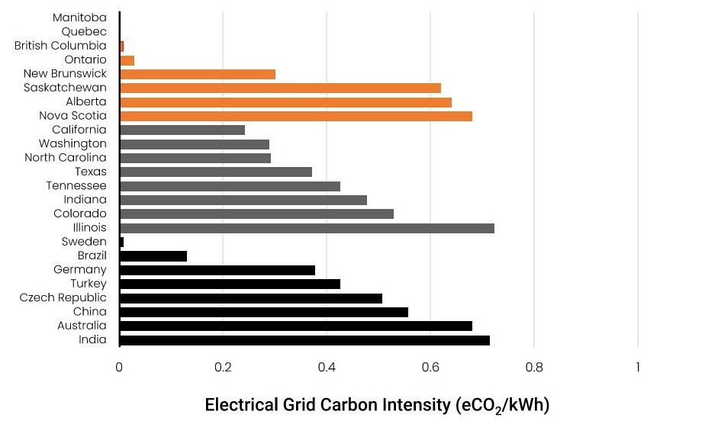
Total Emission Reduction
Electrification and energy efficiency both important for reducing GHG
Impact of energy use reduction not as impactful in locations that have a lower carbon intensive power gird
But still need to think about grid capacity
Notes:
Word of caution
The answers vary depending on where the building is located
In Vancouver, for example, our electrical grid is very clean, So a decision to use electricity as opposed to natural gas already goes a long way in keeping GHGI low.
One could then argue that the reduction in energy use is not as critical as looking at reducing embodied carbon, especially that that carbon is upfront
But that would be ignoring the grid capacity. The construction of a new Dam or nuclear facility doesn’t come without its emission and other environmental impact.
We cannot go around electrifying all the buildings and think that there will be enough electricity to accomplish it all at once, especially if we don’t pay attention to how energy efficient or not every building is.
So I hope we can agree that:
1- Electrification and energy efficiency are both important for reducing GHGI

Slide 36
Efficiency Rule No. 1:
The best savings…
… is what you don’t use in the first place.
Notes:
In my books, rule no.1. is CLICK
They are doing it with structure, we Should also be doing it with the enclosure
With an energy performance goal in mind, either dictated by Code or sustainability goals, start by making decisions that will be beneficial to reducing the amount of material you will needing to get to a certain thermal performance.
It will make people happy that we use less insulation –
But I will repeat myself, I am not talking about diminish the embodied carbon at the expenses of the thermal performance
I am talking her in providing the same level of performance but with less material.
So what are those Decisions that will make a difference?

Slide 37
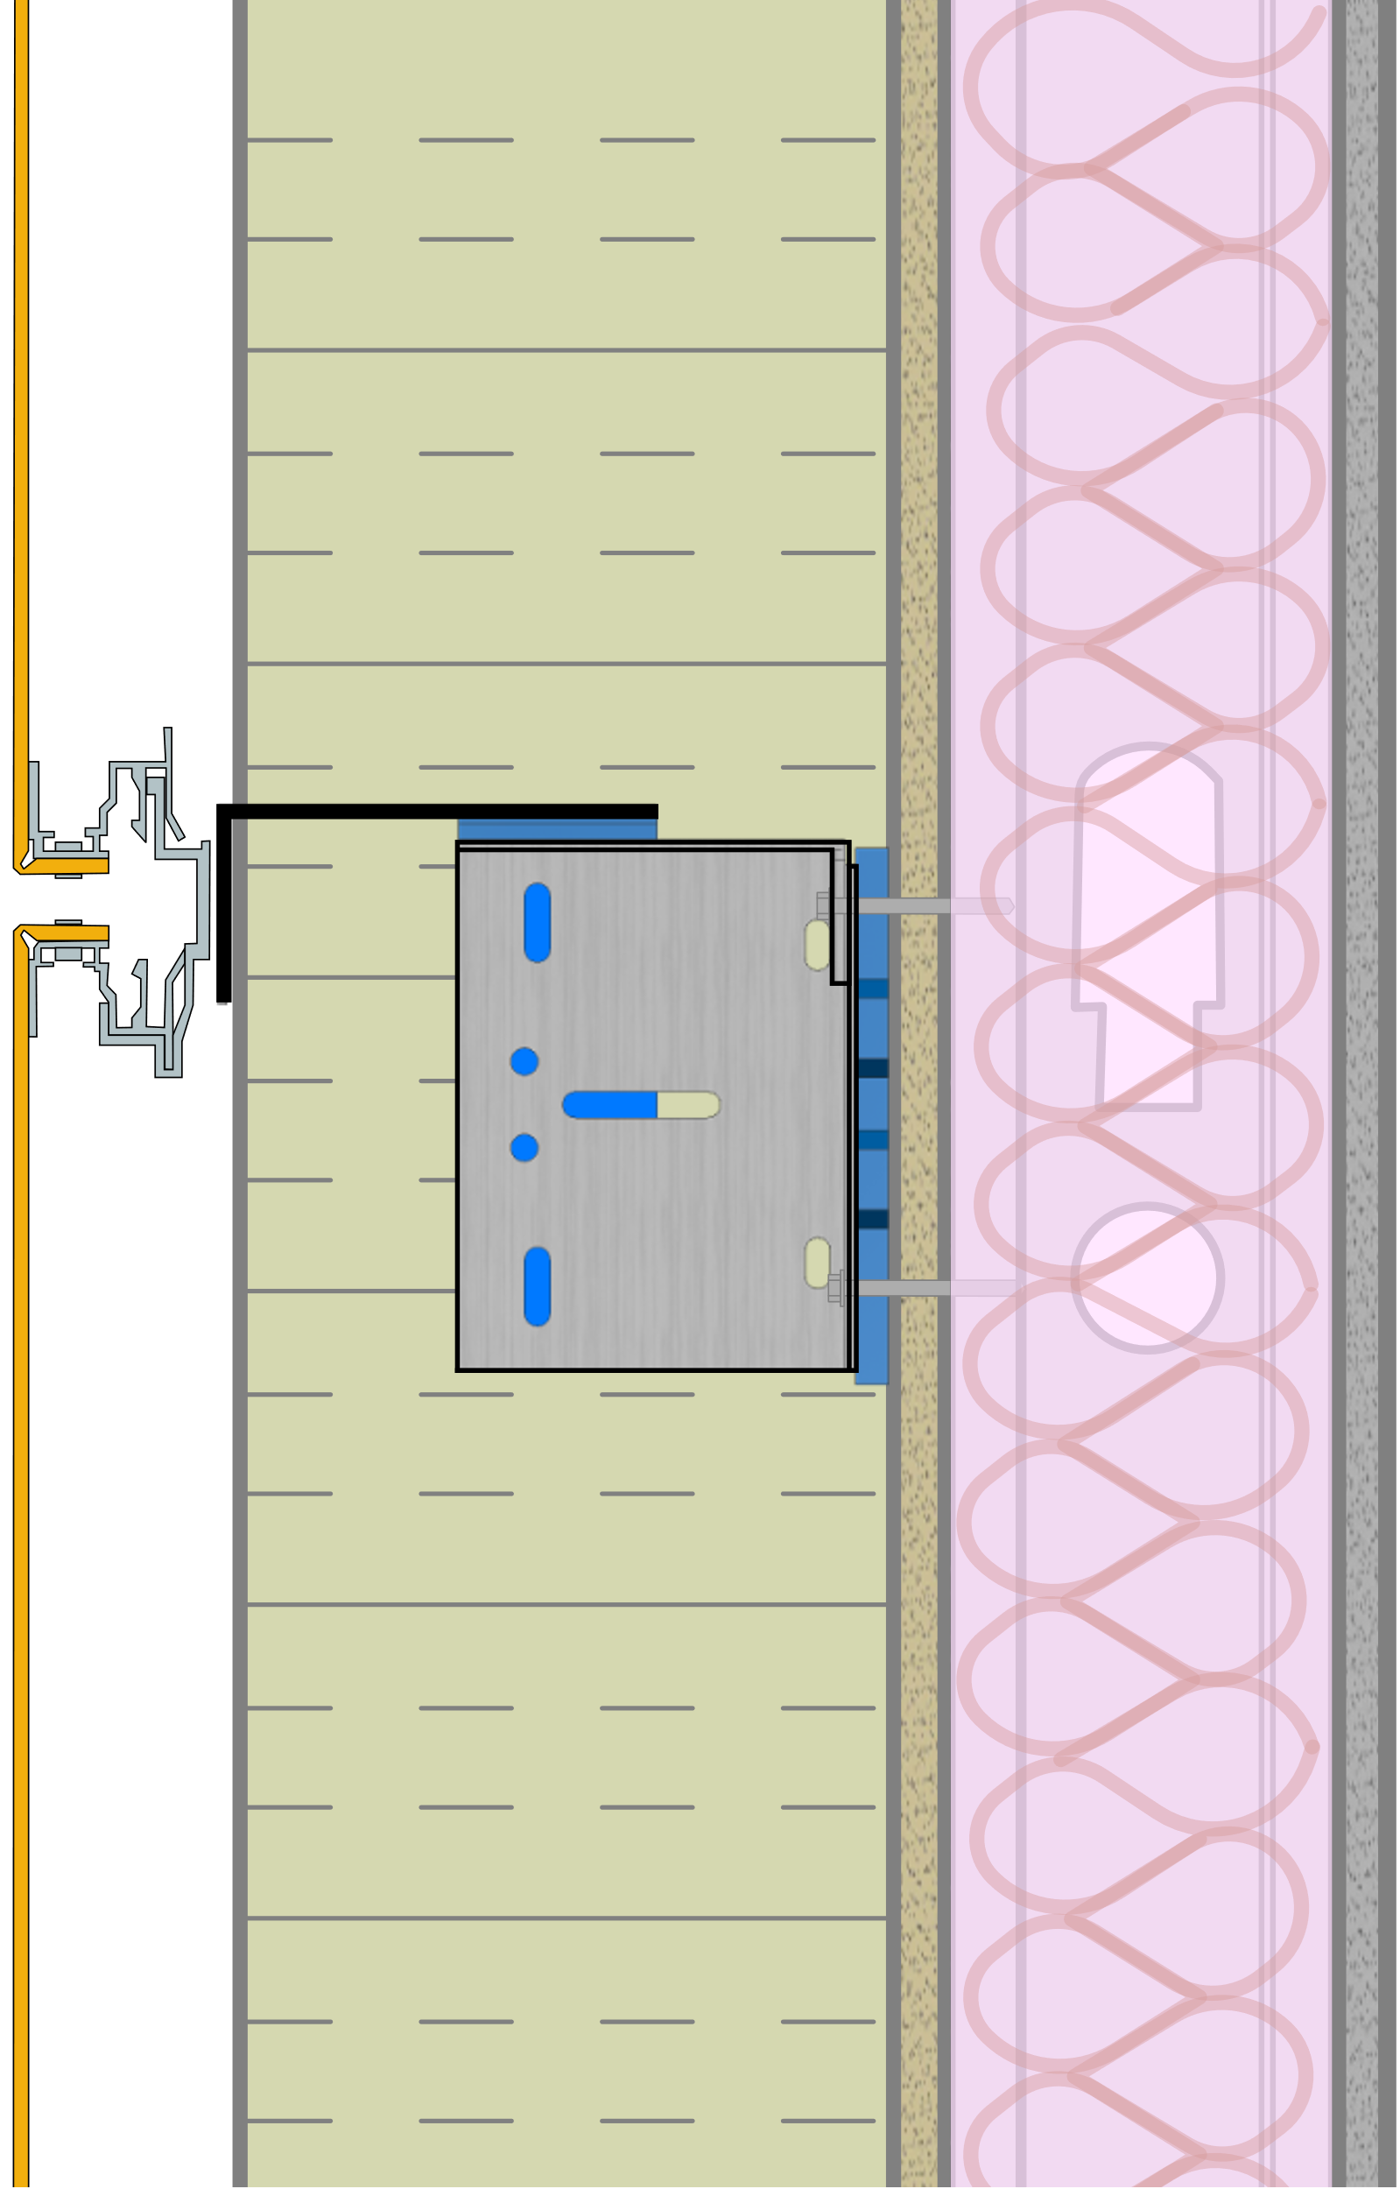
What About “THE PERFECT WALL”?
This wall is 3” wider
As wall thickness increases to meet higher energy performance requirements, it might be reasonable to look at hybrid walls
Vapour-Permeable Membranes and intelligent vapour barriers
Cladding Attachment Limitations
Split Insulated
Exterior Insulated
=
Don’t make stupid decision for the wrong reasons
5 inches of Mineral Wool
8 inches of Mineral Wool
R-30 Effective Steel-Framed Wall Assembly
Notes:
The exterior insulated wall assembly is certainly the most resilient wall! But is it the perfect wall?
READ slide
And there might reasons for that:
Acoustics
Buildable floor area (when calculated to the exterior of cladding while salable floor are is to the interior finish)
Embodied carbon
Cost and spacing of clips
BUT CLICK!
And I am going to show you a few of the things that have become evident

Slide 38
Needs a mention
Air tightness
Heat recovery efficiency
Window to wall ratio
Notes:
There are many levers that can be pulled to help the reliance on heavily insulated walls:
I talked early on the impact of air tightness- so I am not going to go over that again
And the 2 others a fairly is to conceptualize because they are direct levers
Increase the efficiency of your HRV less pressure on the wall to perform
Decrease your percentage of windows less pressure on the wall to perform
Now let's look other levers which may not be as evident, either in their application or their impact

Slide 39
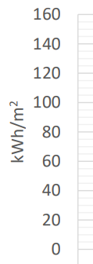
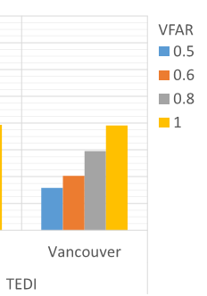
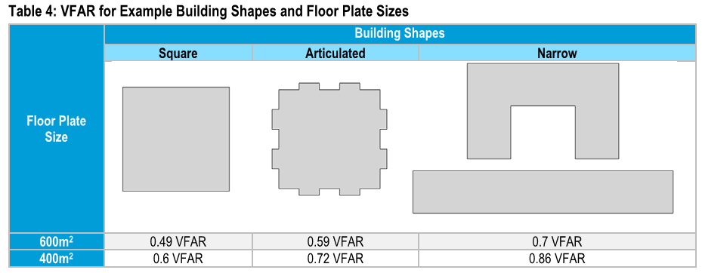
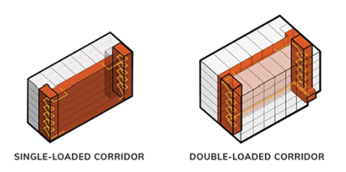
Form Matters
Vertical Surface Area to Floor Area Ratio
Floor to ceiling height matters
Single loaded VS Double loaded
Source: 2017 Metrics Research Full Report, BC Housing
Notes:
The first one is very architectural: The form of the building
It may not matter in demonstrating compliance to a standard like Ashrae that compares you to a base line of the same form, but it does impact greatly the intensity of the thermal energy used.
In a multi-storey building, a good part of the heat goes out through the walls.
So the thermal energy demand intensity (TEDI) is very dependent on the wall surface area compared to the floor area.
I have put down some results from the 2017 Metrics research project that was used to establish the Step Code targets in BC.
And let’s not focus so much on the numbers (I know everything is metrics in my slides) let’s rather focus on the proportions
If you look at different forms, with everything else being equal…
You can have a VFAR of around .5 like for the 600m2 square, that will lead to a TEDI of 30,
If conversely you use a single loaded corridor U shaped building with a courtyard, you’re just under 60, so you have almost double the TEDI
the more articulation you have in a building or the narrower you make it, the more pressure you put on the envelope and the need for insulation. And trust me, there is no amount of insulation that will make up for 15 TEDI

Slide 40

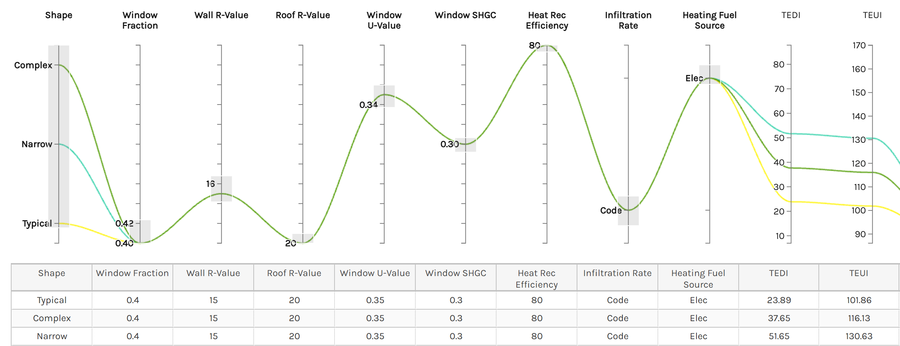
Getting an idea of performance
www.buildingpathfinder.com

Slide 41
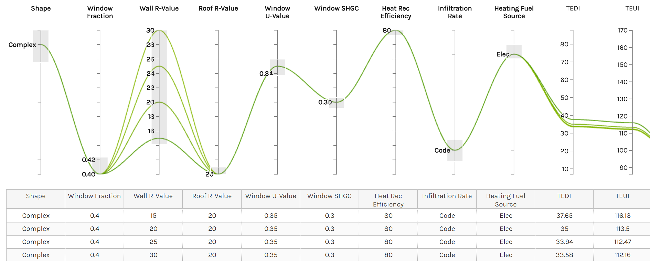
Getting an idea of performance
www.buildingpathfinder.com

Slide 42
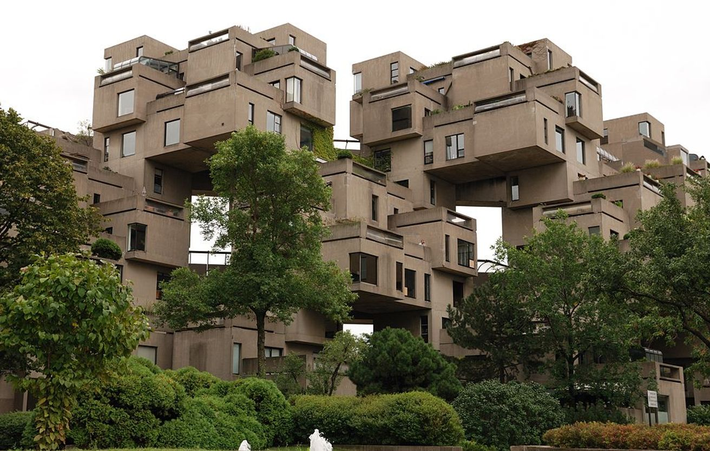
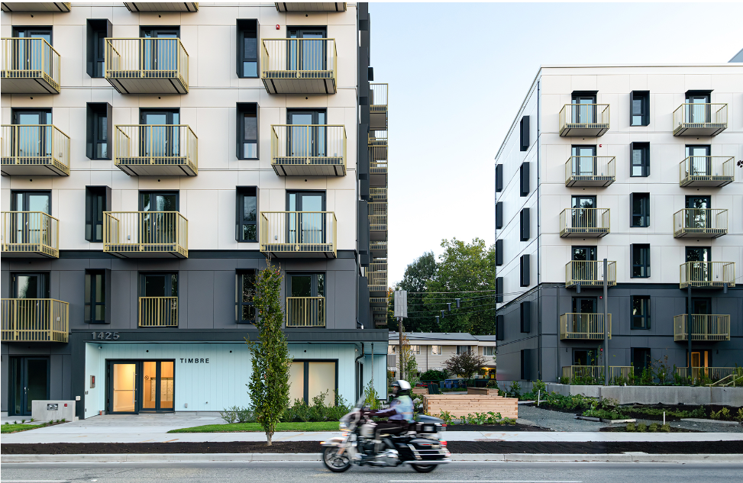
Not all buildings need to be iconic
Notes:
Don’t get me wrong
Habitat is a Super interesting buildings
They still do tours
But looks at eh surface area of envelope
Most building can be much more simple and still look nice

Slide 43
Opaque Wall Uvalue
Notes:
The next 3 example are a bit more focus as they will directly impact the performance of the opaque wall
Just a reminder, that when we look at the overall performance of the opaque wall we are looking at
The u value of the clear field
+ the sum of the detail transmittance X their lengths or number
So if we can reduce the linear transmittance of details- either by making it a better detail or having less of it, then we put less pressure on the clear field value to obtain the same overall U value. Thus… reducing the need for insulation.
With that in mind, let’s first talk about

Slide 44
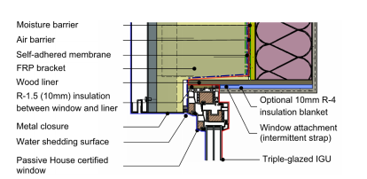

Window Frame & Detailing
Sill
Head
0.28 W/m K
0.08 W/m K
0.08 W/m K
0.53 W/m K
0.11 W/m K
0.04 W/m K
Source: Guide to Low Thermal Energy Demand for Large Buildings , BC Housing
Notes:
Window frame conductivity and window placement impact on linear transmittance
I have pulled 3 specific examples of linear transmittance for different windows and their placement.
And there are many more examples that I could have put on this slide.
But I thought these 3 were good enough to make my points:
First the alignment of the window and more specifically the thermal break with the exterior more continuous insulation makes a big difference.
Then the isolation of the steel studs gets more attention
and finally The thermal quality of the frame will also make a difference
Yes the window frame performance makes a difference in the performance of your wall not just in the U value of the window itself (which is obviously important too)
I am not suggesting here that we always to go to the example shown in the picture to the right, Just that good placement and basic isolation of window frame from the steel studs cost close to nothing, and the impact on the wall performance is not insignificant. So if you want to minimize the amount of exterior insulation, don’t how your window is installed in the wall.

Slide 45



Glazing Configuration
Horizontal
Vertical
Punched
Wall Clear Field R16 | Horizontal Strip Glazing | Vertical Strip Glazing | Punched Window Opening | Two Punched Window Openings
Interface Length (m) | 5 | 2.7 | 6.6 | 9.6
Overall R-Value | 10.2 | 12.2 | 9.2 | 7.8
Source: Chapter 4, Guide to Low Thermal Energy Demand for Large Buildings, BC Housing
Notes:
Then let’s talk about Glazing configuration.
For a fix window to wall ratio of 40% in this example, we can see that the choice of the window configuration will have an impact on the length of window perimeter.
Now for the Same R16 clear field for the opaque wall, and same window detail, we can see how that will impact the overall Rvalue of the wall. The smaller the length, the better the Overall Rvalue
The vertical or horizontal strip windows are quite good but not typical for residential building.
If we concentrate on the punch windows, we can see that if you chose to have 2 windows instead of one for the same area you could impact the wall performance in the order of 8%, not insignificant
So while the detail at the window transition that we talked about in the previous slide is important, the length of the detail as a role to play too. Bottom line pay attention to the configuration.

Slide 46




Balcony Configuration
Point
support
5
6
7
Thermal Break
4
8
3
2
1
2x interface
4
3
2
1
Source: Perkins + Wills: Thermally Broken Balcony Report
Notes:
The 4th and last architectural design consideration I want to bring to your attention today is balconies.
Of course , the easy way to look at it, is don’t put any in!
But if, for reason like I don’t know livability, balconies are required, aside from limiting their size, you can consider the following
What I have here is an inset balcony and a cantilevered balcony, and you can see that the length of balcony can be significantly higher for the inset balcony, like twice as much in this case.
While there is an opportunity to mitigate the thermal bridging with both configurations:
With the inset balcony for example, the balcony can be point supported, which performing at the same level as the thermally broken cantilevered balcony
But think about the form that was discussed as the first consideration!!
With that in mind, your best option is to have a cantilevered balcony, preferably point supported but not necessarily

Slide 47


Low Carbon Study
Enclosure centric study
Identify how embodied carbon can be meaningfully reduced for new construction and renewals for the full building lifecycle
Provide guidance to aid decision making at the component and system level
Highlight solutions that balance emissions with durability, cost, and occupant comfort
Link
Notes:
Really, I touched the tip of the iceberg here, and if you would like to dig in a little more, I think you would probably appreciate a more Enclosure centric study we have recently publish with eh support of BC housing

Slide 48

The future
The Good
It can make your life easier
The Bad
It can hallucinate , you still need judgement
The Ugly
Will it diminish the need for entry level position?
Image : The Scholarly Kitchen
Notes:
No Joe also asked me to look to the future
I am not going to be very original and talk about AI
And I am not an expert at it, from from it, so I am going to keep short

Slide 49
THANK YOU smercier@evokebuildigns.com

Slide 50



Pembina Reframed
Cost effectiveness
Resiliency & adaptability
Health & Wellness
Energy efficiency & carbon emissions
Notes:
A few years ago, we were one of 6 teams that analysis an existing building and proposed a retrofit to respond to the mandate they had put forward:
It included way more then energy efficiency and reducing the operational carbon:
Cost effectiveness was an important factor, in terms of what they were getting for the money they would pay
Resiliency and adaptability needed also to be considered
Being in a seismic zone that meant to look at upgrading the building seismically
It also looked at the wellness of the occupant, not only in terms of thermal confront but other more subjective considerations liked
And of course, it was trying to balance all this while still considering the embodied carbon

Slide 51


Le Chateau – DEEP retrofit
Rendering of intended retrofit
Notes:
Most of it you don’t see:
Seismic, Mechanical , electrical and envelope upgrades
But it does make their implementation easy or unimportant
This was an in-depth study, and the project was a real building with very real constraints, created by both by occupants
It was
And while I don’t have the time to go through this study today there is a couple of take away I wanted to bring up

Slide 52


Balancing act
Conventional building envelope renewal
Best solution for market transformation
Notes:
With infinite money you can achieve a lot but when the money is limited, which is always the case, you have to make balanced decisions
But hen do you arrive at the point of diminishing return
The use of parametric analysis is a great help in identifying the relative impact of different decision on the erngy consumption
It then becomes easier to identify the tipping point and make the decision based on cost easier
The difficulty we ran into with the study is that the embodied carbon evaluation was late, and we had to make decisions based principally on cost and operational Carbon improvement. On that premise we made decisions in terms of course of mechanical systems in terms of heating and ventilation but also thickness of insulation and whether we would use double or triple glazed window (we selected double BTW). Ultimately when all said and done, we were the project achieved the objectives with the least embodied carbon… at least that’s what Patrick told me!
At the end of the day however, GHG from operation and embodied carbon is a bit more complicated than just looking at Energy efficiency.
It depends on where the project is located and the grid
And it remains that, when it comes to Building Envelope at least, little is know or precise about embodied carbon

