Slide 1


Using AeroBarrier in Existing Multifamily and Existing Homes
Summer Camp XXVII 2025
Mike Lubliner, CARES
Dave Bohac, CEE
Twenty-Seventh Westford Symposium on Building Science

Slide 2



Exterior AeroBarrier: Air Sealing Attics and Crawlspaces of Occupied Residences
AeroBarrier Case Studies Weatherization & “Gut Rehabs” Low-Rise Multifamily Dwellings Opportunities In Existing Public Housing
Mike Lubliner
CARES
Dan Auer & Jesse Bennett
King County Housing Authority
Dave Bohac
Center for Energy & Environment

Slide 3
Acknowledgements
Weatherization & “Gut Rehabs” Low-Rise Multifamily Dwellings
Mike Lyons & Mark Modera - Aeroseal™
Dave Bohac - Center for Energy and Environment
Collin Olson - The Energy Conservatory
Chase Davis - Obrien 360
Chase Counts - Arrow Insulation
Andre Dejarlais -Oak Ridge National Laboratory
Joe & Betsy – Building Science Corporation

Slide 4

King County Housing Authority
Weatherization & “Gut Rehabs” Low-Rise Multifamily Dwellings
KCHA is a key leader in affordable public/private housing partnerships with; Puget Sound Energy, Washington State Department of Commerce, Bonneville Power Administration, Northwest Energy Efficiency Alliance, with state & national support!
Washington’s largest landlord - https://www.kcha.org/
Affordable rental housing & assistance to more than 50,000 people
Low-rise multi-family are “woody walkups/corridor 50%/50%”
Typical individual mechanical & utility metering
Deep energy retrofits in LRMF, SF & buys/operates MH “parks”

Slide 5
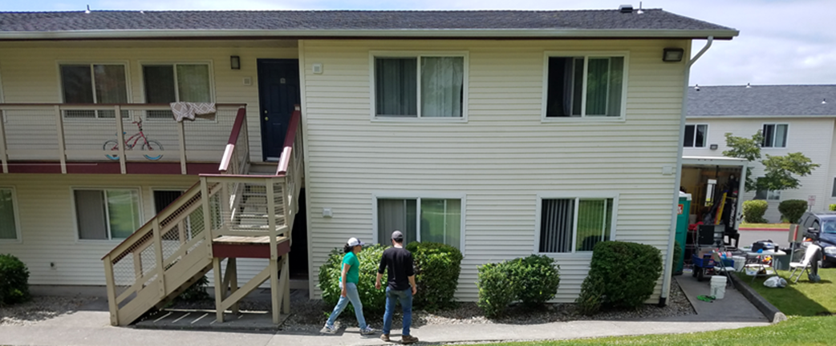
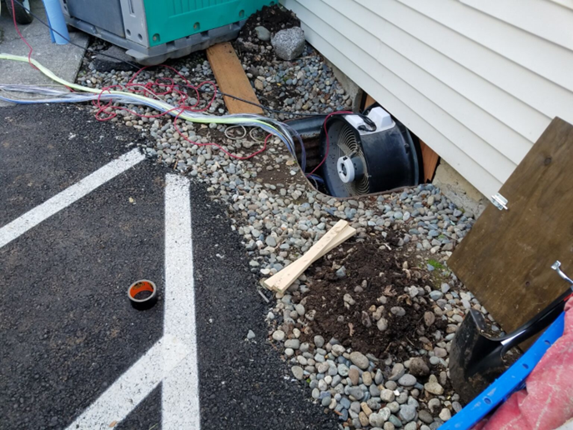

Windsor Heights Seattle
Gut Rehab “car decking” over vented crawlspace

Slide 6
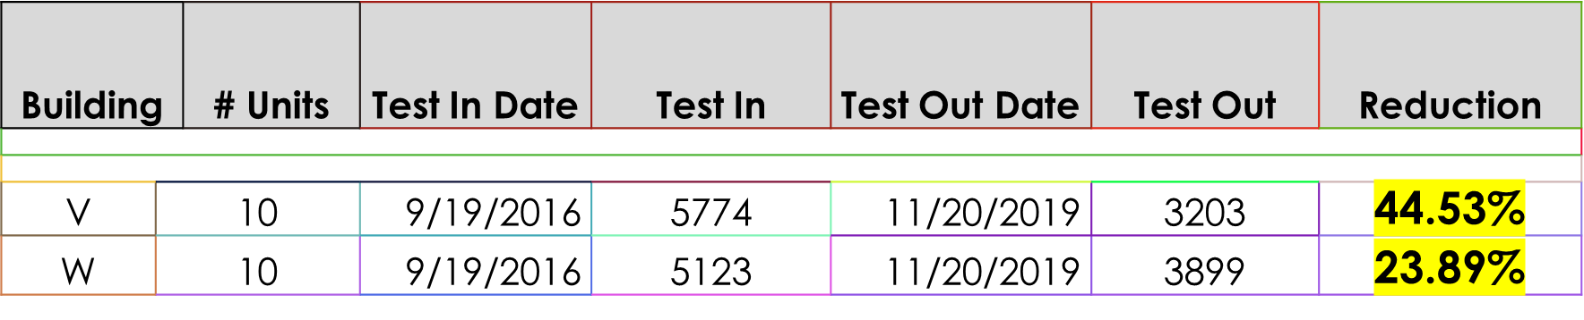
Results With & Without AeroBarrier
Windsor Hts: Gut Rehab “car decking” over vented crawlspace
Old “rat-piss and falling down” R-19 batt insulation removed (W&V)
All crawlspace vents were sealed & BD used to pressurize crawl (V)
AeroBarrier was injected Building V crawlspace
All crawlspace vents were then unsealed (V)
New R-30 floor batts installed (V)
No AeroBarrier for Building W

Slide 7
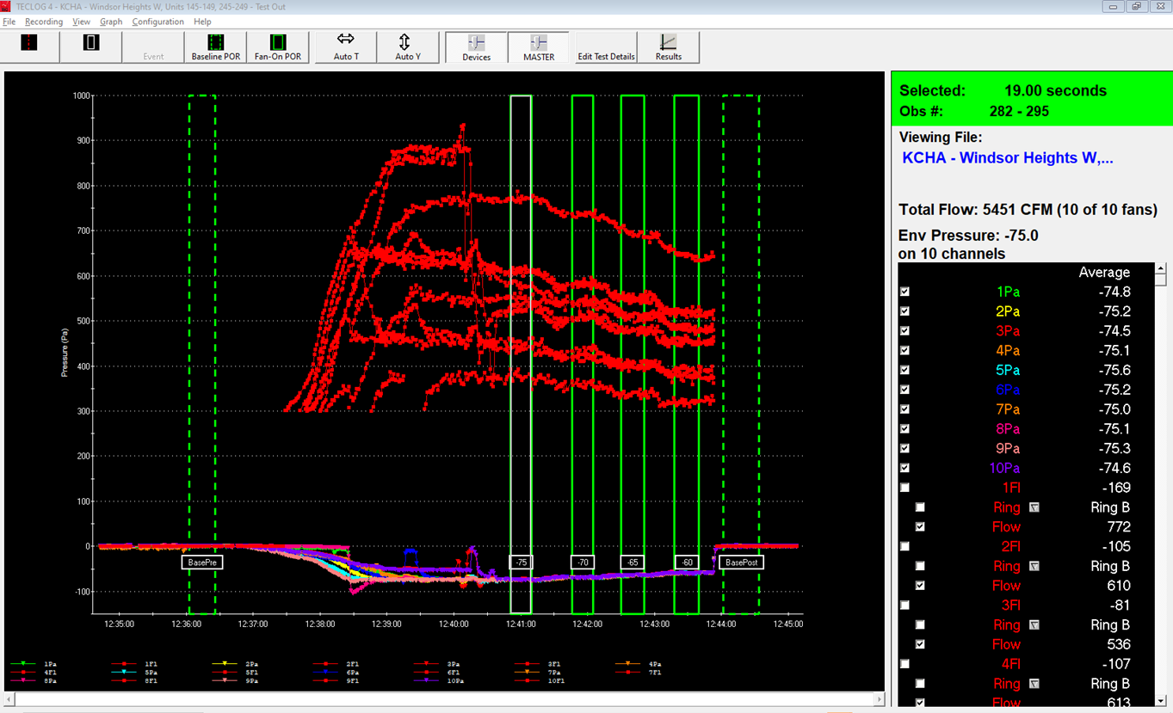
Building W: Without AeroBarrier
Windsor Hts: Whole building exterior envelope leakage test results (TECLOG 4)

Slide 8
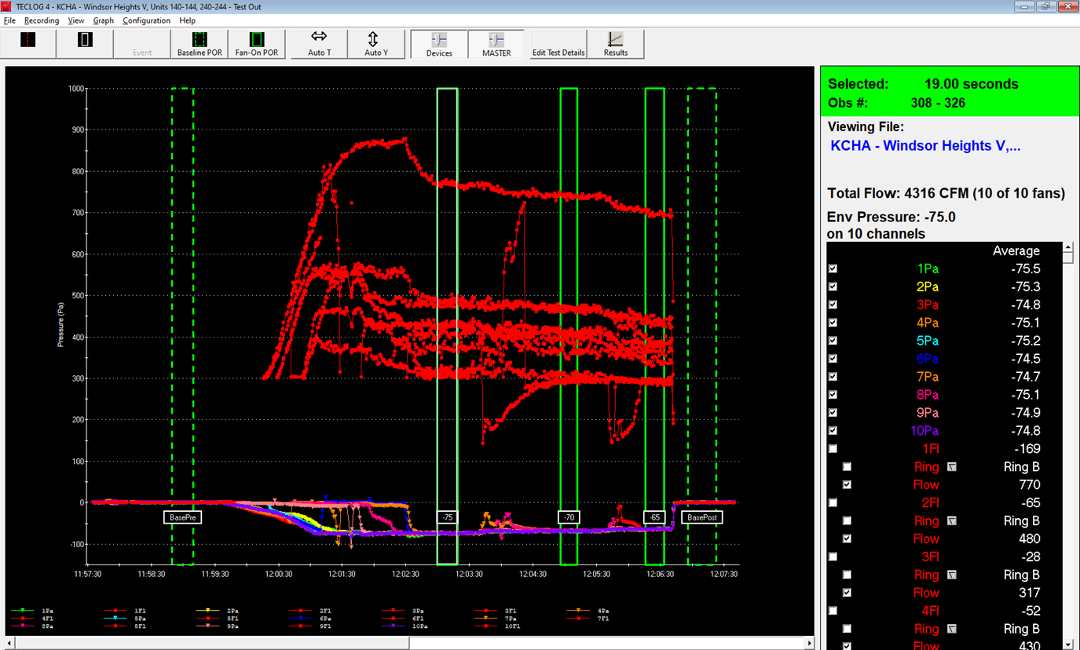
Building V: With AeroBarrier
Windsor Hts: Whole building exterior envelope leakage test results (TECLOG 4)

Slide 9

Evergreen Terrace Renton WA
Gut Rehab “car decking” over vented attic
Total Leakage Reduction
20 ACH50 to under 2 ACH50

Slide 10
Results
Renton: Gut Rehab “car decking” over vented attic
14 buildings, 50 units, 1963’s w/upgrades
AeroBarrier - pressurized injection “unit by unit” each unit to seal; attic and walls
Un-insulated slab on grade
Attic loose fill R19 - R49
Build tight ventilate RIGHT – Ducted HRV
Ductless Heat Pumps – Got AC!

Slide 11
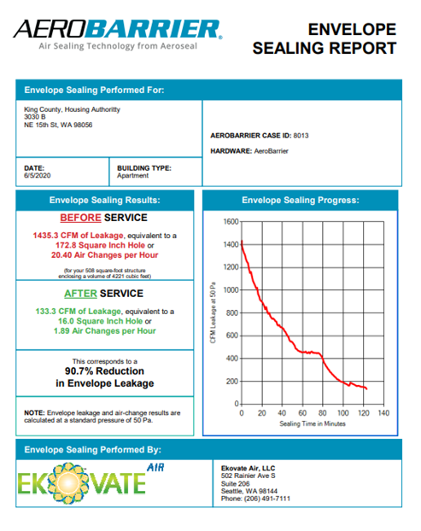
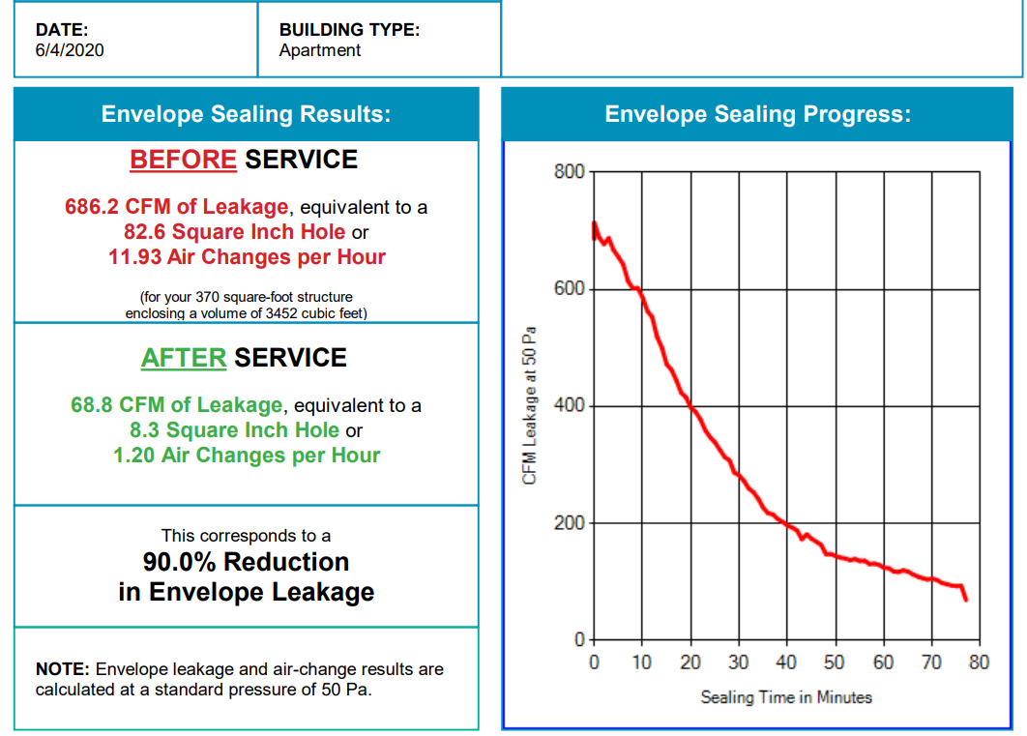
AeroBarrier Reports
Renton: Gut Rehab “car decking” over vented attic

Slide 12
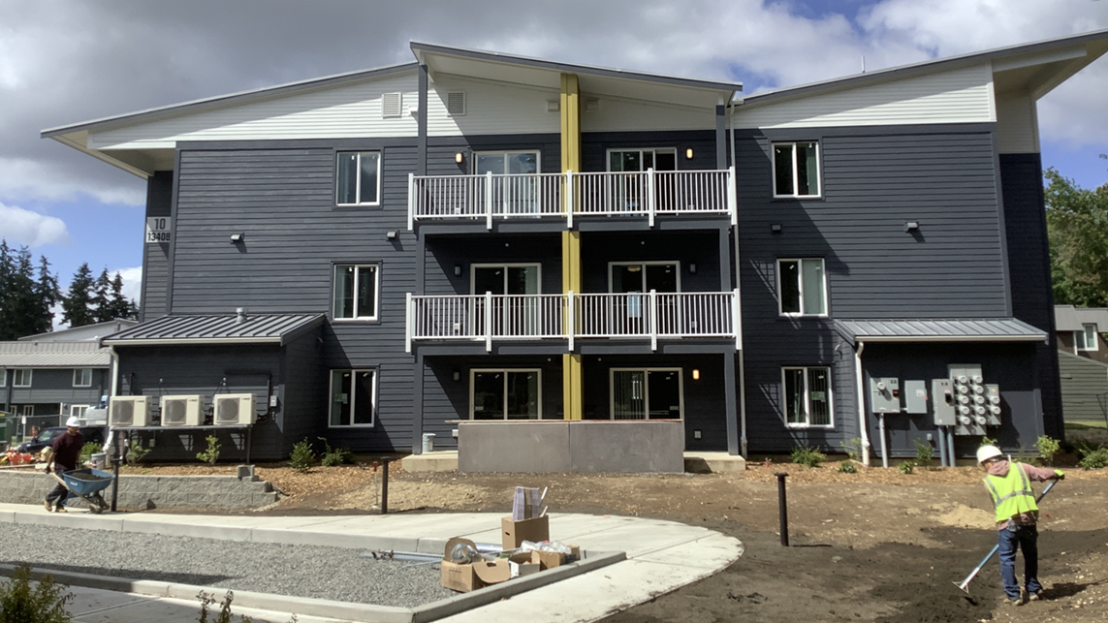
Kirkland Heights Kirkland
New Construction w/100% AeroBarrier (woody walkup)

Slide 13
Results
Kirkland Heights: New Construction w/100% AeroBarrier (woody walkup)
27 buildings, 325 units, 80% completed
Slab on grade, three-stories
Non guarded test (total leakage) w/windows open in adjacent units
Built to WA - WSEC “tighter with HRV - energy credits” for compliance w/ER heat
CO2 central HPWH – New emerging technology (Ecotope – Mechanical-DHW)
HRV in each unit to each room, ER heat, No Cooling
PV - on site

Slide 14
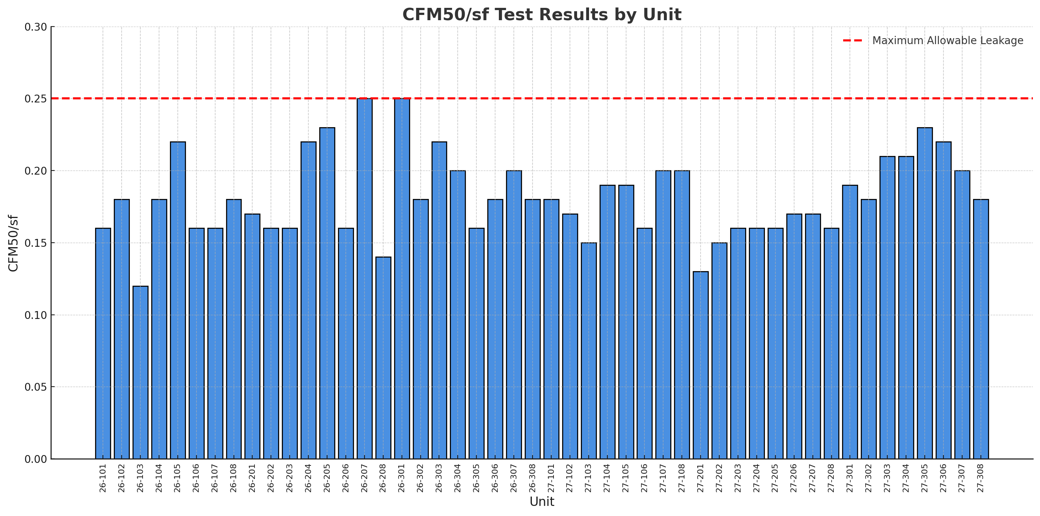
Results
Kirkland Heights: New Construction w/100% AeroBarrier (woody walkup)
The units in the newly constructed buildings averaged 27% below the 0.25 CFM50/sf target

Slide 15
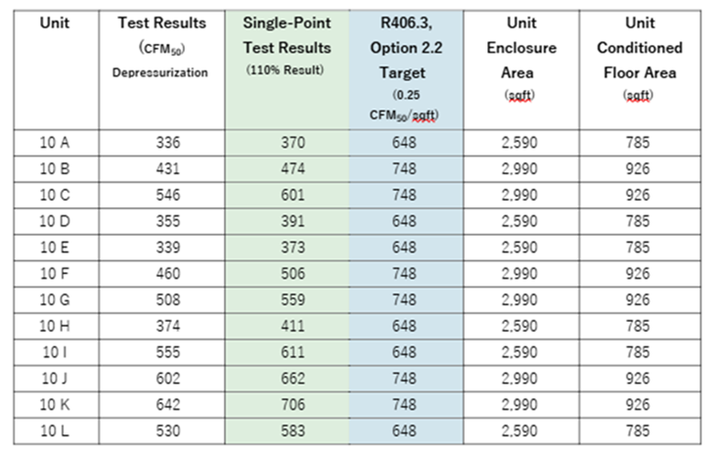
Results
Kirkland Heights: New Construction w/100% AeroBarrier (woody walkup)
Building 10 example
June 12-14, 2024
All units passed WSEC Option 2.2
Target: 0.25 CMF50/sf (unit SA)
521 cfm50 vs. 698 cfm50
Average 25% below code

Slide 16
Results
Kirkland Heights: New Construction w/100% AeroBarrier (woody walkup)
Arrow bid $1.85/sq ft to remove batt insulation in an attic.
Arrow bid $1.60/sq ft to remove loose fill insulation in an attic.
Air seal specifications requires air sealing all joints in the attic floor:
Air seal attic w/existing insulation = $0.60 - $0.65/sq ft
Air seal attic w/o insulation = $0.55 - $0.60/sq ft
$2.15 - $2.50/sq ft – Remove old and air seal w/o AB

Slide 17
Future Research?
Deep energy retrofits case studies at gut-rehab:
Conduct Survey to Identify Stakeholder Value Proposition(s)
Conduct (SIR) Cost/Benefits Parametric Analysis
Research to Assess:
Tenant, building owners, contractors, utilities & WX crews, KCHA contactors feedback:
Odor Control
Sound Control
Thermal Comfort
Indoor Air Quality
Utility Bills impacts (energy and demand)
Savings to Investment Ratio
Other Non-energy Benefits
Your thoughts are appreciated!

Slide 18
Dwellings Resilience Improvements
Air sealing “big-leaks”, Blower door guided pre/post whole building and each unit tests
Dense-pack 2x4 walls, added to existing R2- R11 to R15 (insulates & air seals)
Continuous wall insulation often added when re-siding
Energy Star or better; window, door, appliances, lighting replacements
Vented attic old insulation removed or moved & air seal big holes, insulate to R38-49
Vented crawl floor insulation moved & air seal, & replaced, insulate to R30-38
Insulating uninsulated slab at grade at perimeter
Replace HVAC electric/gas heaters with DHP’s & EPCHOA “DDPTAC”
Upgraded ventilation system to 62.2 and install H/ERV’s, if & when appropriate
Upgraded electric/gas DHW to Heat Pump Water Heaters when appropriate
PV on roof when reroofing and appropriate

Slide 19

Where are the leaks that are bigger than the other leaks? Right-On!
Deep energy retrofits case studies at gut-rehab:
Chat with Dan & Jesse
Chat with Dave & Luby
Chat with Dr. Mark Modera & Emily
Build tight & ventilate right!

Slide 20



Exterior AeroBarrier: Air Sealing Attics and Crawlspaces of Occupied Residences
AeroBarrier Case Studies Weatherization & “Gut Rehabs” Low-Rise Multifamily Dwellings Opportunities In Existing Public Housing
Mike Lubliner
CARES
Dan Auer & Jesse Bennett
King County Housing Authority
Dave Bohac
Center for Energy & Environment

Slide 21



Acknowledgements
Exterior AeroBarrier: Air Sealing Attics and Crawlspaces of Occupied Residences
Mike Lyon
Lead Application Engineer
Aeroseal
Curtis Harrington
Co-Director of Engineering
UC Davis, WCEC

Slide 22
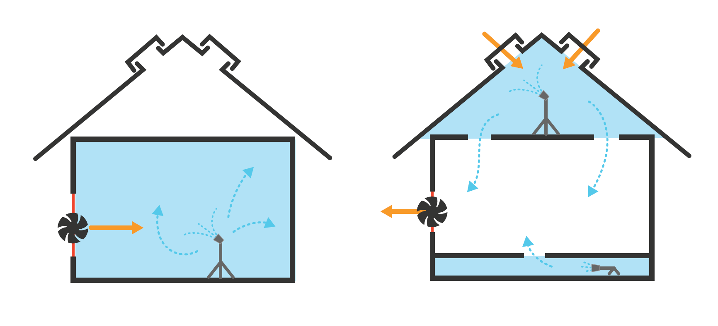
New Exterior Outside – In Method
Traditional
Inside – Out Method
Notes:
Through this new approach, a blower door depressurizes the residence while the sealant fog is released in an adjoining unconditioned area (e.g vented attic, vented crawlspace, unconditioned garage, unconditioned basement).
When applied from the attic, of an occupied home, the sealant particles fill wall-top, attic bypass, and other attic leaks as the particles are drawn into the home leak locate by fan depressurization of the home.

Slide 23
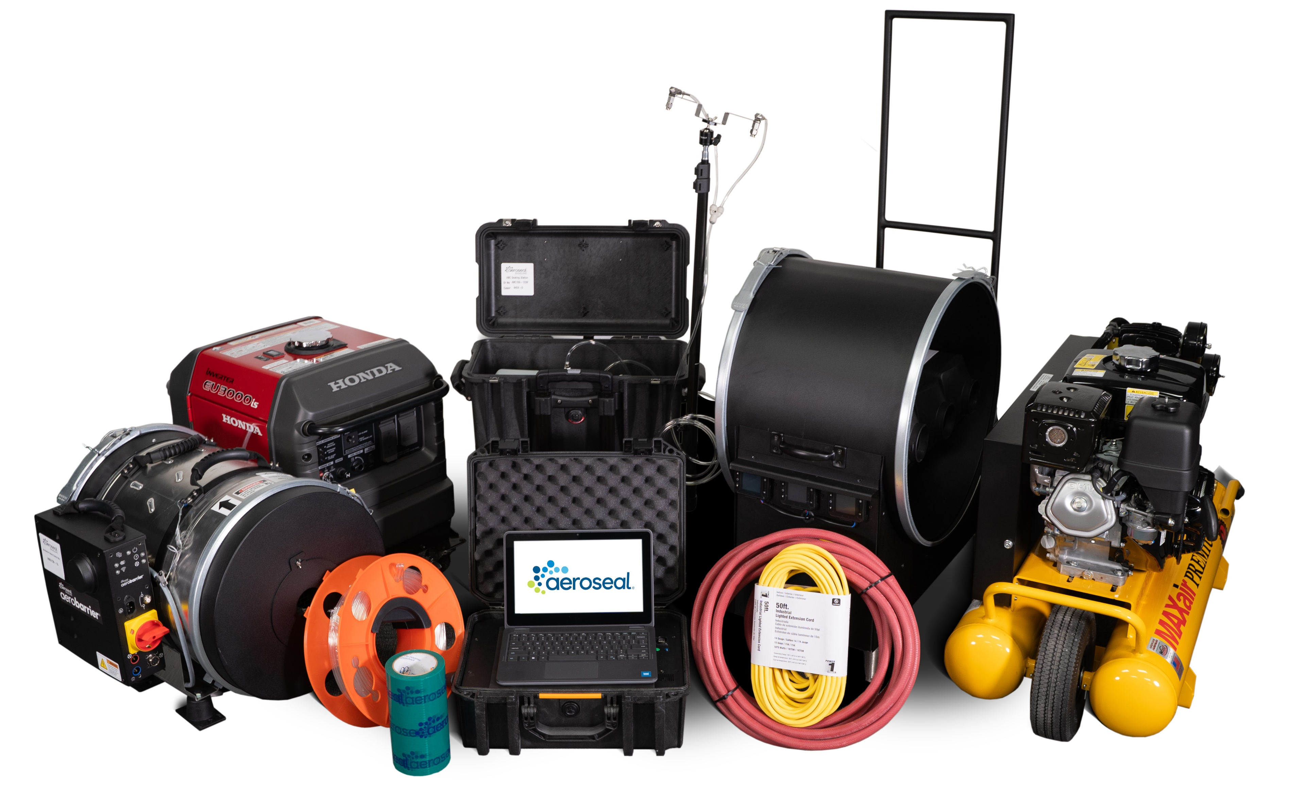
AeroBarrier Select
Equipment Development - ongoing

Slide 24
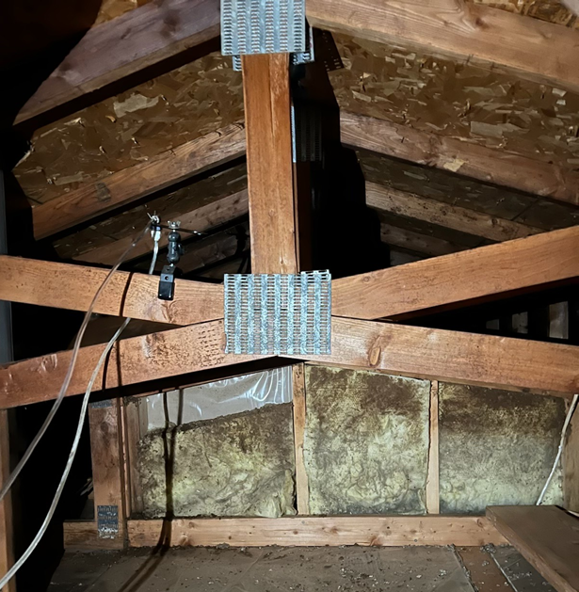
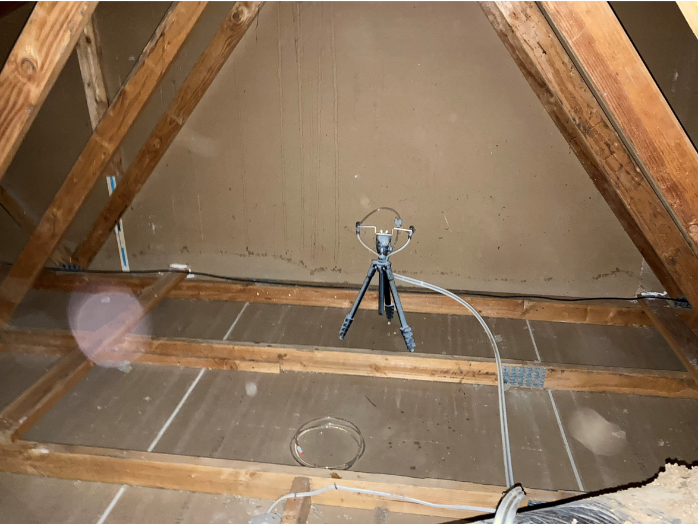
Attic Sealing Process
Exterior AeroBarrier
Less invasive
No surface preparation required
Requires removal of attic insulation
Depressurize living space while injecting in attic
Occupants leave for ~1-2 hours

Slide 25
DOE BENEFIT Project
Exterior AeroBarrier
Test process in a realistic product delivery environment in SF & MF homes and evaluate; field performance, experience needed to refine the process and validate the value proposition to stakeholders. Research tasks include:
Stakeholder outreach (HPC, SME meeting etc.)
Market structure scenario(s) research
Identify barriers/opportunities in (WAP) & (HPC) for low-income clients
Energy/economic - Savings to Investment Ratio (SIR) analysis
Inform moisture durability, and (IAQ) non energy benefits.
On Hold
Notes:
I had expected to share results from a new project that we hoped to start this year, but that project has been put on hold. Fortunately, other R&D work is moving forward, and I’ll be reporting on those results.

Slide 26
CalNEXT Demonstration Project
Exterior AeroBarrier
Goal – Develop and demonstrate less invasive approach for aerosol sealing of existing homes
Adapt existing aerosol sealing methods to address occupied homes
Measure performance of sealing approach in different building types
Develop and document installation protocols
Provide recommendations for sealing equipment
Curtis Harrington
Co-Director of Engineering
UC Davis, WCEC

Slide 27
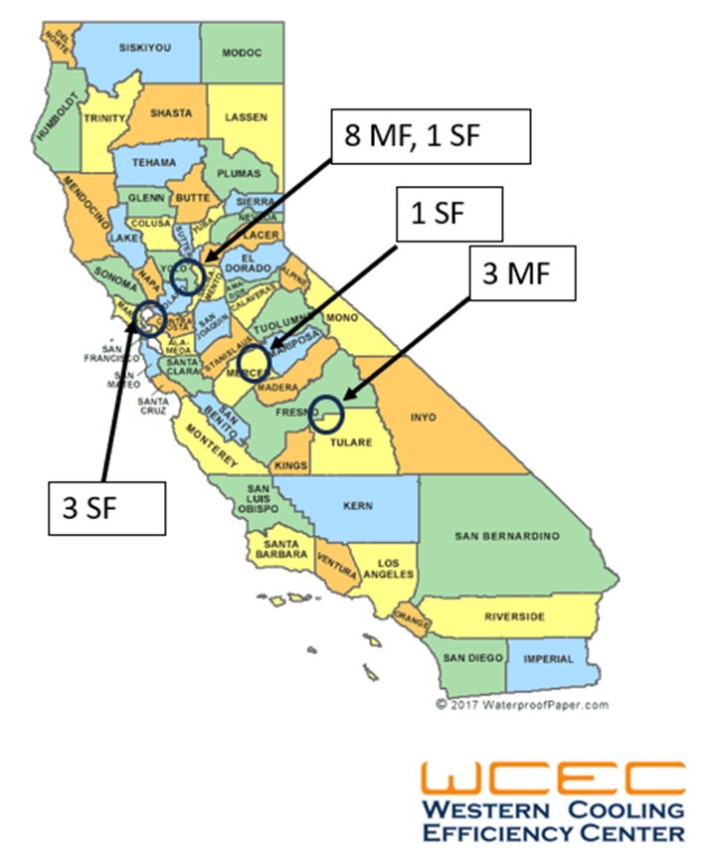
CalNEXT Demonstration Project
Exterior AeroBarrier
5 single-family
1 attic only
2 crawlspace only
2 attic and crawlspace
11 multifamily
all 11 attic only
Compare to other sealing methods
Manual applied canned foam
Spray-on elastomeric
Notes:
This approach works well for any confined spaces adjacent to the living space – attics, crawlspaces, unconditioned basements, attached garages. We have results for 5 houses – 1 that was attic only, 2 CS only, and 2 that were a combination of attic and CS. We also have results for 11 MF units from 2 buildings and those were attic only. For some of the MF units we have aerosol results to compare to manual sealing.

Slide 28
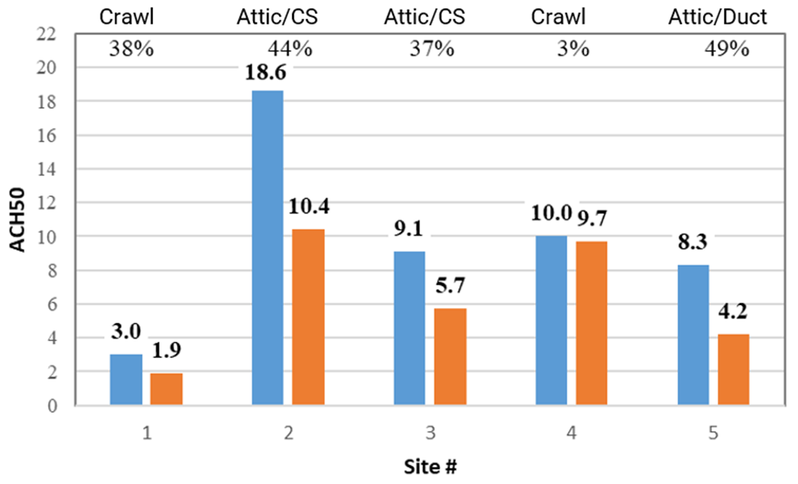
Single Family Homes
Exterior AeroBarrier
Vintage: 1900-1972
Size: 1,191-2,491 ft2
Starting leakage:
3-18.6 ACH50
Average = 34% 42% w/o site 4
Notes:
This bar chart shows the results for the five CA houses. Blue bars are pre-sealing leakage and orange are post-sealing. These are older houses with floor areas from 1,200 to 2,500sf and are 1 and 2 story. Up at the top you can see the percent reduction and down at the bottom what was sealed. Keep in mind that these are the leakages of the entire house – not just the area being sealed. The reductions ranged from 3% to 49% with an average of 34%. I’ll go through a few of these in more detail.

Slide 29
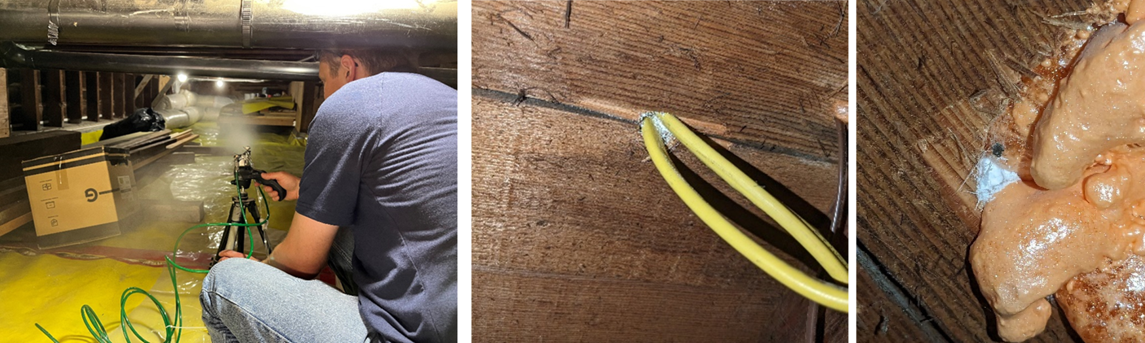
Site 1
Exterior AeroBarrier: Single Family Homes
Early 1900s, gut rehab, 1,420 sf
Crawlspace sealing only (conditioned attic)
3.0 >> 1.9 ACH50 (38%)
87% of 283 CFM50 CS to house leakage was sealed
Notes:
Site 1 was a single-family 1,420 ft2 home in California climate zone 3. It was originally built in the early 1900s but underwent a gut rehabilitation project within the last 10 years. The renovation included significant attention to air sealing details resulting in a relatively tight baseline leakage of 3.02 ACH50. The home was a single story with a conditioned attic, which prevented the sealing technique from being used in that space.
It had a small basement connected to the crawlspace area and included an exterior door that allowed the research team to perform guarded testing. With the basement depressurized to -50 Pa, the house reached -10 Pa relative to outside, which provided an assessment of the extent to which the house and basement were connected relative to the house exterior leakage. A guarded test showed that there was a total of 283 CFM50 (134 q50) of envelope leakage through the floor between the house to the basement. A post-seal test showed that the aerosols successfully sealed 87% of this floor leakage, and another guarded test showed no measurable pressurization of the occupied space when pressurizing the basement, demonstrating that very little leakage connection remained between the zones. Total sealing time was about one hour, with about 1.5 hours of setup, including covering of contents in the basement and cleanup. The overall envelope leakage sealed was 1.14 ACH50 for a final result of 1.9 ACH50.
Aerosol fog inside the occupied space was noticeable, but very minor. We did not observe any deposition on the owner’s belongings. One window was opened a small amount during the sealing to help flush particulates out of the building. Opening the window did not affect the sealing process since overall leakage flow was low, and therefore pressure was able to be maintained. Figure 1 shows photos of some of the aerosol seals formed on the underside of the floorboards. This site shows that the distribution of sealant can work against gravity and that cool, humid spaces can be effectively sealed with the aerosol method.

Slide 30
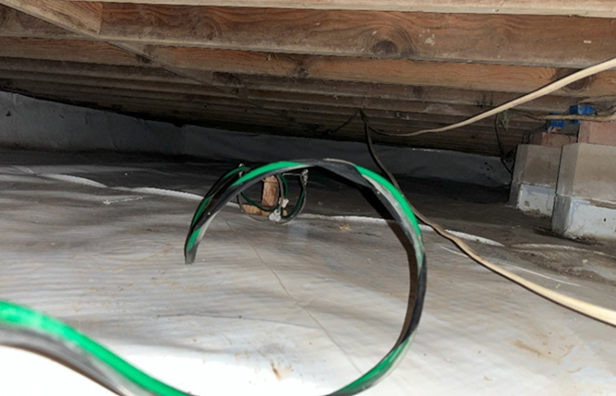
Site 4
Exterior AeroBarrier: Single Family Homes
1961, 2-story, 2,491 sf
Partial crawlspace and slab-on-grade
Crawlspace sealing only – difficult attic insulation removal
10.0 >> 9.1 ACH50 (3%)
60F and raining (100% RH), depressurization ~ 70Pa
Opened a patio door to reduce sealing in living space
Notes:
Site 4 was a 2,491 ft2 two-story home in California climate zone 3, with denim insulation in the attic and a small ~600 sq. ft. crawlspace below part of the home (Figure 6). The rest of the home’s footprint was slab-on-grade with a garage and covered outdoor space. The insulation would have been labor intensive to remove, so the team elected to attempt crawlspace sealing only. Despite the limited available opportunity for sealing with the aerosols, this home was chosen to see if the technology could be effective on this limited scale.
The weather on the day of sealing was considered the worst-case scenario with high humidity and significant ground moisture. The aerosol sealing process is sensitive to humidity levels and relies on some evaporation of moisture around the particles to achieve the appropriate tackiness. It rained most of the day and local observations recorded 100 percent humidity with a high temperature of 60°F. To address the high humidity levels, the team used a 30 kBtu/hr (8.8 kW) propane space heater to raise the temperature of the air entering the crawlspace. The heater was placed at the outdoor entrance of the crawlspace, allowing preheating of the makeup air entering the cavity. Two sets of nozzles were used for the sealing. The heater allowed constant flow to one set of nozzles and the other cycled off intermittently due to high humidity.
Site 4 had an initial house leakage of 4,190 CFM50 (1,977 q50). Sealing was conducted for 2.5 hours with very little reduction in home leakage. Due to the high level of initial leakage, the full-speed fan operation only produced a house depressurization of 70Pa. It was later discovered that the chimney damper was open. The leakage reduction from sealing was only 129 CFM50 (61 q50) or 3% of the total home leakage. Particles were noticeable in the zone above the floor, suggesting that leaks there were leaks between the crawlspace and house interior. A visual inspection identified a large hole behind the washer, baseboard leaks, and around a chimney, but manual sealing efforts at those locations showed no measurable impact on total home leakage flow. It is possible that there were other holes too large for the aerosol to effectively seal but this could not be verified.
For this test site the team placed two particulate matter (PM) sensors in the house (Sensirion SPS30). One was placed near the blower door inlet and the other upstairs. This provided an indication of the particle size and concentration in the living space. The PM sensor the blower door initially read a low baseline concentration of only 165 particles/in3 (10 particles/cm3). After sealing started, PM counts increased significantly, to a maximum of 213,000 particles/in3 (13,000 particles/cm3). Opening a patio door decreased the particle concentration at the blower door inlet to 12,000 to 16,000 particles/in3 (750 to 1,000 particles/cm3).

Slide 31
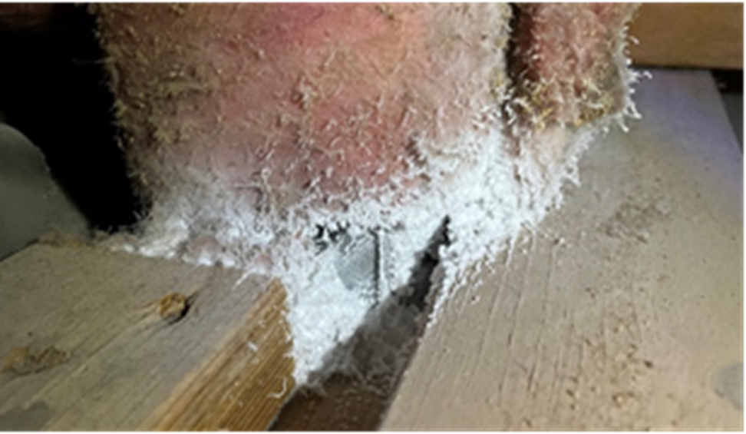
Site 5
Exterior AeroBarrier: Single Family Homes
1972, 1-story, 2,136 sf
Attic sealing only, ducts in attic
12.7 >> 8.5 >> 4.2 ACH50 (49%)
sealed 133 CFM25 or 34% of the total duct leakage
Sealing occurred at exposed joints, better sealing w/removed insulation
Notes:
Blower door tests were conducted at Site 5 before the manual sealing of large openings was performed, showing a relatively high leakage of 12.7 ACH50. The leaks identified for manual sealing included a large gap around a light fixture and around an exhaust fan housing. The home was preparing for a full electrification upgrade, including replacing a natural gas furnace and hot water heater. These systems were both located in the home, but the new systems were being installed outside of the conditioned space. The combustion makeup air duct was open to the attic. It was temporarily blocked and scheduled to be permanently sealed. Another blower door test was performed after the temporary sealing produced a leakage of 8.6 ACH50 which was used for the house baseline leakage. Weather conditions were relatively cool and damp during this installation, with intermittent rain showers, but attic conditions were much drier than experienced at Site 4. Two propane heaters were stationed in the attic during the sealing that provided adequate heating to avoid reaching humidity limits for the aerosol injection system. Even with these challenges, the air sealing was successful, sealing 1,250 CFM50 (590 q50) or 4.3 ACH50 which was 50 percent of the total home leakage for an end result of 4.3 ACH50.
Another advantage of the attic and crawlspace sealing approach is that exposed ductwork in those locations could be sealed in the process. Site 5 had sheet metal ductwork present in the attic. A duct leakage test before and after sealing was performed to measure the duct leakage reduction. The fiberglass insulation around the metal ducts was not removed prior to sealing. The insulation filtered the sealant particles before they could reach the duct, but the exposed parts near register boot connections were available to be sealed (Figure 3). Overall, the process sealed 133 CFM25 (200 CFM50, 0.7 ACH50) or 34% of the total duct leakage. There were signs of leakage beneath the insulation as evident by sealant buildup on the insulation and it is expected that removing the insulation prior to sealing would have resulted in increased sealing.

Slide 32
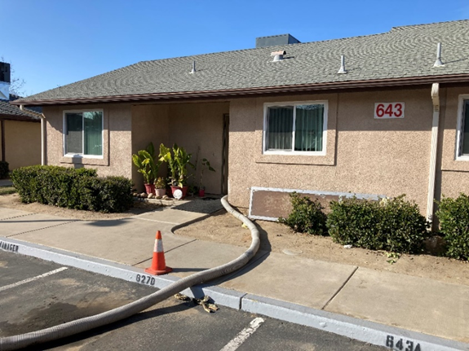
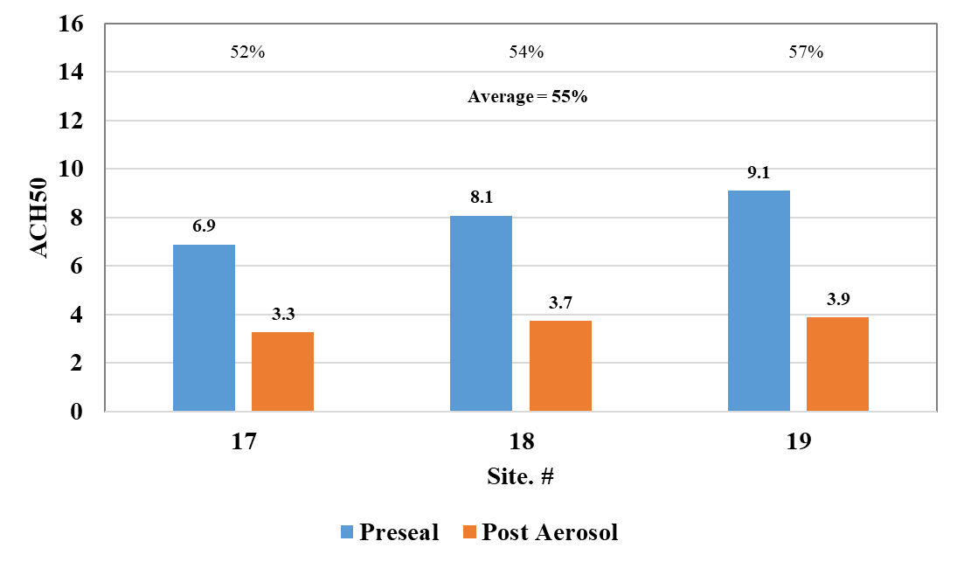
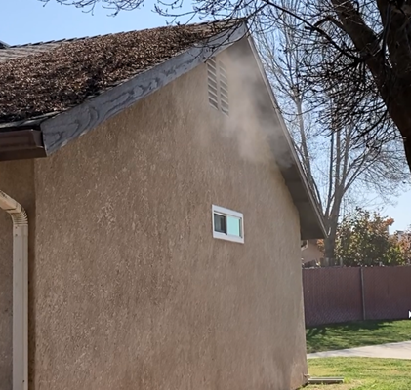
First Multifamily Sealing
Exterior AeroBarrier
Notes:
The test site included 938-ft2 and 764-ft2 single-story apartments built on a slab with a ventilated attic. The aerosol sealing process was applied to three apartments, while the remaining 37 apartments received conventional foam sealing of the attic by the insulation service contractor. The foam sealing focused on electrical penetrations, HVAC connection boots, and construction seams. Two conventionally sealed apartments were tested and compared to the three that were sealed with aerosols. All baseline and post-sealing leakage tests were performed with the attic insulation removed. Figure 54 shows the sealing results for each attic sealed with the aerosol process and those sealed with manual foam application. The aerosol sealing reduced the homes’ total envelope leakage by an average of 4.4 ACH50 or 55%, from an average initial leakage of 8.0 ACH50 to a final leakage of 3.6 ACH50. The average reduction was 0.59 CFM50 per ft2 of ceiling area. By contrast, the conventionally sealed attics reduced the homes’ leakage by an average of only 14%, from an initial leakage of 7.2 ACH50 to a final leakage of 6.2 ACH50.

Slide 33
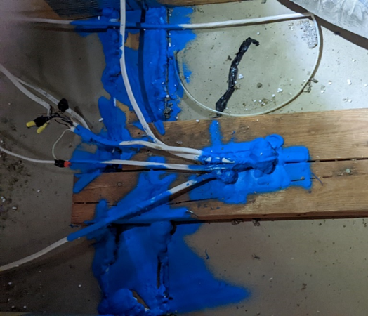
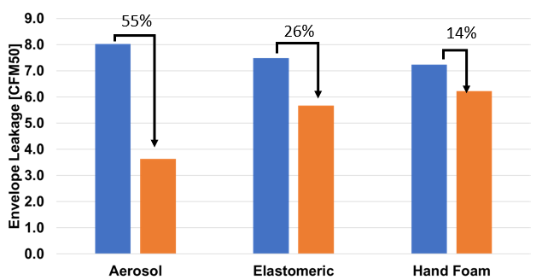
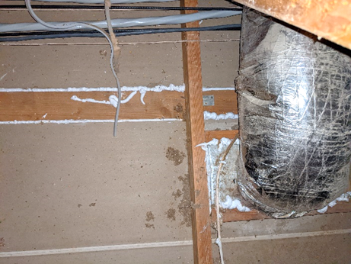
Compare to Manual Methods
Elastomeric
Sealed 3 apartments with each of the methods
(ACH50)
Hand Foam

Slide 34
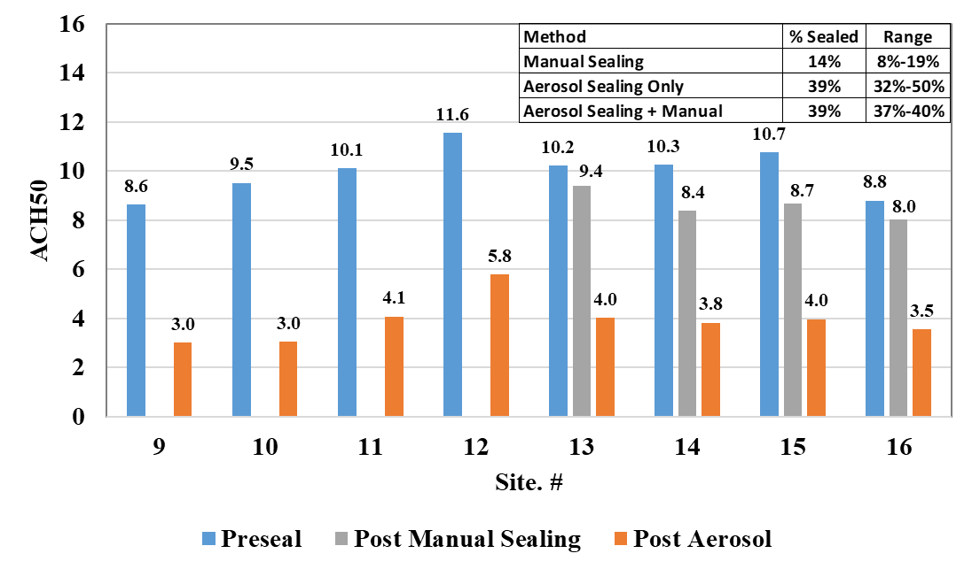
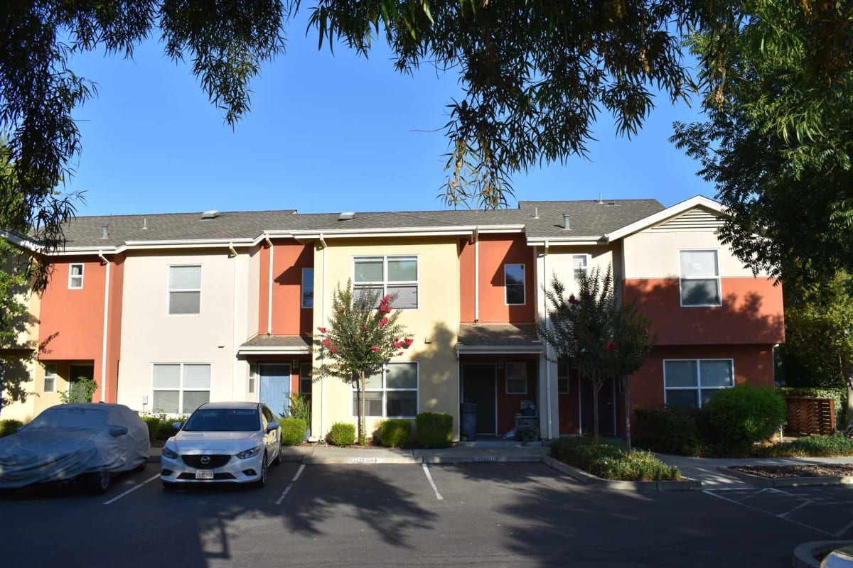
8 Multifamily Sites – Attic Sealing
4 AeroBarrier Only and 4 Manual + AeroBarrier
Notes:
Air leakage measurements for total unit leakage (exterior and interior). Guarded testing of one unit determined that 46% of the total leakage was through the attic.
The combination of manual sealing before and then AeroBarrier didn’t achieve any greater reduction in total leakage. However, it did reduce the average sealing time from 88 minutes to 52 minutes.
AB only total time was 4-5 hours

Slide 35
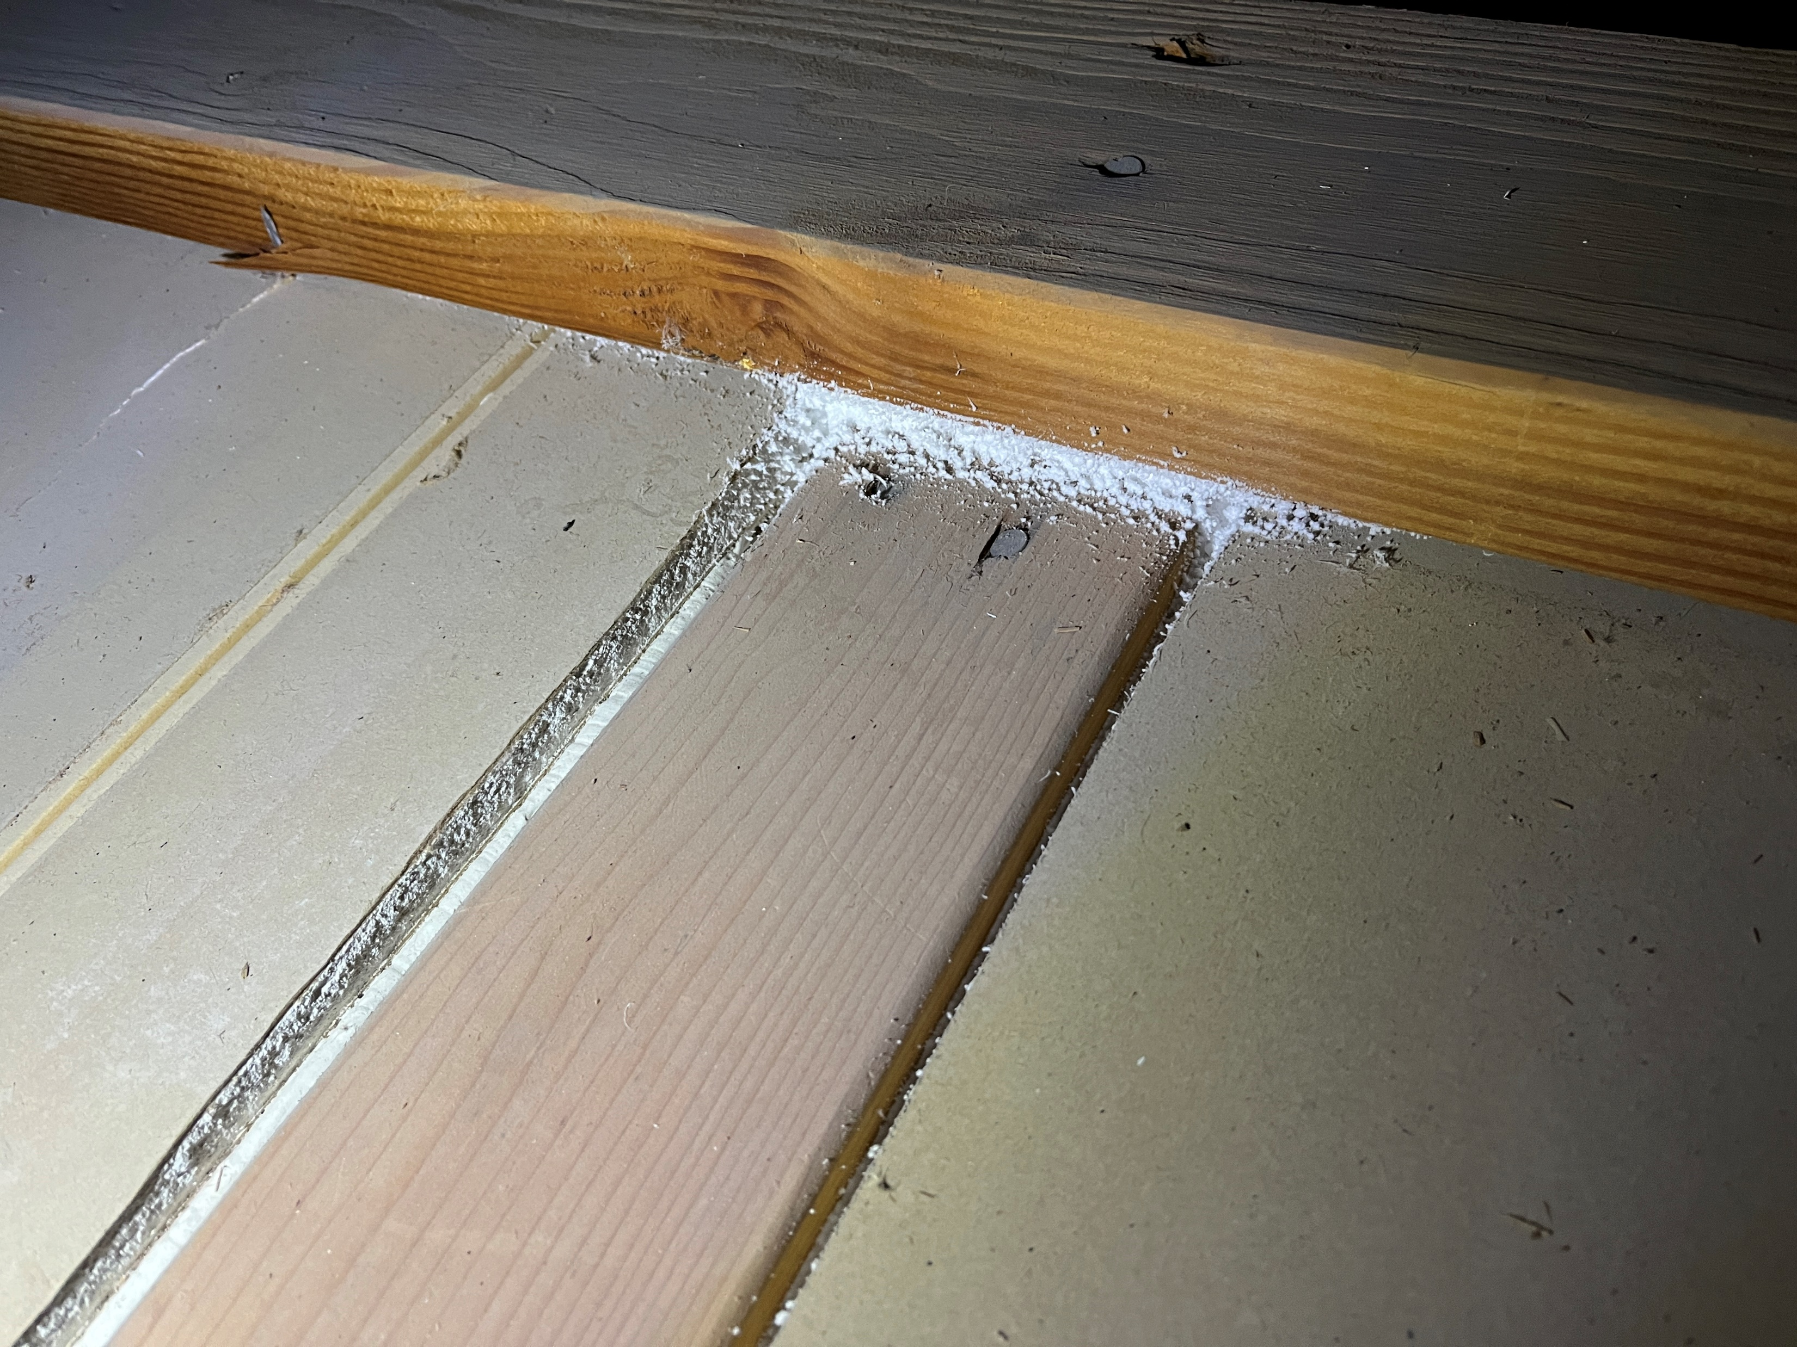
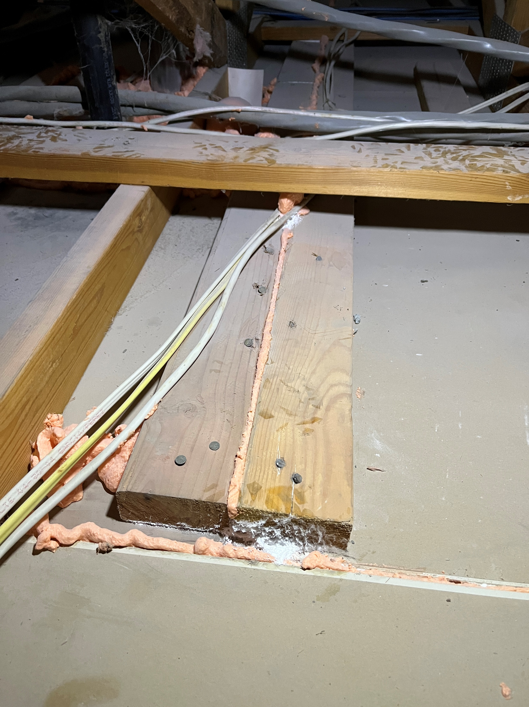
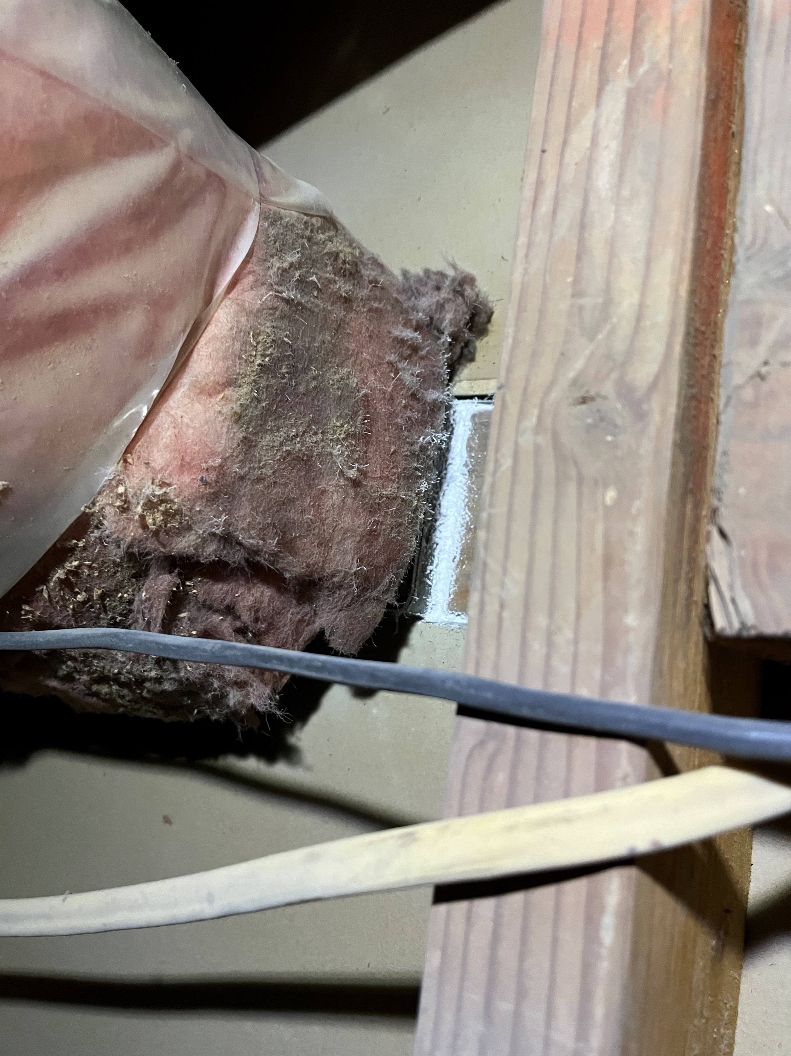
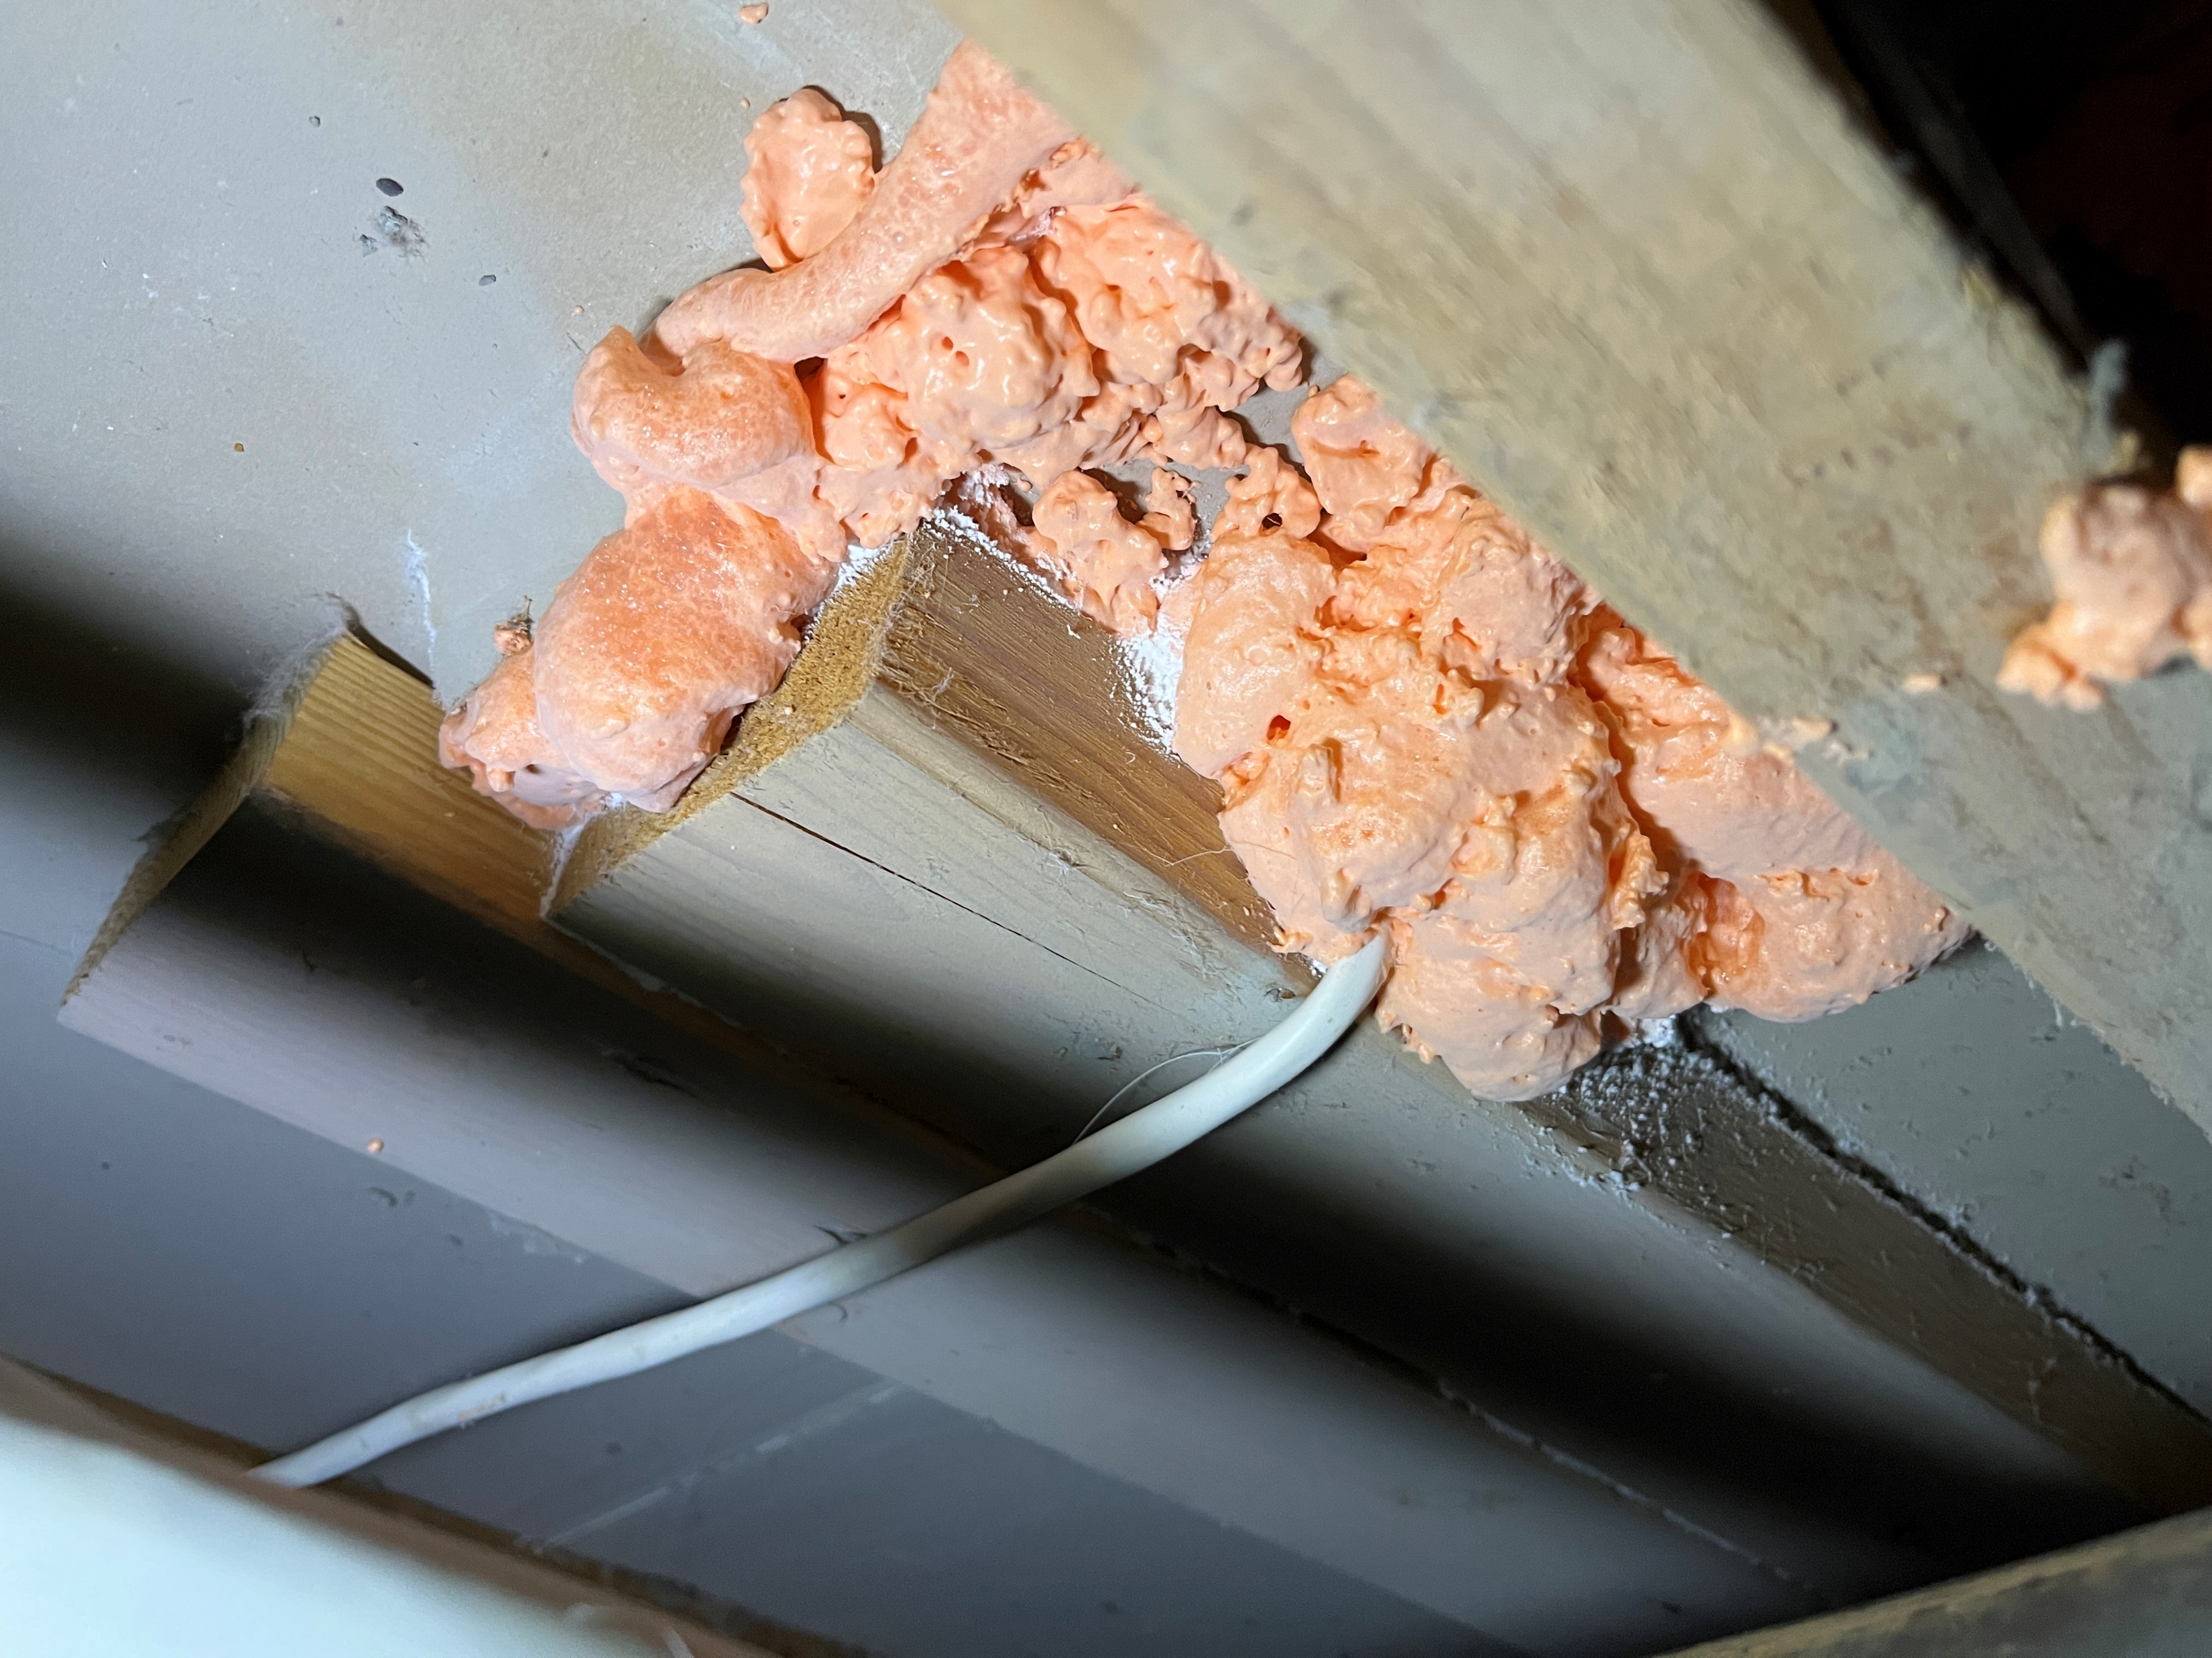
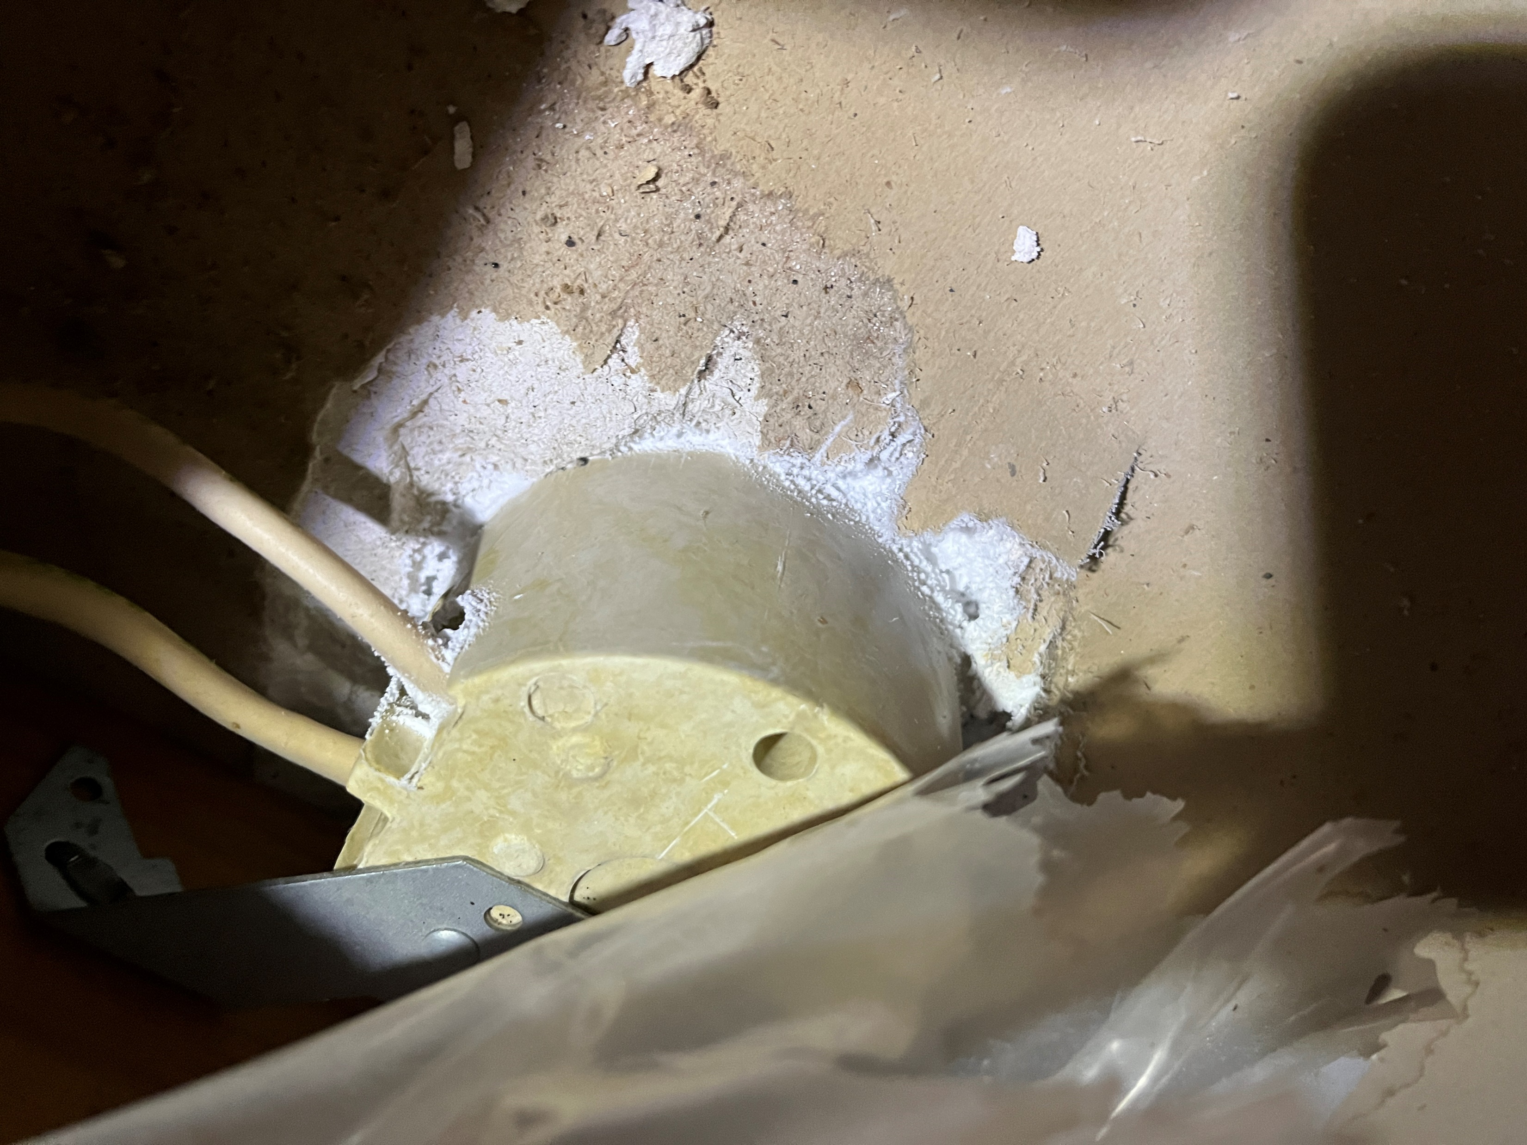
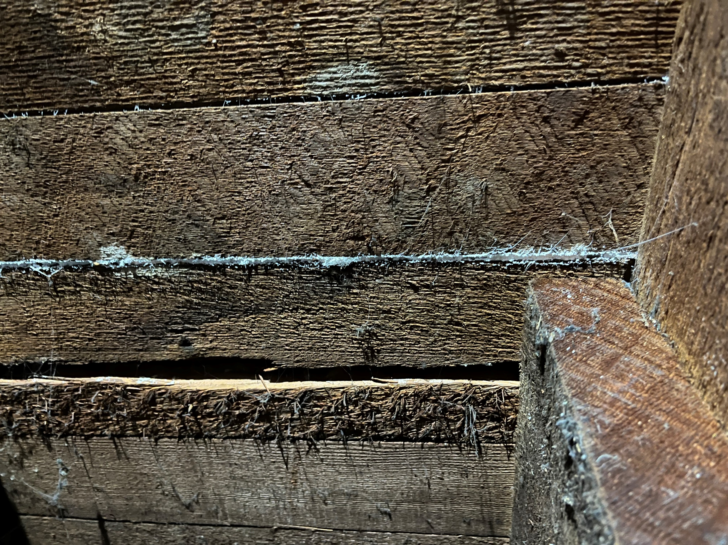
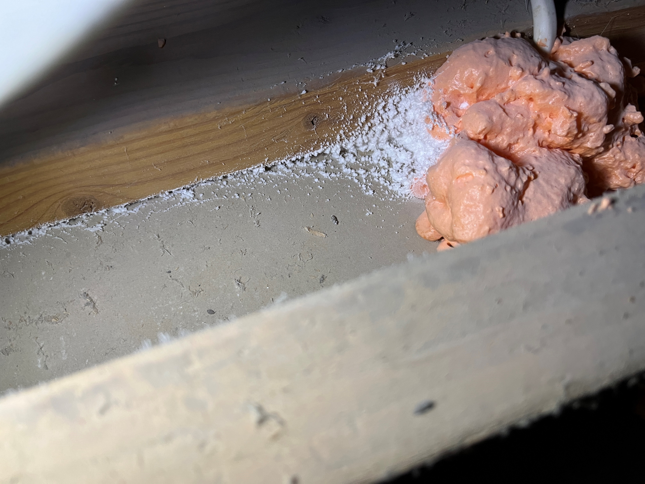
Sample Seals

Slide 36
Barriers to Adoption
Exterior AeroBarrier
Requires removal of insulation
Manually seal gaps > 3/8”
Requires tenants to leave for 1-2 hours
Higher cost than manual sealing
Still on the pathway to commercialization

Slide 37
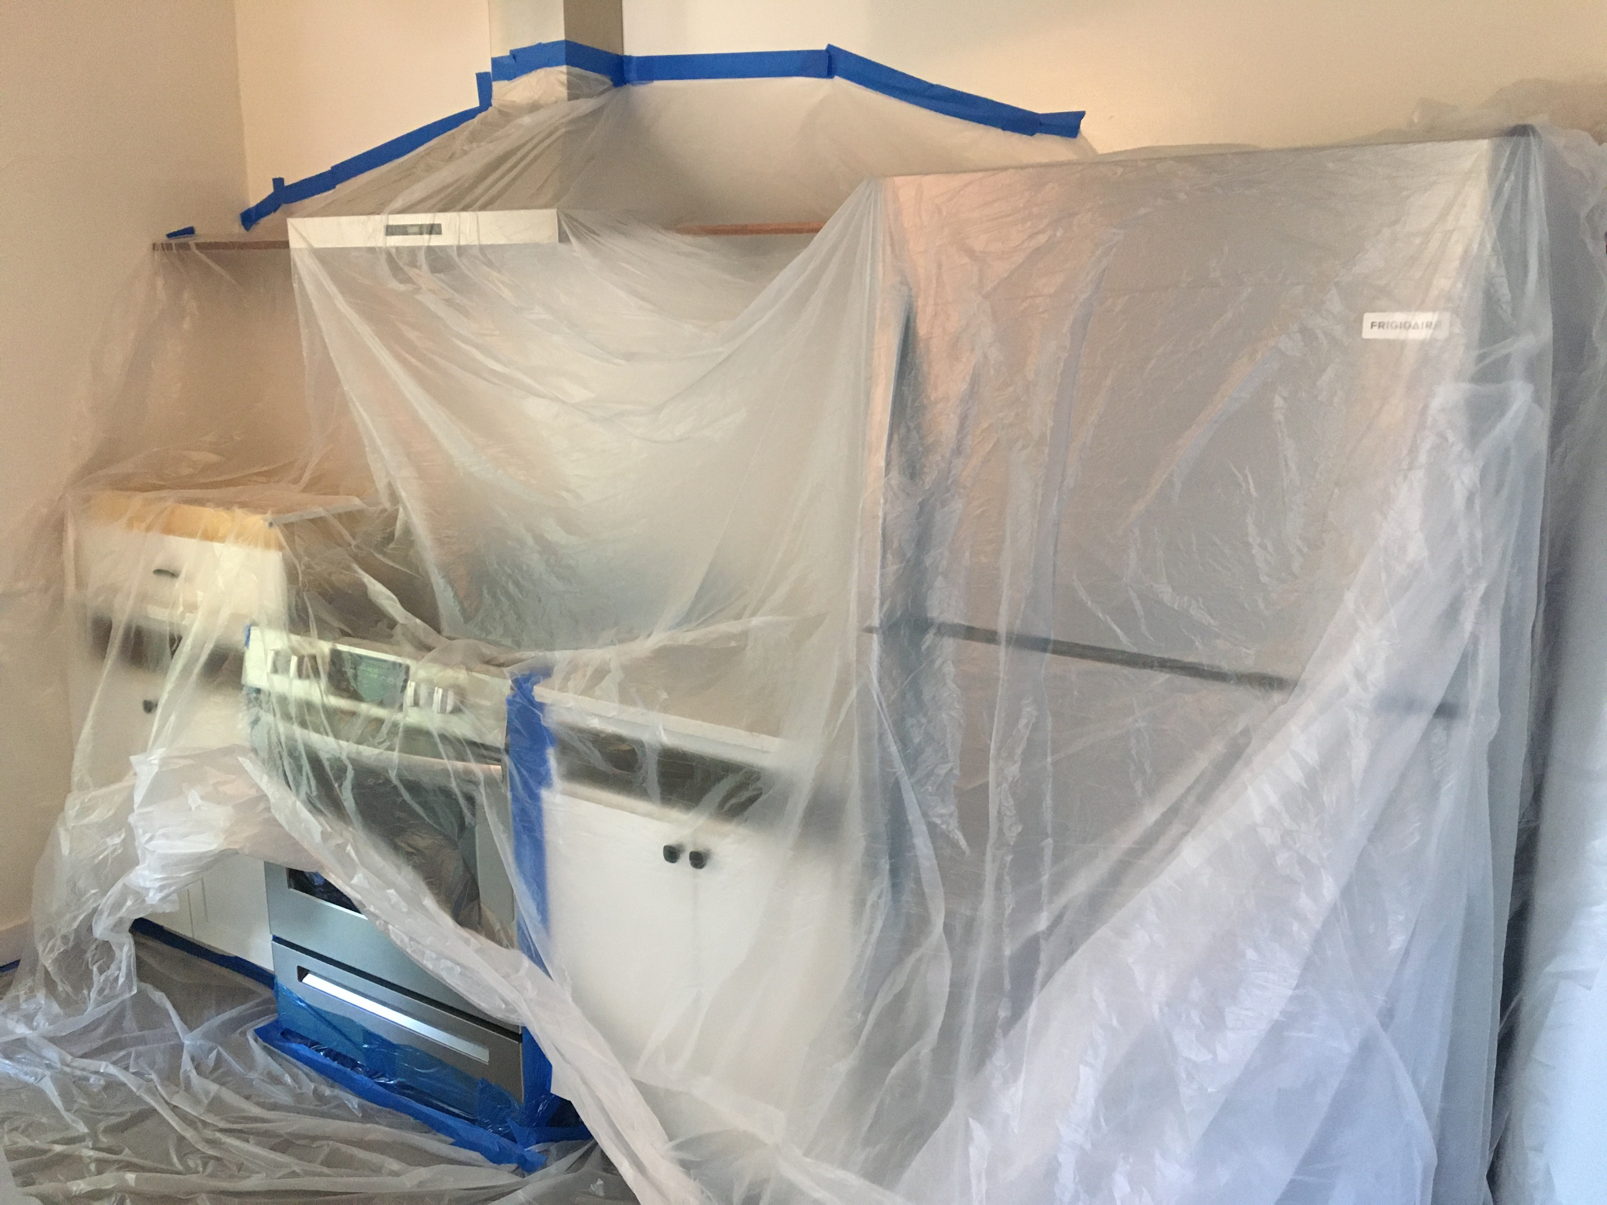
Opportunity
Exterior AeroBarrier
X
Air sealing responsible for single largest natural gas reductions in WAP (20% - 30%)
Outperforms conventional attic air sealing
42% SF average leakage reduction (37% - 49%)
39% MF average leakage reduction (32% - 50%)
Manual: 14% can foam, 26% elastomeric
Greater reduction with other WX measures
Little or no prep to occupied space
Process can seal ducts at the same time
New equipment > save labor and reduce invasiveness

Slide 38




THANK YOU
dbohac@mncee.org
mike@lubycares.com

