Slide 1

To Air is Human…but is it the Best Way to Control IAQ?
27th Westford Building Science Symposium
August 4-6, 2025
William Bahnfleth, PhD, PE
Professor, The Pennsylvania State University

Slide 2

One of my earliest AIVC memories is a presentation by Andrew Persily where he casually shared his insight that we design our ventilation ‘for no particular reason’. The precise underpinning for many of the requirements included in prescriptive ventilation standards is unclear and this is on purpose. The consensus process from which they originate is a cherished resource to create support and consistent adoption but is not conducive to clear scientific reasoning. An insight that would haunt me ever since.
Jelle Laverge, Ghent University (July 2025)
https://www.aivc.org/sites/default/files/CR22.pdf

Slide 3
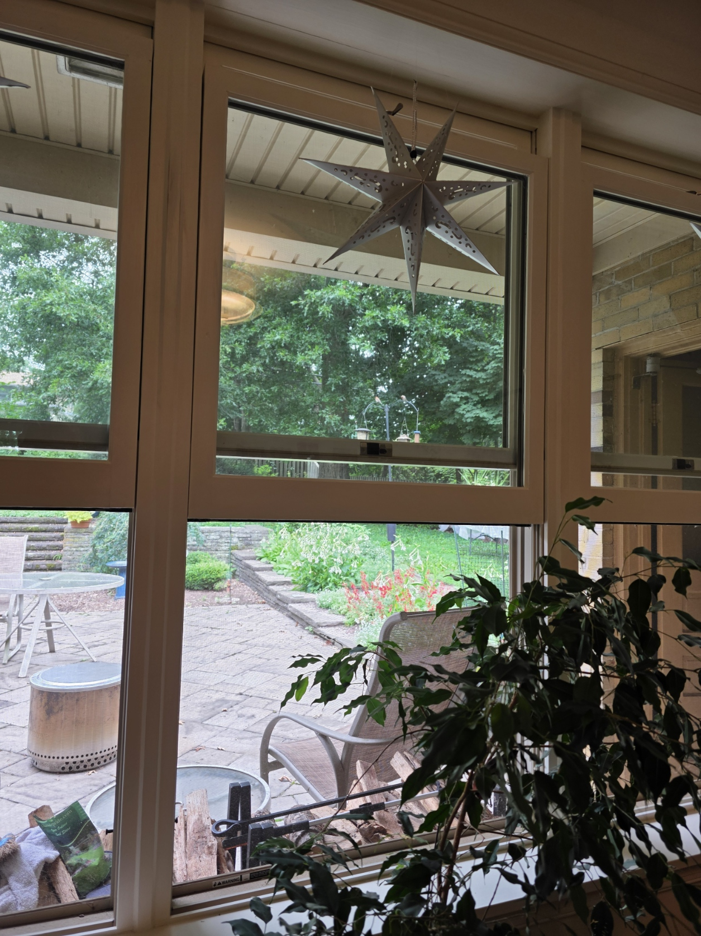
Why ventilate? Conventional wisdom…
Ventilation means dilution with outdoor air
Many air contaminants have indoor sources
Building materials
Indoor processes
Occupants
Consequences of exposure are bad
Odors
Chronic toxicity
Oncogenesis
Productivity loss
Outdoor air is “fresh” – bring in lots of it to make indoor air fresh, too!

Slide 4
Dilution
C_{SS} = Steady state concentration of a contaminant
C_{O} = Concentration of contaminant in ventilation air
S = Source strength (emission rate of a contaminant)
Q = Flow rate of uncontaminated ventilation air (e.g., cfm or L/s)

Slide 5
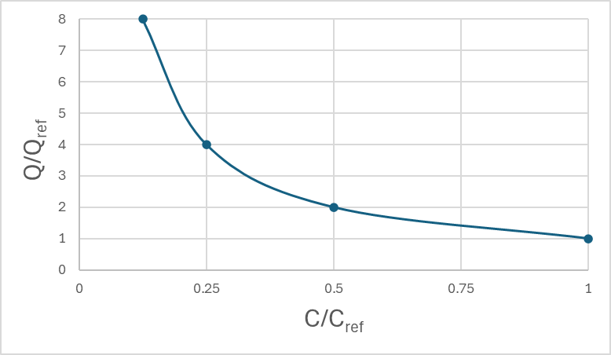
Dilution has diminishing returns, exponentially growing costs
Suppose ventilation air is contaminant-free (c₀ = 0)

Slide 6

Outdoor air frequently isn’t fresh
“Delhi residents can breathe in ‘moderate’ air quality”

Slide 7
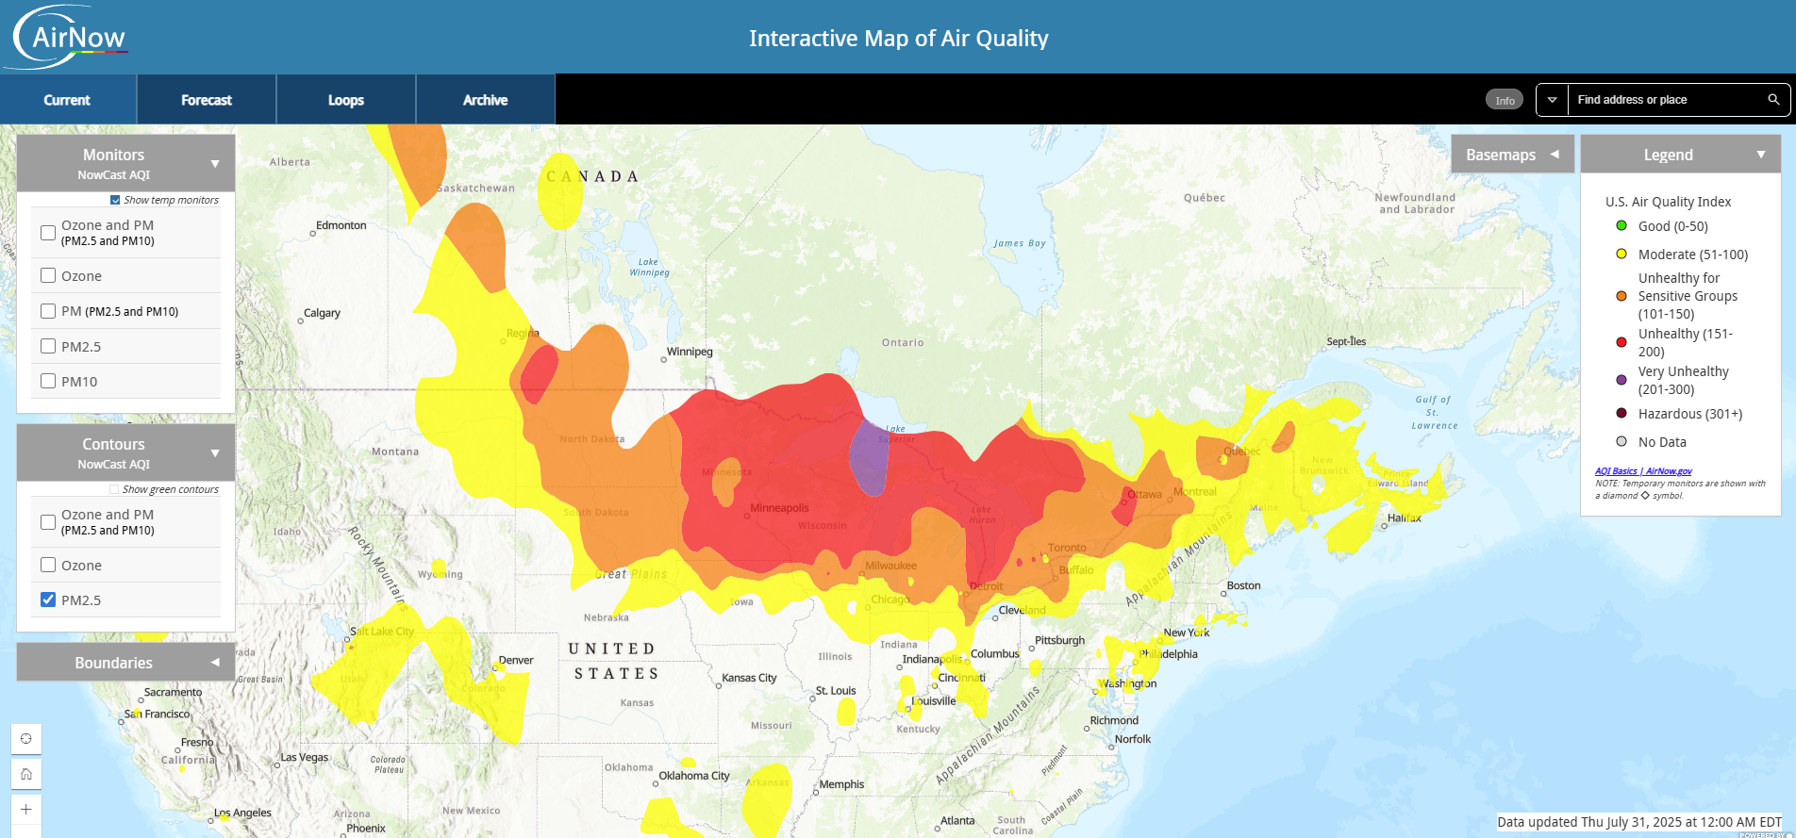
https://gispub.epa.gov/airnow/

Slide 8
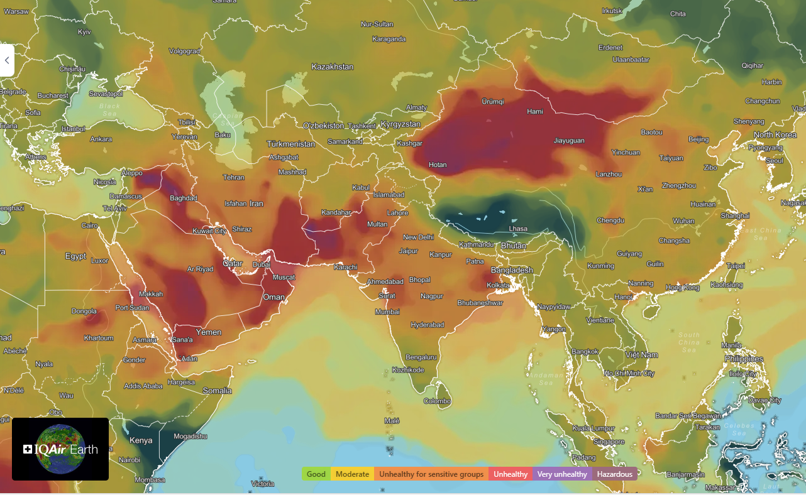
https://www.iqair.com/in-en/air-quality-map

Slide 9
Ventilation ≠ outdoor air
Definitions of ventilation in standards:
(T)he process of supplying air to or removing air from a space for the purpose of controlling air contaminant levels, humidity, or temperature within the space. (ASHRAE Standard 62.1)
(T)he process of supplying or removing air by natural or mechanical means to or from any space. Such air may or may not have been conditioned. (ASHRAE Standard 62.2)
Related concept - ventilation air:
(T)hat portion of supply air that is outdoor air plus any recirculated air that has been treated for the purpose of maintaining acceptable IAQ

Slide 10
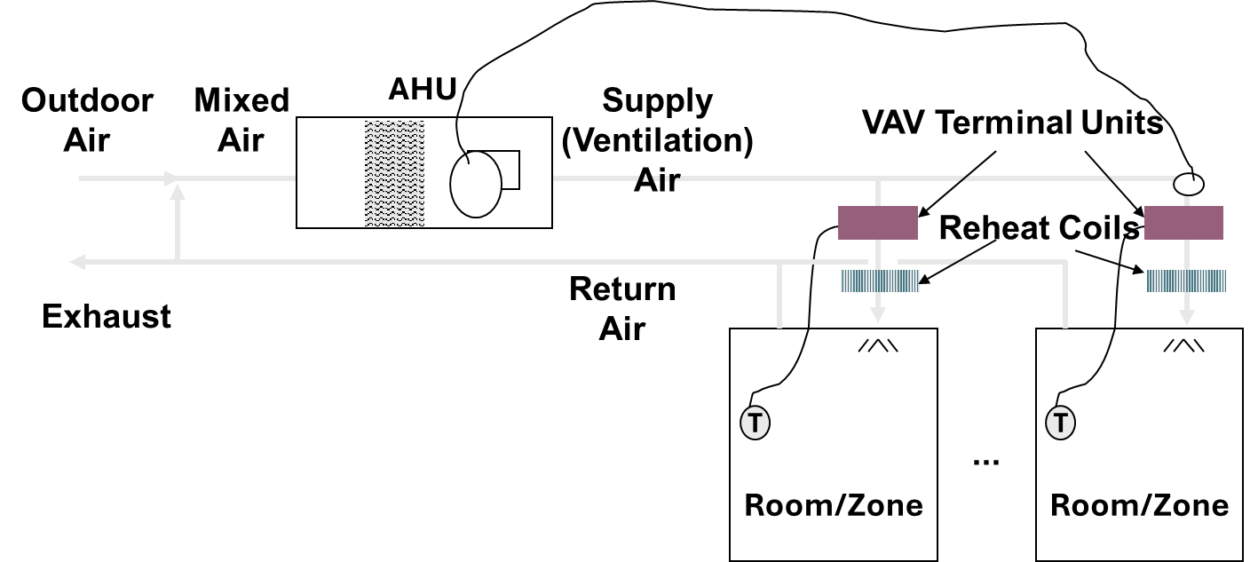

Slide 11
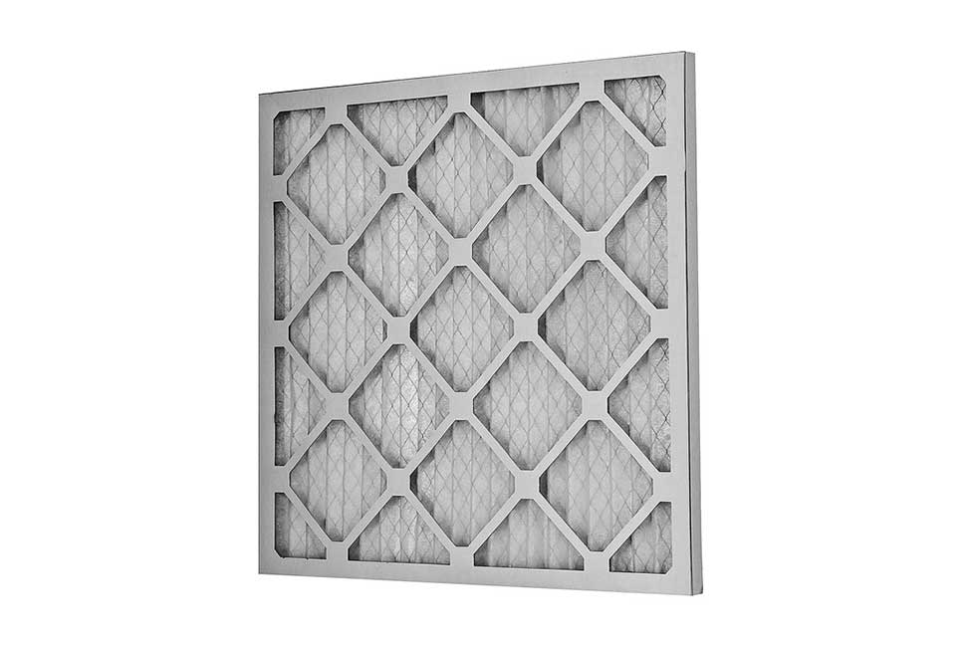
Recirculating systems supply outdoor air, filter particles
Outdoor air acts similarly (sort of) on many contaminants
Mechanical filters remove particles – outdoor and indoor sources
Can add other controls for gases and infectious aerosols
Usually, combined effect isn’t quantified

Slide 12
Recirculation is a mixed blessing
Good
Higher air change rate clears contaminants faster
Enables control of indoor contaminant sources with air cleaning
Air economizer capacity increased
Not so good
Multiple space recirculation spreads contaminants
Transport energy increased compared to dual path (DOAS) systems

Slide 13
Two-Zone Example
Release in Zone 1-Initial concentration of 100%

Slide 14
Recirculation spreads contaminant to other space, but recirculation through filter speeds up clearance
Notes:
This example illustrates the rapidity with which contaminants released in one zone are transported to another zone when there is recirculation. The zones in this case are of identical size, so the maximum concentration in the initially uncontaminated zone is a significant fraction of the initial concentration in the release zone. If this zone had been larger, or there had been additional zones (making the release zone a smaller fraction of the total floor space), the non-release zone peak concentration would have been considerably lower.

Slide 15
Equivalent clean airflow (ECA) – a better measure of control?
The effect of any control can be expressed in terms of dilution with uncontaminated air
If all controls and removal rates are expressed as ECAs, performance-based IAQ becomes more attainable
Must also rate performance of controls in terms of ECA
If used comprehensively, need at least three types – gas, particle, infectious aerosol

Slide 16
Equivalent clean airflow of a filter
Filter has actual airflow Q_{f} and efficiency η
If Q_{V} is equivalent clean air for filter, C₀ ≡ 0. can show for a well-mixed space:
Filtration Only
Dilution Only

Slide 17
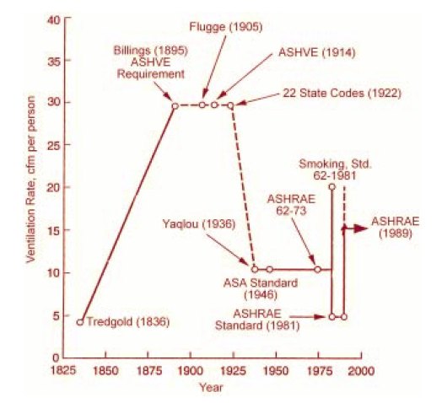
How much ventilation?
Recommendations have varied widely over two centuries
Physiological
Limit infection risk
Perceived air quality
Safe contaminant exposures
Stated in terms of outdoor air
Emphasis on energy impact increasing over time
Janssen, J.E., 1999. The history of ventilation and temperature control: The first century of air conditioning. ASHRAE Journal, 41(10), p.48.

Slide 18
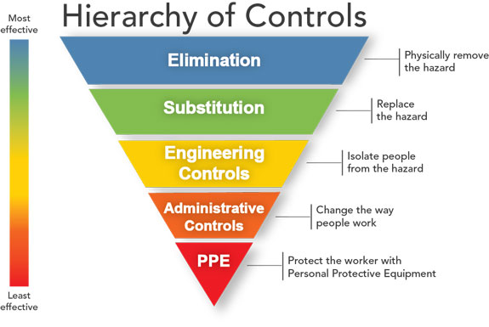
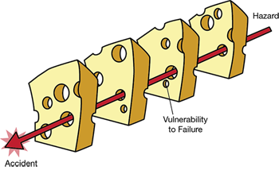
Ventilation is only one way to improve IAQ
Reason, J., 2000. Human error: models and management.
Bmj, 320(7237), pp.768-770.

Slide 19
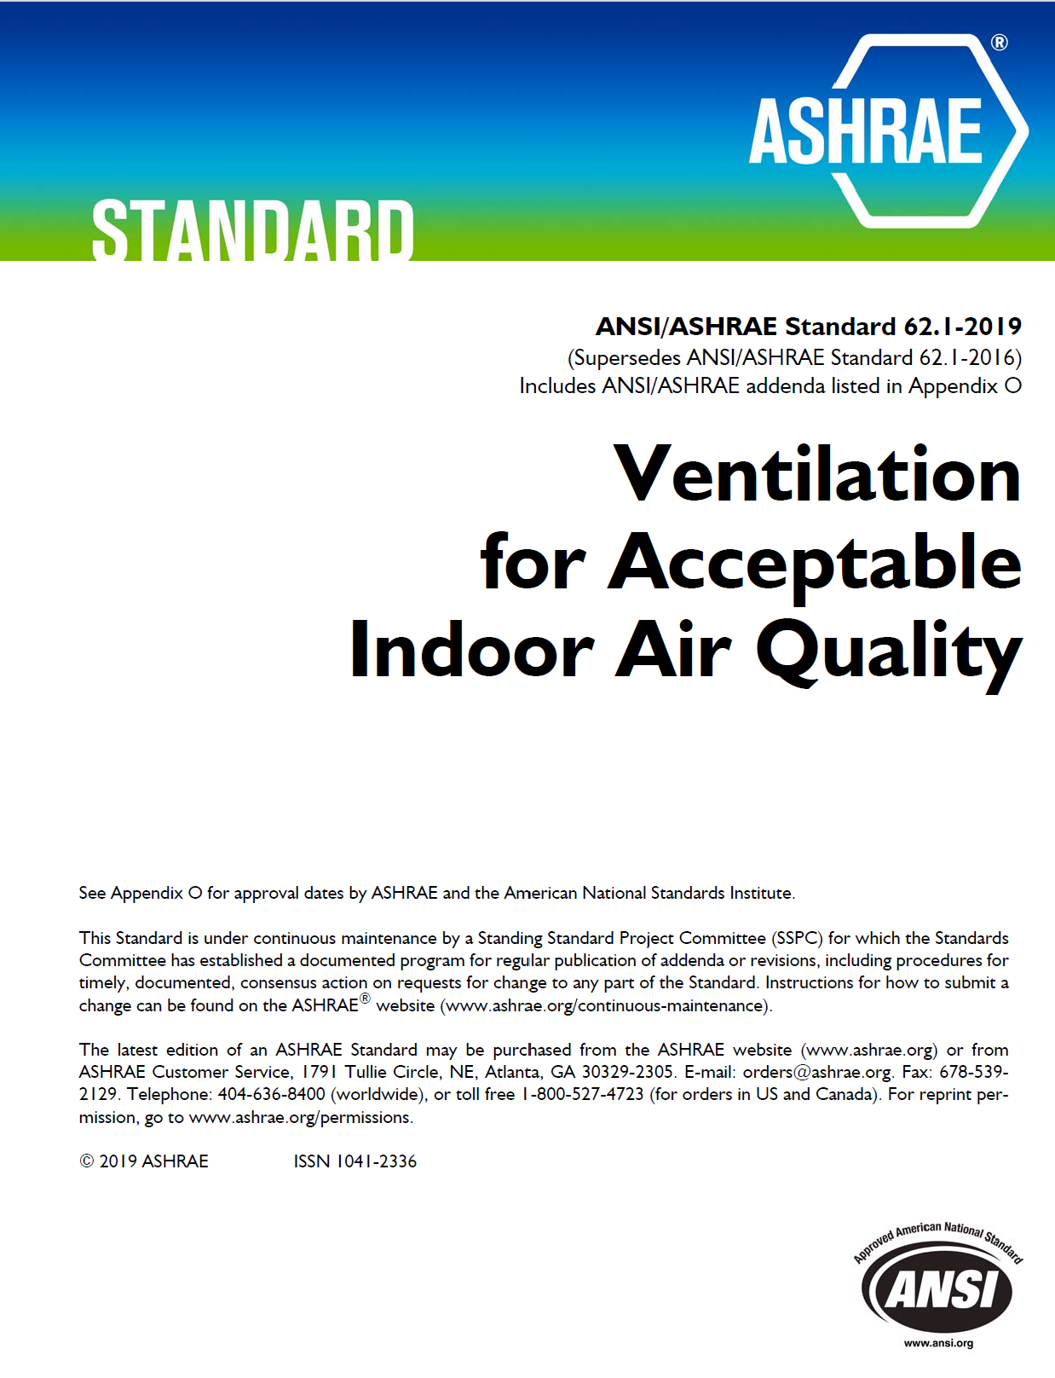
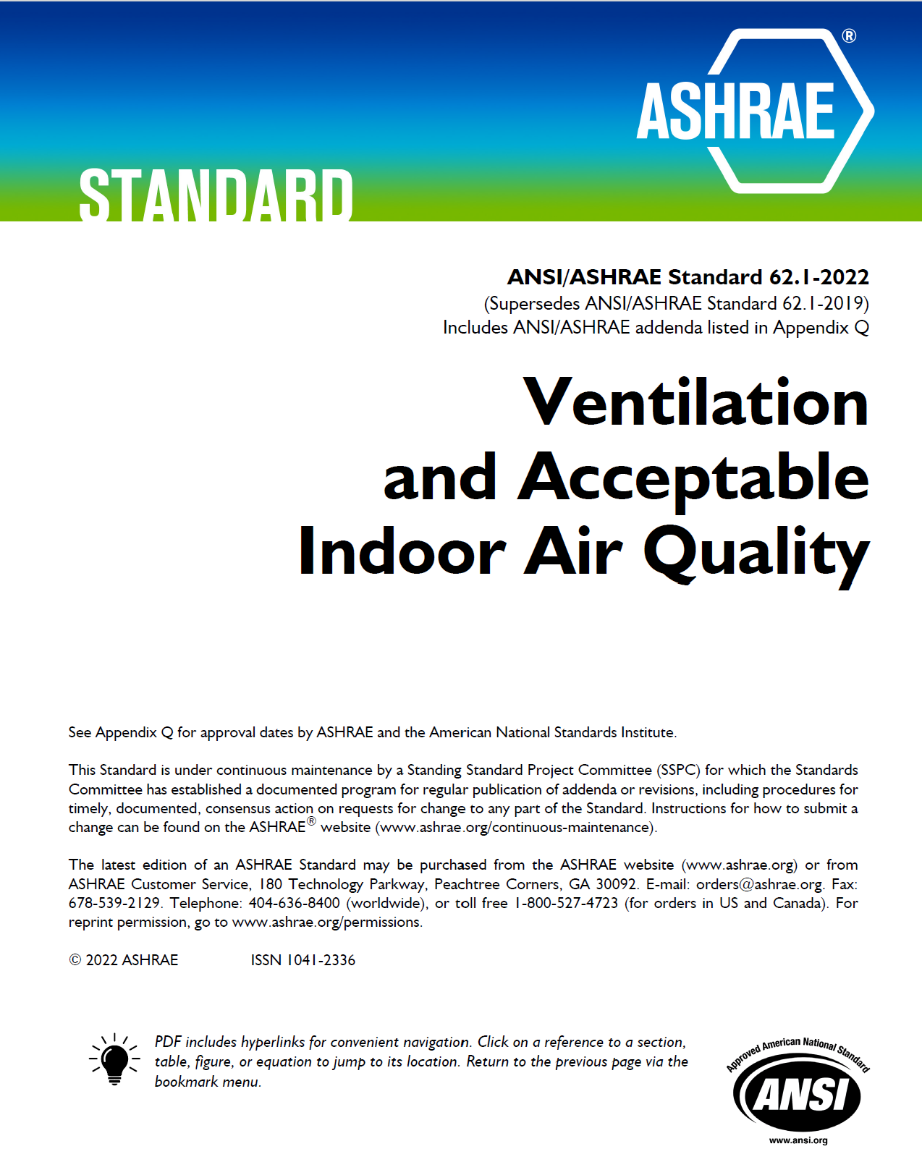
2019
2022

Slide 20
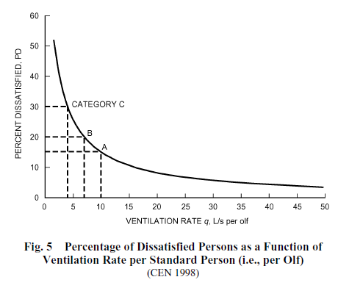
Perception + safety have prevailed for ~100 years in non-healthcare facilities
Acceptable indoor air quality (ASHRAE Standard 62.1): air in which there are no known contaminants at harmful concentrations, as determined by cognizant authorities, and with which a substantial majority (80% or more) of the people exposed do not express dissatisfaction.
1 L/s ≈ 2 cfm

Slide 21
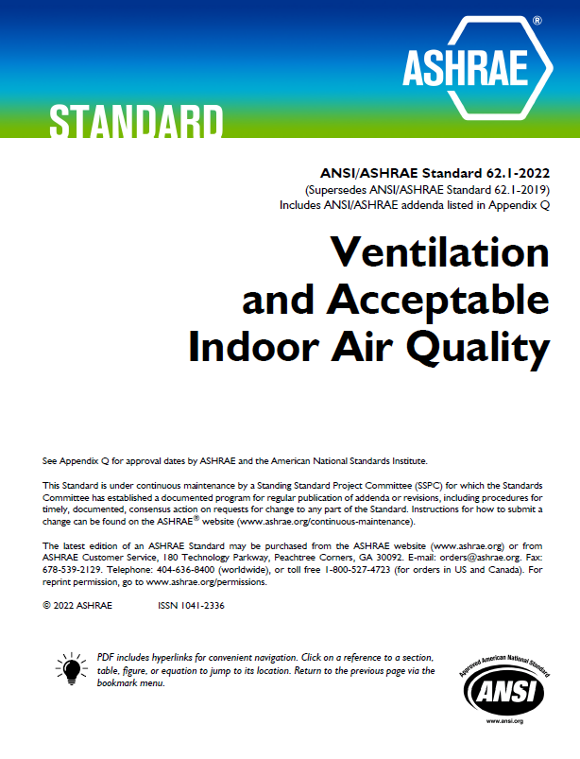
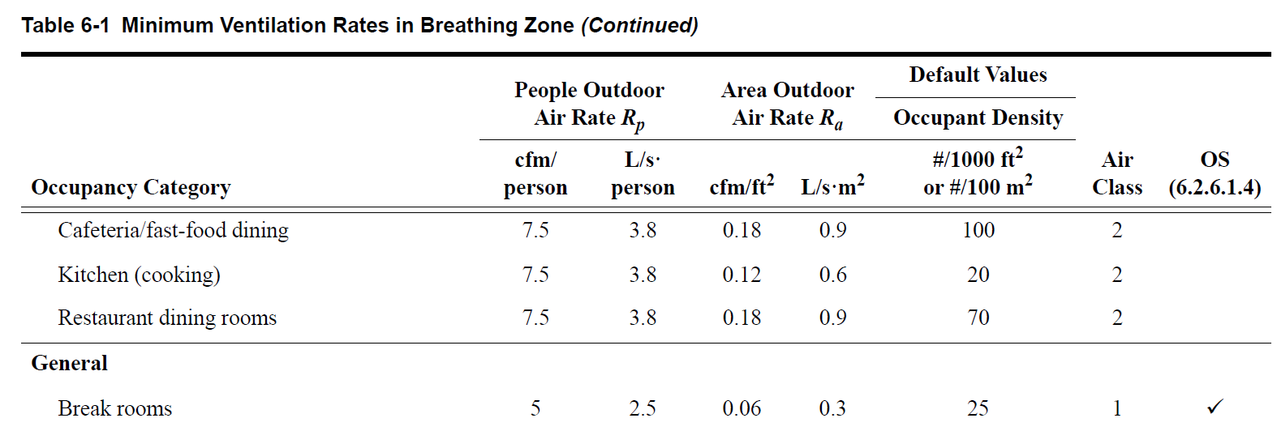
Current non-residential standards
Ventilation Rate Procedure (VRP, prescriptive)
Per-person rate (R_{p}) and area rate (R_{a})

Slide 22
Current non-residential standards
Indoor Air Quality Procedure (IAQP, performance)
Design compounds (14 chemicals, 3 mixtures) and PM 2.5
Designer specifies controls – outdoor air, air treatment – to comply with design limits
Must also satisfied perceived air quality requirement
Subjective and objective verification required

Slide 23
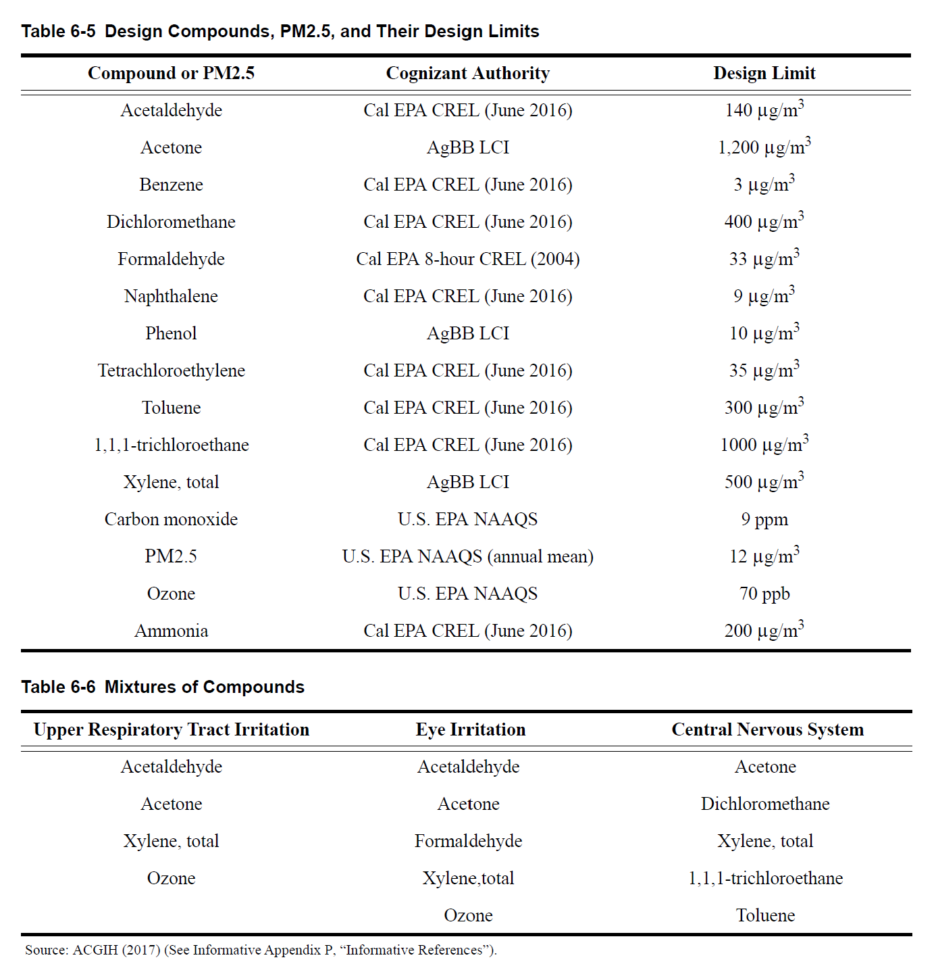
For mixtures, “mixed exposure sum” < 1

Slide 24
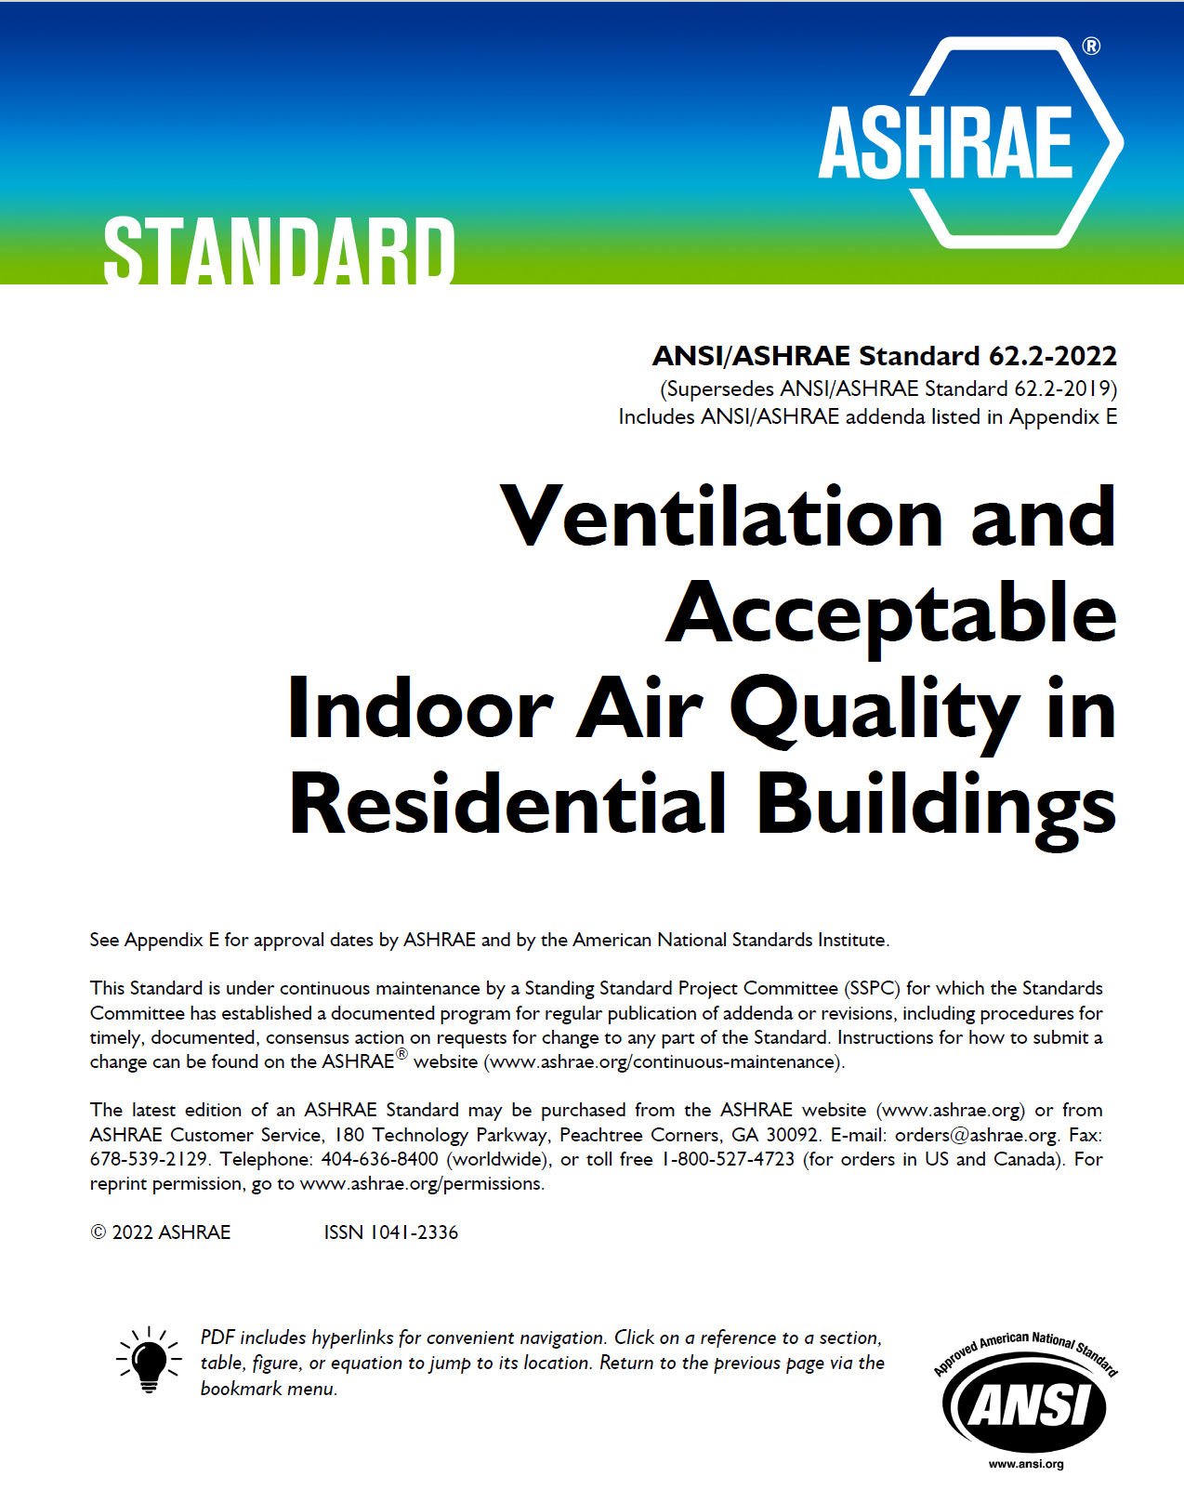
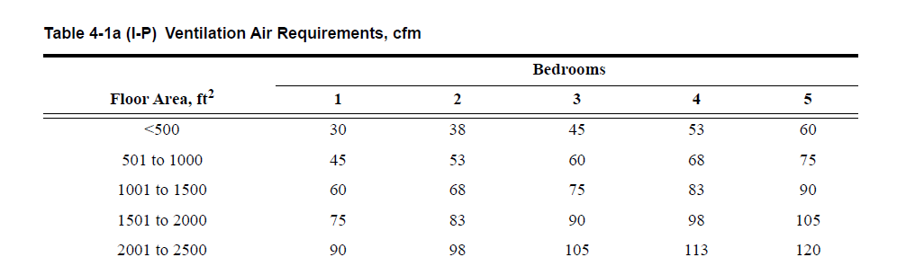
Current residential standards
Same definition of acceptability as 62.1
Similar prescriptive approach
# Bedrooms ( = people) + area
Credit for infiltration

Slide 25
Current residential standards
Recent addenda have addressed
Use of equivalent clean air approach
Performance compliance path…but different than 62.1 IAQP
Control of infectious aerosols by adaptation of ASHRAE Standard 241 requirements (informative appendix)

Slide 26
Observations on the status quo
We generally know what the rationale is
Quantitative details are hard to come by…if they exist
Ironically, evidence basis is weaker for health care ventilation
Many would like to see the bar raised on what is acceptable
More transparency regarding basis for requirements
Performance approach or evidence-based prescriptive
Expand requirements to new areas – health and productivity
Bigger role for air cleaning/disinfection – but are we ready to do it?

Slide 27
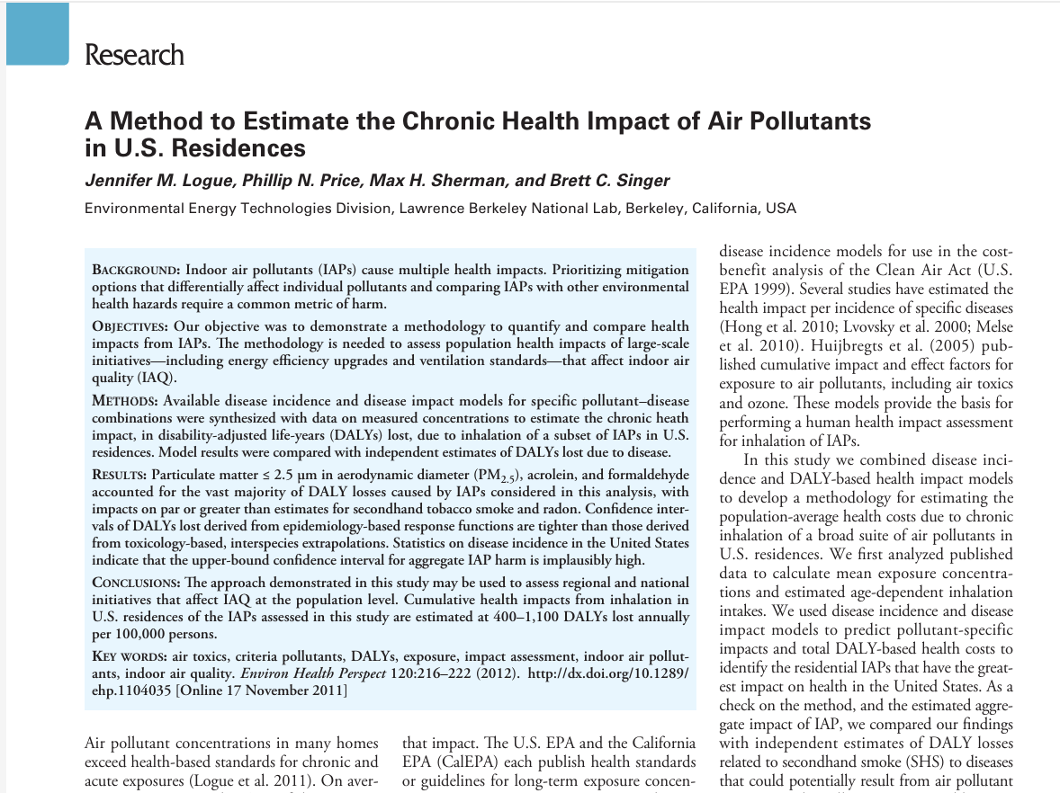
Recent research seeks to rationalize IAQ control for chemical and particulate contaminants
Built on work of Logue, et al. (2012)
Objectives
Quantify and compare harm from indoor air contaminants
Disability-Adjusted Life-Year basis
Analysis suggests that a small number of contaminants are significant
Environmental Health Perspectives 120:2 CID: https://doi.org/10.1289/ehp.1104035

Slide 28
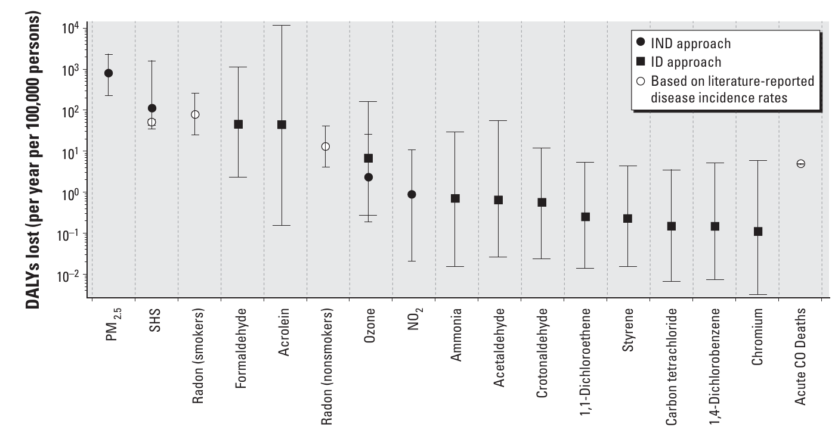

Slide 29
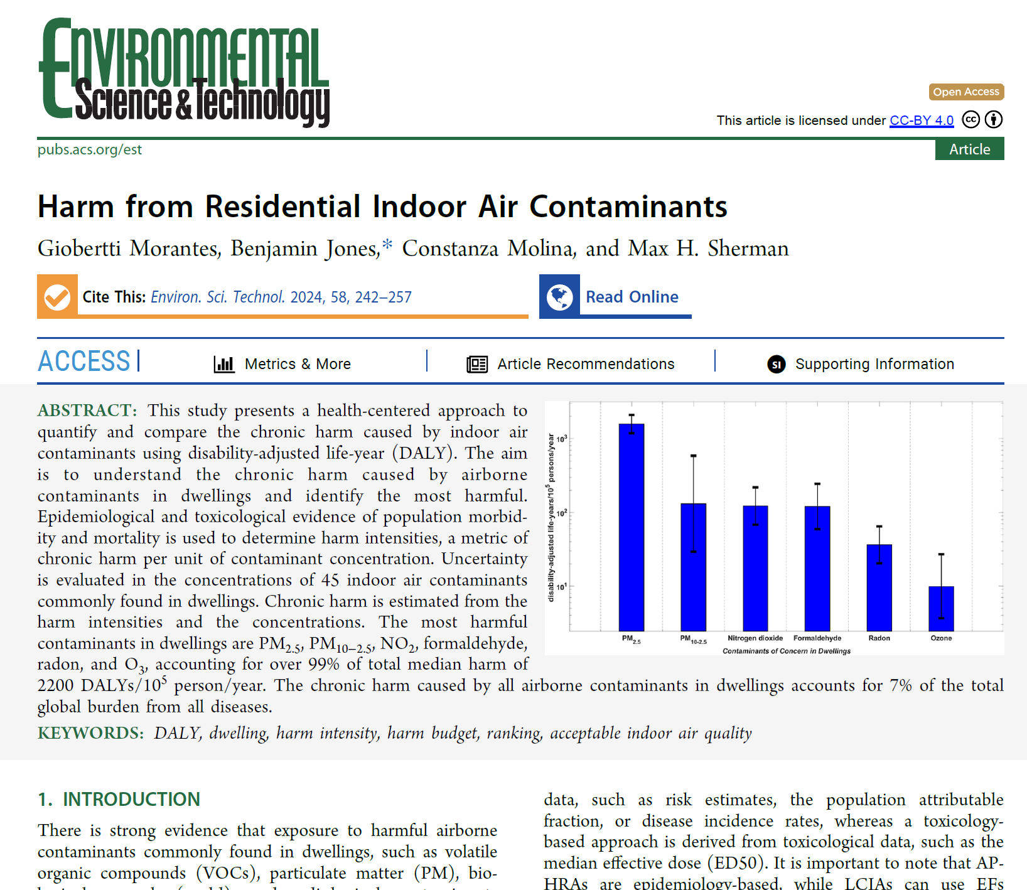
Morantes, et al. reexamined residential data
Screened over 300 indoor air contaminants to obtain 25 with useable data
Considered harm (toxicology and epidemiology data)
Quantified harm in DALY per unit of exposure
Applied estimates of typical indoor concentrations
Similar results to Logue, et al.
Proposed basis for an IAQP in ASHRAE Standard 62.2
https://doi.org/10.1021/acs.est.3c07374
Environ. Sci. Technol. 2024, 58, 242−257

Slide 30
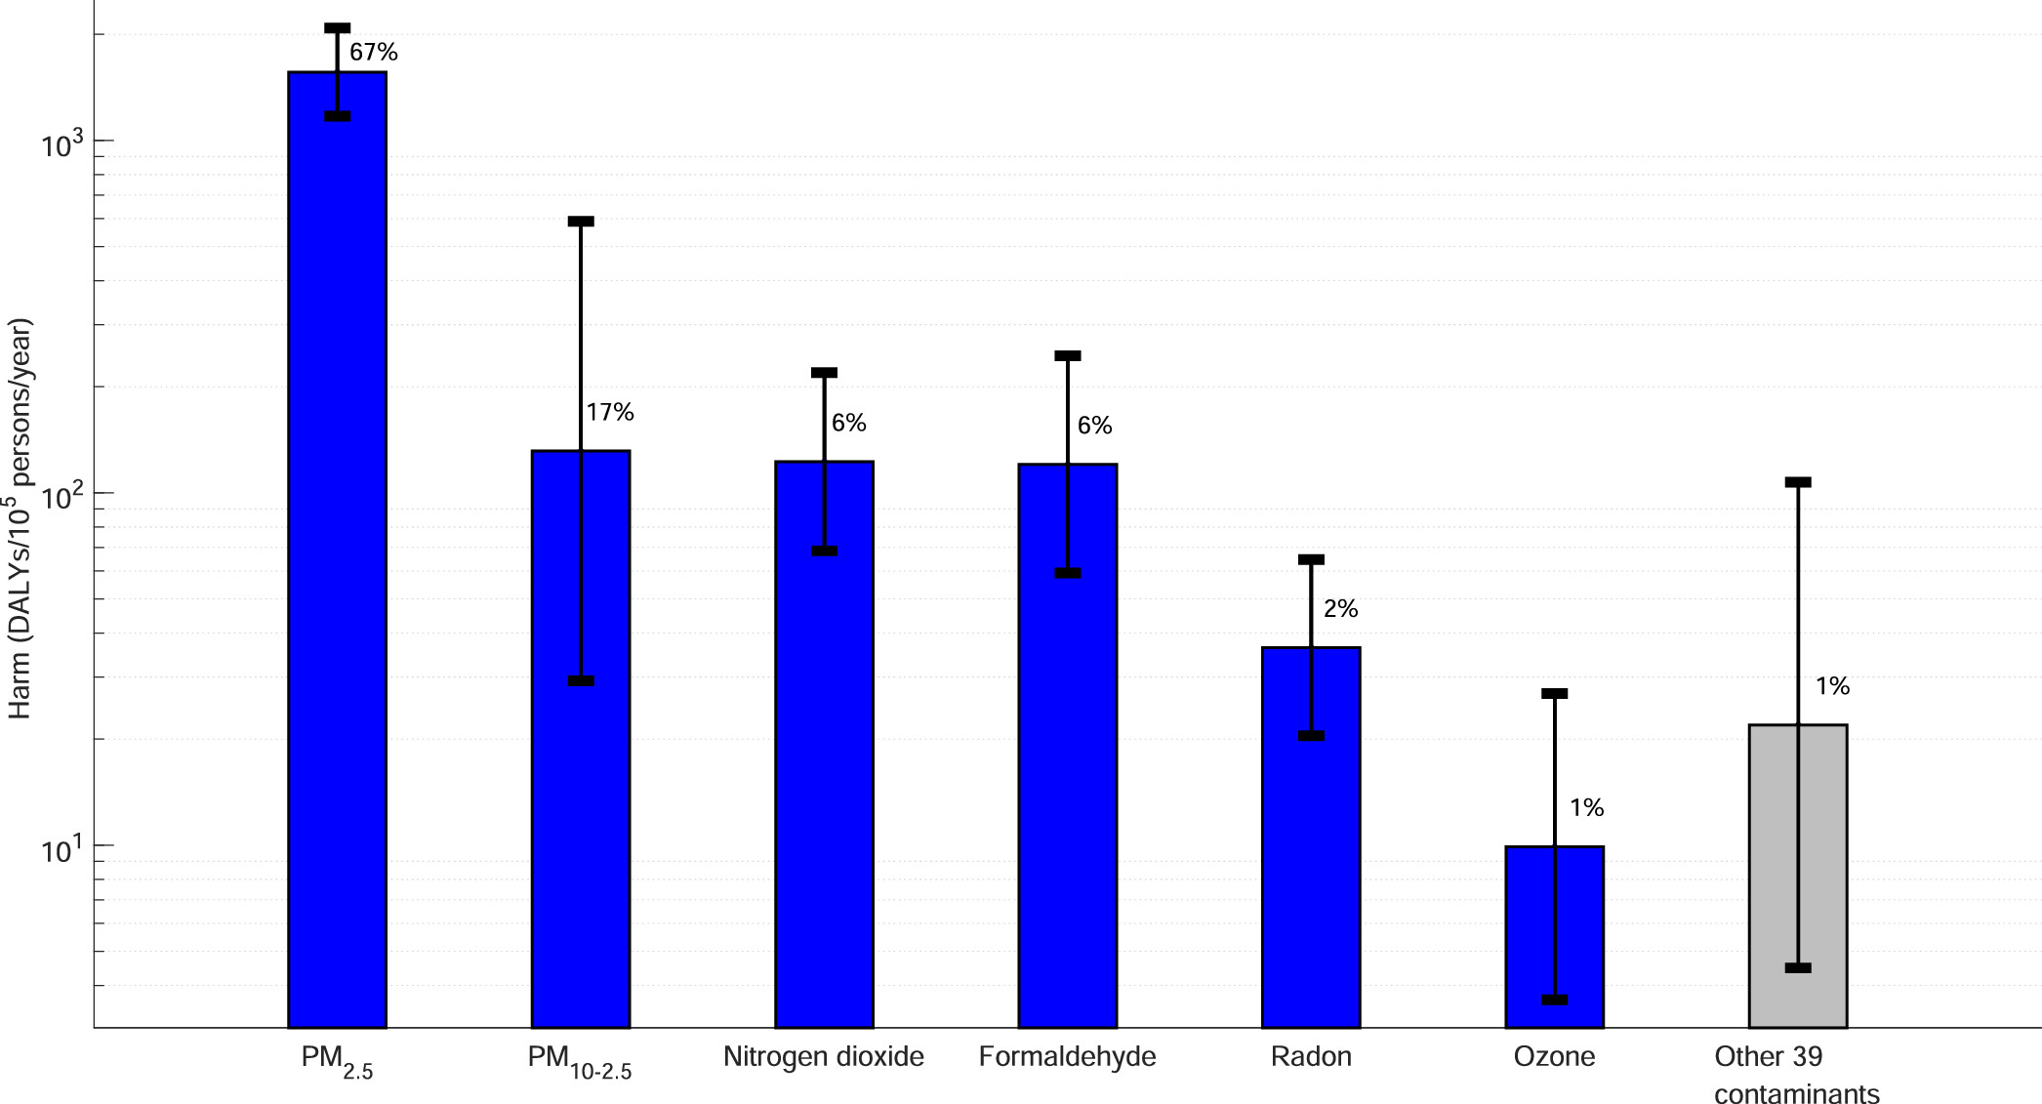
Six contaminants (2 are PM) responsible for 99% of harm – particles pose greatest risk

Slide 31
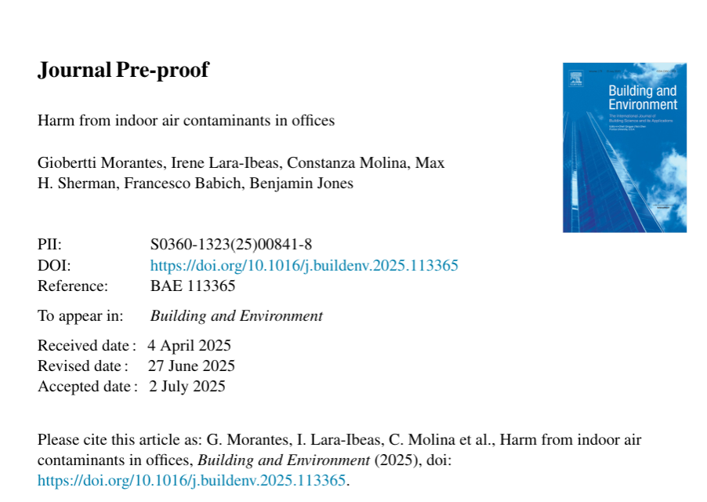
Morantes, et al. now extended to offices
Same methodology as in prior residential work
Somewhat different outcome because of differences in contaminant profiles
Particles are still the most harmful
Top four cause > 99% of harm
ASHRAE SSPC 62.1 is considering relevance to IAQP

Slide 32
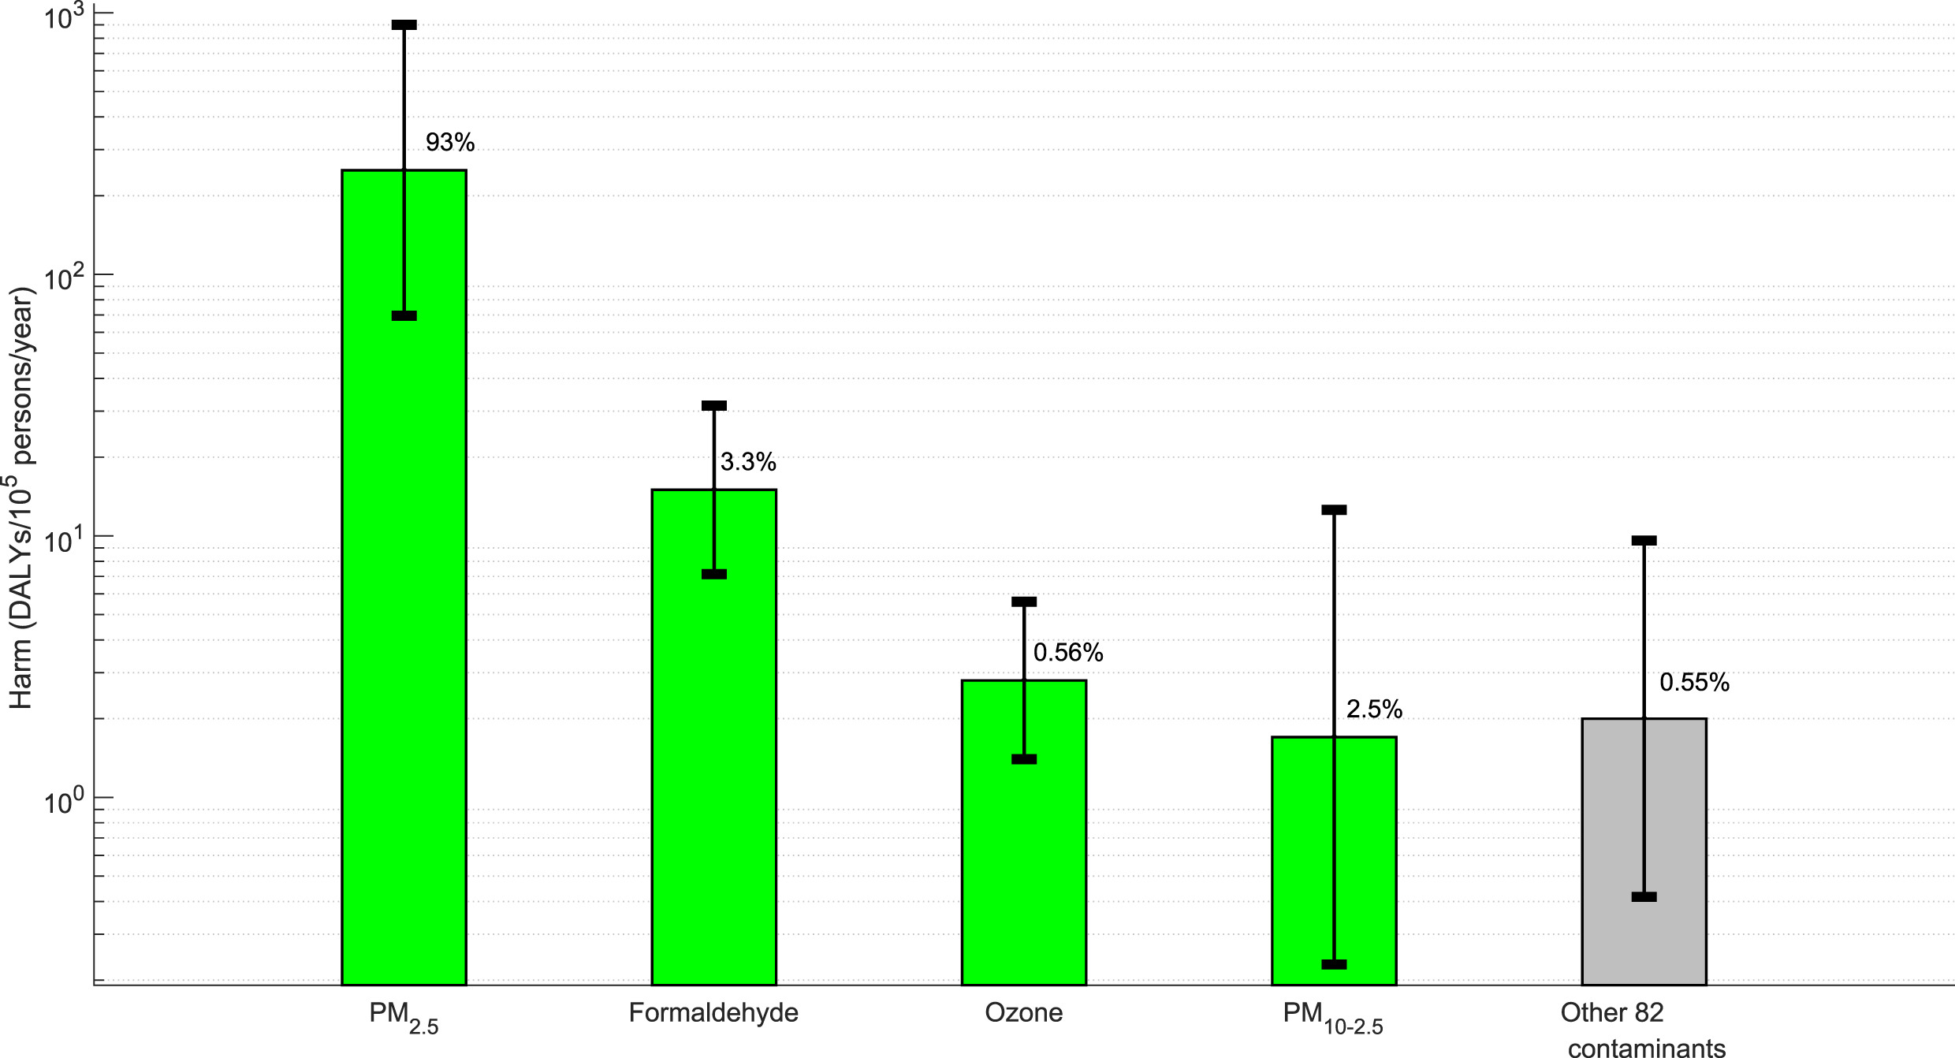

Slide 33
DALY may not be the answer to everything, but has a role to play
Trade-offs can be tricky
Calculation of some DALY is not very precise
Work so far has trimmed the list of contaminants of serious concern
Someone still needs to draw the line to define acceptability
Most promising – suggests performance based control may be practical

Slide 34
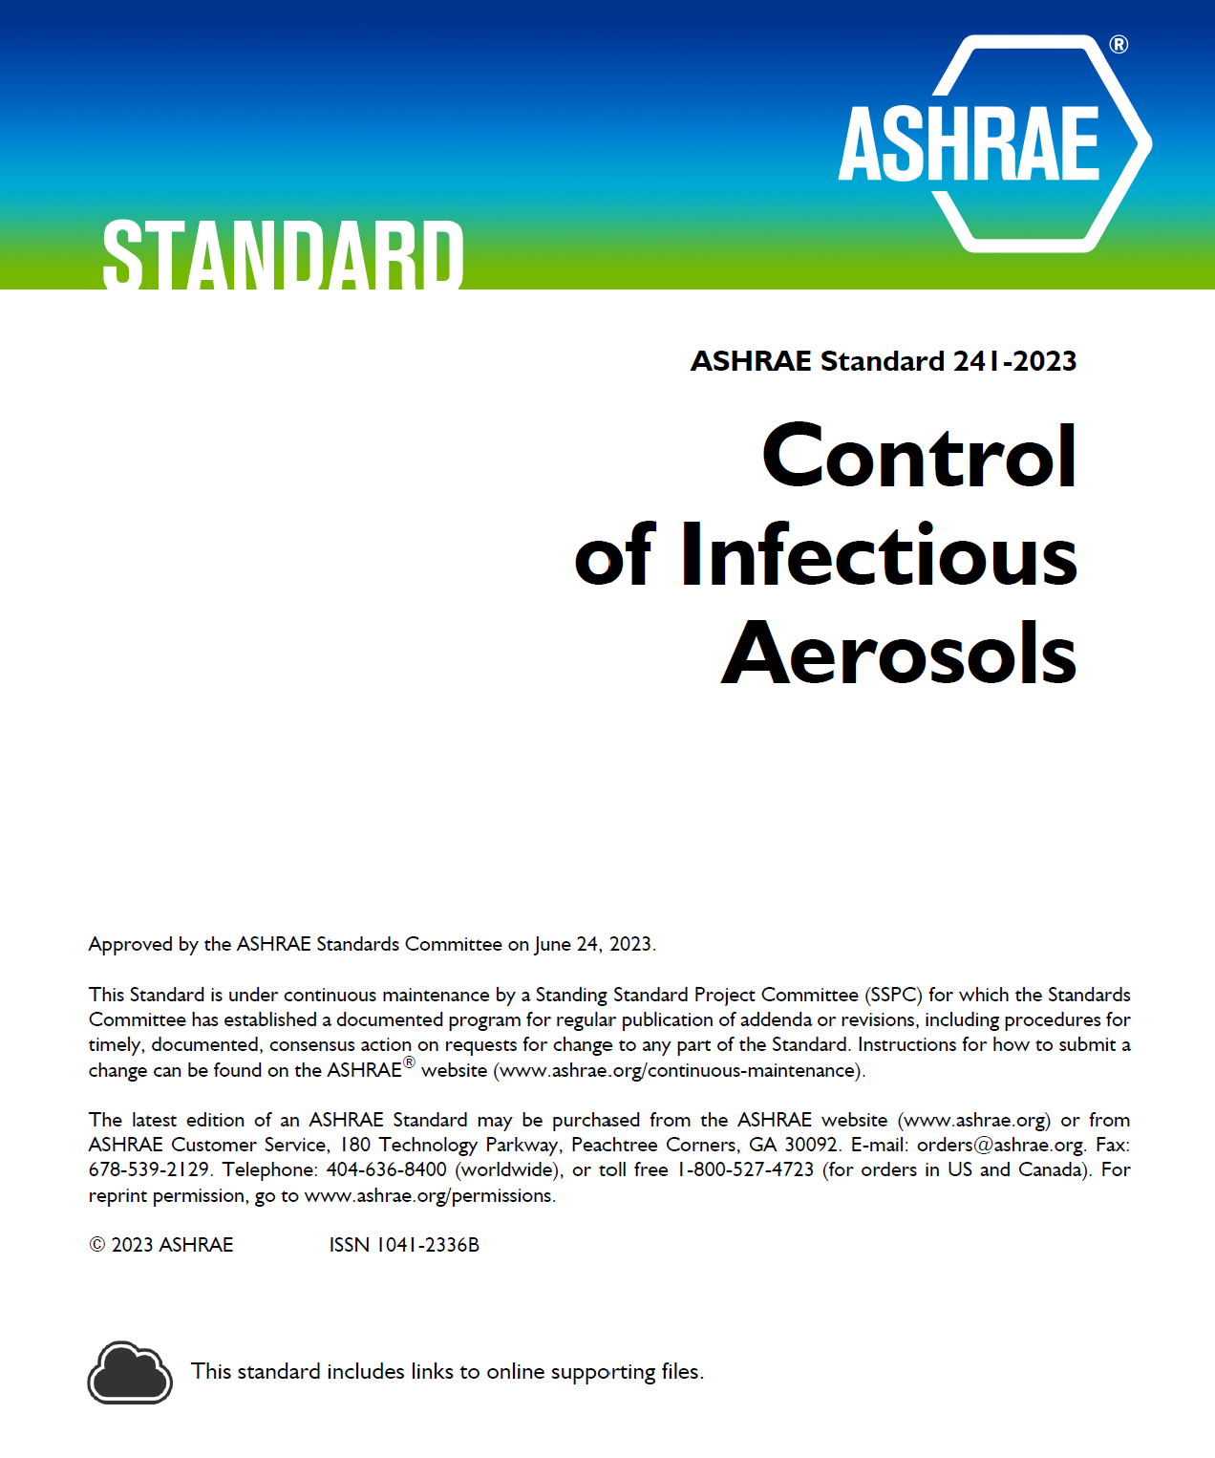
New developments – resilience in standards and guidelines: infectious aerosols
Addresses risk of airborne infection transmission in all facility types
Applies during periods of elevated risk (Infection Risk Management Mode, IRMM)
General IAQ standards are prerequisites (e.g., ASHRAE 62.1, 62.2, 170)
Specifies equivalent clean airflow requirements per person (ECAi)
Level playing field for air cleaners
Based on population-level risk assessment, documented in an open publication

Slide 35
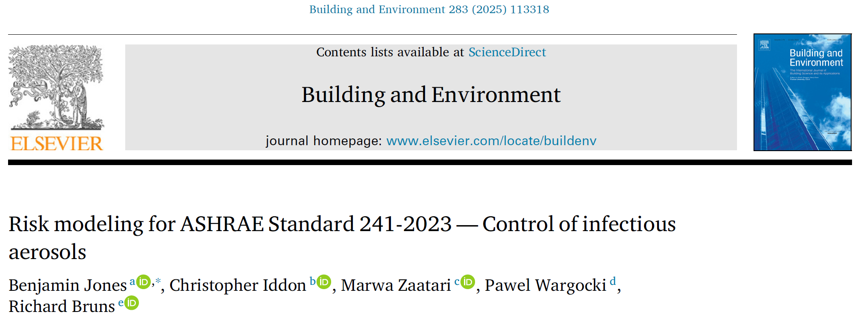
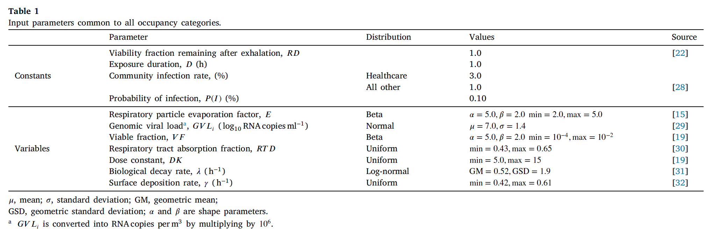

Slide 36
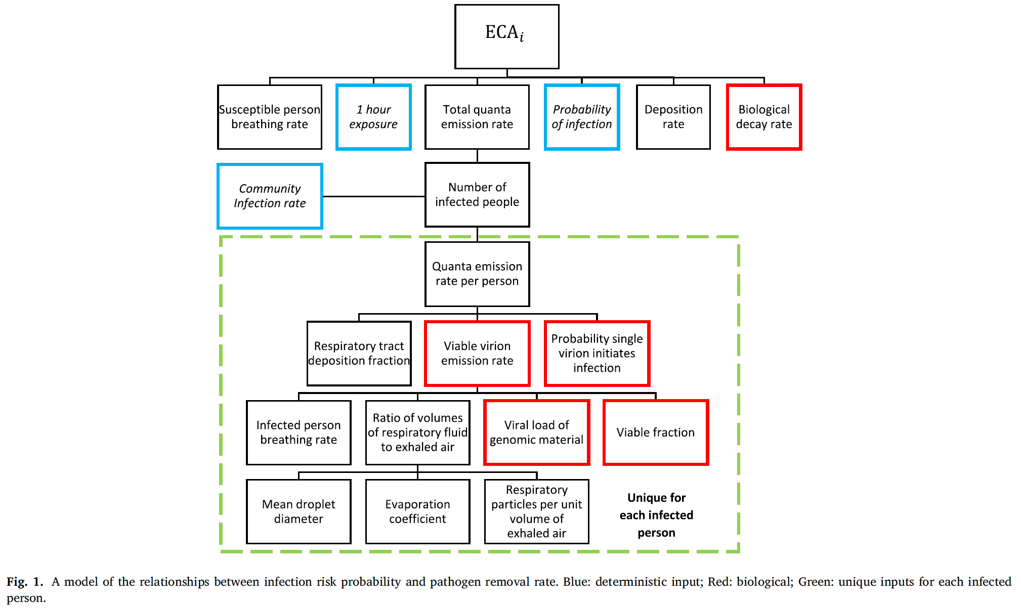

Slide 37
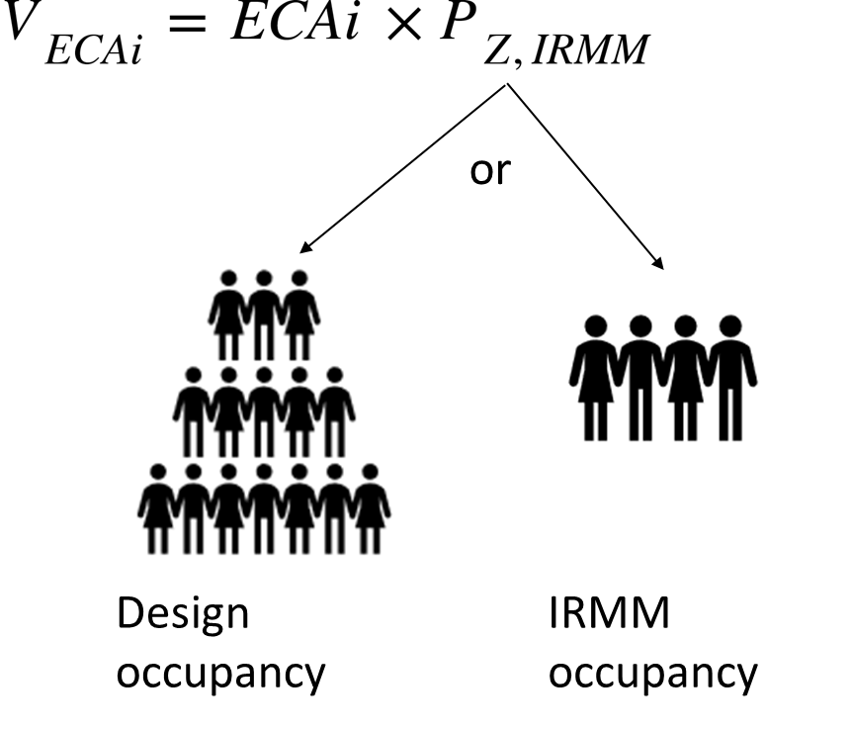
Required ECA depends on space type, number of people and activity
Occupancy categories
Correctional facilities
Commercial/retail
Educational facilities
Industrial
Health-care
Public assembly/sports & entertainment
Residential
25 space types – office, classroom, food and beverage, etc.
ECAi range 20-90 cfm/pers (10-40 L/s-pers) values doubled if there is loud vocalization
Notes:
V_{ECAi}= minimum equivalent clean airflow rate required in the breathing zone in IRMM
ECAi=equivalent clean airflow rate required per person in IRMM from Table 5-1.
P_{Z,IRMM}=number of people in the breathing zone in IRMM. Can be different from design occupancy.
Available V_{ECAi} and ECAi can determine maximum number of occupants in IRMM.
Current coverage includes 25 space types in 7 occupancy categories, 20-90 cfm/person.

Slide 38
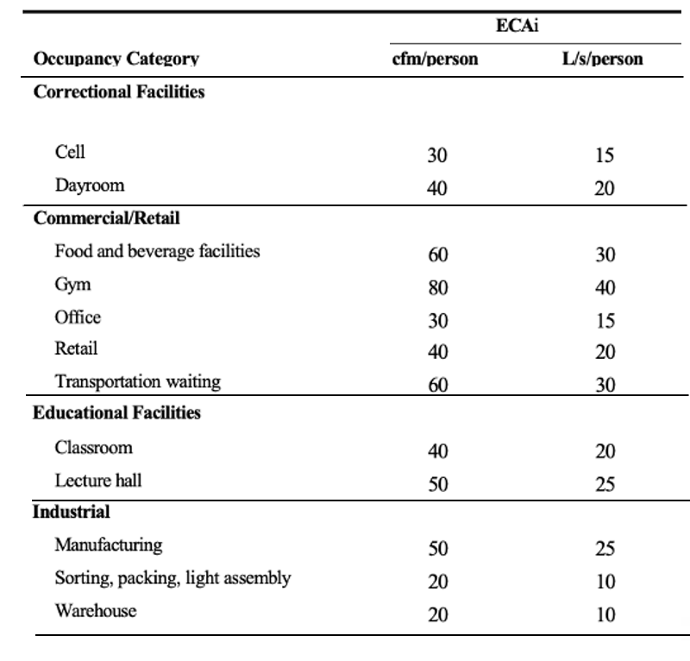
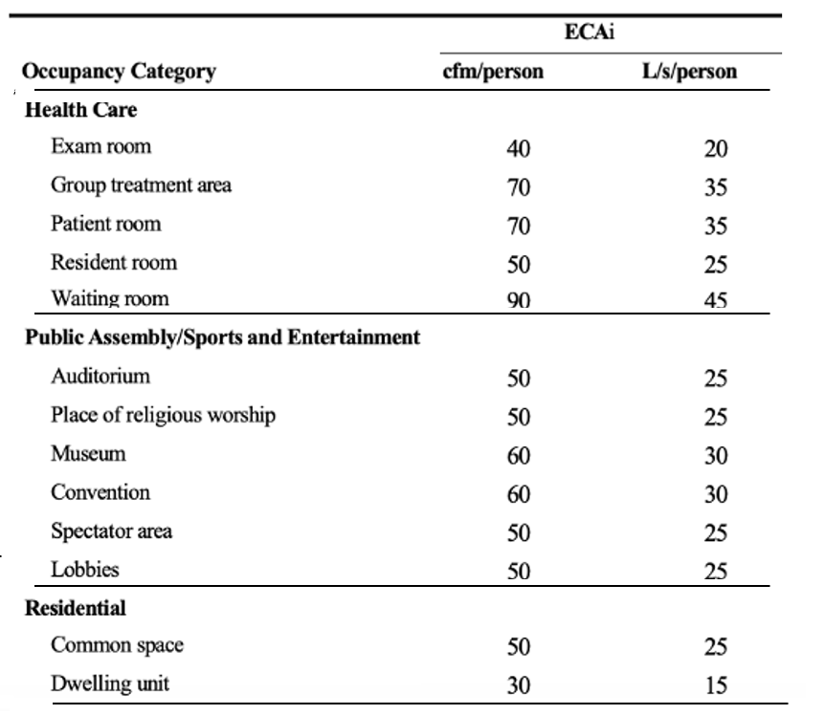
Table 5-1 – Minimum Equivalent Clean Airflow per Person in Breathing Zone in IRMM

Slide 39
Comparing standard 62.1 outdoor air, CDC recommendations, and ECAi
ANSI/ASHRAE Standard 62.1 VRP inputs
ECAi rates are much higher than 62.1 OA rates…but closer after effect of filters is added
Constant risk ECAi values give very different ACH values for different space types
CDC recommends 5 eACH all the time
ECAi has units of flow rate per person because personal risk of infection scales with ECA per person
 | R_{P} [cfm/pers] | R_{A} [cfm/ft²] | Occupant Density [#/1000 ft²]
Office | 5 | 0.06 | 5
Classroom | 10 | 0.12 | 35
Restaurant | 7.5 | 0.18 | 70
 | ASHRAE 62.1 Default [cfm/pers] | ASHRAE 241 ECAi [cfm/pers] | ASHRAE 241 ACH with 8’ ceiling
Office | 17 | 30 | 1.1
Classroom | 13 | 40 | 10.5
Restaurant | 10 | 60 | 31.5

Slide 40
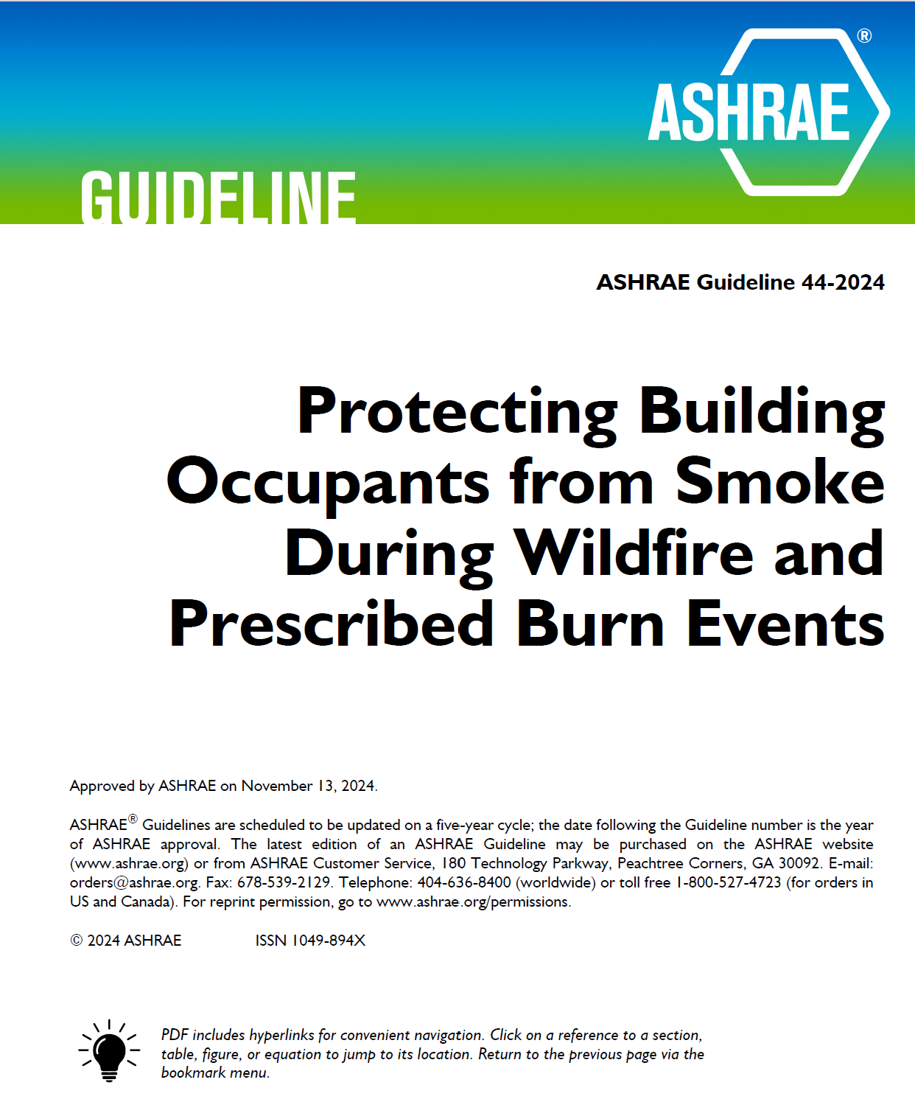
New developments – resilience in standards and guidelines: wildfire smoke
ASHRAE Guideline 44-2024
Guidance, not code-intended
Commercial, institutional, health care, multi-unit residential
Can use for prescriptive or performance-based design
Focuses on PM control with filters and pressurization
Addresses operation through development of a Smoke Readiness Plan

Slide 41
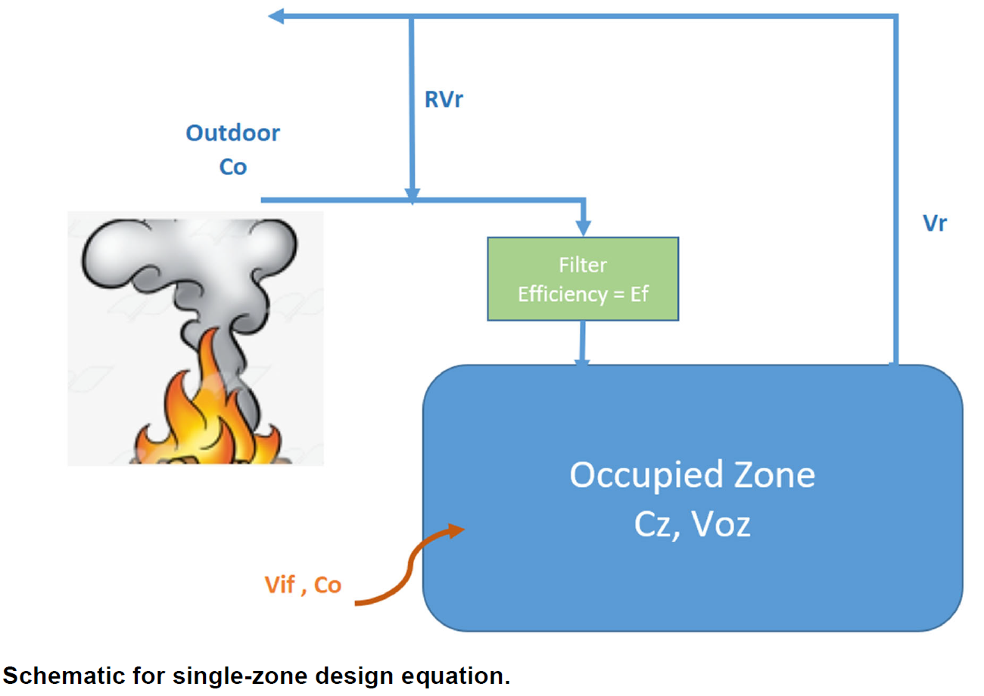
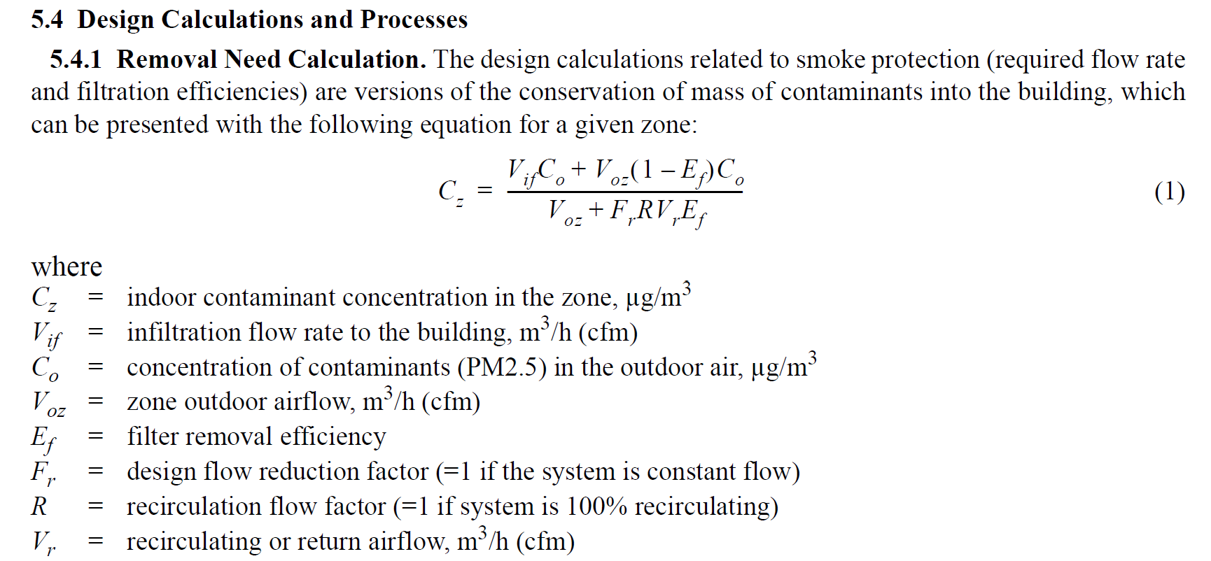

Slide 42

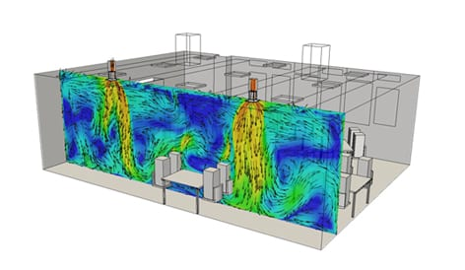
One more layer of complexity – air distribution
All ventilation standards assume “perfect mixing”
Some adjust with factors like ventilation effectiveness
Effectiveness depends on the application
In reality, details of air distribution matter
They are hard to address prescriptively and expensive to address by testing.
Well-mixed space
Mixing ventilation

Slide 43
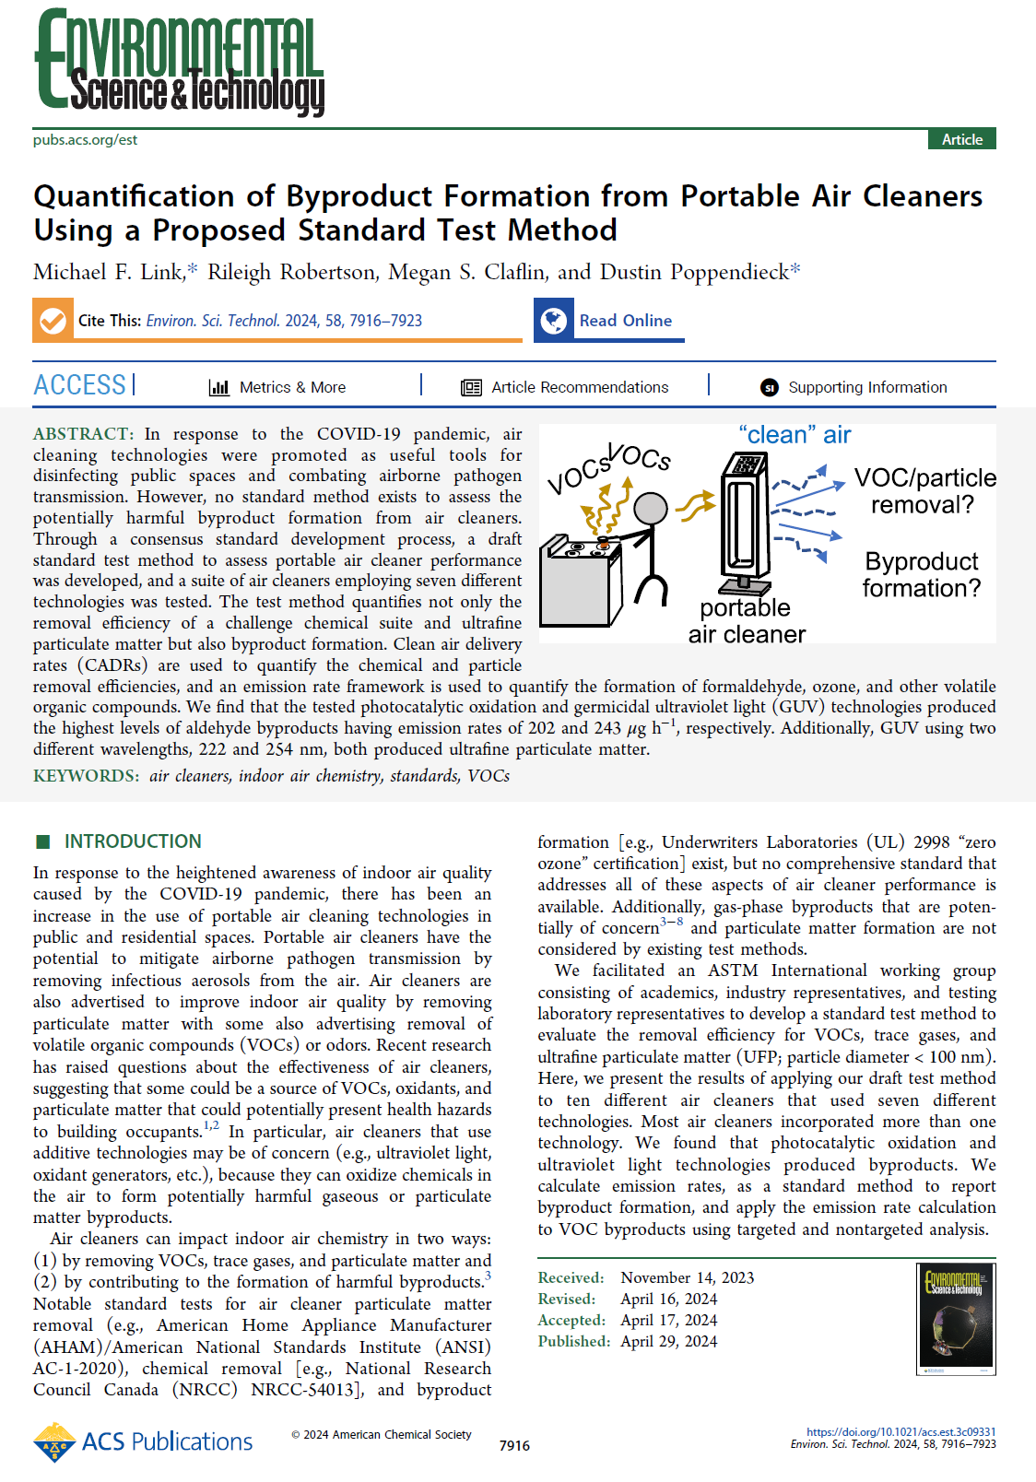
Air cleaners are finally getting the attention they need – performance and safety
Covid-driven air cleaner market revealed…
Most performance claims were unsupported by strong evidence
Reporting of performance tests was highly misleading
Safety testing for anything but ozone production
Positive outcome
Updated and new performance test standards (e.g., ASHRAE 185.3)
Research on emissions from all air cleaner types
Byproduct test standard is under development (ASTM WK81750, New Test Method for Chemical Assessment of Air Cleaning Technologies)
https://pubs.acs.org/doi/10.1021

Slide 44
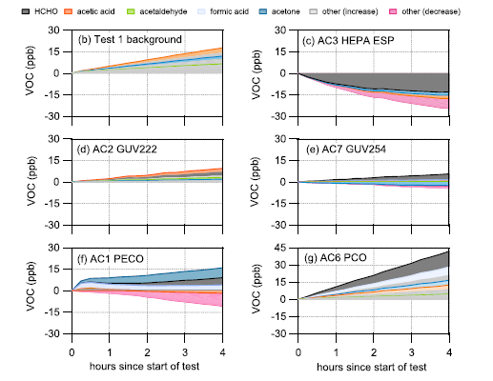
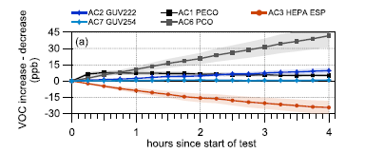
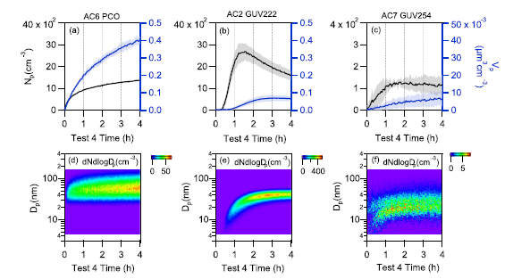
Link, et al. (2024)
https://doi.org/10.1021/acs.est.3c09331
Environ. Sci. Technol. 2024, 58, 7916−7923

Slide 45
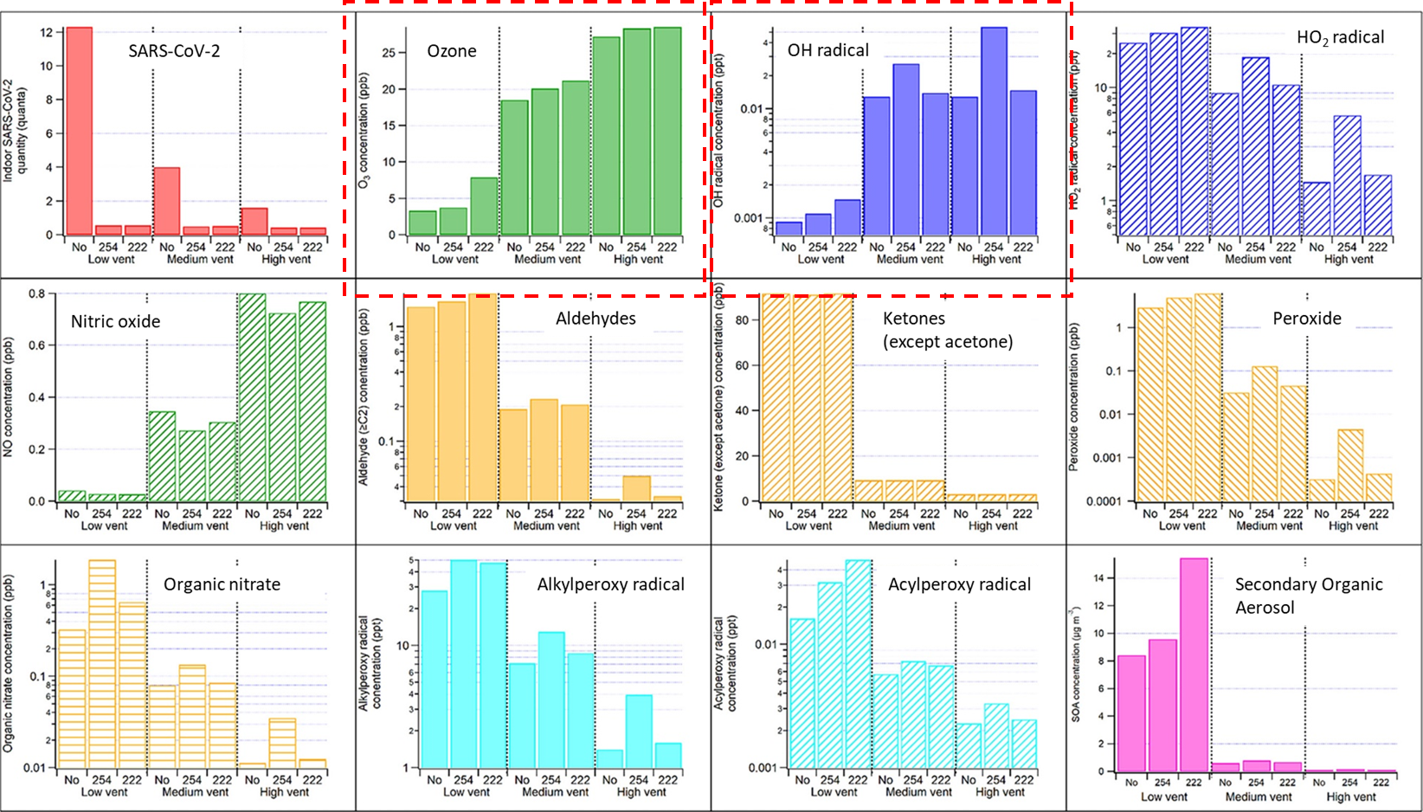
Modeling of byproduct formation – 222 nm and 254 nm GUV, variable outdoor air rates
Outdoor airflow rates
-low 0.3 ACH
-medium 3 ACH
-high 9 ACH
Peng, et al. 2023. doi.org/10.1021/acs.estlett.2c00599

Slide 46
Do ventilation units matter?
Air change rates (usually ACH)
Flow rate measured in room volumes per unit time – not actual replacement
Used for healthcare, labs, animal facilities
Expanded use during covid-19 pandemic
Cannot directly determine contaminant concentration from ACH
Useful for estimating clearance time, room air distribution
Absolute flow rates (cfm, L/s…) per unit of something
Per person or per unit of floor area
Used in residential and non-residential standards
Needed for calculating concentration

Slide 47
1well-mixed air change reduces concentration by 63%
C_{SS} = Steady state concentration of a contaminant
C_{O} = Concentration of contaminant in ventilation air
S = Source strength (emission rate of a contaminant)
Q = Flow rate of uncontaminated ventilation air (cfm, etc.)
ACR = Air change rate (ACH)

Slide 48
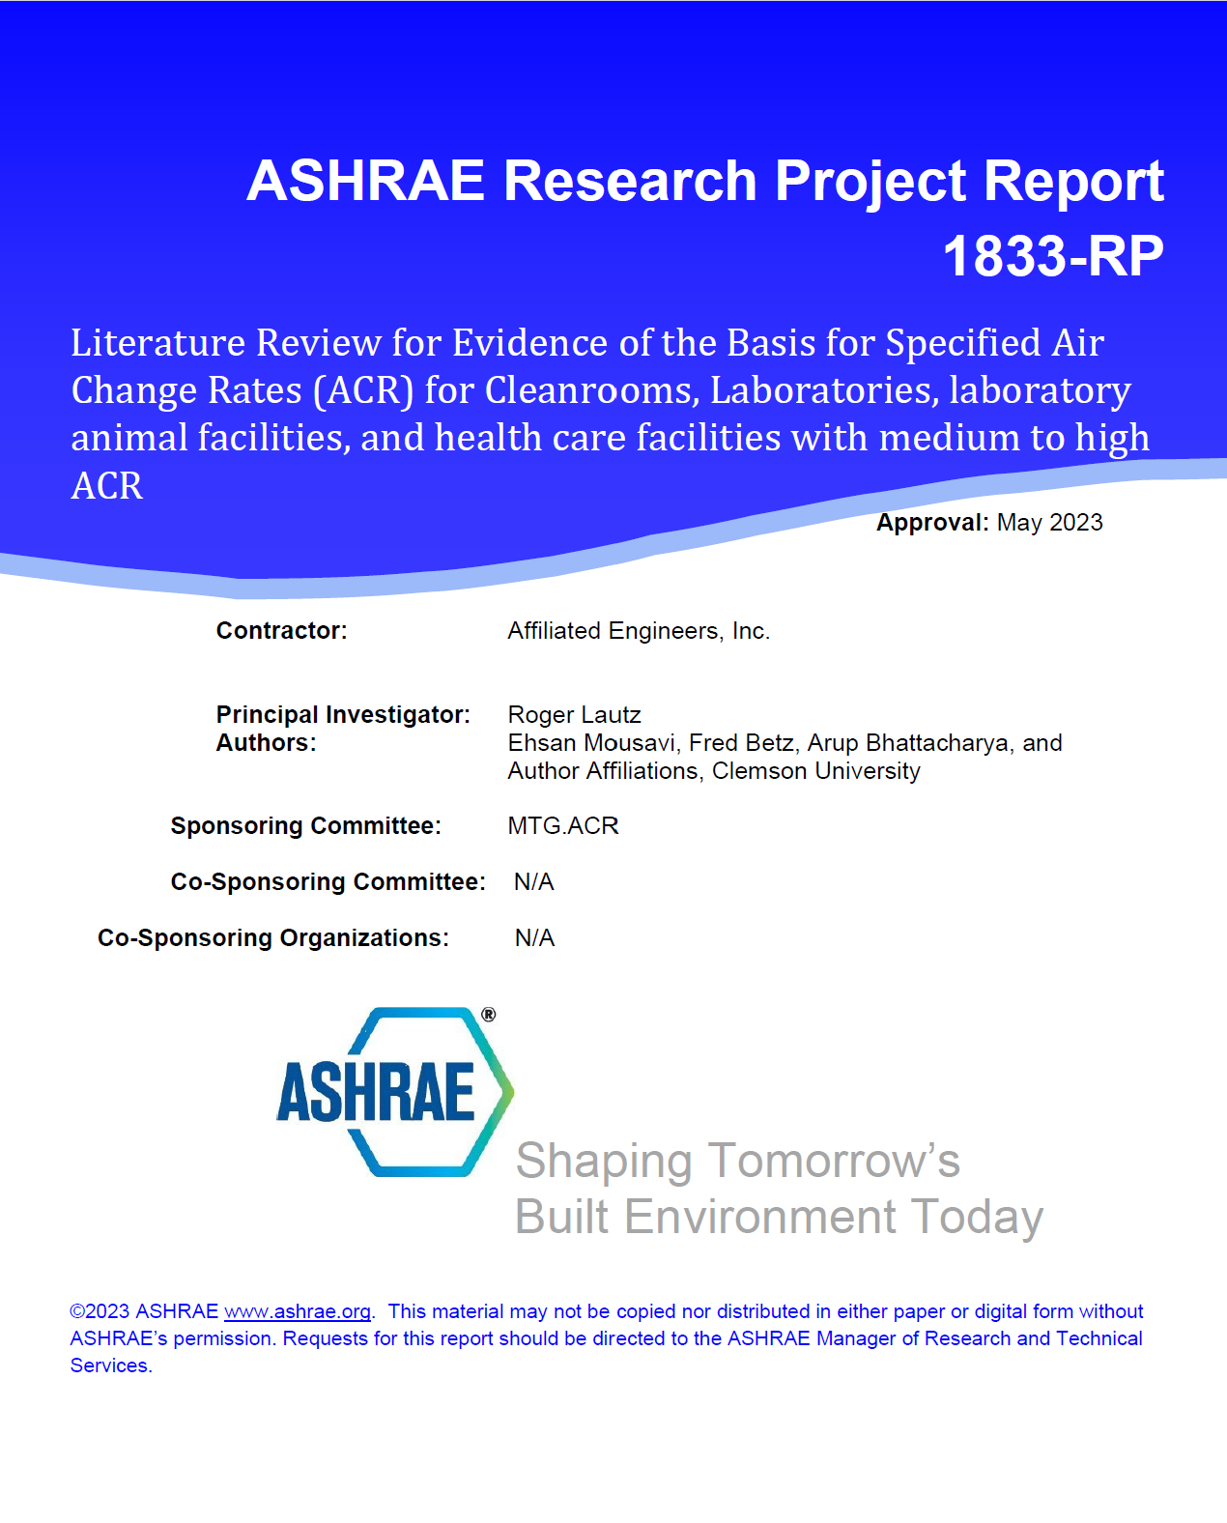
ASHRAE sponsored research on evidence for air change rates in standards (1833-RP, 2023)
15 years after publication of Standard 170
“The only robust evidence is that ventilation can be used to control thermal comfort and therefore minimize distraction and fatigue among caregivers.”
“Unfortunately, a single optimal air change rate was not identified for any healthcare space.”
“(G)iven the observed pace of change for the HVAC industry,…air change rate’s days are numbered, but it is likely a large number.

Slide 49
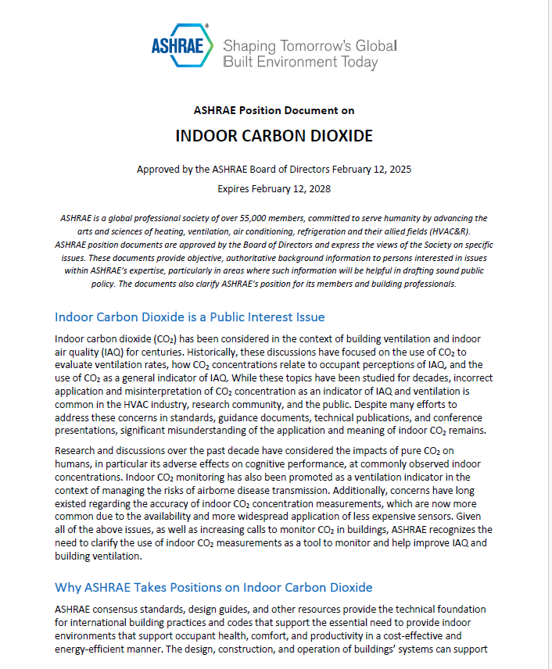
What about carbon dioxide?
ASHRAE Position Document
The history CO₂ concentrations in relation to building ventilation and IAQ
Health and cognitive impacts of exposure to CO₂
Existing standards and regulations for indoor CO₂ concentrations
CO₂ as an indicator of IAQ and ventilation
Use of CO₂ as a tracer gas for estimating ventilation rates
Increases in outdoor CO₂ concentrations
Air cleaning directed at CO₂ removal alone
CO2 as an indicator of the risk of airborne disease transmission

Slide 50
ASHRAE positions, paraphrased
Indoor CO₂ concentration is not an overall indicator of IAQ but can be helpful if you know what you’re doing
For the purpose of evaluating ventilation rates, indoor-outdoor CO₂ is a tracer gas and is accurate only if inputs are accurate and test assumptions are valid
There is evidence of effects of CO₂ at typical indoor concentrationson health, well-being, learning, sleep, and work performance, but it is mixed
In theory, there is a connection between CO₂ concentration and airborne infection risk, but in practice, it’s hard to apply
Sensor characteristics and placement are critical for monitoring and control

Slide 51
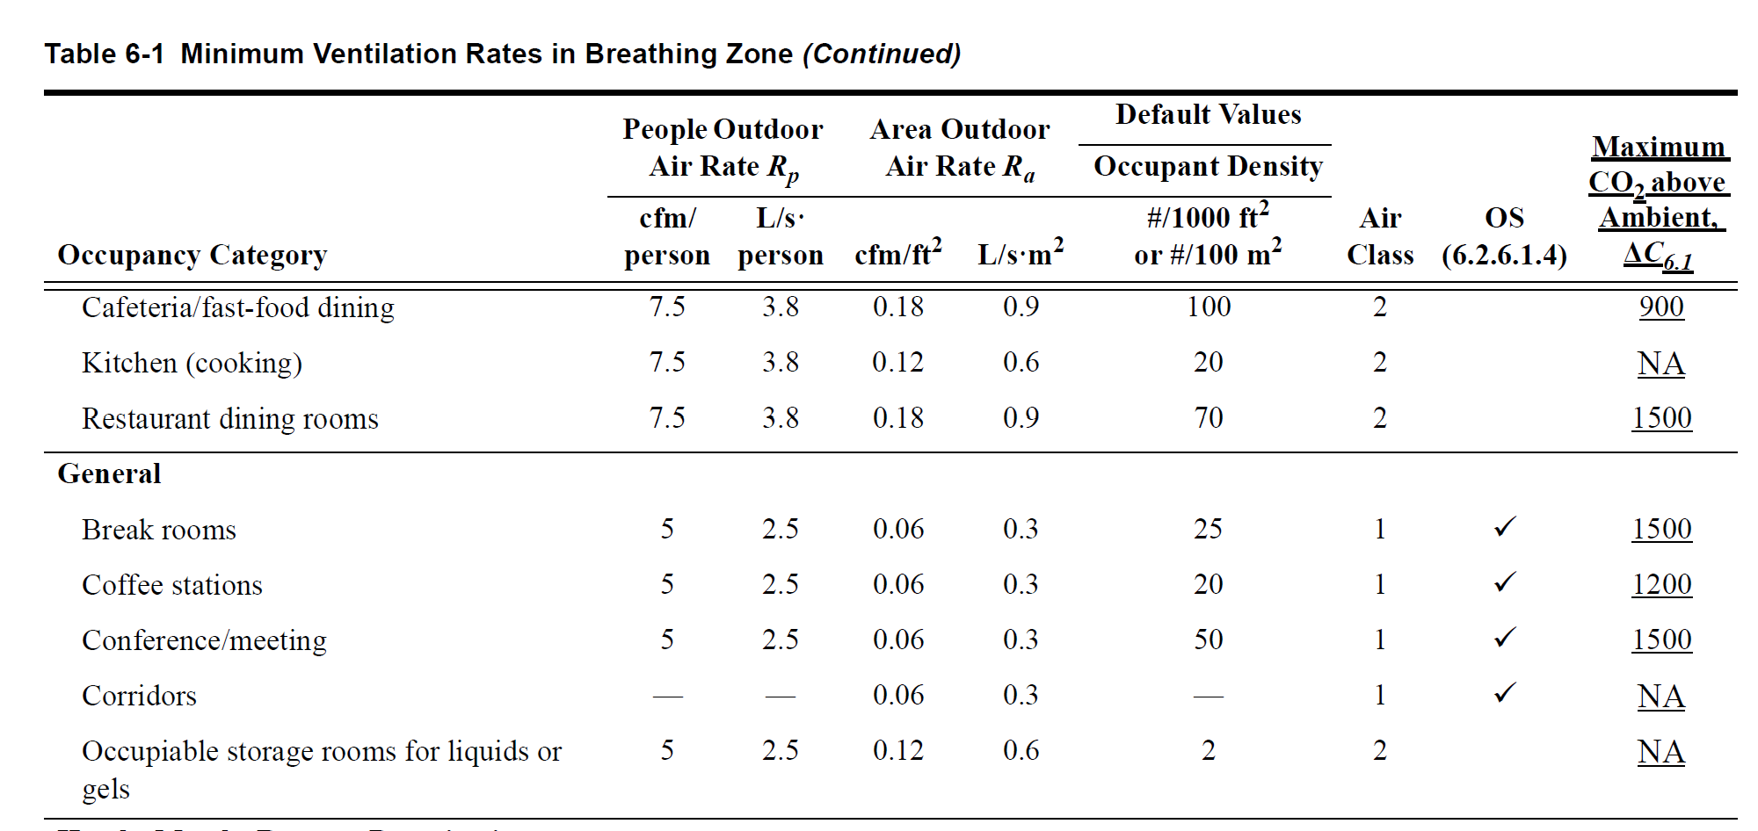
ASHRAE Standard 62.1 now supports CO₂ Based Demand Control (but I still think it’s a bad idea a lot of the time)

Slide 52
CO₂ Concentration for Steady State 62.1 Compliance Single-Zone, 1000 ft² Lecture Classroom, 65 Sedentary Adults, 500 ppm Ambient
At full occupancy, 8.4 cfm/pers. Minimum OA 60 cfm

Slide 53
Wrap-up
Prescriptive outdoor air supply remains the dominant ventilation control for IAQ
Objectives of ventilation standards have not changed much in the past 50 years
There is some evidence behind some outdoor air requirements but not others
There is great interest in improving IAQ, but more outdoor air is not the way to do it

Slide 54
More wrapping up…
Promising trends
Standards and guidelines for extreme events
Equivalent clean air approach
Performance approach based on quantified harm or benefit/sensor technology to support it
Evidence that a small (manageable) number of contaminants must be controlled – and PM is #1
Potential for air cleaners to carry more of the burden – less OA may be fine in some cases
Improvements in air cleaner testing

Slide 55
Still wrapping up…
Needs/concerns
Potential cost and complexity of performance standards
Some important knowledge gaps
Air distribution
Modeling of infection risk
Air cleaner performance and safety
Need to harmonize standards
Need for appropriate level of regulation/enforcement, including post-occupancy

Slide 56


Thank You!
Bill Bahnfleth
wbahnfleth@psu.edu

