Slide 1
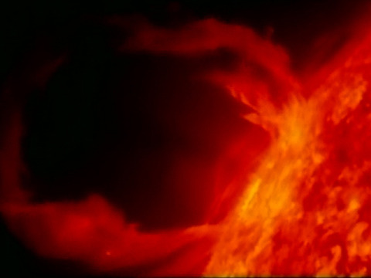
Using the Sun in Buildings
Twenty-Seventh Westford Symposium on Building Science
Marc Rosenbaum, PE, CPHC, MA CSL – Energysmiths – West Tisbury, MA
Notes:
REQUIRED. This should come after the Welcome/Best Practices and Copyright slides.

Slide 2
Why Bother?
Make better buildings, for people and the planet
- Use to provide space heating
- Avoid cooling load
- Heat domestic water
- Heat outdoor pools
- Make electricity
- Light buildings
Marc Rosenbaum, PE – Energysmiths – West Tisbury, MA
Notes:
REQUIRED. This should come after the Welcome/Best Practices and Copyright slides.

Slide 3
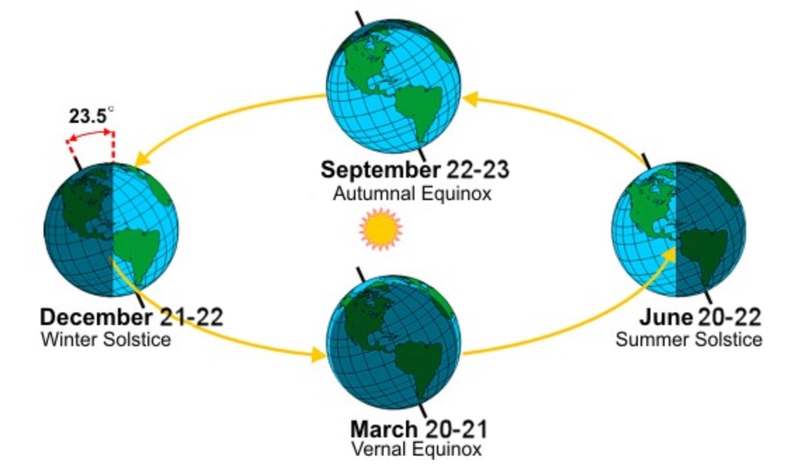
The Earth’s Axis is Tilted
Marc Rosenbaum, PE – Energysmiths – West Tisbury, MA
Notes:
REQUIRED. This should come after the Welcome/Best Practices and Copyright slides.

Slide 4
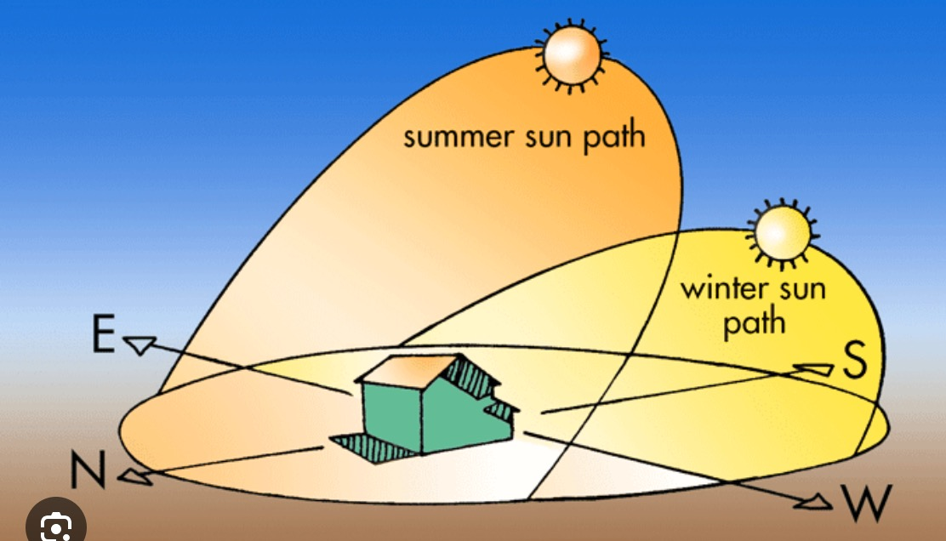

Sun Paths
Marc Rosenbaum, PE – Energysmiths – West Tisbury, MA
Notes:
REQUIRED. This should come after the Welcome/Best Practices and Copyright slides.

Slide 5
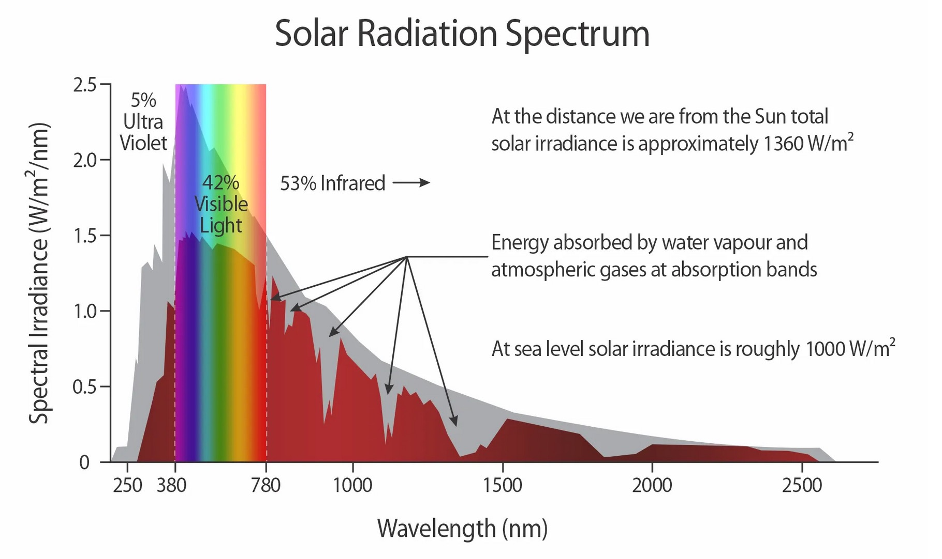
Solar Spectrum
Marc Rosenbaum, PE – Energysmiths – West Tisbury, MA
Notes:
REQUIRED. This should come after the Welcome/Best Practices and Copyright slides.

Slide 6
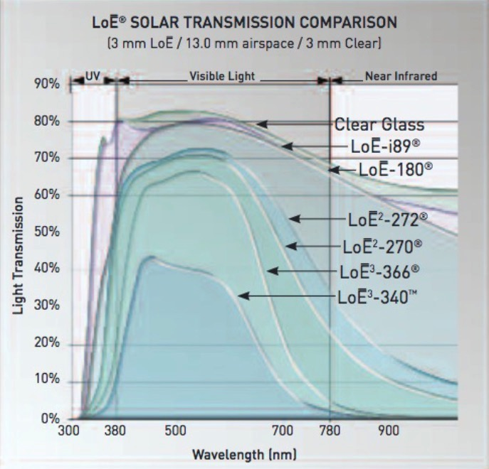

Glazing and Coatings
SHGC –
Solar Heat Gain Coefficient
VLT –
Visible Light Transmission
SHGC VLT
Dbl Clear 0.763 0.814
Clear-180 0.674 0.788
272-Clear 0.413 0.716
366-Clear 0.272 0.645
Marc Rosenbaum, PE – Energysmiths – West Tisbury, MA
Notes:
REQUIRED. This should come after the Welcome/Best Practices and Copyright slides.

Slide 7
Calculating Solar Radiation (Insolation)
Clear Day vs. Average Day
  Most modeling software uses average day solar data, in order to calculate average annual solar performance (space conditioning, water heating, electricity, daylighting)
  Clear day data is useful to calculate design cooling loads
  Clear day data is also used to calculate amounts of energy storage, both thermal and electrical, and to size blowers and pumps for transporting solar energy
Marc Rosenbaum, PE – Energysmiths – West Tisbury, MA
Notes:
REQUIRED. This should come after the Welcome/Best Practices and Copyright slides.

Slide 8
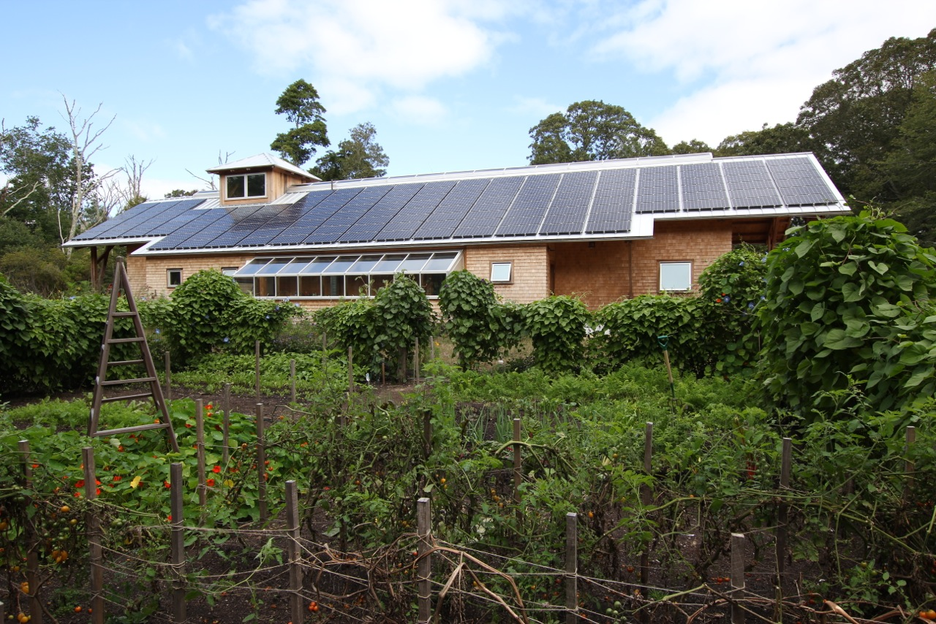
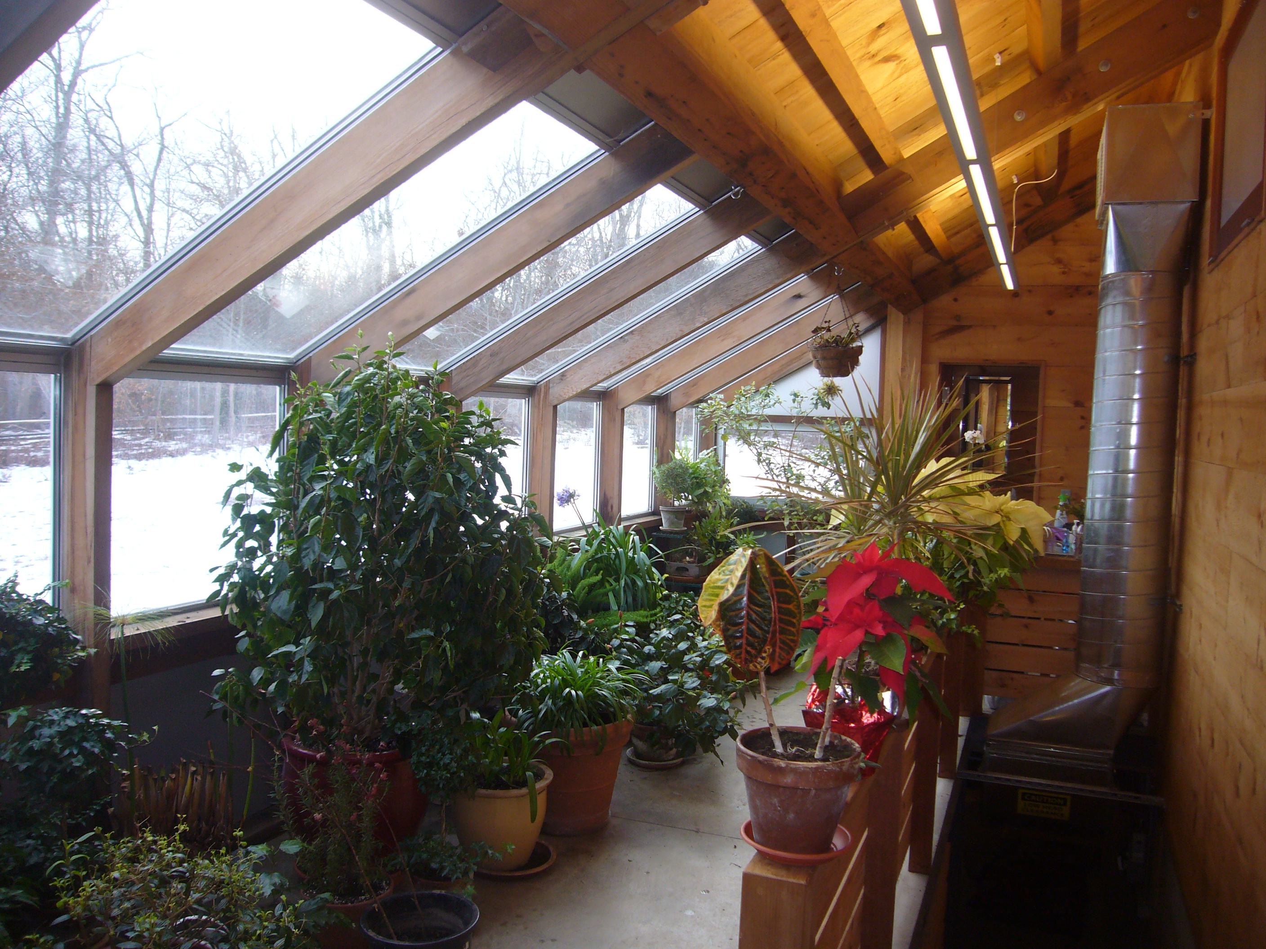
Fan-forced Solar Greenhouse
Active storage; passive release
A blower moves air carrying excess solar heat from the greenhouse to water storage in the Thermomass basement below
Marc Rosenbaum, PE – Energysmiths – West Tisbury, MA
Notes:
REQUIRED. This should come after the Welcome/Best Practices and Copyright slides.

Slide 9
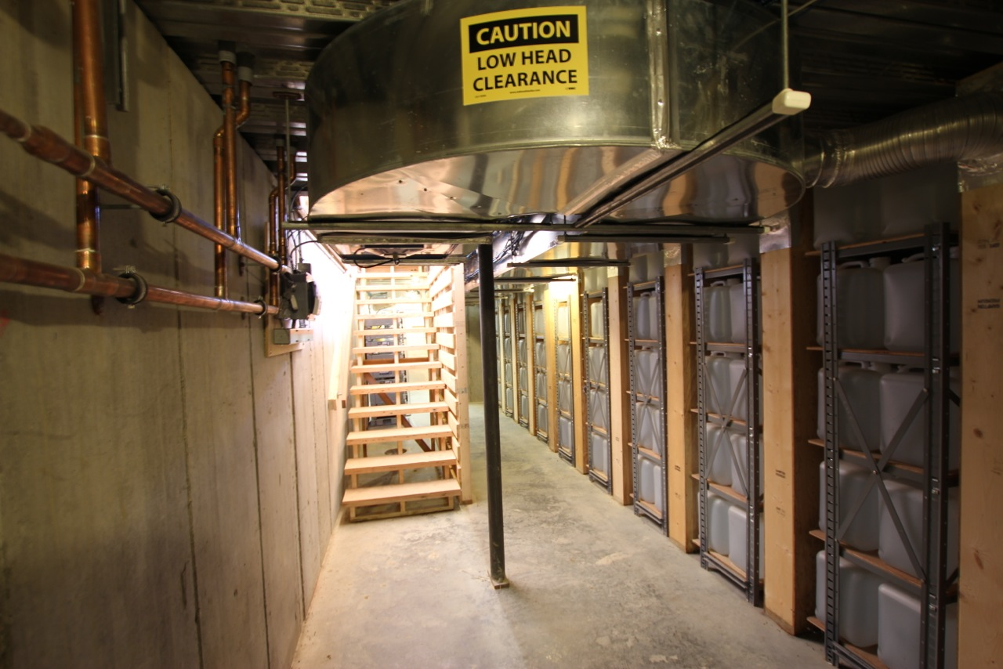
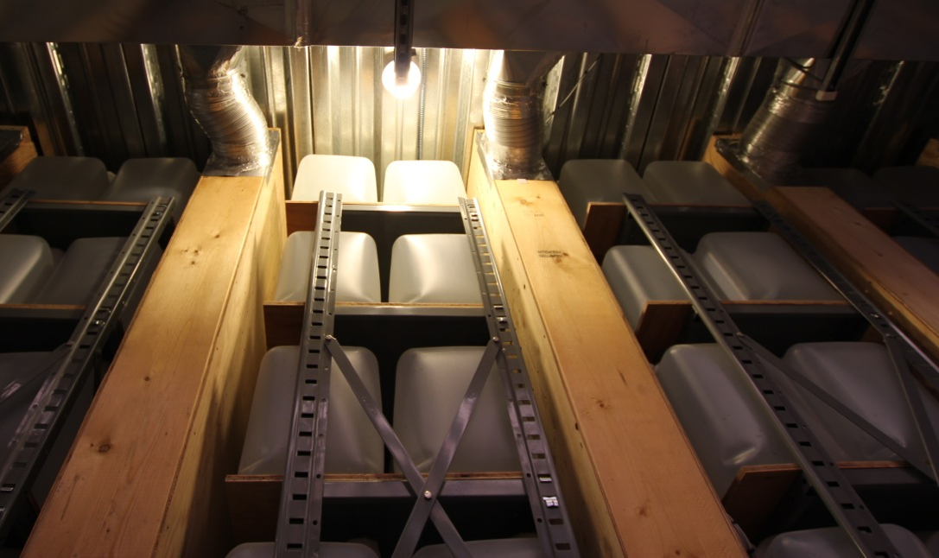
Fan-forced Solar Greenhouse
Peak hourly clear day insolation sizes the blower
Peak hourly clear day insolation sizes the heat transfer from the air to the water containers
Daily clear day insolation sizes the heat storage (300 five gallon water containers)
Marc Rosenbaum, PE – Energysmiths – West Tisbury, MA
Notes:
REQUIRED. This should come after the Welcome/Best Practices and Copyright slides.

Slide 10
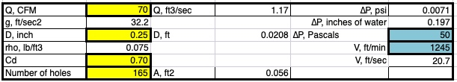
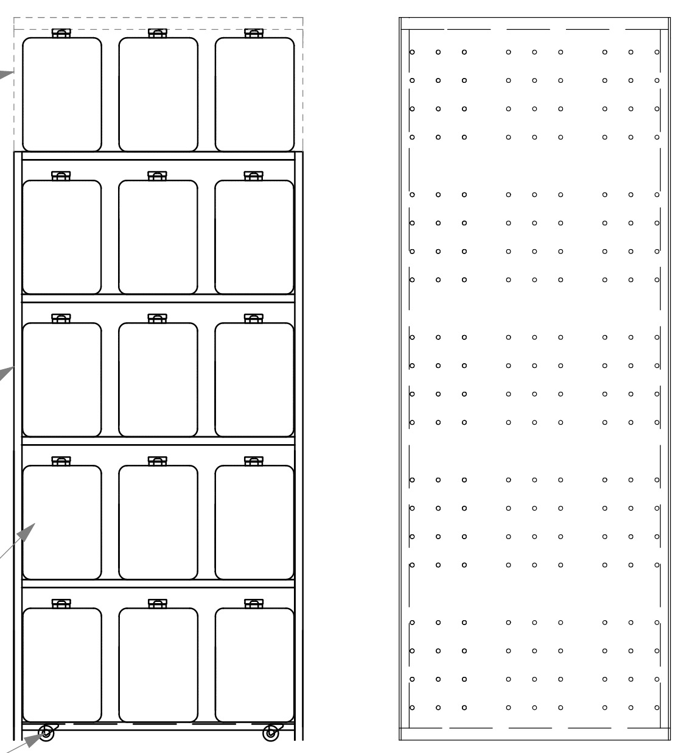
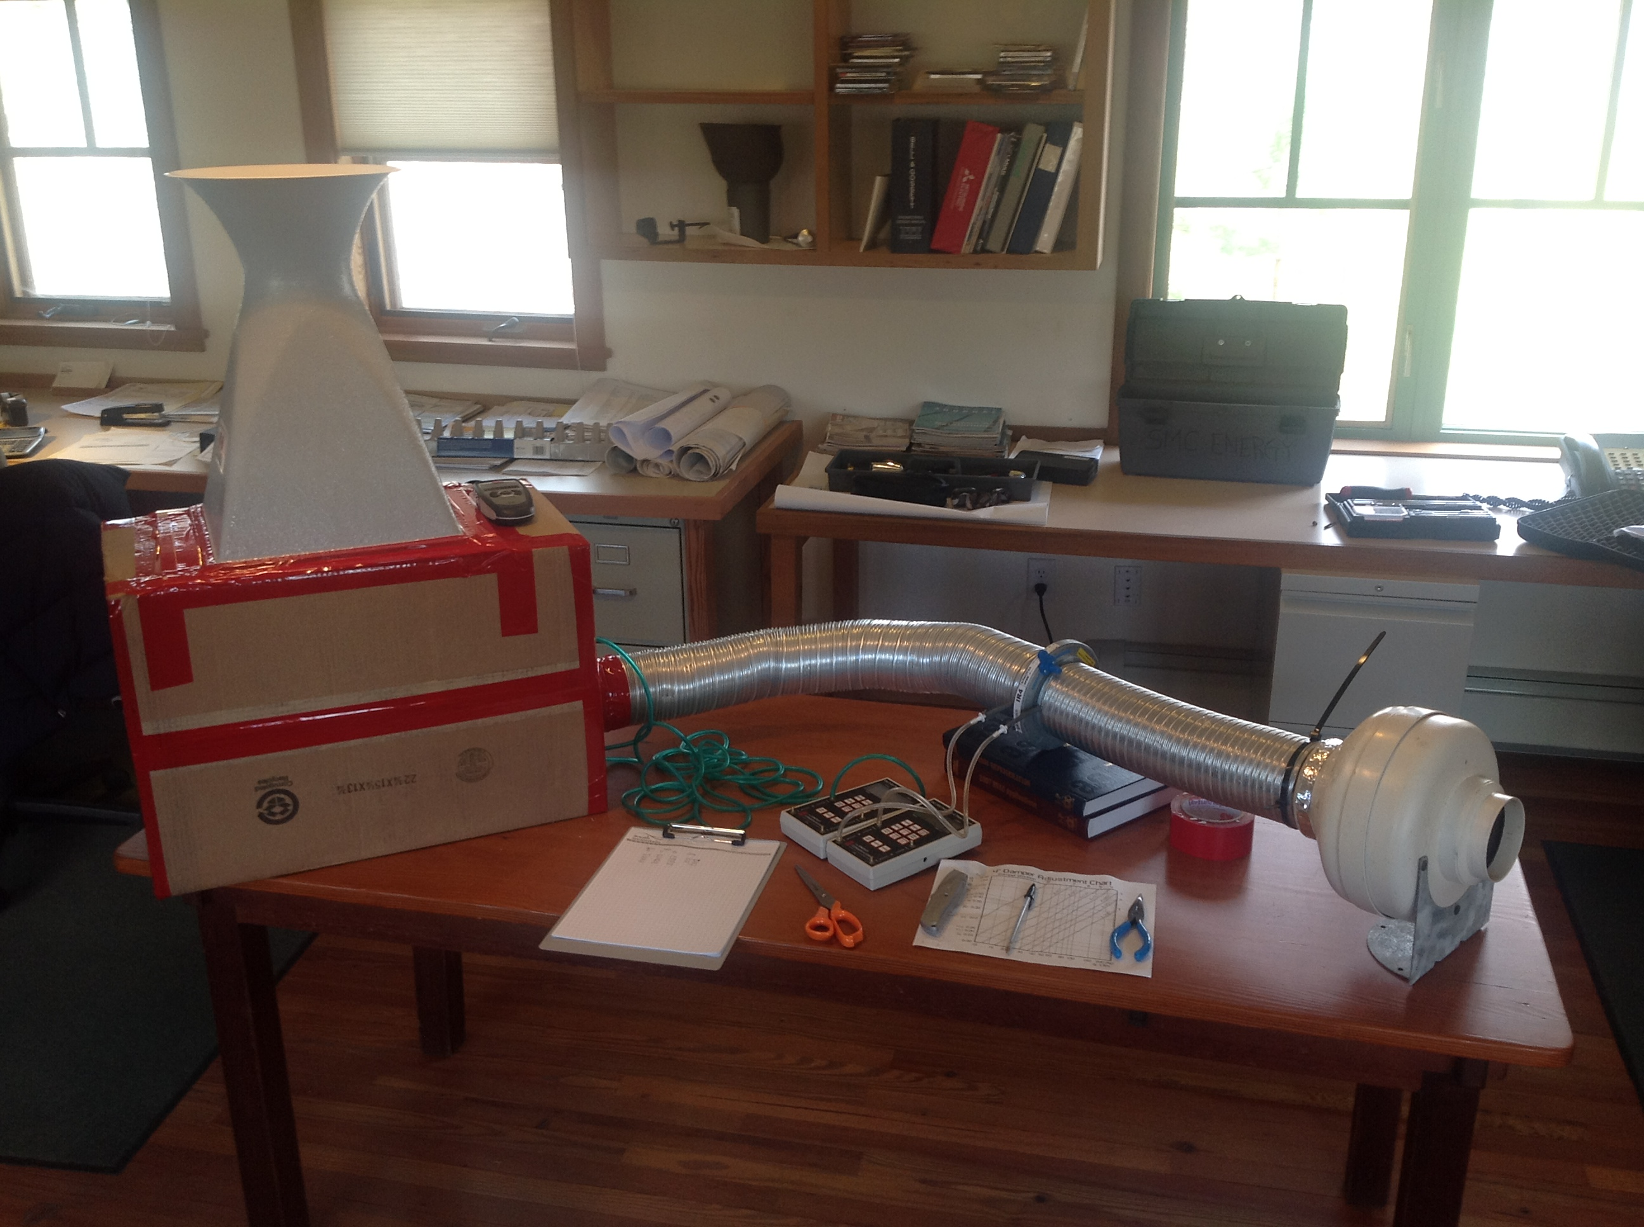
Modeling the Manifold Air Jets
Marc Rosenbaum, PE – Energysmiths – West Tisbury, MA
Notes:
REQUIRED. This should come after the Welcome/Best Practices and Copyright slides.

Slide 11
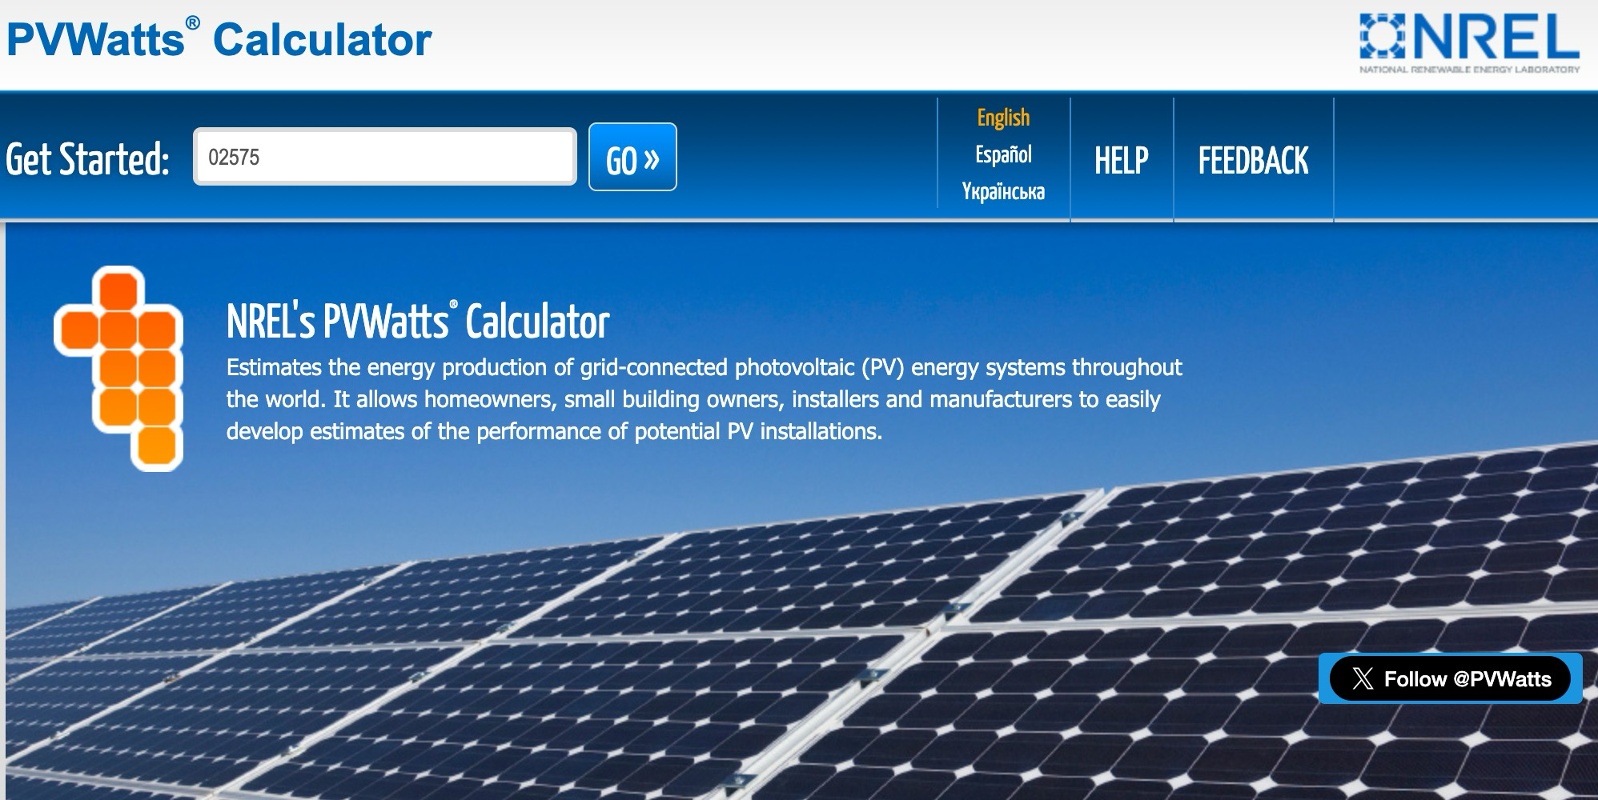
Solar Radiation Calculators Online
https://pvwatts.nrel.gov/
PVWatts is free online software designed to model solar electric system performance
Marc Rosenbaum, PE – Energysmiths – West Tisbury, MA
Notes:
REQUIRED. This should come after the Welcome/Best Practices and Copyright slides.

Slide 12
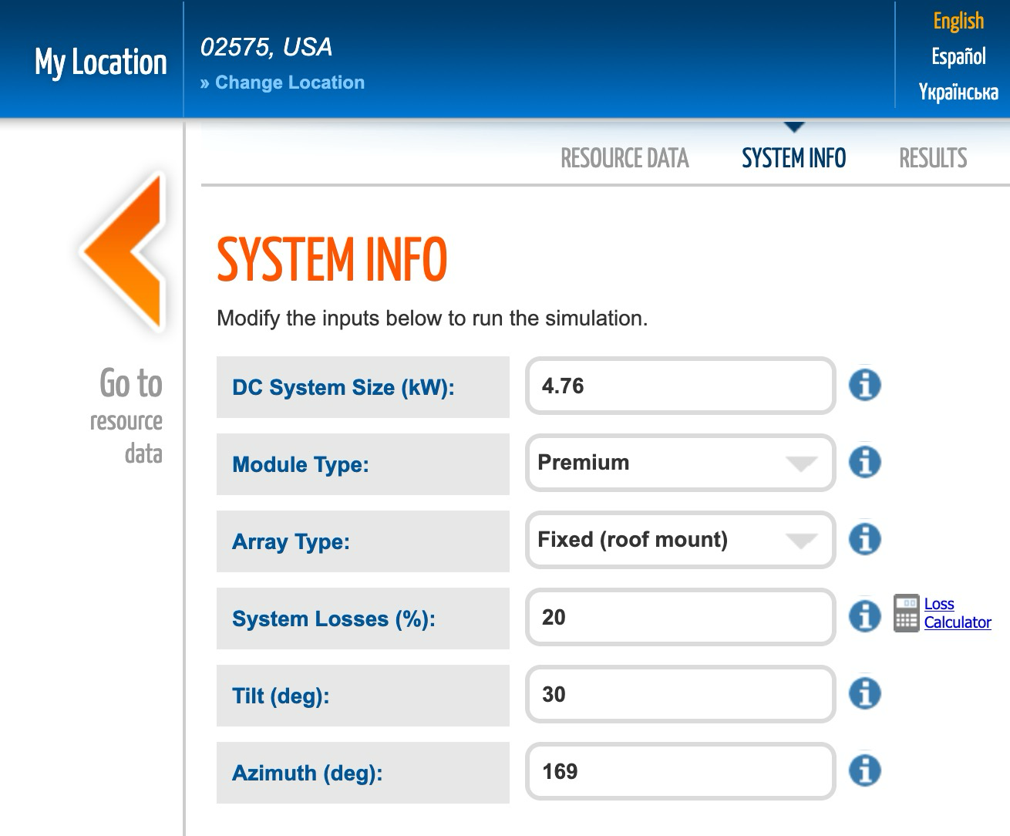

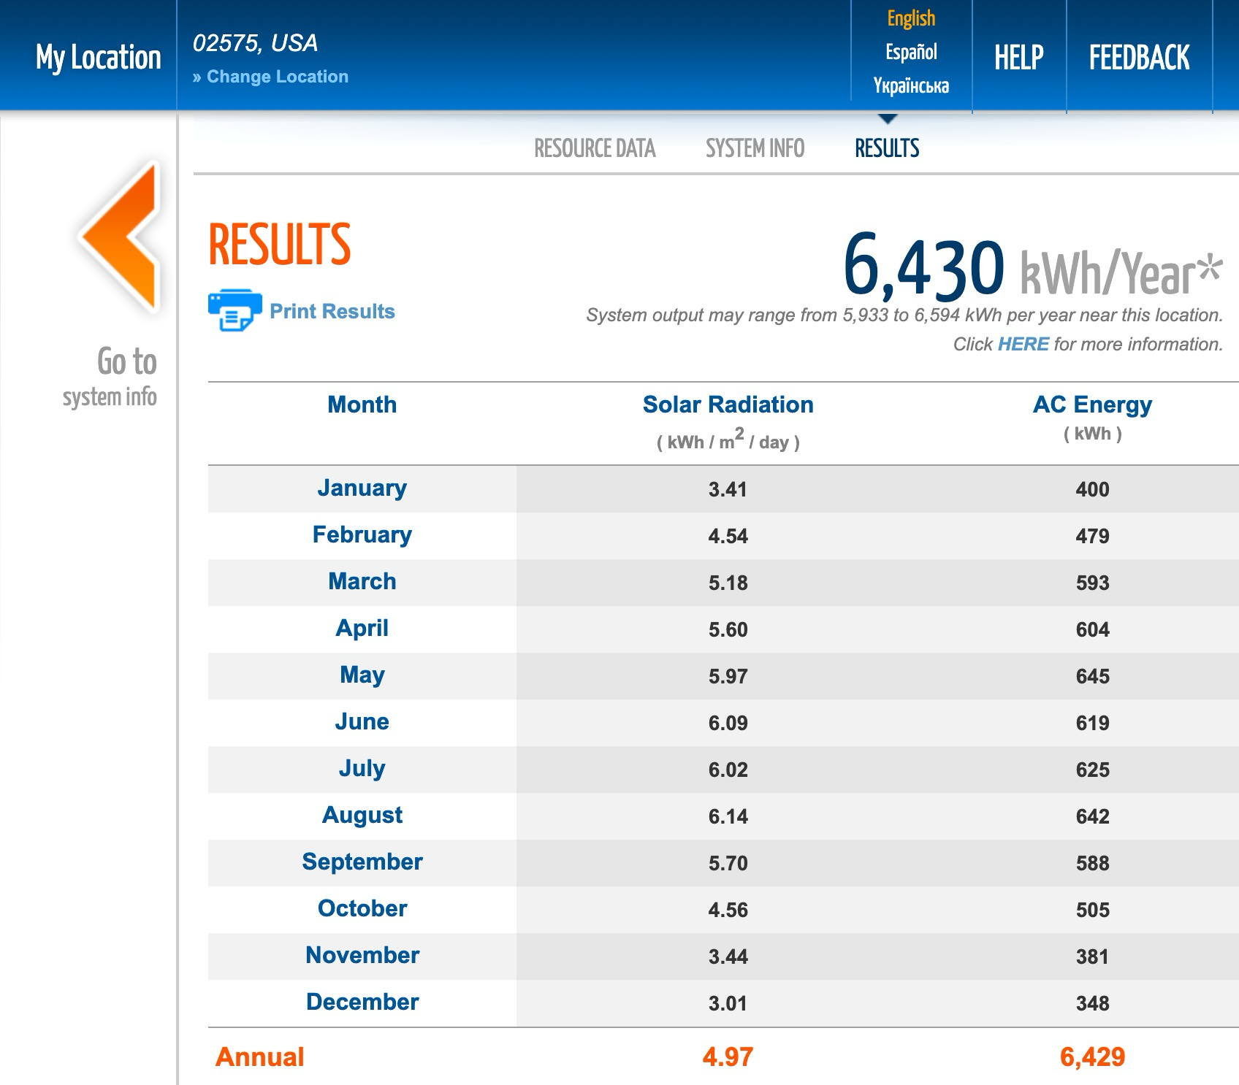
Solar Radiation Calculators Online
My PV System
Average Day Insolation
Marc Rosenbaum, PE – Energysmiths – West Tisbury, MA
Notes:
REQUIRED. This should come after the Welcome/Best Practices and Copyright slides.

Slide 13

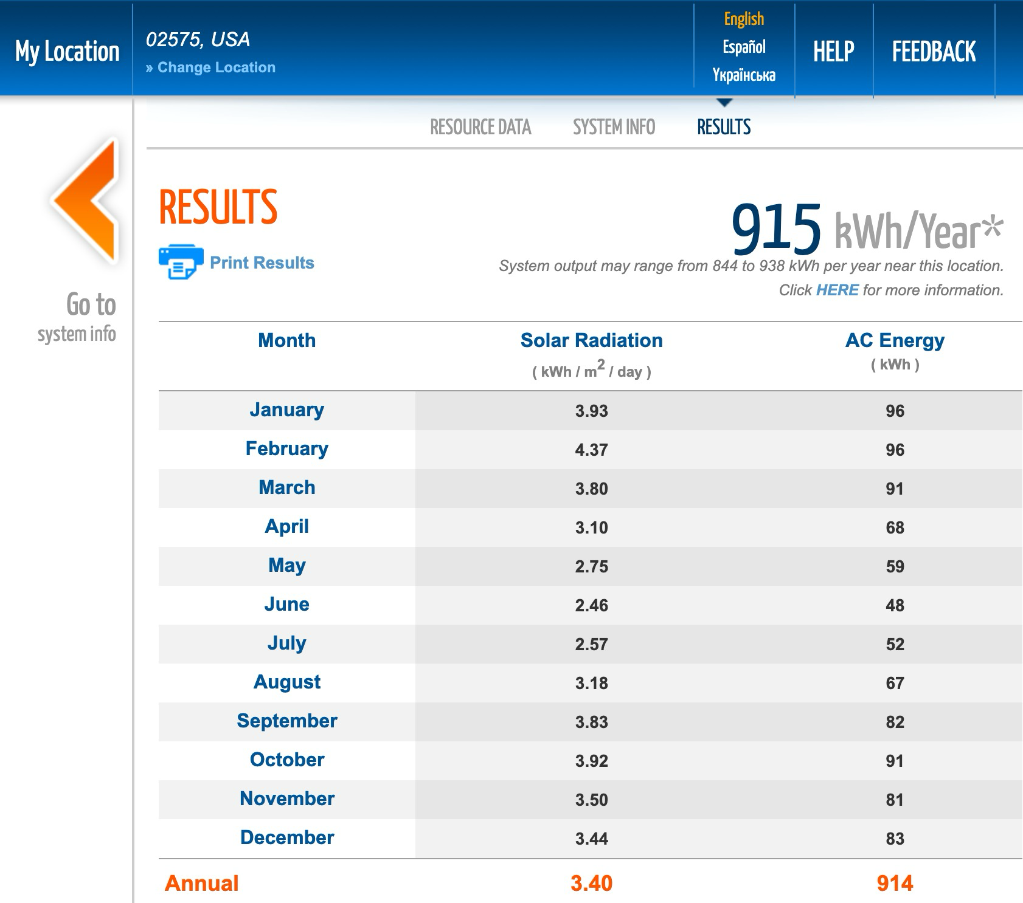
Solar Radiation Calculators Online
Pvwatts is made to model solar electric systems, but can be used to model radiation on vertical surfaces
Change Tilt to 90 Degrees
Marc Rosenbaum, PE – Energysmiths – West Tisbury, MA
Notes:
REQUIRED. This should come after the Welcome/Best Practices and Copyright slides.

Slide 14

Solar Radiation Calculators Online
https://www.susdesign.com/tools.php
Marc Rosenbaum, PE – Energysmiths – West Tisbury, MA
Notes:
REQUIRED. This should come after the Welcome/Best Practices and Copyright slides.

Slide 15
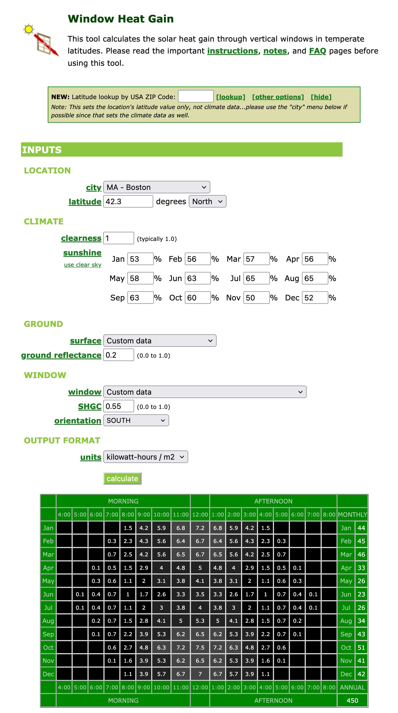
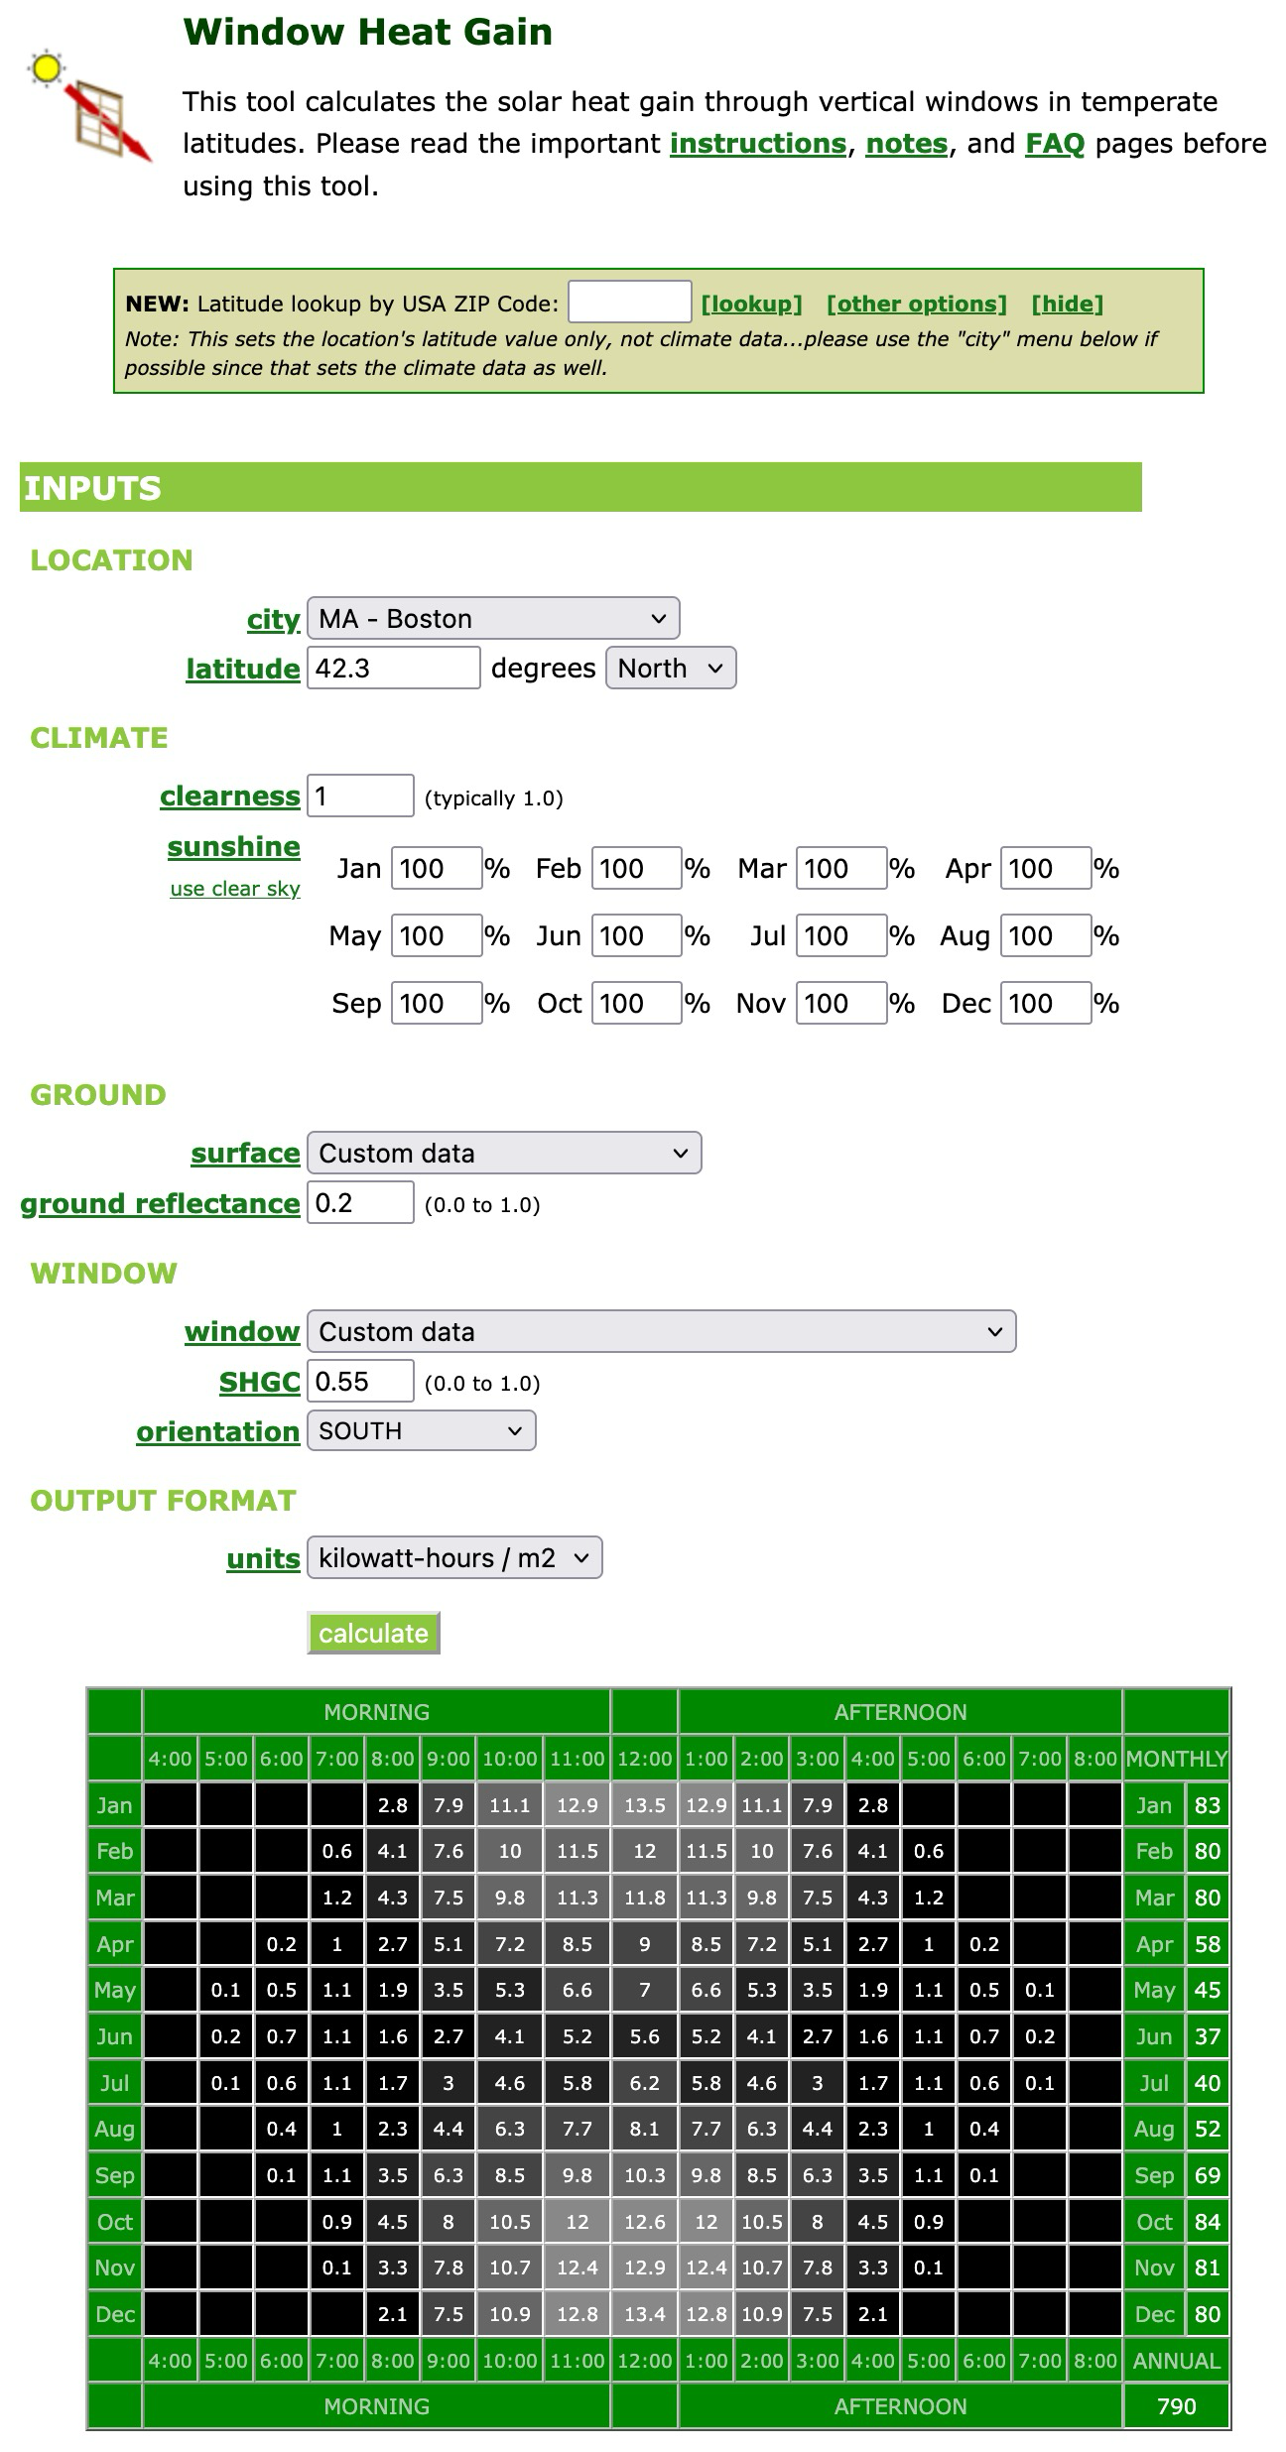
Solar Radiation Calculators Online
https://www.susdesign.com/tools.php
Marc Rosenbaum, PE – Energysmiths – West Tisbury, MA
Notes:
REQUIRED. This should come after the Welcome/Best Practices and Copyright slides.

Slide 16
Effects of Tilt and Azimuth
Average Monthly kWh/m2/day by Azimuth and Tilt, Martha’s Vineyard
Marc Rosenbaum, PE – Energysmiths – West Tisbury, MA
Notes:
REQUIRED. This should come after the Welcome/Best Practices and Copyright slides.

Slide 17
Matching the Load to Tilt/Azimuth
Is the load seasonal or annual?
  Heating and pool heating are seasonal
  Electricity and domestic water heating are annual
Is occupancy seasonal?
  Schools (and solar hot water seasonality)
Is the system output exportable?
  Only electricity is exportable (on a per building basis)
Marc Rosenbaum, PE – Energysmiths – West Tisbury, MA
Notes:
REQUIRED. This should come after the Welcome/Best Practices and Copyright slides.

Slide 18
Effects of Location
Marc Rosenbaum, PE – Energysmiths – West Tisbury, MA
Notes:
REQUIRED. This should come after the Welcome/Best Practices and Copyright slides.

Slide 19
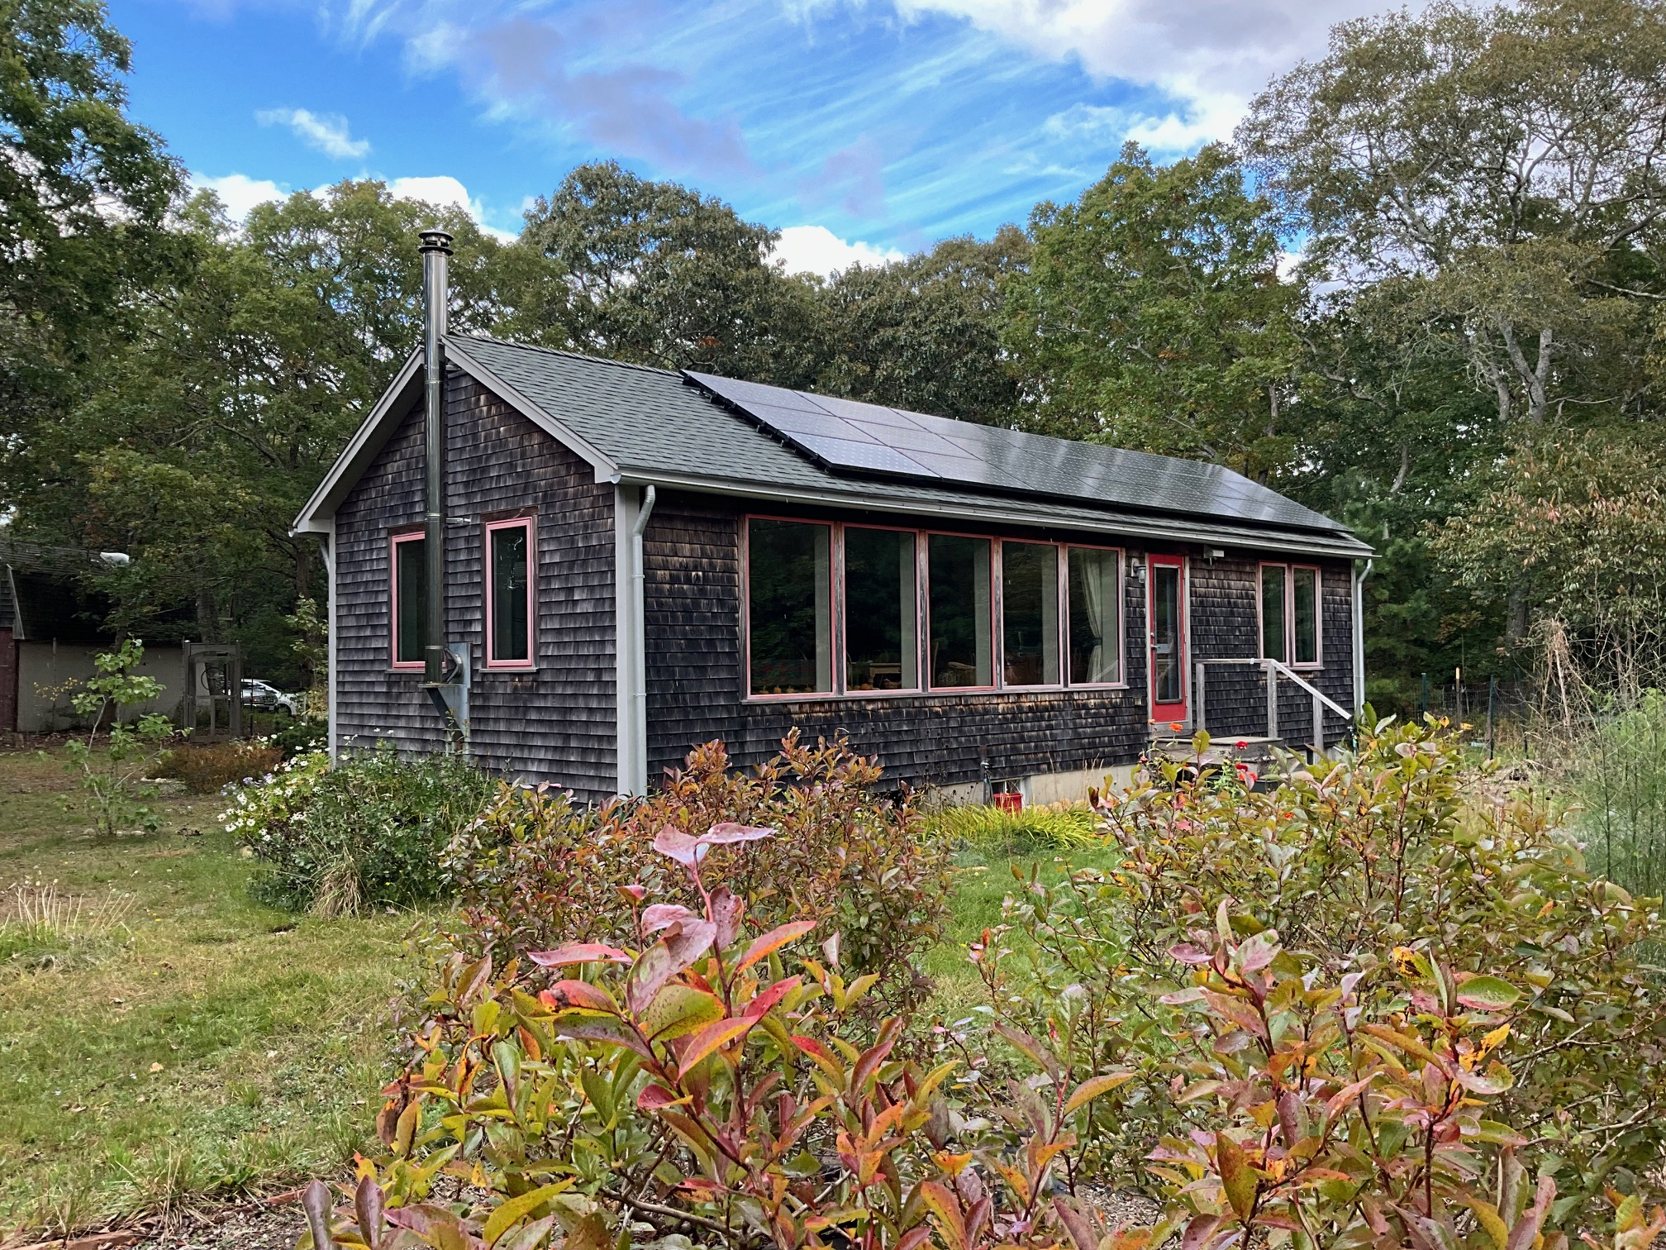
Matching the Aperture to Load
Distinguish between average and peak insolation
110 sf net glazing, 11˚ east of south
Marc Rosenbaum, PE – Energysmiths – West Tisbury, MA
Notes:
REQUIRED. This should come after the Welcome/Best Practices and Copyright slides.

Slide 20
Matching the Aperture to Load
January net heating load is 5,000,000 BTU
Daily average January insolation = 953 BTU/sf
Glazing SHGC = 0.60 (triple, 2 lites Cardinal 180)
Glazing area to offset January heating load = 282 sf
Daily clear day January insolation = 1,733 BTU/sf
Average January daytime heating load is 44,000 BTU
Clear day solar gain is 293,000 BTU, so the net energy that needs to be stored is 249,000 BTU – this is a lot! Interior temperature would rise ~34F. Utilizability
Actual glazing area of 110 sf is still somewhat over-sized ☺ - old guideline of 8% south glass / floor area is too high for very low load buildings
Marc Rosenbaum, PE – Energysmiths – West Tisbury, MA
Notes:
REQUIRED. This should come after the Welcome/Best Practices and Copyright slides.

Slide 21
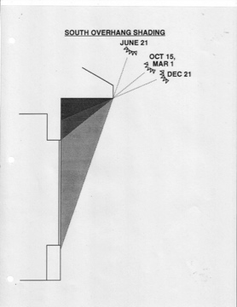
Window Overhangs
Marc Rosenbaum, PE – Energysmiths – West Tisbury, MA
Notes:
REQUIRED. This should come after the Welcome/Best Practices and Copyright slides.

Slide 22
Overhang Objectives
Heating season – don’t block direct sun
Cooling season – block direct sun
The tricky part - the sun’s path April 21st and August 21st is the same, but the heating/cooling load is not.
As the azimuth diverges from true south, overhangs becomes less effective. Overhangs on the east and west must be quite deep to shade the windows from low angle sun – these are known as porches (not Porsches)
Marc Rosenbaum, PE – Energysmiths – West Tisbury, MA
Notes:
REQUIRED. This should come after the Welcome/Best Practices and Copyright slides.

Slide 23
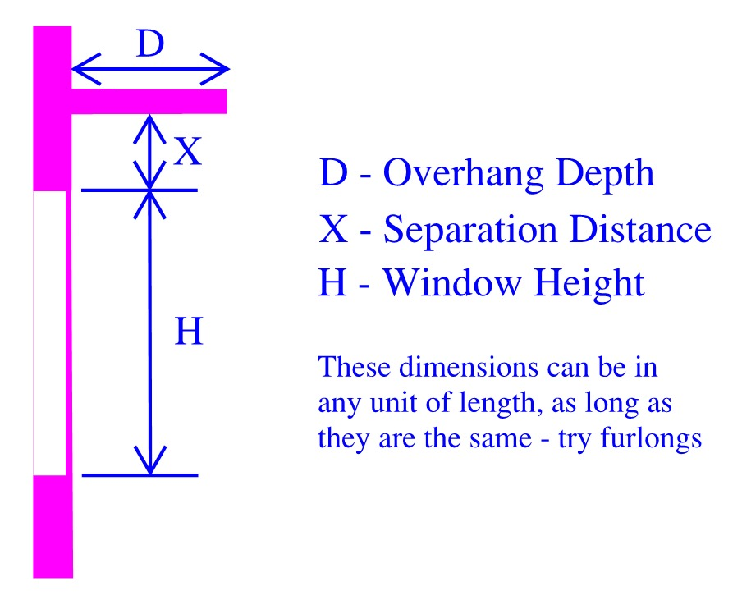
Overhang Terminology
Marc Rosenbaum, PE – Energysmiths – West Tisbury, MA
Notes:
REQUIRED. This should come after the Welcome/Best Practices and Copyright slides.

Slide 24
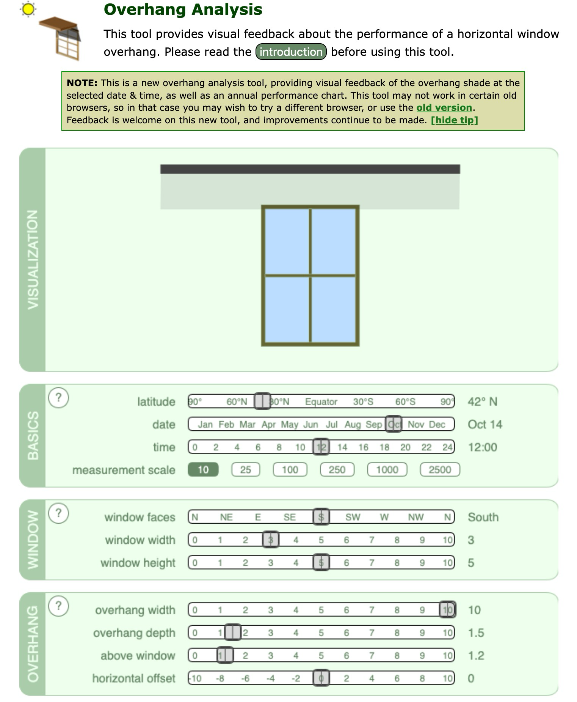
susdesign.com Overhang Analysis
https://www.susdesign.com/overhang/index.php
Marc Rosenbaum, PE – Energysmiths – West Tisbury, MA
Notes:
REQUIRED. This should come after the Welcome/Best Practices and Copyright slides.

Slide 25
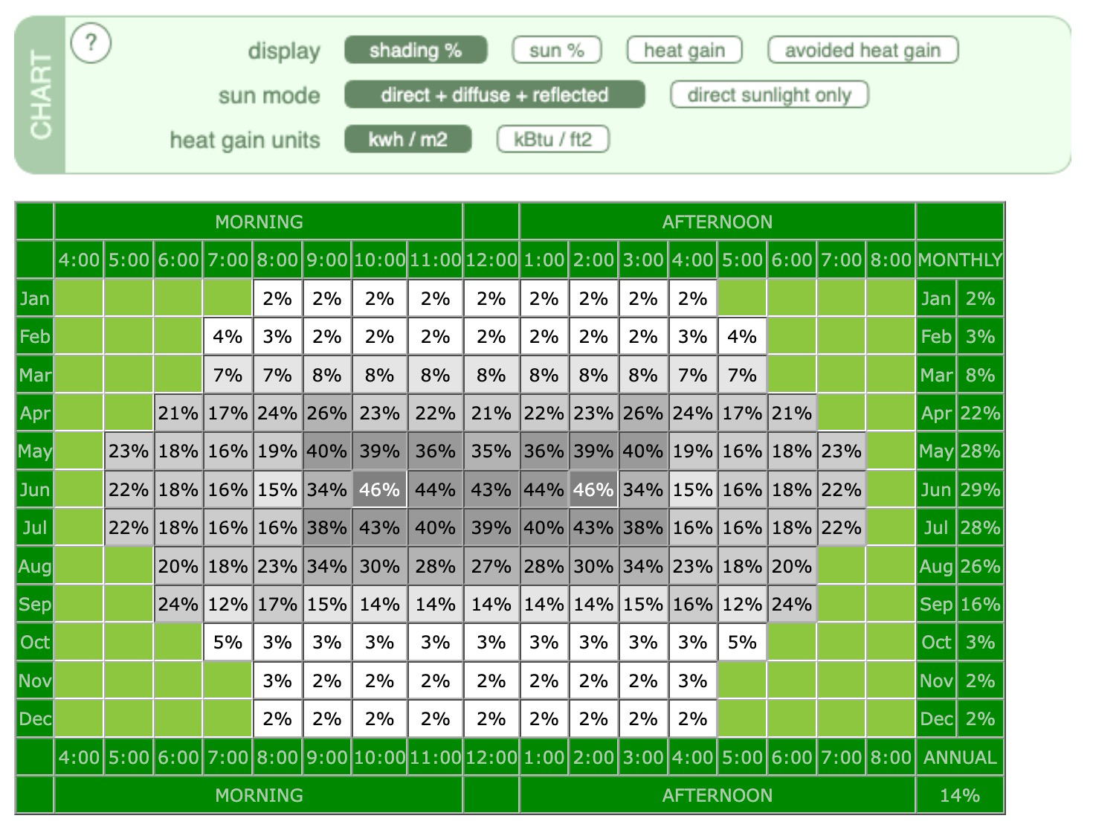
susdesign.com Overhang Analysis
Marc Rosenbaum, PE – Energysmiths – West Tisbury, MA
Notes:
REQUIRED. This should come after the Welcome/Best Practices and Copyright slides.

Slide 26
Solar Pool Heating
Pool collectors are typically unglazed low temperature plastic absorbers
In the Northeast, collector aperture is 50-100% of the pool surface
The most important conservation measure is a pool cover to suppress evaporation
My opinion is that solar electric panels combined with a heat pump pool heater (HPPH) is a better investment because:
  Excess energy can be exported
  HPPHs use much less energy than propane pool heaters
Marc Rosenbaum, PE – Energysmiths – West Tisbury, MA
Notes:
REQUIRED. This should come after the Welcome/Best Practices and Copyright slides.

Slide 27
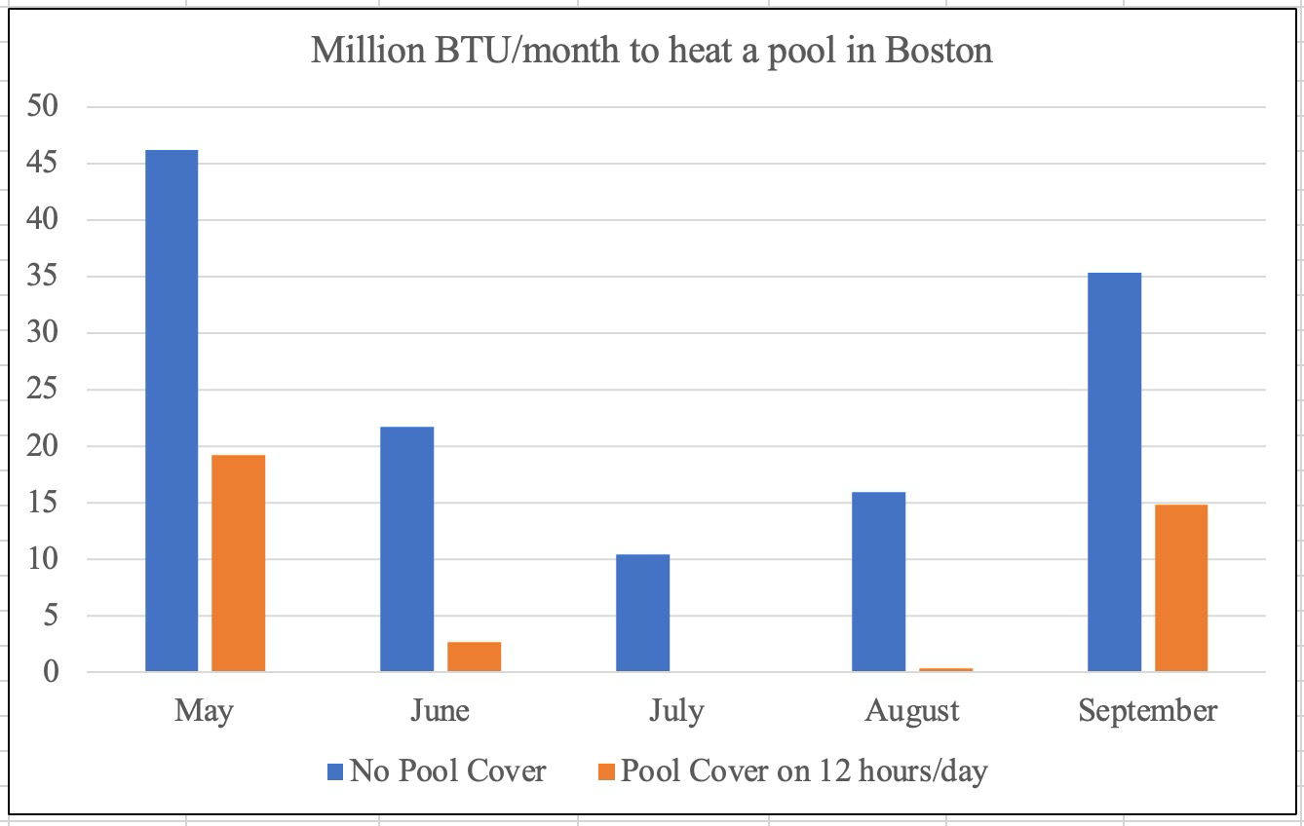
Solar Pool Heating
Initial heating is 6.5 Million BTU
Marc Rosenbaum, PE – Energysmiths – West Tisbury, MA
Notes:
REQUIRED. This should come after the Welcome/Best Practices and Copyright slides.

Slide 28
Daylighting
Daylighting is the controlled admission of natural light from the sun and the sky to provide building occupants with the lighting needed to perform desired tasks.
Daylighting may save energy
Daylighting has multiple beneficial effects on human health
Masterfully done, daylighting can inspire and uplift.
Initial heating is 6.5 Million BTU
Marc Rosenbaum, PE – Energysmiths – West Tisbury, MA
Notes:
REQUIRED. This should come after the Welcome/Best Practices and Copyright slides.

Slide 29
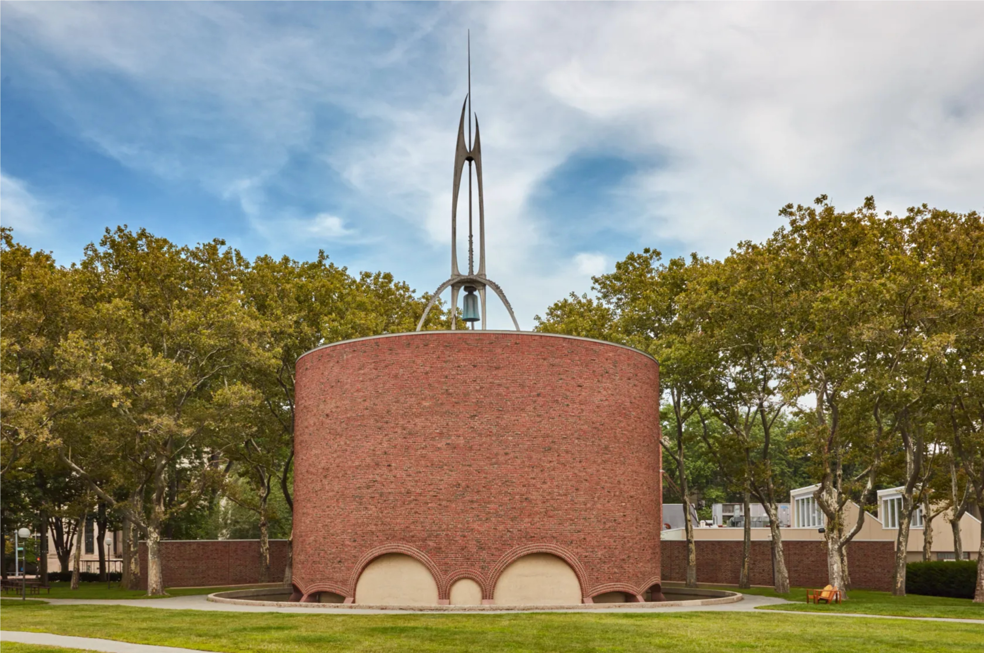
MIT Chapel Eero Saarinen 1954
Initial heating is 6.5 Million BTU
Marc Rosenbaum, PE – Energysmiths – West Tisbury, MA
Notes:
REQUIRED. This should come after the Welcome/Best Practices and Copyright slides.

Slide 30
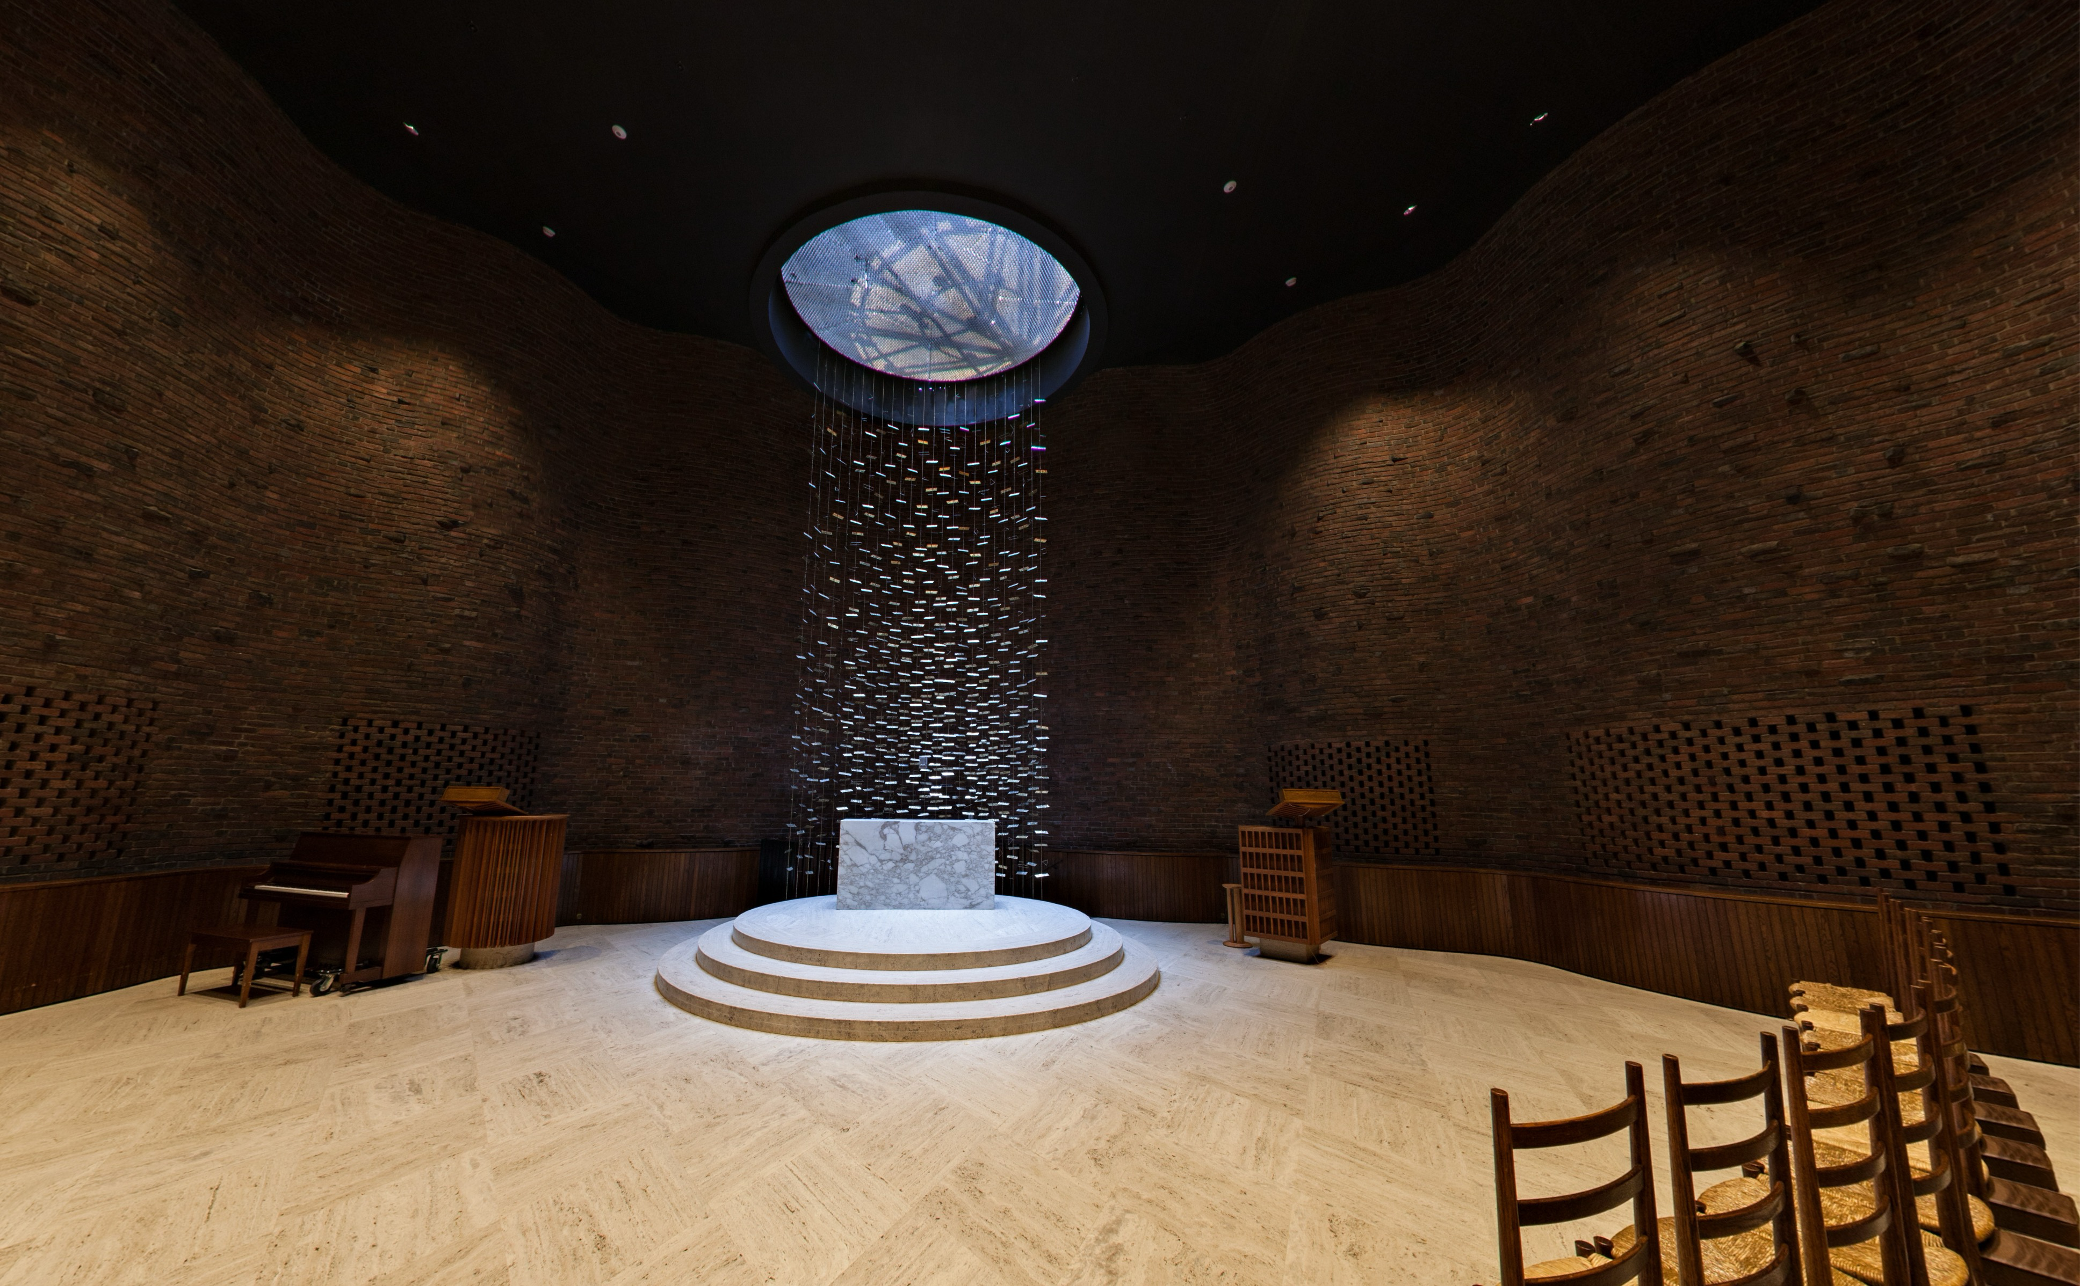
MIT Chapel Interior
Initial heating is 6.5 Million BTU
Marc Rosenbaum, PE – Energysmiths – West Tisbury, MA
Notes:
REQUIRED. This should come after the Welcome/Best Practices and Copyright slides.

Slide 31
Saving Energy with Daylighting
To save energy, electric lighting needs to be controlled and turned down or off as daylighting provides light
Today’s tech allows electric lights to be continuously dimmed (vs step control) and it can be done by individual fixture
Proper analysis of savings from daylighting must include energy used for heating and cooling
Initial heating is 6.5 Million BTU
Marc Rosenbaum, PE – Energysmiths – West Tisbury, MA
Notes:
REQUIRED. This should come after the Welcome/Best Practices and Copyright slides.

Slide 32
Lighting Efficiency
Efficiency is units of light output per unit of energy input – it is measured in lumen/watt (lpw)
One footcandle is one lumen/ft2
What has changed over my working life is the efficiency of electric lighting – LEDs are available with lpw ratings of over 100
LEDs can provide light with less cooling load than sunlight!
So – daylighting is optimally done with the amount of glazing needed for other purposes
Initial heating is 6.5 Million BTU
Marc Rosenbaum, PE – Energysmiths – West Tisbury, MA
Notes:
REQUIRED. This should come after the Welcome/Best Practices and Copyright slides.

Slide 33
Lighting and Perception
Good lighting facilitates our attention on that which within our field of vision is important –
* to perform our intended tasks
* to satisfy our innate biological needs
- orientation in space and time
- safety and security
We are confronted with innumerable stimuli and what we see informs our perception. Perception involves the brain processing what is seen and determining what is important vs. what is noise
Initial heating is 6.5 Million BTU
“Perception thus differs from sensation by the consciousness of farther facts associated with the object of the sensation”
William James
Marc Rosenbaum, PE – Energysmiths – West Tisbury, MA
Notes:
REQUIRED. This should come after the Welcome/Best Practices and Copyright slides.

Slide 34
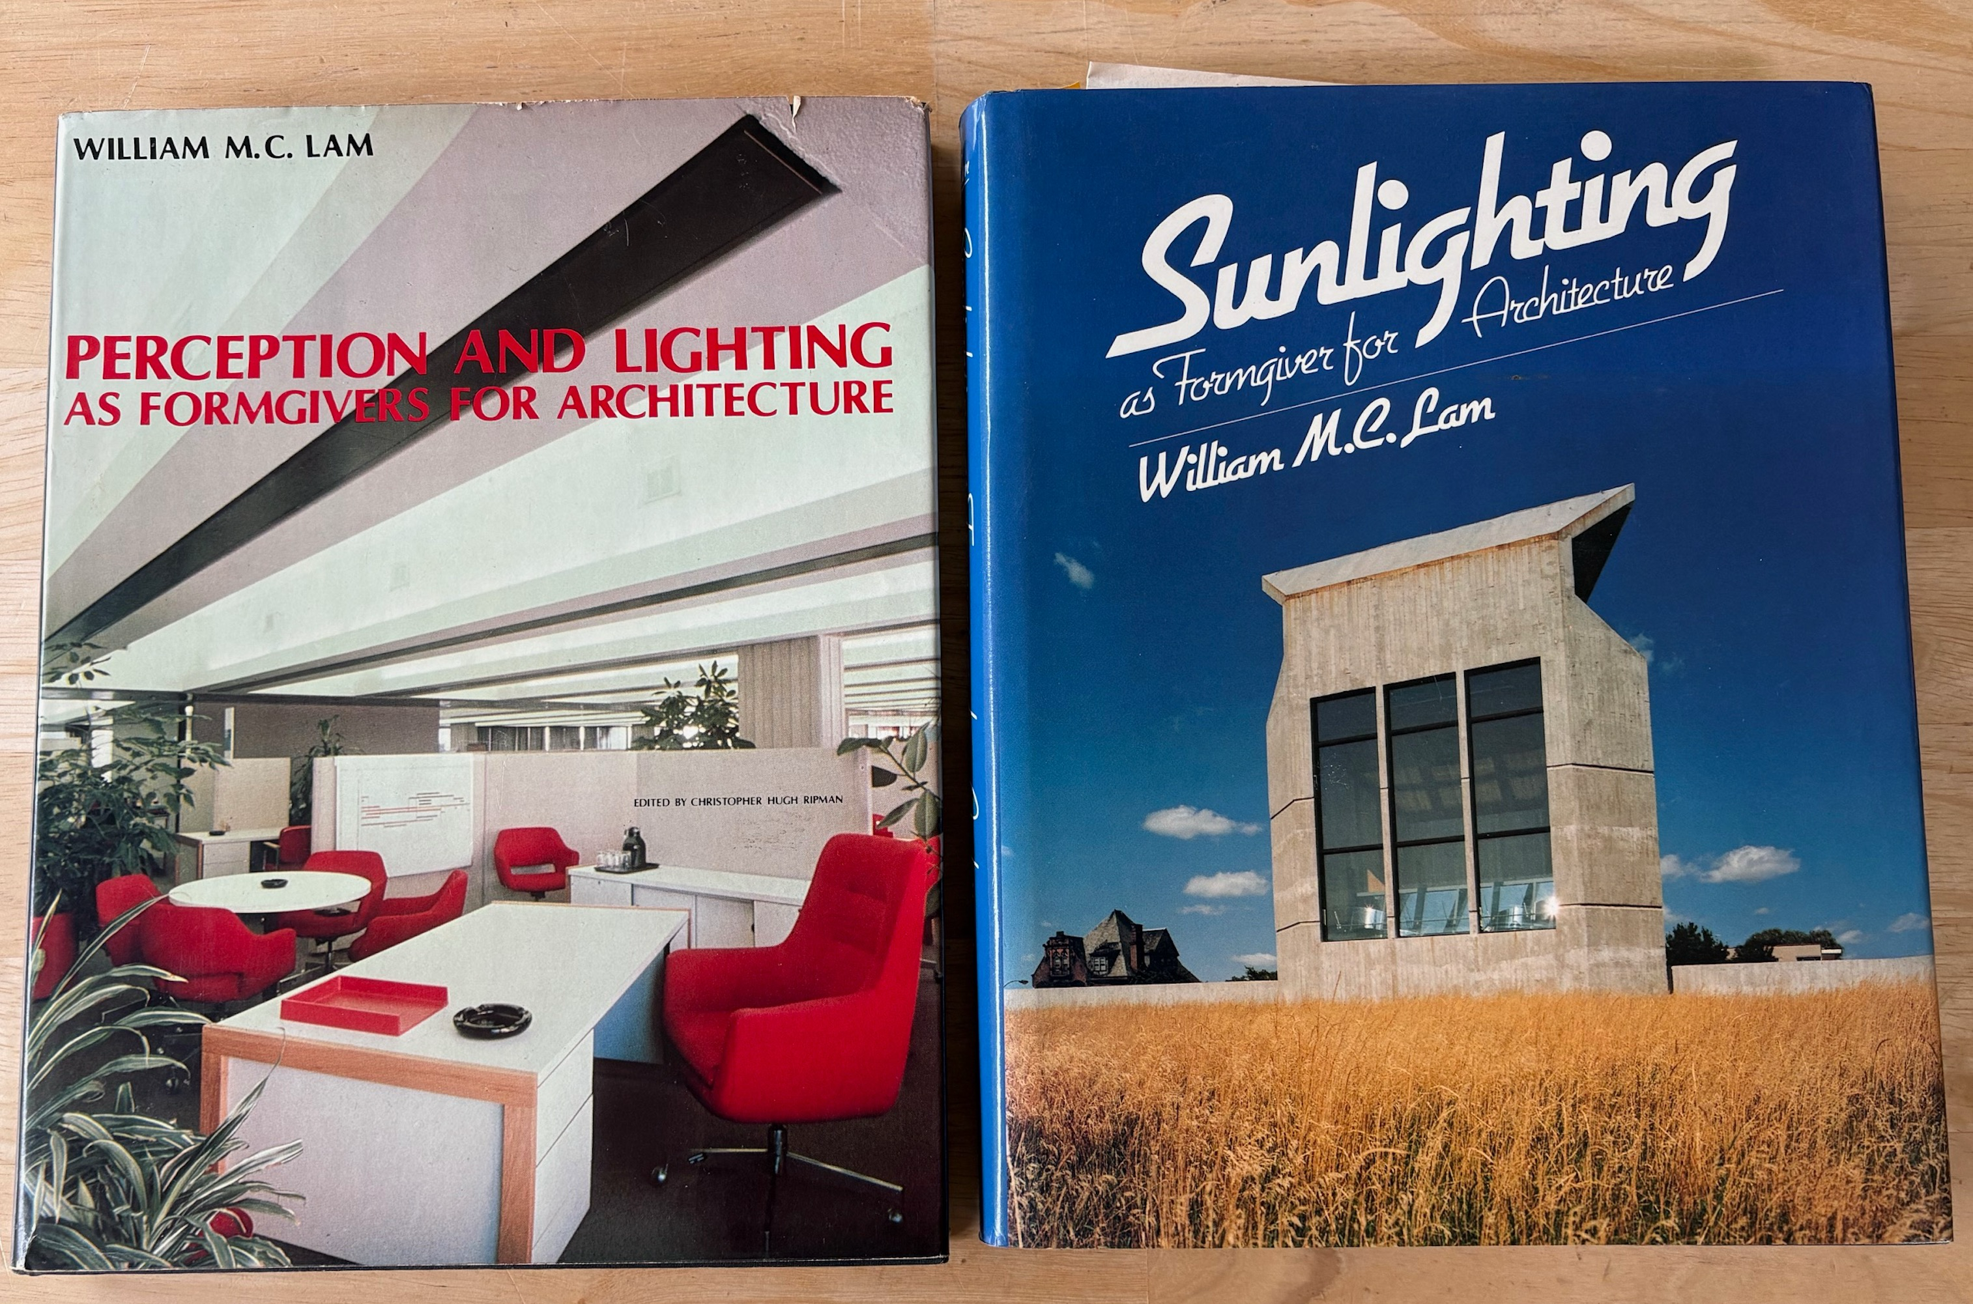
Perception and Lighting
Initial heating is 6.5 Million BTU
Marc Rosenbaum, PE – Energysmiths – West Tisbury, MA
Notes:
REQUIRED. This should come after the Welcome/Best Practices and Copyright slides.

Slide 35
Basic Daylighting Principles
Avoid glare
Provide light from more than one direction
Avoid beam sunlight on the work plane
Minimize contrast between objects
Use light, reflective surfaces to bounce light into the space
Provide views to outdoors
Give occupants control over daylighting sources
Initial heating is 6.5 Million BTU
Marc Rosenbaum, PE – Energysmiths – West Tisbury, MA
Notes:
REQUIRED. This should come after the Welcome/Best Practices and Copyright slides.

Slide 36
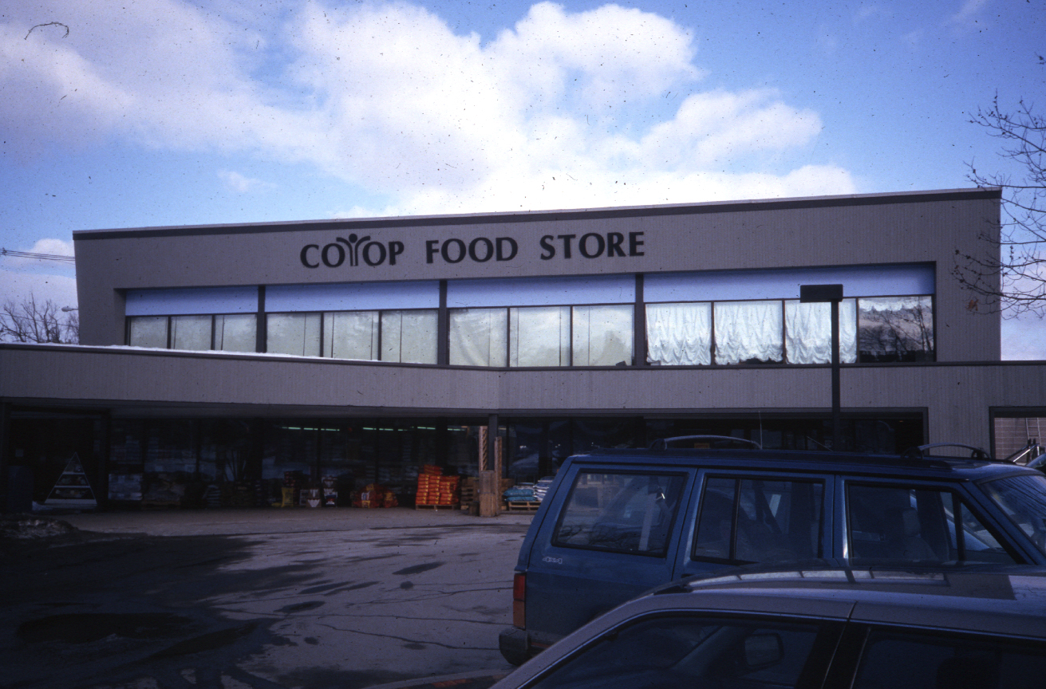
Glare (Not Daylighting)
Initial heating is 6.5 Million BTU
Marc Rosenbaum, PE – Energysmiths – West Tisbury, MA
Notes:
REQUIRED. This should come after the Welcome/Best Practices and Copyright slides.

Slide 37
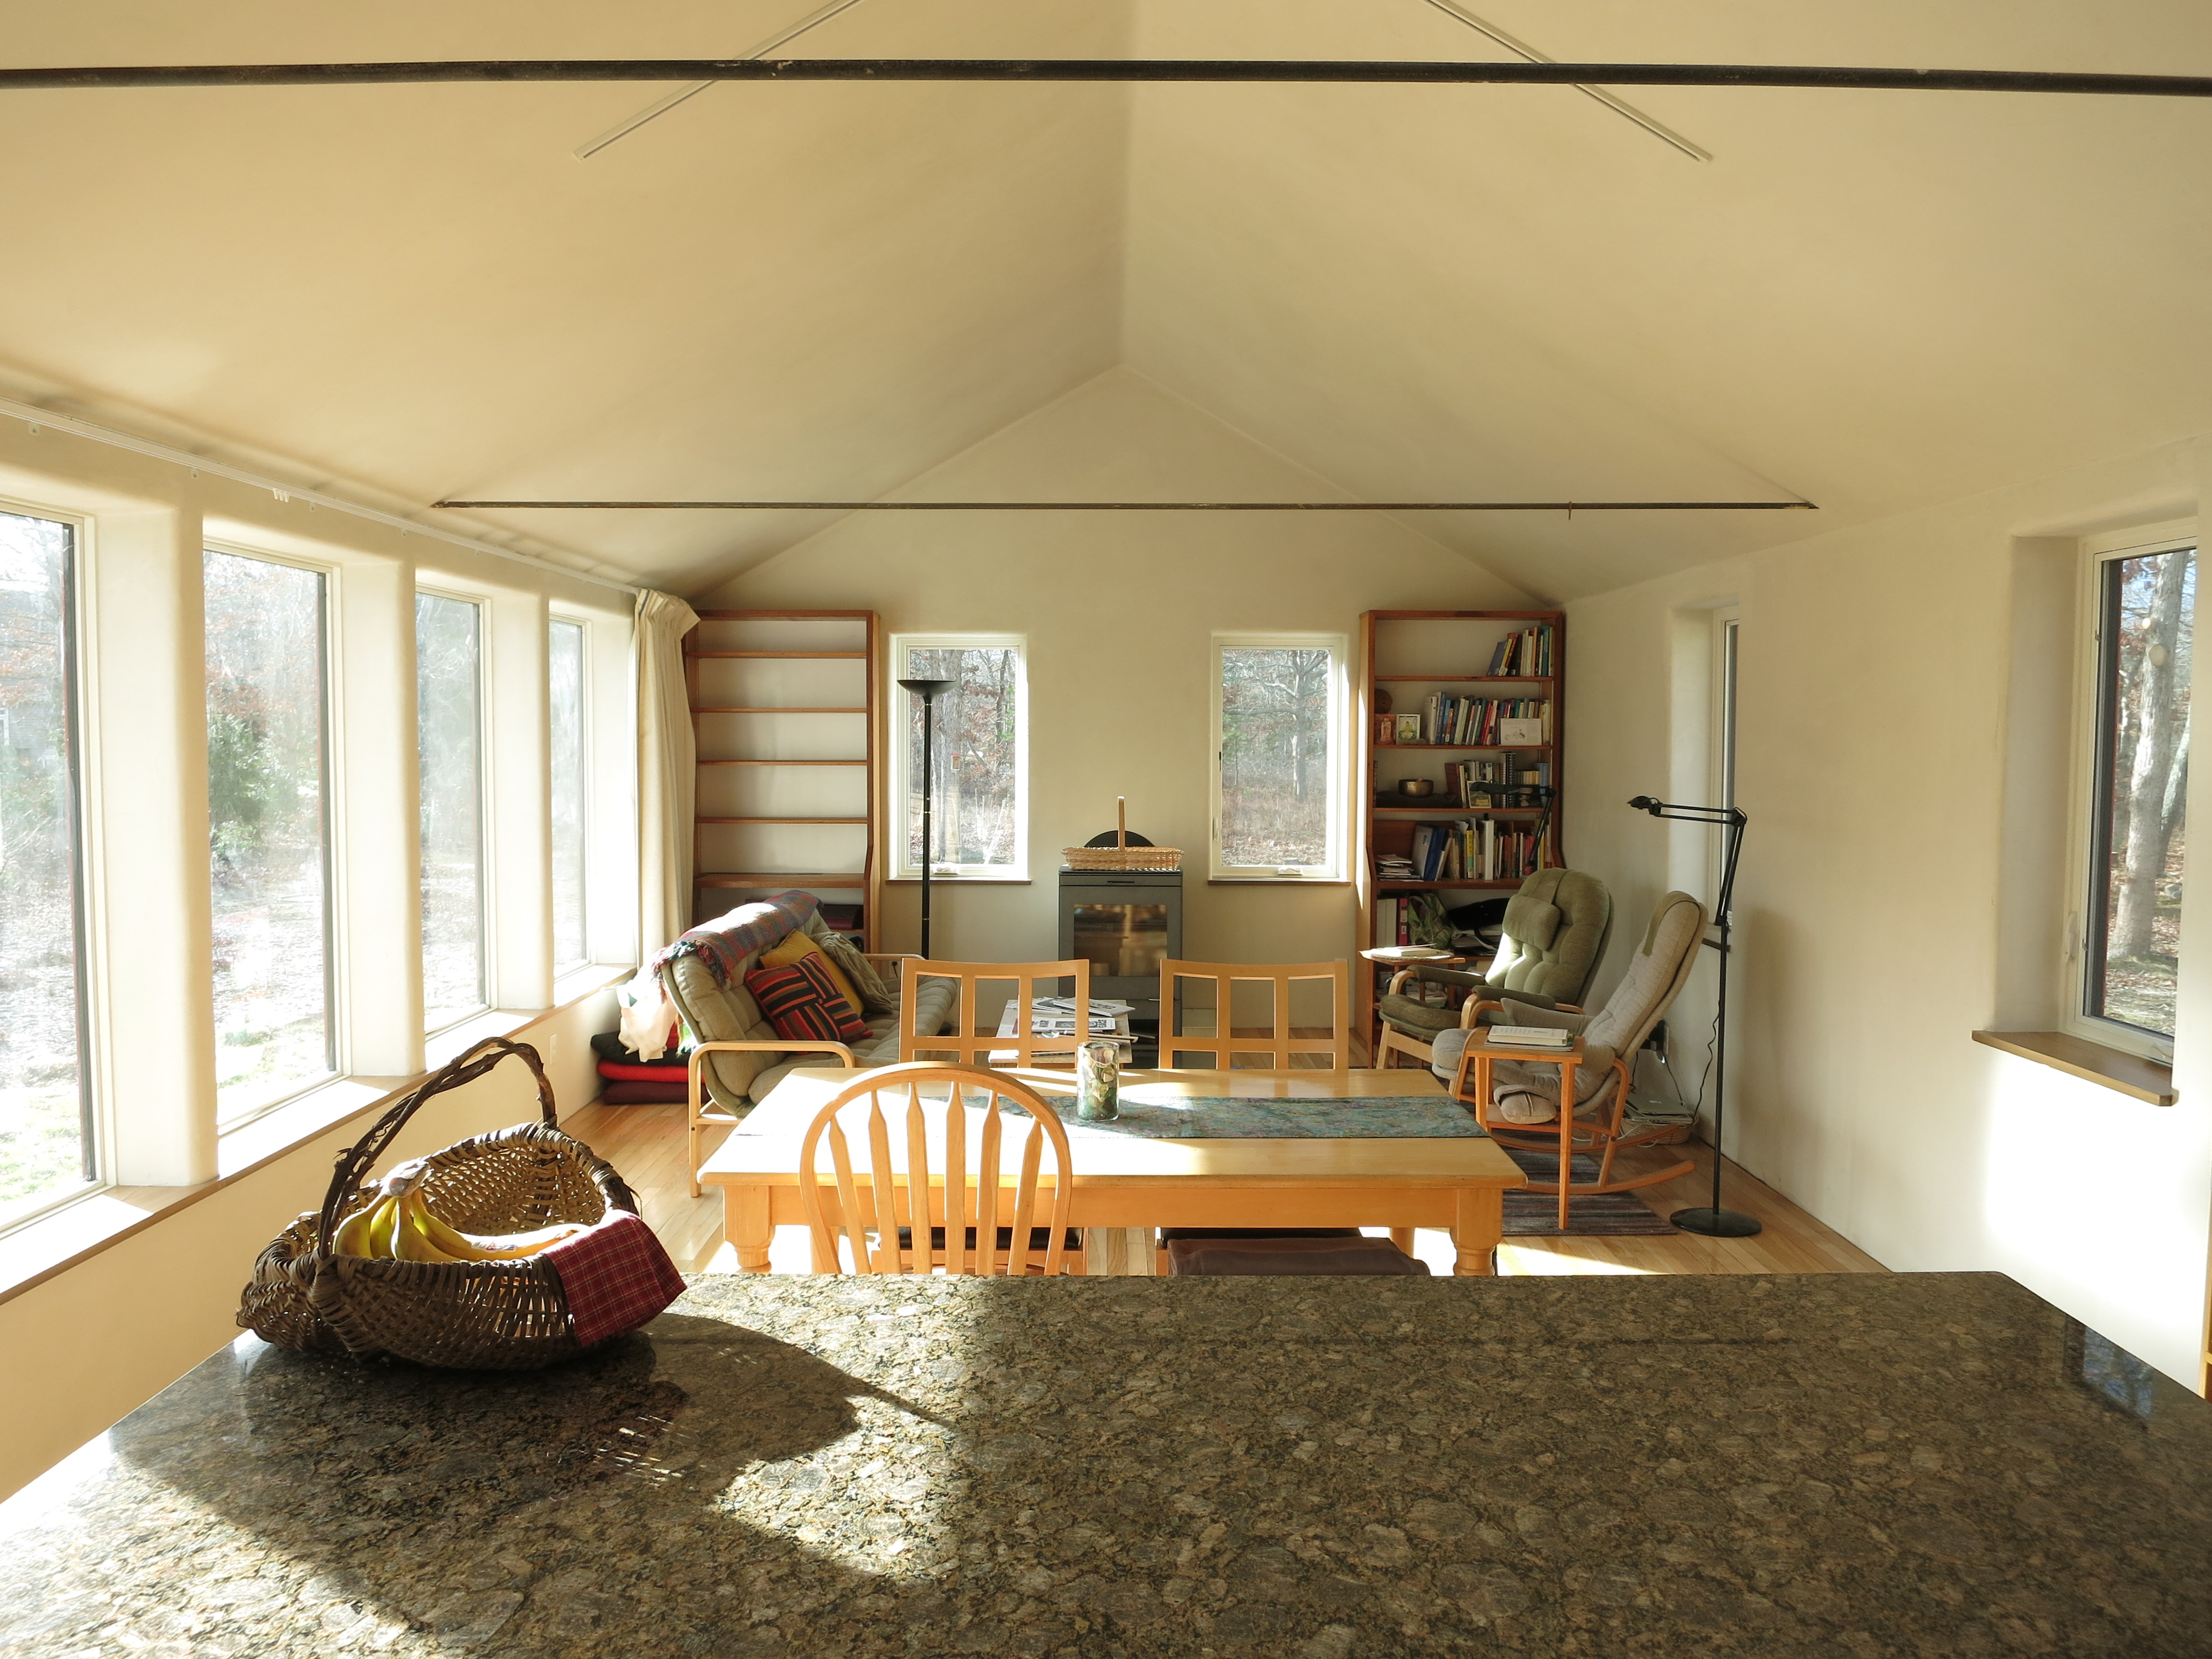
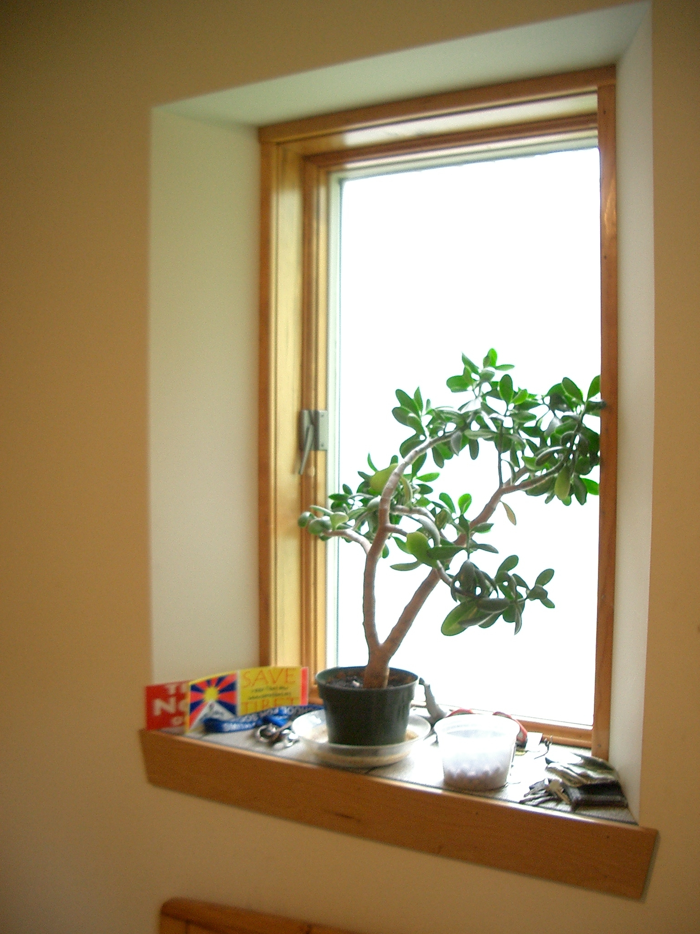
Reducing Contrast
Initial heating is 6.5 Million BTU
White surfaces adjacent to glazing
Marc Rosenbaum, PE – Energysmiths – West Tisbury, MA
Notes:
REQUIRED. This should come after the Welcome/Best Practices and Copyright slides.

Slide 38
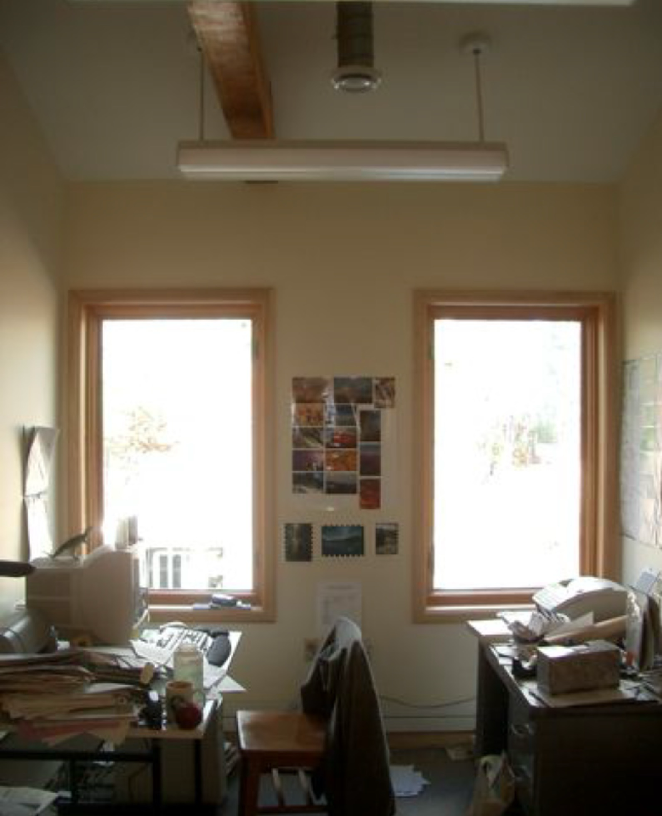
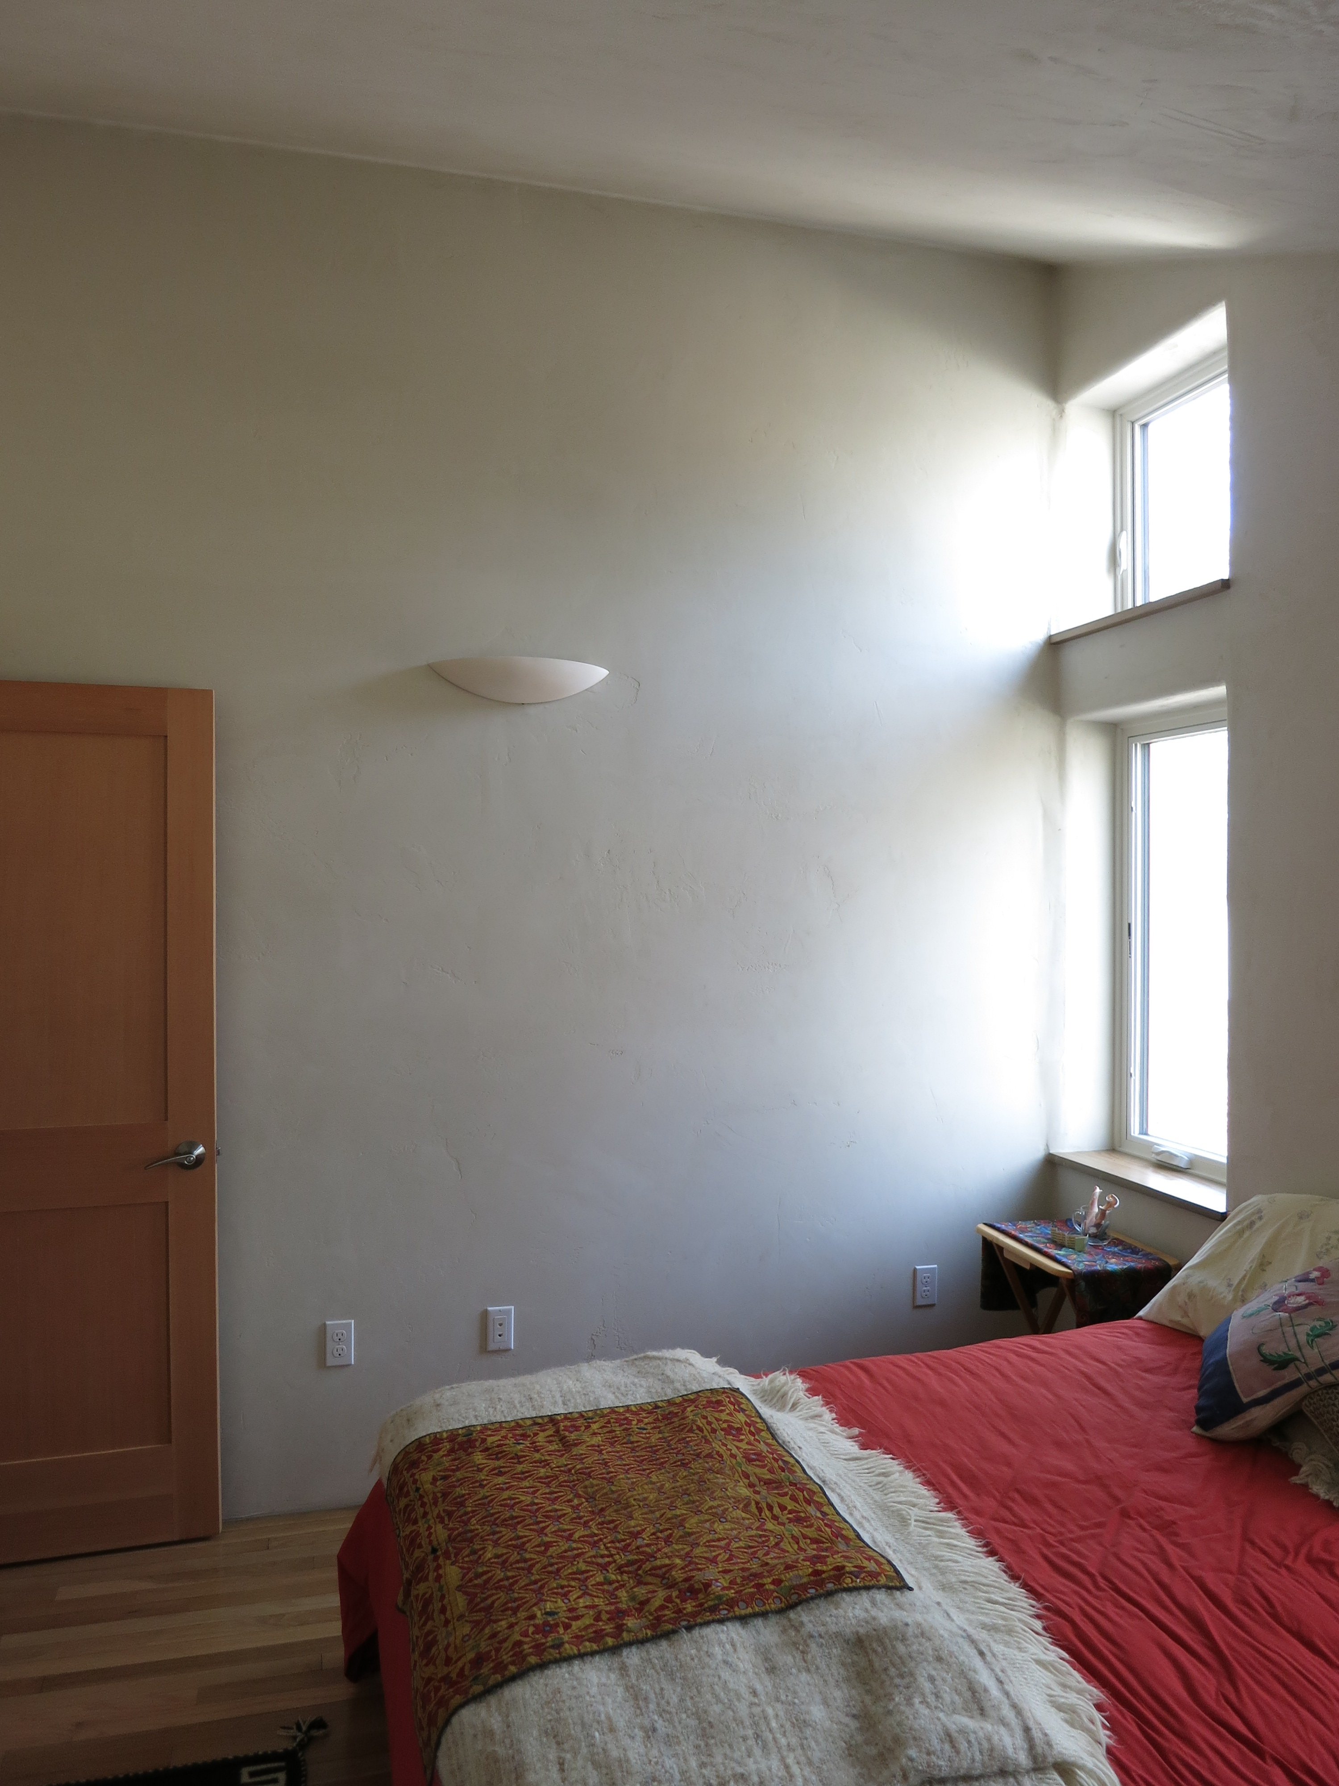
Reflective Surfaces
Initial heating is 6.5 Million BTU
Marc Rosenbaum, PE – Energysmiths – West Tisbury, MA
Notes:
REQUIRED. This should come after the Welcome/Best Practices and Copyright slides.

Slide 39
Daylighting and Climate
Different climates – heating vs. cooling dominated; sunny vs. overcast – engender different daylighting strategies
Sunny, hot climates exclude direct sun
Cool, cloudy climates rely on the whole sky dome rather than direct sunlight
Northern European architects specialized in daylighting in overcast conditons – Alvar Aalto, Eero Saarinen
William Lam pioneered the integration of daylighting in both overcast and sunny conditions
Initial heating is 6.5 Million BTU
Marc Rosenbaum, PE – Energysmiths – West Tisbury, MA
Notes:
REQUIRED. This should come after the Welcome/Best Practices and Copyright slides.

Slide 40
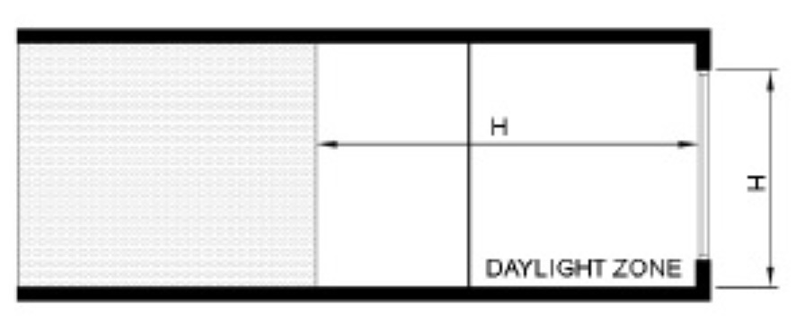
Sidelighting
Sidelighting (windows) is strongly dependent on orientation – north and south are optimal
Windows need control of direct sun while maintaining access to the overcast sky
Sidelighting typically can provide daylight penetration into the space roughly 1-1/2 times the glazing head height
Initial heating is 6.5 Million BTU
Marc Rosenbaum, PE – Energysmiths – West Tisbury, MA
Notes:
REQUIRED. This should come after the Welcome/Best Practices and Copyright slides.

Slide 41
Sidelighting Control
Control of sunlight can be fixed or operable, internal or external
Operability can be manual or automated
Fixed sun control elements optimally should not suppress lighting in overcast conditions in climates with significant overcast conditions
Initial heating is 6.5 Million BTU
Marc Rosenbaum, PE – Energysmiths – West Tisbury, MA
Notes:
REQUIRED. This should come after the Welcome/Best Practices and Copyright slides.

Slide 42
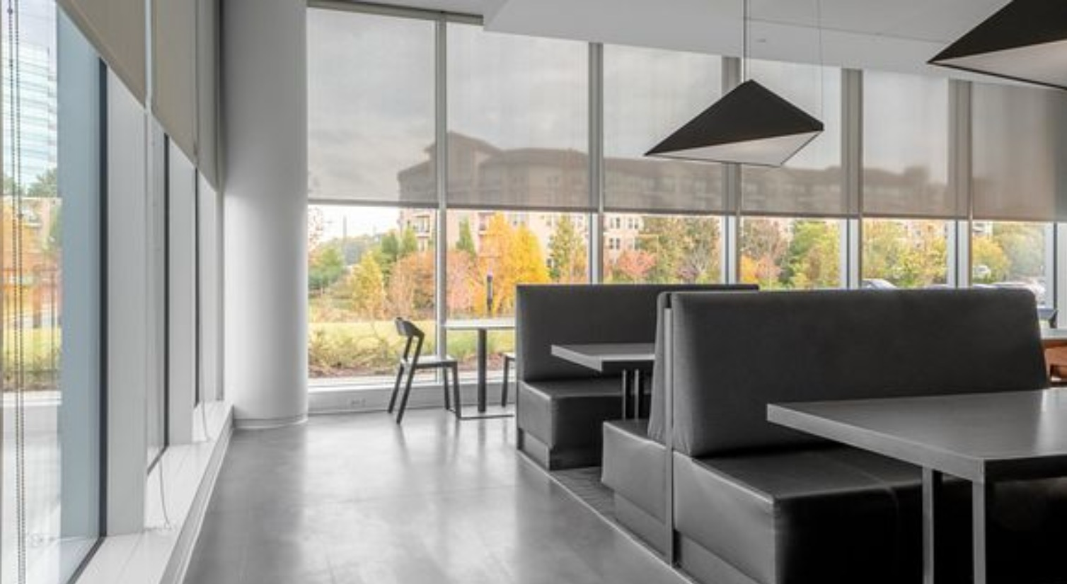
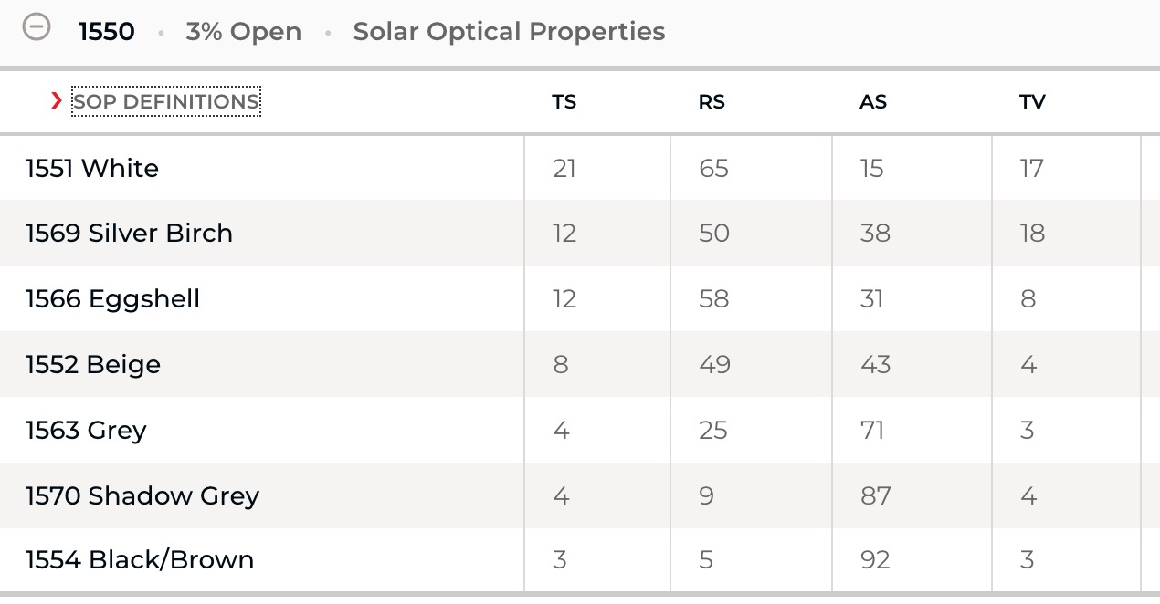
Perforated Shades
Initial heating is 6.5 Million BTU
TS – Total Solar Transmittance
RS – Solar Reflectance
AS – Solar Absorptance
TV – Visible Light Transmittance
Marc Rosenbaum, PE – Energysmiths – West Tisbury, MA
Notes:
REQUIRED. This should come after the Welcome/Best Practices and Copyright slides.

Slide 43
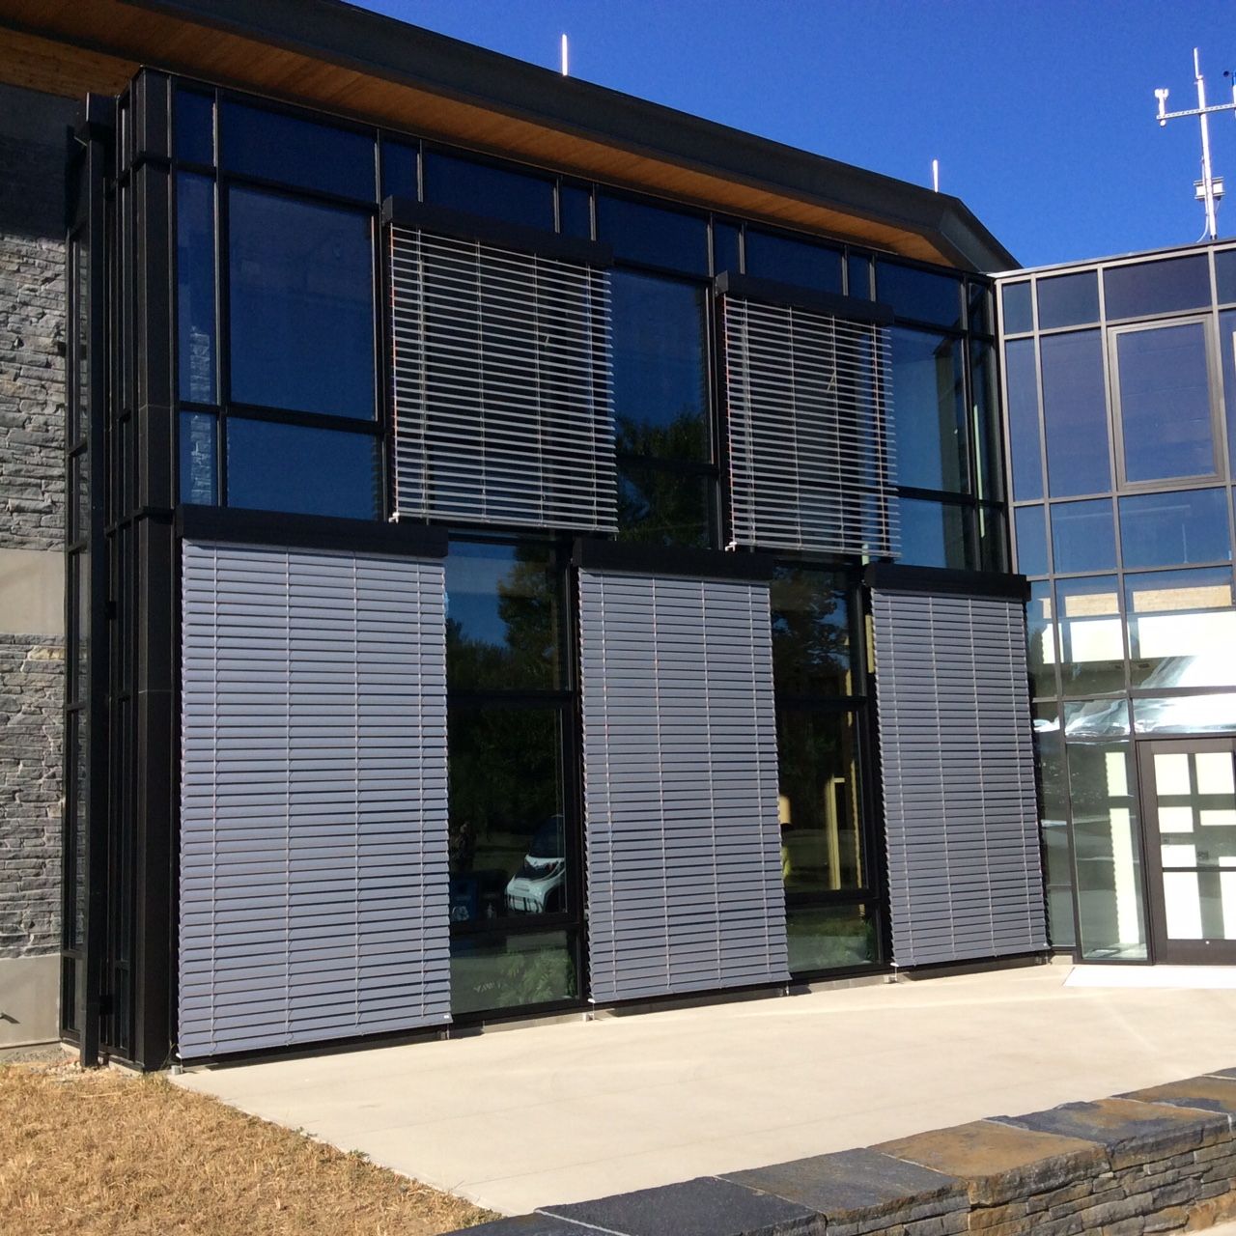
External Operable Blinds
To be effective, blinds need a width/spacing ratio of 2 or more
Exterior blinds are more effective at keeping sun out
Blinds can be reflective on top to re-direct sunlight to the interior ceiling
Initial heating is 6.5 Million BTU
Marc Rosenbaum, PE – Energysmiths – West Tisbury, MA
Notes:
REQUIRED. This should come after the Welcome/Best Practices and Copyright slides.

Slide 44
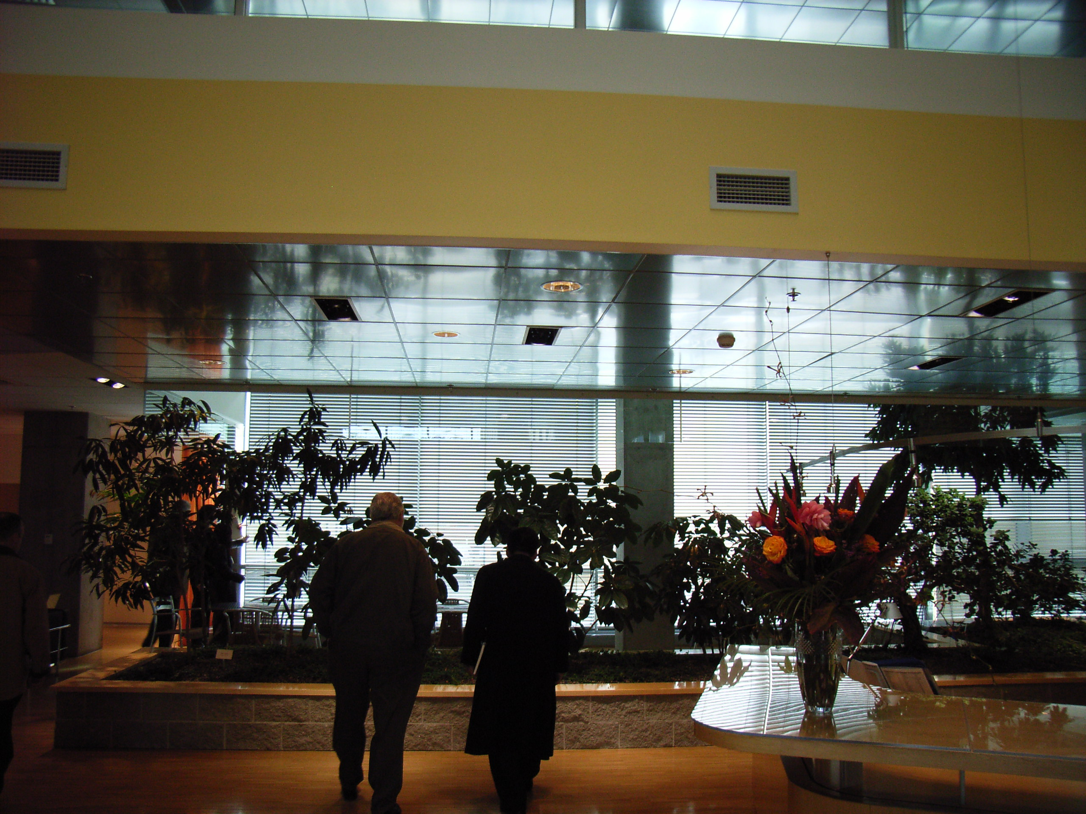
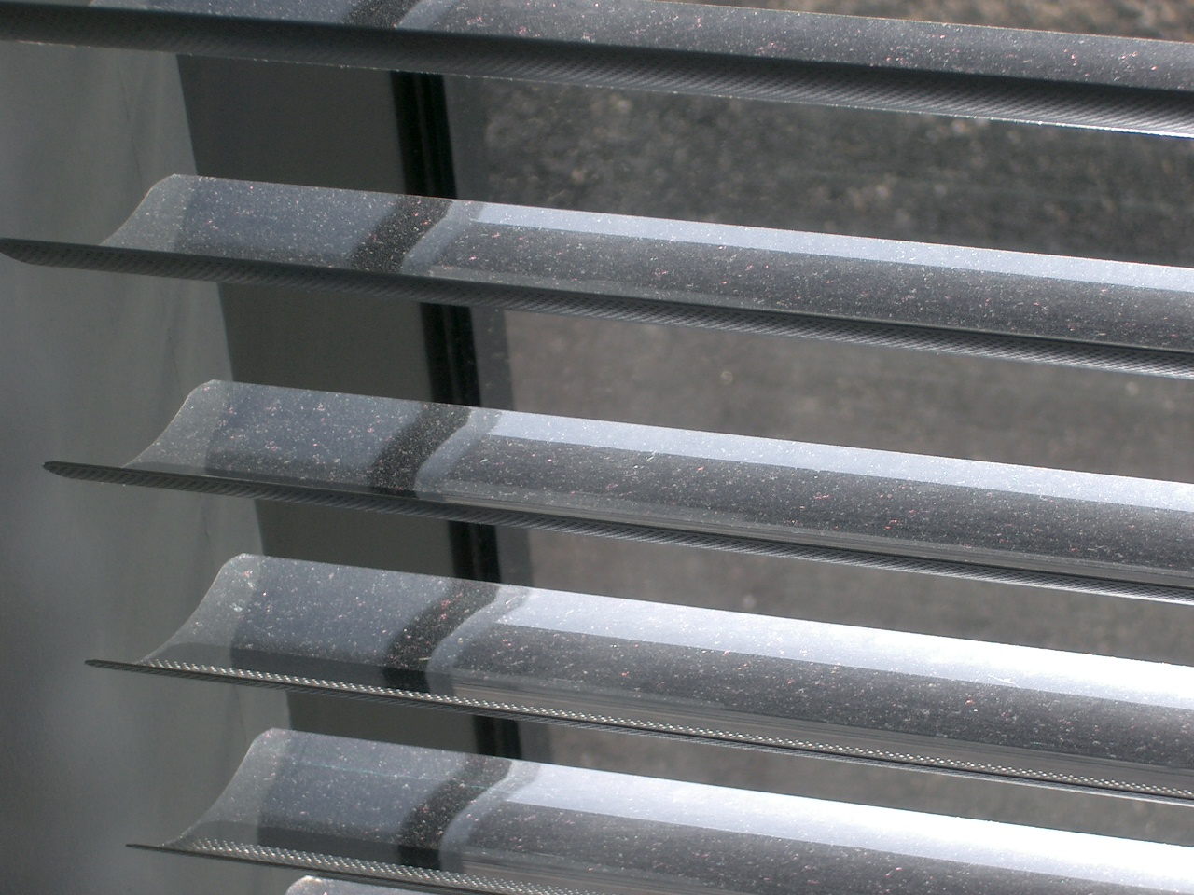
Internal Operable Reflective Blinds
People can see out, and direct sunlight is directed to the ceiling plane
Initial heating is 6.5 Million BTU
Marc Rosenbaum, PE – Energysmiths – West Tisbury, MA
Notes:
REQUIRED. This should come after the Welcome/Best Practices and Copyright slides.

Slide 45
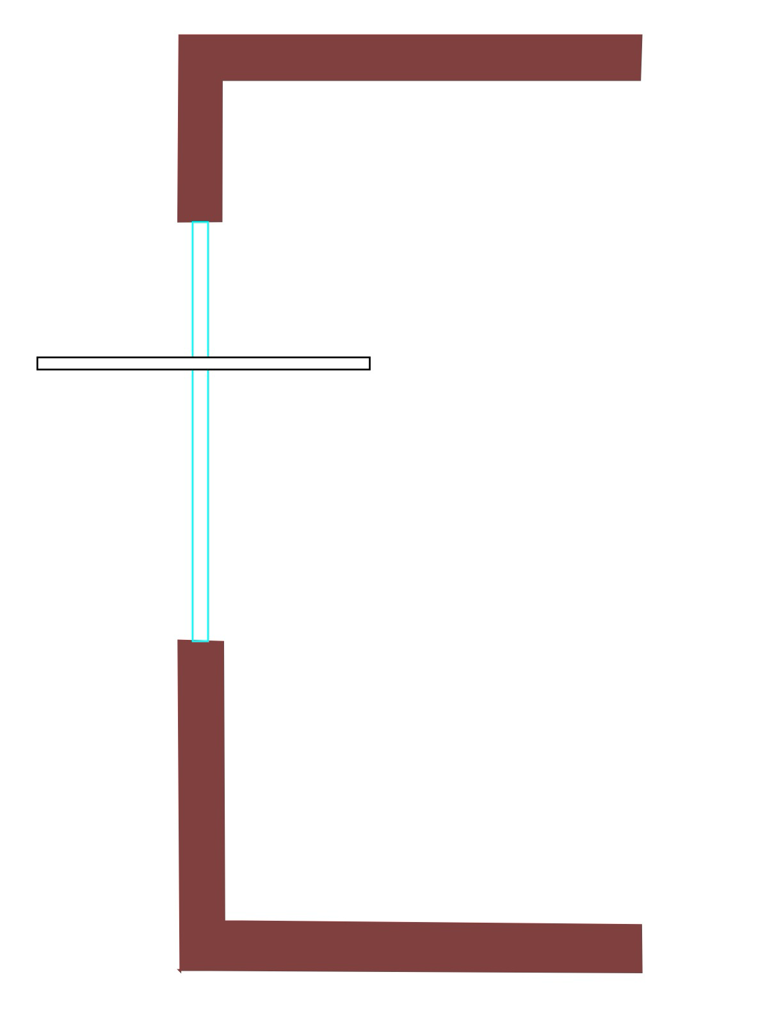

Light Shelves
External LS can bounce more direct beam into the room, and shade the lower window
But...it shades the lower window from diffuse light on overcast days
Internal LS
  Evens light levels front to back of the room
  On S facade, prevents direct beam on workplane or in occupants’ view
  Lowers total light admitted
Initial heating is 6.5 Million BTU
Internal
External
Marc Rosenbaum, PE – Energysmiths – West Tisbury, MA
Notes:
REQUIRED. This should come after the Welcome/Best Practices and Copyright slides.

Slide 46
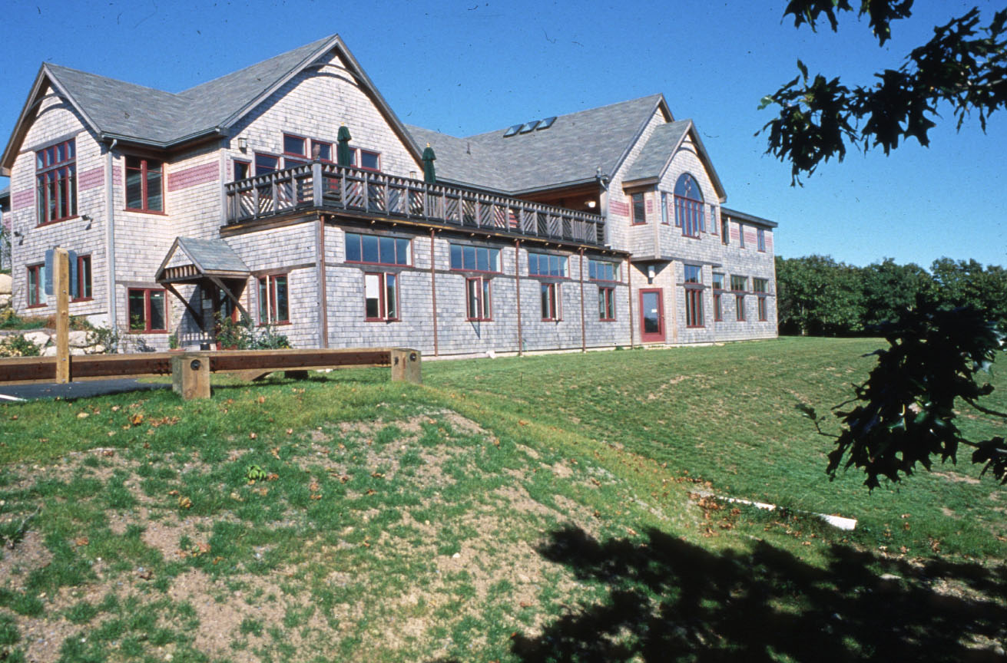
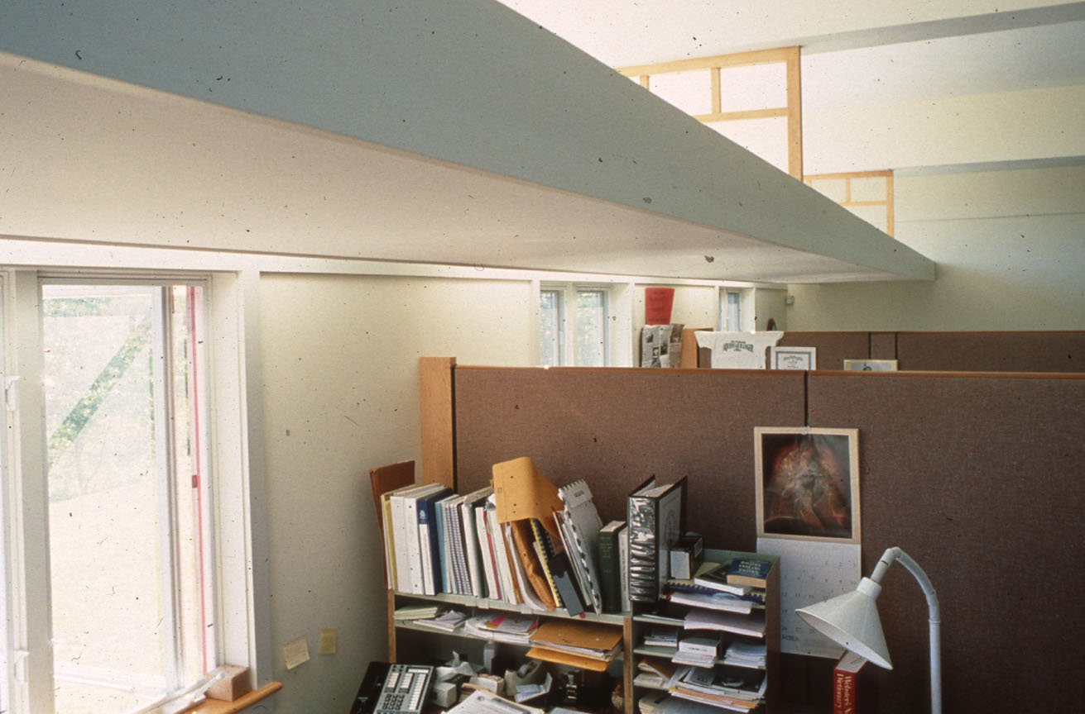
Glazing with Light Shelves
The upper glazing needs no shading devices
As the orientation shifts from south the length of the LS must increase
The glazing below the LS receives shades, manually controlled by the occupant
This approach allows daylight penetration even in direct sun
Initial heating is 6.5 Million BTU
Marc Rosenbaum, PE – Energysmiths – West Tisbury, MA
Notes:
REQUIRED. This should come after the Welcome/Best Practices and Copyright slides.

Slide 47
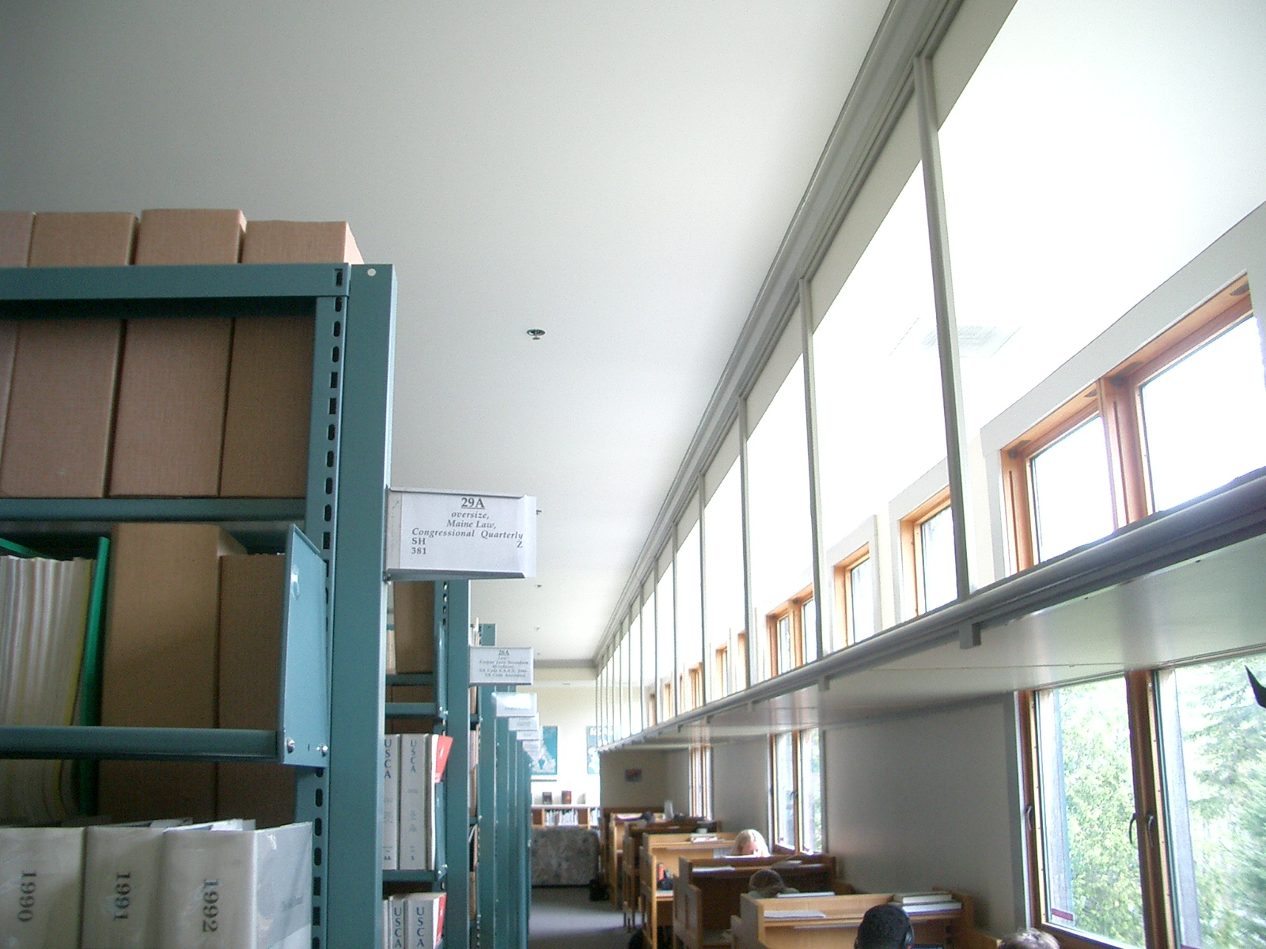
Glazing with Light Shelves
Initial heating is 6.5 Million BTU
Marc Rosenbaum, PE – Energysmiths – West Tisbury, MA
Notes:
REQUIRED. This should come after the Welcome/Best Practices and Copyright slides.

Slide 48
Toplighting
Toplighting can be skylights or south/north facing roof monitors
Skylights may bring in more cooling load but...
South-facing roof monitors may shift peak cooling load to the heating season, and need more glazing
Skylights are very effective in overcast conditions
In sunny conditions, skylights with clear glazing need to be placed to avoid direct beam sunlight on the work plane, but they can be used to provide some “sparkle” to spaces
Translucent glazing in direct sun is still extremely bright and can cause glare issues
Initial heating is 6.5 Million BTU
Marc Rosenbaum, PE – Energysmiths – West Tisbury, MA
Notes:
REQUIRED. This should come after the Welcome/Best Practices and Copyright slides.

Slide 49
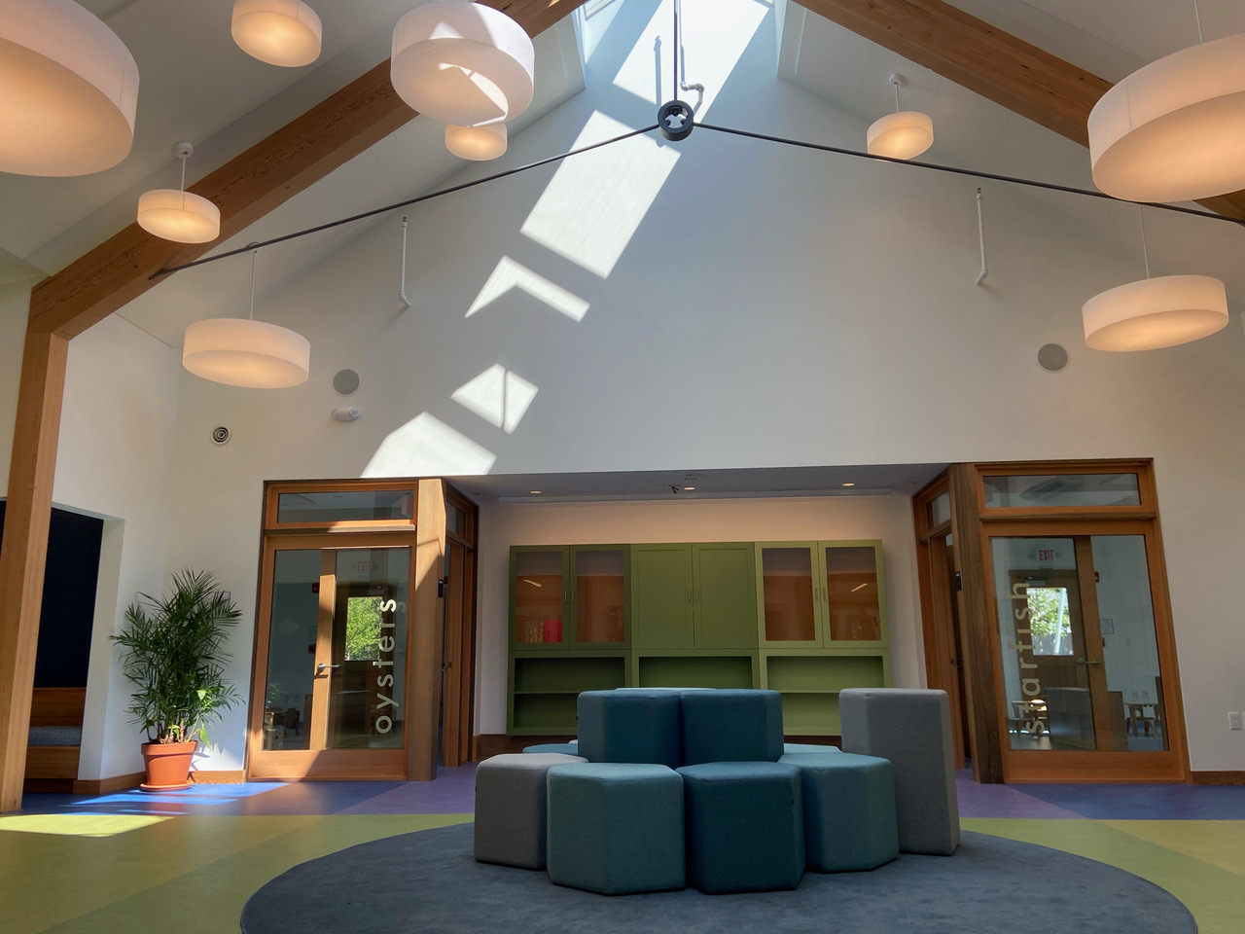
Toplighting
Excessively daylighting lobbies and circulation spaces will make spaces where people work seem darker so they will turn the lights on
Initial heating is 6.5 Million BTU
Sparkle is great in transient spaces
Marc Rosenbaum, PE – Energysmiths – West Tisbury, MA
Notes:
REQUIRED. This should come after the Welcome/Best Practices and Copyright slides.

Slide 50
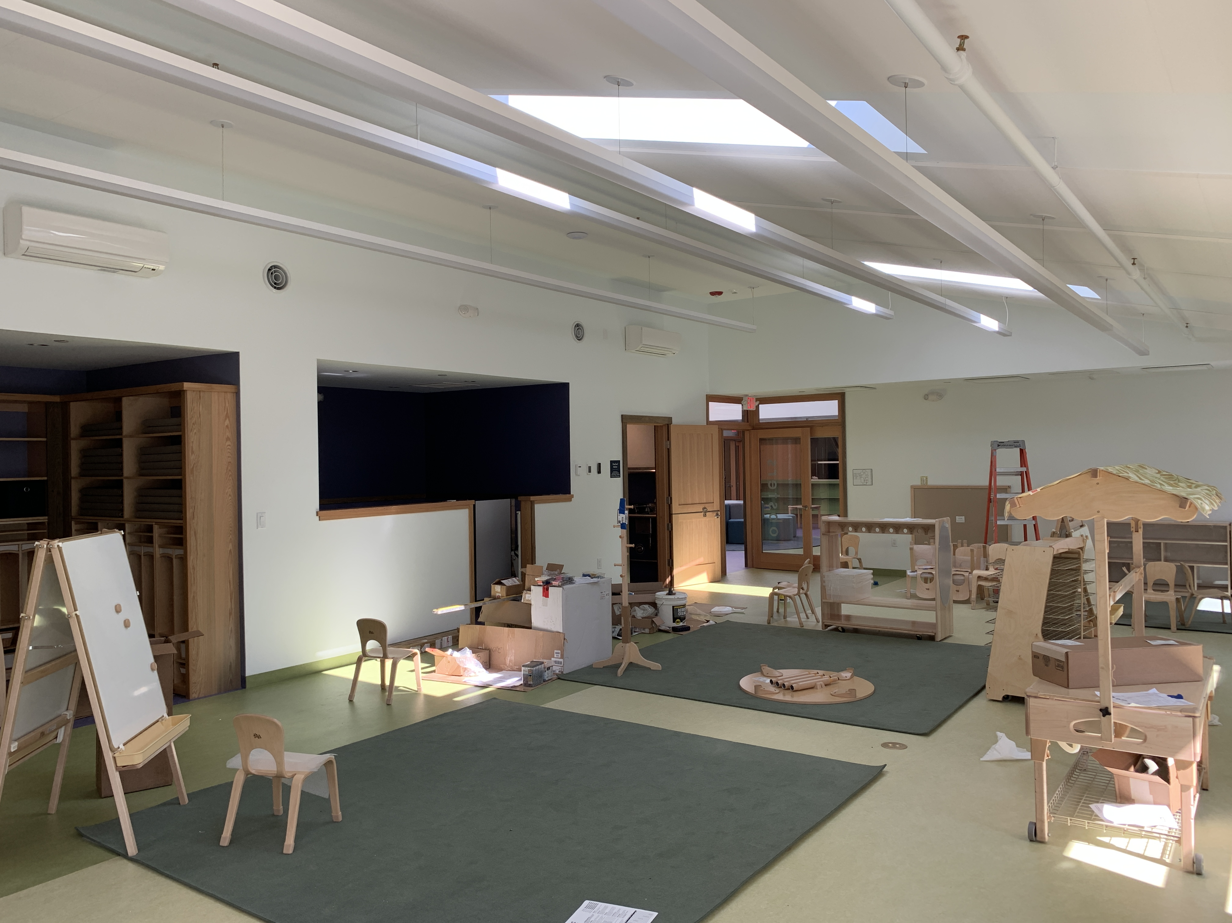
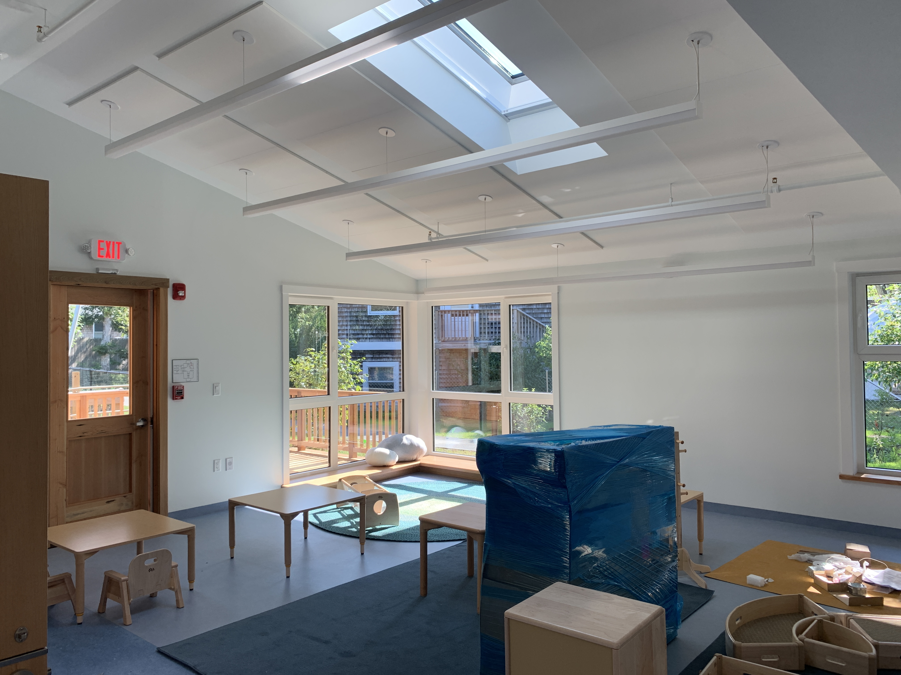
Toplighting
Initial heating is 6.5 Million BTU
Marc Rosenbaum, PE – Energysmiths – West Tisbury, MA
Notes:
REQUIRED. This should come after the Welcome/Best Practices and Copyright slides.

Slide 51
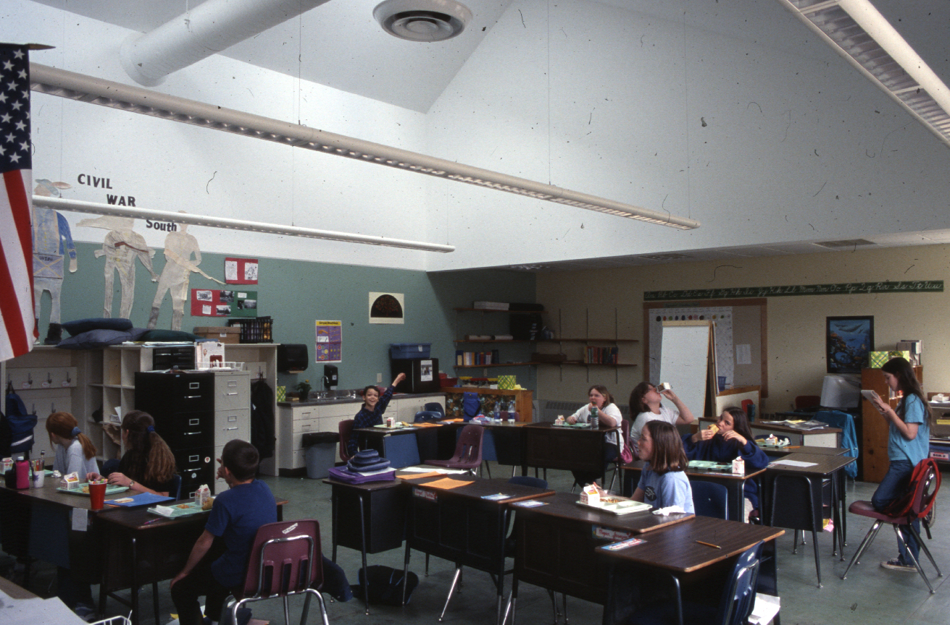
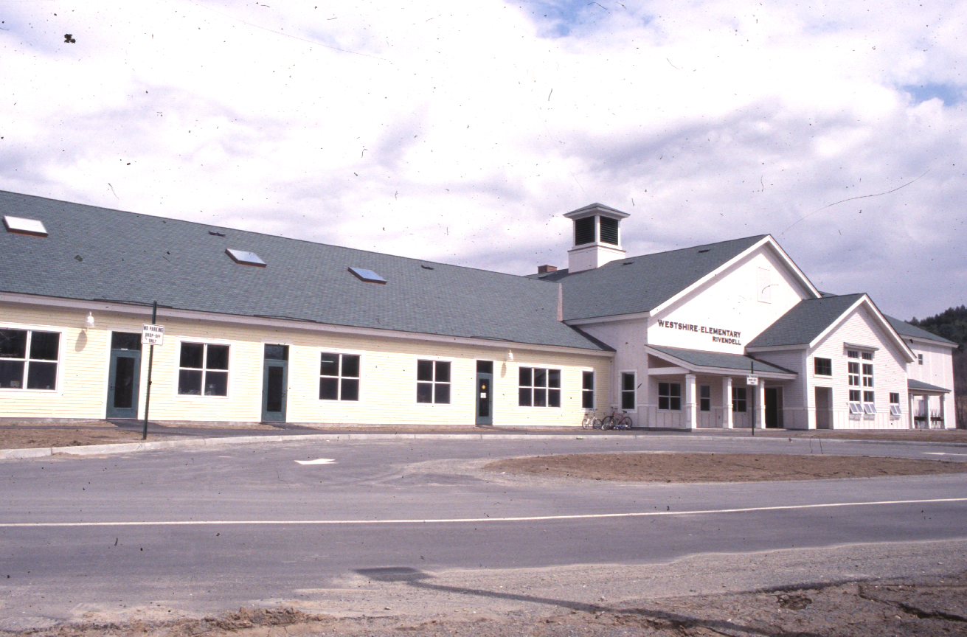
Skylighting
Initial heating is 6.5 Million BTU
Marc Rosenbaum, PE – Energysmiths – West Tisbury, MA
Notes:
REQUIRED. This should come after the Welcome/Best Practices and Copyright slides.

Slide 52
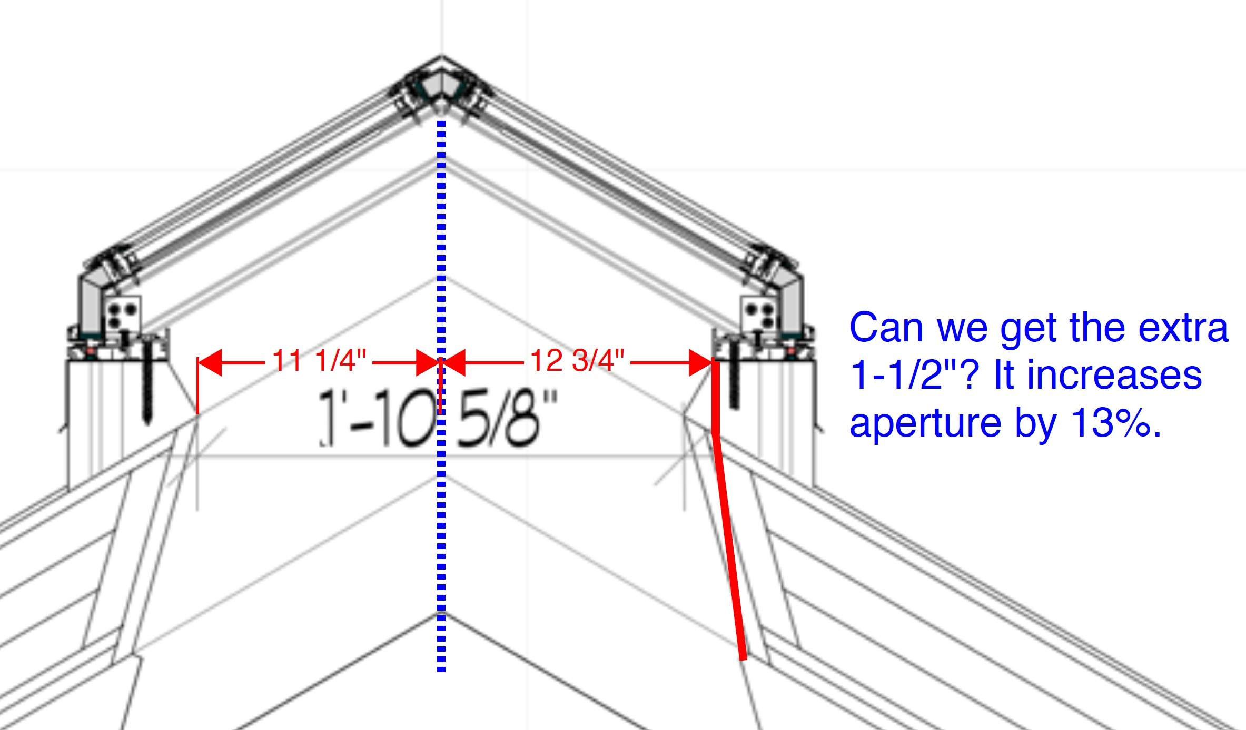
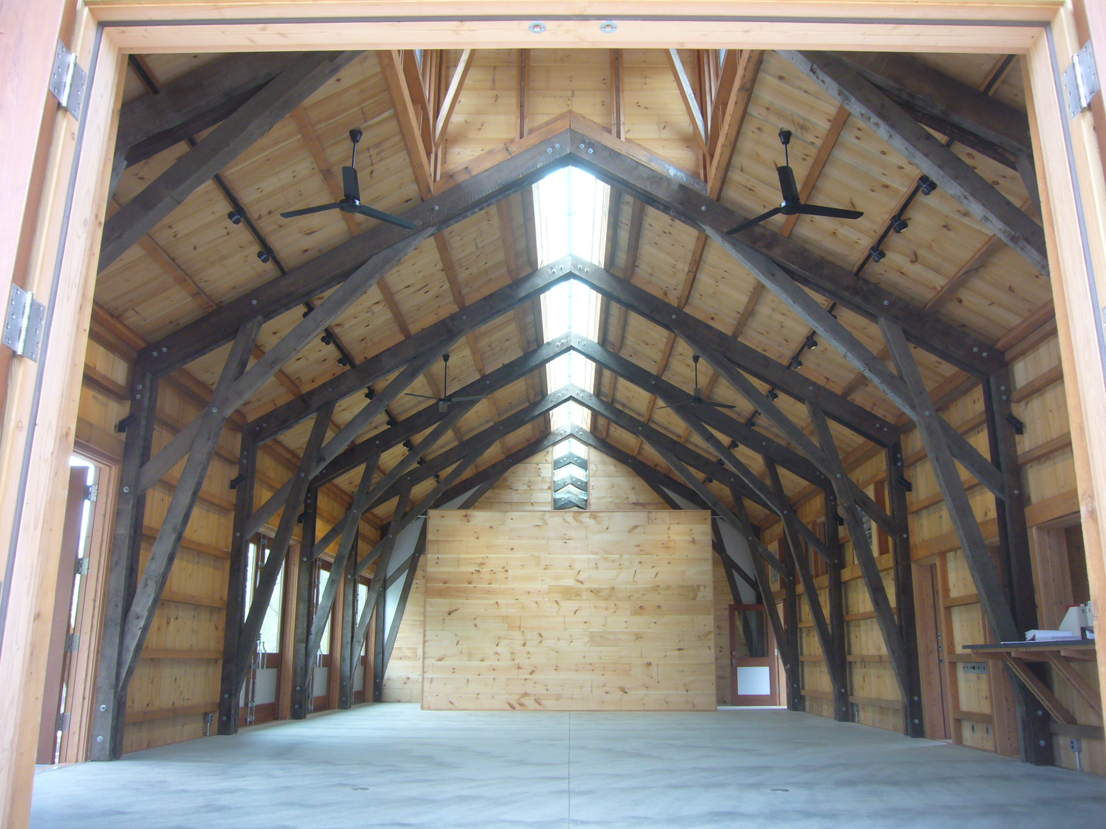
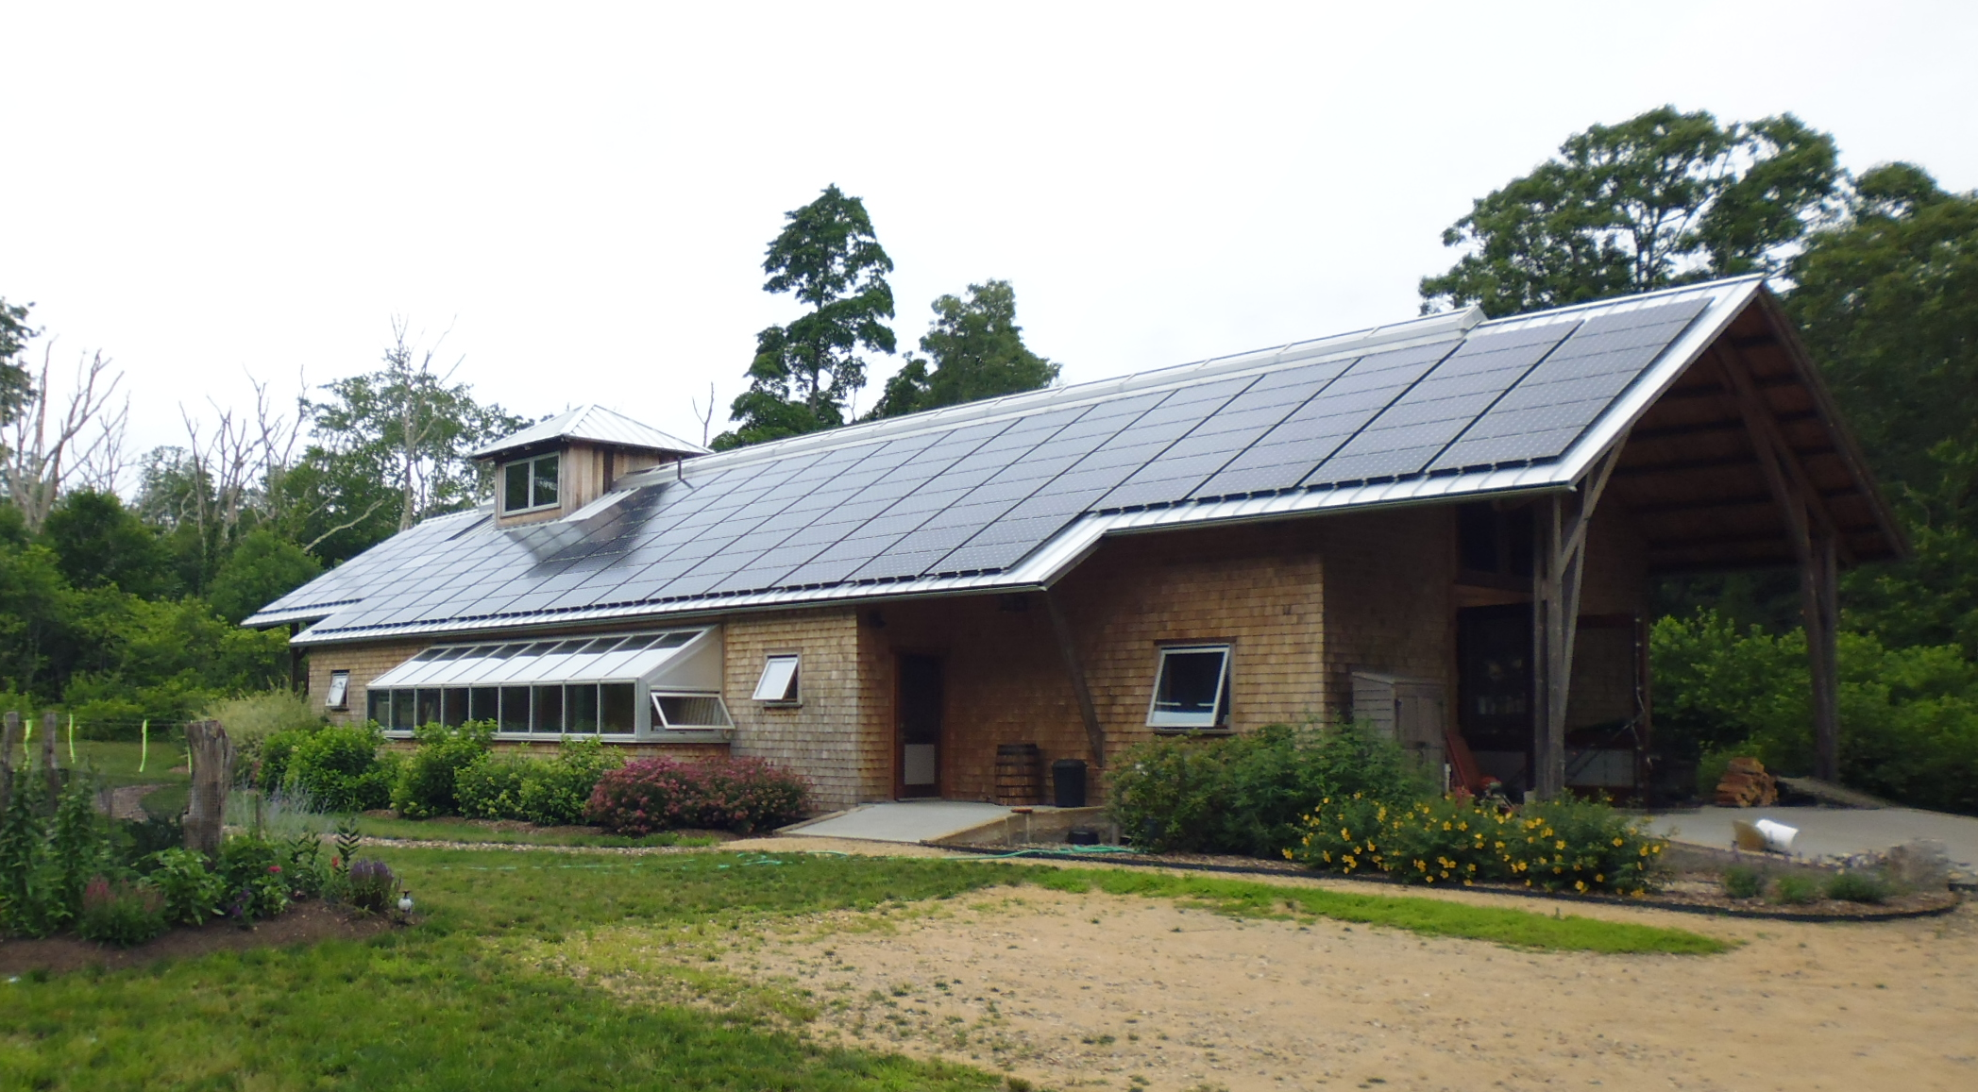
Skylighting
Initial heating is 6.5 Million BTU
Marc Rosenbaum, PE – Energysmiths – West Tisbury, MA
Notes:
REQUIRED. This should come after the Welcome/Best Practices and Copyright slides.

Slide 53
Daylight Factor
Daylight Factor (DF) is the ratio of light on a horizontal plane outdoors to light on the work plane indoors
DF = SFR x VLT x WF x CU
SFR – Skylight area to floor area ratio
VLT – Visible Light Transmittance
WF - Well Factor
CU– Room Coefficient of Utilization
Initial heating is 6.5 Million BTU
Well Factor - how effective the skylight well is at transmitting the light that the skylight admits into the space
Well Factor depends on the geometry of the well, expressed by the Well Cavity Ratio, and the reflectance of the well enclosure
Marc Rosenbaum, PE – Energysmiths – West Tisbury, MA
Notes:
REQUIRED. This should come after the Welcome/Best Practices and Copyright slides.

Slide 54

Daylight Factor
Well Cavity Ratio = 5 x H x (W+L) / (WxL)
Well Factor vs WCR and reflectance
WF = 0.63
Daylight Factor for ridge skylight
DF = SFR x VLT x WF
= 0.07 x 0.56 x 0.63
= 2.6%
Marc Rosenbaum, PE – Energysmiths – West Tisbury, MA
Notes:
REQUIRED. This should come after the Welcome/Best Practices and Copyright slides.

Slide 55

Daylight Factor Results
DF below ridge is 2.7%
Initial heating is 6.5 Million BTU
Light levels are lower beneath the cupola
Marc Rosenbaum, PE – Energysmiths – West Tisbury, MA
Notes:
REQUIRED. This should come after the Welcome/Best Practices and Copyright slides.

Slide 56



Skylighting
Initial heating is 6.5 Million BTU
Light manipulated at the roof
Marc Rosenbaum, PE – Energysmiths – West Tisbury, MA
Notes:
REQUIRED. This should come after the Welcome/Best Practices and Copyright slides.

Slide 57



Modeling Daylighting
Initial heating is 6.5 Million BTU
Light scales
Paint the interior
Marc Rosenbaum, PE – Energysmiths – West Tisbury, MA
Notes:
REQUIRED. This should come after the Welcome/Best Practices and Copyright slides.

Slide 58




Modeling Daylighting
Initial heating is 6.5 Million BTU
Marc Rosenbaum, PE – Energysmiths – West Tisbury, MA
Notes:
REQUIRED. This should come after the Welcome/Best Practices and Copyright slides.

Slide 59



Modeling Daylighting
Initial heating is 6.5 Million BTU
Marc Rosenbaum, PE – Energysmiths – West Tisbury, MA
Notes:
REQUIRED. This should come after the Welcome/Best Practices and Copyright slides.

Slide 60




Modeling Daylighting
Initial heating is 6.5 Million BTU
Marc Rosenbaum, PE – Energysmiths – West Tisbury, MA
Notes:
REQUIRED. This should come after the Welcome/Best Practices and Copyright slides.

Slide 61

Thank You!
Marc Rosenbaum, PE – Energysmiths – West Tisbury, MA
Notes:
REQUIRED. This should come after the Welcome/Best Practices and Copyright slides.

