Slide 1

Small
Simple
Serviceable
HVAC Solutions for Multi-Family Housing
James Petersen, PE - Principal

Slide 2

https://youtu.be/035tT_DvJGs

Slide 3


Slide 4


Slide 5
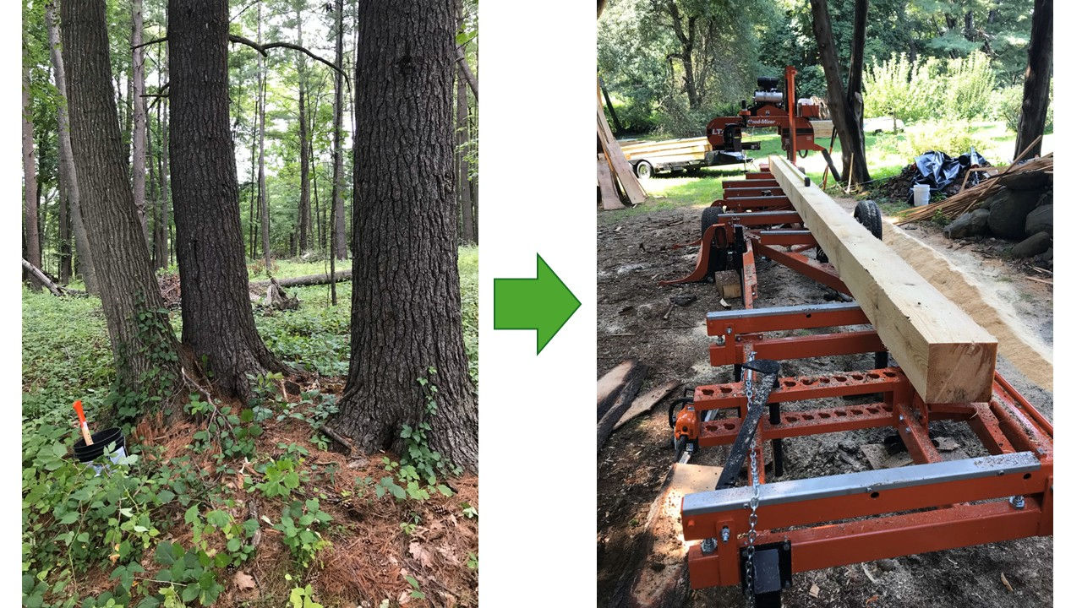

Slide 6
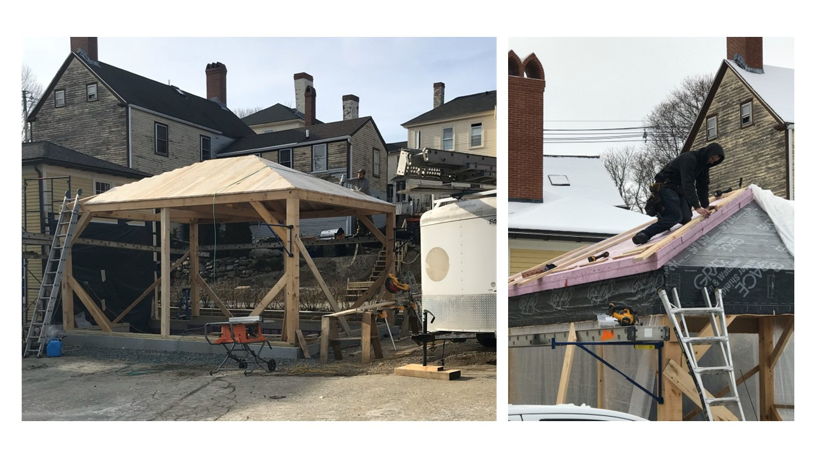

Slide 7
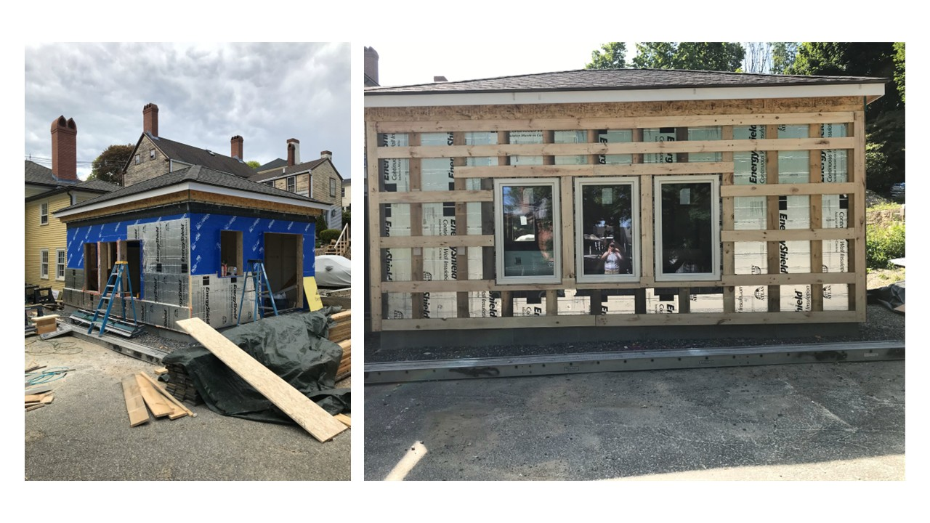

Slide 8
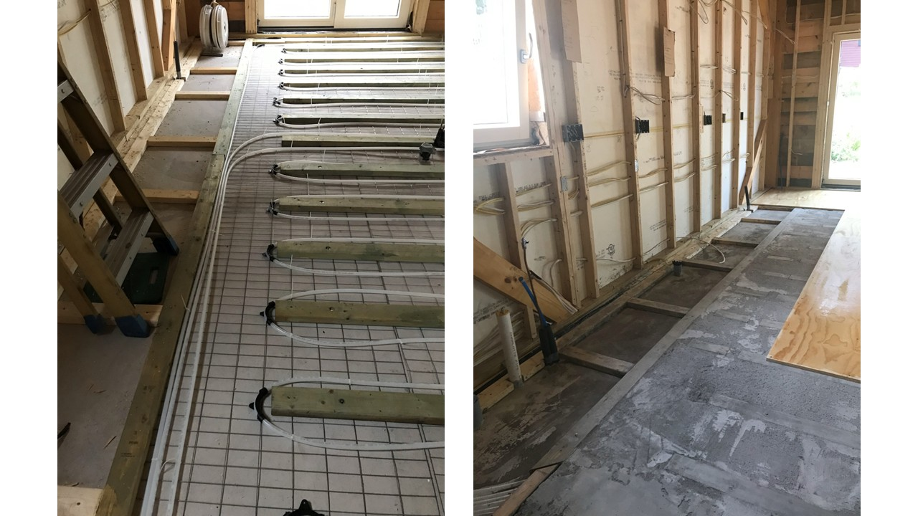

Slide 9
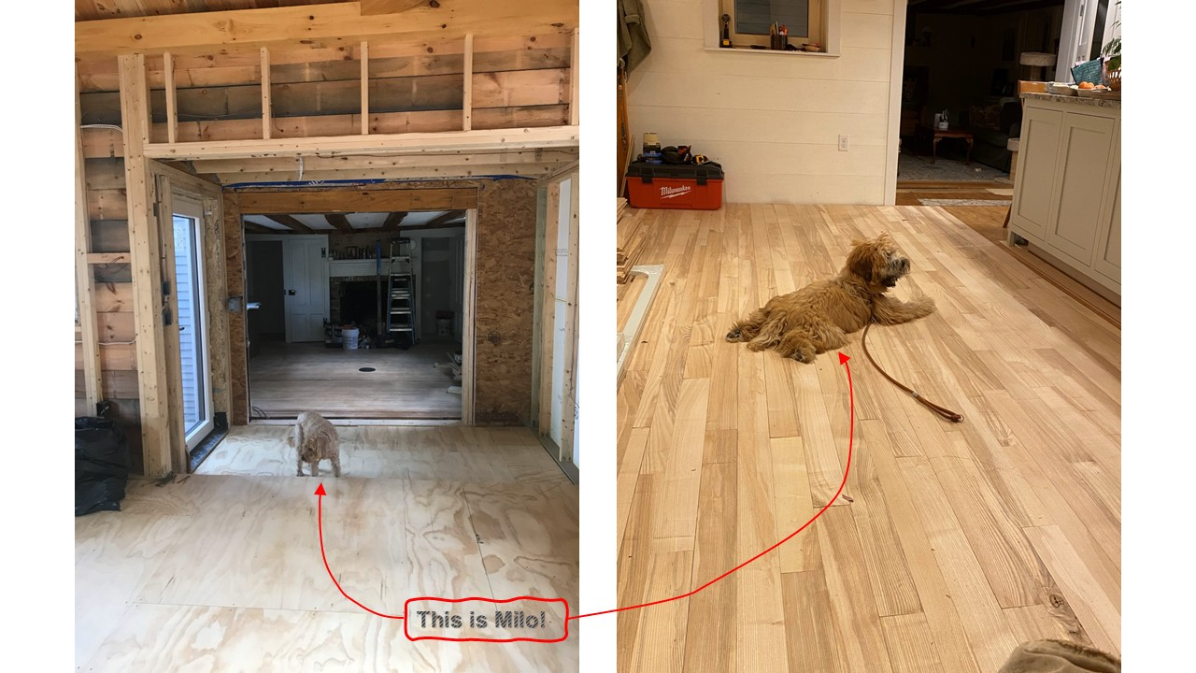

Slide 10
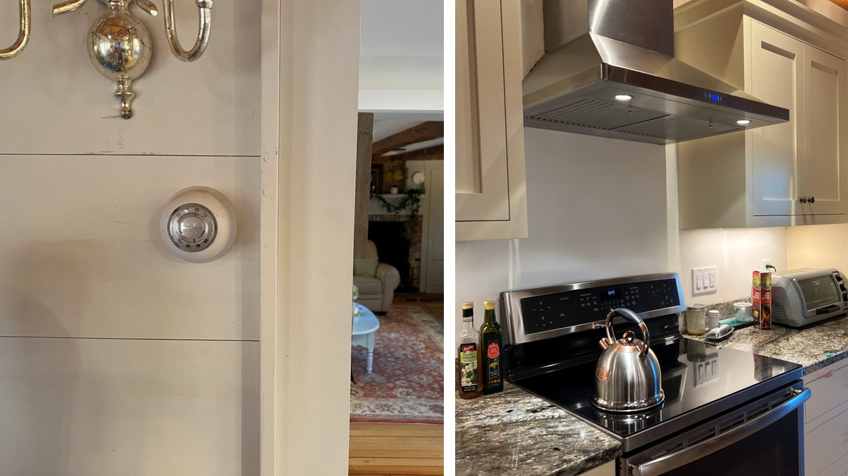

Slide 11
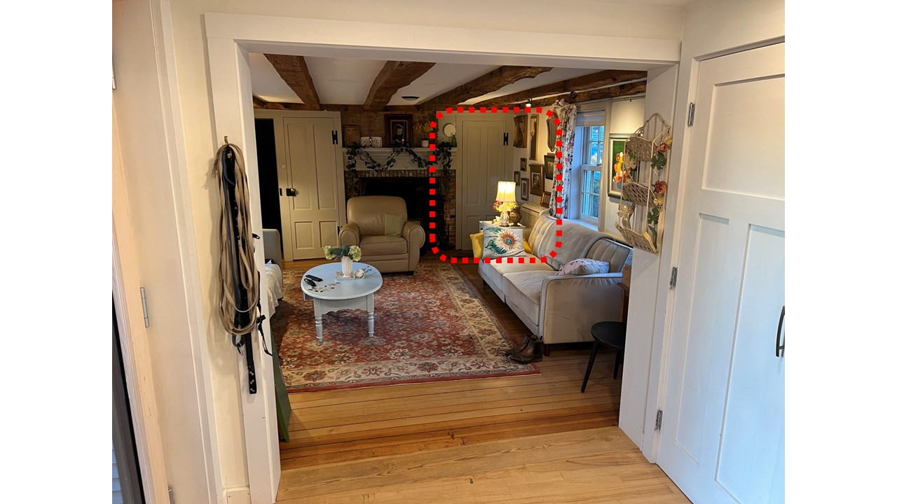

Slide 12


Slide 13


Slide 14
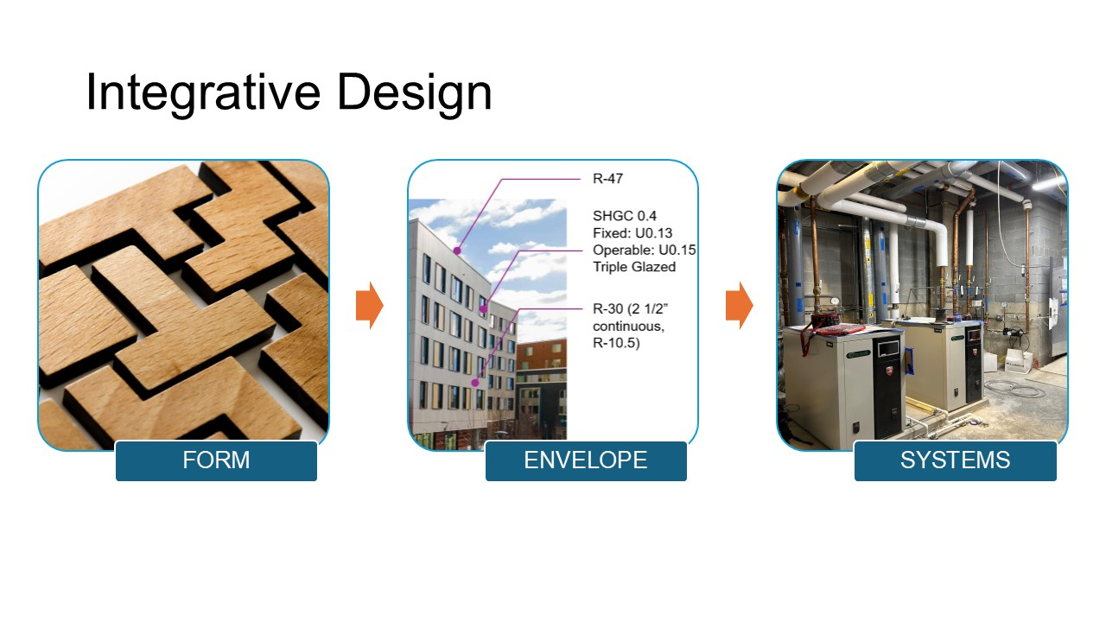

Slide 15
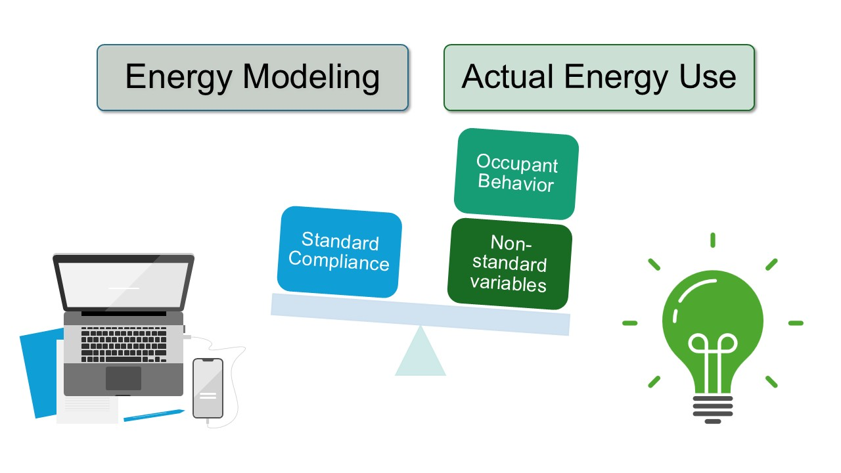

Slide 16
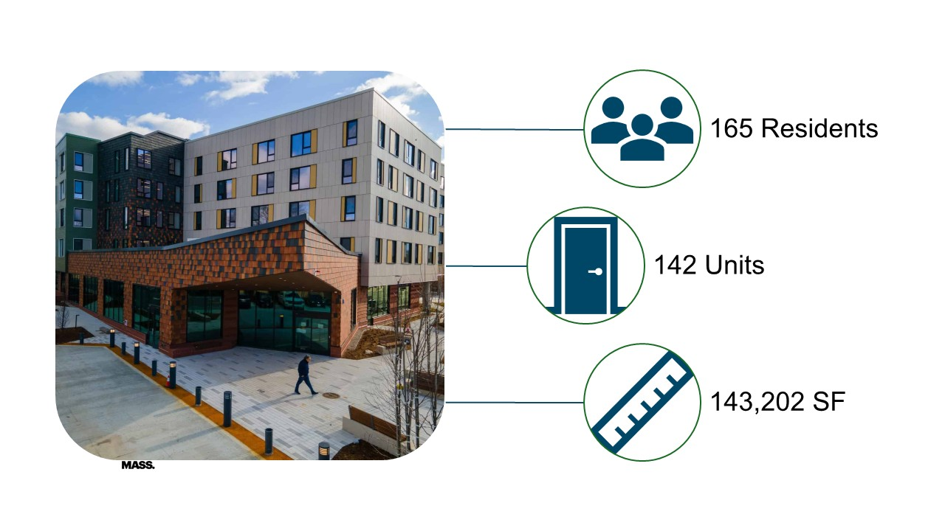

Slide 17


Slide 18


Slide 19
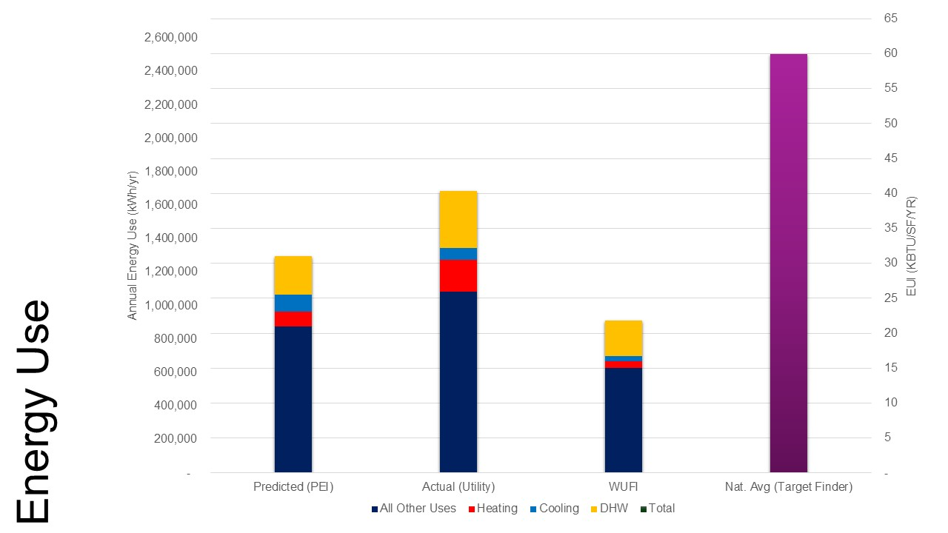

Slide 20
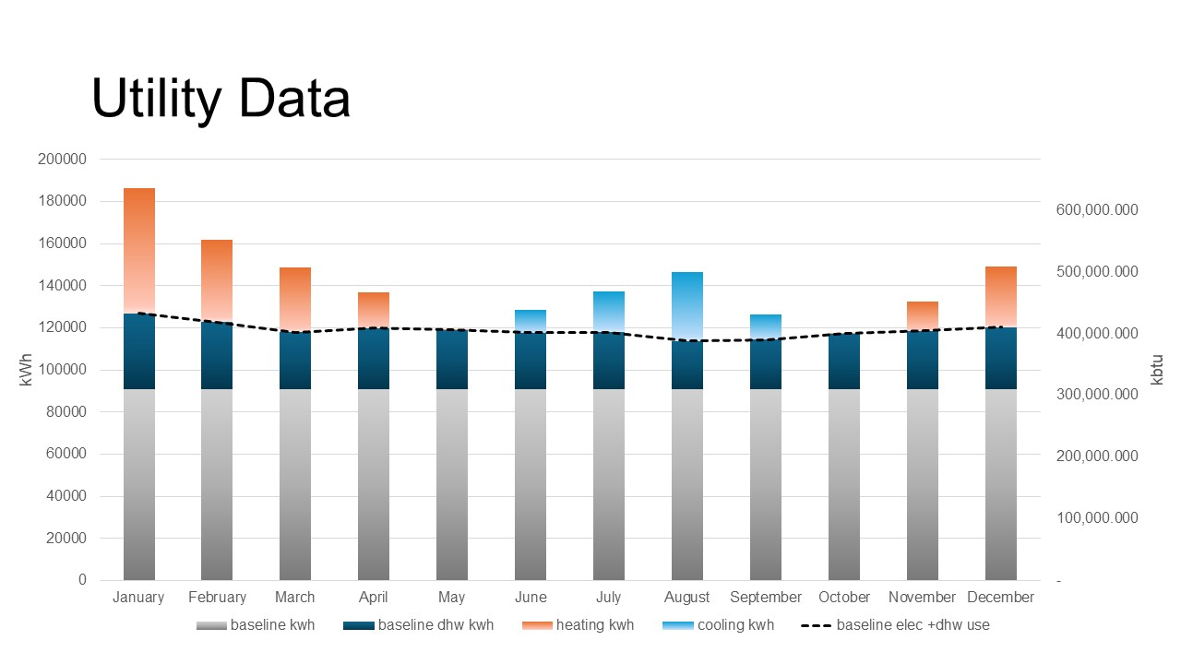

Slide 21


Slide 22

HEATING

Slide 23
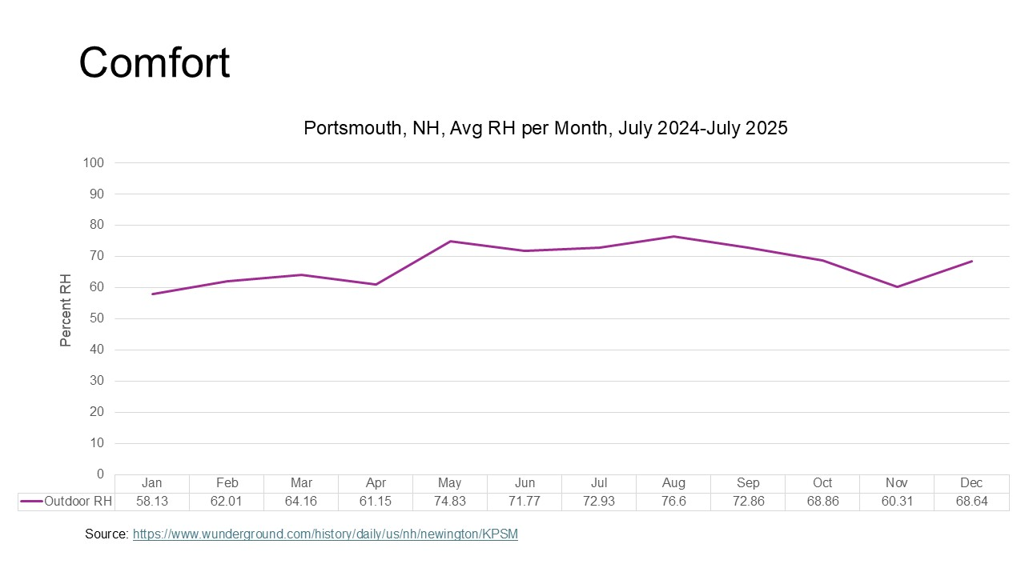

Slide 24
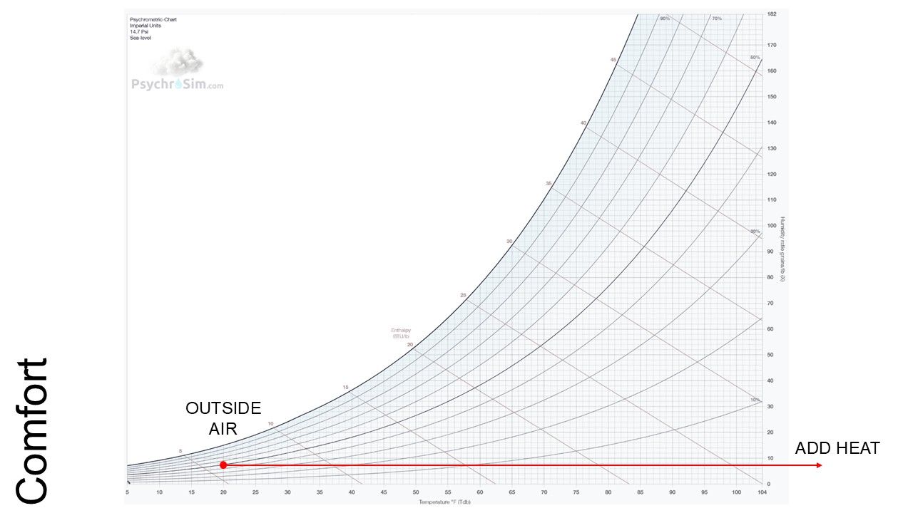

Slide 25
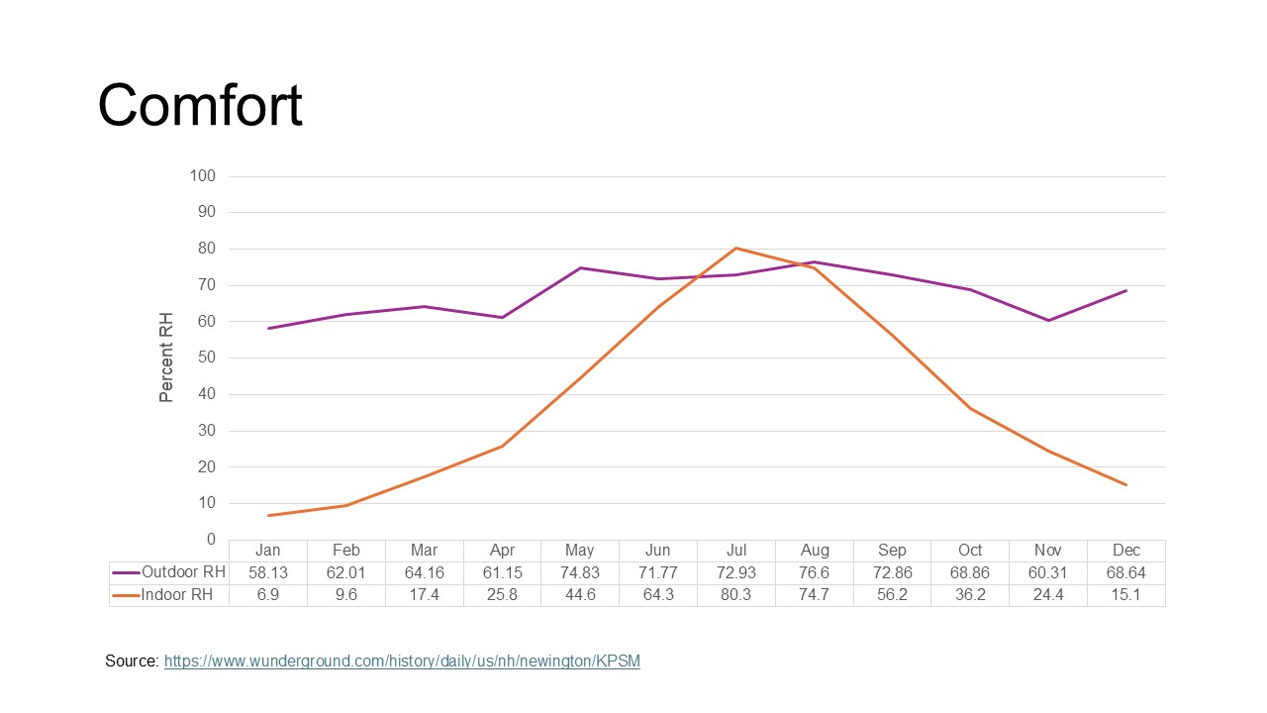

Slide 26
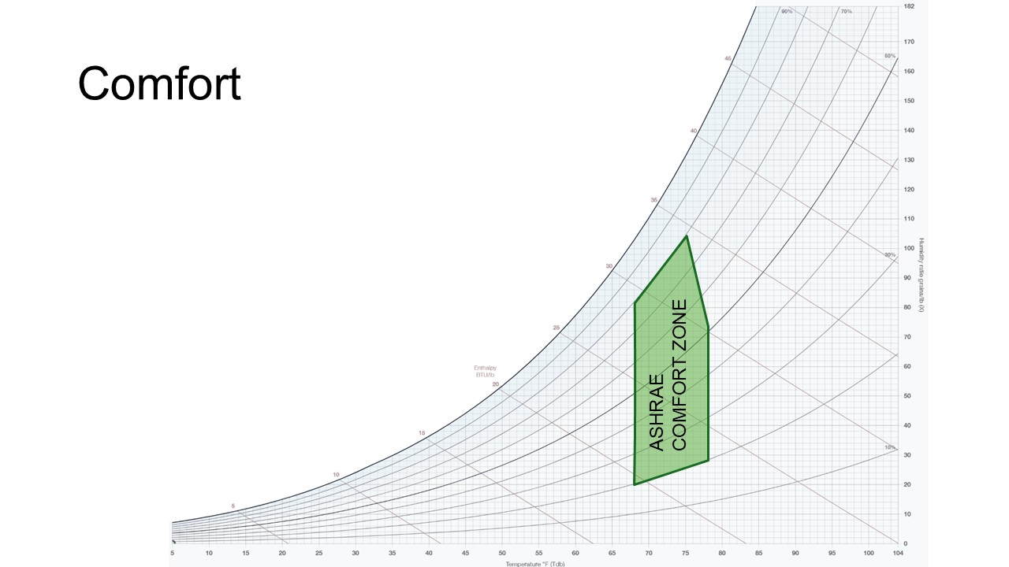

Slide 27
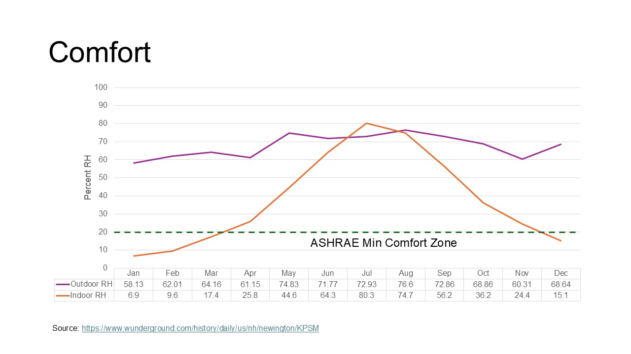

Slide 28
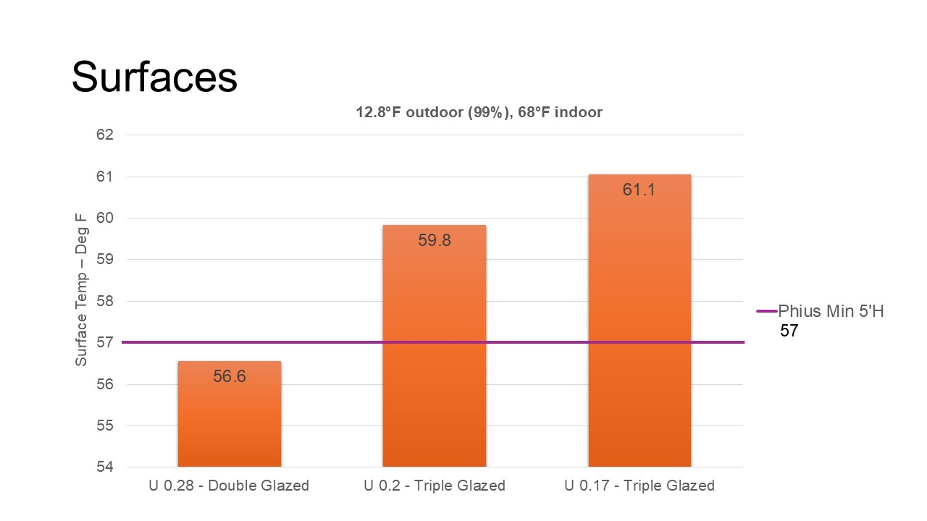

Slide 29
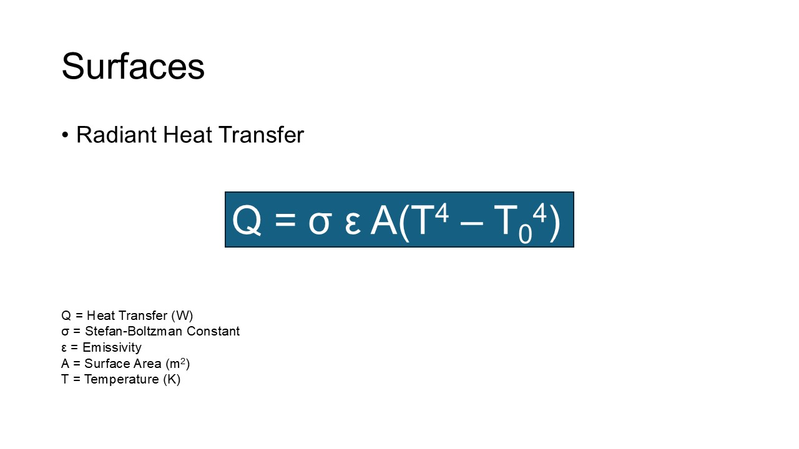

Slide 30
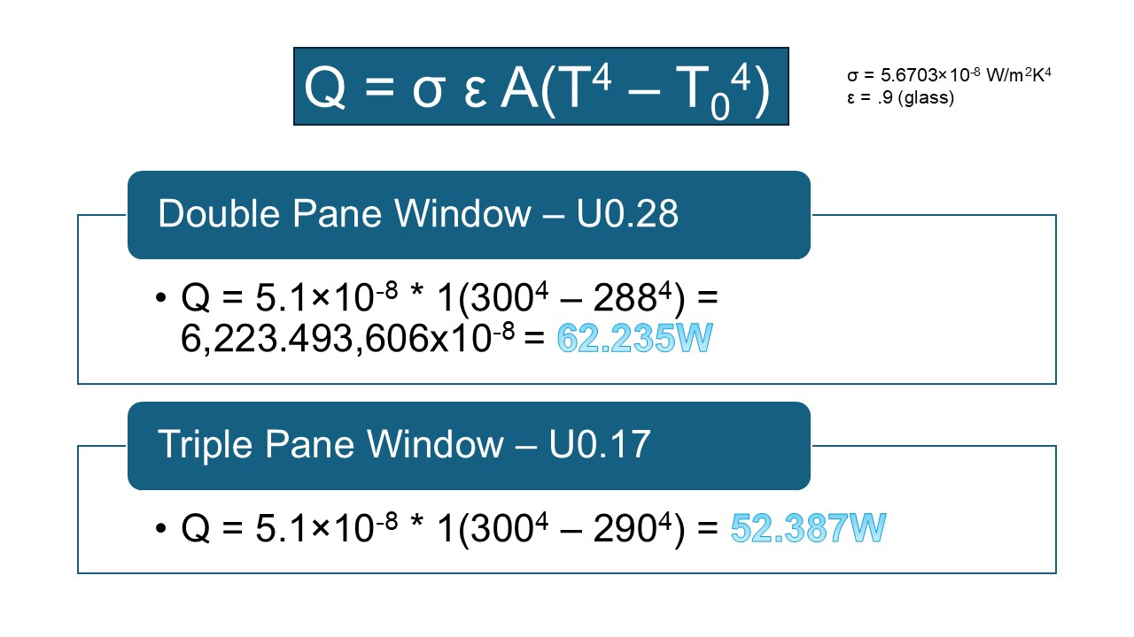

Slide 31
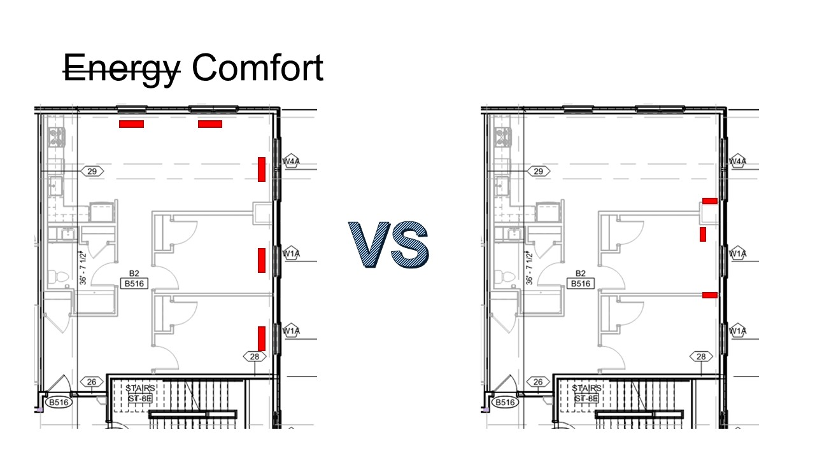

Slide 32
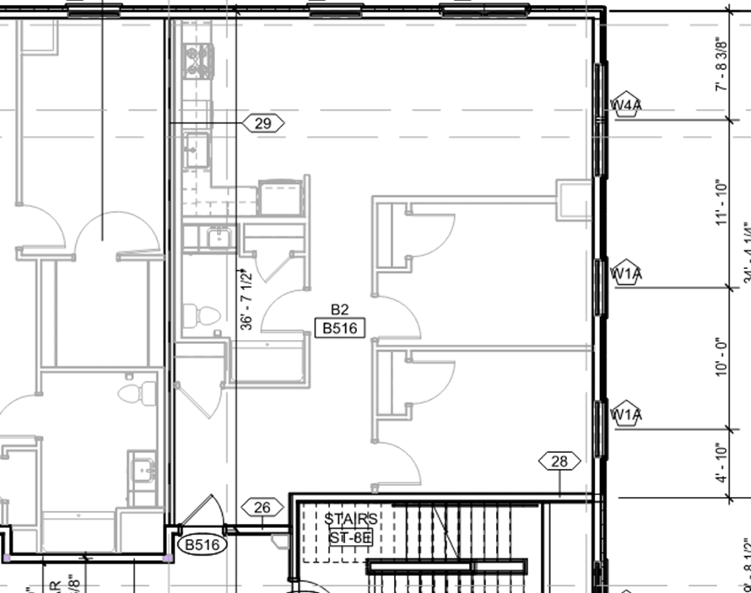
Heating – Rule of Thumb
~1,000SF
LOAD =
35 BTU/HR/SF =
35 X 1000=
35,000 BTU

Slide 33
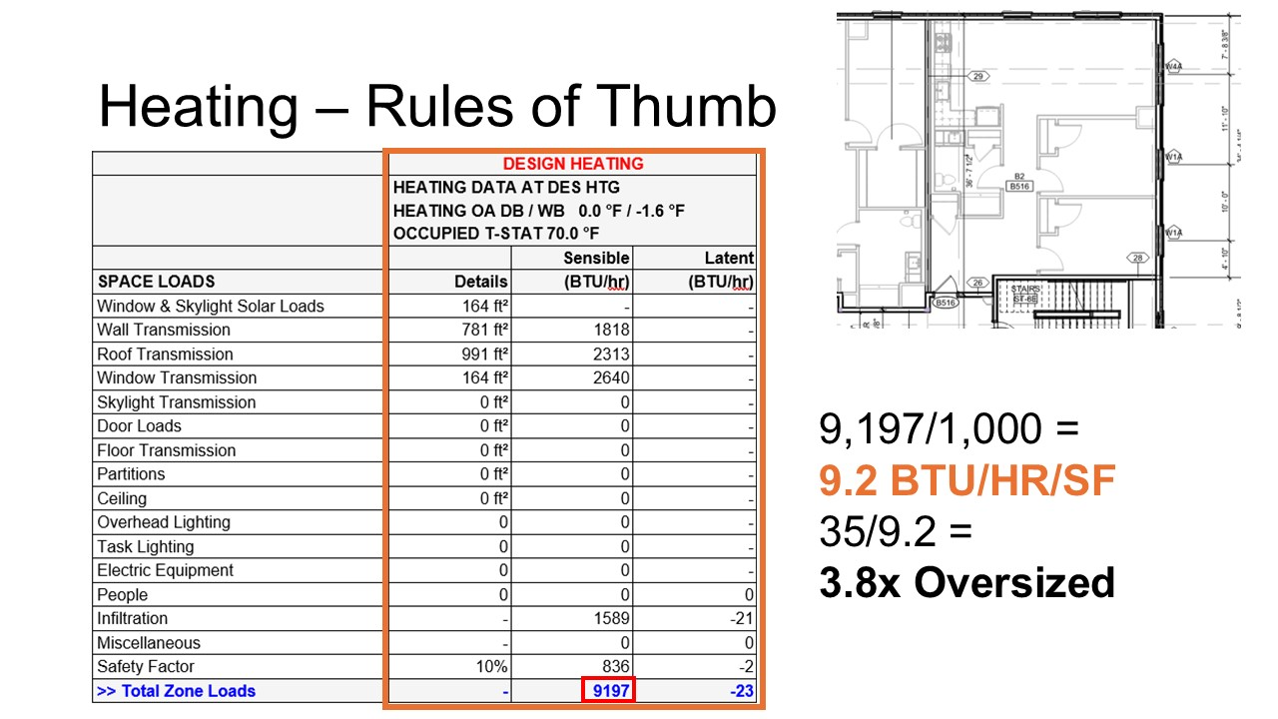

Slide 34

COOLING

Slide 35
Cooling – Rule of Thumb
~1,000SF
LOAD =
400SF/TON=
1000/400=
2.5 TON
30,000 BTU

Slide 36
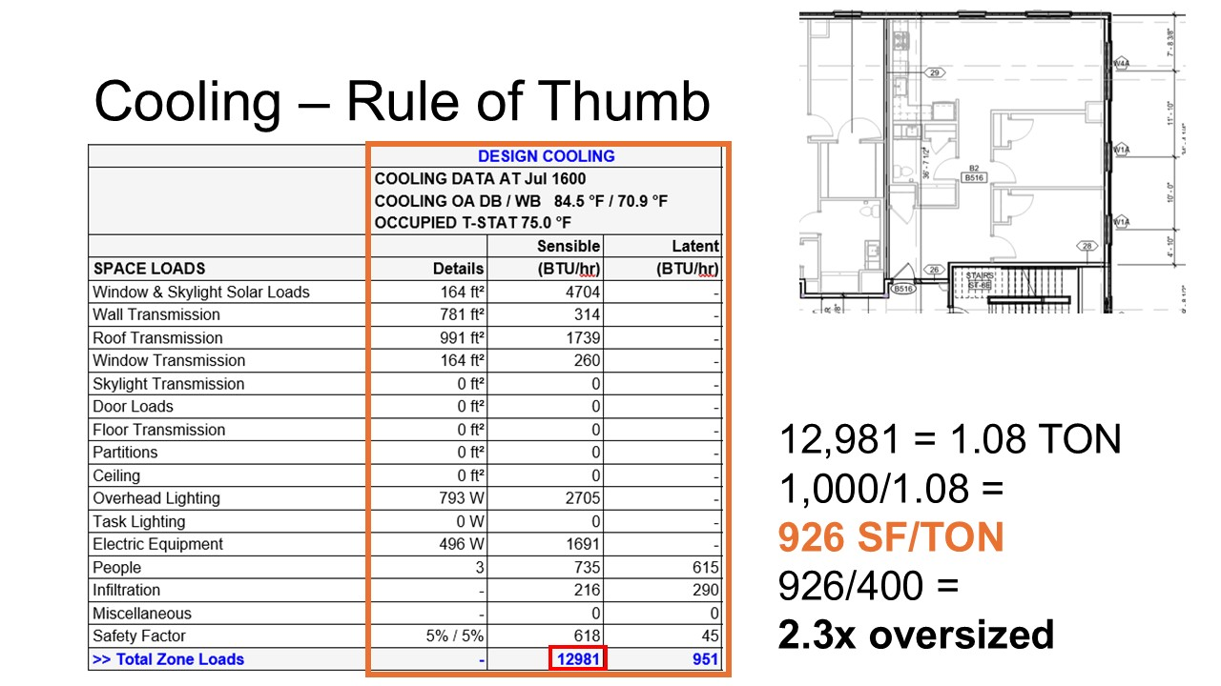
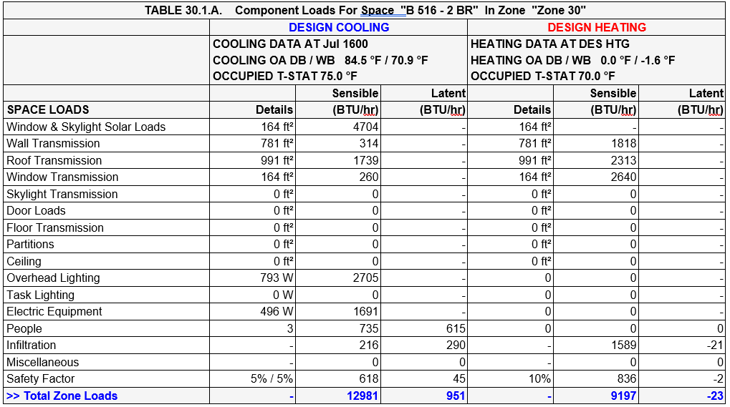
Cooling – Rule of Thumb
12,981 = 1.08 TON
1,000/1.08 =
926 SF/TON
926/400 =
2.3x oversized

Slide 37
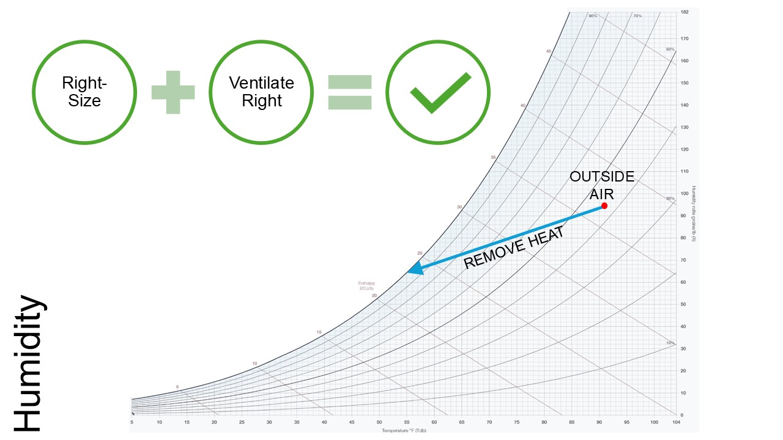

Slide 38
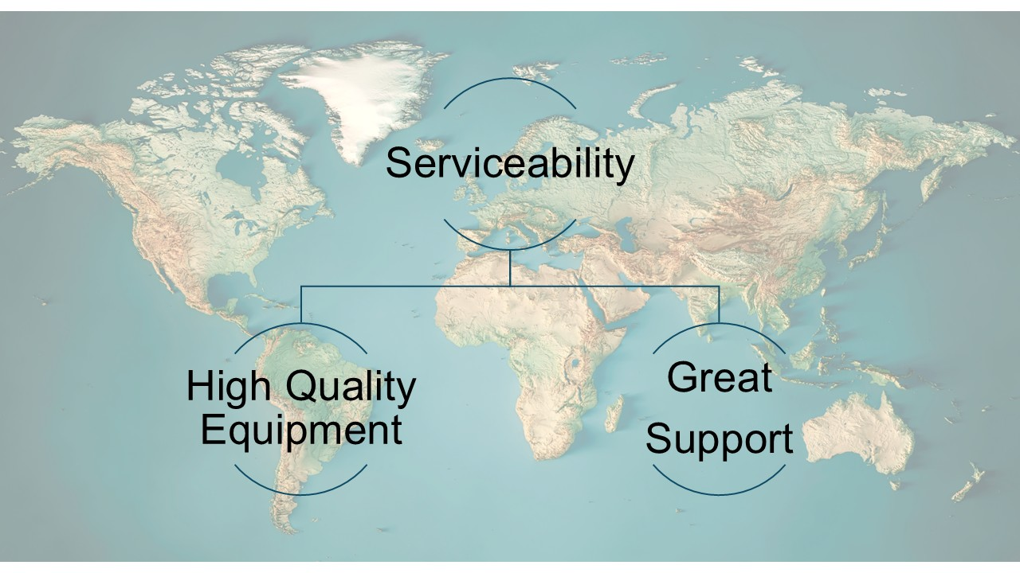

Slide 39
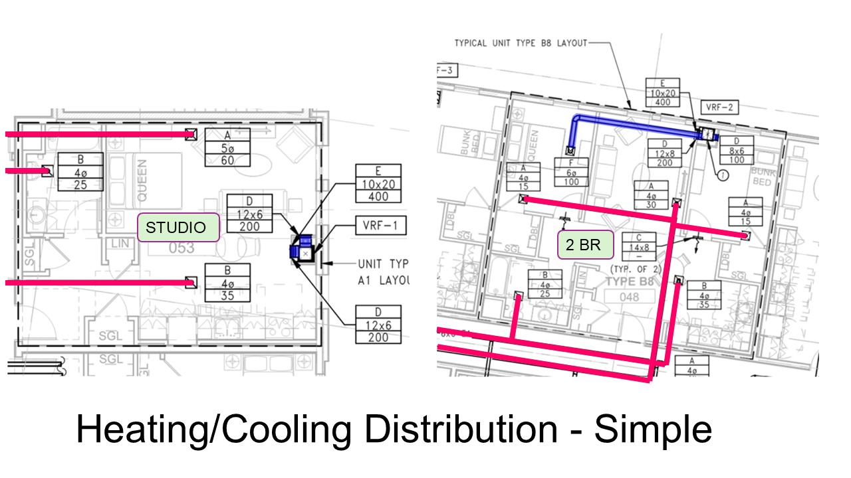

Slide 40
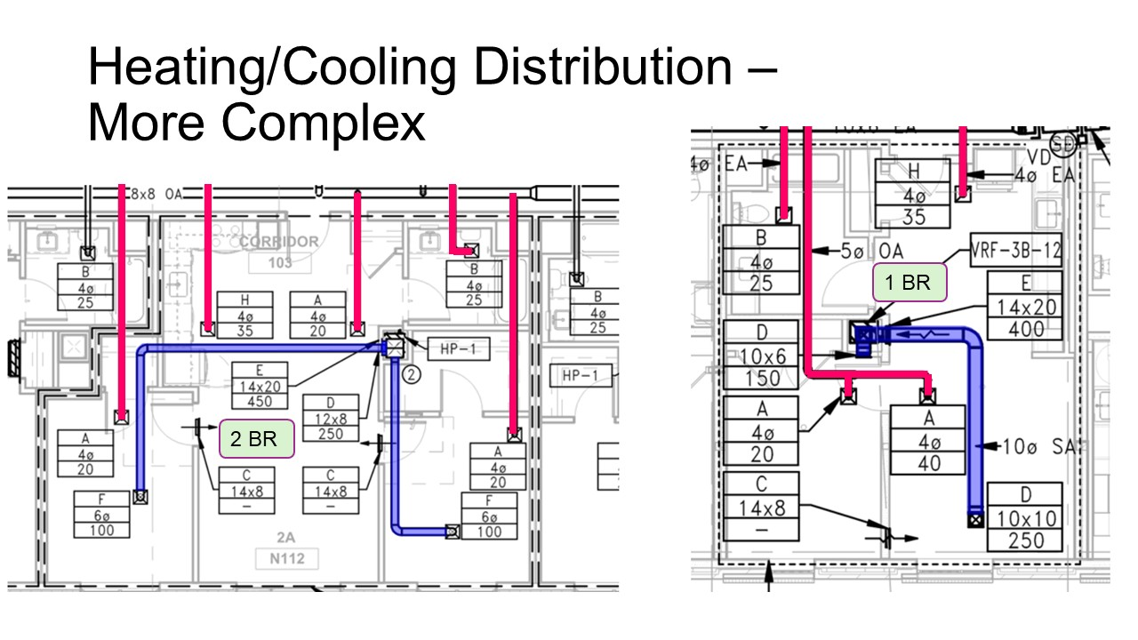

Slide 41
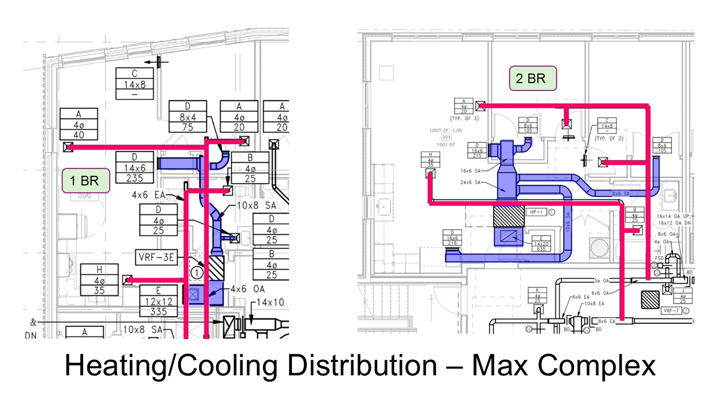

Slide 42
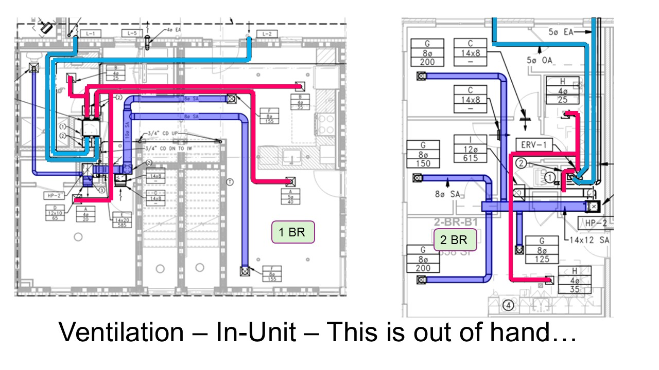

Slide 43

VENTILATION

Slide 44


Slide 45
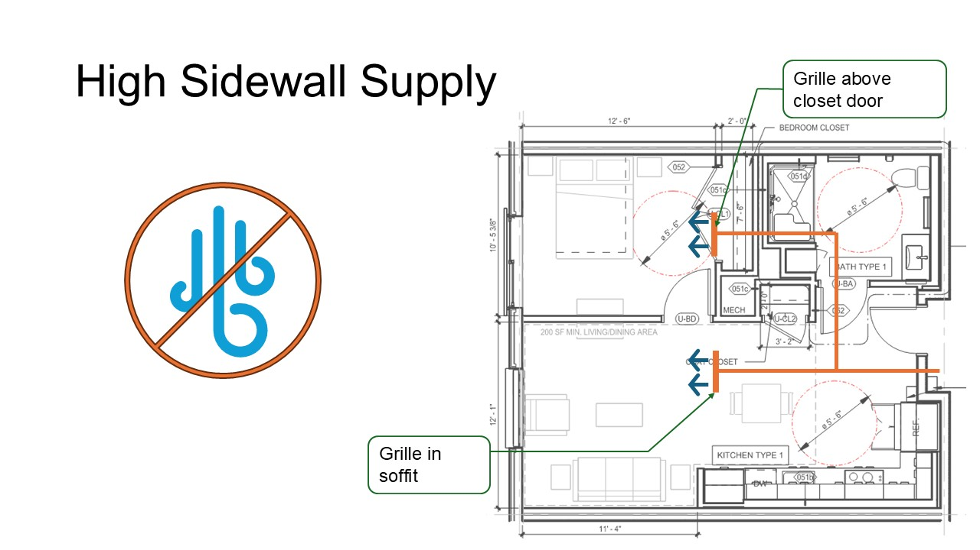

Slide 46
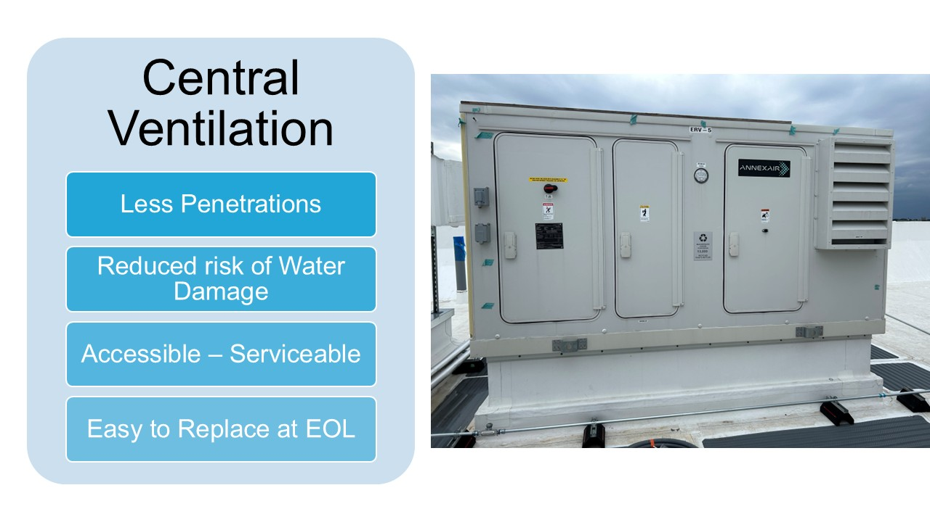

Slide 47
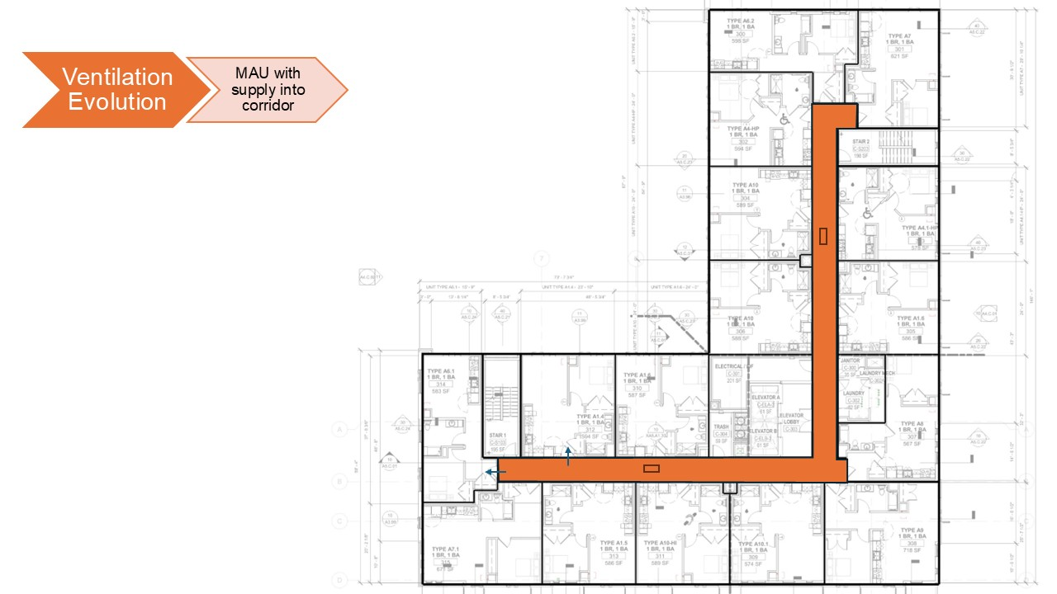

Slide 48
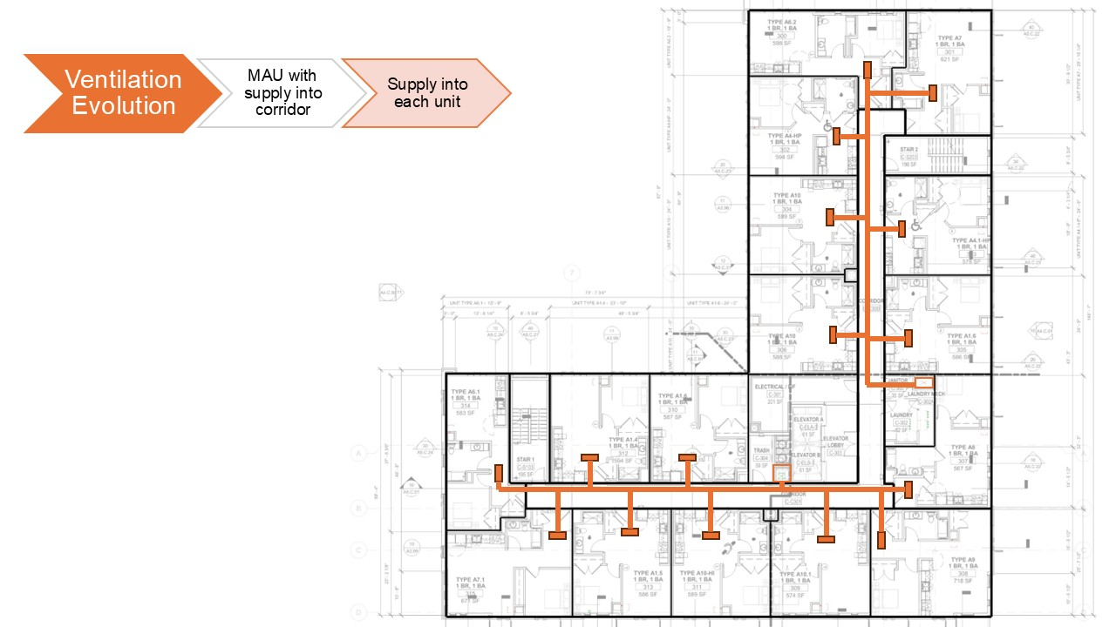

Slide 49
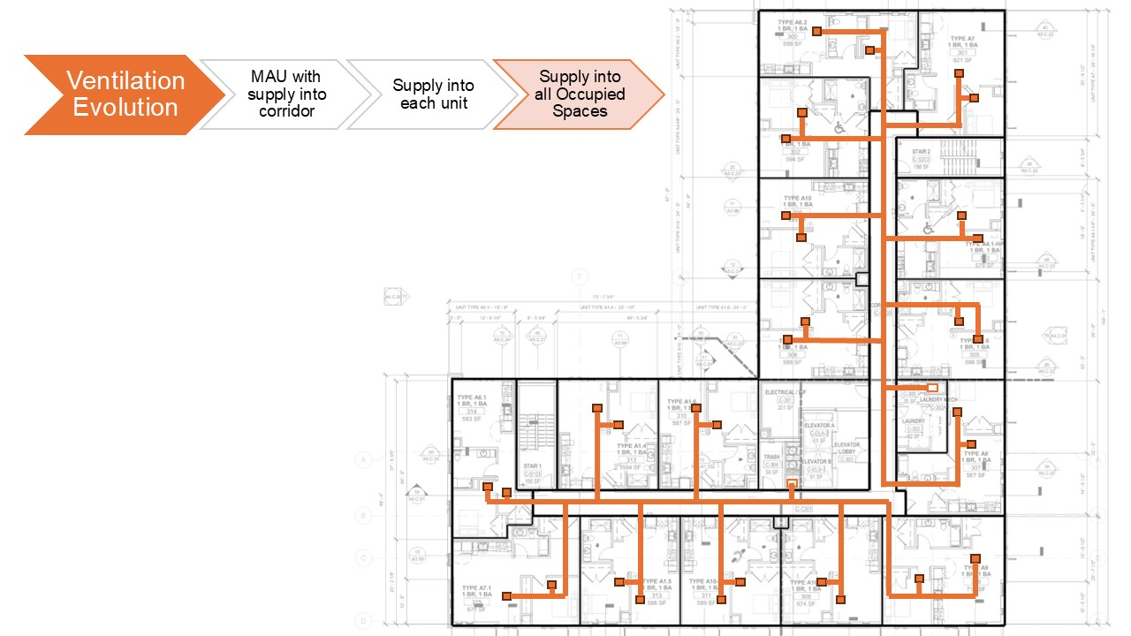

Slide 50
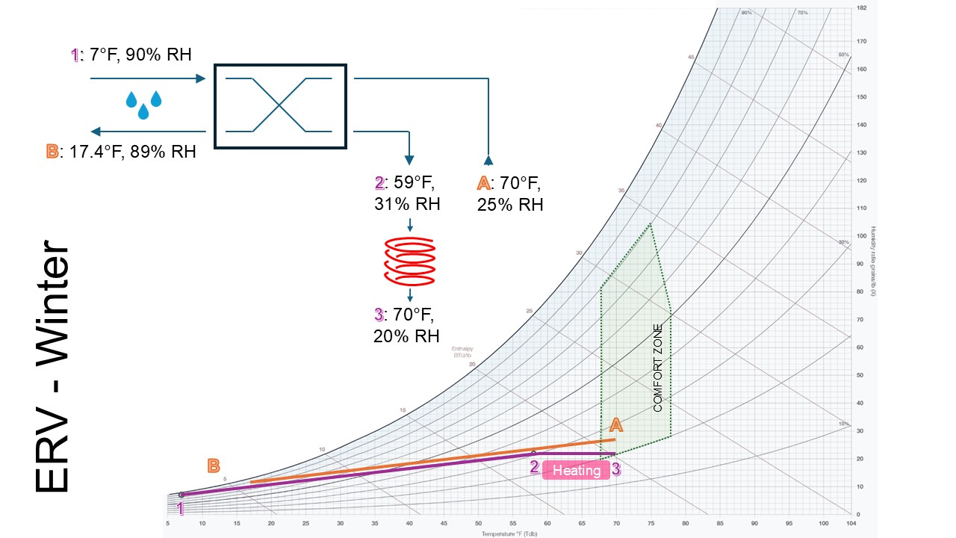

Slide 51
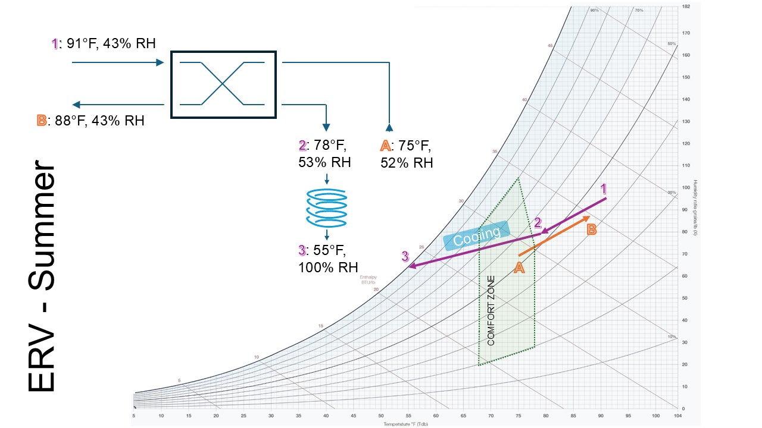

Slide 52


Slide 53
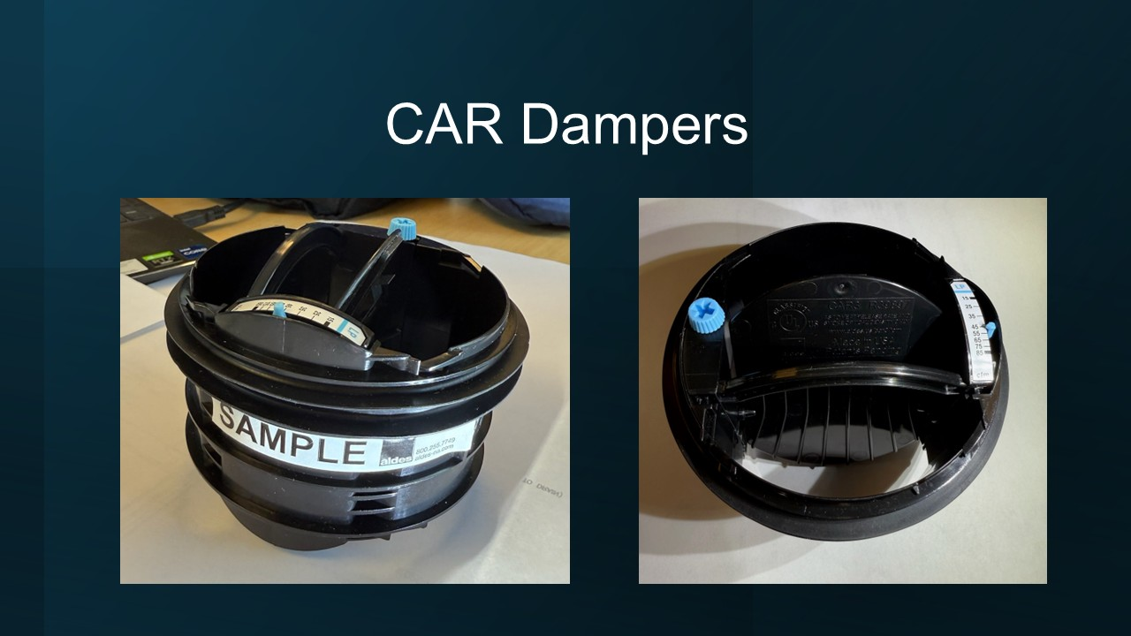

Slide 54
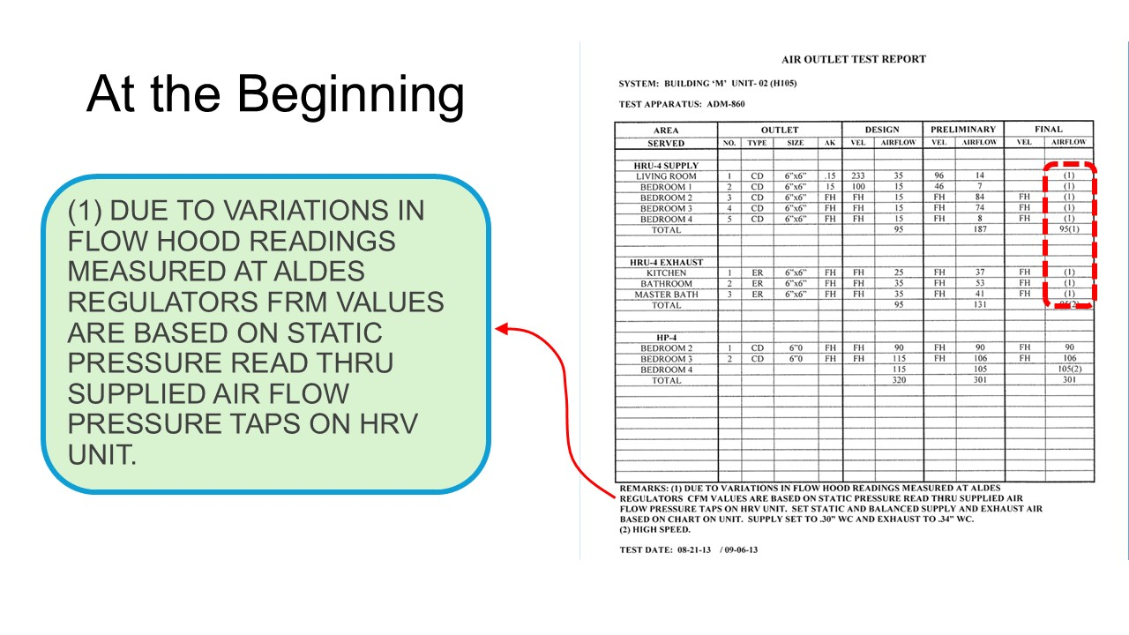

Slide 55


Slide 56
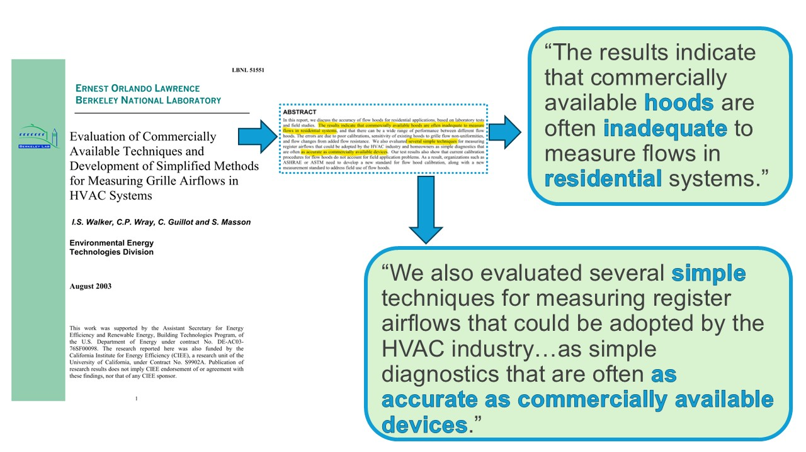

Slide 57
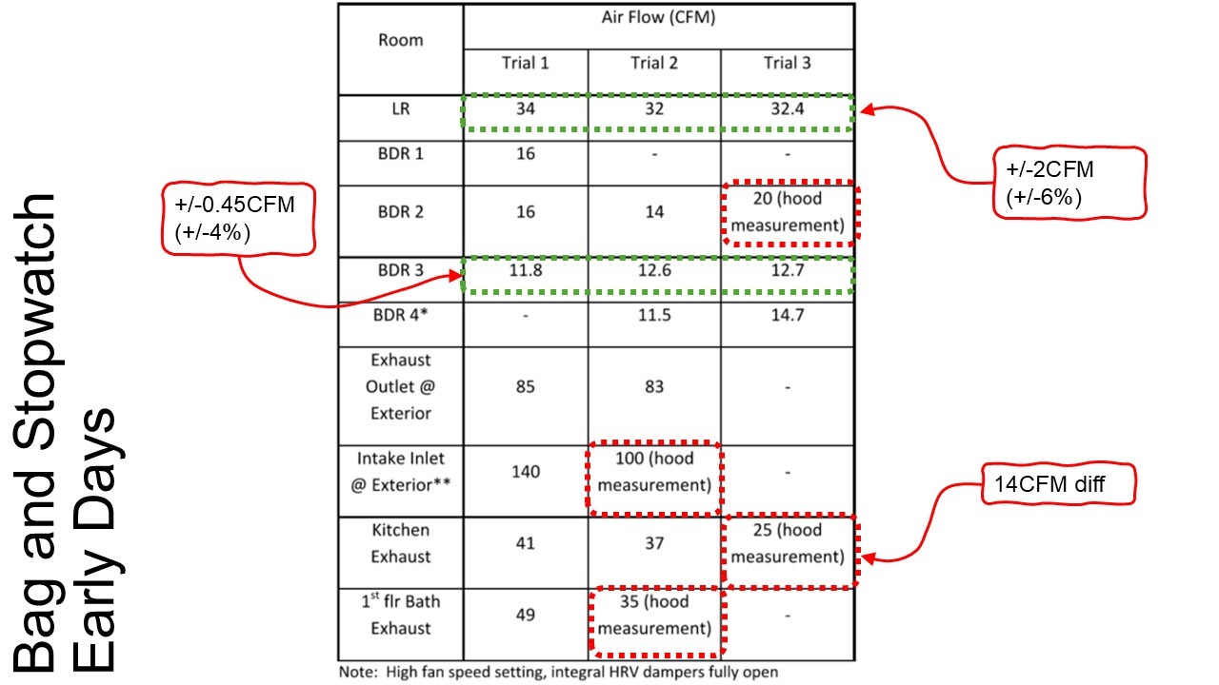

Slide 58
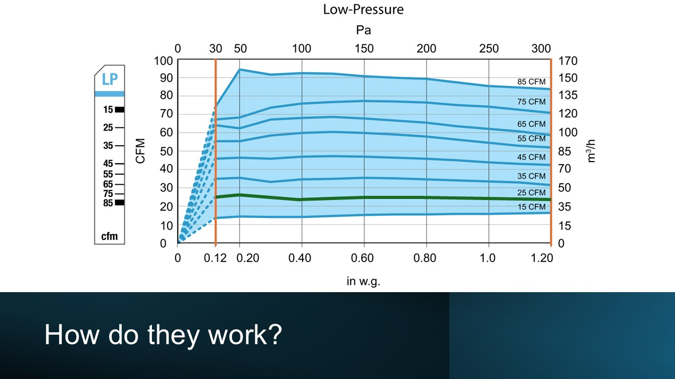

Slide 59


Slide 60


Slide 61
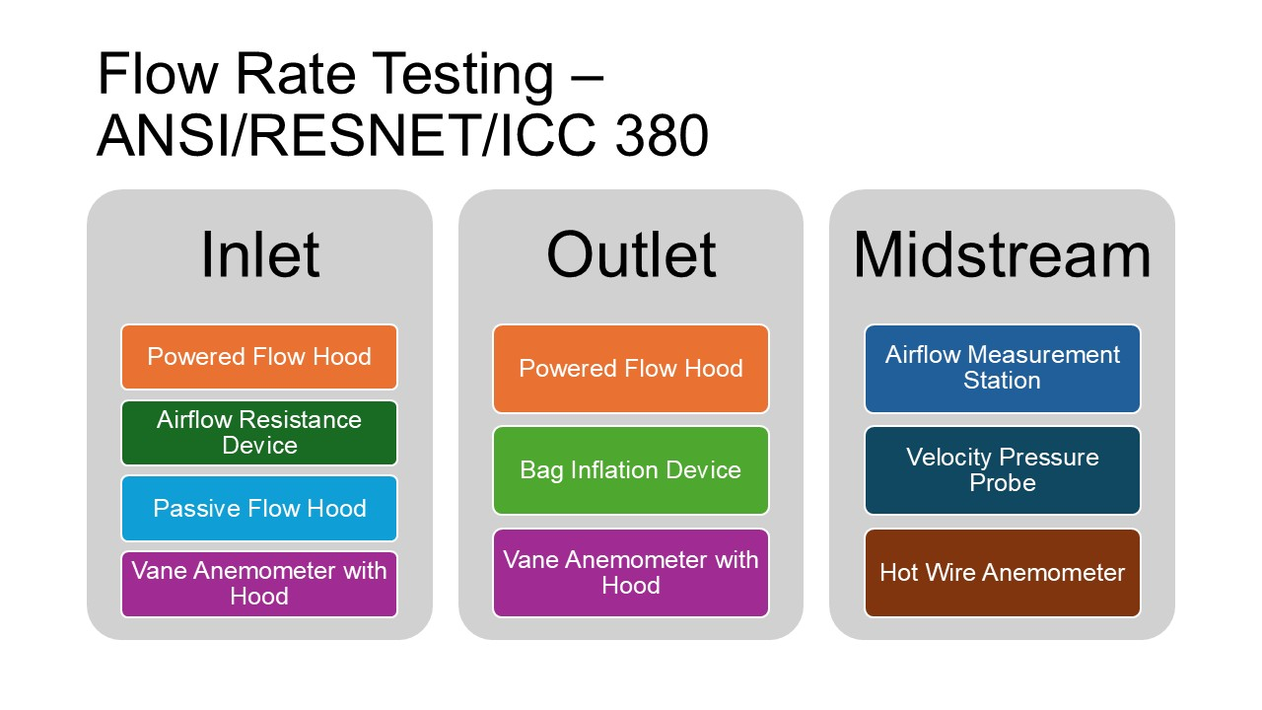

Slide 62


Slide 63
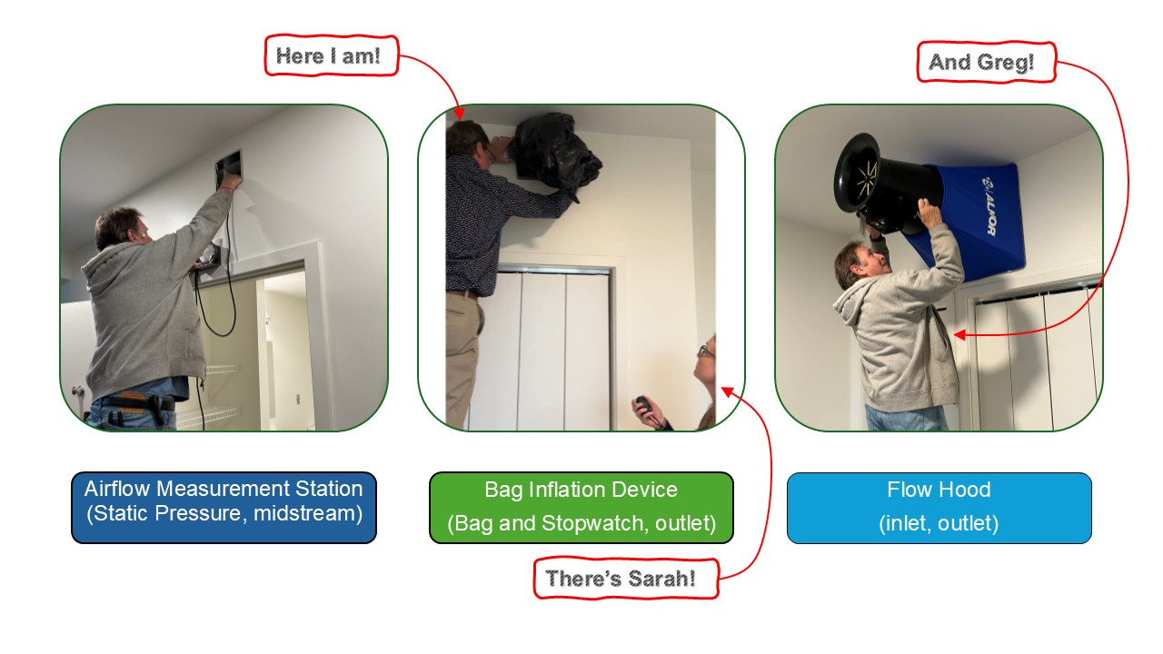

Slide 64
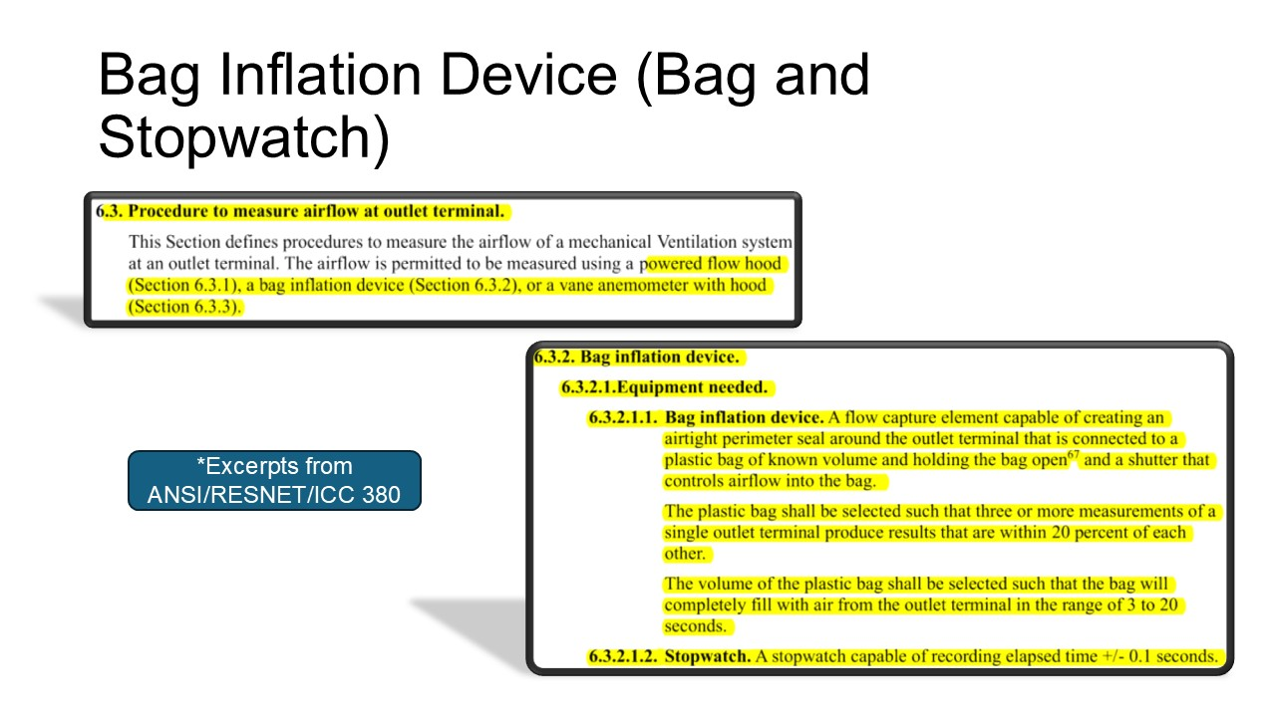

Slide 65
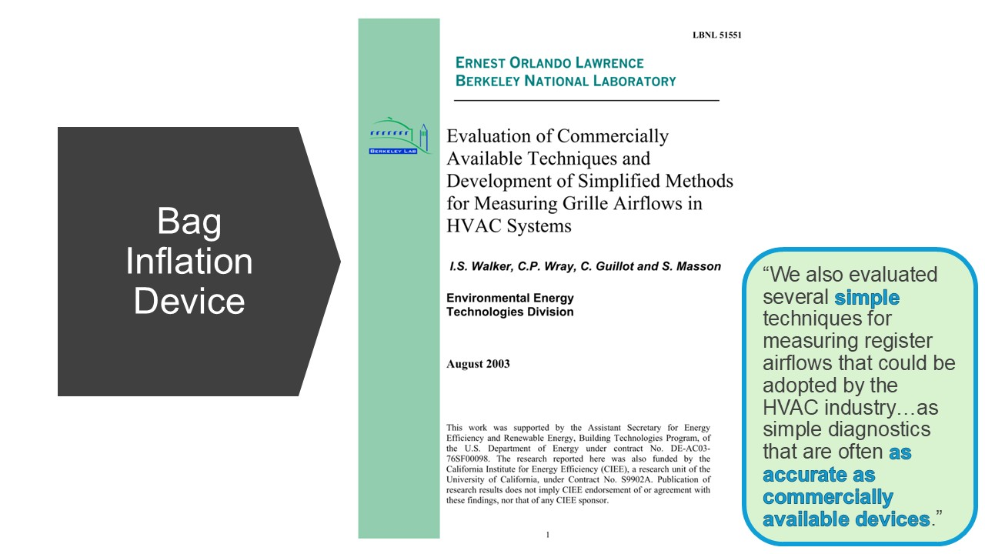

Slide 66
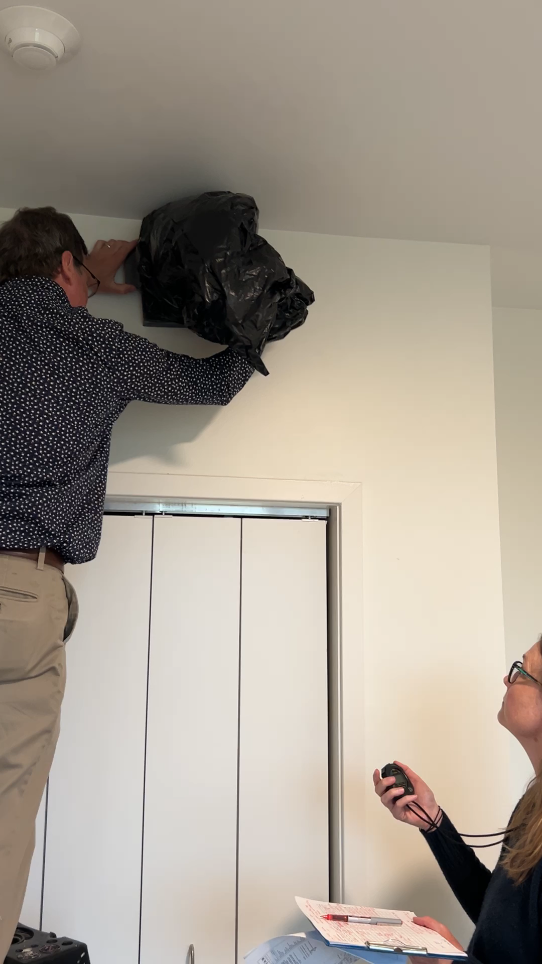
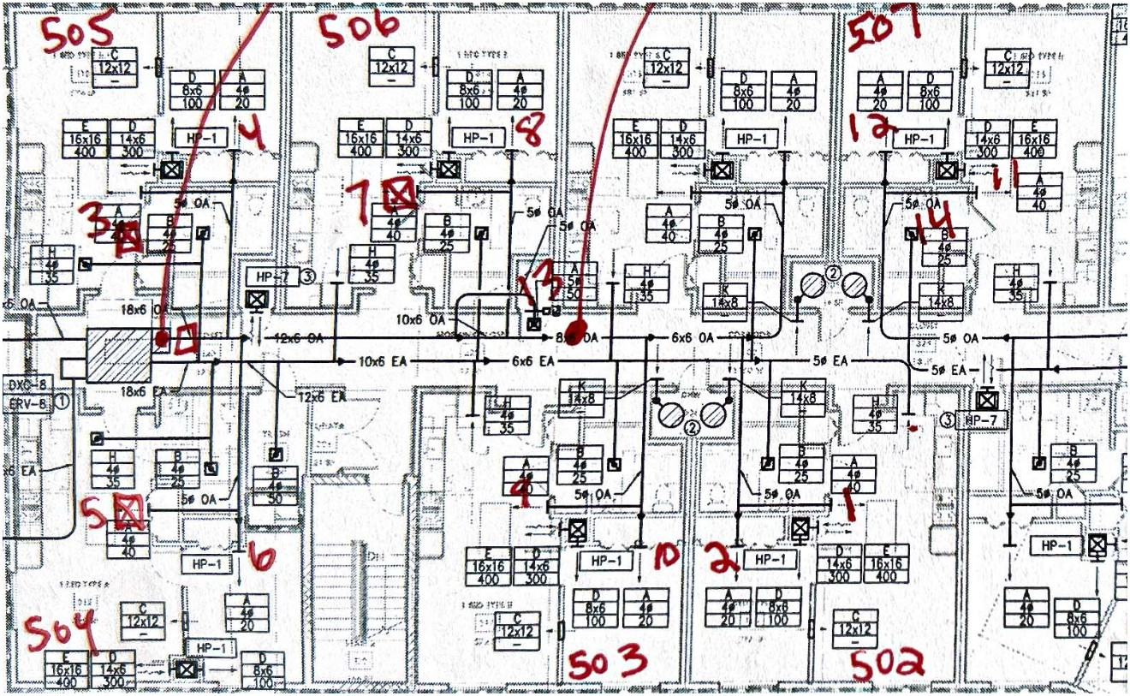
Bag and Stopwatch

Slide 67
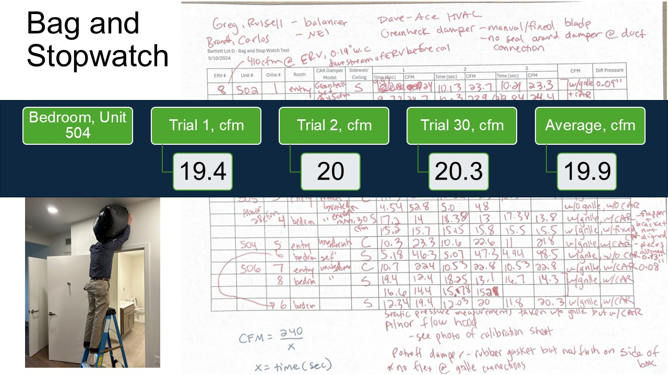

Slide 68


Slide 69


Slide 70


Slide 71


Slide 72

Notes:
2024 Guidebook references MF QA Workbook which calculates this automatically, same requirement

Slide 73


Slide 74


Slide 75


Slide 76


Slide 77


Slide 78


