Slide 1
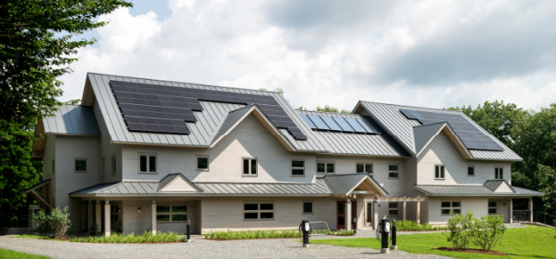
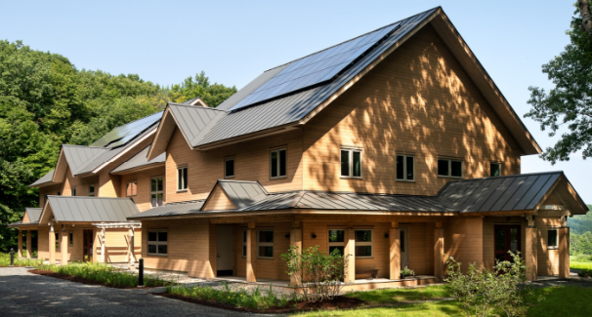
The Putney School New Dorms
Lowering Total Carbon Emissions
Strategies for Design and Construction
Maclay Architects
Andrew M. Shapiro, Energy Balance, Inc
Jacob Deva Racusin, New Frameworks
Westford Symposium on Building Science XXVII
Westford, MA ~ August 6, 2025

Slide 2
Putney School Dorms:
Structure of Presentation
 | Carbon Analysis Framing Project Case Study: Putney School Dormitories Analyzing Embodied and Operational Emissions Over Time Carbon Storage and Time Value of Carbon RESNET 1550 and Next Steps in Total Carbon Reduction

Slide 3
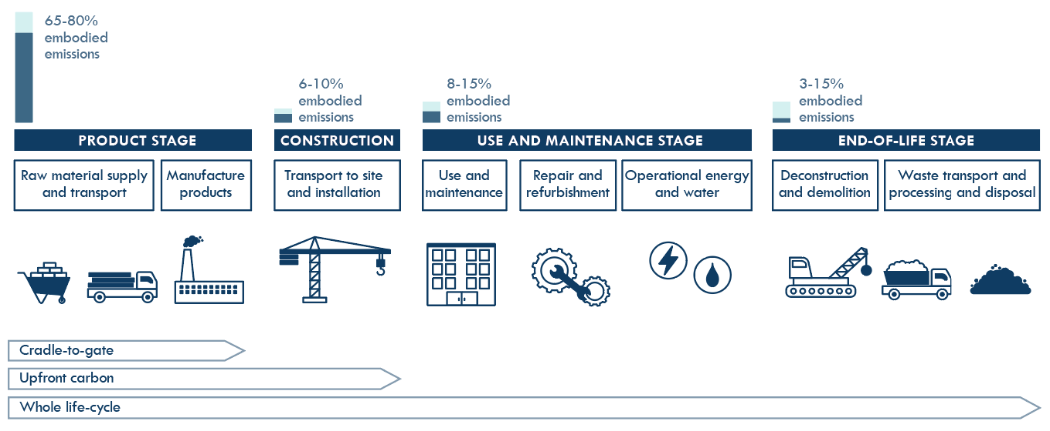
Embodied CO₂e Life Cycle Stage Calculations
NOT INCLUDED
Notes:
Jacob

Slide 4
Basic embodied carbon math
Material quantity
Emission factor
Product emissions
kg CO2e
per life cycle phase
From plan take-offs
From EPDs or other approved data source
Notes:
Jacob

Slide 5
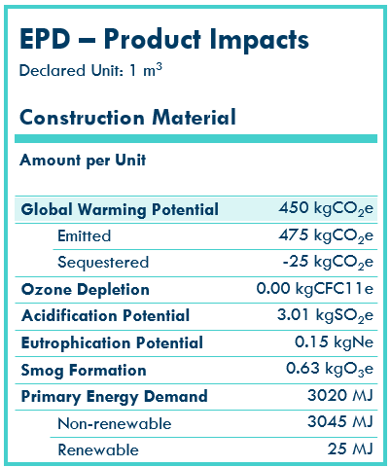
Estimating material carbon emissions
Emission data sources
An Environmental Product Declaration (EPD) "quantifies environmental information on the life cycle of a product to enable comparisons between products fulfilling the same function."
The EPD methodology follows ISO series 14040 & 14025 requirements.
Reports in kg CO2e.
Notes:
Jacob

Slide 6

BEAM Material CO₂ Emissions Estimator (A1-A3)
Direct side-by-side material comparisons
Assembly comparisons
Design development
Whole building models and comparisons
Includes carbon storing materials
Notes:
Melanie

Slide 7
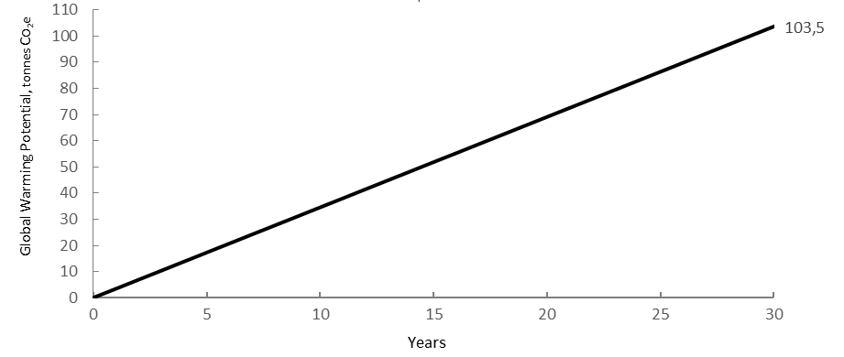
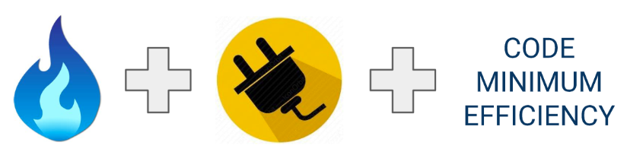
Cumulative Operational CO₂e Emissions – Business as usual
2-Storey house in Toronto:
104 tCO₂e
at 30 years
3.5 tCO₂e
per year
Source: Builders for Climate Action
Notes:
Example: Typical Two-Story House in Toronto
Built to code minimum efficiency.
Uses a mix of natural gas and electricity.
Annual Carbon Emissions: 3.5 tons of CO2 released per year.
30-Year Total Emissions: 104 tons of CO2 over 30 years.
Graph Details:
X-axis: Years (30-year period).
Y-axis: Tons of greenhouse gas emissions.

Slide 8
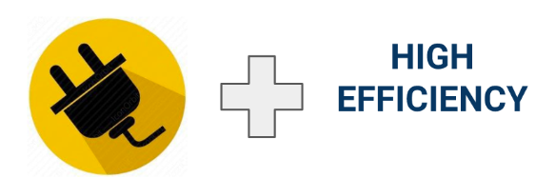
Cumulative Operational CO₂e Emissions –
High Efficiency
104 t
30 years
2-Storey house in Toronto:
104 tCO₂e
at 30 years
3.5 t
per year
0.44 tCO₂e per year
13.2 tCO₂e
At 30 years
Measuring and reducing OC is well understood…
Source: Builders for Climate Action
Notes:
High-Efficiency, Low-Energy Building:
Switches to electricity-only as the fuel source.
Reduced Carbon Emissions:
Less than 0.5 tons of CO2 per year.
Just over 13 tons of CO2 over 30 years.
Energy Management & Fuel Switching:
Proven methods for measuring and reducing operational carbon emissions.

Slide 9
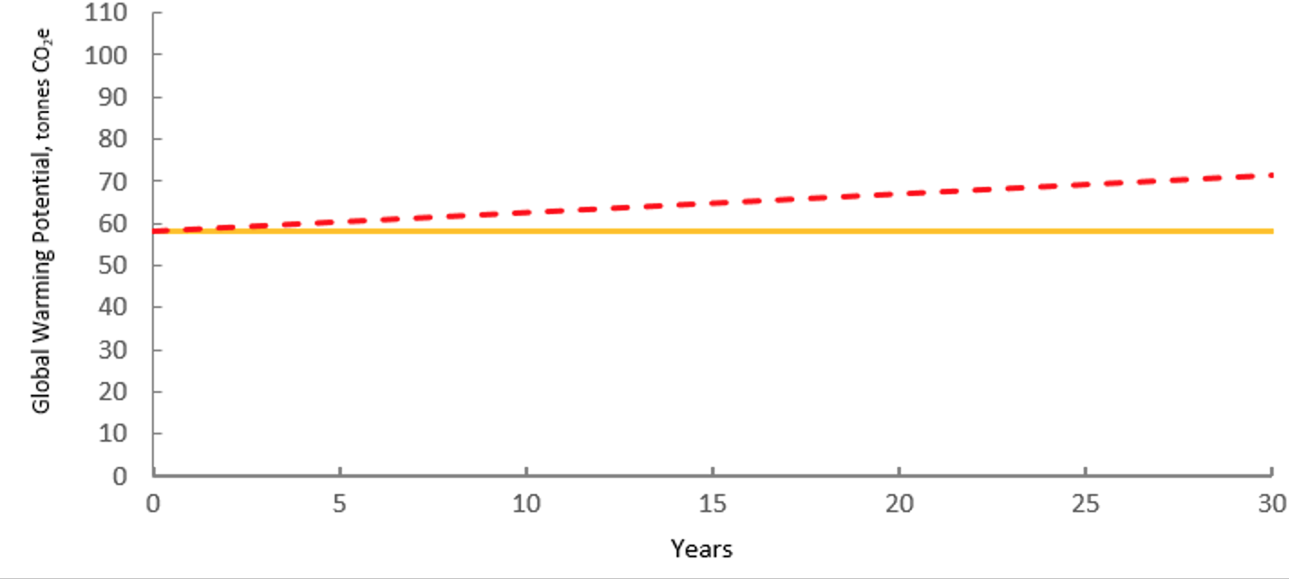
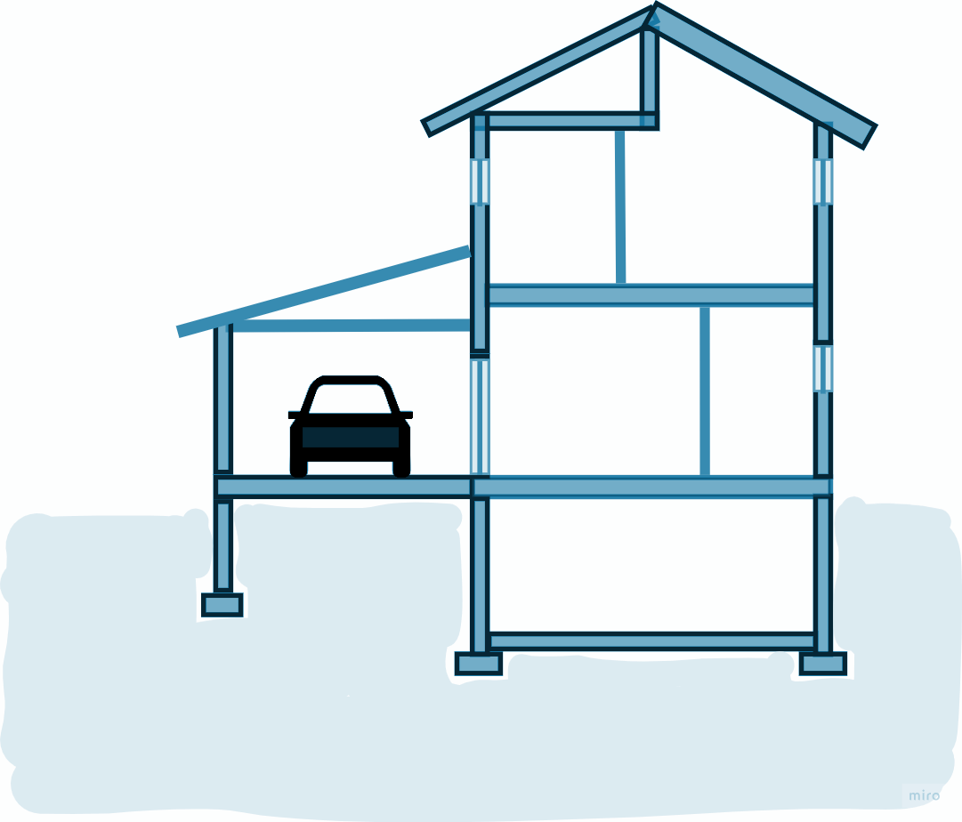
High Embodied + Low Operational
CO₂e Emissions
13.2 t
30 years
+ ?
Material emissions happen up-front when materials are manufactured and assembled
Source: Builders for Climate Action
2-Storey house in Toronto:
Notes:
Carbon Emissions Start Before Operation: Emissions begin with material production and construction, not just building use.
Upfront + Operational Emissions: To understand total building impact, combine upfront embodied carbon with ongoing operational emissions.
Whole Picture Required: Total carbon footprint can only be known by accounting for both embodied and operational emissions.
Graph Details:
X-axis: Years (30-year period).
Y-axis: Tons of greenhouse gas emissions.

Slide 10

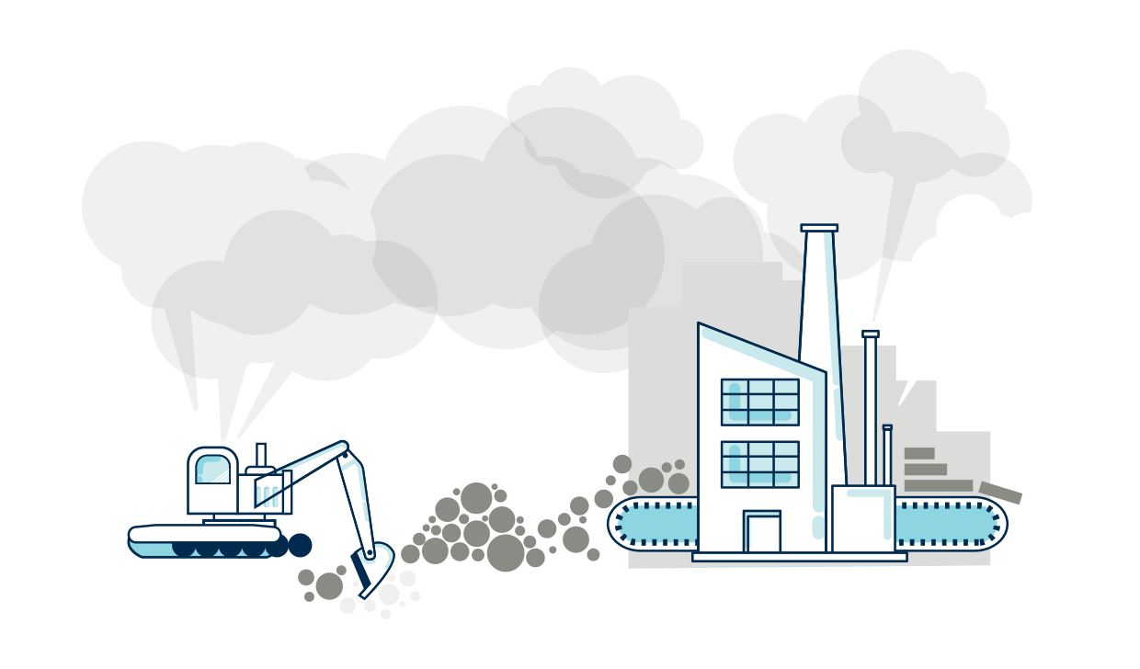

We need to reduce both!
Material
Carbon Emissions
Operational
Carbon Emissions
+
=
ENERGY
USE INTENSITY
CARBON INTENSITY
ENERGY SOURCE
EMISSIONS
Graphic : Builders for Climate Action
Notes:
Look Beyond Energy Use: Evaluating building performance requires assessing both material (embodied) emissions and operational emissions, not just energy use intensity (EUI).
From Energy to Emissions: Convert operational energy to carbon emissions using fuel-specific emission factors.
Carbon Use Intensity (CUI): Combine operational carbon and upfront embodied carbon to create a more comprehensive metric for building performance.

Slide 11
The Putney School New Dorms:
Structure of Presentation
 | The building and context Operational Energy and CO2e Modeling (2 options) Embodied CO2e in Materials (3 options) Total Carbon Picture Over Time (2 options) Lessons Learned

Slide 12
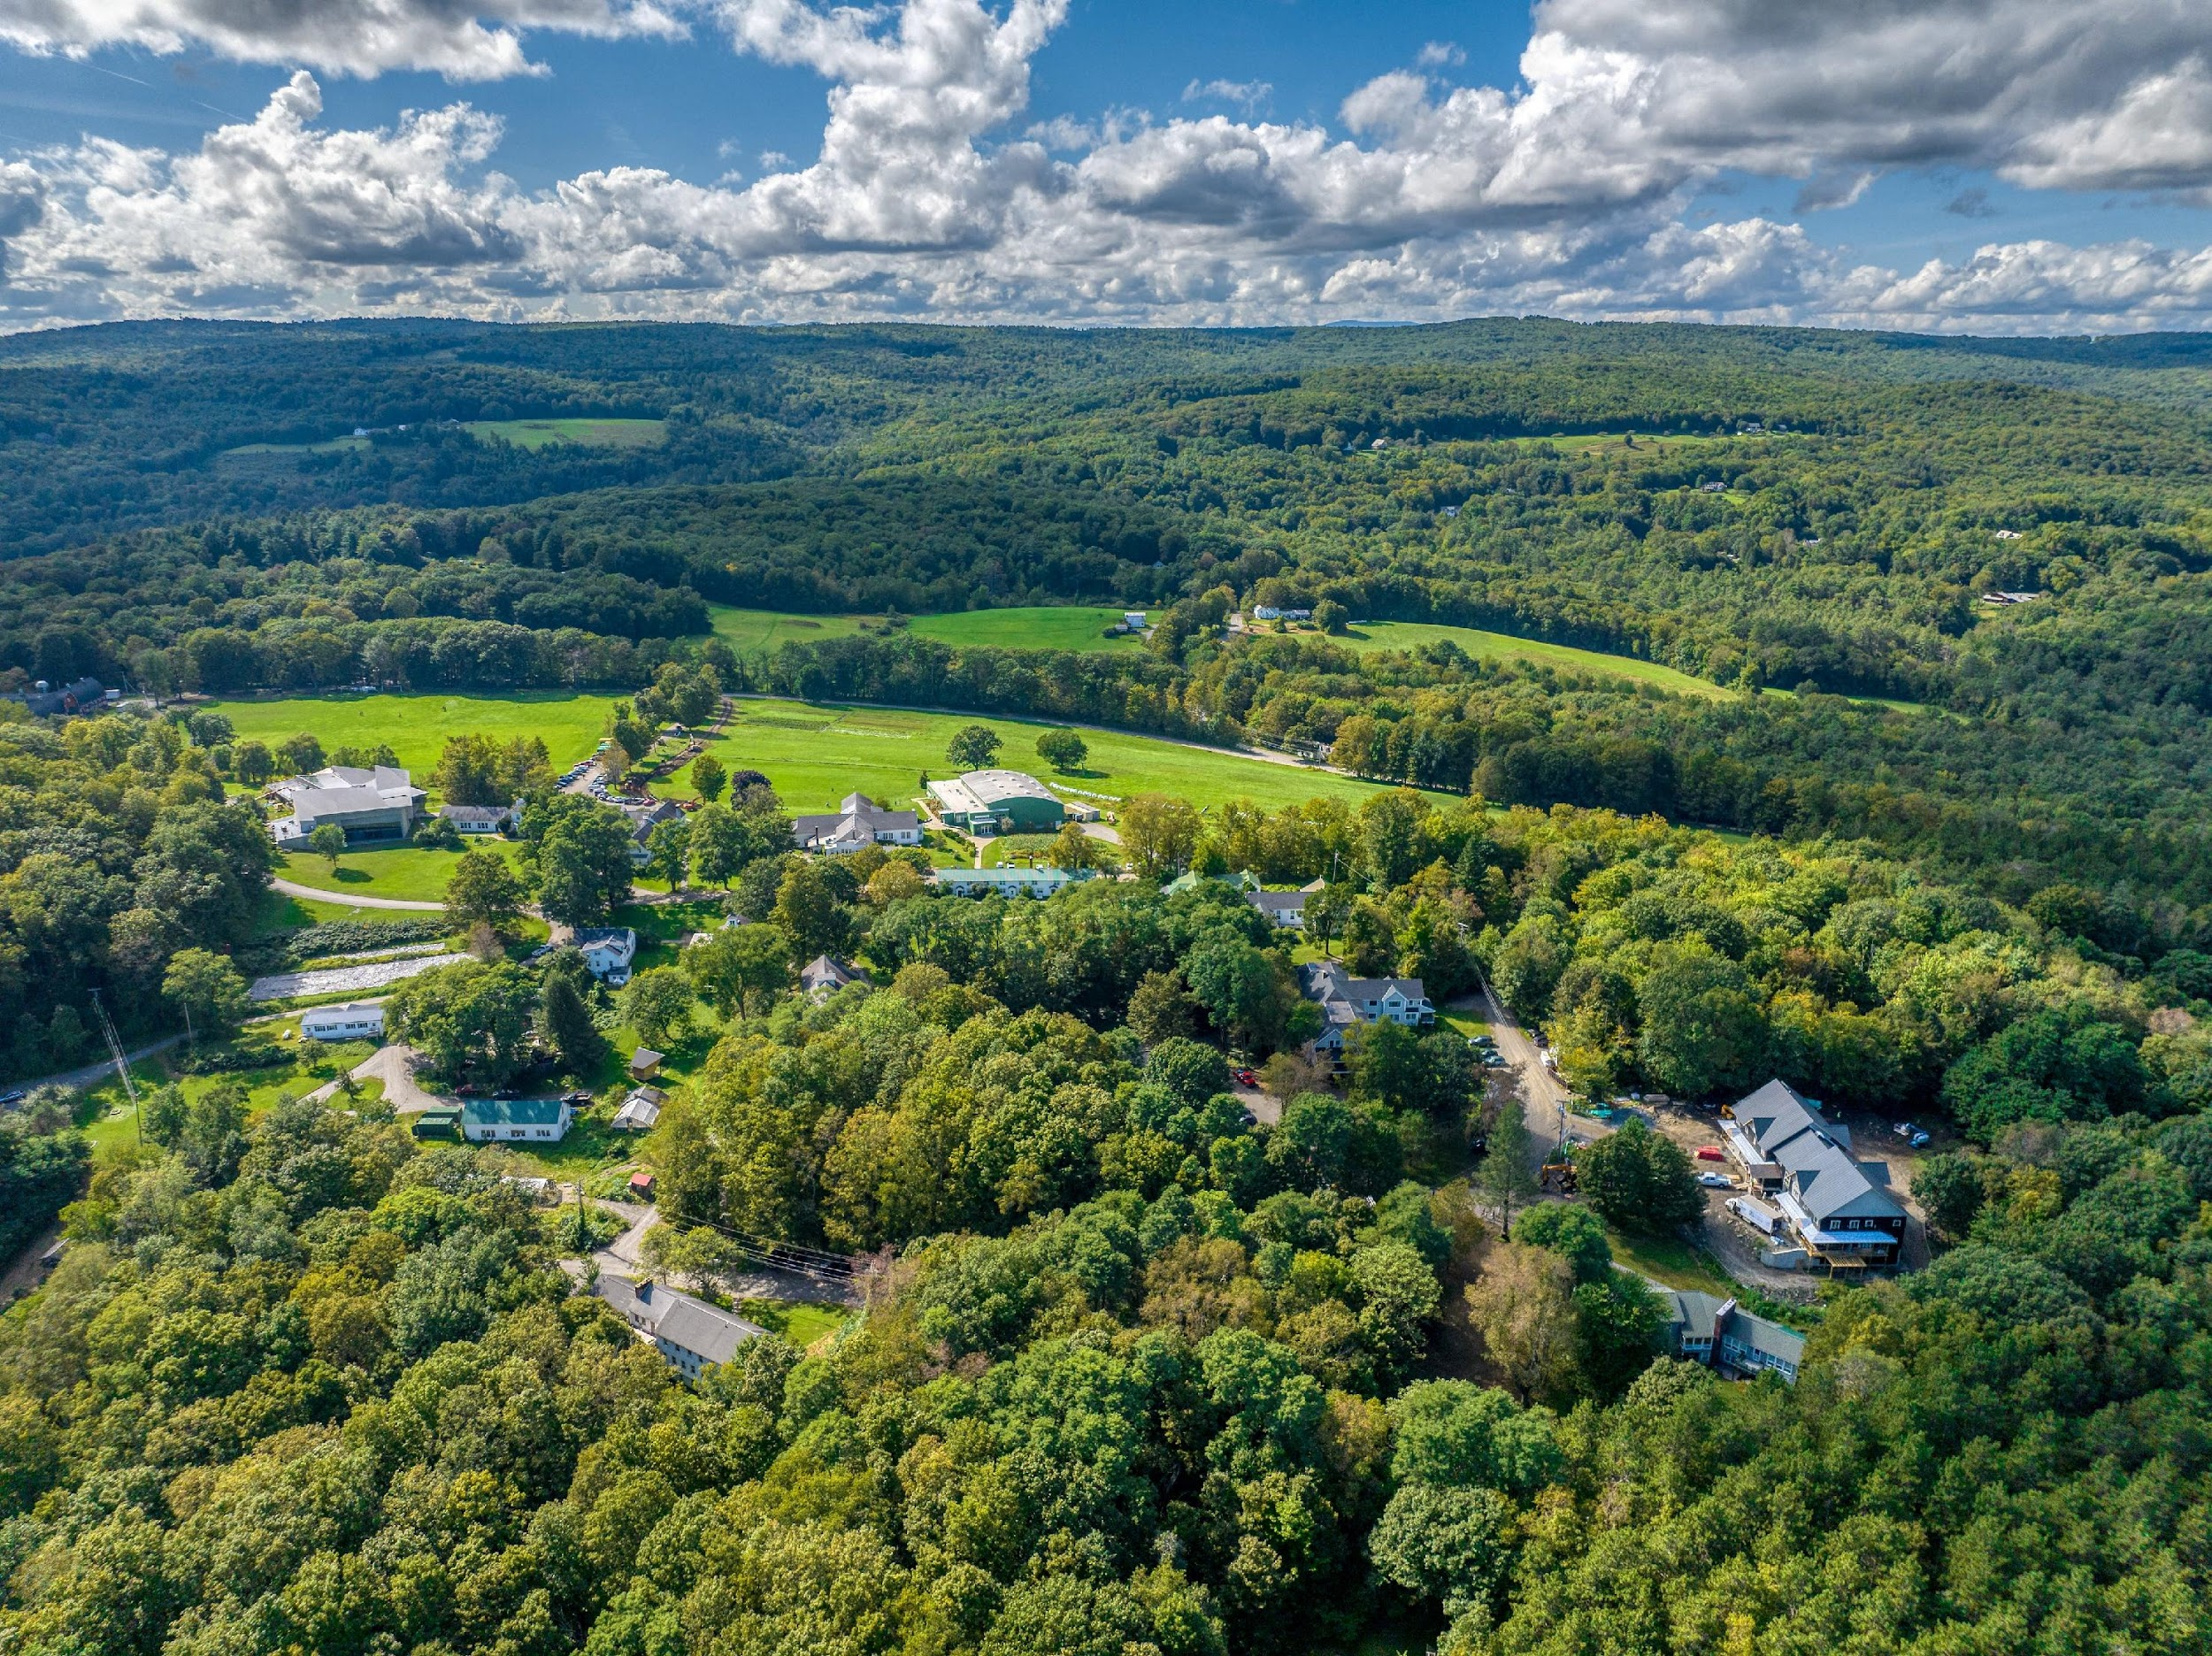
Hepper House
Gund House

Slide 13
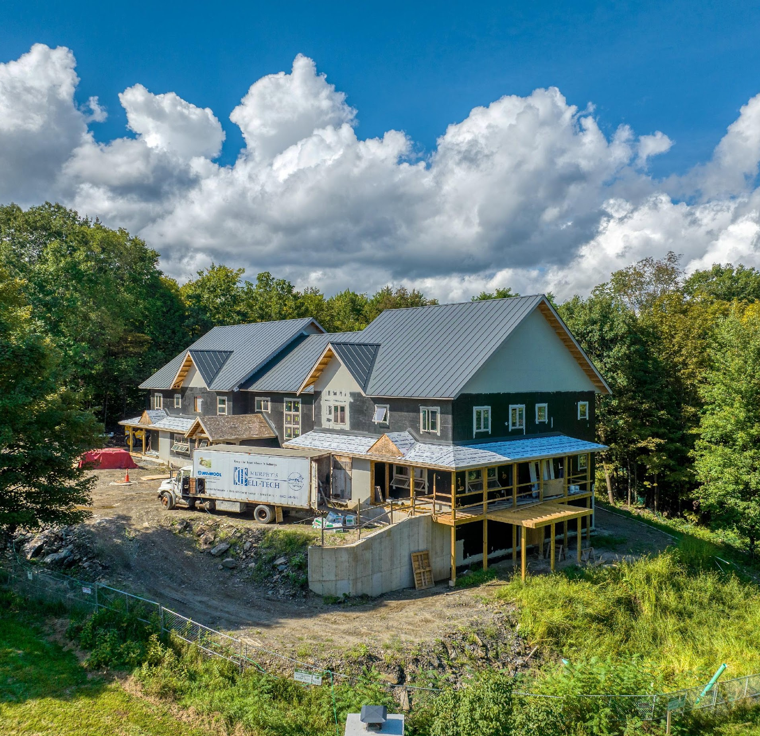
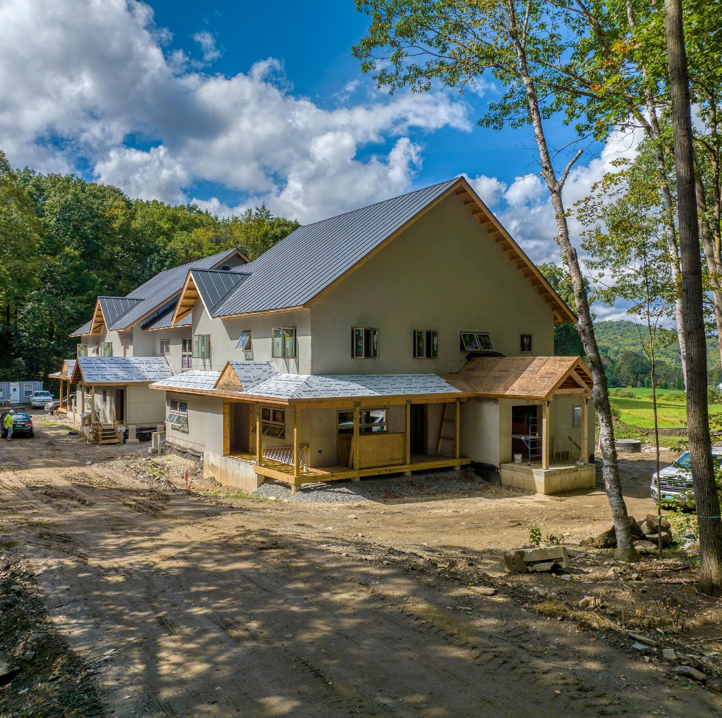
The Putney School New Dorms:
Two Buildings, Nearly Identical
Gund House
Hepper House

Slide 14
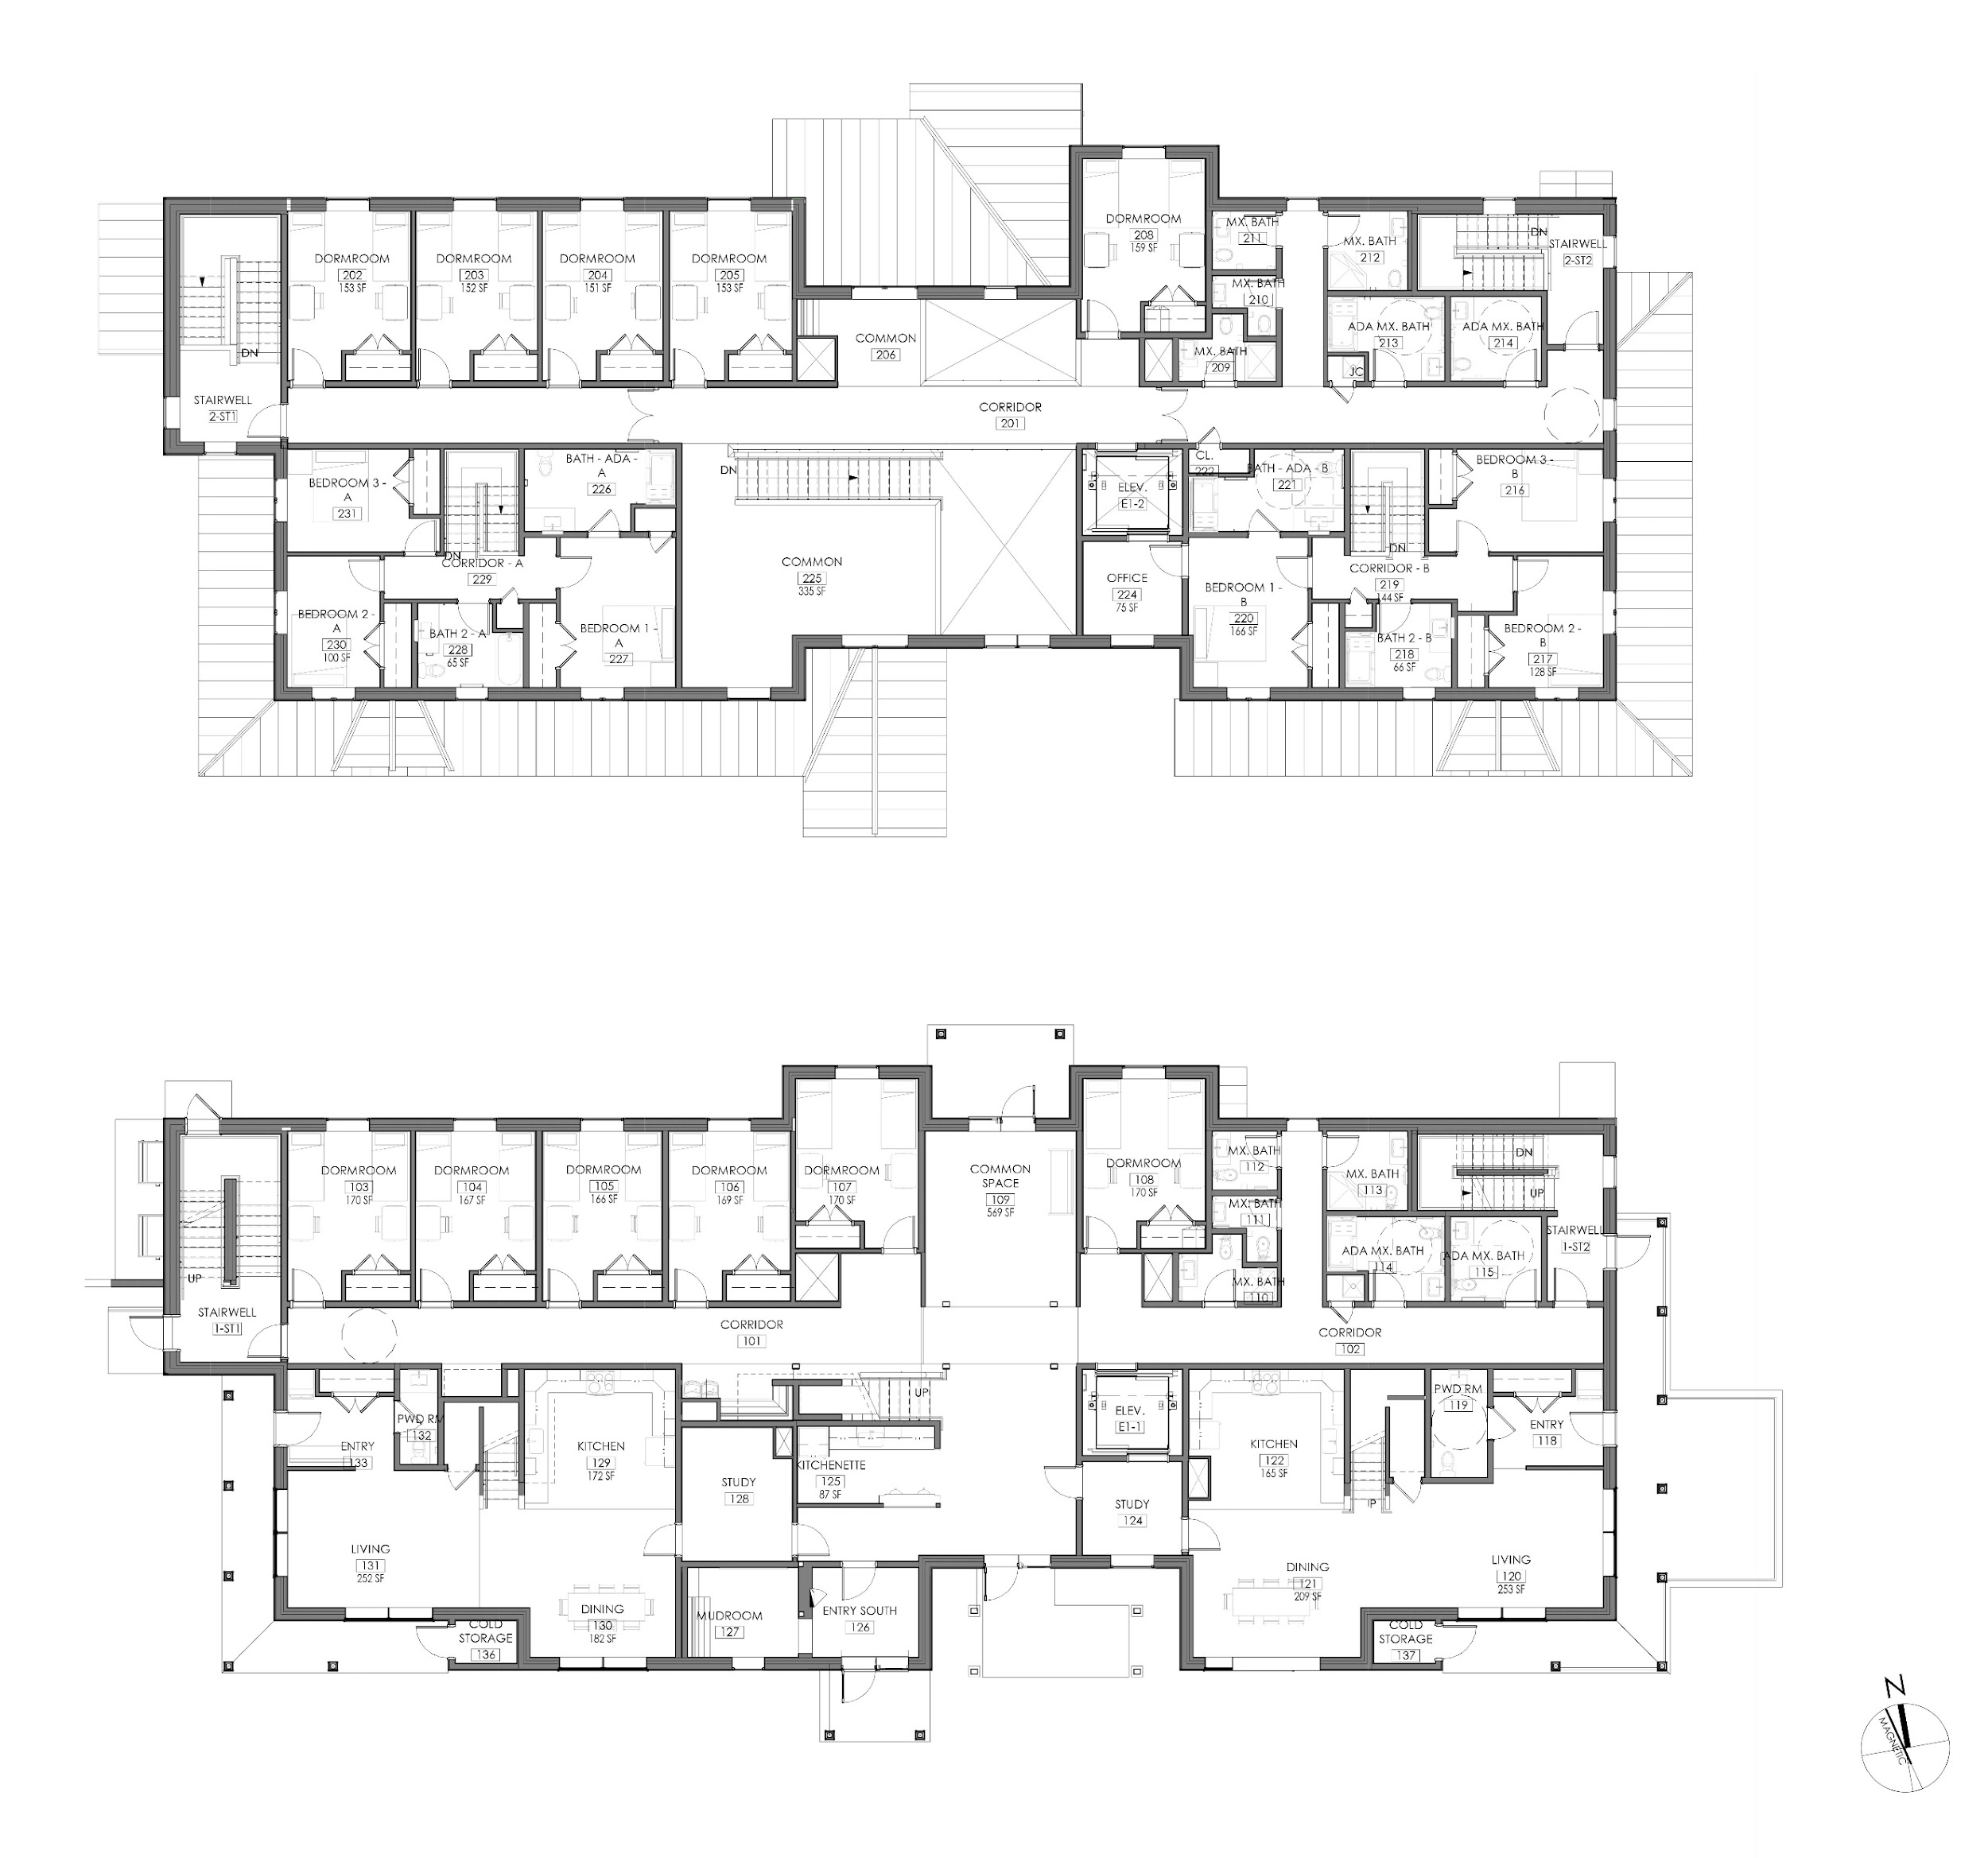
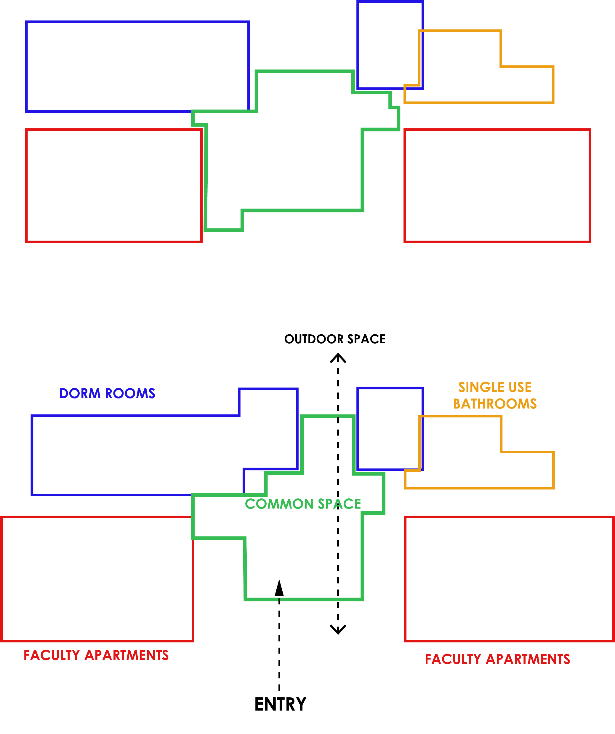
First Floor Plan
Project description, early material decisions/discussions - Cat (5 min)
Second Floor Plan

Slide 15
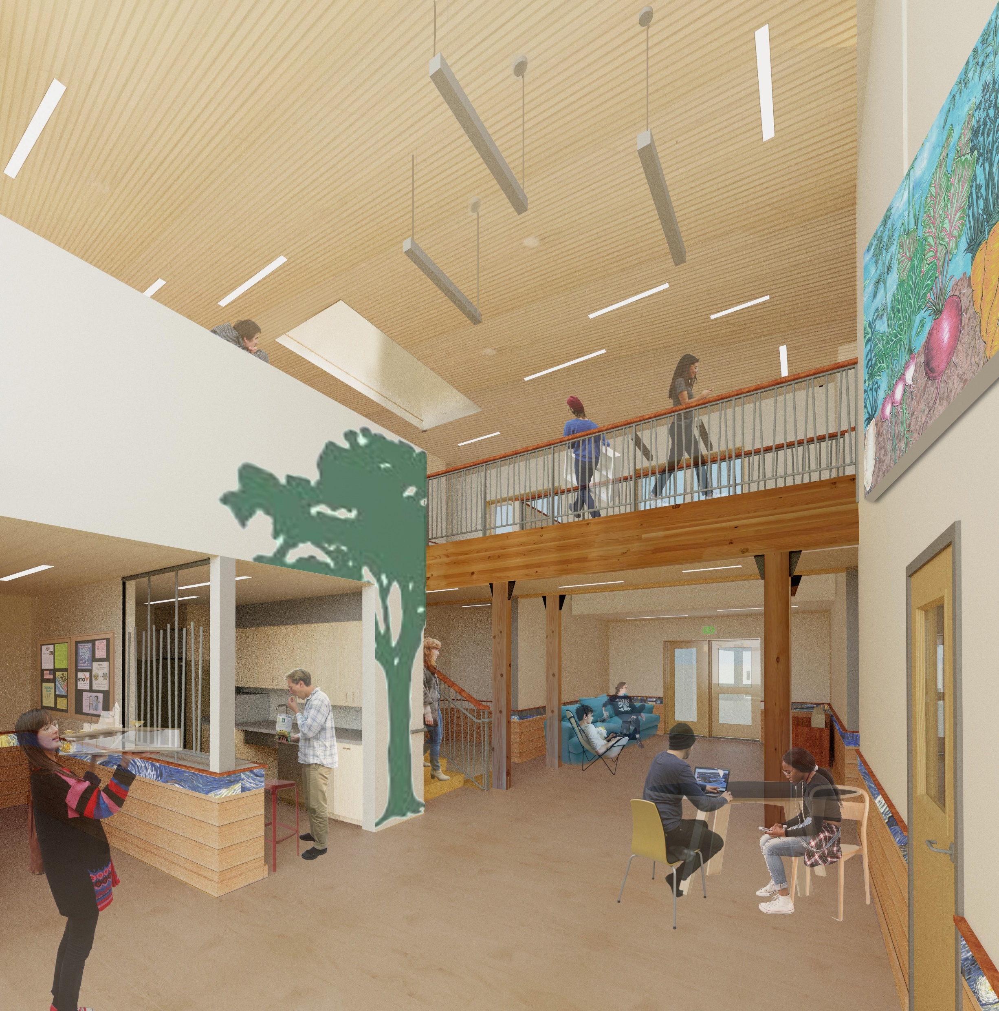
The Putney School New Dorms:
Embodied Carbon – Material Considerations
Original interior rendering:

Slide 16
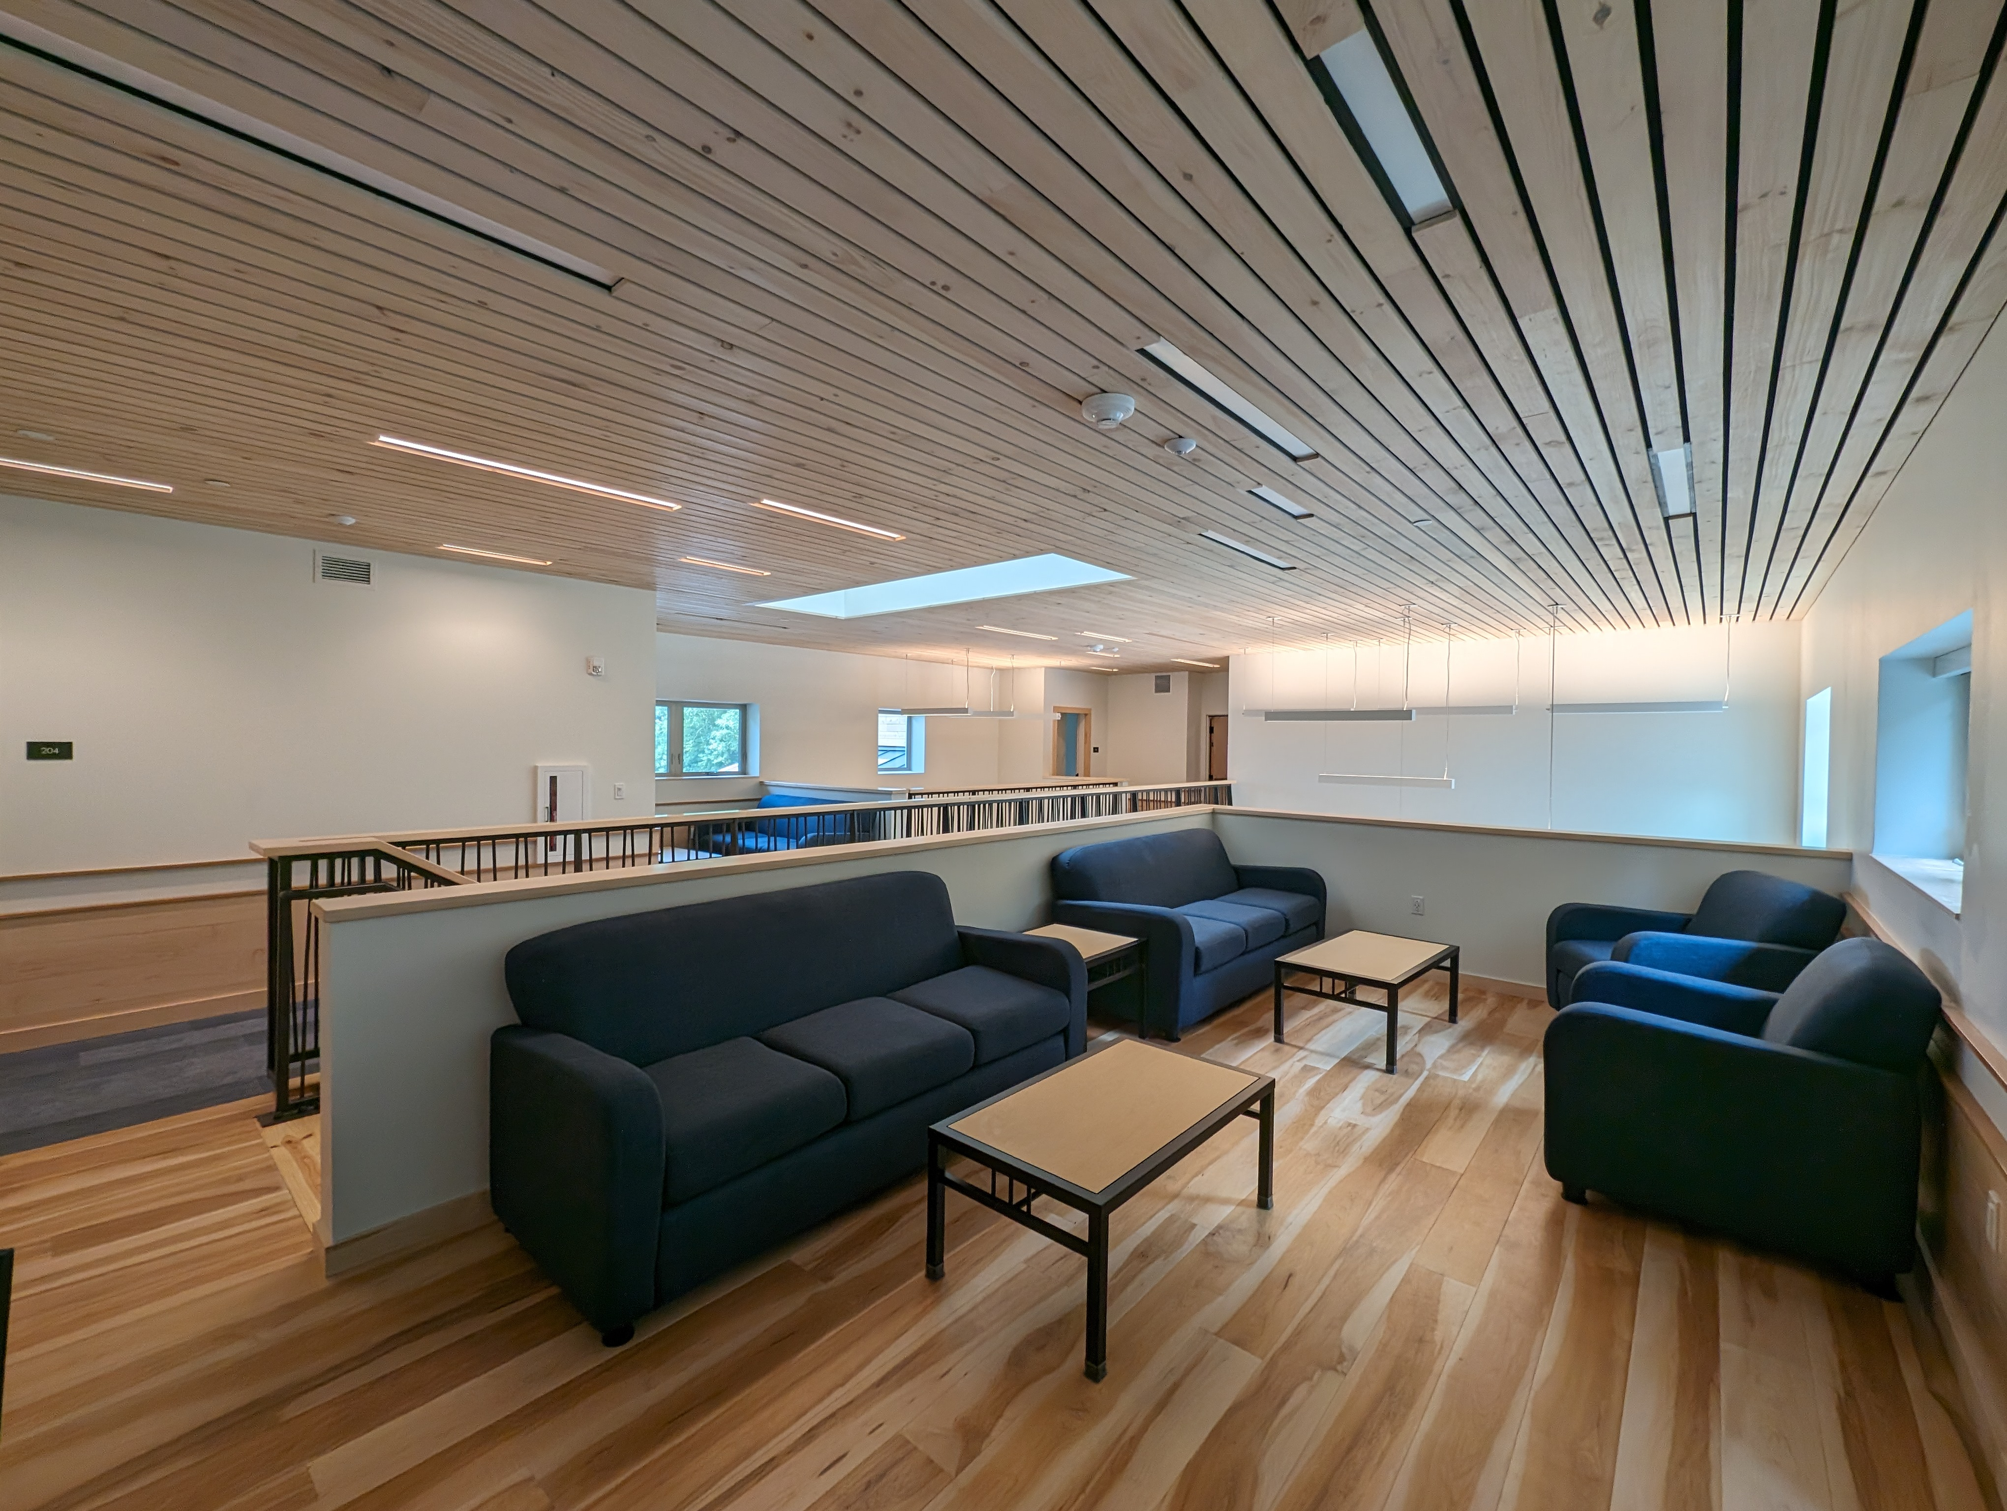
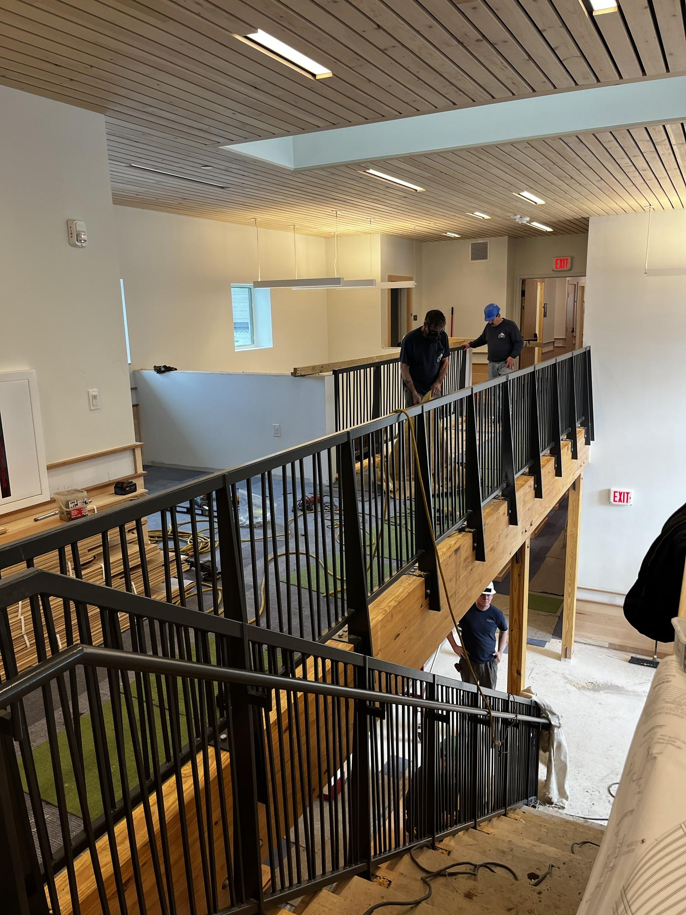
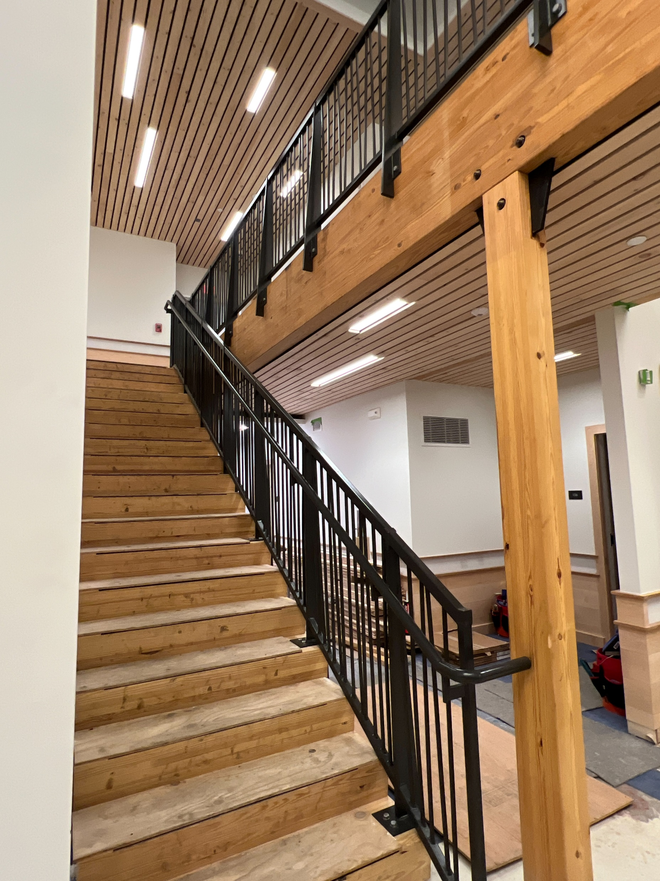
Double-height common space for students

Slide 17
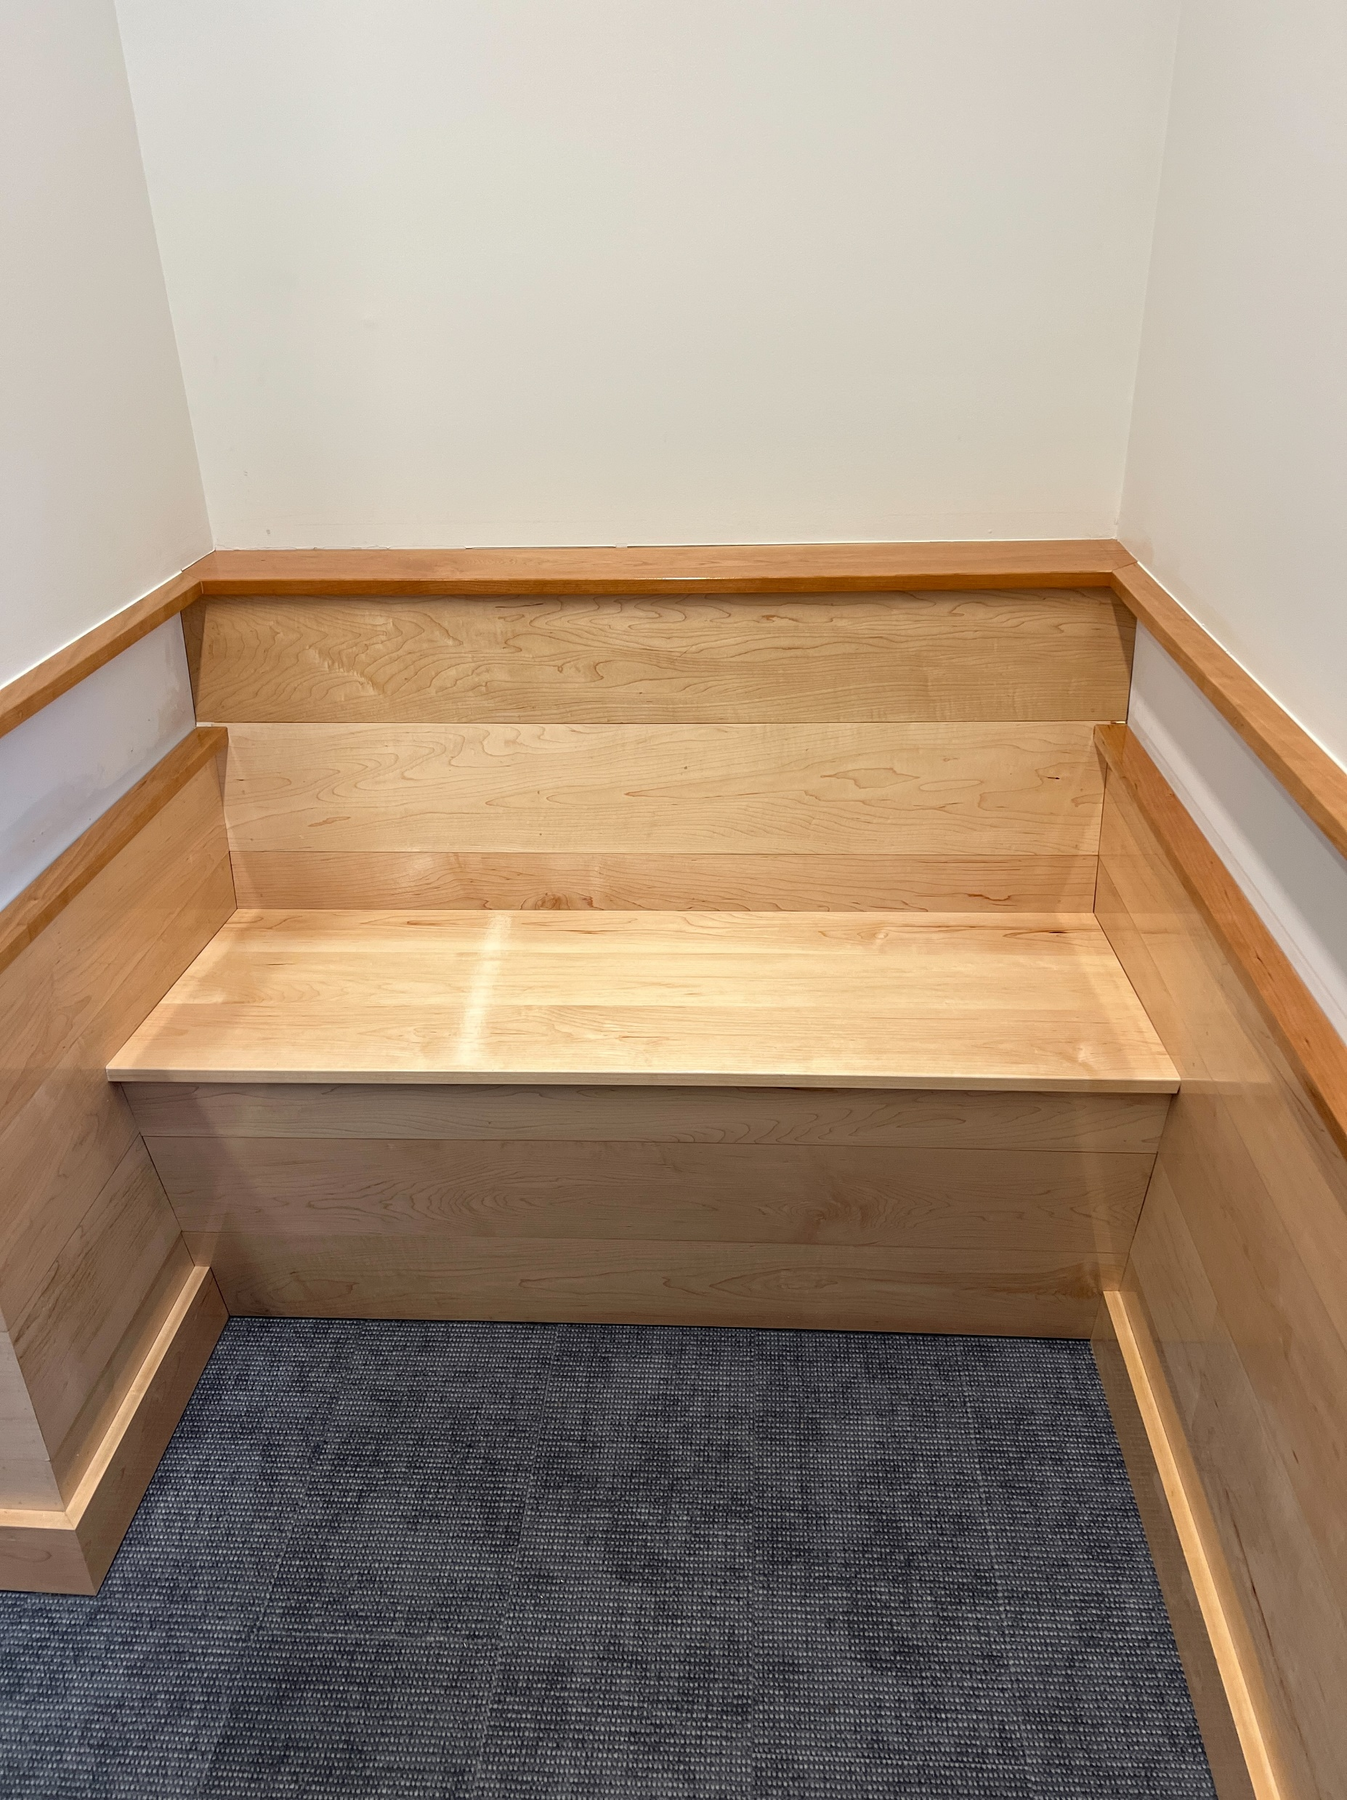
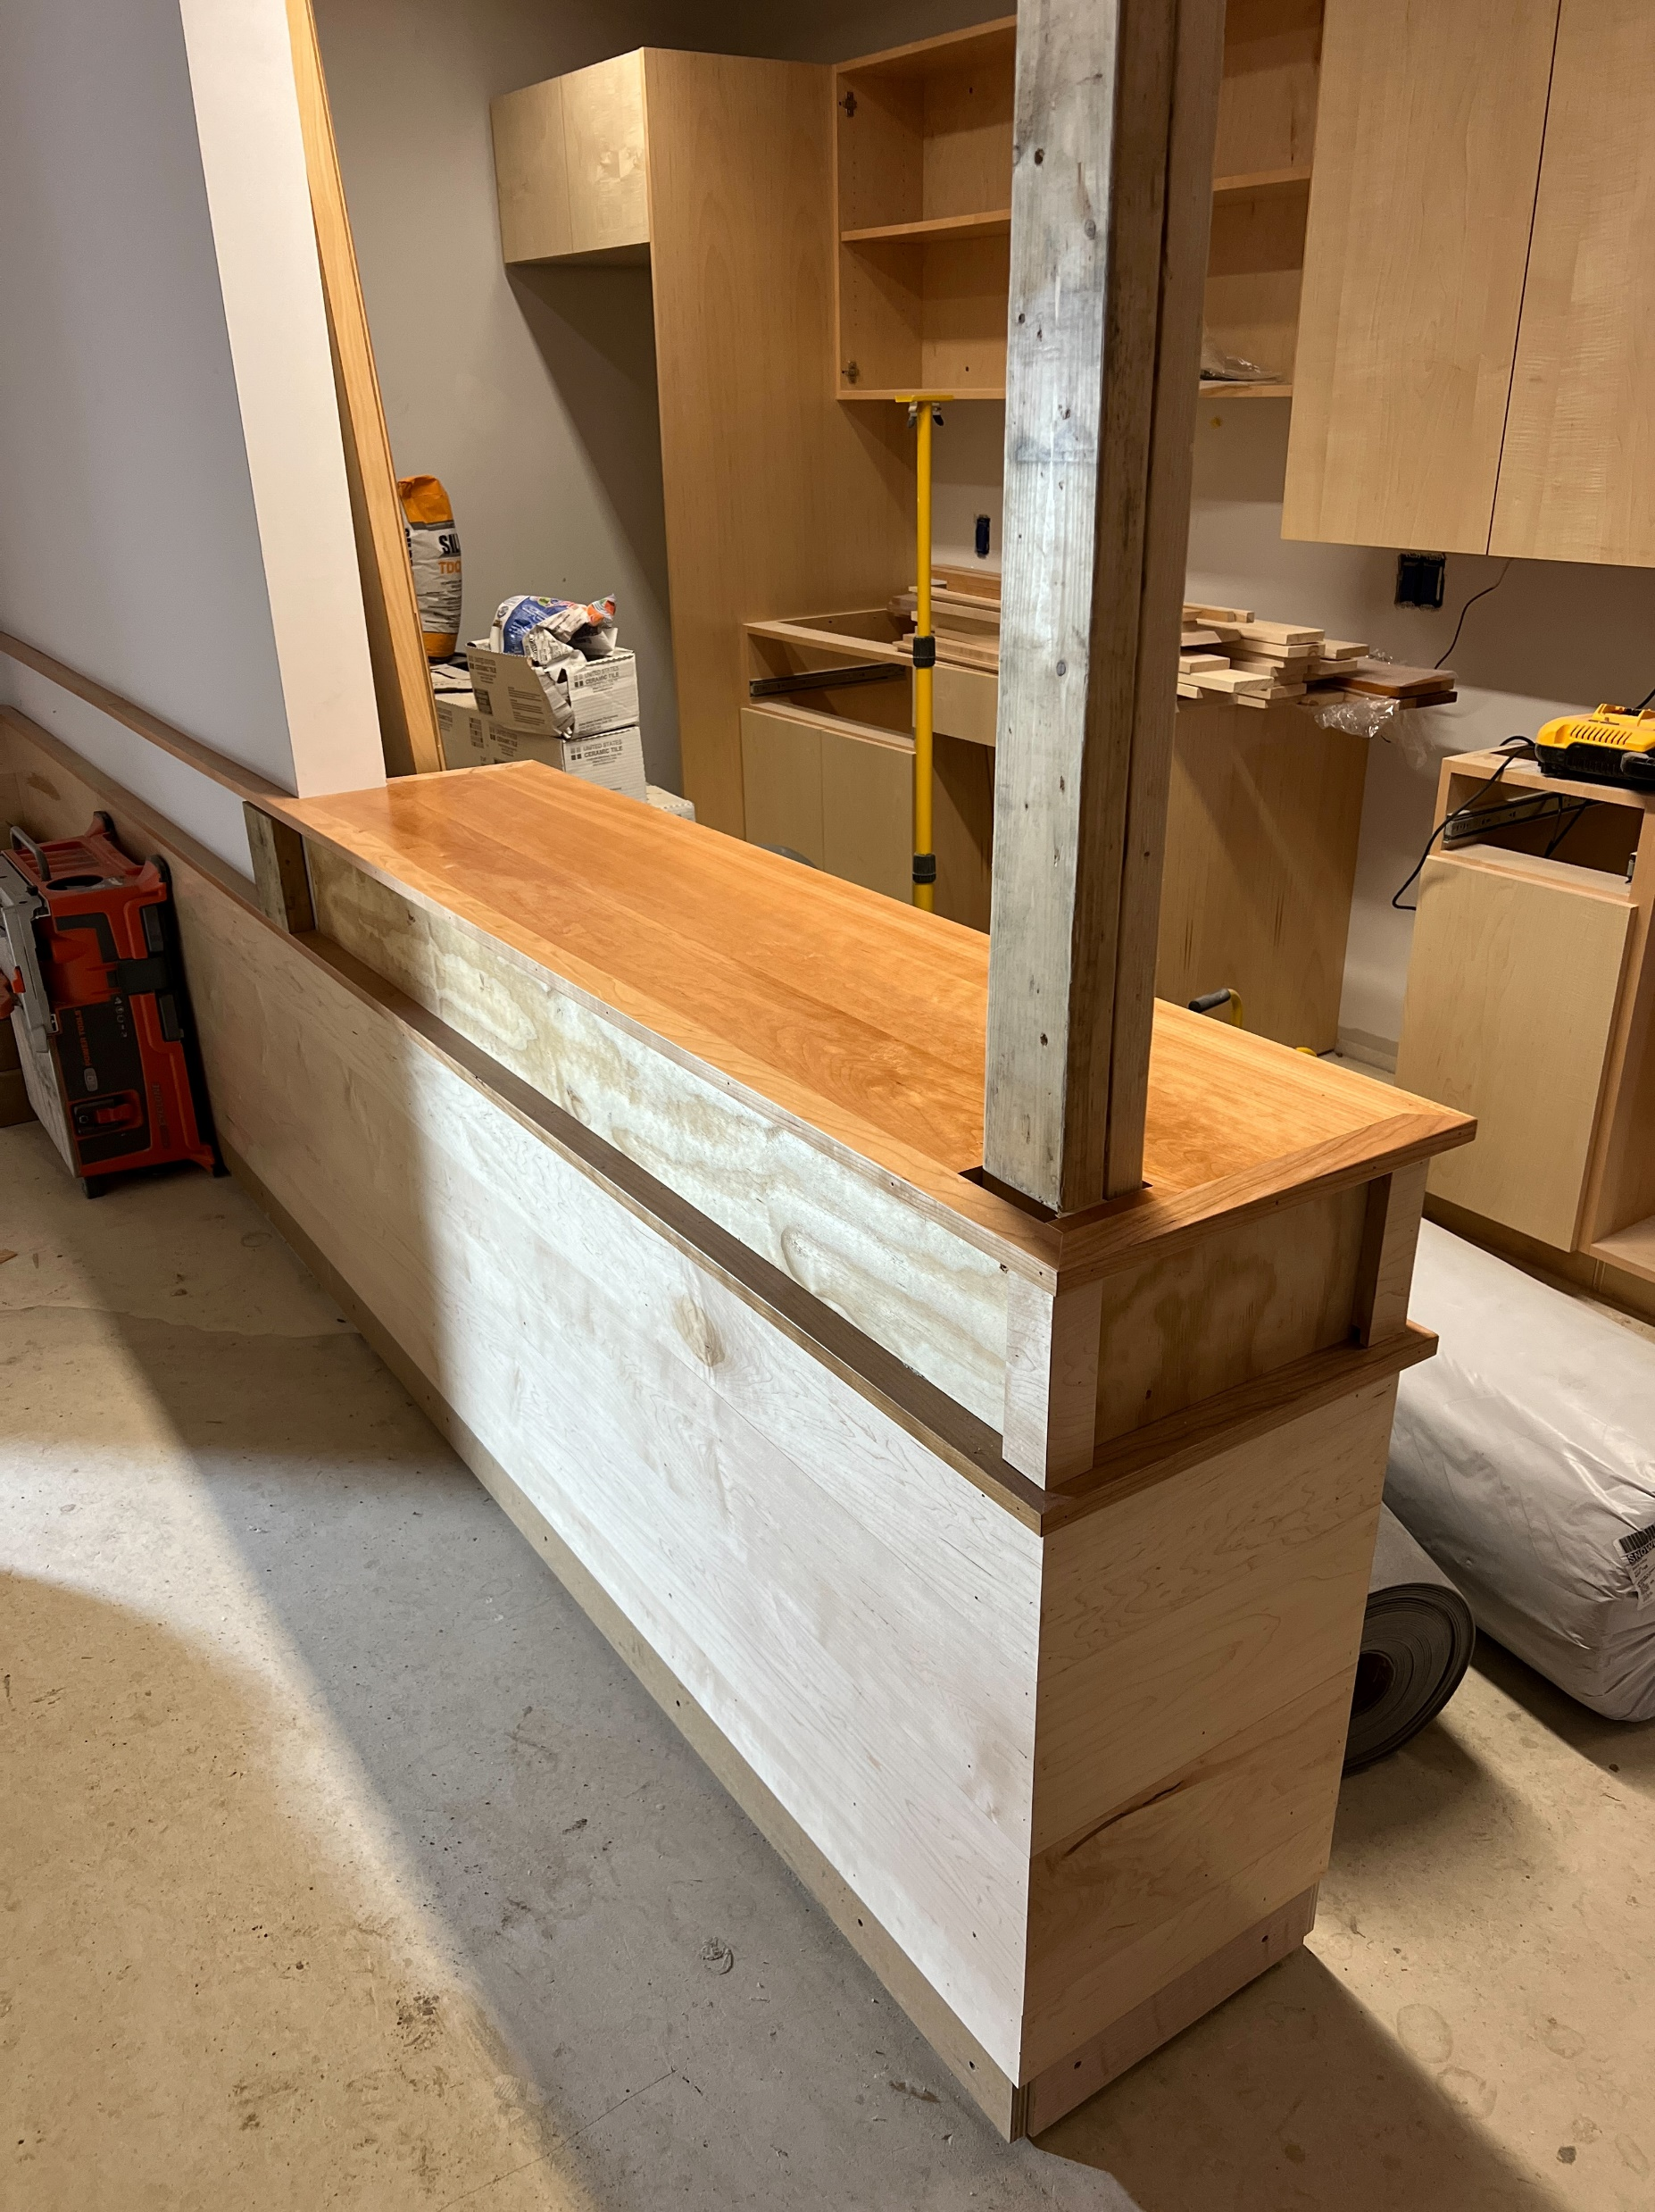
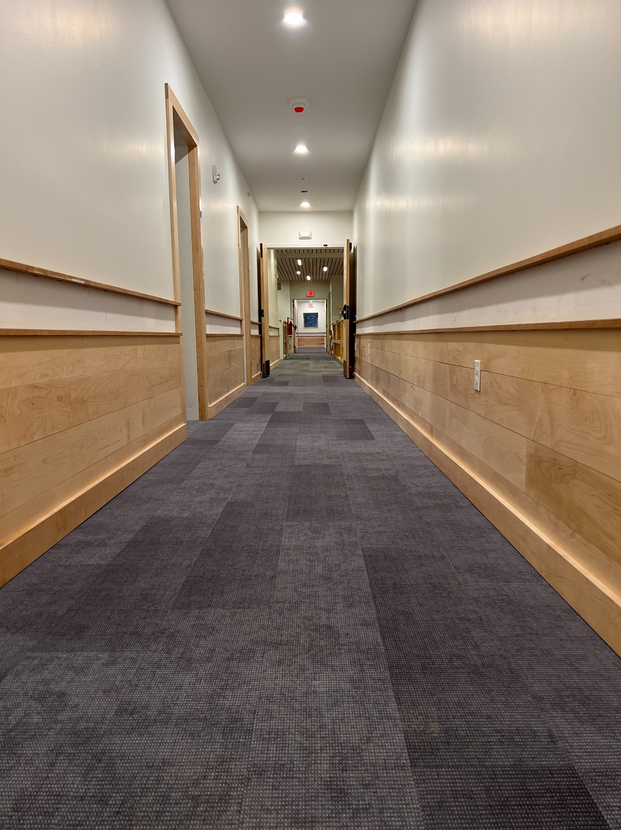
Wood accents anticipating student involvement

Slide 18
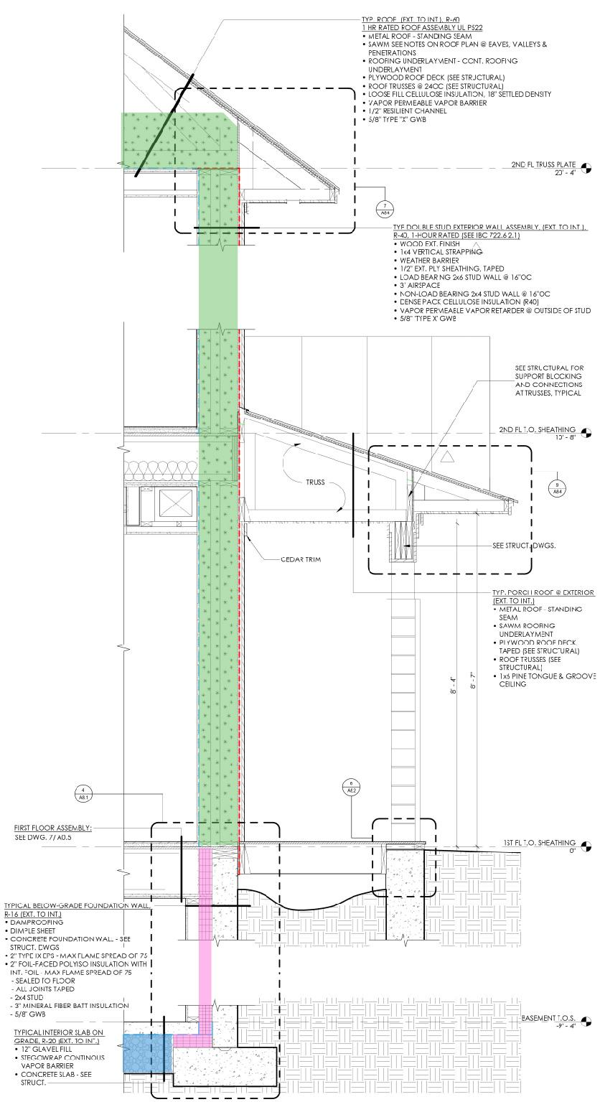
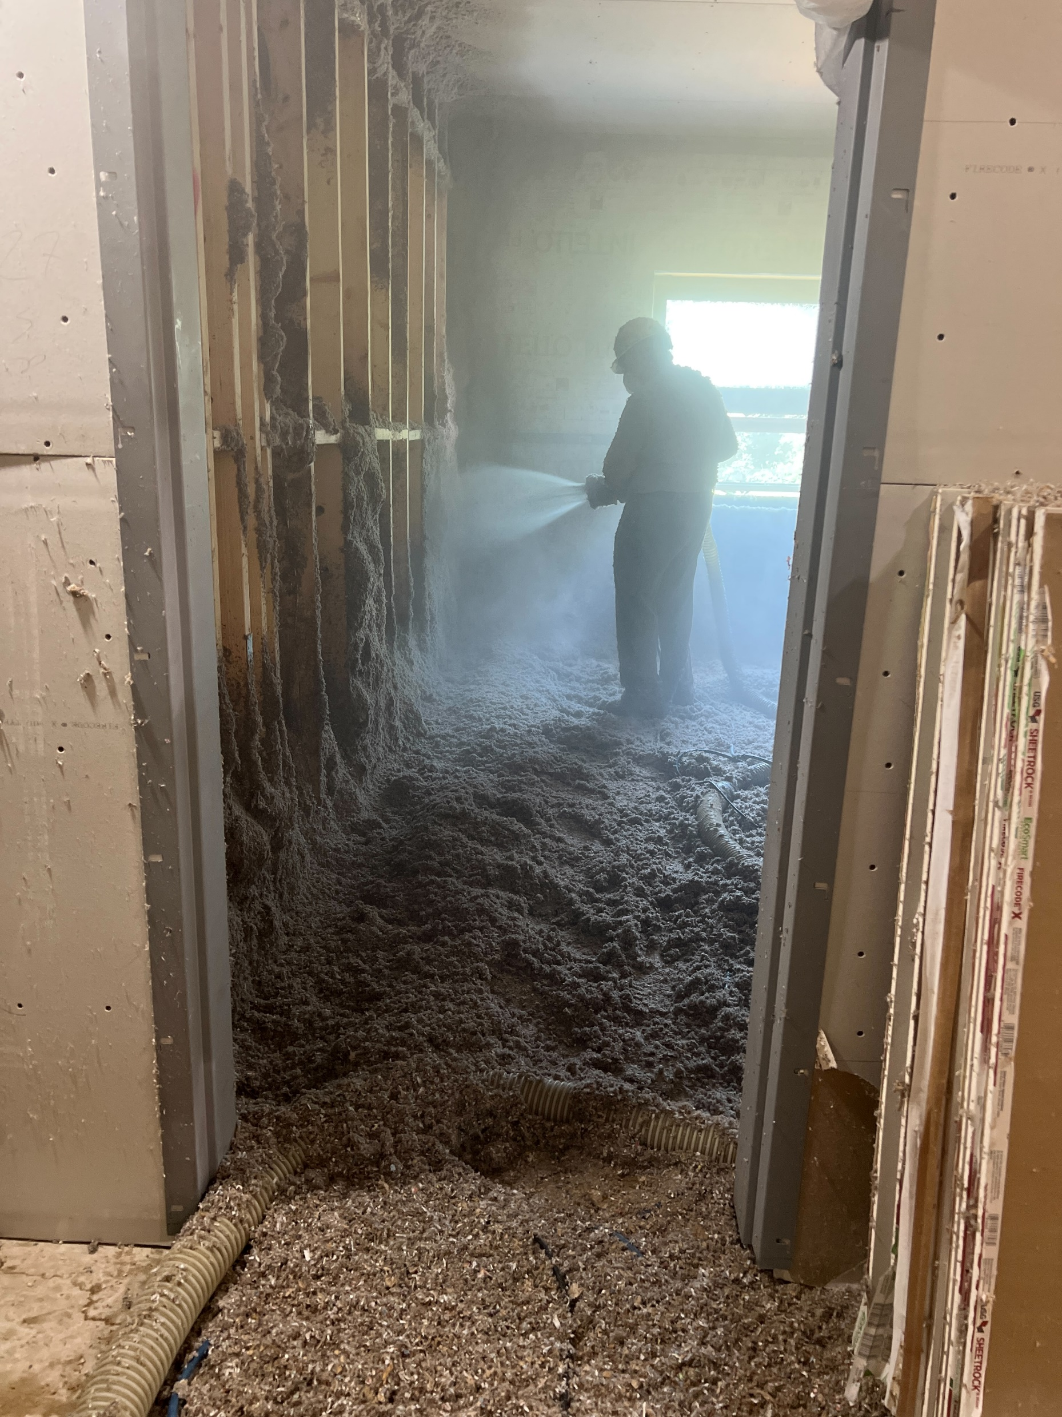
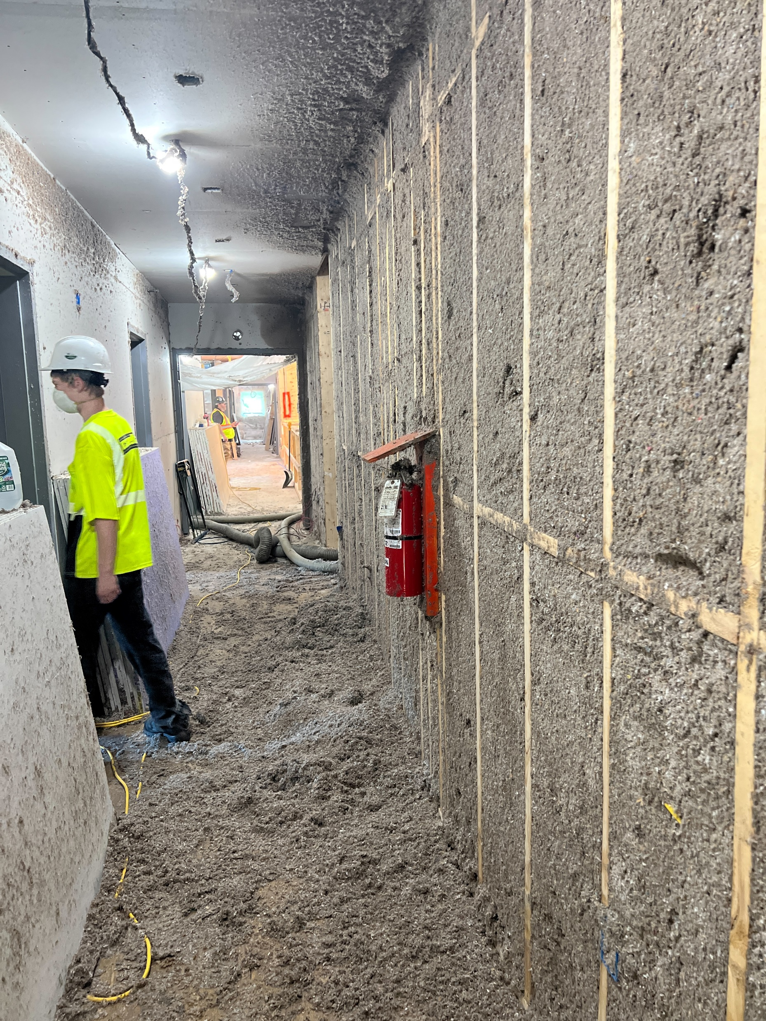
The Putney School New Dorms:
Embodied Carbon & Insulation
18” of Blown Cellulose
R-60
12” of Wet Spray Cellulose
R-40
4” of EPS + Polyiso
R-16
12” of Glavel
R-20

Slide 19
The Putney School New Dorms:
Cement Replacement in Concrete

Slide 20
The Putney School New Dorms:
Cement Replacement in Concrete

Slide 21
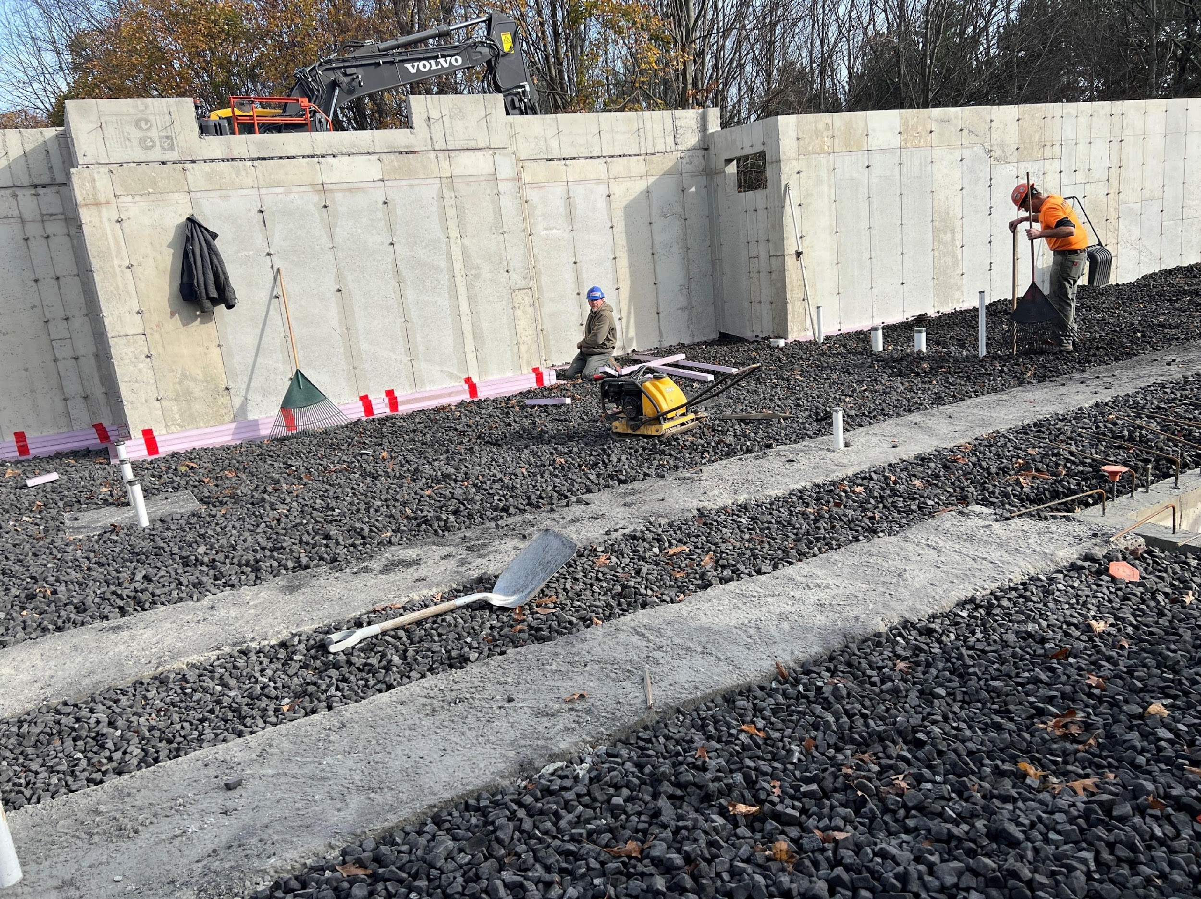
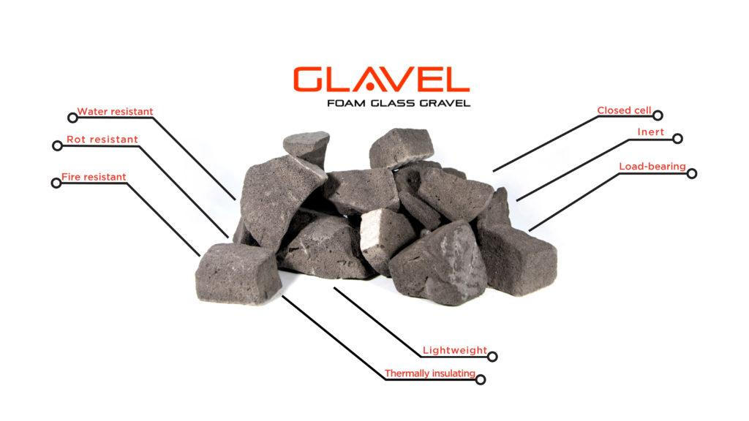
The Putney School New Dorms:
Embodied Carbon & Concrete

Slide 22
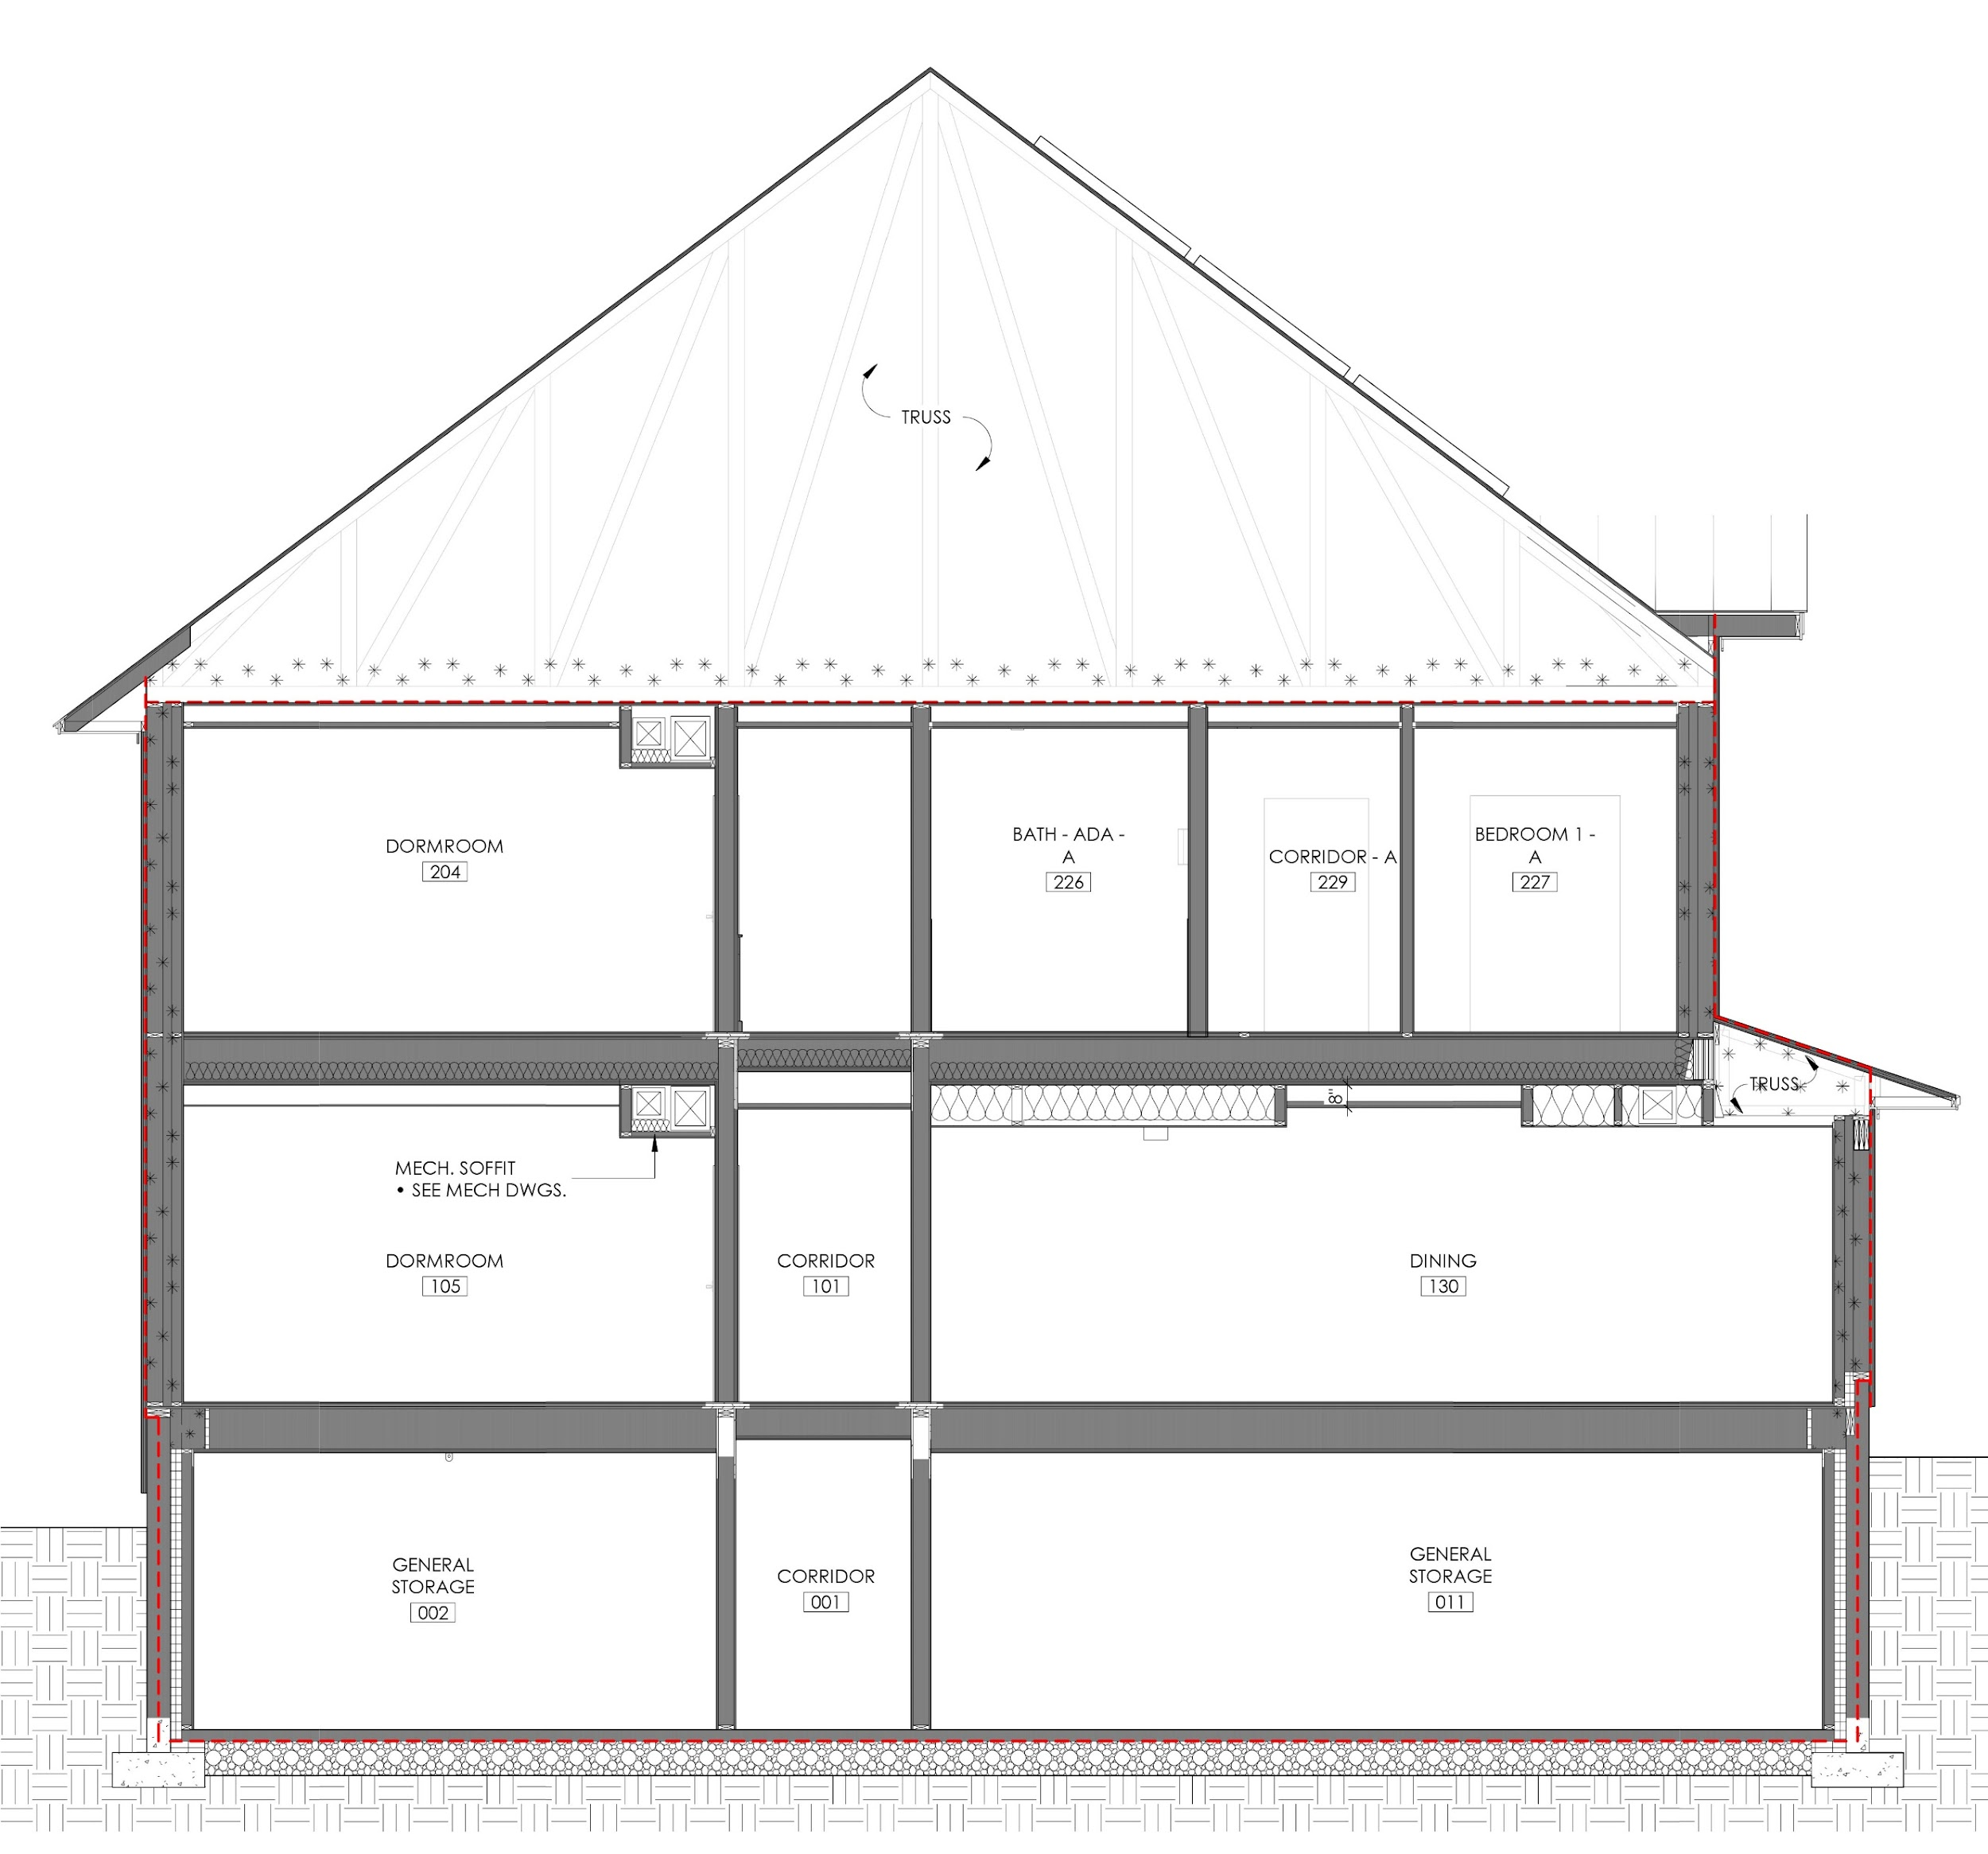
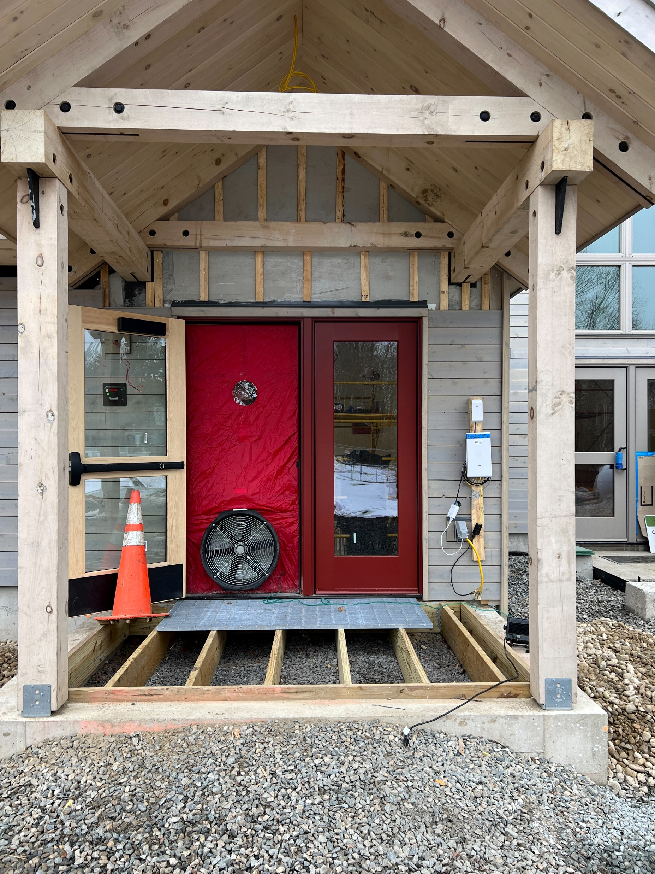

The Putney School New Dorms:
Lowering Operational Emissions at building envelope
Final blower door test of 0.035 CFM50 /SF of Envelope (6 sides)

Slide 23
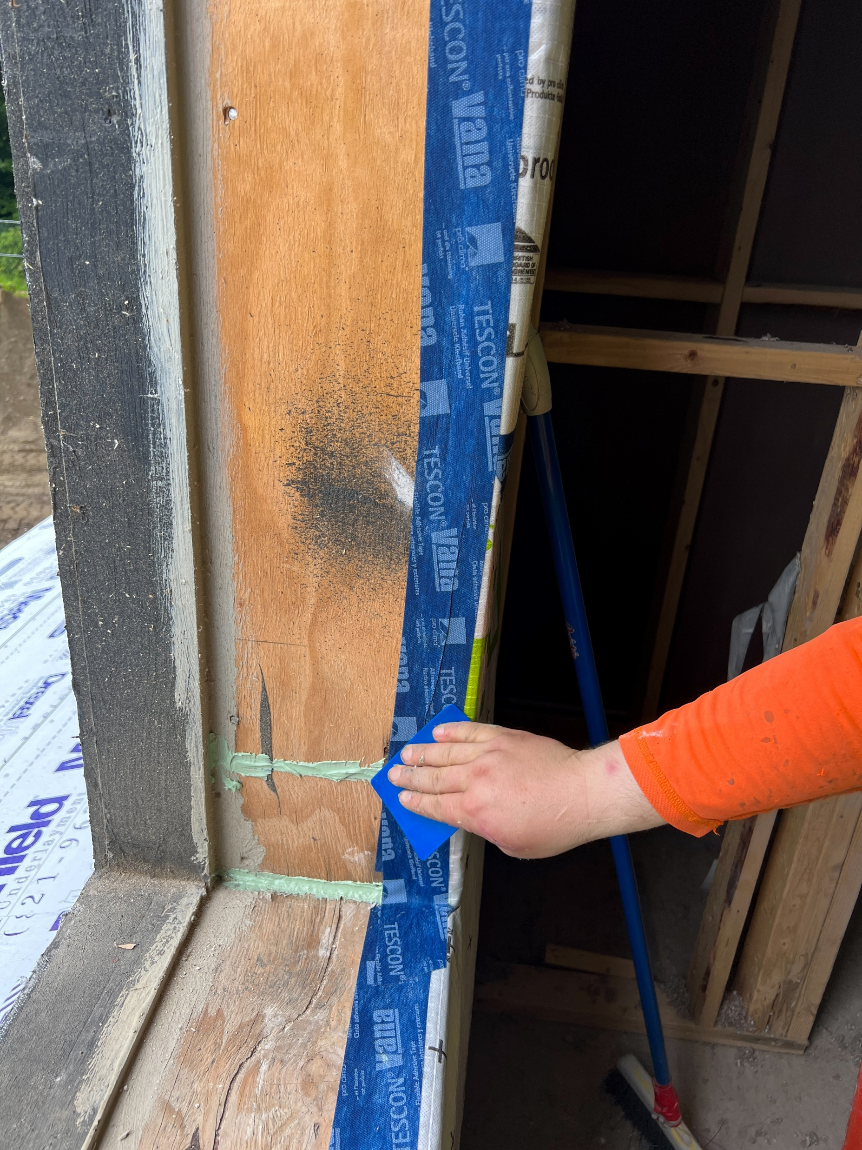
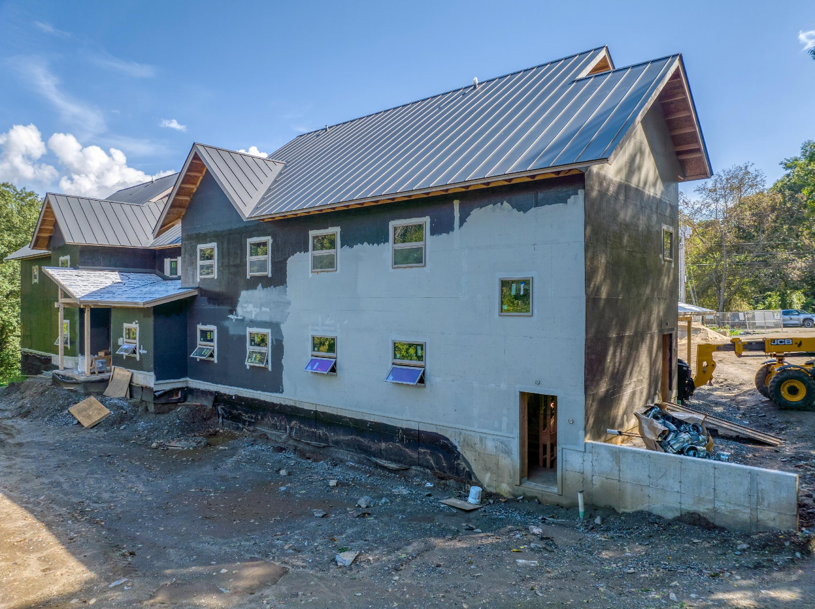
The Putney School New Dorms:
Continuous Air Barrier

Slide 24
The Putney School New Dorms –
Energy and CO2e Modeling
Three options analyzed:
Code building baseline, 2020 CBES
Baseline net zero ready building – Net zero ready performance built as if embodied CO2e was NOT considered
Lower embodied carbon net zero ready – Building as built

Slide 25
The Putney School New Dorms –
Operational Energy and CO2e Modeling

Slide 26
The Putney School New Dorms –
Operational Energy and CO2e Modeling

Slide 27
The Putney School New Dorms –
Operational Energy and CO2e Modeling

Slide 28
The Putney School New Dorms –
Operational Energy and CO2e Modeling

Slide 29
The Putney School New Dorms –
Operational Energy and CO2e Modeling

Slide 30
The Putney School New Dorms –
Operational Energy and CO2e Modeling

Slide 31
The Putney School New Dorms –
Operational Energy and CO2e Modeling
Achieved 0.035 cfm50/sq.ft. shell

Slide 32
The Putney School New Dorms –
Operational Energy and CO2e Modeling

Slide 33
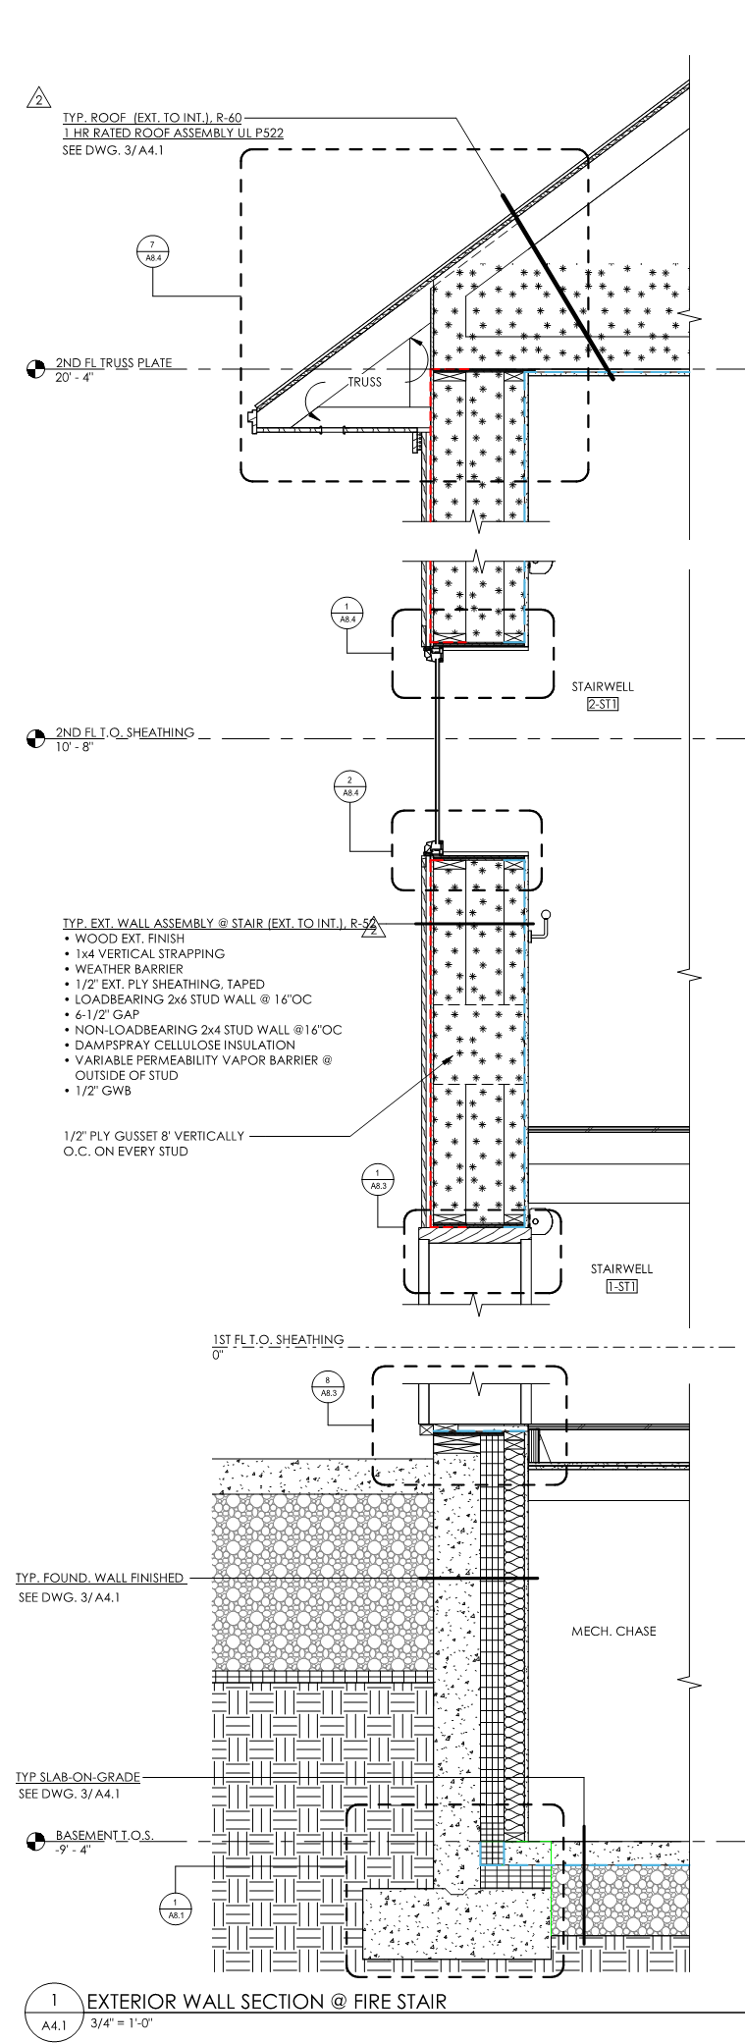
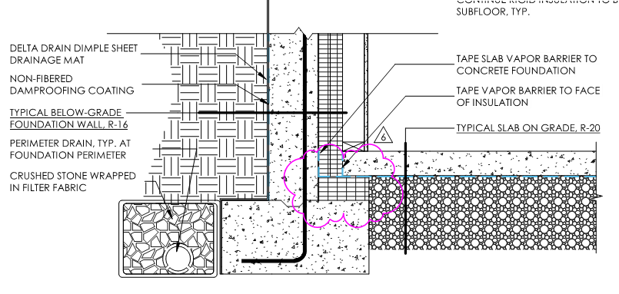
The Putney School New Dorms –
Building Enclosure
Sub-slab Glavel insulation/fill

Slide 34
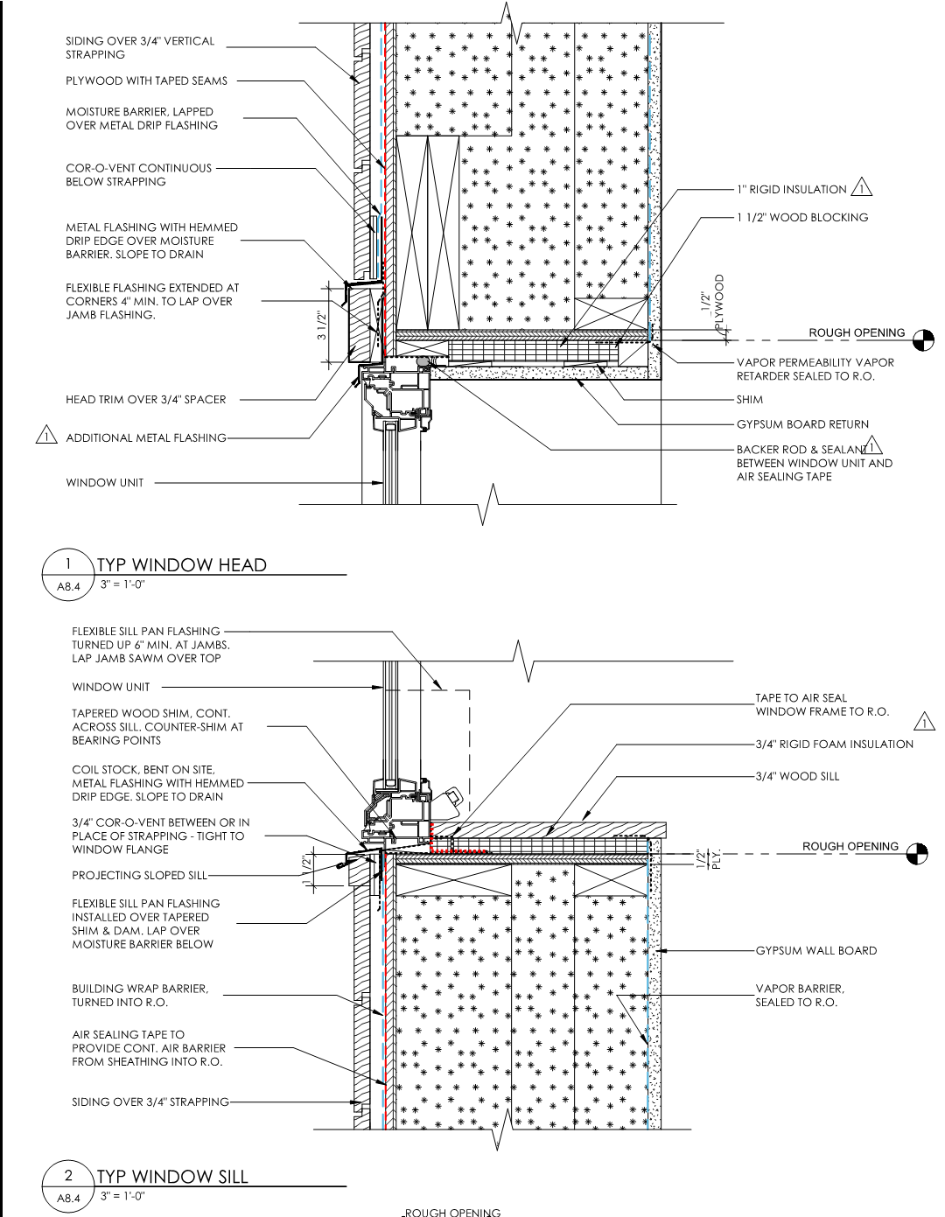
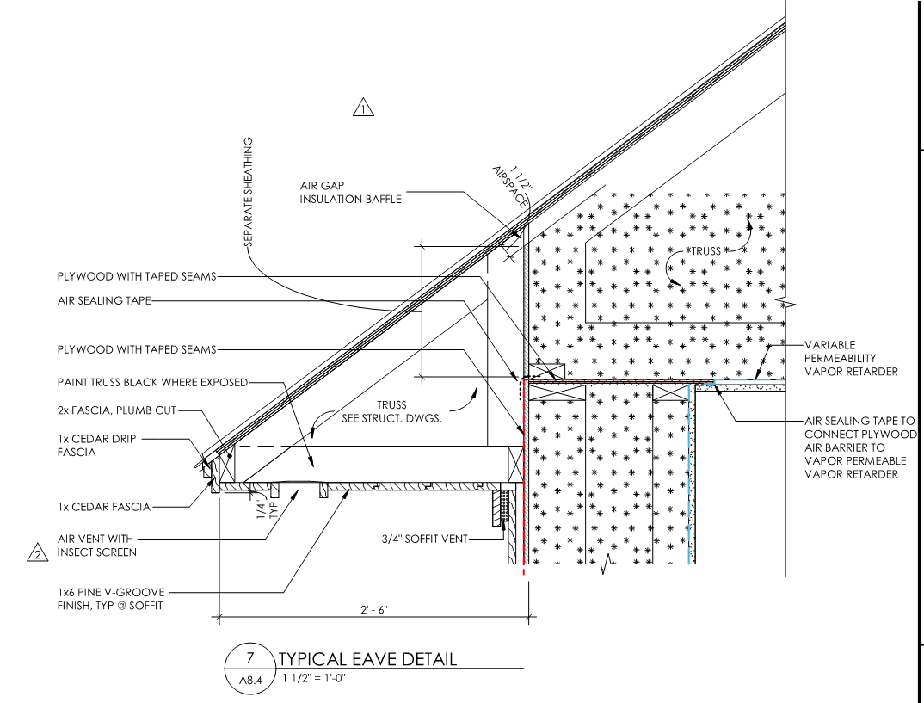
The Putney School New Dorms –
Building Enclosure
Air barrier moves from outside to inside
Uplift and deflection of 40 ft trusses required complex detailing

Slide 35
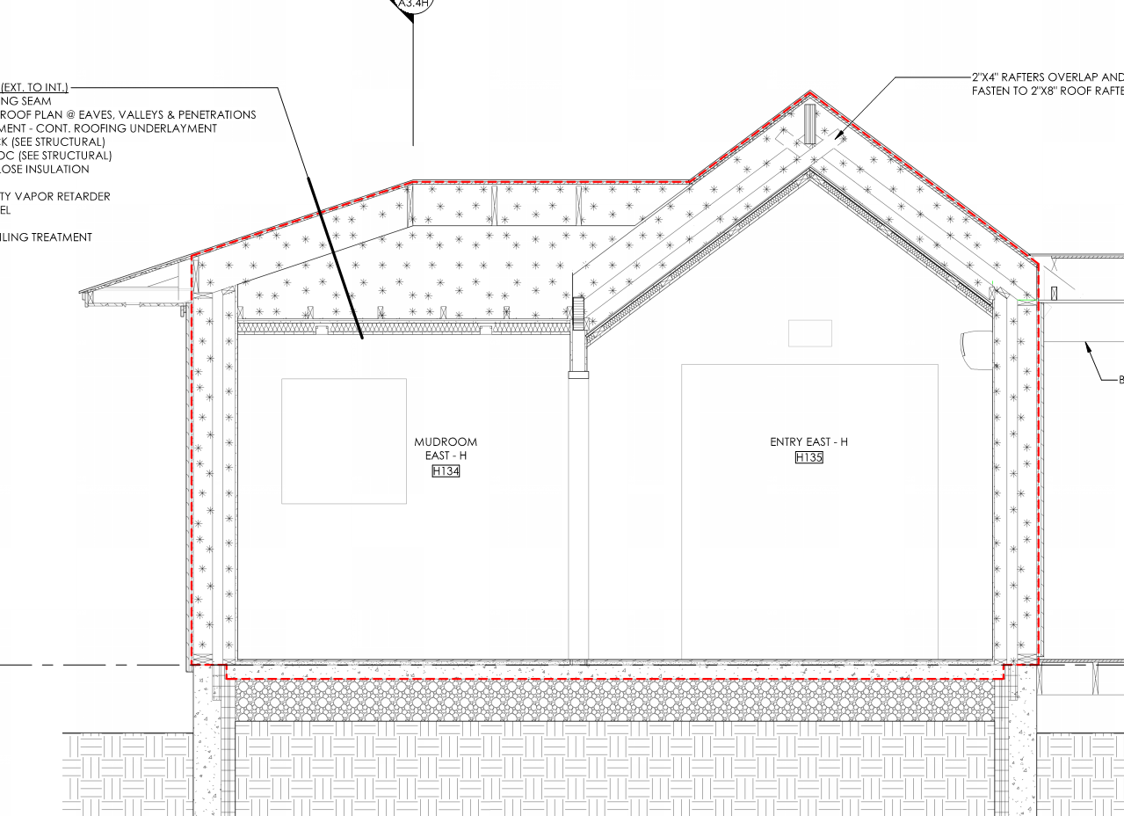
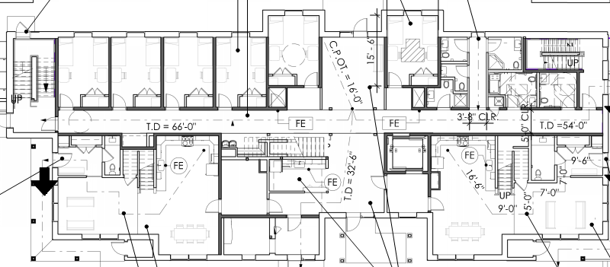
The Putney School New Dorms –
Building Enclosure
Building floorplan complexity increases cost of achieving a high performance enclosure
First floor has 22 corners; second floor has fewer corners

Slide 36
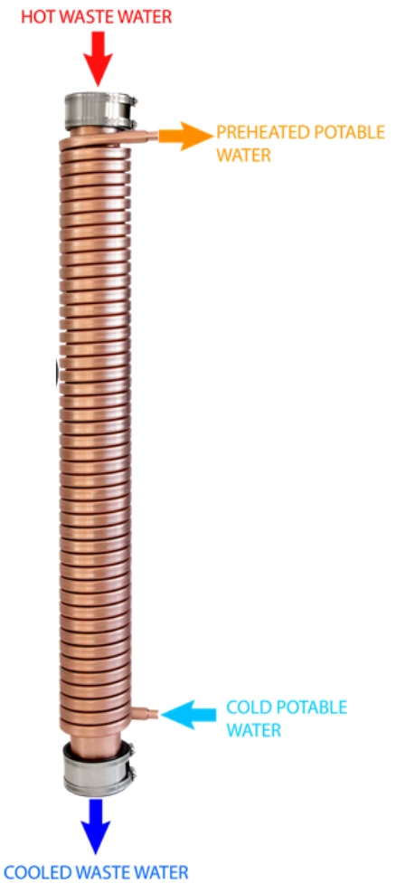
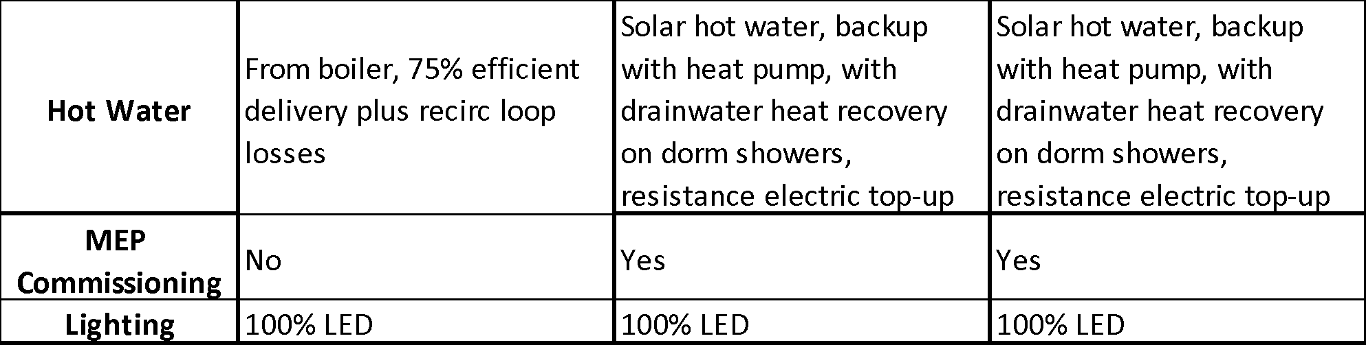
The Putney School New Dorms –
Operational Energy and CO2e Modeling
Drainwater heat recovery system captures about 50% of heat going down the drain

Slide 37
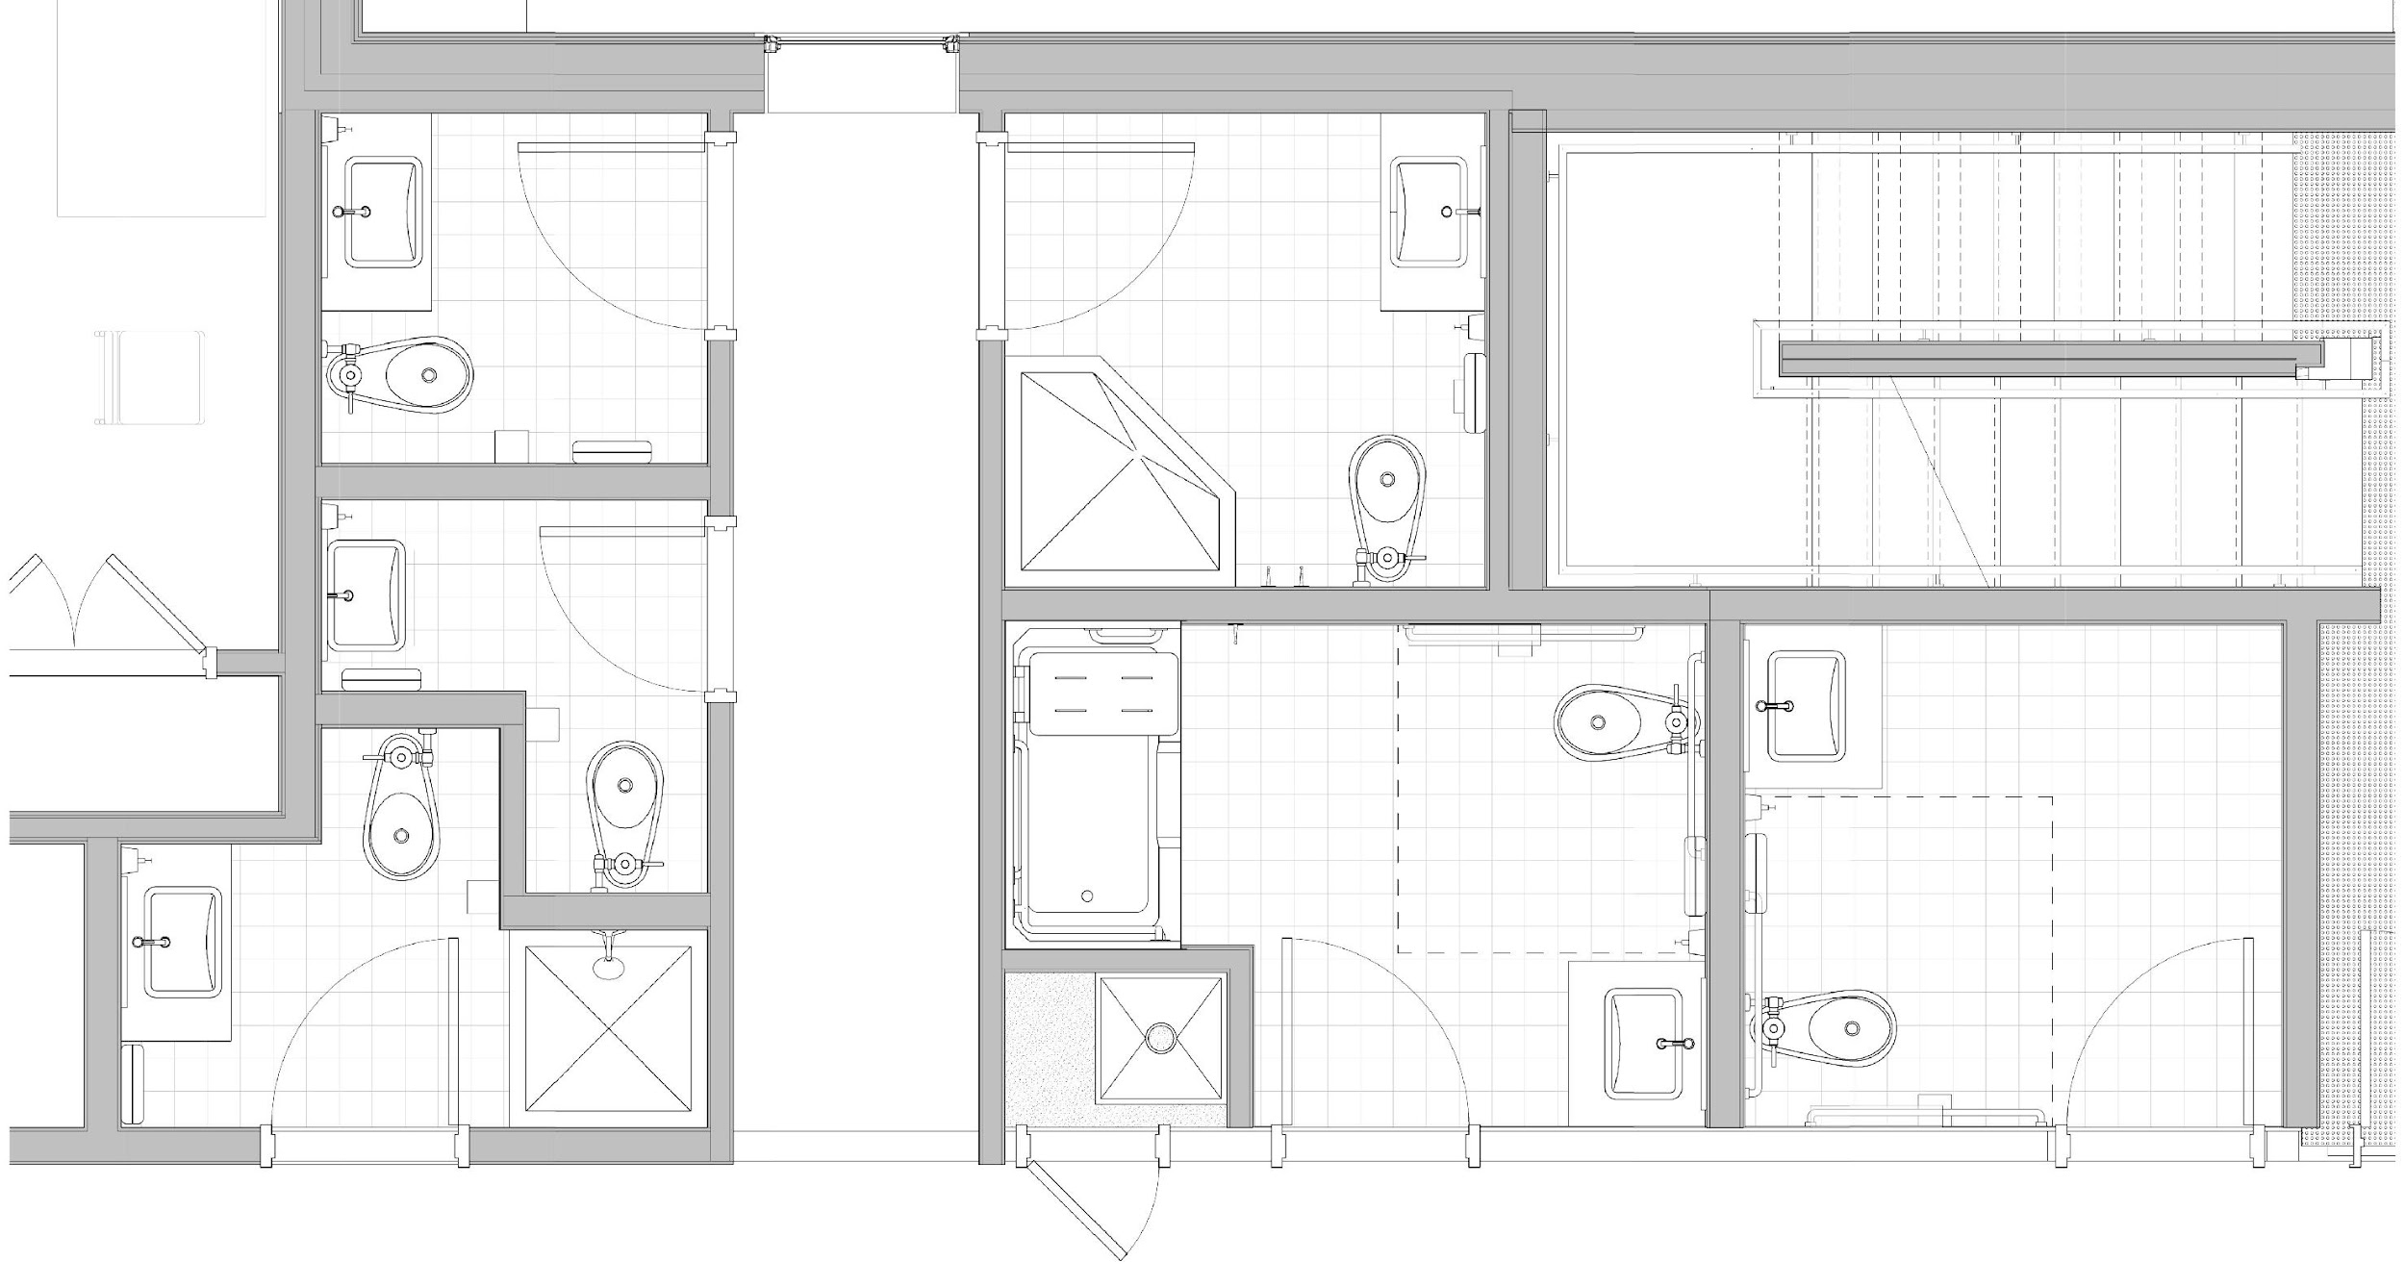
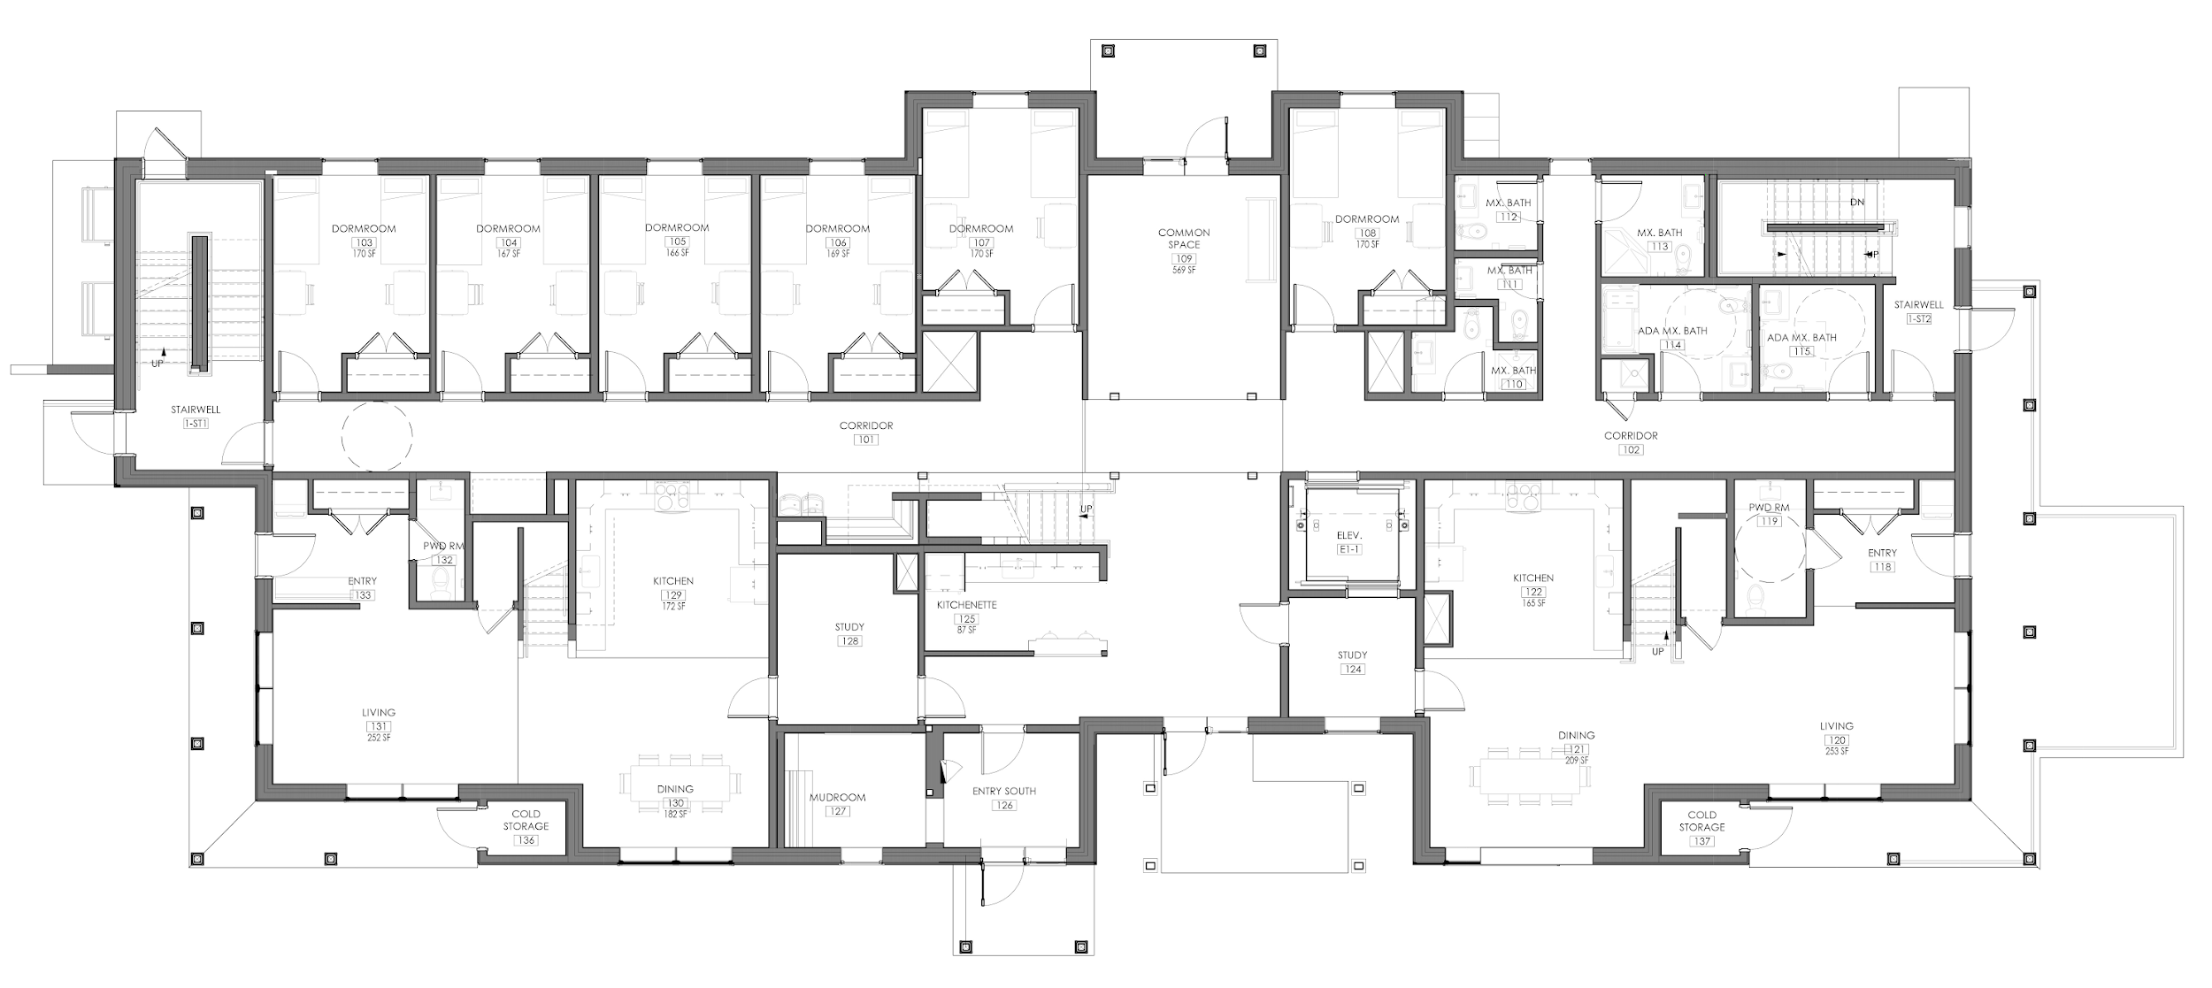
Ganged bathrooms allow shower drainwater heat recovery from dorm room showers – two floors similar dorm room showers and avoids need for recirc hot water system
Apt #1 Apt #2

Slide 38
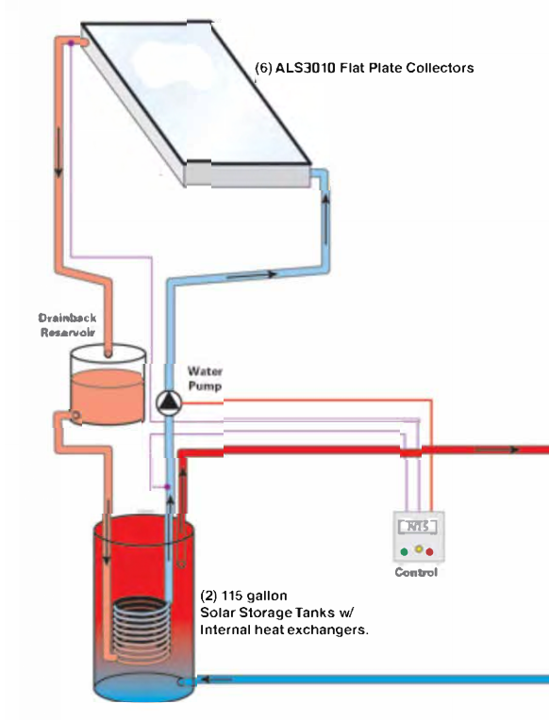
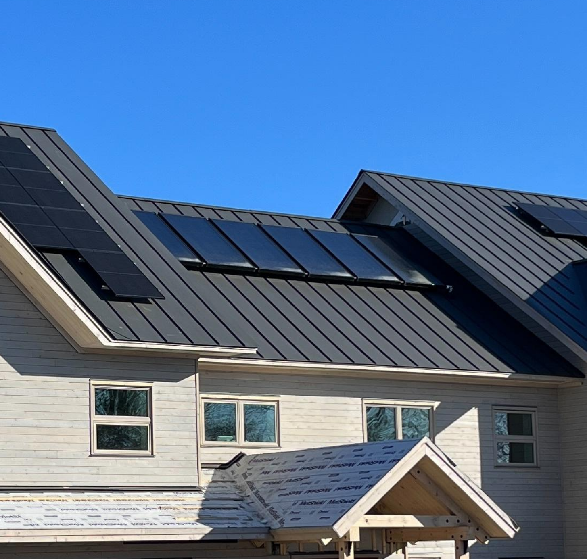
Closed Loop Drain-Back Solar Hot Water
Buildings are to be used in summer!
Near zero pressure in system
Collectors empty except when heating
Stainless tanks, copper piping
Very long antifreeze life
Very long system life
Modeled 50% savings of 15 MWh/year load
>>> Hot water out
<<< Cold water in

Slide 39
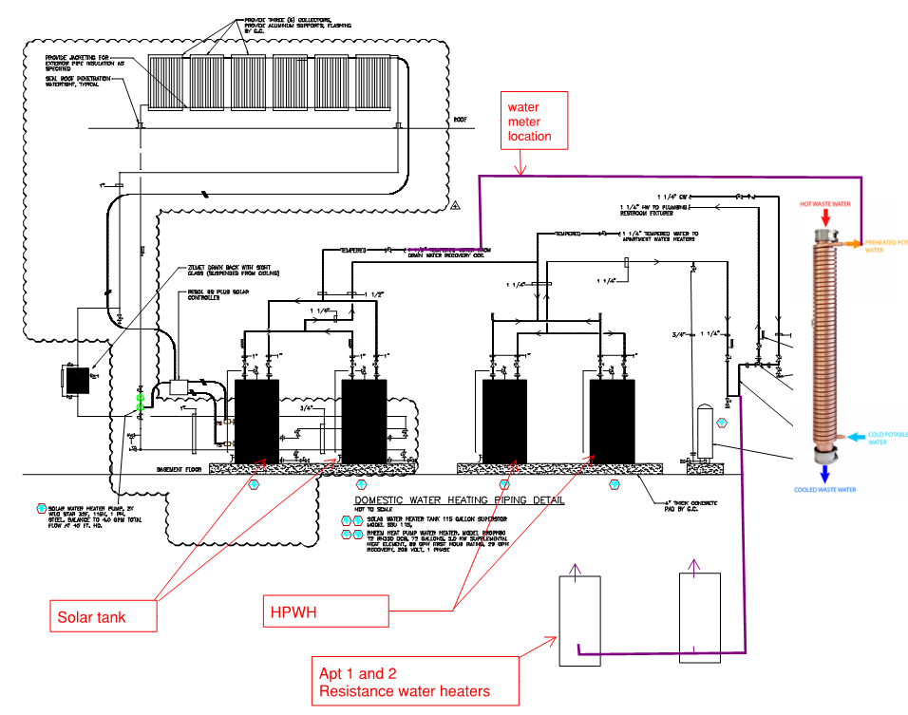
Hot water system

Slide 40
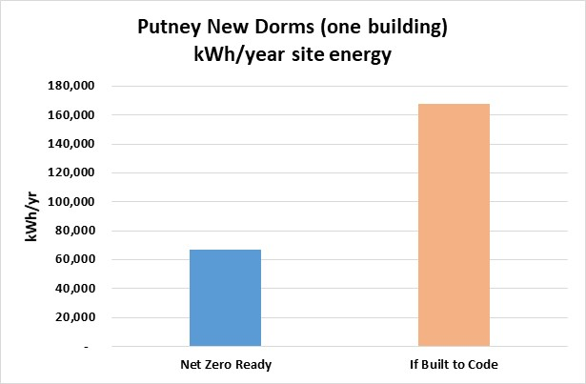
The Putney School New Dorms –
Operational Energy - Modeled
EUI modeled at
<15 kBtu/sq.ft.-yr

Slide 41
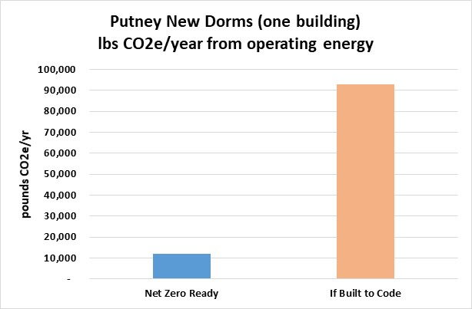
The Putney School New Dorms –
Operational Energy CO2e Emissions - Modeled
Includes PV on roof

Slide 42
The Putney School New Dorms –
Operational Energy CO2e Emissions

Slide 43
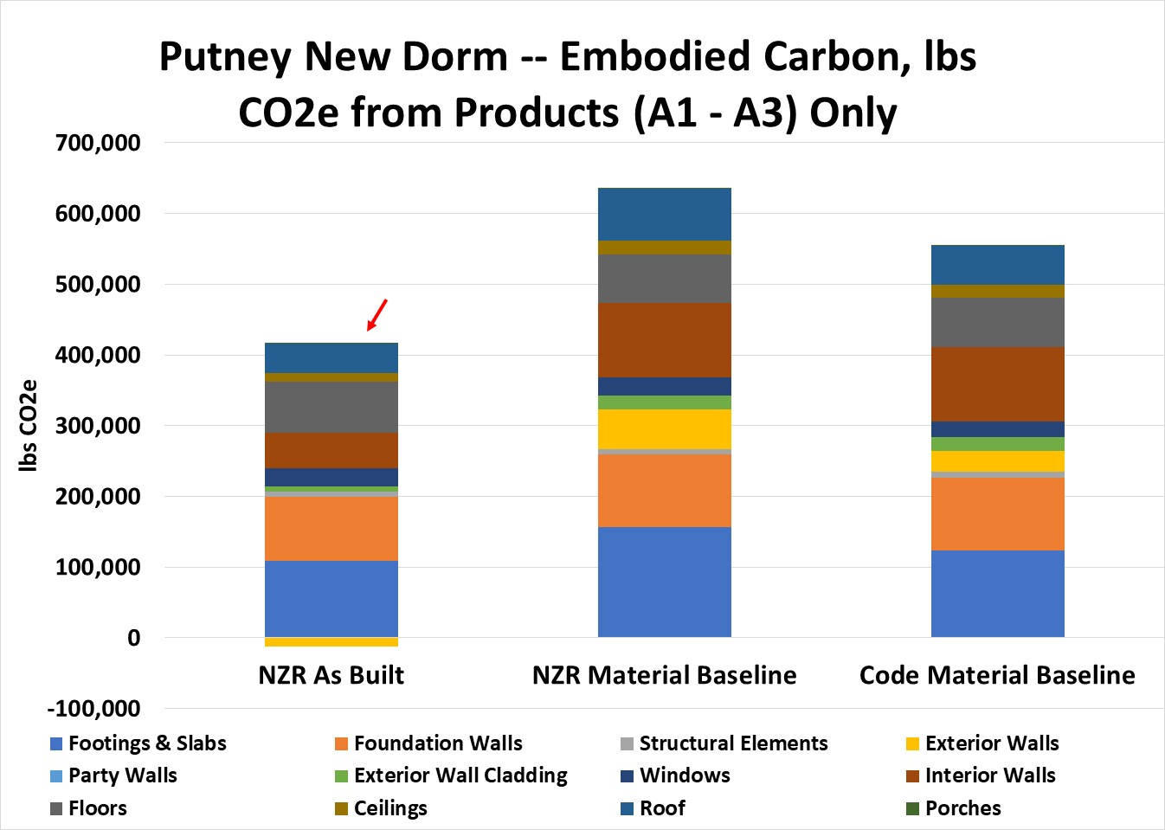
The Putney School New Dorm – Embodied CO2e Emissions - BEAM
Adder for 2” spray
foam in one roof

Slide 44
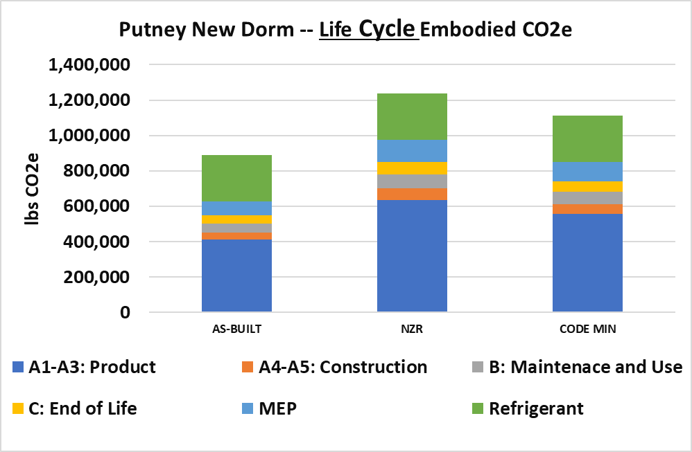
The Putney School New Dorms –
Embodied Energy CO2e Emissions --- Life Cycle Assessment

Slide 45
The Putney School New Dorms –
The BIG PICTURE
What is the atmospheric CO2e over time?
Electric Grid Emissions Expected to Reduce Over Time and
Persistence of CO2 in the atmosphere

Slide 46
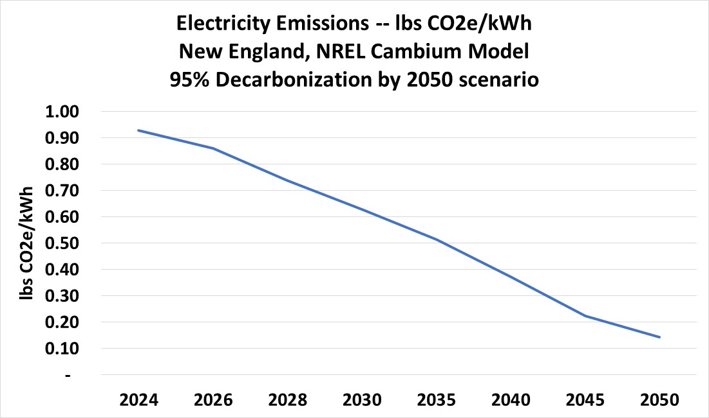
The Putney School New Dorms –
Grid Electricity CO2e Emissions Over Time – NREL Cambium Model

Slide 47
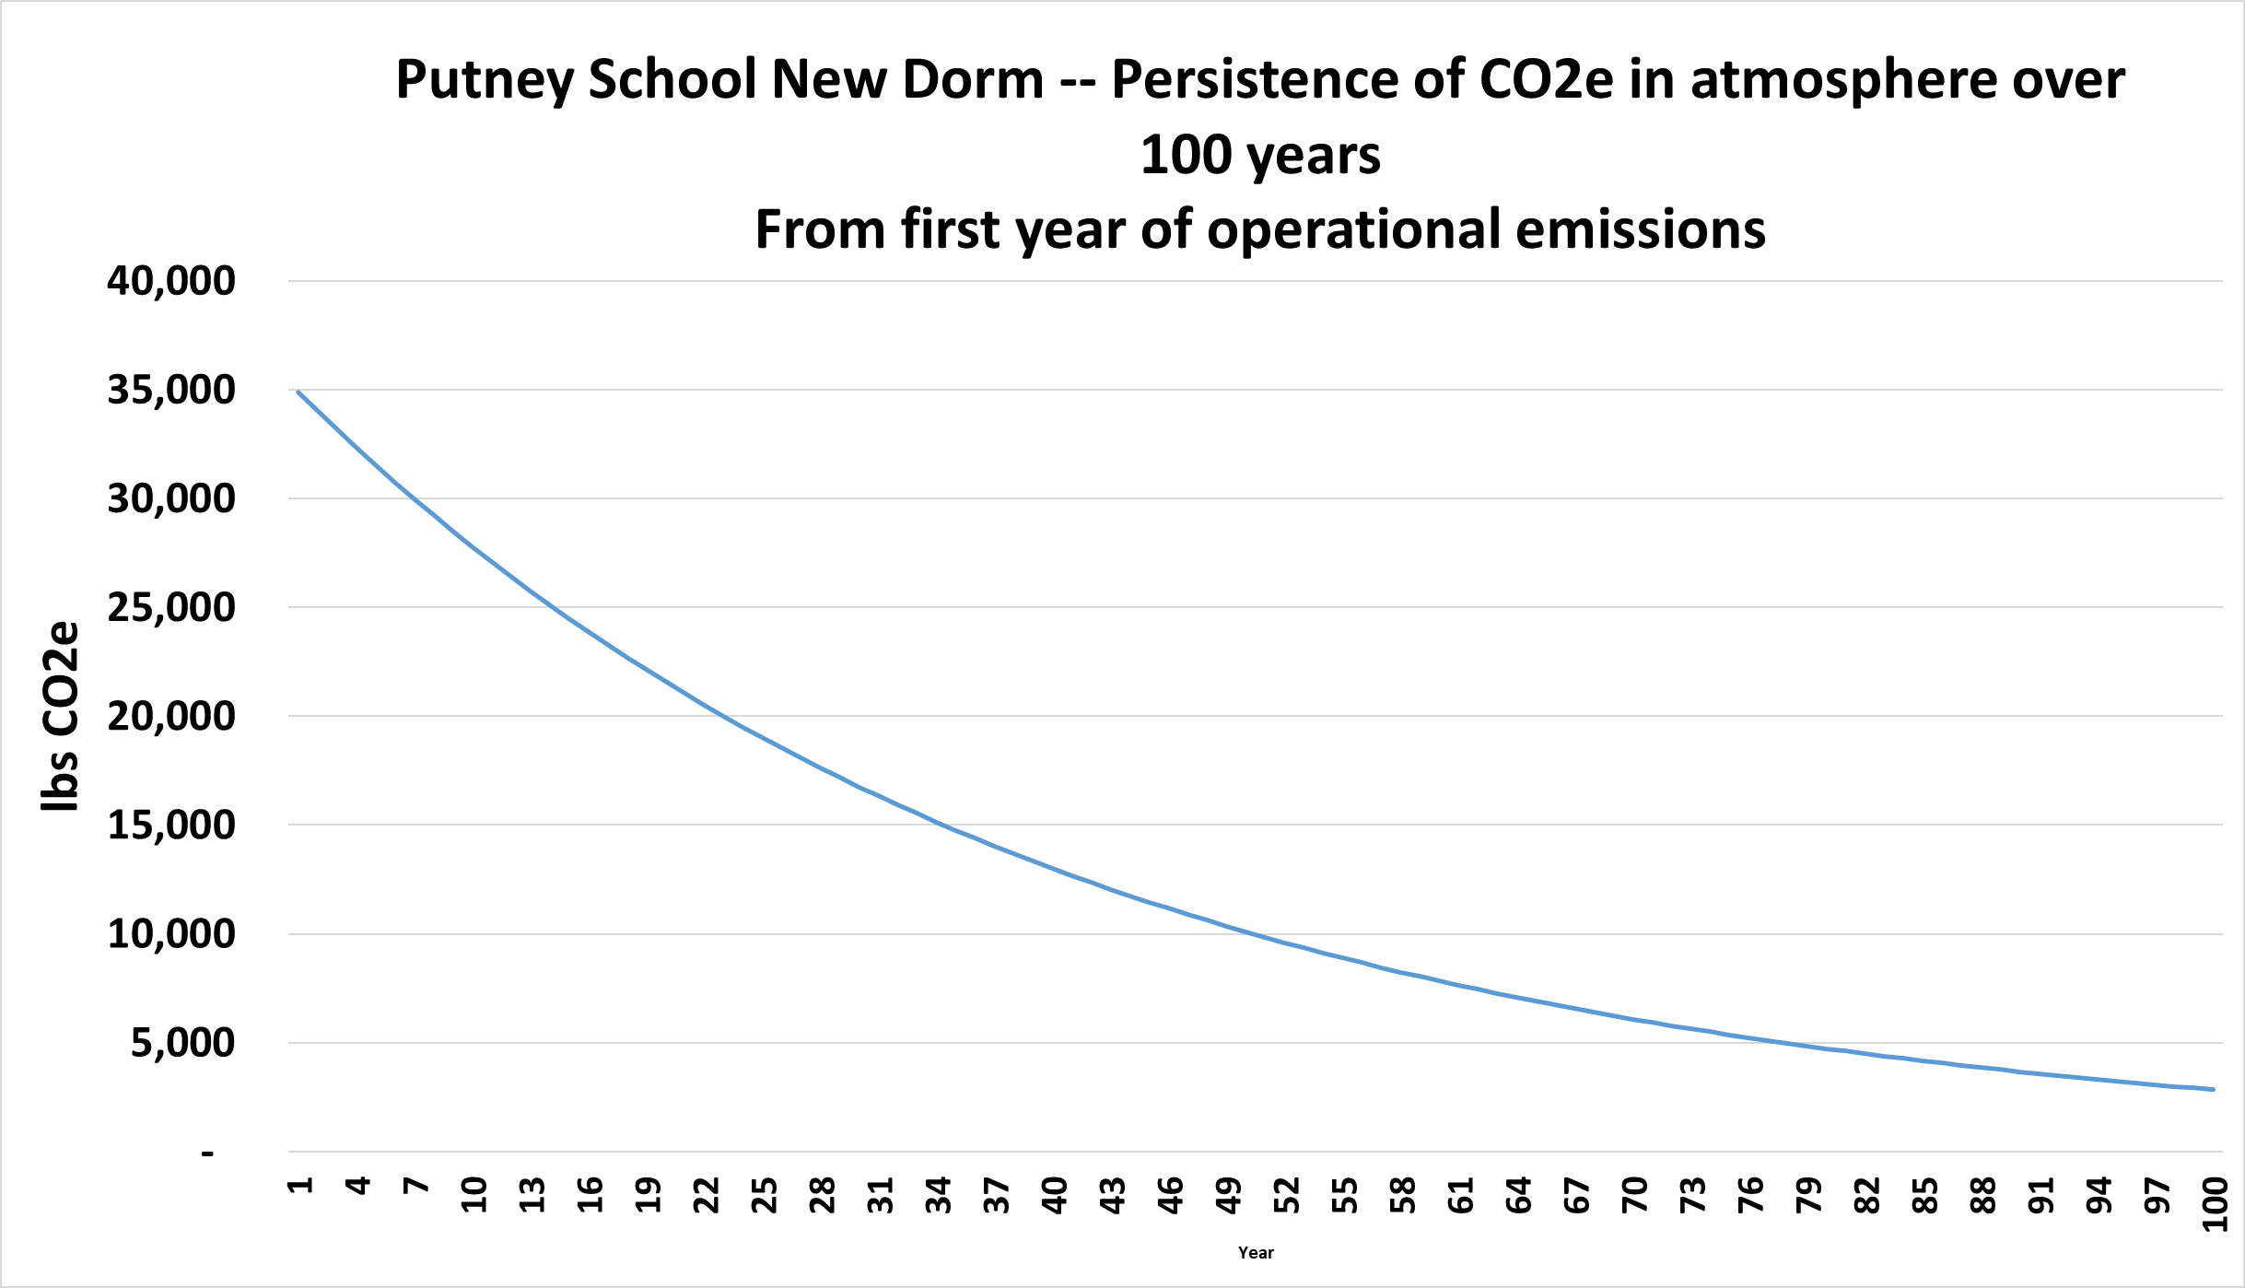
The Putney School New Dorm – CO2e Emissions --- Persistence in Atmosphere

Slide 48

The Putney School New Dorms –
CO2e Emissions --- Persistence in Atmosphere

Slide 49

The Putney School New Dorm – CO2e Emissions --- Persistence in Atmosphere

Slide 50

The Putney School New Dorms –
CO2e Emissions --- Persistence in Atmosphere
A1 – A3 (products) Embodied Only

Slide 51

Energy Use
A1 – A3 Embodied Materials Only
Life Cycle embodied A4 thru C +MEP
Refrigerant leakage

Slide 52

Energy Use
A1 – A3 Embodied Materials Only
Life Cycle embodied A4 thru C +MEP
Refrigerant leakage

Slide 53

The Putney School New Dorms –
Lessons Learned -- Critical Items
Active commitment of owner, design team and builder
Early engagement allows strategy to turn into design, specs and details
Lots of corners and roofs make it much more difficult to achieve a good enclosure

Slide 54


The Putney School New Dorms –
Lessons Learned -- Critical Items
Cement substitutes in concrete difficult to achieve and can have uncertainty in supply
Building enclosure commissioning – including periodic testing of enclosure
Show up more often! Preconstruction meeting needs to be followed by same for each sub just before they begin their piece of the work
Moisture management during construction!

Slide 55



The Putney School New Dorms –
Lessons Learned -- Critical Items
ReArch CM attention to detail AND problem solving was excellent
Skilled, can-do air sealing and insulation subcontractor (Murphy’s CellTech)
Building enclosure commissioning and MEP commissioning (BECx and Cx) with EGauge monitoring system

Slide 56

The Putney School New Dorms –
Lessons Learned – Pinch Points in the Process
Complex enclosure areas required on-site head-scratching sessions with CM, framers, insulation and and air sealing contractor, enclosure commissioner
Cement substitutes availability hard to predict – hold the line: Pre-plan, schedule. SCM landscape is shifting; e.g. ground glass

Slide 57

The Putney School New Dorms –
Lessons Learned – Pinch Points in the Process
An eagle eye on submittals is critical. For example, low embodied gypsum board not in submittal but was easy: same cost, lighter weight and half the embodied energy. But not available for fire rated gypsum board
Incomplete design prior to construction increases stress on process

Slide 58




The Putney School New Dorms – Lessons Learned – Pinch Points
Top of exterior wall detail -- Attic air-sealing detail
Truss uplift/partition wall/air barrier problem solving

Slide 59



Cumulative Embodied and Operational Emissions - 20 years
Total GHGe
@ 20 years =
78 t CO₂e
Source: Builders for Climate Action
Notes:
Consider Both Operational and Embodied Emissions: Both are critical components of a building’s total carbon footprint.
No Trade-Offs: Reducing one should not come at the expense of increasing the other.
What Matters Most: It’s the total emissions that impact the climate—every source counts.

Slide 60

Tackle Embodied & Operational Together
Performance Improvement
Reduce Operation GHGe
Optimizing form and orientation
Adding insulation
Increasing airtightness
Removing thermal bridges
Optimizing windows and doors
Increasing efficiency of Mech. sys.
Passive solar/ventilation design
Source: Builders for Climate Action
Notes:
Many strategies that reduce energy loads through the envelope-first approach also help minimize embodied carbon—or can be done without increasing it.
Start by reducing size and complexity—this lowers both energy demand and material use.
For insulation, choosing low embodied carbon options can offset the impact of added material.
Air sealing is especially effective: it greatly reduces energy use, improves building durability, extends lifespan, and can be done with minimal, low-carbon materials.

Slide 61

System Size and Life Cycle Emissions

Slide 62

Carbon Reduction Potential Over Project Stages
Plan
Design
Construction
Operation and Maintenance
Notes:
The greatest opportunity to reduce both operational and embodied carbon comes during the early design phase.
Key strategies include:
Reusing existing buildings instead of constructing new ones.
Designing smaller, more efficient buildings.
Simplifying the building form to reduce material use and energy demand.
Optimizing material selection to lower embodied carbon.
Making smart choices early sets the foundation for a low-carbon building.

Slide 63



Carbon cycle: more going up than coming down
Burning Fossil Fuels
Atmospheric CO₂
Industrial Emissions
Deforestation
Photosynthesis
Ocean photosynthesis
& respiration
Fossil Carbon
Source: Builders for Climate Action
Notes:
Let’s now focus on the right side of the carbon cycle, where photosynthesis draws carbon dioxide out of the atmosphere and stores it in plants and trees.
By using bio-based materials in construction, we can lock carbon that would otherwise be released at the end of the material’s life cycle back into the building.
This process turns buildings into carbon sinks, preventing emissions at the end of life of bio-based material residues and storing that carbon within the structure.
In this way, buildings can actively help store carbon rather than contribute to emissions.

Slide 64

Carbon storage
“
Bio-based materials may represent our best hope for radical decarbonisation through the responsible management of carbon cycles. The shift towards properly managed bio-based materials could lead to compounded emission savings in the sector of up to 40 per cent by 2050 in many regions.
”
Citation: United Nations Environment Programme & Yale Center for Ecosystems + Architecture. (2023). Building materials and the climate: Constructing a new future. United Nations Environment Programme.
Notes:
This concept is supported by extensive research, including a detailed United Nations report.
The report identifies building materials as a critical focus area for reducing global greenhouse gas emissions across all sectors.
In particular, it highlights bio-based materials as one of the most effective strategies for carbon emission reduction in the building industry.

Slide 65



Slide 66
Carbon storage categories
Varieties of carbon-storing products:
Waste stream materials
Agricultural & forestry residue
Purpose grown crops
Lab-grown materials
Virgin forest products
Carbon Storage
Short Cycle
Carbon Storage
Long Cycle
Source: Builders for Climate Action
Notes:
Short-cycle carbon storage refers to materials that are near the end of their life, releasing carbon back into the atmosphere. These include:
Waste stream materials like cardboard used for cellulose insulation
Agricultural residues like straw
Purpose-grown crops such as hemp
Long-cycle carbon storage refers to materials with a longer growth cycle, like trees.
The impact of cutting trees is more complex, as it's unclear if the tree would continue to photosynthesize if left in the forest, and how long it would take for another tree to replace its carbon-sequestering role.
Forests are more complex ecological systems, making the net atmospheric impact of forest products more difficult to assess.

Slide 67




Short Cycle Carbon Storage
CO2
(stored this year)
CO2
(released this year)
or
CO2
(released
60-100 years)
Short cycle carbon storage comes from feedstocks that are:
At the end of their typical lifecycle
(will not continue to grow and absorb CO2)
Are about to become GHG emissions
(from decay, decomposition and/or fire)
Source: Builders for Climate Action
Notes:
Let’s take a closer look at straw:
After the grain is harvested, leftover straw is usually either burned or left to decompose within a year.
However, if straw is captured and used as insulation material, stored in a building for decades, it avoids emissions that would otherwise occur from burning or decomposition.
This net positive impact benefits the climate for the lifespan of the building, lasting until the end of its useful life.

Slide 68
Short Cycle Carbon Storage
CO2
(stored this year)
CO2
(released this year)
Shrink
Increase
CO2
(released
60-100 years)
Short cycle carbon storage comes from feedstocks that are:
At the end of their typical lifecycle
(will not continue to grow and absorb CO2)
Are about to become GHG emissions
(from decay, decomposition and/or fire)
Source: Builders for Climate Action
Notes:
The key strategy is to redirect agricultural residues, like straw, away from being burned or left to rot.
Instead, we should prioritize using them in long-lived, durable building materials.
This requires better coordination between the agricultural waste stream and the building materials supply chain to turn underused biomass into valuable, carbon-storing products.
This work is already being done by multiple companies in North America building prefabricated building panels insulated with straw.

Slide 69






Long cycle carbon storage
CO2
(30-60
years)
CO2
(Lost
capacity)
CO2
(Soil
losses)
Slash emissions
Mill waste emissions
Kiln emissions
CO2
(60-100
years)
Long cycle carbon storage comes from feedstocks that are:
Have multi-decade growth cycles
Will cease to be a carbon sink if harvested during growth period
Source: Builders for Climate Action
Notes:
The carbon benefits of wood are more complex to measure compared to short-cycle materials like straw.
Wood has a long growth cycle—typically 30 to 60 years—making it harder to determine if a tree would have continued photosynthesizing and absorbing carbon if it hadn't been harvested.
Forest ecosystems also store large amounts of carbon in the soil, which can be lost through erosion and disturbance during logging.
Around 50% of a tree’s mass is left behind as slash, which decomposes and emits carbon—but this is often not reflected in wood product EPDs.
When combined with emissions from processing, it becomes difficult to assess whether the use of virgin wood is a net benefit or harm to the atmosphere.
Because of these complexities, attributing carbon storage to virgin timber is far less straightforward than with short-cycle carbon sources.

Slide 70


Carbon Storage Accounting in Static LCA
A1 - Raw material
B6 - 60 years
C4 - End-of-Life
=0?
-1 ton CO₂ stored
+1 ton
CO₂ released
Graphic : Builders for Climate Action
Notes:
Traditional LCA, or static LCA, does not account for the impact of time on emissions—it's time-insensitive.
In whole building LCA, biogenic carbon storage is credited as a negative emission in the product stage, but this must be reversed at end-of-life, assuming all stored carbon is eventually released.
As a result, bio-based materials are typically given a net carbon storage value of zero over the building's life.
The key limitation of static LCA is that it ignores the climate benefit of delaying emissions—that is, the value of avoided atmospheric carbon during the building’s lifespan.
It also does not allow for assessment of the benefits of carbon storage in a shorter time frame, such as by 2030 or 2050, when conducting analysis for emission reduction to meet those near-term goals.

Slide 71

Cumulative Emissions and the Time Value of CO₂
30
60
100 years
Graphic: RMI
Notes:
Dynamic LCA introduces time as a factor in greenhouse gas accounting, allowing us to track the impact of these emissions over time.
This graph shows a pulse of emissions during the product phase, followed by a slow decay over the building’s lifespan.
At 60 years, a second pulse appears at the end-of-life phase, followed by another decay until the 100-year mark.
By measuring the area under the curve, dynamic LCA helps us understand the cumulative climate impact of these emissions over time—capturing the true impact on global warming, and not just the total mass of emissions over the time period.

Slide 72
Cumulative Emissions and the Time Value of CO₂
Release of carbon at end of life
Graphic: RMI
Notes:
When applying dynamic LCA to carbon storage, we see a clear benefit:
During the product stage, there's a significant reduction in atmospheric CO₂ thanks to the photosynthesis of bio-based materials.
At year 60, a pulse of emissions is assumed at the end-of-life stage, just like in static LCA.
However, dynamic LCA allows us to capture the cumulative benefit of those avoided emissions over time.

Slide 73
Cumulative Emissions and the Time Value of CO₂
Graphic: RMI
Notes:
Even if emissions occur later, there is real benefit in storing carbon now—buying us time to decarbonize other sectors.
End-of-life strategies like circular economy approaches can further mitigate those emissions by avoiding their release into the atmosphere at end of life, reinforcing the value of using bio-based materials today to buy time to improve end of life management practices.

Slide 74
Cumulative Emissions and the Time Value of CO₂
TODAY
2050
Graphic: RMI
Notes:
What matters is not just the net emissions at year 60, but the impact over the next 20–30 years, which is when we need to meet our climate targets.
This reinforces the importance of using the carbon storage value of bio-based material as an immediate-term strategy to reduce atmospheric carbon dioxide and avoid emission release to meet near-term goals.

Slide 75
Two accounting methods:
COUNTING
CARBON STORAGE
VALUING
CARBON STORAGE
Source: Chris Magwood - RMI

Slide 76


Two accounting methods:
COUNTING
CARBON STORAGE
VALUING
CARBON STORAGE
STATIC LCA
DYNAMIC LCA
Source: Chris Magwood - RMI

Slide 77

Two accounting methods:
COUNTING
CARBON STORAGE
VALUING
CARBON STORAGE
STATIC LCA
DYNAMIC LCA
$
Ledger of debits
& credits
Value of interest
earned & paid
Source: Chris Magwood - RMI

Slide 78
Two different insights:
HOW DOES CARBON MOVE WITHIN A SYSTEM?
HOW DOES CLIMATE
RESPOND TO CARBON FLOWS?
COUNTING
CARBON STORAGE
VALUING
CARBON STORAGE
STATIC LCA
DYNAMIC LCA
Source: Chris Magwood - RMI

Slide 79



Notes:
Jacob

Slide 80

Impact of Material
Over 60% of embodied GHGe
of a new home come from 3 product categories,
and
insulation being the second highest contributor.
Embodied Carbon Emissions from New Homes by Material Category, BfCA studies.
Notes:
In residential construction—especially for smaller, lighter buildings—most embodied carbon emissions come from the envelope. This is because of higher surface-to-floor area ratios than larger buildings, as well as lighter wood-based above-grade structures.
Two major contributors are in the above-grade assemblies:
Cladding
Insulation

Slide 81




Why a RESNET standard?
Notes:
Andy

Slide 82
Why a RESNET standard?
LEVERAGE EXISTING MODELING DATA
EMBODIED CARBON
Notes:
Andy

Slide 83







Pilot Program – It’s Happening!
100 Homes Benchmarking Study in MA (2024-25):
Create regional benchmark for policy and program development
Pilot RESNET Standard 1550 to inform improvements
Prepare industry: rater training, workflow, QA/QC
Integrate energy modeling and embodied carbon assessment software
Notes:
100 Homes: funded by MassCEC (state funding) and utilities for MEP for a partnership btw NEHERS, Ekotrope, BEAM, ??? To run 100 homes through draft 1550 standard. Includes rater workflow development, training and educational program, QA/QC program, tool integration btw energy and EC modeling tools, and results in a regional res-specific benchmark study upon which policies and incentives can be structured.

Slide 84

Source: https://www.reddit.com/r/NatureIsFuckingLit/comments/hf0dm1/winding_river_in_the_adirondacks/

Slide 85


veep.org

