Slide 1
August 4, 2025
AeroBarrier Technology Development
Mark Modera
UC Davis and Aeroseal

Slide 2
Presentation Overview
Conceptualization of Envelope Sealing Process
Seal Rate Analysis
Transport Efficiency
Sealing Simulation Tool
Dedicated Test Facility
Sealing Rate Comparison
Separation of Effects Impacting Seal Rate
New Technology Developments
Smaller, Lighter, Faster System
Non-Electric Heat
Airless Atomization
New Applications
Ceiling Plenum Sealing
Underfloor Sealing

Slide 3
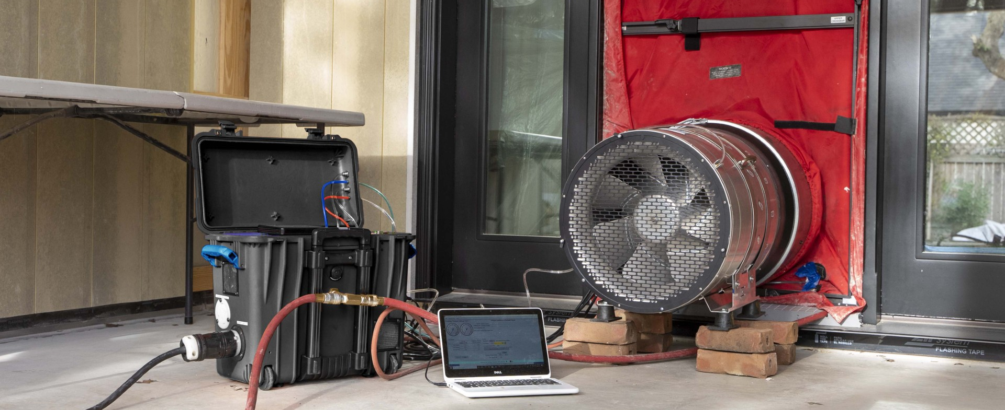
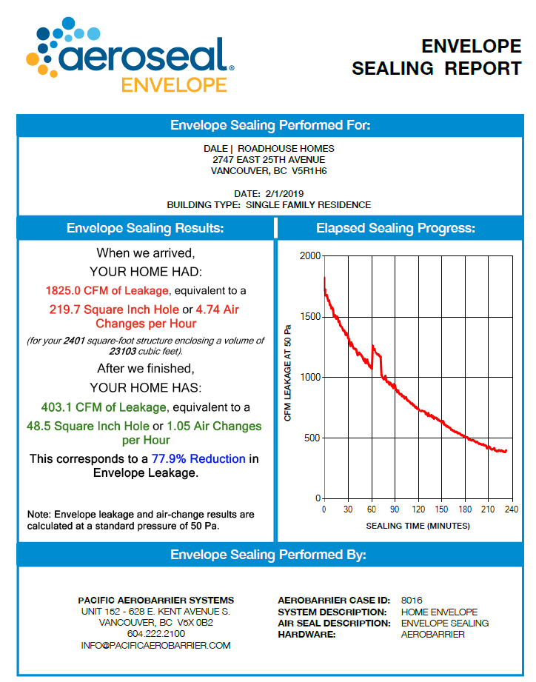
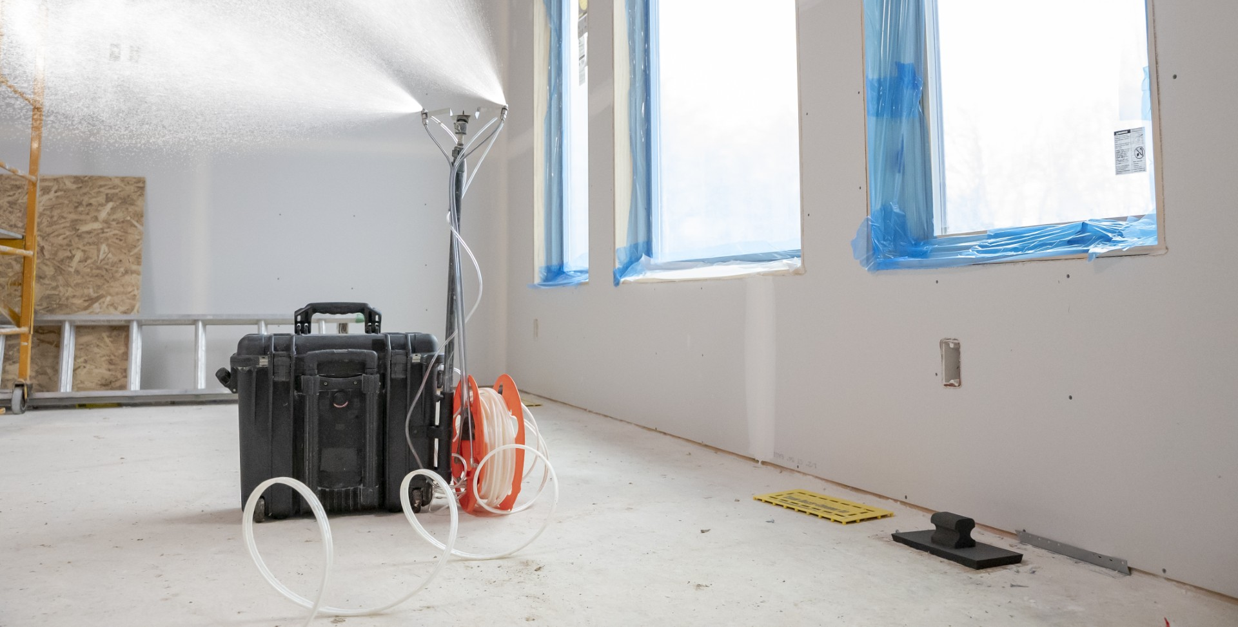
Envelope Sealing Process
Pressurize Building with a Fan
Blower Door on Steroids
Inject Aerosolized Sealant
Air carries sealant to Leaks
Track Sealing Process
Feedback to Technician
Documentation for Builder (or homeowner)

Slide 4
Conceptualization of Envelope Sealing Process
Seal Rate Analysis
where:
InjRate is max sealant injection (limited by psychrometrics)
η_{trans} is Transport Efficiency (fraction getting to leaks)
η_{dep} is Deposition Efficiency (fraction depositing in leaks)
SealDensity is sealant required to seal a given size leak

Slide 5
Conceptualization of Envelope Sealing Process
Transport Efficiency
Settling Velocity
Floor Area

Slide 6
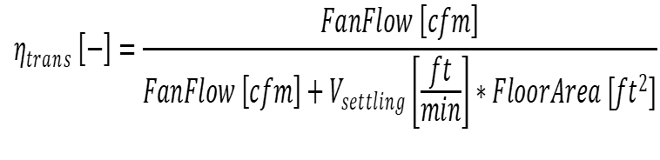
Conceptualization of Envelope Sealing Process
Transport Efficiency
Basically a race between getting to the leaks before falling to the floor
where:
V_{settling} is Settling Velocity (like terminal velocity), a strong function of
particle size

Slide 7
Conceptualization of Envelope Sealing Process
Sealing Simulation Tool
Aerobarrier Sealing Performance Model - 071225present.xlsm

Slide 8
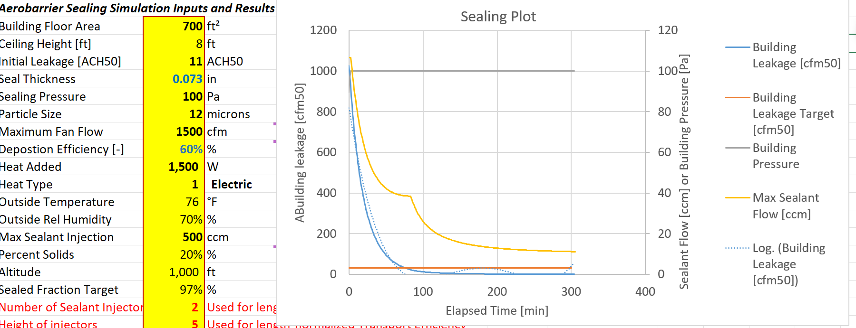
Conceptualization of Envelope Sealing Process
Sealing Simulation Tool
Aerobarrier Sealing Performance Model - 071225present.xlsm

Slide 9
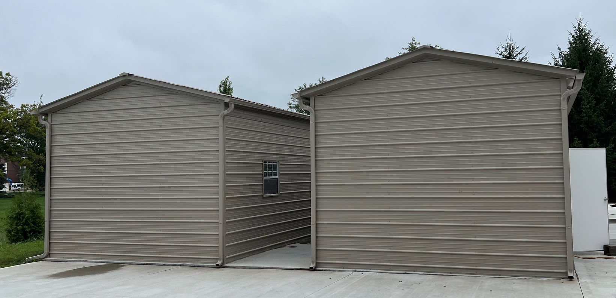
Dedicated Test Facility

Slide 10
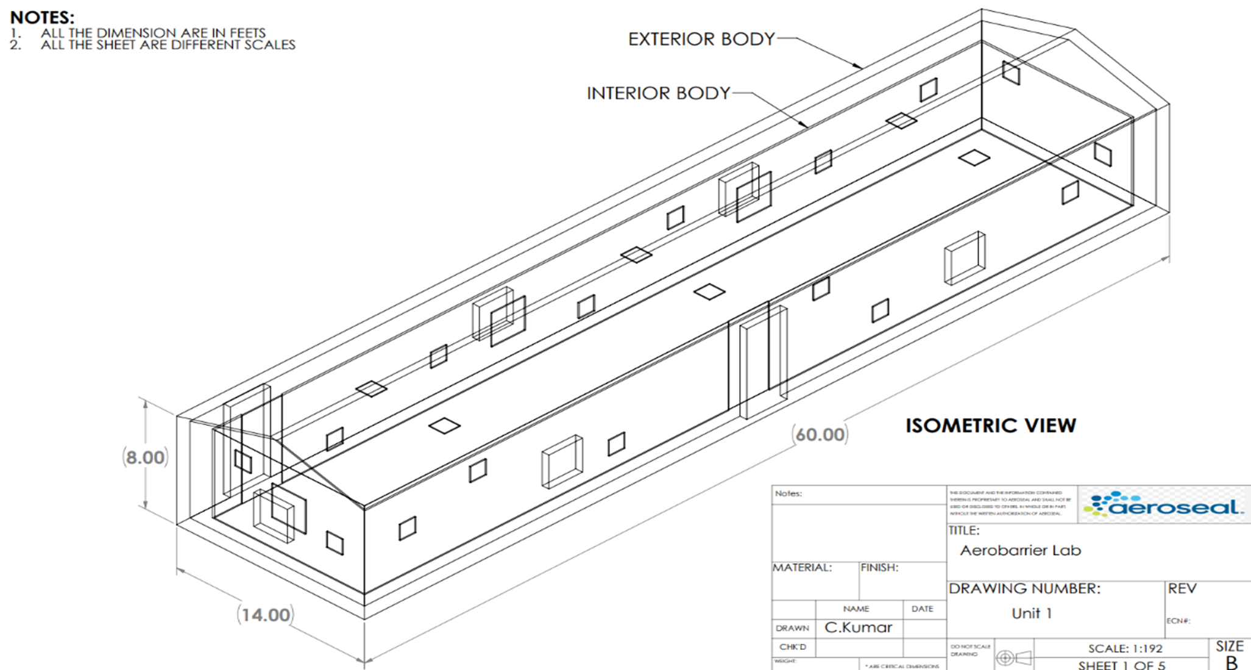
Dedicated Test Facility

Slide 11
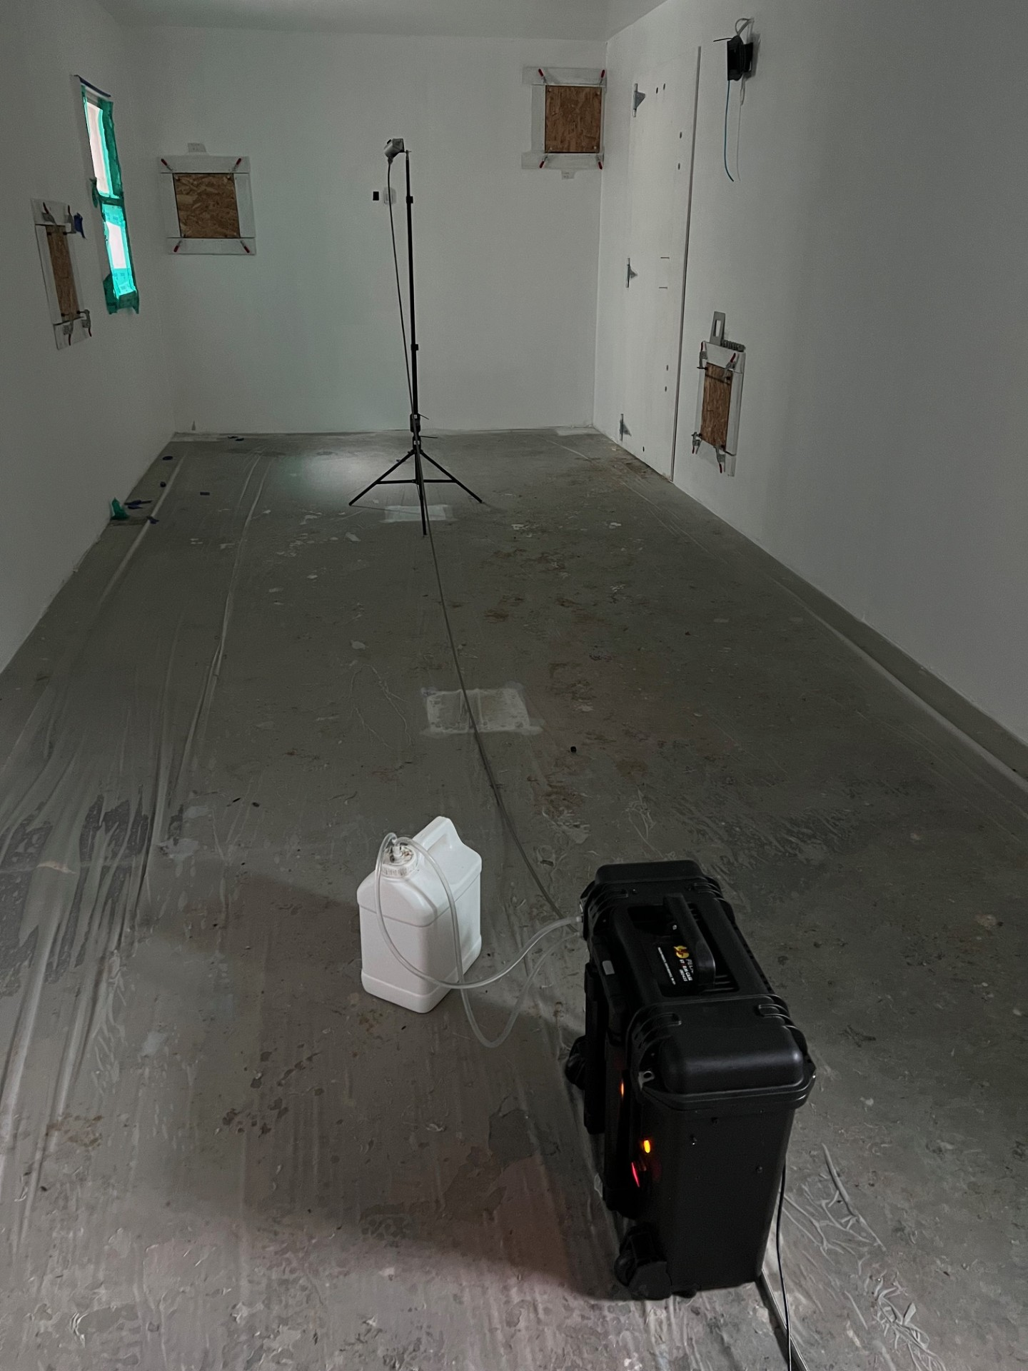
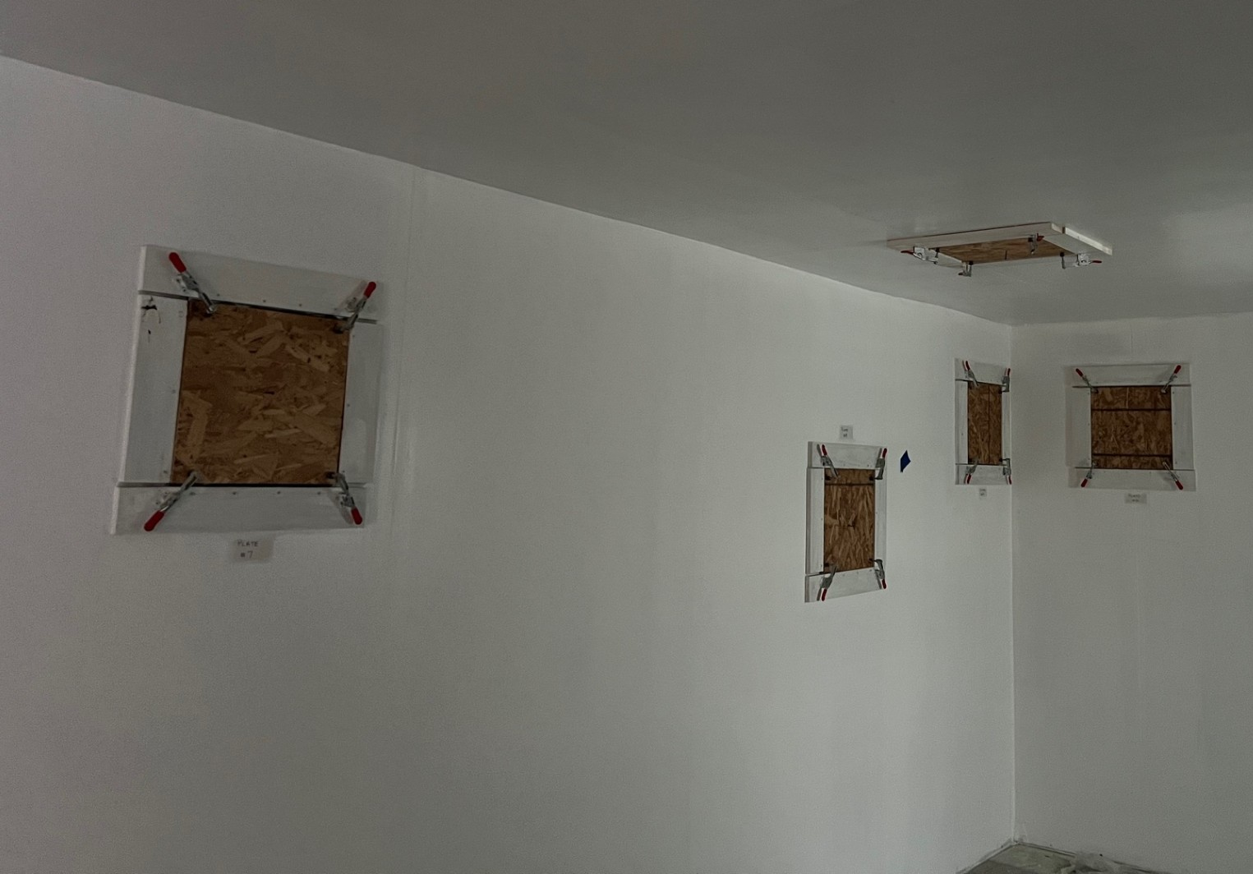
Dedicated Test Facility

Slide 12
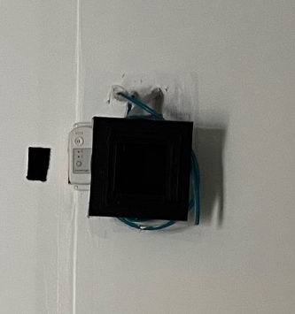
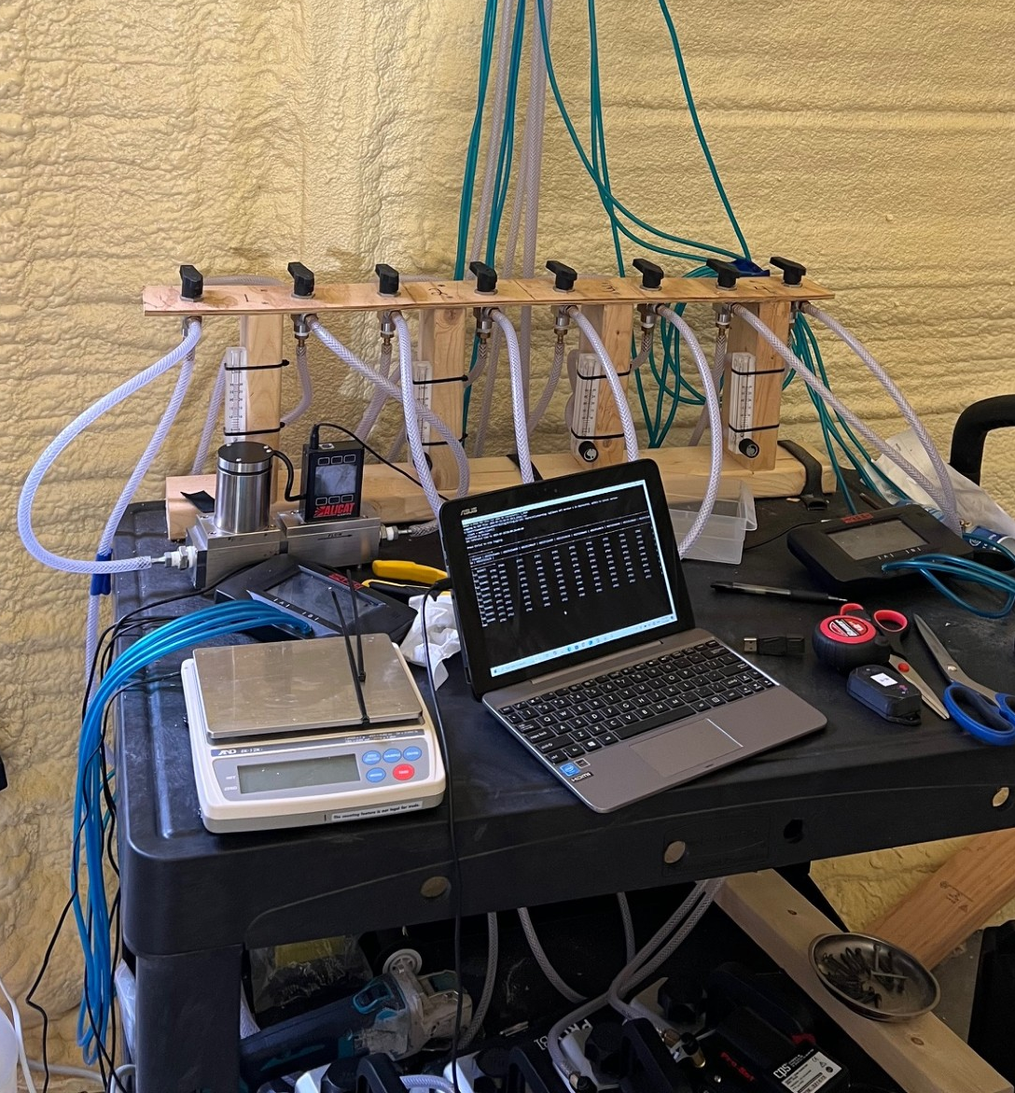
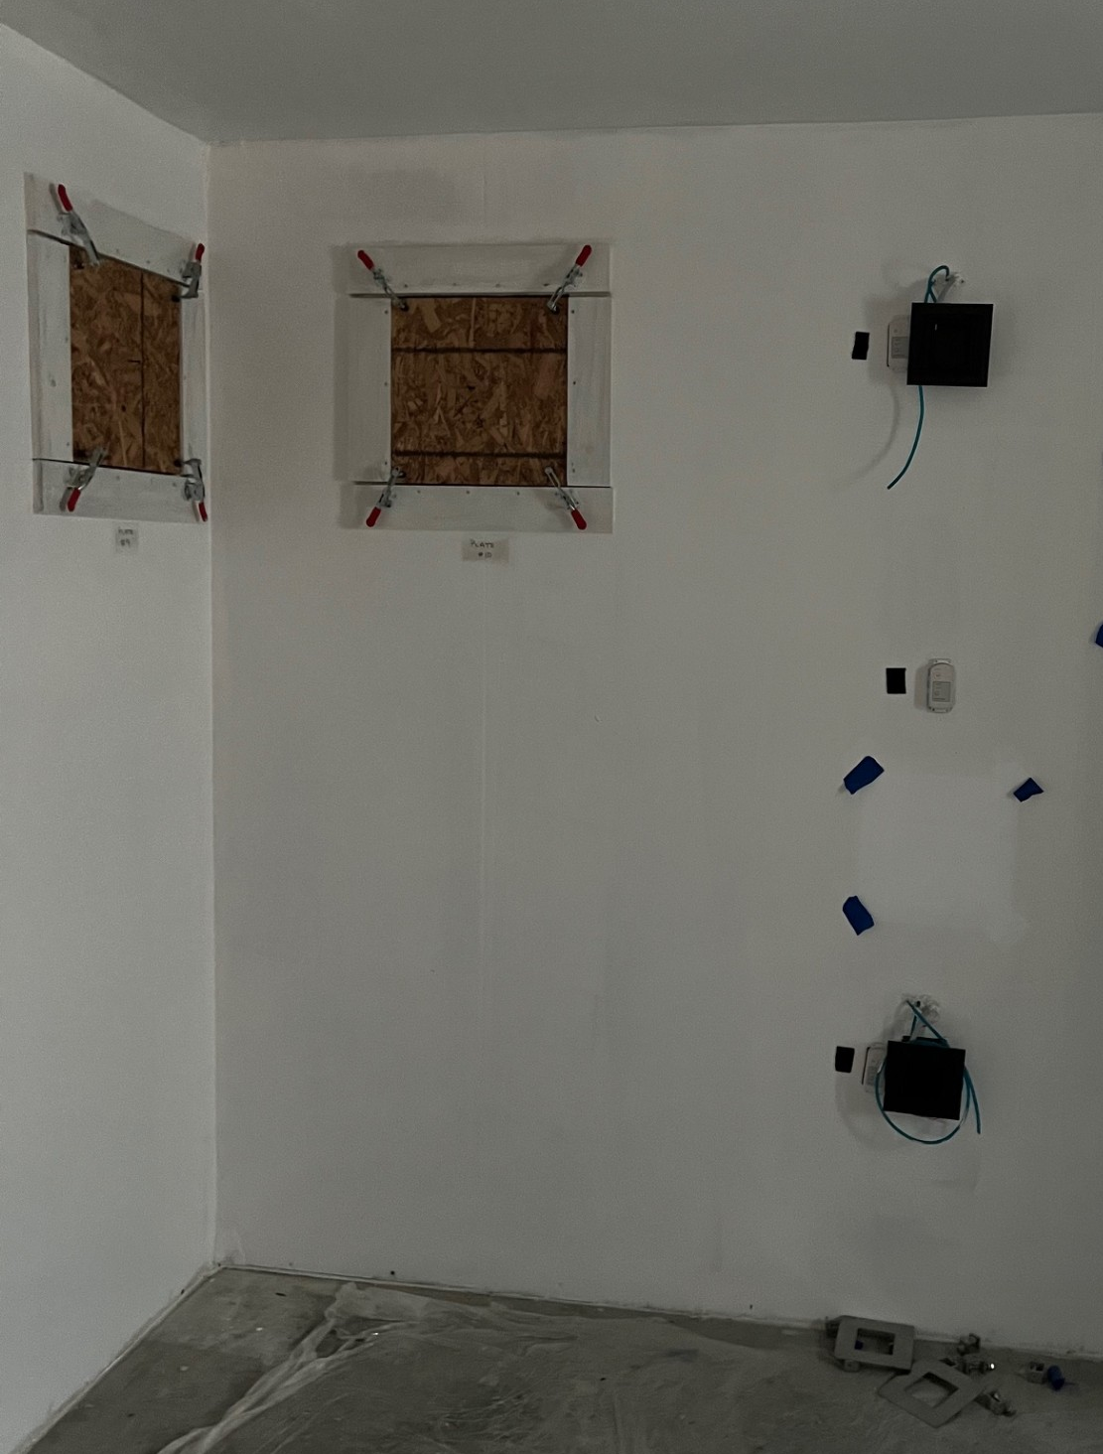
Dedicated Test Facility
Uses concentration measurement boxes to determine Transport Efficiency at FOUR different locations

Slide 13
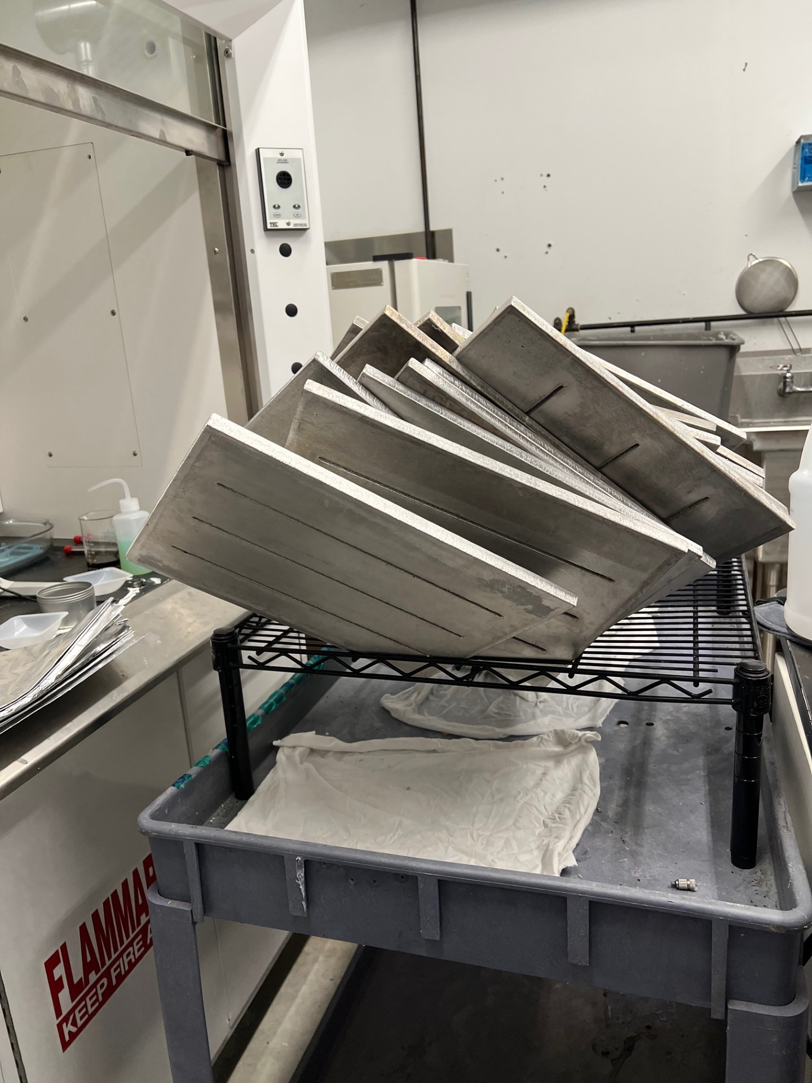
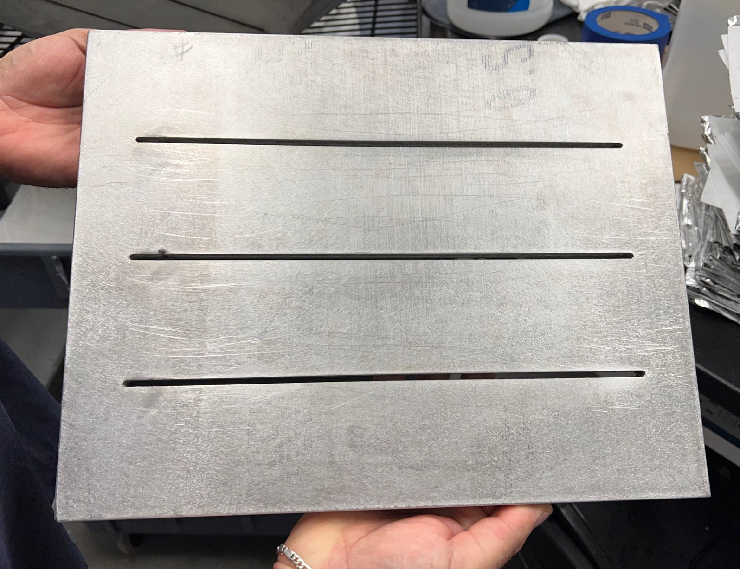
Dedicated Test Facility
Uses re-usable leakage plates to assure the same conditions for all tests

Slide 14
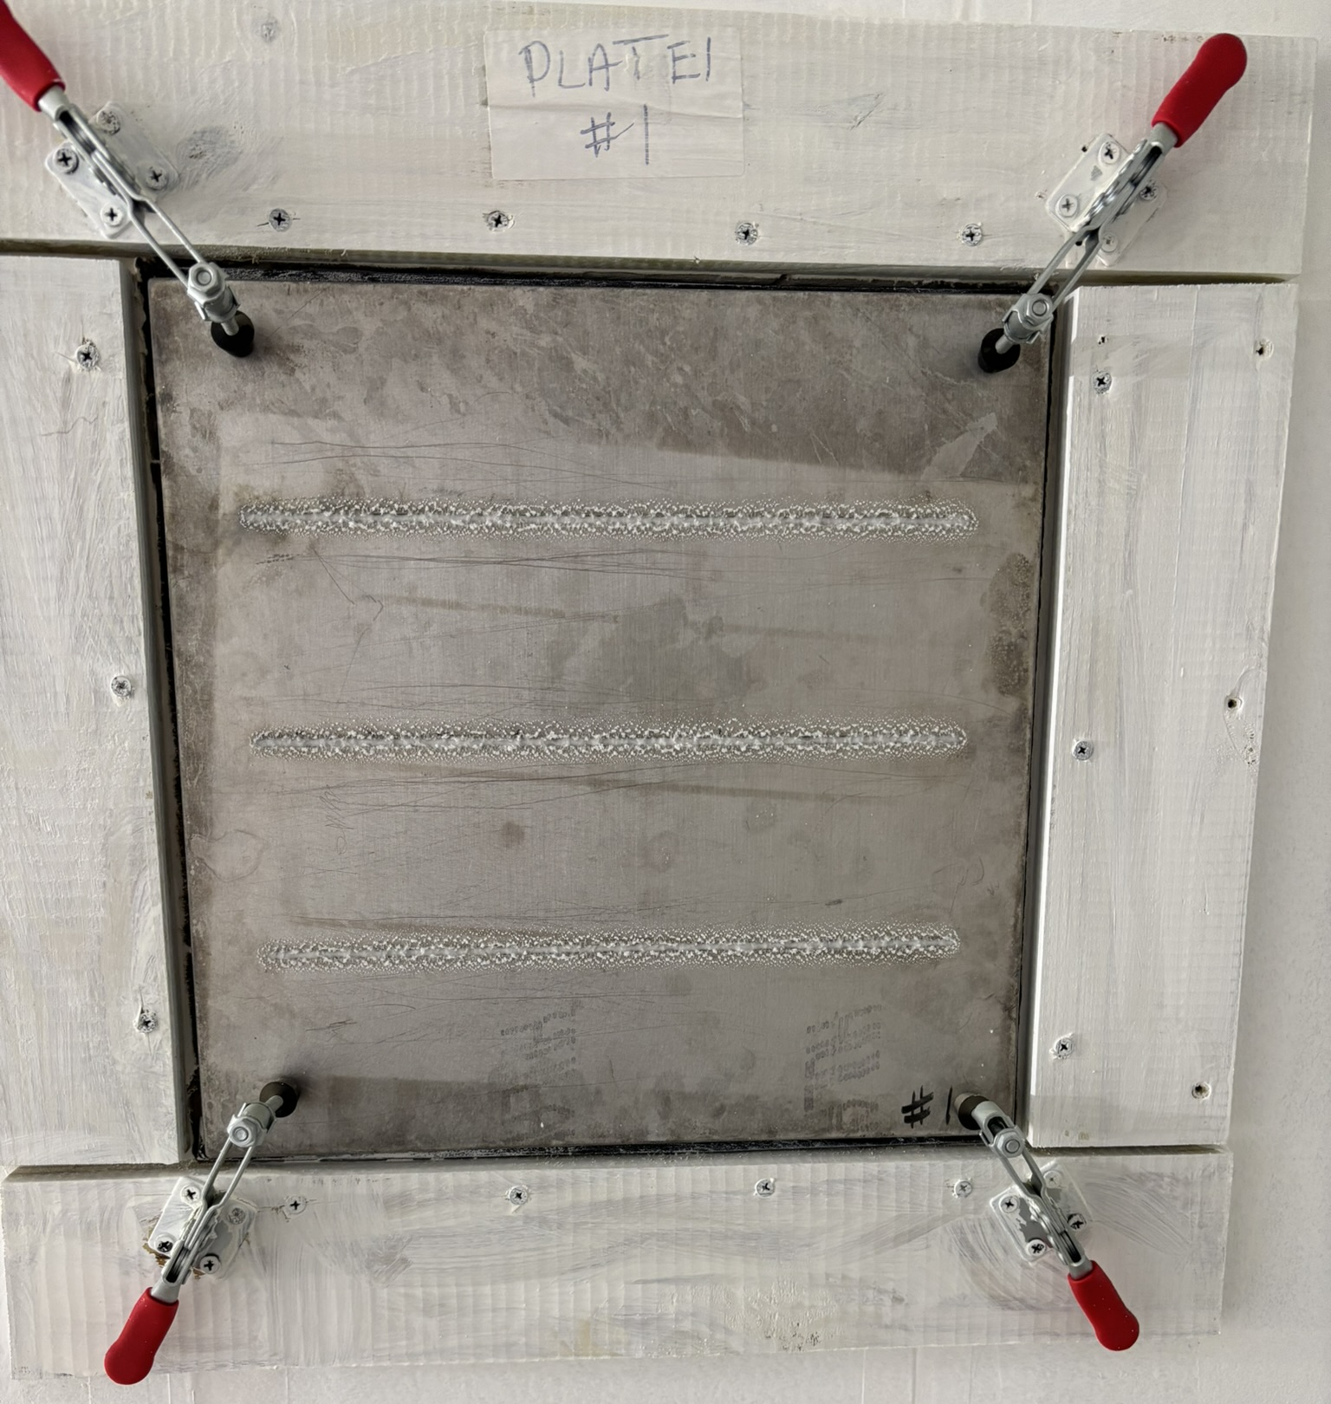
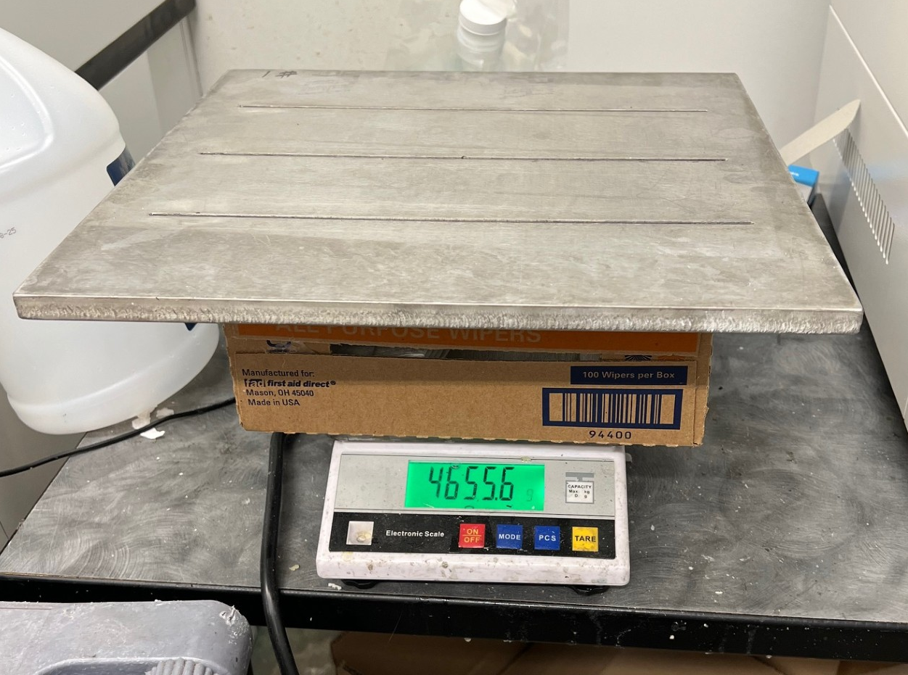
Dedicated Test Facility
Uses scale to weigh plates before and after sealing to determine SealDensity
Uses 2nd scale to weigh total sealant injected
Facilitates calculation of sealant use efficiency
Facilitates calculation of Deposition Efficiency

Slide 15
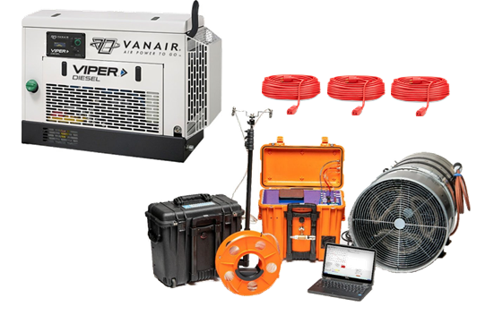
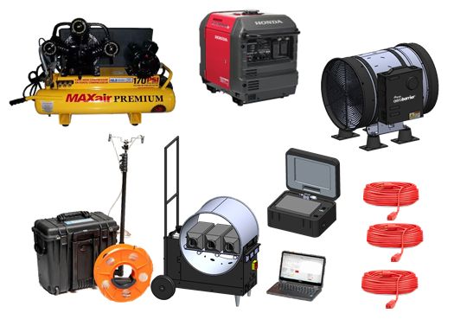
New Technology Developments
Non-Electric Heat =
Smaller, Lighter, Faster System
220 V Fan
Large heavy Compressor/Generator
Compressed Air lines running into house
Non-Electric Heat
110 V Fan
35% less weight

Slide 16
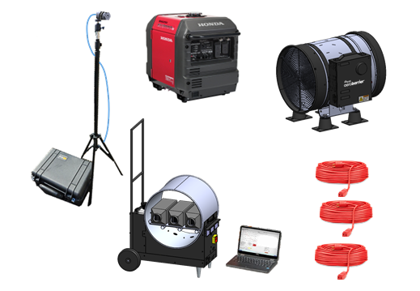
New Technology Developments
Non-Electric Heat + Airless Atomization =
Smaller, Lighter, Faster System
Non-Electric Heat
110 V Fan
35% less weight
Airless Atomization - No Compressed Air
Battery-powered sealing stations
Another 50% weight and volume reduction

Slide 17
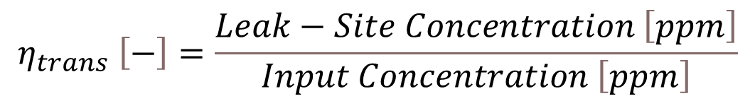
Dedicated Test Facility Application
Quantifying Transport Efficiency
$$η_{trans} \left[−\right]=\frac{Leak−Site Concentration \left[ppm\right]}{Input Concentration \left[ppm\right]}$$

Slide 18
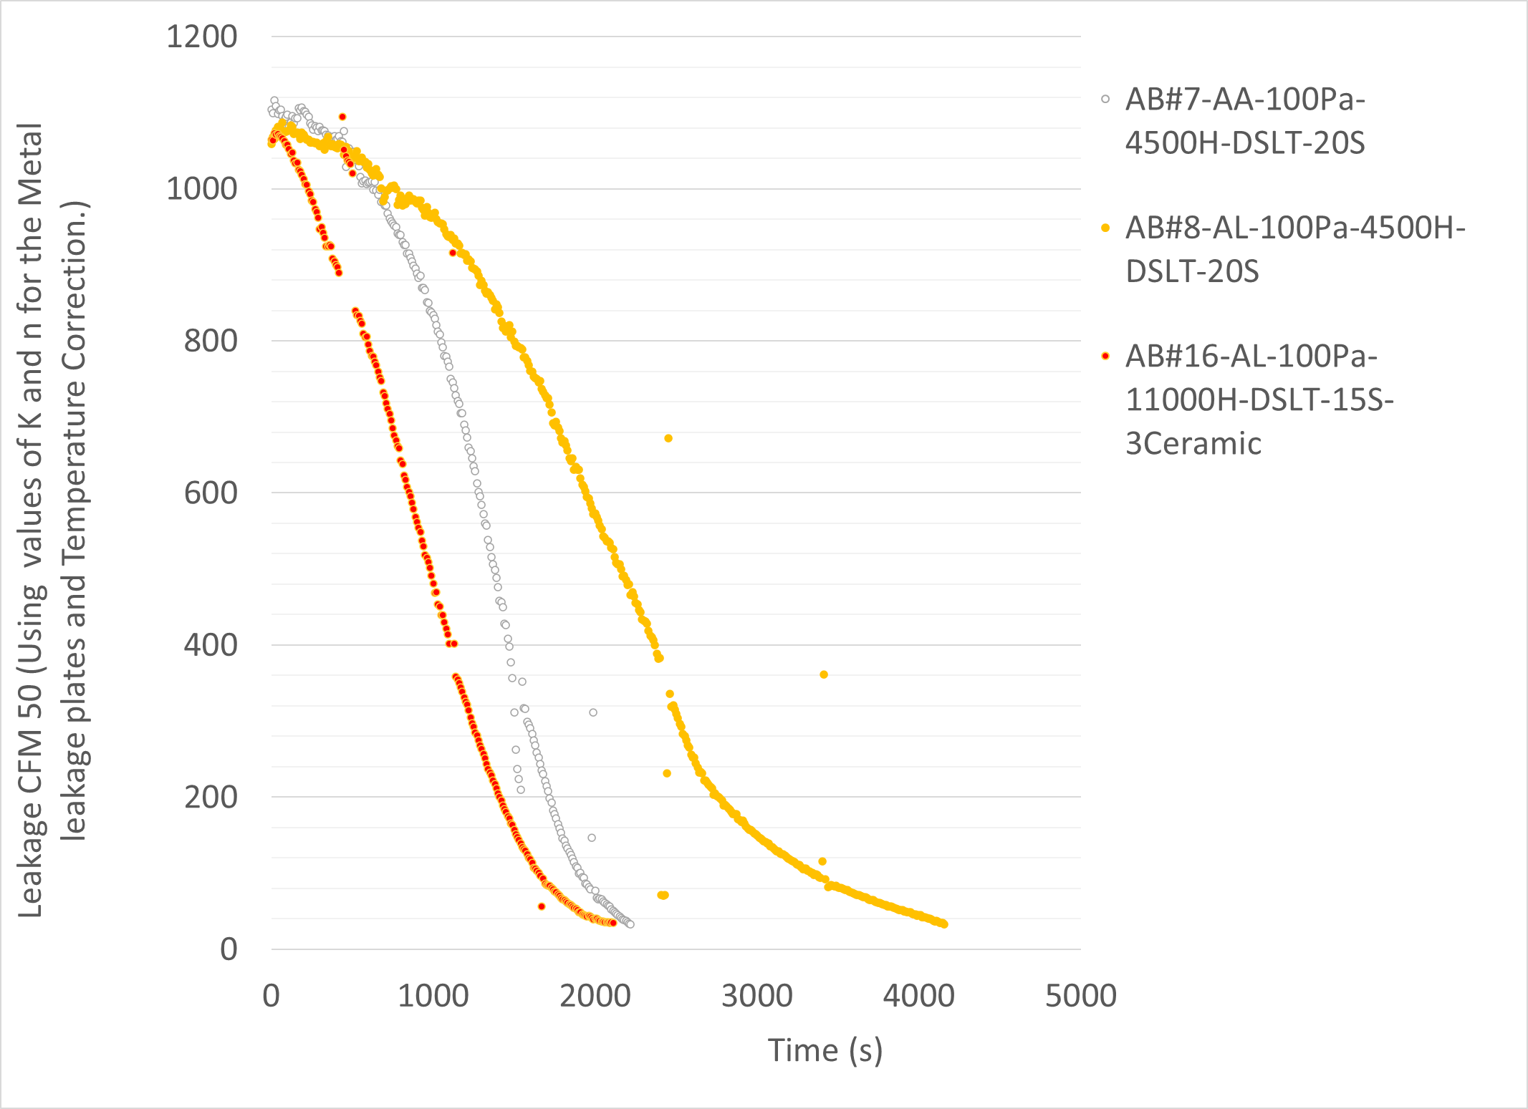
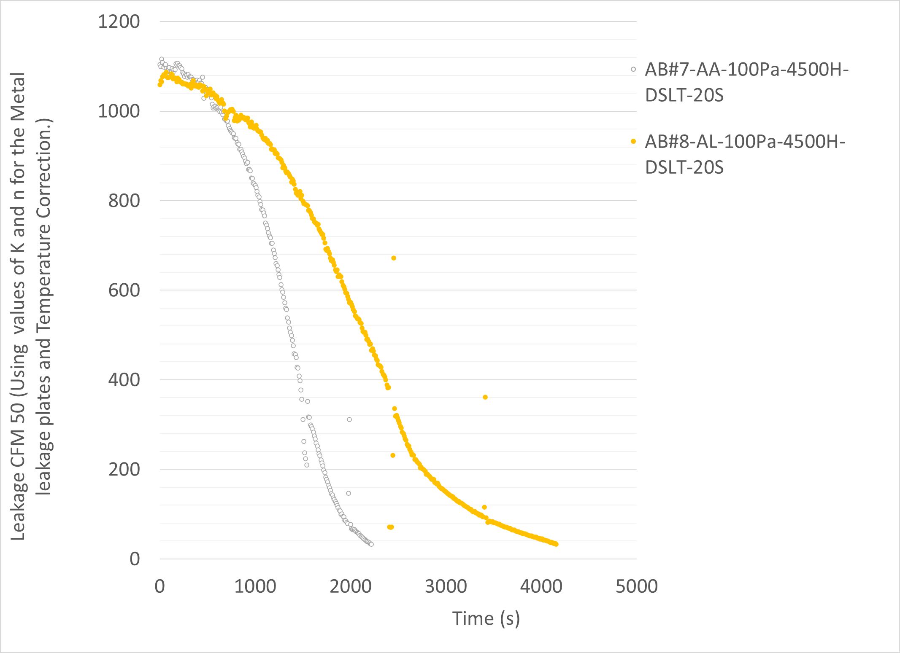
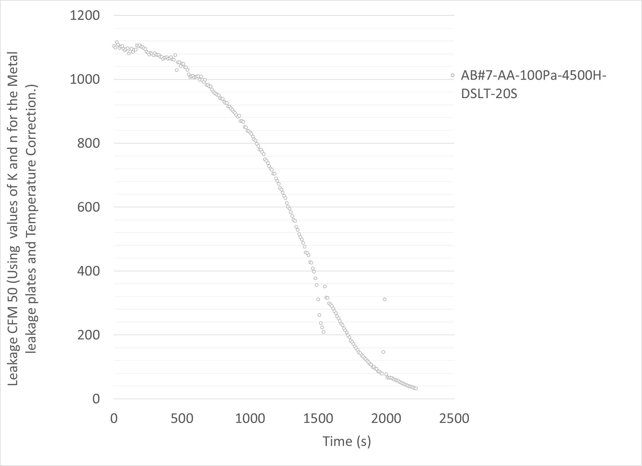
Dedicated Test Facility Application
Getting Airless sealing speeds to match Compressor Systems
Compressor
Airless
Compressor
Airless
New Airless
Compressor

Slide 19
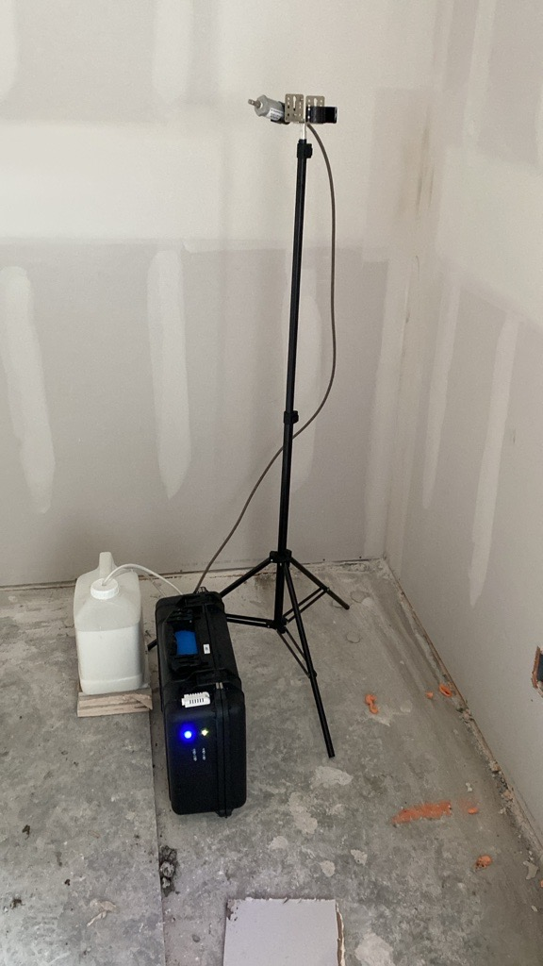
Field Testing Airless System
Saves 20 mins on set-up and clean-up
Has had longer injection times versus Compressed Air
Last week AIRLESS showed shorter injection times versus Compressed Air, based upon innovations tested in the lab

Slide 20
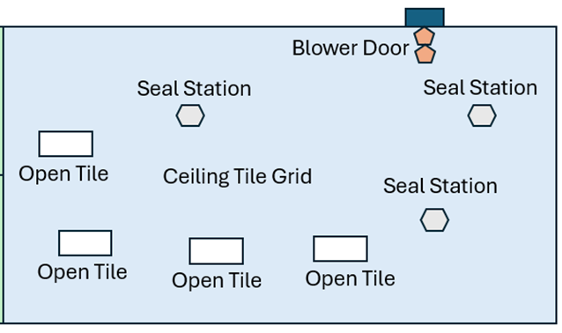
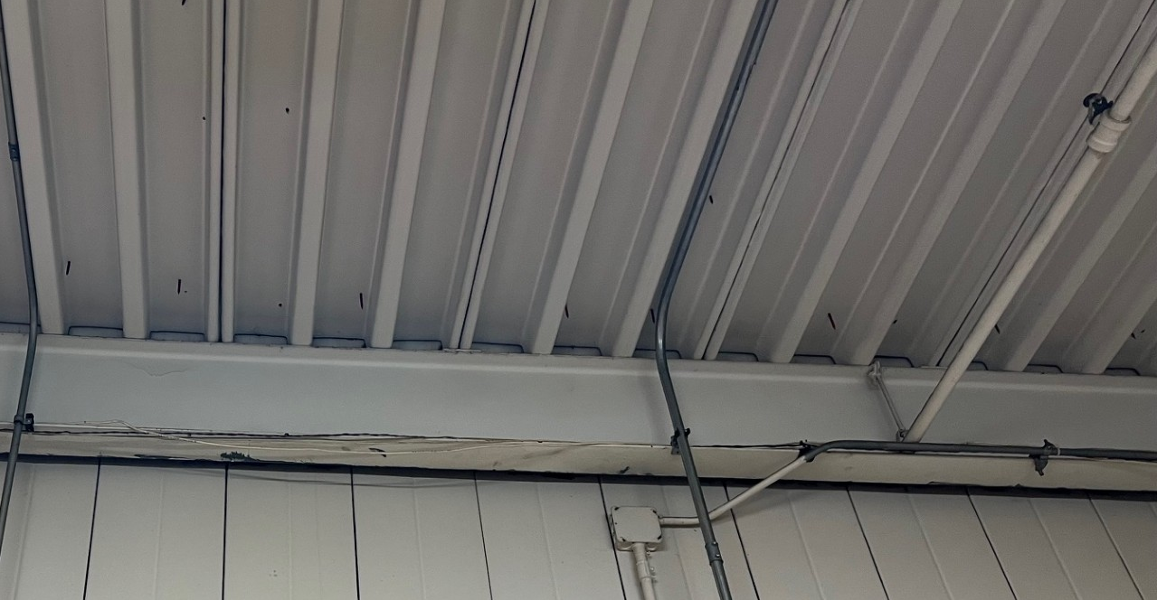
New Applications
Ceiling Plenum Sealing
PROTOCOL
Preparation
Applied spray foam to patch large existing openings between ceiling plenum and adjacent ceiling plenum (i.e. gaps in corrugated roof deck)
Positioned 3 mobile sealant injection stations in the ceiling plenum nearest the perimeter walls
Opened ceiling tiles furthest from the sealing stations to ensure air penetration from the blower door into the ceiling plenum
Injection performed during normal operating hours in an occupied office building
Used an additional blower door to pressurize an adjacent room to limit sealant infiltration into the rest of the facility

Slide 21
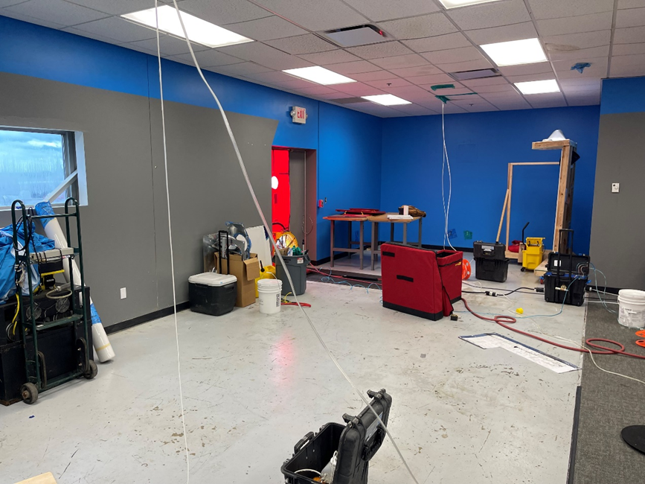
New Applications
Ceiling Plenum Sealing
Results
Sealed approximately 300 cfm50
Stopped prematurely due to some fogging of occupied space
Should be performed during unoccupied hours
Not enough fogging to cause deposition, but enough to cause complaints

Slide 22
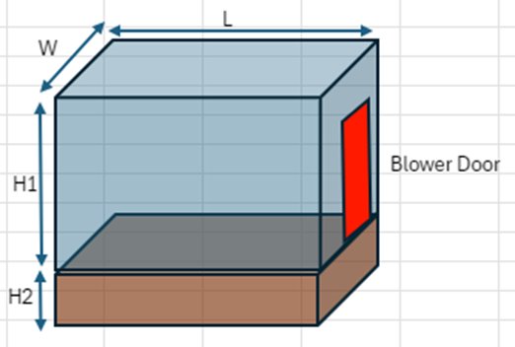
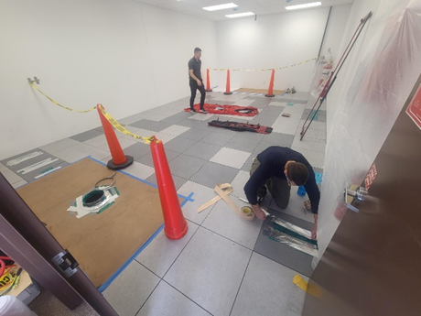
New Applications
Underfloor Air Distribution Sealing
Parameter | Value
Envelope Height (H1) | 9.9 ft
Subfloor Height (H2) | 1 ft
Envelope Width (W) | 18.2 ft
Envelope Length (L) | 31.3 ft
Envelope Volume (L x W x H1) | 5,630 cubic feet

Slide 23
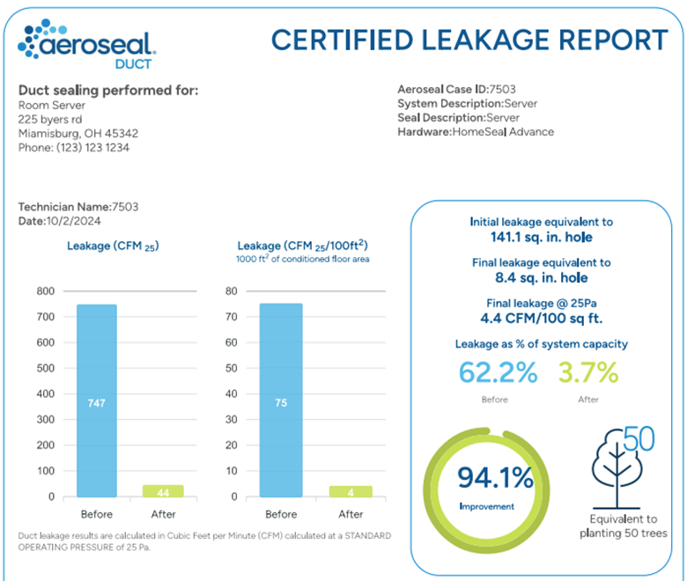
New Applications
Underfloor Air Distribution Sealing
Parameter | Value
Envelope Pre-seal Leakage | 6.3 ACH50
Envelope Post-seal Leakage | 4.9 ACH50
Subfloor Initial Leakage | 747 CFM25
Subfloor Final Leakage | 75 CFM25

Slide 24
Presentation Take-Aways
Facility for Precise Measurement of Aerosol Envelope Sealing Technologies
Separates out factors influencing performance
Airless Envelope Sealing is the Future
Surpassed current Air-Assist atomization in lab and field
Dramatically reduces equipment weight and volume
Reduces set-up and break-down time requirements
New Applications
Continue to find new applications for the technology

