Slide 1

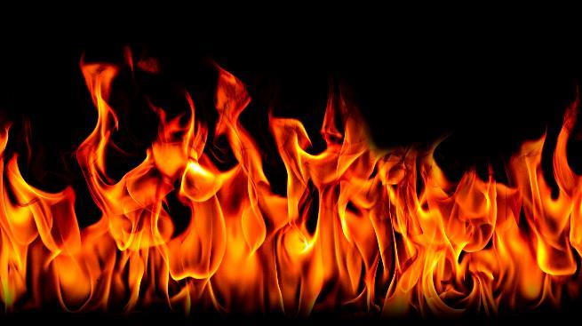

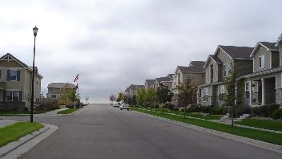
Fire Wall Testing And Air Leakage Control To Aid In Construction Tolerances And In Litigation
Summer Camp XXVII
Twenty-Seventh Westford Symposium on Building Science
Presented by: Edward L. Fronapfel, PE, CBIE, F.ASCE, F.ASCE, DFE, D-IBFES, CFCC, CBCP, PT1, NACHI, Therm II, MAE, F.ASCE, F.NAFE
efronapfel@byothersllc.com
Thanks to:
Robby Schwarz
BUILDTankinc
robby@buildtankinc.com
And his permission to incorporate “10 Strategies: Meeting Air Sealing and Code Requirements for Townhouse Area Separation Walls”
August 6, 2025

Slide 2
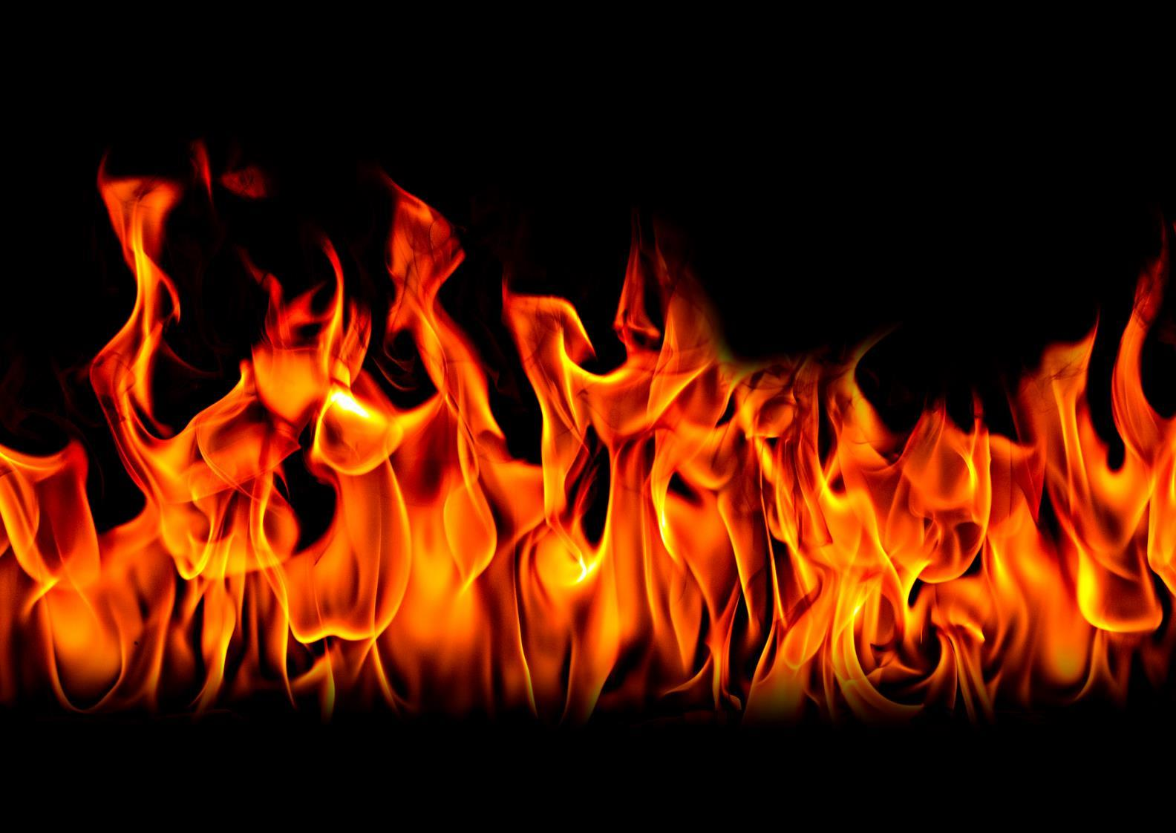
Schedule 0-5 Review of the history of passive fire wall construction in multi-family and commercial applications 5-45 Review of alleged defective work and standard investigation findings from both visual and intrusive testing, review of air-tightening 45-75 Review of testing that was performed and the findings based on a multitude of both proprietary and non-proprietary testing Q and A

Slide 3

Learning Objectives: Collaboration of trades and the End Product Understanding and applying the provisions of 2-hour wall construction Understanding the observation criteria for quality assurance in fire wall construction Understanding the impacts of tolerances on the construction of 2-hour walls Understanding the impacts of air sealant at critical interfaces

Slide 4

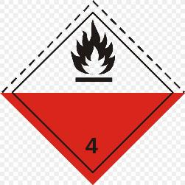
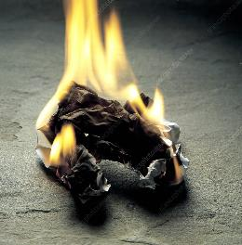
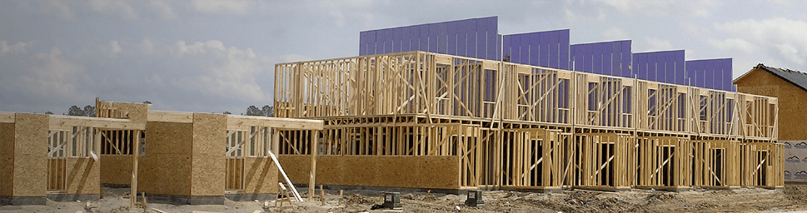

Fire Basics - The Tetrahedron Oxygen from the air Heat Fuel Source Without one – No Fire

Slide 5

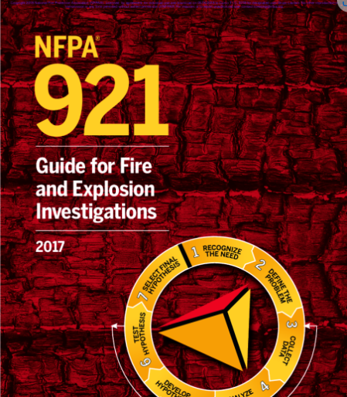
Developing Your Conclusions NFPA 921 – 4.3.5 and 4.3.6 – Hypothesis Inductive Reasoning: Based on empirical data the investigator has collected through observations, knowledge, training and experience Deductive Reasoning: The investigator does not have a valid or reliable conclusion unless the hypothesis can stand the test of careful and serious challenge. Compare the Hypothesis All Known Facts Body of Scientific Knowledge Testing of the Hypothesis Lab, Calculations, Modeling Disprove the Hypothesis (find out why it is not true by each specific component in the assembly) This will prevent “Confirmation Bias” that is formed solely on supporting data

Slide 6
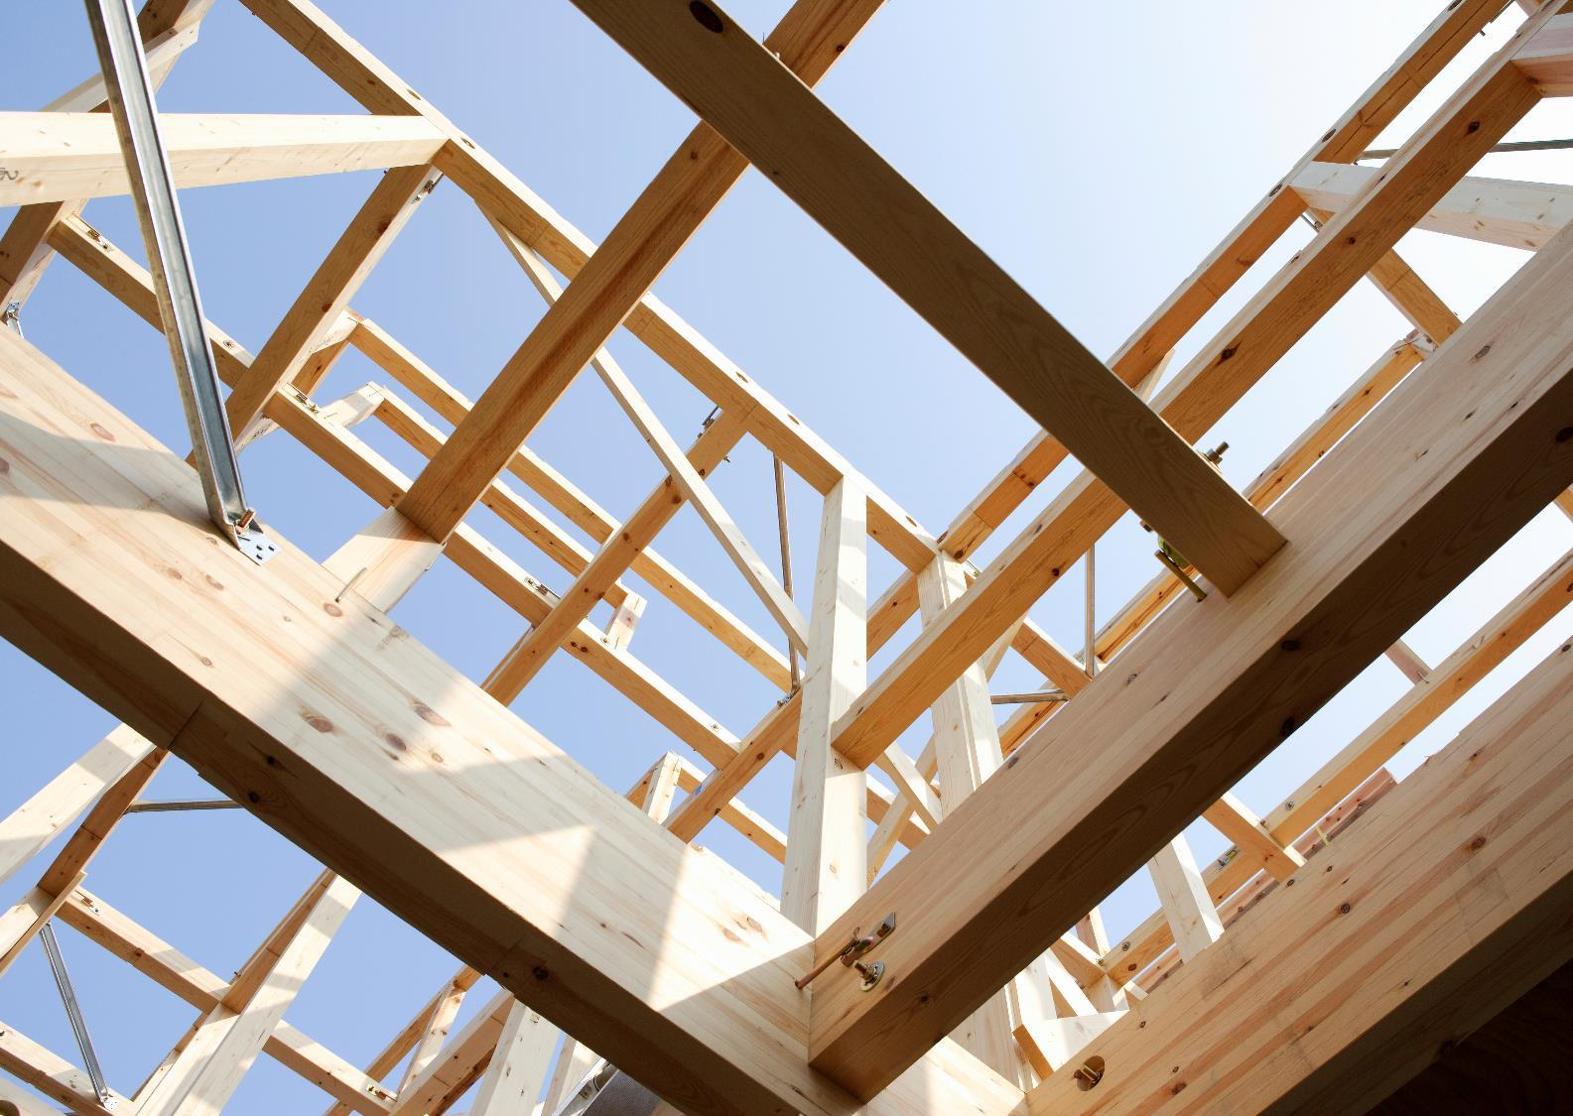
The Fire Wall
Interdisciplinary Requirement Not just the Architect
Civil Engineer – Laying out the buildings per setbacks
Architect – Type of Use, Layouts, Materials, Assemblies
Structural – Type of Structure, the materials
Mechanical/Plumbing/Electrical – Systems that interrupt or pass
Building Science – Assemblies that work, reduce air losses, control the environment
Structure – Sound – Resistance – Reduction in Air Loss

Slide 7

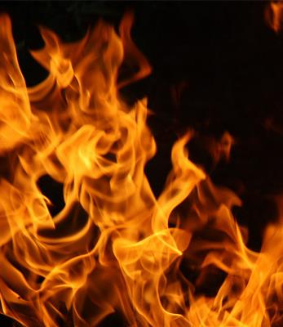
What constitutes the UL fire rated assembly?

Slide 8
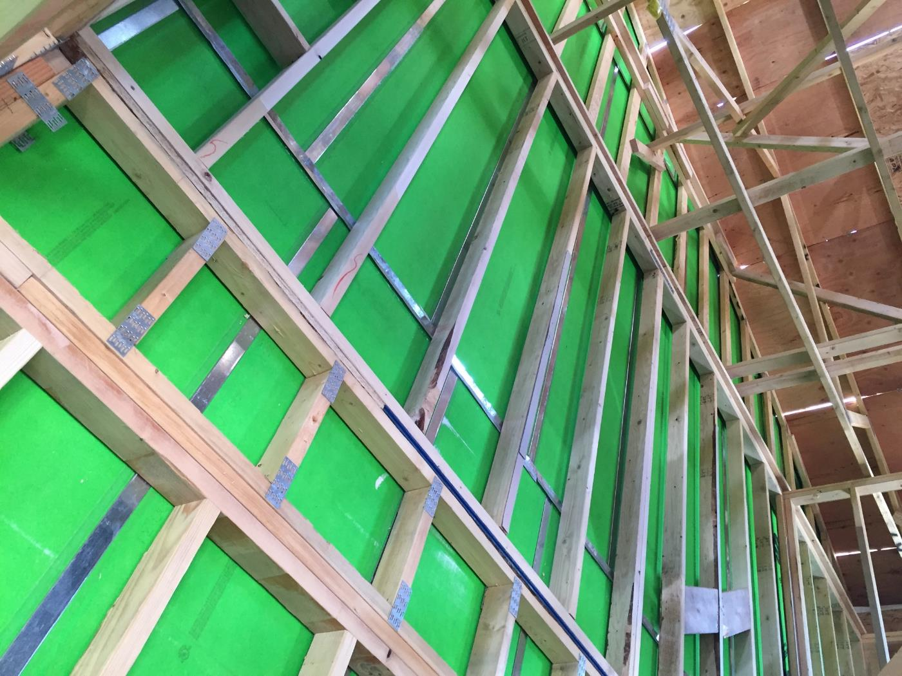
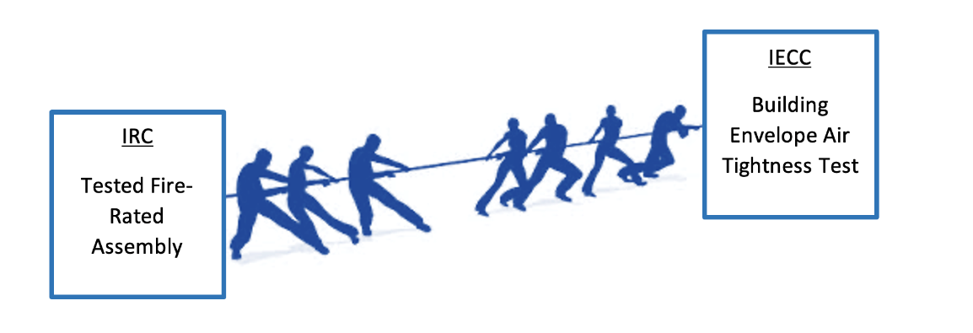
Sound/Structure/Air leakage

Slide 9
Combine your fire prevention needs with your air barriers
Newport Partners a consulting firm headquartered Davidsonville MD coordinated research on behalf of HUD/PD&R
Field research was conducted at Thrive Home Builders townhouse project in Wheat Ridge Colorado
NFPA managed an Advisory Group
This session is designed to inform stakeholders of the key issues involved in building safe and energy efficient in ASWs in townhouses
Our goal is to provide strategies to make the process easier and ultimately more affordable
RESOURCE DEVELOPMENT | Newport Partners LLC

Slide 10
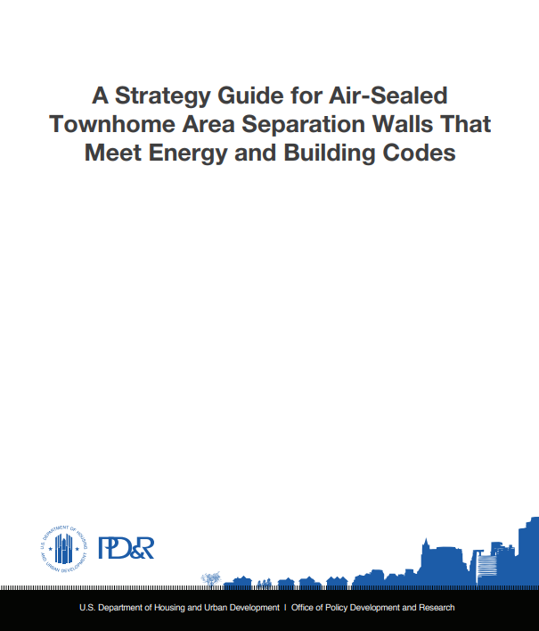
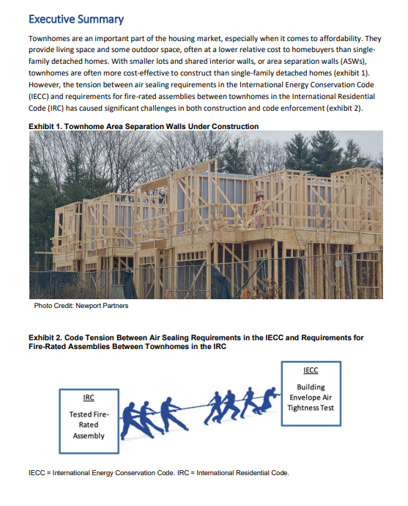
Newport Partners, LLC
A Strategy Guide for Air-Sealed Townhome Area Separation Walls That Meet Energy and Building Codes

Slide 11
Two One Hour and One Two Hour
Because the (2) separate assemblies provide the same level of fire protection between
units (ie, Double 2-hour walls versus the Single 2-hour wall), the subject of this memo
discusses the equivalency of the two separate systems of which, under section 104.2.7
“Modifications,” the building department properly approved.
The construction of the Single 2-hour, in lieu of the Double 1-hour, was approved
because the 2 constructions were documented as equivalent in the 2003 International
Residential Code (IRC), of which the City had knowledge of by the time the Double 1-
hour wall was constructed but after the permits were issued (See R317.2 – 2003 IRC
attached).
In short, the fire-resistive separation walls, as constructed, were deemed to be
equivalent to the originally designed wall, as well as met the intent of the minimum
requirements of the 1997 Uniform Building Code, because of the knowledge of the 2003
International Residential Code. As for the 1-hour fire resistive assemblies between the
garages, these also are acceptable based on the UBC formal interpretation of section
503.2 (See 503.2 UBC interpretation attached).
Area Separation Walls (Sections 504.6.2., 504.6.3., and 504.6.4.)
UBC 504.6.2. requires that the required area separation walls in R-1 VN buildings be constructed with a minimum of 2-hour rated assemblies.
When a 2-hour rated assembly is used, Section 504.6.4. requires that the area separation wall extend above the roof 30-inches, or the 2-hour wall is allowed to terminate at the bottom side of the roof deck provided additional measures are taken to install 1-hour fire-resistive construction within 5-feet of the area separation wall termination (see Section 504.6.4.).
Section 504.6.3. requires that the separation walls extend to the outer face of the exterior wall of the building unless there are enclosed horizontal projecting elements such as porches or balconies.
In these cases, the area separation wall must extend to the end of the horizontal projecting element, but only if it is enclosed

Slide 12
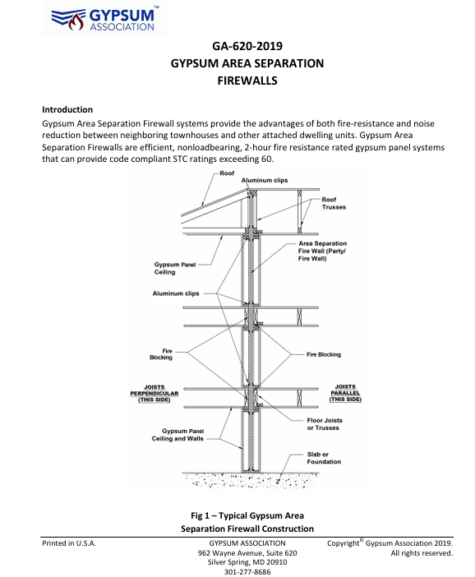
*Microsoft Word - GA-620 GYPSUM AREA SEPARATION FIREWALLS FINAL 031319.doc

Slide 13

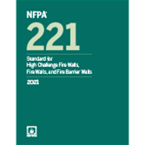
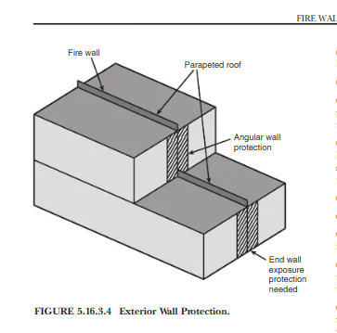
NFPA 221 (1929-2021) Standard for High Challenge Fire Walls, and Fire Barrier Walls 6.2 Structural Stability: 6.2.1 Fire walls shall be designed and constructed to remain stable after collapse of the structure due to fire on either side of the wall. 6.2.2 fire walls constructed in compliance with the requirements of Sections 6.3, 6.4, 6.5 shall be deemed to provide the required stability. 6.4.2 Framework 6.4.2.1 Structural framing on either side of the wall shall line up horizontally and vertically and shall support the roof. 6.4.2 The framework on each side of the fire wall shall be continuous and tied together through the wall. 6.4.2.3 The frame work on each side shall be designed so that it resists the maximum lateral pull that can be developed due to the framework collapse on the opposite side. 6.5 Double Fire Walls 6.5.1 A double frame wall consists of two back to back walls 6.5.2 There shall be no connections, other than to the flashing between the walls. 6.5.3 Each fire walls shall be supported laterally by the building frame on its respective side and shall be independent of the fire wall and framing on the opposite side.

Slide 14
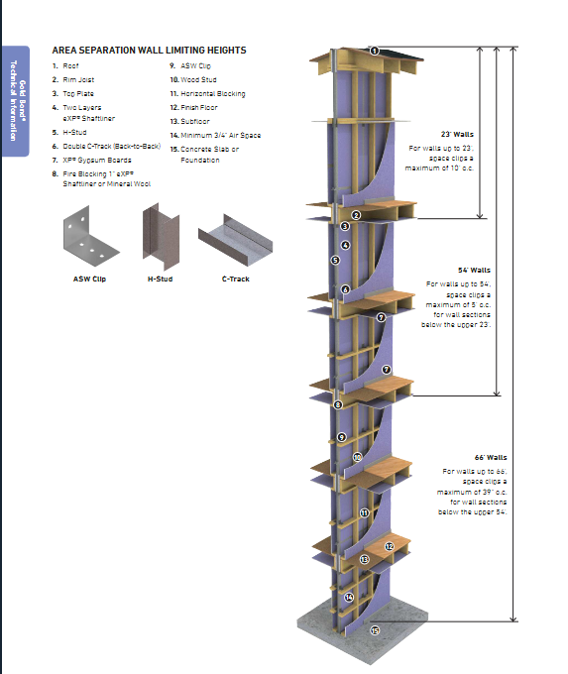
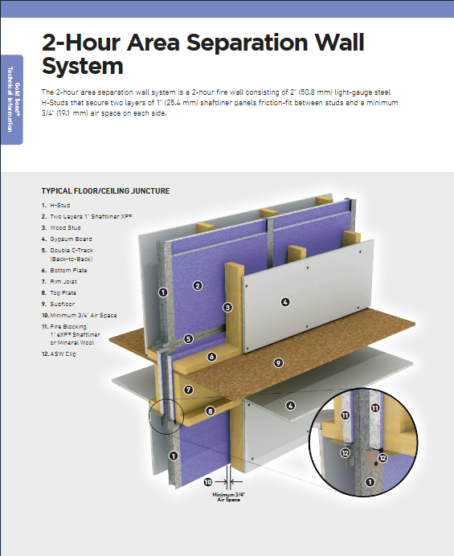

Slide 15
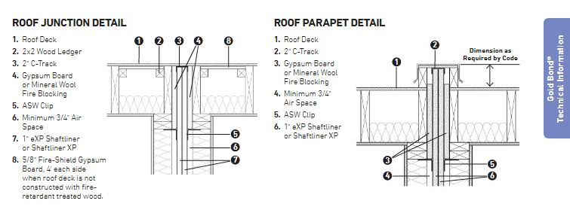
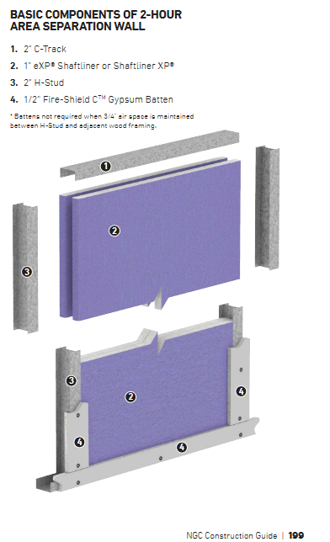
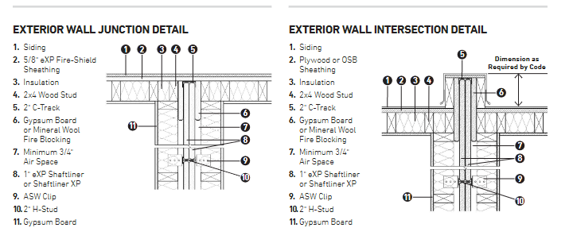
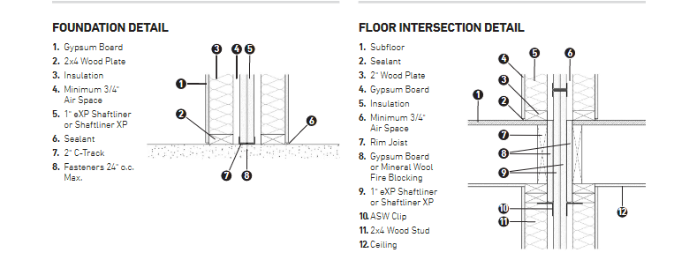

Slide 16
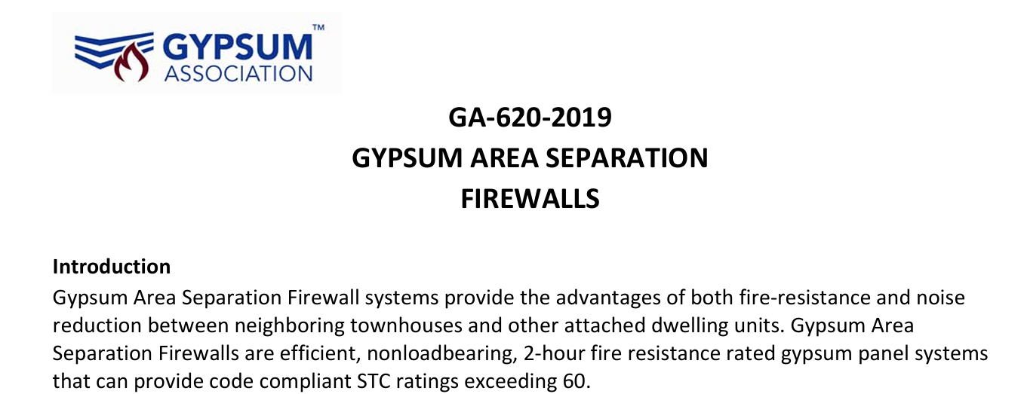
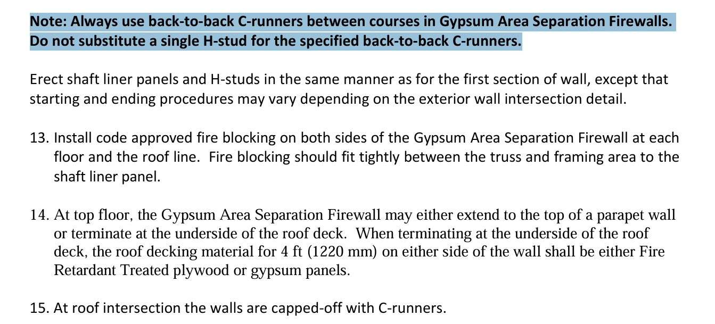
Gypsum Association

Slide 17
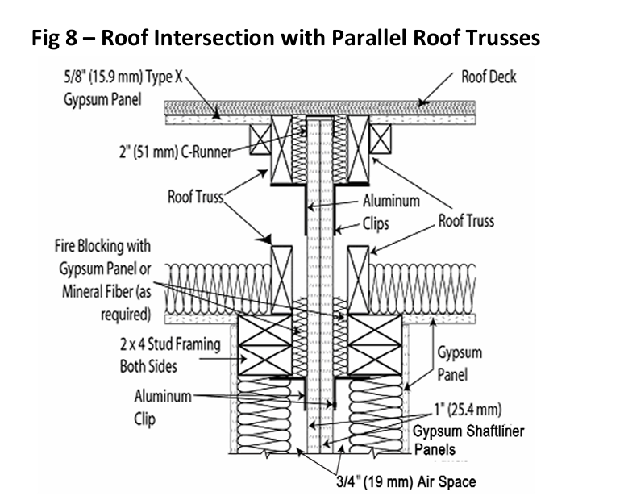
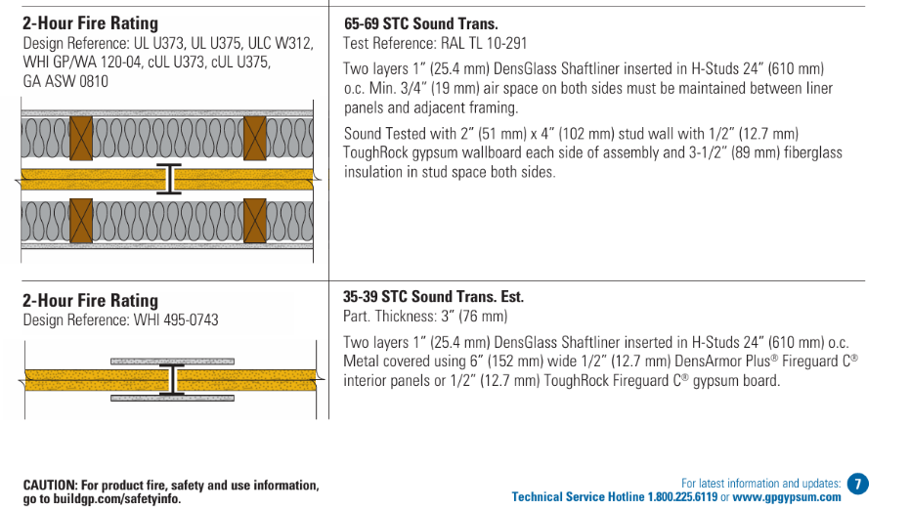
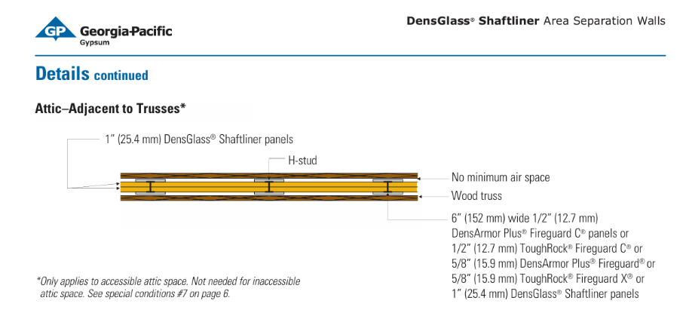
Fire and Sound
GYPSUM ASSOCIATION

Slide 18

CFM/SQFT of Unit Envelope Area
https://abmichigan.com/improving-occupant-comfort-multifamily-buildings/

Slide 19
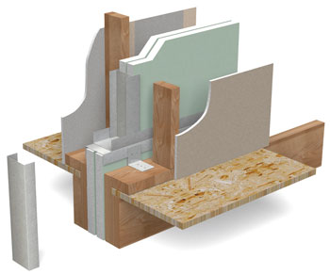
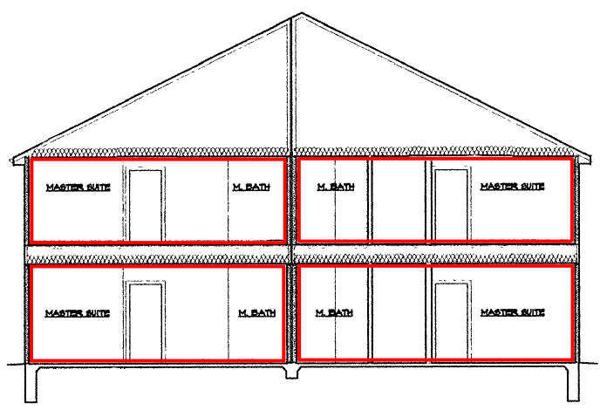
Compartmentalization

Slide 20
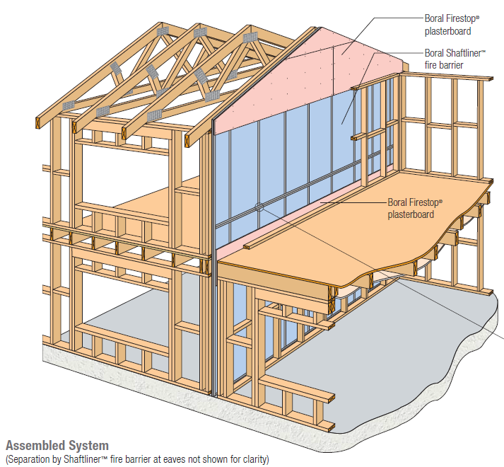

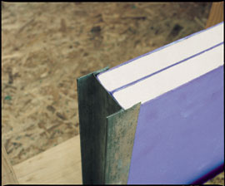
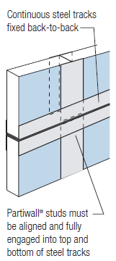
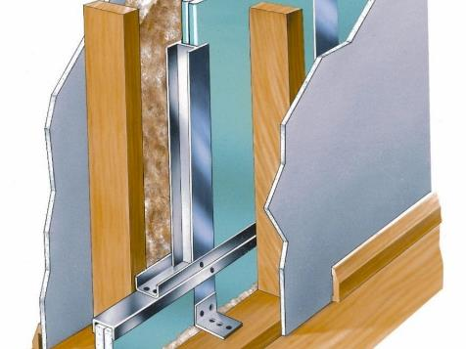
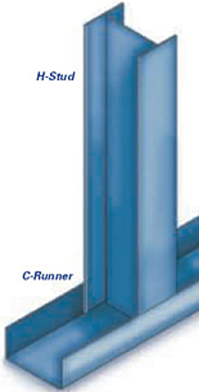
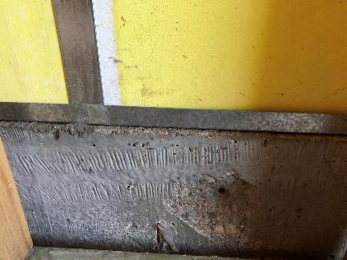
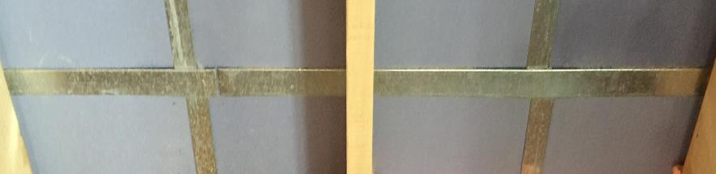

Slide 21
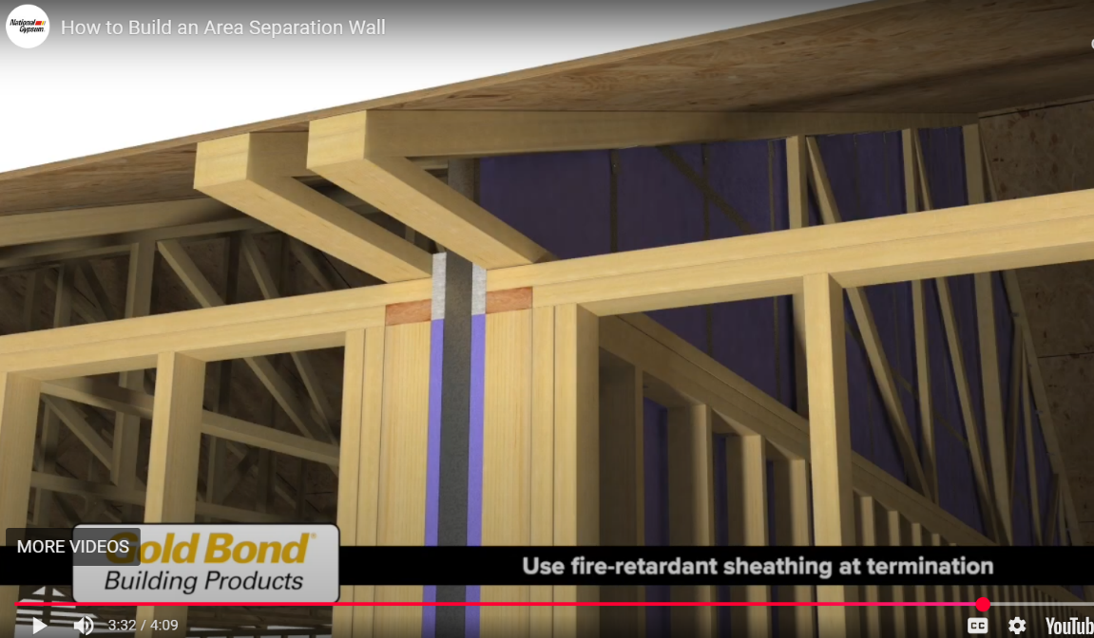
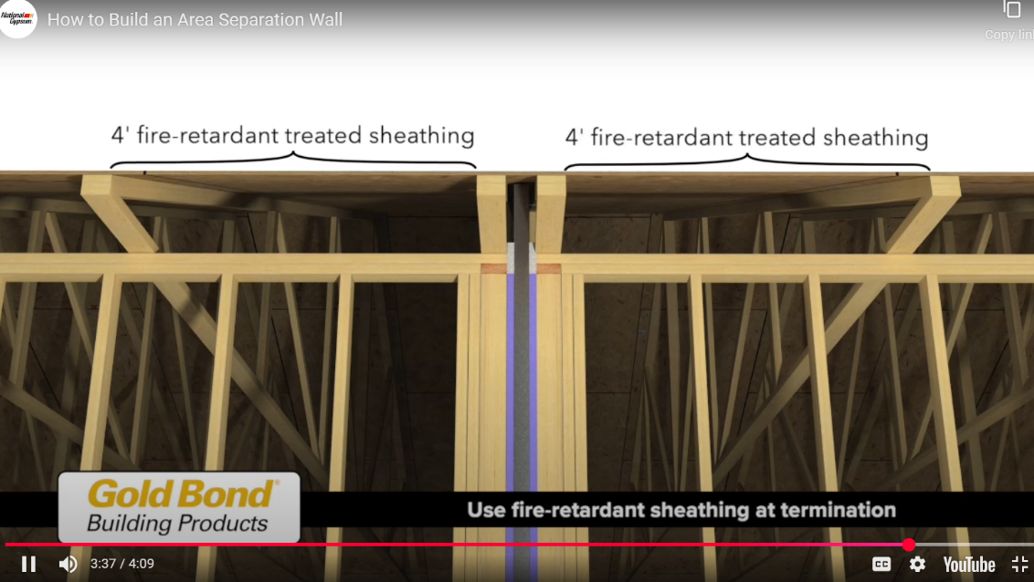

Slide 22
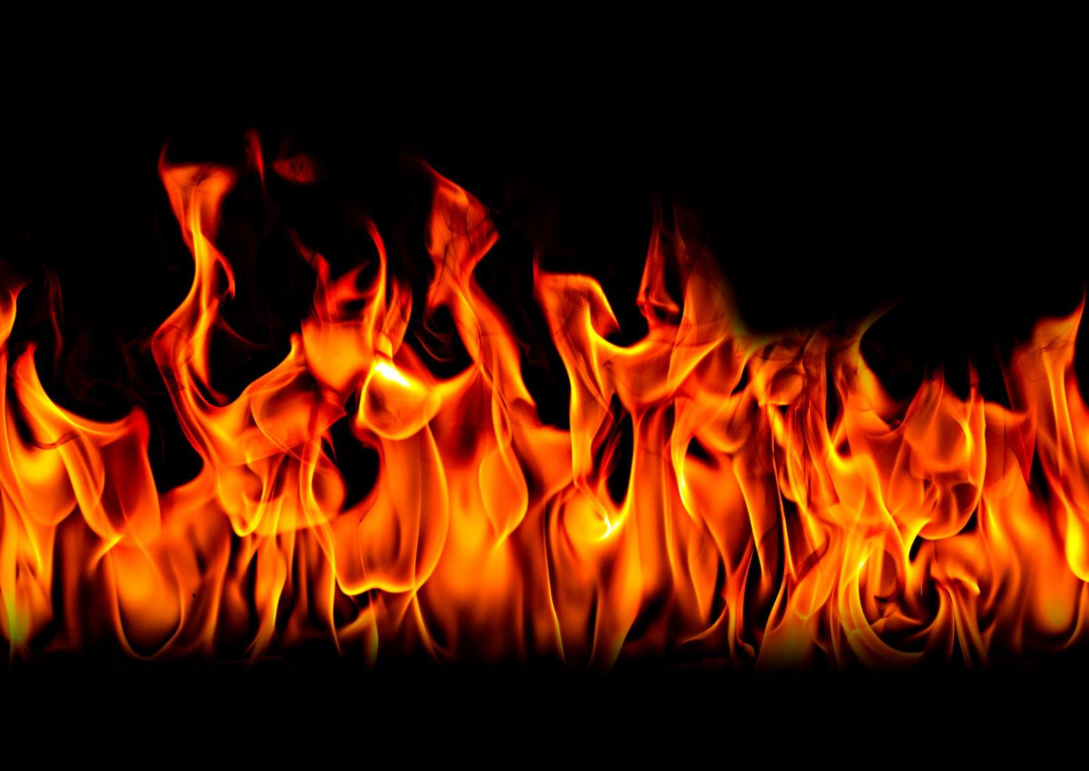
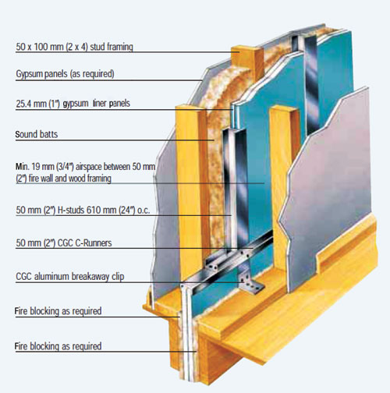
When one is next to the other Horizontal Separation Vertical Separation Mechanical Separation Reductions – Sprinklers! Activation! Smoke Control! Maintenance, Repairs and Replacements (Code changes) Passive is easy to provide without having to engage the future owners

Slide 23
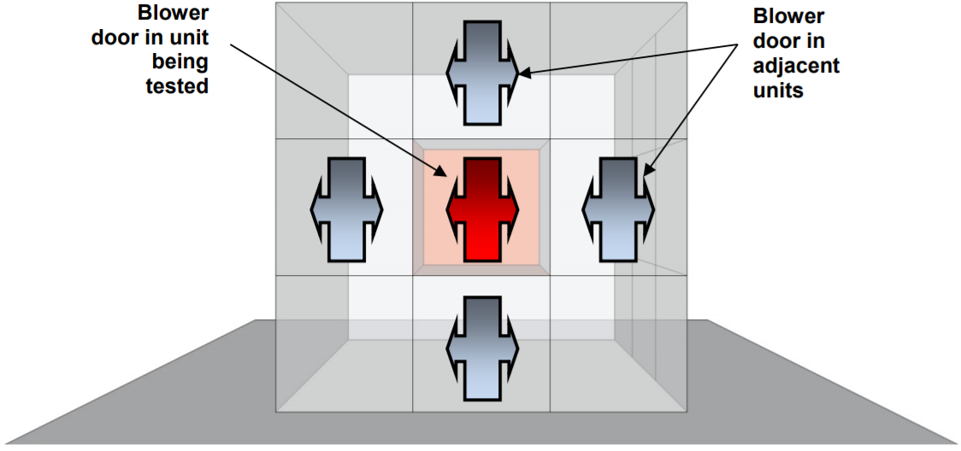
Guarded
https://pdfs.semanticscholar.org/1d09/4068aac94e1ef32515607df1a7f263db6897.pdf?_ga=2.113266831.907656350.1578976064-1166214141.1578976064

Slide 24
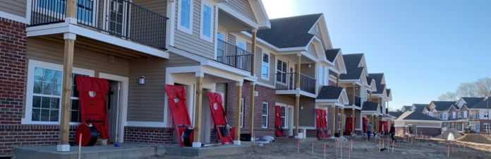
Guarded Testing is not cost effective!
https://www.mncee.org/blog/may-2019/research-sidesteps-obstacles-measuring-air-tightne/

Slide 25
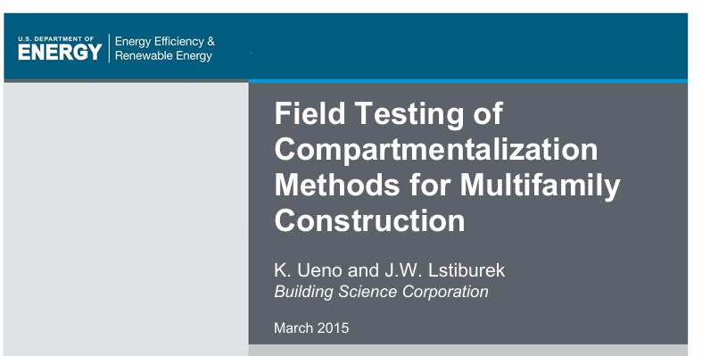
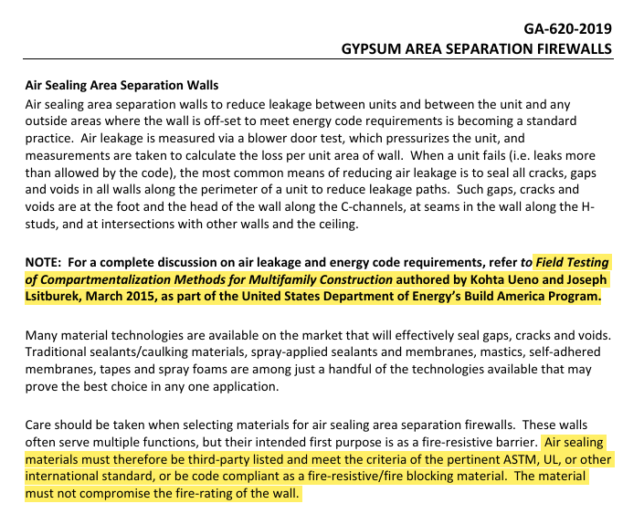
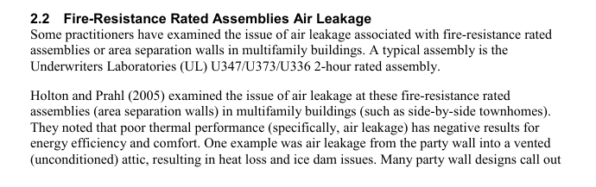
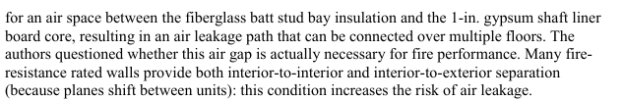
Air Sealing Separation Walls
Field Testing of Compartmentalization Methods for Multifamily Construction

Slide 26
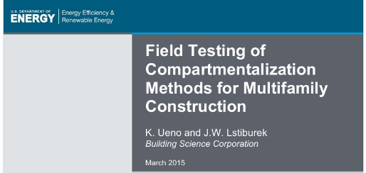
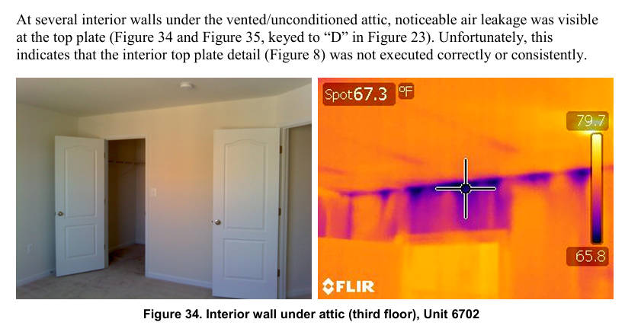
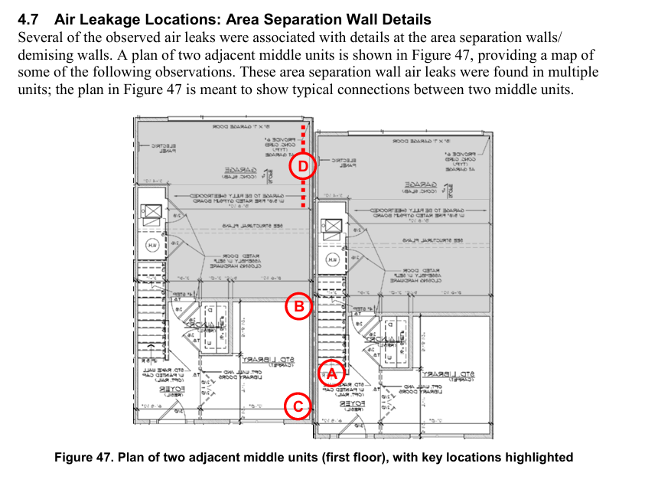
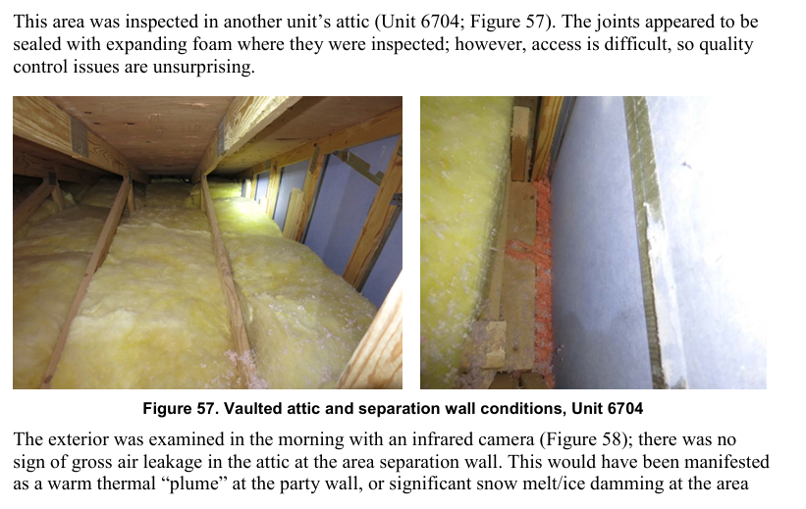

EERE Findings

Slide 27




IECC and the Building Thermal Envelope
BUILDING THERMAL ENVELOPE.
The basement walls, exterior walls, floors, ceiling, roofs and any other building element assemblies that enclose conditioned space or provide a boundary between conditioned space and exempt or unconditioned space.
Blue – Exterior air barrier
Yellow Thermal barrier
Red Interior air barrier
https://energyrecovery.com.au/MVHR/BuildingAirtightness

Slide 28






Slide 29



Dwelling Unit | A | B | C | D | E | F
Aero Barrier Applied | y | N | Y | N | Y | N
Blower door after Aero Barrier Applied (A,C,E) |  | 7.32 ACH50 |  | 5.67 ACH50 |  | 3.73 ACH50
Blower door Pre-Aero Barrier (some air sealing performed) | 4.96 ACH50 | 5.97 ACH50 | 6.23 ACH50 | 4.81 ACH50 | 6.44 ACH50 | 3.76 ACH50
Blower door After Aero Barrier | 1.64 ACH50 | 1.50 ACH50 | 1.88 ACH50 | 1.53 ACH50 | 1.67 ACH50 | 1.60 ACH50
Final Code Blower door | 2.19 ACH50 | 2.39 ACH50 | 2.75 ACH50 | 2.05 ACH50 | 2.34 ACH50 | 2.02 ACH50

Slide 30



Dwelling Unit | A | B | C | D | E
Aero Barrier | y | N | Y | N | Y
Blower door after Aero Barrier Applied (A,C,E) |  | 7.28 ACH50 |  | 6.74 ACH50
Blower door Pre-Aero Barrier (some air sealing performed) | 4.63 ACH50 | 7.24 ACH50 | 6.43 ACH50 | 6.62 ACH50 | 5.10 ACH50
Blower door After Aero Barrier | 1.83 ACH50 | 1.80 ACH50 | 1.90 ACH50 | 1.70 ACH50 | 1.59 ACH50
Final Code Blower door | 2.88 ACH50 | 3.00 ACH50 | 2.54 ACH50 | 2.64 ACH50 | 2.31 ACH50

Slide 31






Slide 32



Aero Barrier
Eliminating caulking or gaskets
Around electrical outlets and
Other drywall penetrations
Along ASW and ceiling spaces
To vented attics.

Slide 33




Image from Building America Report – 1508. Kohta Ueno, Joe Lstiburek. March 2015.

Slide 34






It all about sealing the gap with cost-effective options that don’t impact compliance

Slide 35





Slide 36


What occurs – Code Derived to Risk

Slide 37

Material Testing to Assembly Testing
This Photo by Unknown Author is licensed under CC BY-SA-NC

Slide 38
5 Shaft Liner Assemblies
U336 - UNITED STATES GYPSUM CO
U347 - NATIONAL GYPSUM CO
U366 - CERTAINTEED GYPSUM INC
U373 - GEORGIA-PACIFIC GYPSUM L L C
U375 - AMERICAN GYPSUM CO

Slide 39

ASTM E 119: Fire Tests of Building Construction and Materials
Standard Test Methods for Fire Tests of Building Construction and Materials
The test is used to measure and describe the response of materials and assemblies to heat and flame under controlled conditions for a specified time period
When required, the fire exposure is followed by the application of a standard fire hose stream applied in accordance with ASTM E2226
Hose stream test assesses the impact, erosion, and cooling effects of a fire fighting like hose stream on a burned assembly
SECTION 703 FIRE-RESISTANCE RATINGS AND FIRE TESTS 703.2 Fire-resistance ratings. The fire-resistance rating of building elements, components or assemblies shall be determined in accordance with the test procedures set forth in ASTM E 119 or UL 263 or in accordance with Section 703.3 (alternative methods for determining fire resistance).
ASTM E 119 Acceptance Criteria:
4.3 The test standard provides for the following:
4.3.1 For walls, partitions, and ﬂoor or roof test specimens:
4.3.1.1 Measurement of the transmission of heat.
4.3.1.2 Measurement of the transmission of hot gasses through the test specimen.
4.3.1.3 For loadbearing elements, measurement of the load carrying ability of the test specimen during the test exposure

Slide 40






Slide 41
4. Signiﬁcance and Use
4.2 The test exposes a test specimen to a standard ﬁre controlled to achieve speciﬁed temperatures throughout a speciﬁed time period. When required, the ﬁre exposure is followed by the application of a speciﬁed standard ﬁre hose stream applied in accordance with Practice E2226. The test provides a relative measure of the ﬁre-test-response of comparable building elements under these ﬁre exposure conditions.
The exposure is not representative of all ﬁre conditions because conditions vary with changes in the amount, nature and distribution of ﬁre loading, ventilation, compartment size and conﬁguration, and heat sink characteristics of the compartment. Variation from the test conditions or test specimen construction, such as size, materials, method of assembly, also affects the ﬁre-test-response. For these reasons, evaluation of the variation is required for application to construction in the ﬁeld.

Slide 42
ASTM E 119: Fire Tests of Building Construction and Materials
4.4 The tests standard does not provide the following:
4.4.1 Information as to performance of test specimens constructed with components or lengths other than those tested.
4.4.2 Evaluation of the degree by which the test specimen contributes to the ﬁre hazard by generation of smoke, toxic gases, or other products of combustion.
4.4.3 Measurement of the degree of control or limitation of
the passage of smoke or products of combustion through the test specimen.
4.4.4 Simulation of the ﬁre behavior of joints between building elements such as ﬂoor-wall or wall-wall, etc., connections.
4.4.5 Measurement of ﬂame spread over the surface of test specimens.
4.4.6 The effect on ﬁre-resistance of conventional openings in the test specimen, that is, electrical receptacle outlets, plumbing pipe, etc., unless speciﬁcally provided for in the construction tested. Also see Test Method E814 for testing of ﬁre stops

Slide 43

Test Speciman
Test Specimen
5.1 The test specimen shall be representative of the construction that the test is intended to assess, as to materials, workmanship, and details such as dimensions of parts, and shall be built under conditions representative of those applied in building construction and operation. The physical properties of the materials and ingredients used in the test specimen shall be determined and recorded.
5.2 The size and dimensions of the test specimen speciﬁed herein shall apply for classifying constructions of dimensions within the range employed in buildings. When the conditions of use limit the construction to smaller dimensions, the dimensions of the test specimen shall be reduced proportionately for a test qualifying them for such restricted use

Slide 44



The Test

Slide 45


Constructing the walls
NGC Construction Guide™ | National Gypsum Company

Slide 46



Construction

Slide 47





The Problem
Notes:
47

Slide 48
Common Claims in Construction Defects
Mixing of Products
Breaches
Use of H-clips instead of back to back C-Clips
Lack of ASW Clips (Height)
Lack of Floor/Ceiling Closure
Lack of Proper Fasteners
Lack of ¾ - Inch Air Space
What variables matter?
What information is available from manufacturer’s regarding their exact testing?
Multiple Burns Required to determine each variable in relation to loss of functional use.
And so, we began……

Slide 49



Slide 50



Slide 51



Slide 52



Slide 53



Slide 54




Slide 55



Slide 56



Slide 57






Slide 58

Breaches
Fire-Resistive Wall Assembly – ASWs and ASW Panels with Gaps:
Noted locations where the metal ASW components were not provided. :
Discontinuous ASWs and ASW panels with gaps.”
These conditions can be repaired without replacement. For instance, American Gypsum Marketing Bulletin, DCN 2004, June 2020, illustrates the following repair instructions:

Slide 59

Number of Screws and Type
1 ¼” Screw – Wood
3/8-Inch Pan Head - Channel

Slide 60


Slide 61
Define Life Safety – Potential?
Q. Okay. So of those 108 units, that's not
3 100 -- it's not 195 units, correct?
4 A. No. But as we've already gone over this,
5 they are very consistent in certain aspects, and those
6 aspects are also consistent with the design that we
7 understand was to be constructed. So I think it's
8 very likely that the balance of the units are
9 constructed in a similar fashion.
10 Q. Okay. So if you're not sure how long it
11 will last --
12 A. It actually doesn't matter, as long as
13 it's -- it's less than two hours, which is the minimum
14 code requirement.
15 Q. Okay. And you've given an opinion that
16 you believe that the fire wall assembly is -- and I'll
17 use -- you believe that there is a life safety issue
18 with the construction of the fire-resistive assembly
19 separating the dwelling units at this project?
20 A. Yes.
21 Q. And what do you mean by life safety?
22 A. Well, the -- what is safe is defined by
23 the building code, and that's the minimum standard of
24 safety. And these walls do not meet that standard.
25 So in a fire event, particularly these areas where
120
1 there's missing walls, those walls will not protect
2 life or property as intended by the code. So that, in
3 my opinion, that's a life safety issue.

Slide 62





Slide 63


Conclusions before your Conclusions (Ipse Dixet) NFPA 921 – 4.3.9 and 4.3.10 – Bias Expectation Bias: Reaching a premature conclusion without having examined all the relevant data. The forensic observer uses a premature determination to dictate the investigation, processes, analysis and ultimately the conclusion. They chose to use only the data that supports the pre-formed conclusion, without the use of scientific methods and review of all potentially relevant data. Confirmation Bias: Different hypothesis may be compatible with the same data. The Scientific Method should be provided to disprove the hypothesis. Confirmation Bias solely relies on the supporting data, and neglects non-supportive data. The conclusions made from the hypothesis and testing should be based when rigorous testing has disproved the hypothesis

Slide 64
Mixing of Products
Fire-Resistive Wall Assembly – Gypsum Manufacturer Substitutions
The architectural plans reviewed specify Underwriters Laboratories LLC (UL) Design U347 and GA File No. ASW 1005 for construction of the area separation walls at the Project and includes a detail indicating the construction of those assemblies.”
The panels used at the Project are not approved for use in the specified UL347 assembly nor do they match the panels indicated on the architectural plans
At this time, it is unclear if the contractor received approval to utilize the materials placed for the assembly specified or if an alternative assembly was utilized. Therefore we are requesting documentation from the Builder demonstrating code-compliant ASW system installed at the Project, considering the gypsum panels installed at the Project are not acceptable for the ASW design specified by the Architect and approved by building department.
The failure to utilize the proprietary product does not equate to a failure to perform the intended function of a 2-hour firewall assembly.
We agree as forensic engineers that testing can be provided to determine the walls’ performance, and such testing has been done over the last few years under our direction.

Slide 65

Plaintiffs Conclusion:
It is our opinion that the code-required 2-hour fire rating is compromised when the construction of the ASW assembly is closer than 3/4-inch to the framing and/or missing/non-compliant clips/channels are installed. Proximity to framing is important during a fire event to ensure that heat transfer across the ASW assembly does not cause combustion in an adjacent unit for the specified 2-hour rating of the assembly.
Without aluminum clips in areas designated by the UL tested assemblies and the construction documents, the framing supporting the shaft wall can fail and cause failure of the firewall. During a fire event, the aluminum clips on the fire side will melt (as designed), disconnecting the wood framing from the ASW assembly, while the aluminum clips on the non-fire side will provide the structural support for the firewall assembly. Without the required aluminum clips on both sides, the system cannot perform as intended
From Claimant’s Expert

Slide 66
Fire-Resistive Wall Assembly – Utilization of H Channels on Horizontal and 3/4-Inch Separation
The referenced assemblies indicate for horizontal seams to be joined with back-to-back “C” channels and vertical seams to be joined with H channels. These components are also indicated by the manufacturers of the ASW panels used at the Project.
At all locations observed, non-compliant steel members used to join the horizontal panel joints at the ASW. The metal ASW components were not provided. As indicated above, during observations of the ASW assemblies at the Project, the following were noted:
In order to provide performance-based and ultimately approved testing of as-built assemblies, to properly evaluate the issues through ICC NTA, LLC (ICC NTA) test, and review and determine the performance of the as-constructed shaftliner area separation wall assembly as generally described in UL listed assemblies 336, 347, 366, 373, and 375.
The wall assembly was evaluated in general accordance with the following:
ASTM E119-18c “Standard Test Methods for Fire Tests of Building Construction and Materials”
ANSI/UL 263-2018 “Standard for Safety for Fire Tests of Building Construction and Materials”
ASTM E2226-15b “Standard Practice for Application of Hose Stream”

Slide 67

Fire-Resistive Wall Assembly – Aluminum Clip Installation
Aluminum clips were utilized to attach the gypsum board “H” channels to the framing members. The clips were noted to be manufactured by Phillips Manufacturing Company (Phillips).
UL’s Design No. U347 and all GA specified area separation walls also require aluminum angle clips securing the area separation wall to the adjacent framing. The clips are also specified by the manufacturers of the ASW panels used at the Project. The previously referenced GA-600-2003 Fire Resistance Design Manual states:
“At intermediate floors metal floor/ceiling track shall be installed back-to-back to secure the top of the lower section of the partition to the bottom of the next section being installed.”
Missing and/or non-compliantly installed aluminum clips were noted to occur throughout the Project.
Phillips indicates proper clip installation and fasteners in their publication titled, Installation Recommendations, H-Stud Area Separation Wall Assemblies, Version 1.1, dated 2013.
“Secure Phillips ASW Clips to the studs with one 3/8” Type S pan head screw through the short leg of the clip. Secure the clip to the wood framing with one 8d nail or 1-1/4” Type W screw through the long leg of the clip.”

Slide 68


Proposed Assemblies

Slide 69


Construction of the Walls

Slide 70

Layout

Slide 71



Detailing

Slide 72


Constructed Assemblies

Slide 73


Connections and Convection

Slide 74

Control
7 Control
7.1 Fire-Resistance Test:
7.1.1 Time-Temperature Curve:
7.1.1.1 The furnace temperatures shall be controlled to follow the standard time-temperature curve shown in Fig. 1.The points on the curve that determine its character are:
1000°F (538°C) at 5 min
1300°F (704°C) at 10 min
1550°F (843°C) at 30 min
1700°F (927°C) at 1 h
1850°F (1010°C) at 2 h
2000°F (1093°C) at 4 h
2300°F (1260°C) at 8 h or over
7.1.1.2 For a more detailed deﬁnition of the time-temperature curve, see Appendix X1

Slide 75

3 Minutes

Slide 76

10 minutes

Slide 77

15 Minutes

Slide 78

20 Minutes

Slide 79

27 Minutes Consumption - Purple

Slide 80

Similar to all Results 25 to 30 Minutes Combustibles Consumed

Slide 81

32 Minutes - Green

Slide 82

Deflection

Slide 83



Edge of Chamber Review

Slide 84

1922 National Board of Fire Underwriters Hose Stream Test Pioneers to the Insurance Organization and Fire Prevention Codes
Impact, Erosion and Cooling

Slide 85

2 Hour Hose Stream – Did Not Pass – so…

Slide 86

120 Minutes

Slide 87

Remove for Hose Stream Test (2 Hour)

Slide 88


ASTM E119 “Standard Test Methods for Fire Tests of Building Construction and Materials” burn test. Screenshot immediately after 2-hour furnace burn test. Note: wall assembly passed the 2-hour burn test.

Slide 89


Hose Stream

Slide 90


Successful Pass of Hose Stream

Slide 91


Unexposed Side

Slide 92


Slide 93



Hypothesis Disproven
Exemplar photograph of wood framing after 2-hour burn test with shaft wall panels removed showing no damage or charring to wood framing on non-burn side due to breaching or heat transfer.

Slide 94

Timing Review of Performance

Slide 95


Heat transfer through the channels considered?

Slide 96



Graphical Representation

Slide 97

Summary of Tests

Slide 98

10 Strategies for air sealing ASWs
Notes:
We are going to offer 10 strategies for you to assess and see what works best in your situation.
6 Strategies are for overcoming regulatory barriers
2 are for material testing, and
2 are field solutions

Slide 99


Strategy 1: Adopt the 2021 IECC for Air Tightness Tradeoffs
Notes:
Strategy 1: 2021 IECC allows greater flexibility in air sealing requirements.
This tradeoff will help builders who can consistently test below 5 ACH50 without adding air sealant materials to the common wall.
Prescriptive compliance path requires 3 ACH50 in climates 3-8 (5 ACH50 in climate sones 1 and 2)
More relaxed 5ACH infiltration limit allowed for two compliance paths
R405 Total building performance option
R406 Energy Rating Index Option
Visual inspection of air sealing still required
Higher ACH counteracted by increased efficiency in other areas
*All images are Newport unless stated otherwise.

Slide 100
R402.4.1.2 Testing
The building or dwelling unit shall be tested for air leakage. The maximum air leakage rate for any building or dwelling unit under any compliance path shall not exceed 5.0 air changes per hour or 0.28 cubic feet per minute (CFM) per square foot [0.0079 m3/(s × m2)] of dwelling unit enclosure area.
Potentially an R405 Building Performance and R406 Energy Rating Index Compliance Strategy

Slide 101

Tradeoff
A trade off refers to putting something more in one assembly so you can put something less in another
HOWEVER, in the IECC’s case the energy performance scale remains balanced
You can tradeoff R-values, U-values, air tightness, duct leakage, etc. depending on the compliance path you are using
The blue ball represents 4.5 ACH50
The prescriptive code requires 3 ACH50 in CZ5
The 3 silver balls balanced the energy equation because they represent better windows, higher R-values, and reduced duct leakage than is required by the IECC
Therefore, I traded off poor air tightness performance for better windows, R-values, and duct leakage

Slide 102
Tradeoff
How it really works in the Field
The blue ball represents
Attic insulation R38
No slab edge insulation R0
No Continuous Insulation
The prescriptive R-value path says in CZ5 you must
R60 attic Insulation
R10 Slab Edge Insulation
R5 continuous insulation
The 3 silver balls balanced the energy equation because they represent better windows, air tightness, and reduced duct leakage than is required by the IECC
Therefore, I traded off LESS ………, for MORE ………

Slide 103



Strategy 2: Adopt 2021 IECC Compartmentalization Test
Notes:
Strategy 2: 2021 IECC compartmentalization test exception.
Compartmentalization allowed in following scenarios:
Attached single and multiple family building dwelling units (all townhouses)
Buildings or dwelling units 1,500 square feet or smaller
Regular testing requirement is .28 per cfm of enclosure, 5.0 ACH CZ 0,1,2, 3.0 ACH all other CZs, or
All townhomes are eligible for the exception allowing a looser 0.30 per cfm of enclosure leakage rate.
The higher enclosure leakage rate makes the home easier to pass
*Photo credits: Robby Schwartz

Slide 104
R402.4.1.2 Testing
The building or dwelling unit shall be tested for air leakage. The maximum air leakage rate for any building or dwelling unit under any compliance path shall not exceed 5.0 air changes per hour or 0.28 cubic feet per minute (CFM) per square foot [0.0079 m3/(s × m2)] of dwelling unit enclosure area.
Exception: When testing individual dwelling units, an air leakage rate not exceeding 0.30 cubic feet per minute per square foot [0.008 m3/(s × m2)] of the dwelling unit enclosure area,
Attached single and multiple family building dwelling units.
Buildings or dwelling units that are 1,500 square feet (139.4 m2) or smaller.

Slide 105
CFM/SQFT of Unit Envelope Area
https://abmichigan.com/improving-occupant-comfort-multifamily-buildings/

Slide 106

Conclusion
Six of the ten strategies provided in this guide are regulatory in nature
Address tension between Energy Codes and Fire Code
Model code amendments
Local adoption amendments
Additional testing
Using existing solutions in the code
Broad acceptance
The Energy Code is a Life Safety Code
Next Steps
https://www.barronheating.com/home-performance/

Slide 107

Strategy 3: Add Air Tightness Tradeoffs to 2012, 2015, 2018, IECC
Notes:
Strategy 3: adopting amendments similar to 2021 options at the state or local level.
2021 has the extra air sealing options explained in the first two strategies.
2012, 2015, 2018 codes all have mandatory air sealing requirements.
*Photo: Robby Schwarz

Slide 108
Amend the code during adoption
2012 IECC
Add Language from 2021 IECC
Limited to R405
2015 IECC
Add language from 2021 IECC
Stringent ERI Targets Have Limited Use of this Path.
2018 IECC
Add language from 2021 IECC
Consider amending to include R406
Consider amending R406 to IECC 2018 levels

Slide 109

Amend the code during adoption
Be careful how you amend the air leakage requirements in the IECC
R405 and R406 are performance compliance alternatives
If you allow 5 ACH50 you have to do something more somewhere else
If not, it is a role back

Slide 110

Strategy 4: Amend Residential Code with Options from International Building Code
Ability to amend the IRC with options listed in the 2018 or 2021 IBC
The IBC allows six alternative options for demonstrating compliance with fire-rated assemblies
This Strategy is intended to allow builders, designers, or code officials flexibility to use equivalent approaches while saving the effort and cost of additional testing
Notes:
Strategy 4: Amend residential code with IBC options:
The 2018 and 2021 International Building Code allow alternate methods for compliance on fire- rated assemblies.
All methods are compared to the standards outlined in ASTM E119 or UL263 and deemed equivalent to meeting those test standards.
ASTM= American Society for Testing & Materials
UL= Underwriters Laboratories
Flexibility especially useful for builders producing large quantities of townhomes.
Six alternative options to show compliance
Allow for designs that have been documented to have previously met the test requirements.
Allow prescriptive designs based on IBC 721, similar to an instruction manual for building unique fire rated assembly based on component parts
Allow calculations based on IBC 722, provides methods and equations for calculating fire resistance rating of specific materials or material groups.
Engineered analysis. The analysis would need to compare the proposed common wall assembly with already established fire ratings.
IBC exception 104.11, allows code official broad authority to approve equivalent alternative method. This was added to allow innovation in the code, a parallel allowance is included in IRC 104.11, but isn’t directly referenced in IRC section 302.
Code official approved agency can in turn approve design fire ratings. Agency can declare that designs meet the fire rating outlined in ASTM E119 or UL263 without being tested.

Slide 111

Strategy 4: IBC 703.3 Options
1: Fire-Resistance Designs
Documented to be consistent with E119 or UL263 by Approved Sources
2: Prescriptive Designs
Based on IBC 721/ a guide for building fire rated assemblies
3: Calculations
Based on IBC 722/calculated fire rated assembly
4: Engineered Analysis
Based on comparison to assembly tested to ASTM E119 or UL263
5: Alternative Protection Methods
Based on IBC 104.11/approved equivalent alternative
6: Fire-Resistance Designs
Certified by Approved Agency/code official
Notes:
Strategy 4: Amend residential code with IBC options:
The 2018 and 2021 International Building Code allow alternate methods for compliance on fire- rated assemblies.
All methods are compared to the standards outlined in ASTM E119 or UL263 and deemed equivalent to meeting those test standards.
ASTM= American Society for Testing & Materials
UL= Underwriters Laboratories
Flexibility especially useful for builders producing large quantities of townhomes.
Six alternative options to show compliance
Allow for designs that have been documented to have previously met the test requirements.
Allow prescriptive designs based on IBC 721, similar to an instruction manual for building unique fire rated assembly based on component parts
Allow calculations based on IBC 722, provides methods and equations for calculating fire resistance rating of specific materials or material groups.
Engineered analysis. The analysis would need to compare the proposed common wall assembly with already established fire ratings.
IBC exception 104.11, allows code official broad authority to approve equivalent alternative method. This was added to allow innovation in the code, a parallel allowance is included in IRC 104.11, but isn’t directly referenced in IRC section 302.
Code official approved agency can in turn approve design fire ratings. Agency can declare that designs meet the fire rating outlined in ASTM E119 or UL263 without being tested.

Slide 112
Strategy 5: Amend the Code for Additional Materials
ASTM E119
UL 263
IBC 703.3
Air Sealing Materials
Code Approved Fire-Rated Assembly
Notes:
Strategy 5: Amend code allowing including air sealing materials in the tested wall.
Air sealing materials are often not detailed or included in ASTM E119 or UL 263.
Due to lack of prior inclusion, use of those materials may invalidate the assembly.
Add language allowing caulks and sealants to the tested common to R302.2.1 and 302.2.2.
Result: code is not altering the ASTM or UL testing, merely allowing additional materials to be added to the tested wall.

Slide 113

IRC Section R302 Fire-Resistant Construction
Language could be added to section R302.2 Townhouses
R302.2.1 double walls and R302.2.2 common walls,
“For the purposes of this code, caulks and sealants may be added to the tested common wall for air sealing purposes.”
The code is not altering ASTM E119 or UL 263 testing
It is allowing additional materials to be added to the tested wall
Performance criteria for the sealant materials, to ensure fire safety, should be spelled out
Air sealants could be allowed but limited in amount or application by the code

Slide 114


Strategy 6: Redefine the Common Wall Area
Notes:
Strategy 6: Redefine the Common Wall Area
R302.2.2 defines common walls, try modifying that so common walls are only of the edge of exterior wall rather than the exterior
This allows for regular air sealing on the width of the exterior wall without having to worry about fire rating
2021 includes this concept via new language
Example: this has been done in Denver when they adopted the 2018 IRC. An amendment was added redefining the common wall area similar to the 2021 requirements but applied to the 2018 code.

Slide 115


2021 IRC Section R302.2.2 Common Wall
Exception:
Common walls are permitted to extend to and be tight against the inside of the exterior walls if the cavity between the end of the common wall and the exterior sheathing is filled with a minimum of two 2- inch nominal thickness wood studs.
Notes:
This is a minor code amendment and does not
require additional testing. This solution allows some air sealing without any impact on the common wall
fire rating. The intersection of the common wall and the exterior wall is point of significant air leakage.
However, it is not the only point of leakage. It is possible that air leakage could be reduced using this
option and townhouses that are close to passing the ACH50 requirement would then meet the
requirement.

Slide 116
Strategy 7: Test a Broad Class of Materials Nonproprietary Approach
Testing
Sealant
Applies to Sealants in Category
Applies to any Rated Wall Using that Sealant
Notes:
Strategy 7: Test a broad class of materials for fire ratings
Complete an area separation wall with commonly used air sealing materials, then test the completed assembly for fire rating
This strategy has already been performed on proprietary sealants
Testing could be expanded to focus on entire classes of air sealing materials
These tests can potentially establish the safety of those materials for fire rating purposes, allowing for their inclusion
This approach requires interpretation from UL/ ASTM and testing through UL

Slide 117

R302.4 Dwelling unit rated penetrations
Penetrations of wall or floor-ceiling assemblies required to be fire-resistance rated in accordance with Section R302.2 or R302.3 shall be protected in accordance with this section.
R302.4.1.2 Penetration firestop system. Penetrations shall be protected by an approved penetration fire stop system installed as tested in accordance with ASTM E814 or UL 1479
R302.8 Foam plastics. For requirements for foam plastics, see Section R316
R302.9 Flame spread index and smoke-developed index for wall and ceiling finishes
R302.9.4 Alternative test method. As an alternative to having a flame spread index of not greater than 200 and a smoke-developed index of not greater than 450 where tested in accordance with ASTM E84 or UL 723

Slide 118


IRC R316
R316.3.1 Foam plastic insulation 4 inches thick or less. Foam plastic insulation installed at 4 inches (102 mm) in thickness or less shall have a flame spread index of not more than 75 and a smoke-developed index of not more than 450 where tested in the maximum thickness and density intended for use in accordance with ASTM E84 or UL 723.

Slide 119



https://www.hilti.com/c/CLS_CONSTRCUT_CHEM_7132/CLS_FOAMS_7132

Slide 120


Example: Test Two-Part Foam
Notes:
Test a broad class of materials for fire ratings.
Two-part foam is a common air sealing material.
Include testing the entire class of two-part foam.
Get this tested for fire rating, once certified that will allow for inclusions as fire rated material.

Slide 121


Strategy 8: Additional testing of individual UL assemblies
This is a proprietary approach testing a specific assembly with specific materials
Notes:
Additional Testing of individual UL assemblies with specific sealants included in approval.
Similar to previous strategy
Previous method was test broad class sealants across an assembly
This strategy is testing specific configuration with specific or even proprietary sealants
Recent example: 5 UL assemblies tested
U336, U347, U366, U373, and U375 were recently tested
Example: U347, 373, and 375 allow for optional Dupont Great Stuff Gaps and Cracks, Great Stuff Pro Gaps and Cracks, and Great Stuff Pro window and Door products as well as others.
Testing needs to be paid for & requires sponsor (possibly sealant manufacturer)

Slide 122

New Burn Testing for Air Sealing
Spray Polyurethane Foam Alliance Coordinated Burn Testing
7 sealant products were tested using UL 94, a Standard for Testing of Flammability of Plastic Materials
All seven products were tested, and all passed
One sealant was selected as representative and tested in a full-scale UL263/ASTM E119 assembly burn test
Probable that it was the worst performer in the small-scale test?
This product passed
UL agreed that any product passing the small-scale test will be considered as passing the UL263/ASTM E119 large-scale test
The sealant manufacture must follow through with listing in the BXUV guide and all have not done that. Probably due to additional UL fees
If another manufacture wants to be listed, they have to fund and pass the small-scale test and reimburse the project sponsors through SPFA for a portion of the large-scale testing cost
BXUV.Gernaral Provisions - Fire-resistance Ratings - ANSI_UL 263 _ UL Product iQ.pdf

Slide 123
Shaft Liner Assemblies Allowing Air Sealing
Updated December 2020
U336 - UNITED STATES GYPSUM CO
U347 - NATIONAL GYPSUM CO
U366 - CERTAINTEED GYPSUM INC
U373 - GEORGIA-PACIFIC GYPSUM L L C
U375 - AMERICAN GYPSUM CO

Slide 124





Slide 125
BXUV Language
8. Caulking and Sealants* — (Optional - Intended for use as an air barrier - Not intended to be used as fire blocking) - A bead of sealant applied around the partition perimeter in the 3/4 in. air space between wood framing (Item 4) and shaftliner panels(Item 3) to create an air barrier.
DUPONT DE NEMOURS, INC. — Great Stuff Gaps & Cracks, Great Stuff Pro Gaps & Cracks, Great Stuff Pro Window & Door
ICP ADHESIVES & SEALANTS INC — Handi-Foam Fireblock, Handi-Foam Fireblock West, and Fast Foam Fireblock

Slide 126


*
* Indicates such products shall bear the UL or cUL Certification Mark for jurisdictions employing the UL or cUL Certification (such as Canada),respectively.

Slide 127



Installation Process
Not spelled out in the BXUV Guide
Option #1
Air seal gap
Place Fire Stop material on top
Option #2
Place solid gypsum in ¾-1” gap and air seal

Slide 128

Strategy 9:
Field Solution with Innovative Technology
Notes:
Insert information on Field Evaluation
Aero Barrier is a comparatively new technology.
Originally developed from Aero Seal duct sealant
Name brand aerosolized air sealing, accesses air leaks that are difficult to access by traditional means
Seals gaps under ½”, leaving the ¾” fire gap unaffected.

Slide 129

ABR-CaseStudies-Thrive.pdf

Slide 130


Field Evaluation with Innovative Aerosolized Air Sealant
Notes:
Aero Barrier installation process
Sequencing and scheduling is key to making this technique work cost effectively
Rigid air barrier such as drywall is installed first
HVAC ductwork is installed next
Large seams over ½” need to be sealed prior to Aero Barrier application
Cover all openings that are not air sealed such as windows or vents.
Equipment is set up outside the house, distribution nozzles set up inside (both shown in above photos).
With large gaps previously sealed, Aero Barrier can then be used to eliminate smaller leaks.
Aero Barrier allows builder to achieve whatever ACH they desire.
*Robby Schwarz image of the aeroseal applicator stand

Slide 131


Field Evaluation with Innovative Aerosolized Air Sealant
Notes:
A field evaluation was conducted comparing Aero Barrier to traditional air sealing methods. <insert results of blower door test>
Aero Barrier provides forgiveness related to the impact of other trades, such as gaps around lighting or plumbing penetrations
Example: drywall gaps between the junction/ lighting boxes and drywall have been sealed.
Aero Barrier required 1-2 hours for installation and half hour cleanup, much faster than traditional air sealing.
More consistent results than manual air sealing.
It can seal traditionally hard to access locations.

Slide 132
Image from Building America Report – 1508. Kohta Ueno, Joe Lstiburek. March 2015.

Slide 133

Strategy 10: Add Fire Sprinklers
https://spectrumforfireprotection.com/blog/automatic-fire-sprinkler-market-to-exhibit-rapid-surge-in-consumption-in-the-covid-19-crisis-2026/
Notes:
Strategy 10: Add fire sprinklers
Townhouses with automatic fire sprinklers require only a 1-hour fire rating, as opposed to two hours.
1 hour rating must be tested from both sides to ASTM E119, UL 263, or IBC 703.3
The easier 1-hour fire rating is easier to implement.

Slide 134

Fire Sprinklers
Fire sprinkler system reduces the requirement for 2-hour separation wall down to a 1-hour wall
What are the issues with 1-hour walls?
Needed on both sides
Jurisdictions my allow for a reduction of the number of fire hydrants in a community if fire sprinklers are installed which could offset innovative air sealing techniques
Issues with fire sprinklers and the IECC
http://hotcore.info/kareff-07079.html

Slide 135


2021 IECC Table R402.4.1.1 Air Barrier, Air Sealing, and Insulation Installation
New language in Component Sections:
Rim Joist
Basement, crawls space and slab foundations
Shaft Penetrations
Narrow cavities
Garage separation
Recessed lighting
Plumbing wiring or other obstructions
Footnote b
Air barrier and insulation full enclosure is not required in unconditioned/ventilated attic spaces and at the rim joist

Slide 136


Table 402.4.1.1 Component – Concealed Sprinklers
Air Barrier Criteria
Insulation Installation Criteria
When required to be sealed, concealed fire sprinklers shall only be sealed in a manner that is recommended by the manufacturer. Caulking or other adhesive sealants shall not be used to fill voids between fire sprinkler cover plates and walls or ceilings

Slide 137







Slide 138








Fire Sprinklers and air leakage?
https://www.multihousingnews.com/post/rehau-upgrades-residential-fire-sprinkler-system-with-fitting-technology/

Slide 139
Conclusions: The Summary Version Although the assemblies are not compliant with strict UL requirements, they in fact do not represent any life-safety issue.
Clips Matter – 5 feet O.C.
Horizontal Restraint Required
Fuel Source is likely eliminated very quickly in a two-hour scenario = reality of risk to occupants or structure
Separation of Structure matters (one side falls)
Hose test likely unrealistic for attic separation structure salvage during fire fighting operations
Clips do not burn away (melt)
Combustibles do not provide alternate fuel source on the non-exposed side
Fire Retardant products at boundaries will provide protection. On the exposed sides, fire will not be contained, so this is limited to the interstitial space discussions.
Construction Defect Claims can be sorted into variables of risk, and repairs do not require a full removal and reconstruction.

Slide 140
Conclusion
Six of the ten strategies provided in this guide are regulatory in nature
Address tension between Energy Codes and Fire Code
Model code amendments
Local adoption amendments
Additional testing
Using existing solutions in the code
Broad acceptance
The Energy Code is a Life Safety Code
Next Steps
https://www.barronheating.com/home-performance/

Slide 141

Thank you
Edward L. Fronapfel, PE, CBIE, F.ASCE, F.NAFE…
efronapfel@byothersllc.com
303-229-2200

