Slide 1
Restoring STC
Through Proper Firestopping
Notes:
It is a funny thing to consider. But the simple fact of the matter is that there is a symbiosis between firestopping and sound proofing. As it turns out, other symbiotic relationships exist as well. What if the barrier is not fire-rated, but rather a smoke partition? You don’t’ firestop penetrations and joints, but what if a material is applied that is meant to resist the passage of smoke? What if an air barrier is applied? What we are going to discover during this presentation is that unrestricted air flow plays a major role in sound transmission, and it is significantly affected by materials that are applied for the purpose of to restrict air flow, regardless of the primary goal.

Slide 2
Learning Objectives
Learn the basics of sound physics and how sound travels.
Understand how sound transmission loss is tested and how it is converted to STC and other single number ratings
Know what STC means, and more importantly, what it does not mean
Understanding the key component leading to sound transmission and how proper application of materials helps to mitigate sound travel.
Evaluate the effectiveness of various firestopping materials and applications in addressing fire containment and sound transmission requirements.
Notes:
After this presentation, the goal is for each of us to understand the basics of sound physics and how sound travels. We will also learn how sound transmission loss is tested and how the data generated is converted to a single number rating, with one in particular that we are mostly familiar with and that is STC or Sound Transmission Class. We will discuss what STC is and, more importantly, what it is not. We will discuss the key influencer that must be addressed when considering sound mitigation and how this can be done through proper firestopping. And finally we will talk about the fine tuning of sound mitigation through the use of various materials that help provide a few STC points.

Slide 3
Introduction
Know your enemy, and know yourself
What is sound?
Frequency and Amplitude
Direct vs. Indirect Paths
Testing for Sound Transmission Loss and Sound Transmission Class (STC)
Loudness and the decibel
Where there is smoke, there is sound
Construction methods to improve STC
Notes:
Thank you and welcome to today’s presentation on restoring STC through proper firestopping. As an introduction, I want to freely admit that I am not an expert on acoustics. I am a mechanical engineer and am trained to understand physical sciences, but as it relates to acoustics, it is enough to have a conversation but not enough to be 100% knowledgeable about the subject. But the physics involved in sound transmission is fascinating to me. To have a better understanding the acoustical relationship between STC and how firestopping achieves many of the goals of sound transmission reduction, is key to understanding how, by stopping fire and smoke, you also benefit by effectively stopping sound. There is a ton of information to learn as it relates to understanding sound transmission, and today’s presentation is meant to provide some insight to what sound is, how it is measured, and how firestopping plays a key role. There is a lot to cover here, and this is only touching the surface. In addressing this topic we will cover:
First off, as with many things, it all starts with a hole. And that is not only with firestopping. Yes, we routinely make holes in barriers to accommodate service items, and these need to be sealed to restore the expected performance of a barrier – no matter what kind of performance we are talking about. Sometimes, building materials are simply porous and need to be sealed if our goal is to protect against transmission of any unwanted fluid, gas, or flame – and yes let’s add sound to that list of routinely unwanted penetrants.
Next we will focus on sound, in particular, how we measure transmission of sound
We will discuss two characteristics of sound waves that are used prominently in the measurement of sound transmission loss
The differences between direct and indirect sound transmission which is critical to understand in order to figure out how to fix problems
Understanding the measurement units of sound help to speak the language so better communication happens
Then we will talk about Sound Transmission Class very specifically and how we test assemblies and achieve this number we call STC
Why STC is important for privacy, and at what levels constitute a privacy barrier
Then we will show how assemblies that are properly firestopped will generally be well-performing acoustical barriers
To close we will get into some construction practices that are used to improve STC and
Firestop materials that are effective in reducing sound transmission.

Slide 4
Know your enemy, know yourself
The Enemy | The Damage | The Weapon | The Win
Water | Mold, rot | Water Resistive Barrier, Flashing | Dry structures, controlled water shedding
Vapor | Condensation where you least want it | Vapor Barrier | Controlled vapor permeance
Thermal | Wasted Energy / Discomfort | Insulation | Climate Control and Energy Efficiency
Air | Transfer of conditioned/ unconditioned air | Air Barrier (Product) Air Barrier (Assembly) | Reduced air permeance Reduced air leakage Energy Efficiency
Fire | Death and destruction | Passive Containment | Compartmentalization
Smoke | Death / Smoke Damage | Smoke Containment | Compartmentalization
Sound | Irritated People / Privacy loss | Sound Proofing | Sound Transmission Reduction

Slide 5
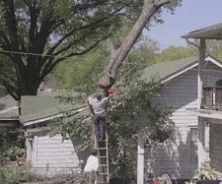
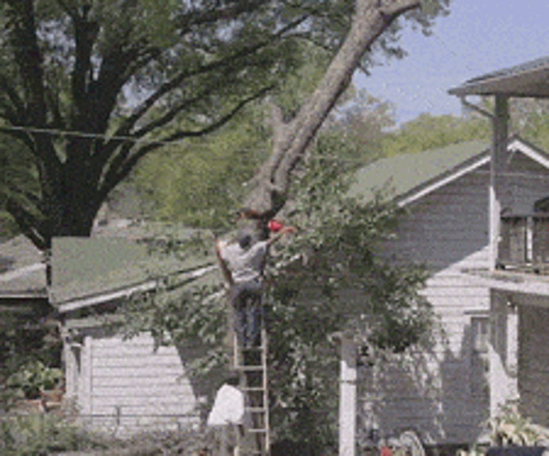
Philosphical Question
When a tree falls in the woods and nobody is there to hear it, does it make a sound?

Slide 6
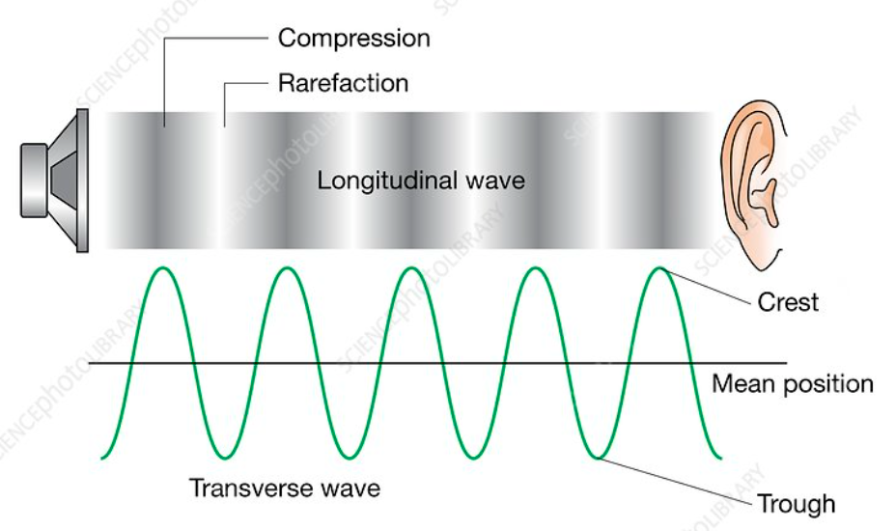
What is sound?
A series of pressure pulses that travel as a wave through a medium.
Difference between sound and noise
Longitudinal vs. Transverse
Amplitude (dB)
Frequency (Hz)
Vibrating source creates the pulse waves.
Ears and microphones hear them
Notes:
Sound is all around us. It always exists, and it affects us in many different ways. But what exactly is sound?
The textbook answer is that sound is a vibration that propagates as an acoustic wave through a transmission medium such as a gas, liquid, or solid. Acoustics is a very technical subject, but if you think about it, we all intuitively know something about sound. They can be soft or loud. They can be annoying or pleasant. You can feel sound, especially when the volume is up and the frequencies are low. In the Art of War, Sun Tzu states “If you know the enemy and know yourself, you need not fear the result of a hundred battles. If you know yourself but not the enemy, for every victory gained you will also suffer a defeat. If you know neither the enemy nor yourself, you will succumb in every battle. What I am presenting today is really meant for you, like me, to gain a deeper understanding of what sound is, because in this case we need to treat sound as the enemy. We need to understand our enemy to be able to fight the battle. The image on the right shows a wave pattern called a longitudinal wave. This is because the motion of the wave is in line with the direction the wave is moving. A sound wave is a longitudinal wave. This graphic illustrates the pressure pulses by showing a dark vs. light pattern. Now if you imagine the wave pattern is moving left to right, you can start to get a feel for that wave of pressure and how it travels from the source to your ear.
The lower image pattern is called a transverse wave because the wave motion is perpendicular to the direction the wave travels. Even though sound waves are longitudinal and not transverse, transverse waves are more visually easy to illustrate how sound waves travel. Both waves share descriptive characteristics, but transverse waves easier to visualize and are used throughout this presentation.
Many descriptive terms are used to define unique sounds, including amplitude, frequency, pitch, tone, quality, color, and timbre, to name a few. We are going to focus on the first two of these terms, amplitude and frequency, as we discuss sound transmission loss. The other terms address the unique quality of a sound. For example, you can play the same note on a trumpet and a saxophone at the same volume, but each instrument has a unique sound quality that distinguishes them. Sound waves have an amplitude, which is the difference between the average pressure condition and the peak or valley pressure condition. Changes in amplitude register to us as a change in volume, and amplitude is measured in decibels. A wave changes in amplitude depending on how much the wave is energized. As the energy level increases, the amplitude or volume increases. As the energy level decreases, the volume decreases. Indeed, it is the measurement of the reduction of wave energy that is tied to the term STC or sound transmission class.
Sound waves also have a frequency, which is the number of pulses that pass a fixed point in one second. We sometimes use the terms “low note” or “high note” to associate frequency in music. Low notes have low frequency and high notes have a higher frequency. Sometimes we use the word pitch, although pitch is actually a human perception on how low or high a tone sounds. It is not a precise measurable thing as is frequency. However, we will be using the term pitch as it relates to frequency in this presentation for simplicity. Frequency is measured in Hertz and the lower the frequency the lower the pitch. When performing sound transmission testing, a range of frequencies are specified to be tested. In a normal hearing person, the range of hearing is from about 20 Hz to about 20,000 Hz, and as we age that top number begins to reduce. But the frequencies that are tested range from 80 Hz to 5000 Hz. This covers a range that includes typical frequencies you may be exposed to inside a building that could affect you, whether that noise is coming from inside or outside. STC is evaluated on a frequency range from 125 Hz to 4000 Hz.
As stated before, sound originates from a vibrating source, such as a speaker, which compresses and relaxes the air, and sends that pulsing air in a direction away from the speaker.
and that wave then travels from the source to a listening device, such as our ears. But because sound is a vibration of pressure pulses, even if you have a hearing deficiency you can feel sound. Ludwig Van Beethoven, who famously wrote his 9th and final symphony well after he was fully deaf, was said to sit at the piano holding a pencil in his teeth, touching the other end to the soundboard so he could feel the vibration of the note.

Slide 7

Frequency – Practical Example
C4
C5
Octave
27.5 Hz
4186 Hz
A0
C8
261.63 Hz
523.26 Hz
Notes:
Speaking of pianos, here is a practical way to display examples frequency and amplitude. The lower keys on a piano are on the left side.
The lowest key on a keyboard, A0 produces a sound with a frequency of 27.5 Hz. Here is what it sounds like
(A0 piano key)
This will be a display of amplitude difference, played at middle C. The frequency is about 262 Hz for both of these sounds. This first sound you will hear has the lower amplitude.
(C4 piano key soft). The next sound is at the same frequency but has a larger amplitude.
(C4 piano key loud)
It requires more force on the key to produce the louder sound, which translates to more energy to the wave and a higher amplitude. The highest frequency on an 88 key piano is the C8 key which produces a sound with a frequency of 4186 Hz. Here is what it sounds like.
(C8 piano key)
The center key on the keyboard is called middle C, or C4. C5 is 8 white keys away and it is the same note but at a higher frequency
What is this range between C4 and C5 called? I’ll give you a hint. It involves 8 keys or steps between. If you’ve ever spent time learning a musical instrument, you know it is called an octave. Later in the presentation, I will explain what an octave is in terms of frequency.

Slide 8
Amplitude and Frequency
1
2
3
4
1
2
Notes:
The chart on the left shows the difference in wave pattern when a change in amplitude occurs, but the frequency remains the same. You can see that the peaks and valleys occur at the same time, but there is a change vertically. The sound represented by the orange wave would have the same pitch as the blue wave, but would be a louder sound. The orange wave has a higher energy level than the blue wave. The red arrow shows what happens to the wave when you double the amplitude. When amplitude grows the sound we hear intensifies. We call this amplification.
The chart on the right shows the difference in wave pattern when the amplitude stays the same, but the frequency changes. In this case, the sound represented by the orange wave would be at the same volume as the blue wave but the pitch would be higher. The red arrow here shows what happens when the frequency is increased. The peaks and valleys move closer together. A change in frequency is simply changing the number of pulses in a given period of time. In this particular case, the frequency is doubled from the blue wave to the orange wave.
The blue wave shows two peaks and two valleys crossing a time range.
And the orange wave shows four peaks and four valleys crossing the same time range. This means that the pitch of the orange wave would be higher than the pitch of the blue wave. When you are referring to an STC value, which wave characteristic is reduced? Amplitude or Frequency?

Slide 9
A little quiz
A
B
C
D
Notes:
Time for a little quiz.
Here are two red blocks representing a sound-rated barrier. In the next few animations I will be showing you four wave patterns and it will be your job to choose which one is most appropriately representing what happens to the wave when it penetrates through a sound barrier from left to right.
The top two waves, A and B, show a change in the frequency.
The bottom two waves, C and D, show a change in the amplitude. Have you picked which one is the most appropriate?
If you guessed A or B, those are incorrect. Frequency is not directly related to sound transmission loss. Sound transmission loss can vary with different frequencies, but this is not what we are describing when we talk about sound transmission loss. So between these two waves that are left, which is most appropriate?
D is actually amplifying the signal as it is passing through, so D is incorrect.
If you guessed C, you are correct. When we add an STC rating to a barrier we are effectively reducing the amplitude of the wave. We are removing energy from the wave. The higher the STC value, the higher the reduction in sound transmission.

Slide 10
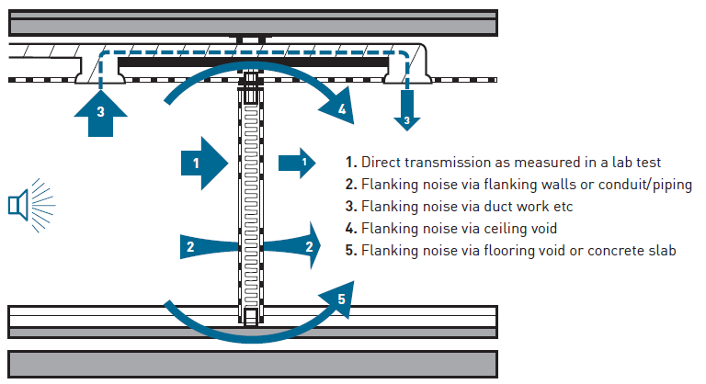
Direct path vs Indirect path
Two paths for sound transmission
Direct Path – Enters an adjacent room directly through a barrier.
Indirect Path – Also called flanking path, enters an adjacent room through peripheral means.
  Structural
  Non Structural
Notes:
There is much more to understand than just this number we call STC. But we have to start somewhere and STC is the defining term to address airborne sound isolation in a lab setting. That is key to understand. STC only applies to lab testing, and I will cover that in more detail later.
First and foremost it is important to understand that sound travels from compartment to compartment in one of two ways.
The first way is called the direct path represented by arrow number 1 in the graphic. This isolates the sound that is traveling from the source, directly through the wall or floor, and into the adjacent room. When we test a baseline condition for STC, it is this type of sound transmission path that we address through lab testing by building the structure and then isolating the wall performance only, eliminating all flanking noise.
The second way, which is much more difficult to understand and can be difficult to control, are sounds that travel through a barrier by an indirect path. This is called flanking. Some flanking transfer can be blocked or at least reduced by firestopping as flanking sounds can be carried through a barrier by
penetrating items represented by arrow 2
or through joint systems represented by arrow 5. Sound transmission through these paths can be mitigated with proper firestopping. However, other paths for flanking naturally exist as well that, no matter how well the firestopping works to restore STC, if these conditions are not addressed, the STC rating of the firestop assembly will not matter. Flanking sounds can be transmitted through structural elements that are attached to both compartments,
or they can be transmitted through other openings, such as air ducts represented by arrow number 3, doors leading to a common corridor,
or open cavities in concealed spaces represented by arrow 4 to name a few. The key takeaway from this slide is that the art of sound isolation relies on many factors. Firestopping is one of them, but there is a reliance on all systems to work together because a failure of any one of them results in a failed system. The old adage rings true, that the chain is only as strong as the weakest link.

Slide 11
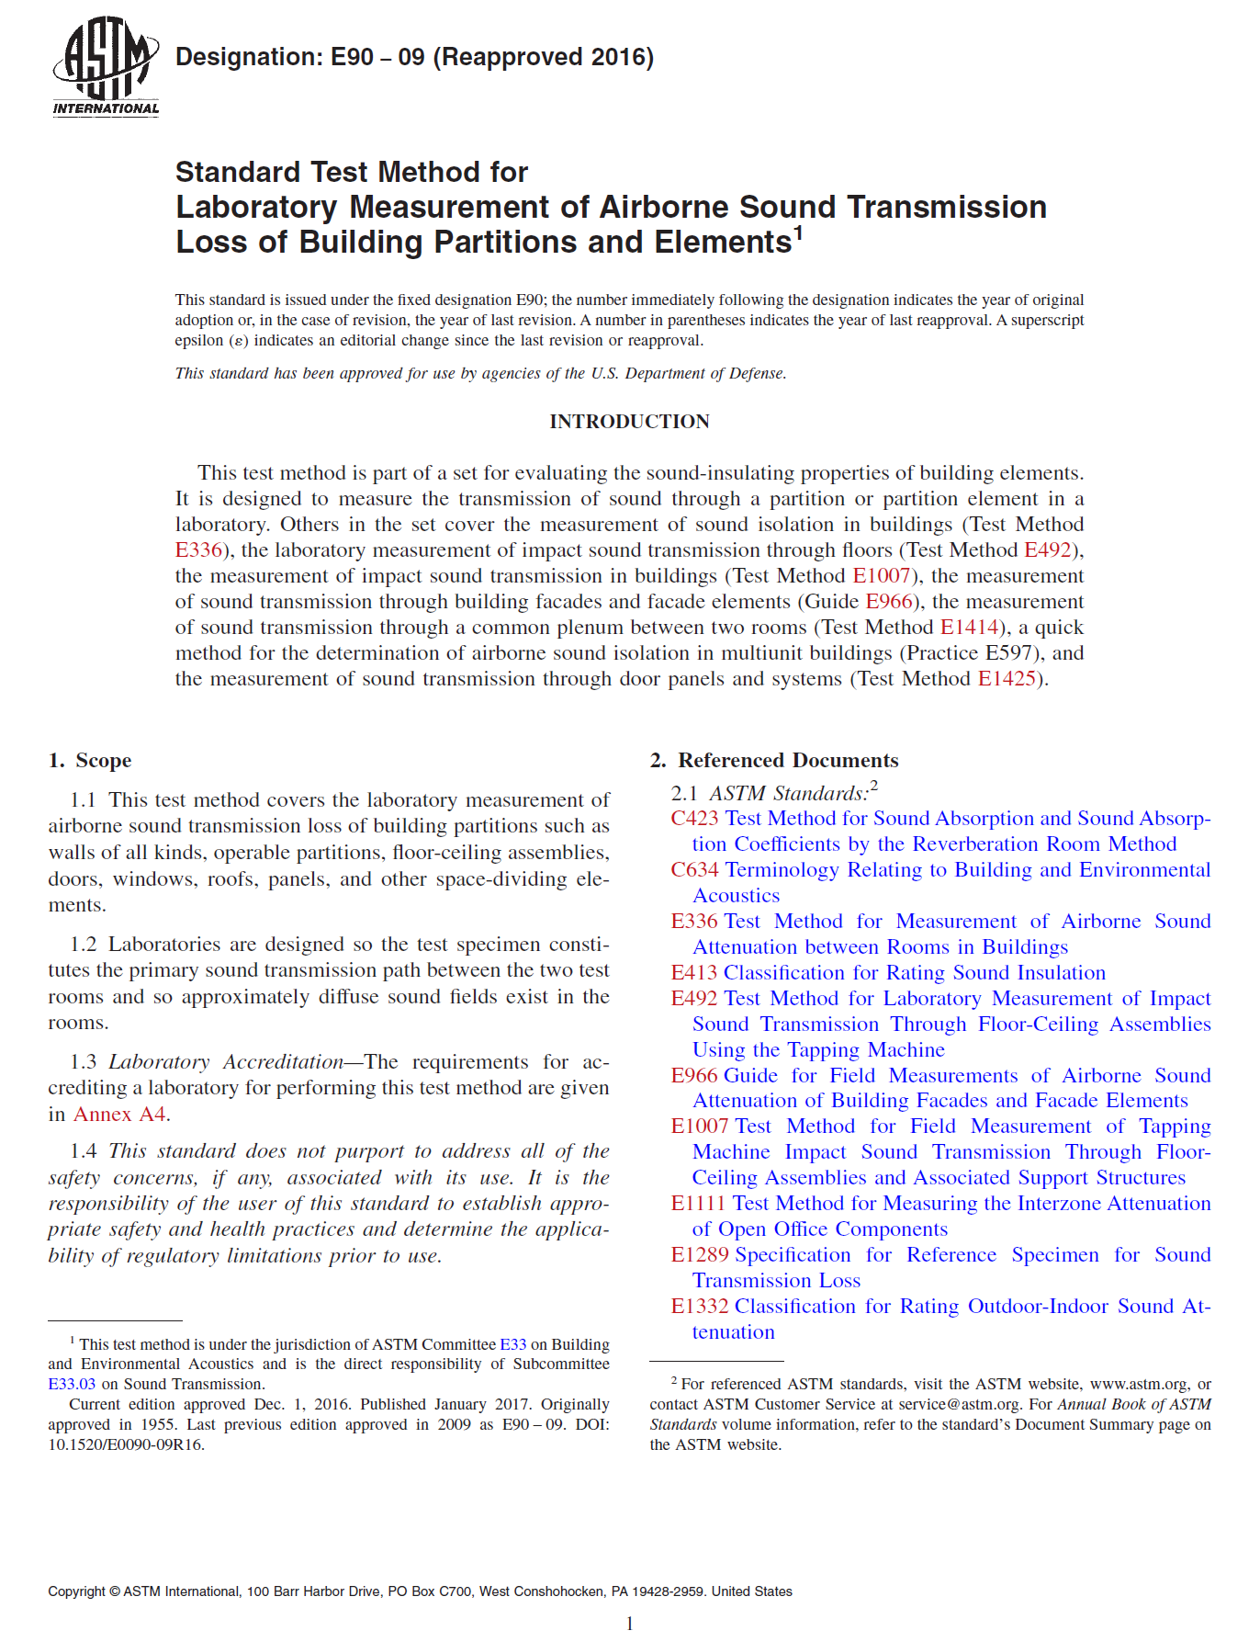
Measuring the noise
Over 1000 ASTM standards related to sound in some way
53 ASTM standards relevant to Building and Environmental Acoustics
2 ASTM standards are used to measure and identify STC.
Laboratory Measurement
Airborne Sound Transmission
Notes:
Firestopping is supremely important to the protection of lives because it buys us time to escape a potentially life-threatening situation. Thankfully, fires are much less common than the everyday potential of sound transfer and the problems it can create. The question we are addressing today is, can firestopping effectively reduce sound transfer? And the answer is absolutely yes – when applied properly. Some fundamental parallels can be drawn between sound transmission and fire containment, primarily in that both start with the design of the barrier. You design a sound barrier with the idea that you are reducing sound by a prescribed amount across the barrier, and similarly you design a fire barrier with the idea you are holding back fire spread for a prescribed amount of time. Fire containment barriers have primary and a secondary role in preventing flame and smoke passage. Primarily, firestop materials are designed to be subjected to direct fire exposure and are designed to withstand that attack, but secondarily they sit in place and prevent smoke travel, even when the threat may be several compartments away. Sound transmission barriers, on the other hand, are designed around the need for privacy or comfort and are called into duty on a daily basis. Once the walls are built, we then poke holes and create gaps, and in doing so we effectively destroy the intended design of both fire and sound barriers. And, in both cases, we restore the intended design by installing materials. Fortunately, firestopping functions to restore both design features where it is called into use. But if there is one takeaway from this presentation, it is that the firestop does not provide an STC rating regardless of how it has been tested. It restores STC ratings, just as it restores fire containment ratings.
Over 1000 ASTM standards exist as it relates to the understanding and controlling of sounds around us. Because the systems firestop products are used in can also be called into action for sound attenuation, it seems we should become just as knowledgeable on the standards and ratings that exist to measure sound transmission as we are with the fire standards. And while every firestop application does not require the protection against sound transmission, often enough it does matter when occupancies demand certain levels of privacy, like a hospital room for example. While the containment of fire is a life safety issue and sound containment is a comfort or privacy issue, it does not lessen the importance of sound transmission reduction in a fire-rated wall because unwanted noise can hinder our ability to carry on with everyday life. It can range from something as subtle as hearing a conversation in the room next door which detracts our attention away from what we are trying to concentrate on, or loud repetitive noises coming from the street preventing us from sleeping, or perhaps loud music from an adjacent apartment interrupting our need for a quiet space.
Fortunately, we do not have to understand all 1000 ASTM standards. But still, there are no less than 53 ASTM standards that exist to address building and environmental acoustics.
Among these standards, there exist test methods, specifications, practices, guides, and classifications, that identify types of sounds, ways to test materials and systems and how to interpret or enumerate the results, identifying materials and how to apply them, among many other tools that are used to understand and control our environments to enhance those sounds we welcome, and to reduce or eliminate those unpleasant or distracting sounds we call noise. Of these there are a handful of standards that we need to better understand. The primary standard we are focusing on at the moment is the standard that directs the methods for testing in a laboratory for airborne sound transmission. That standard is ASTM E90.

Slide 12
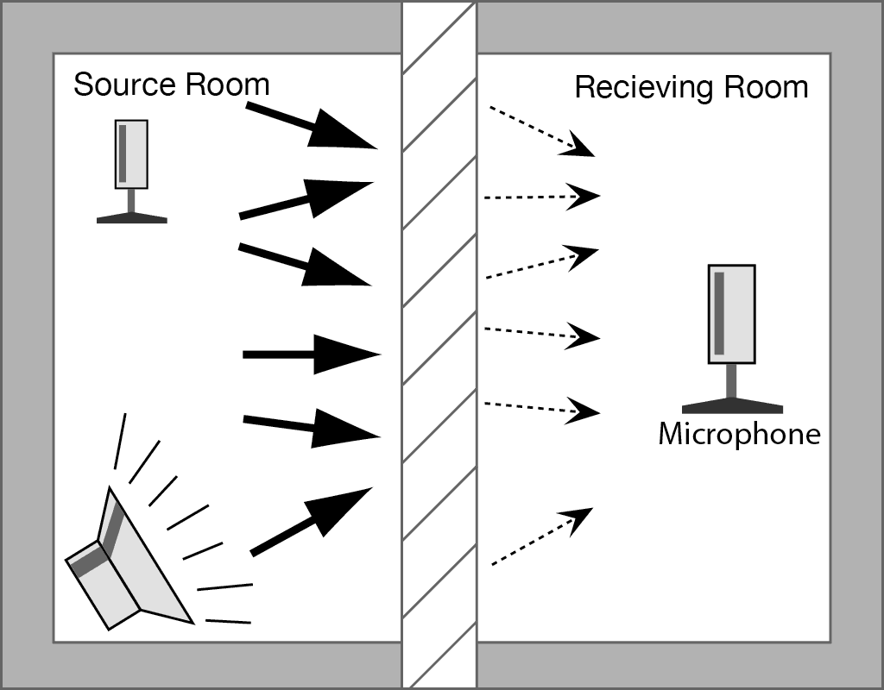
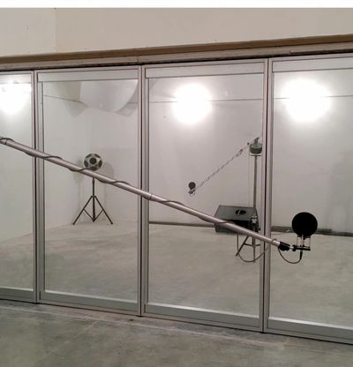
Sound Transmission Coefficient (STC) Ratings
Source Room
Receiving Room
Notes:
As previously stated, ASTM E90 testing is operated only in a testing laboratory and is limited to the testing of the barrier system direct path and to any flanking purposely placed that may occur via joints or penetrations within the area of the wall or at the perimeter borders of the barrier system. No other flanking potential exists in this test, which is good for narrowing down specific contributors to sound transmission in a designated area of an assembly. But, it is important to know it does not necessarily carry over to the field condition based on the test results in the lab because of the potential for other indirect paths not recreated in the lab setting. For sound isolation to work, all sources of sound pollution must be addressed and all systems meant for sound isolation must work together. The test method ASTM E90 is designated as a test method for airborne sound isolation. Airborne sound is any sound wave that emanates from a source and travels as a wave through air until it reaches a solid object. When it reaches that object and makes an impact, that object will begin to vibrate, and that vibration traveling through the structure is called structural sound transmission. Once the vibration travels to the other side, the other vibrating surface creates waves in the air on the other side and becomes airborne sound again. Structural sound transmission can be influenced by airborne sound transmission, but it commonly emanates from direct physical impact to a structure, such as a chair moving across the floor or a footstep, and this requires a different type of test. Here is an example of a structural sound transmission occurring by direct impact.
(Play sound). This was an impact sound from a contractor who was putting new light fixtures just outside my hotel room one day. I was literally working on this presentation, preparing to present when this occurred. At first, it was annoying, but then I appreciated this stroke of serendipity and recorded the sound and included it in my presentation. This type of sound transmission would not be addressed through an ASTM E90 test. As previously stated, we are measuring airborne sound isolation and this happens when the sound is initiated and received as a sound wave, even though it likely has transitioned to structural sound transmission at some time during the path of energy wave travel. The test uses two rooms that are divided by a partition, which is the test assembly, as shown in the figure on screen. The rooms are built so sound is not absorbed by any surface except the test specimen, so the test specimen is the only object in the double chamber that changes the sound energy from the source room to the receiving room.
In the photo on the right, the far room on the opposite side of the glass wall is the source room.
You can see a loudspeaker facing toward the rear wall in the source room
In the far corner you see a dodecahedron speaker, which is just a fancy word for a speaker that simultaneously delivers sound from 12 opposing directions. The source can come from either type of system. The near room, where you can see a boom mic, is the receiving room. During the test, a pink noise is produced in the source room, where it travels through the test assembly and is ultimately received by microphones placed in the receiving room. The test lasts about 6 to 7 minutes.
The test specimen is installed as the dividing partition, as shown in this image.
The perimeter is sealed with a sound-deadening material to isolate the test specimen, protecting against any sound transfer due to edge flanking. Joint systems can be installed at the top or bottom of the wall barrier and covered in a dense mastic putty which can later be removed to reveal the exposed joint as a flanking path. Penetrations can be added, which are then sealed with various firestop materials. However, all flanking sounds that might otherwise exist in a built environment are eliminated. A test standard does exist for testing that includes all flanking transfer as well. That test method is commonly misnamed field STC testing. The applicable test standard is ASTM E336. Instead of STC, though, it produces a single number rating called Normalized Noise Isolation Class (NNIC).

Slide 13
Why Pink Noise and not White Noise?
White and Pink noise consist of a multitude of frequencies within a specified range that are played simultaneously.
White noise is produced when the energy level is the same at every frequency.
Pink noise is produced when the collective energy level across each octave is the same.
Pink noise is said to have calming effects, similar to a rainstorm.
Pink noise represents the sound energy most close to that of human perception.
Notes:
In the previous slide I mentioned a pink noise signal is produced in the source room, but what is pink noise? Most of us have heard of white noise, but what is pink noise and how are these different?
Both white and pink noise cover a band of frequencies that are simultaneously played at the same time, and both produce a static noise.
A white noise signal is generated so that every frequency in the entire range is played at the same energy level or amplitude.
Pink noise, on the other hand, is designed so the energy level across every octave is played at the same level. Here is are examples of white noise and pink noise, respectively. See if you can tell the difference?
White Noise
Pink Noise. Notice that pink noise seems to have a deeper feel to it. The lower frequencies are enhanced. Whereas the white noise is more in your face. The higher frequencies are enhanced.
To restate, the difference is white noise has the same energy for every frequency and pink noise has the same energy across every octave. So what is an octave? Let’s reconsider the 8 white keys on the piano again. The C4 key and the C5 key are playing the same note, but C5 begins the next highest octave. This happens when the frequency at the bottom of the range is doubled to produce the frequency at the top end. The frequency for the C4 key is 262 Hz. The frequency for C5 is 524 Hz. What is the frequency for C6? 1048 Hz.
Pink noise has a more dark feel to it. Some describe pink noise as similar to the sound of a rainstorm, and that it has a calming effect.
The reason pink noise is used in ASTM E90 tests, as opposed to white noise, is that pink noise best represents the sound energy levels closest to matching human sensitivity to sound pressure levels. Maybe that is why it is more of a calming sound.

Slide 14
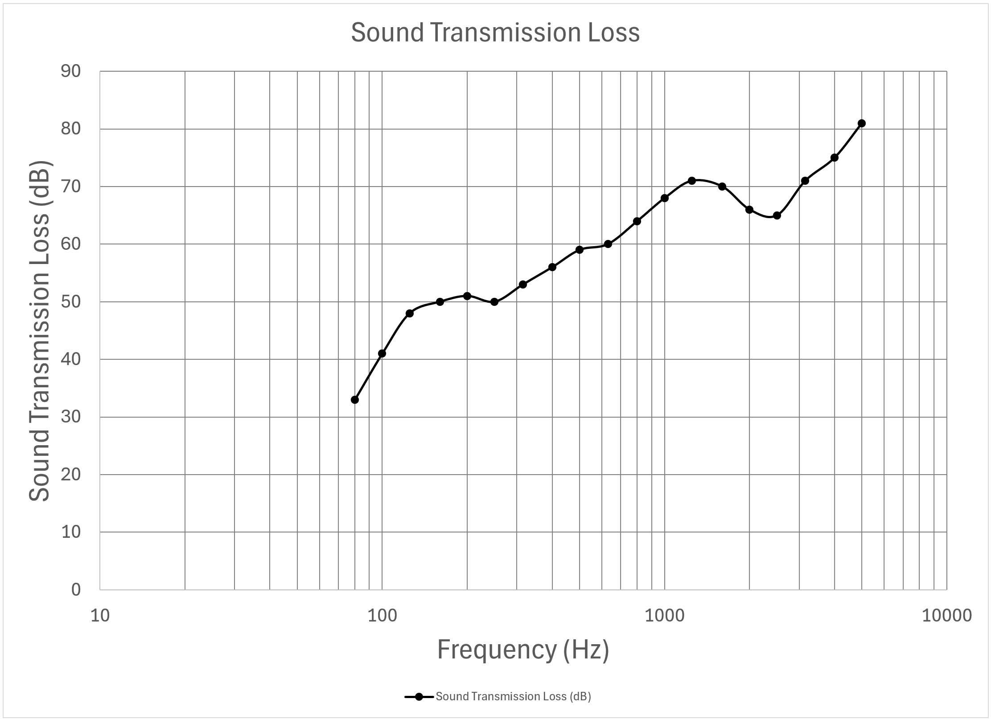

The testing path to an STC
Begins with testing for Sound Transmission Loss (STL) using ASTM E90
Each incremental frequency is evaluated as a change in dB from the source to the receiving room
Data is converted to STC using ASTM E413
Can be field tested as well, producing Normalized Noise Isolation Class (NNIC) using ASTM E336
Impact Insulation Class | IIC
Noise Isolation Class | NIC
Noise Reduction Coefficient | NRC
Normalized Noise Isolation Class | NNIC
Sound Absorption Average | SAA
Sound Transmission Class | STC
Absorption Normalized High Frequency Impact Rating | AHIR
Apparent Impact Insulation Class | AIIC
Apparent Outdoor-Indoor Transmission Class | AOITC
Apparent Sound Transmission Class | ASTC
Ceiling Attenuation Class | CAC
Door Transmission Class | DTC
Field Outdoor-Indoor Transmission Class | FOITC
High Frequency Impact Rating Class | HIIC
High Frequency Impact Rating | HIIR
Impact Sound Rating | ISR
Normalized Impact Sound Rating | NISR
Normalized Noise Isolation Class | NNIC
Outdoor-Indoor Noise Isolation Class | OINIC
Outdoor-Indoor Transmission Class | OITC
Notes:
There are no less than twenty of what are called “Single Number Ratings” that are used to classify sound transmission in one way or another, generalizing in an understandable way how much sound is transferred across a barrier.
STC is just one of those twenty dimensionless single number ratings. It just so happens to be the one everybody gravitates to.
Another single number rating that is typically measured when we run a test for STC is OITC, or Outdoor-Indoor Transmission Class, which weighs the lower frequencies heavier using a specialized standard for that noise spectrum as specified in ASTM E1332. Today the primary focus for this presentation is STC.
STC calculation begins with testing in accordance with ASTM E90 Standard Test Method for Laboratory Measurement of Airborne Sound Transmission Loss of Building Partitions and Elements. This is the base test method used for gathering data called sound transmission loss.
The data produced from the test represents the difference in sound pressure levels from the source side of a barrier to the receiving side of the barrier at specified incremental frequencies and is a measure of the direct path sound transmission plus any flanking due to exposed penetrations and/or joints.
Each black dot on the chart on the right represents the difference in the signal sound intensity and the receiving sound intensity as measured in dB at specific frequencies, starting from 80 Hz. and ending at 5000 Hz. But the result is a group of data that is not easily understood by itself as it shows many different sound transmission losses. To be easier to communicate, the data are converted into the single number rating we know as STC. This is done by taking all the data measured in E90 testing and looking at it through the tools presented in the classification standard ASTM E413 Classification for Rating Sound Insulation.
Included in the E413 standard is what is called the contour for calculation of single number ratings, shown here with the red dotted line. This curve covers the frequencies between 125 Hz and 4000 Hz and is applied to the charted data and is moved upward or downward until the contour best fits the measured data within the prescribed limits of the standard. Any number that registers below the contour line is called a deficiency and there are a set number of deficiencies that are allowed by the standard. When the curve position is set, the STC score is indicated as the position of the contour line at
500 Hz. The 500 Hz location is the vertical red line. From there you
Draw a horizontal line to determine the STC rating. In the case of this data, the STC value is 63. I want to draw your attention back to the black curve on the chart.
Notice the red circle around an area showing a dip in performance. This is actually a characteristic of gypsum wallboard called a coincidence dip. Due to its material nature, this dip between about 1500Hz and 2500Hz is common to any sound transmission test for framed walls using gypsum wallboard.
As mentioned on a couple slides ago, a single number rating can be achieved by field testing as well. Testing in accordance with ASTM E336 produces what is called a Normalized Noise Isolation Class (NNIC) and includes flanking losses. Because flanking is included, the NNIC will generally register as a lower number than an STC.

Slide 15
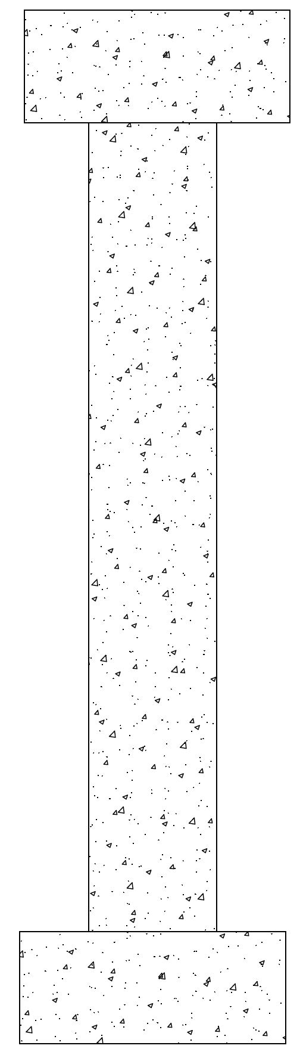
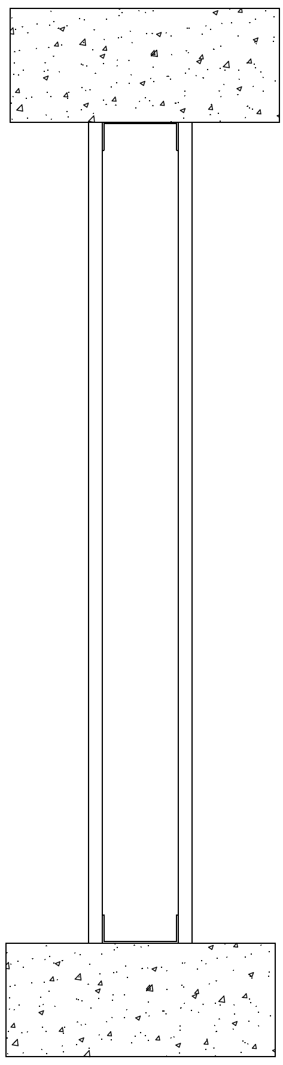
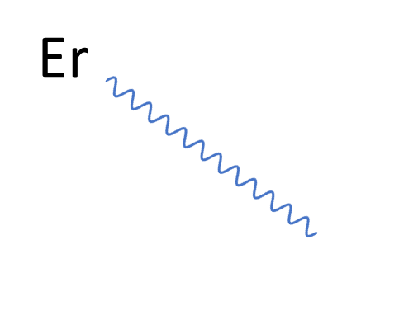
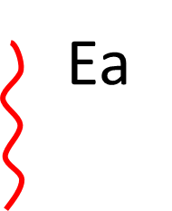
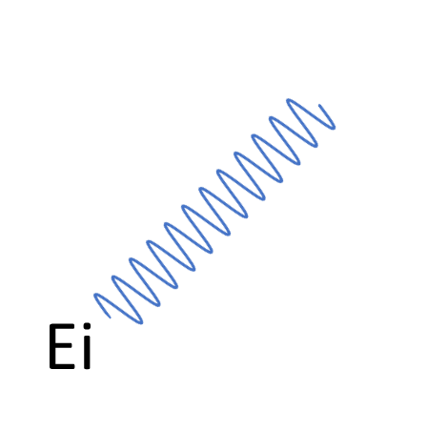
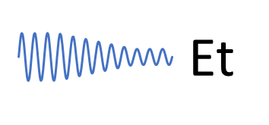
Energy Balance
Energy is always balanced
Total or Incident Energy (Ei)
= Energy Reflected (Er)
+ Energy Transmitted (Et)
+ Absorbed or Transformed Energy (Ea)
Mass walls reflect more than framed walls.
Flexibility translates to improved STC
Notes:
As discussed, sound waves have an energy level that translates to a volume level, and our goal is to reduce the sound volume from one side of a compartment to the other by reducing the energy of the wave. When explaining energy levels, it is important to know that energy in the universe cannot be created, nor can it be destroyed, according to Newton’s First Law of Thermodynamics. Energy is always balanced. And if we are talking about sound as an energy wave, and its reduction in energy to the opposite side which we call sound transmission loss, where does the energy go? If you can’t destroy energy, how do you reduce sound across a barrier? The answer to that question is that the energy is transformed into another type of energy, but it still exists. It just exists in a different form. When you go outside on a cold day and you forget your gloves in the house, what do you do? You rub your hands together, right? Well at least until you can’t stand it any longer and you return to the house to get your gloves. Little did you know, but you are effectively transforming the energy from your hands moving across each other into heat through the magic of friction.
Here is an illustration of what happens to sound waves that approach a sound barrier. The sound energy wave comes to a surface, and this energy is called the Incident Energy. It is the total energy available that is traveling as a wave.
Part of the incident energy wave bounces back, and this is the reflective energy. This is the type of sound energy that we call an echo. Echoes start at a volume and the volume decreases over time and distance traveled depending on how much energy is transformed through friction in air, and subsequent absorption by other surfaces as the wave travels.
Another portion of the incident energy is transmitted through the barrier and is reduced depending on the wall's STC rating. The higher the STC, the more reduction in wave energy.
This is where the energy transformation takes place, through friction of particles within vibrating elements that rub against each other - just like your hands on a cold day. Part of the energy transmitted is transformed into heat. This is the critical energy transformation that takes place that reduces the sound level on the opposite side of the barrier. If you add them the reflected energy, the transmitted energy, and the absorbed or transformed energy, they will always equal the Incident Energy.
Mass walls, such as the solid concrete wall shown, tend to reflect more of the sound which is why you get echos in rooms surrounded by solid poured concrete walls. But you will have less echo from a CMU wall. Why? It is due to the porosity of the CMU. The nominal STC value of an 8-inch thick CMU wall is only 44. Why? The porosity allows sound waves to travel through the CMU on the unrestricted airflow. If you have a CMU wall, STC can be improved significantly by simply painting the CMU or covering it with an impermeable air membrane.

Slide 16
Frequency Intervals of Testing
640
1280
320
2560
160
80
5000
Notes:
During an ASTM E90 test, the pink noise signal is played in the source room, and simultaneously any sound that travels through the sound barrier is recorded in the receiving room as we have discussed. But the sound transmission is only recorded incrementally at 16 different frequencies for STC, and when other single number ratings are desired, other frequencies outside the 125 Hz to 4000 Hz range can be recorded as well. When we run tests, we have typically had measurements taken at 19 different frequencies that encompass the 16 frequencies necessary for STC calculation. Here is a sound sample indicating the 19 different frequencies where Sound Transmission Loss recordings are taken that can be used for STC and OITC calculations.
(Hit Enter)

Slide 17
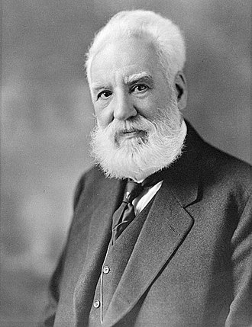
What is a Decibel (dB)
angstrom (Å), distance – Anders Jonas Ångström
ampere (A), electric current – André-Marie Ampère
baud (Bd), symbol rate – Émile Baudot
clausius (Cl), entropy – Rudolf Clausius
coulomb (C), electric charge – Charles-Augustin de Coulomb
curie (Ci), radioactivity – Marie and Pierre Curie
dalton (Da), atomic mass – John Dalton
darcy (D), permeability – Henry Darcy
debye (D), electric dipole moment – Peter Debye
egree Celsius (°C), temperature – Anders Celsius
degree Fahrenheit (°F), temperature – Daniel Gabriel Fahrenheit
degree Öchsle (°Oe), density – Ferdinand Öchsle
degree Rankine (°R), temperature – William John Macquorn Rankine
einstein (E), photochemistry – Albert Einstein
farad (F), capacitance – Michael Faraday
faraday (Fd), electrical charge – Michael Faraday
galileo (Gal), acceleration – Galileo Galilei
gauss (G or Gs), magnetic flux density – Carl Friedrich Gauss
hartree (Ha), energy – Douglas Hartree
henry (H), inductance – Joseph Henry
hertz (Hz), frequency – Heinrich Rudolf Hertz
jansky (Jy), electromagnetic flux – Karl Jansky
joule (J), energy, work, heat – James Prescott Joule
kelvin (K), thermodynamic temperature – Lord Kelvin
langmuir (L), gas exposure dose – Irving Langmuir
maxwell (Mx), magnetic flux – James Clerk Maxwell
neper (Np), relative power level – John Napier
newton (N), force – Isaac Newton
oersted (Oe), magnetic field strength – Hans Christian Ørsted
pascal (Pa), pressure – Blaise Pascal
poise (P), dynamic viscosity – Jean Léonard Marie Poiseuille
poncelet (p), power – Jean-Victor Poncelet
rayleigh (R), photon flux – Robert Strutt, 4th Baron Rayleigh
Rockwell scale (HR), indentation hardness – Stanley Rockwell
röntgen (R), dosage of X-rays or gamma radiation – Wilhelm Röntgen
shannon (Sh), information – Claude Shannon
stokes (S or St), kinematic viscosity – George Gabriel Stokes
svedberg (S or Sv), sedimentation rate – Theodor Svedberg
sverdrup (Sv), volume transport rate – Harald Sverdrup
tesla (T), magnetic flux density – Nikola Tesla
torr (Torr), pressure – Evangelista Torricelli
troland (Td), luminance (human eye) – Leonard Troland
volt (V), electric potential, electromotive force – Alessandro Volta
watt (W), power, radiant flux – James Watt
weber (Wb), magnetic flux – Wilhelm Eduard Weber
decibel (dB), dimensionless proportions and ratios, e.g. relative power levels – Alexander Graham Bell
A ratio of a measured quantity over a referenced quantity.
Why is the B capitalized?
It is logarithmic – an exponential relationship
  20dB has 10x more sound power than 10 dB
  30dB is 10x more sound power than 20 dB
  30dB is 100x more sound power than 10 dB
  100dB is 1 bil. x more sound power than 10dB
Notes:
In order to understand the intensity of sound, it helps to understand the term in which it is defined.
I use the term “defined” instead of “measured” because the decibel (dB) is, actually, not a measurement at all but a ratio of two values that have the same units and the units cancel out. When defining sound intensity, the ratio of two values of sound pressure created by sound wave pulses are calculated to quantify the signal difference in dB. In the case of sound intensity, the denominator is a constant based on the sound pressure level that is equivalent to the human minimum threshold of hearing, and the numerator is the measured value recorded during the test.
You may wonder why the term decibel leads with a lower case d and has an upper case B. Well, just like many units of measurement, such as the Newton for force, the Pascal for pressure, or the Curie for radiation, the decibel was named after a person of significance related to its use. In the case of the decibel, which is one tenth of a Bel, that person was Alexander Graham Bell and that is why the B is capitalized. The term “Bel” was created by telephone engineers to identify changes in the amplitude between two sound signals. When you have a range of deciBels, they are measured using a logarithmic chart.
Why is it measured on a logarithmic scale? What does that even mean?
Logarithmic scales are used to show relationships between numbers that grow incrementally versus numbers that grow exponentially. In this case (dB) grows incrementally, and the number it is associated with, sound power, grows exponentially. Notice the vertical gridlines on the chart, that they push together at the end of each range. That is because each range on the chart is a multiple of 10 from the previous range, not an increment of 10. The logarithmic chart allows us to visualize the relationship in a linear way, when in reality it is not linear at all. It is exponential.
This is another way to show the data from the chart, using a table format. The column on the left shows the sound power increasing in magnitude for every 10 dB rise.
Another, perhaps clearer way to explain the relationship is this. For each increase in 10 dB, there is a 10-fold increase in sound power. So a 20 dB signal has 10 times the power of a 10dB signal.
Likewise, a 30 dB signal has 10 times the energy of a 20 dB signal. Now, unless we are otherwise trained to think this way, it would be natural to believe that a 30 dB signal is 20 times the energy of a 10 dB signal, until we understand the logarithmic relationship.
Truly a 30 dB signal is 10X10 the energy of a 10 dB signal, or 100 times the energy.
And if you carry that further, a 100db sound is 1 billion times the energy level of a 10 db sound, or in other words produces 1 billion times the pressure on a listening device as does a 10 dB sound.

Slide 18
Sound Power vs. Loudness
Pressure measurement vs. Perception
ff – f – mf – mp – p – pp – Very loud or strong to very soft
Typical decibel range of a symphony orchestra is 70 dB to 110 dB.
Decibel range is 40 points
Wave amplitude is 10000x higher
Perception is about 16 times louder
dB Rise | Result in Sensitivity
3 | Noticeable Rise
5 | Highly Noticeable
10 | About twice as loud, not 10X
Notes:
The reason for this logarithmic relationship is that our perception of sound, what we call “loudness”, is not linear to the power of sound. When noise intensity rises, we use the term “loud” to describe a sound level with high intensity, such as a loud bang, and “soft” to describe a sound with low intensity, such as a soft whisper. And the Italians gave us musical terms forte (strong or loud) and piano (soft). These terms are relevant to the human perception of the intensity of sound, but they are descriptive and not precise, and perception of the same sound can be different from person to person. So the measurement of sound level in dB gives us a more precise look. Our perception of a change in loudness is described as noticeable at around a 3dB rise. At 5dB it is very noticeable, and at 10dB sound intensity is usually described as about twice as loud.
Sometimes you will notice sound levels reported as dBA. Different dB classifications were created to address various sound sensitivities through the use of weighting the signal along a frequency band. dB-A is the most common application and is highly filtered in the lower frequency bands. There are four other less-used weighting curves, dB-B, dB-C, dB-D, and dB-Z.
This is where my knowledge ends on these various weighted scales, but they do exist for various reasons. It is only really important for this topic to know dB-A is most commonly referred to because it is based on how the human ear responds.

Slide 19
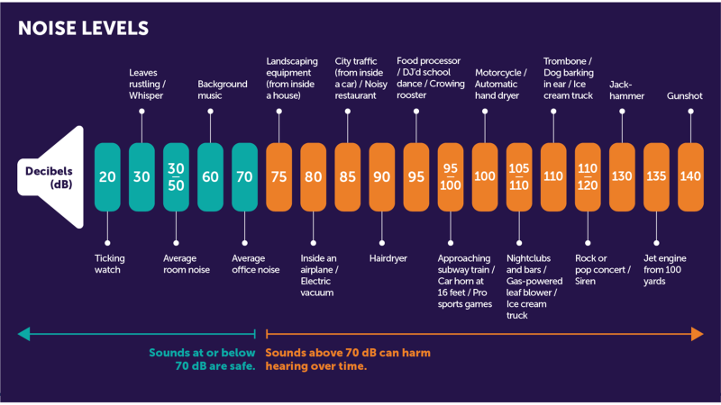

Notes:
The chart shown here gives us a practical idea to this relationship. Human hearing can register sounds at very low decibel counts. The lowest sound level that a typical human can register is 0dB at 1000 Hz.
But think about how difficult it is to hear a 20 dB sound of a ticking watch. And think about the difference in sound intensity when you approach the 100 dB level.
90 db is the sound of a hair dryer.
Just 10 more points you are at the sound of a motorcycle.
20 more points a firetruck siren.
10 more points a jackhammer.
And 10 more points, at 140db, a gunshot, although some gunshots can register as high as 170 dB.
The loudest sound ever produced on earth registered a sound pressure level estimated at 310 dB, with some reports saying the sound could be heard over 3000 miles away. This was from the volcanic eruption in Krakatoa back in 1883.

Slide 20


STC Requirements in Code
Chapter 12 of the IBC
Section 1206
ICC A117.1 for Enhanced Classroom Acoustics
Guidelines and Specifications
Notes:
In general, you won’t find much direction in the building code as it relates to sound transmission requirements.
But there are a few references in Chapter 12 of the IBC that do direct STC and NNIC requirements.
Section 1206 is where you will find code direction for airborne sound transmission in walls and partitions, and structural borne sound transmission in floor ceiling assembles that separate dwelling units from sleeping units, or from adjacent public areas. In these areas, for walls and partitions STC values are required to be not less than 50, and if field testing is observed, the NNIC should be no lower than 45. For floor-ceiling assemblies the Impact Insulation Class Rating is to be not less than 50 and, if field tested, the Normalized Impact Sound Rating should not be less than 45. But remember the building code is the ground floor minimum requirement.
There is direction to refer to ICC A117.1 for enhanced classroom acoustics, which refers to the Noise Reduction Coefficient, and the maximum noise level coming into a classroom from another source should not exceed 35 dBA.
Where you will find other minimum requirements that exceed the building code requirements are in specifications or specific guidelines, such as the Guidelines for Design and Construction of Hospitals published by the Facility Guidelines Institute. In this document you will find minimum requirements as high as STC 60 for separations between adjacent areas such as between a Patient Room and a Service Area or MRI Room. In addition, another reference is what Mike referred to earlier in his presentation, the 2010 ICC-G2, provides guidelines for sound transmission as published by the International Code Council, publisher of the IBC.

Slide 21
STC values for privacy
STC roughly relates to reduction in decibels, but it is more complicated than that.
General conversation is about 60 dB
Privacy levels begin around STC 40
STC 40 wall will reduce the sound intensity of general conversation roughly 60-40 or to about 20 dB
STC | General Conversation (60 dB) | Loud Conversation (70+ dB)
40 | Heard but not understood | You can hear and understand words
45 | Virtually cannot be heard | Can be heard but rarely understood
50 | Not heard | very difficult to hear, cannot be understood
Notes:
It is a common misrepresentation to state that the STC correlates directly to a reduction in dB equivalent to the STC number. It, however, can be used to manage an expectation of sound transmission loss
but as you could see from the STC chart shown earlier, at the lower frequencies the sound transmission loss was around 30 dB and at the higher frequencies it was around 80 dB. It is more likely to be true around the 500 Hz range, but not across the entire spectrum.
But for the purpose of getting a general idea of how STC works for privacy, here is an example. A general conversation will register about 60 dB.
Privacy levels of sound reduction begin at around 40 STC.
What that means is that you can expect, for a wall rated at STC 40, a conversation may be held in one room and in the adjacent room should register around 20 dB, the same as a ticking watch. You may hear a muffled low frequency sound without the tinny high frequency sounds you would hear in the room of origin. As you can see from the chart, with an STC value of 40 a general conversation could be heard but not understood, but you can hear and possibly understand when the conversation gets a bit louder. If there is a potential for loud conversations to take place, and you still want to maintain privacy, you might need to increase the STC to about 50 or higher.

Slide 22
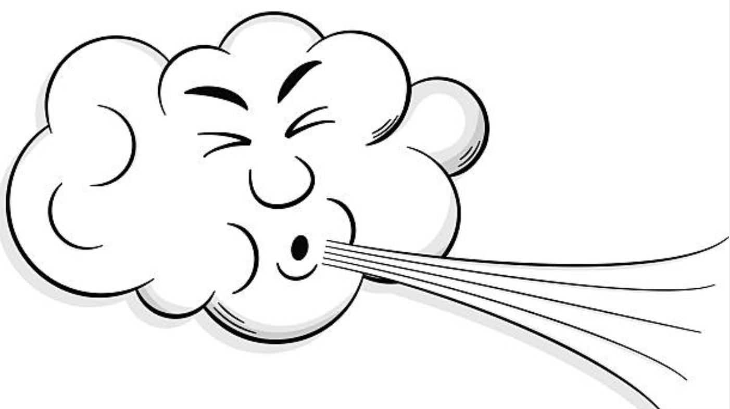

Where there is smoke there is sound
Smoke and sound travel freely in air.
Continuous wall is effective to reduce sound wave amplitude
Continuous wall is effective as a smoke barrier
Discontinuities
  Joints
  Penetrations
Notes:
Sound waves, like smoke, travel freely and unimpeded through unprotected openings in sound and smoke barriers, but they are driven in two different ways. Consider a wall system which is both a sound and a smoke barrier, represented by the details shown here.
A continuous wall will reduce the amplitude of the sound wave by deflecting waves and/or absorbing energy.
Similarly, the same continuous wall will prevent the free passage of smoke and hot gasses by blocking air flow.
The driving force behind sound transmission is the energy of the wave. Higher energy level, or volume, will still see resistance with an effective sound barrier but a louder sound on the source side of the barrier will translate to a louder sound on the receiving side, albeit still reduced.
What drives the flow of transient smoke is purely pressure difference. Smoke is not a wave but rather a fog of particulate matter so it will attempt to drive through a wall in the direction from the high-pressure side to the low-pressure side always. Higher pressure will create more of a drive for the smoke to find its way through cracks and crevices, but if no cracks and crevices are present, transmission will be effectively blocked. But one common feature in construction will allow both sound and smoke to cross the boundary uninhibited and that is unprotected openings.
When discontinuities happen in barriers such as joints at the head and foot of a wall.
Or when penetrations occur through a barrier
The openings, left unprotected, will let the sound travel through because there is nothing there to absorb the wave energy or deflect the wave.
And they also will allow smoke to flow through because the pressure is now allowed to carry smoke through the unprotected opening. Fortunately for us, the remedy that works for firestop also works for sound.

Slide 23
The affect of firestop on Smoke and Sound
Proper firestopping stops smoke by stopping air flow
Proper firestopping stops sound by stopping air flow
Some flanking can occur with penetrations.
Notes:
Now we are getting into a little more detail on the practical side as to the relationship between STC and firestopping. Let’s look at these two walls again, and this time we will go through the motions of adding firestop and its effect on both sound transmission and transient smoke reduction.
As fire stoppers, we are familiar with the concept of preventing the free passage of smoke by making sure avenues for airflow are sealed well. In this instance you can see illustratively that proper firestopping will do exactly that, because you are blocking pathways for transient smoke to move from one compartment to the next.
What might be less intuitive is that the same process of firestopping that stops transient smoke from traveling to the next compartment, also effectively reduces sound from moving through as well because sound freely moves through air, and any measure used to stop airflow from one compartment to another, whatever that reason may be, is an effective sound sealer.
But unlike smoke travel, sound travel is only reduced not eliminated and the reduction in sound transfer is now relegated to the design of the wall and the features incorporated in that wall that effectively mute sound waves. You still are faced with sound transfer through flanking, and there is not much you can do about that. So, the best you can do is to stop the air flow, and by firestopping properly, you are effectively reducing sound transfer by removing the airflow path.

Slide 24
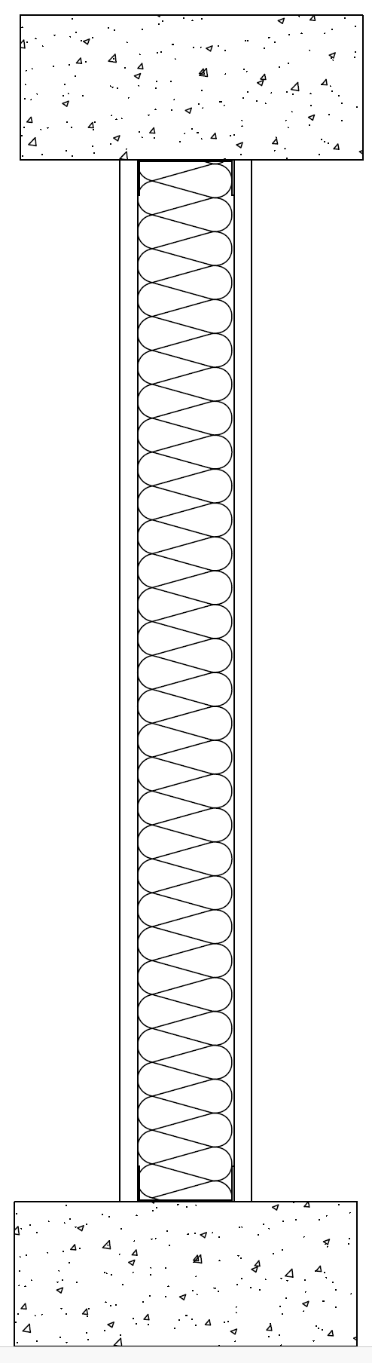
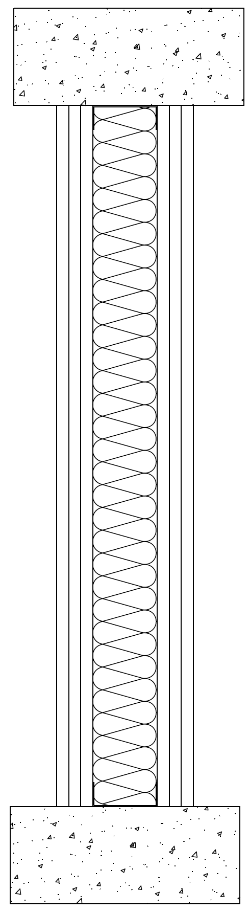
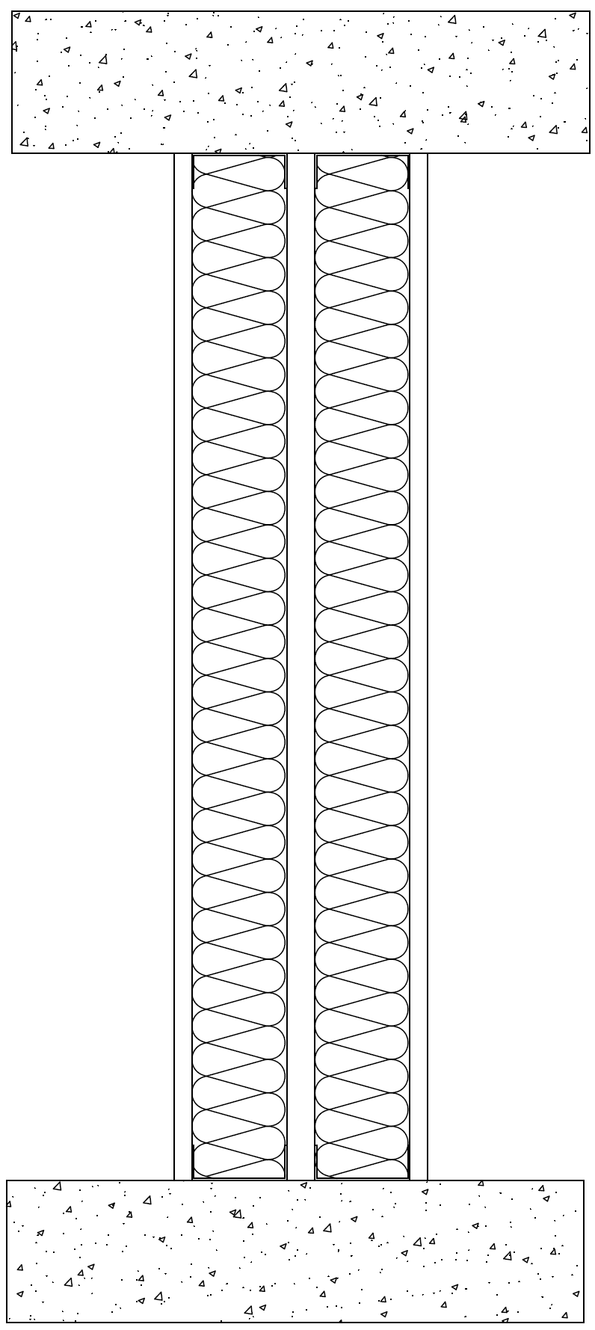
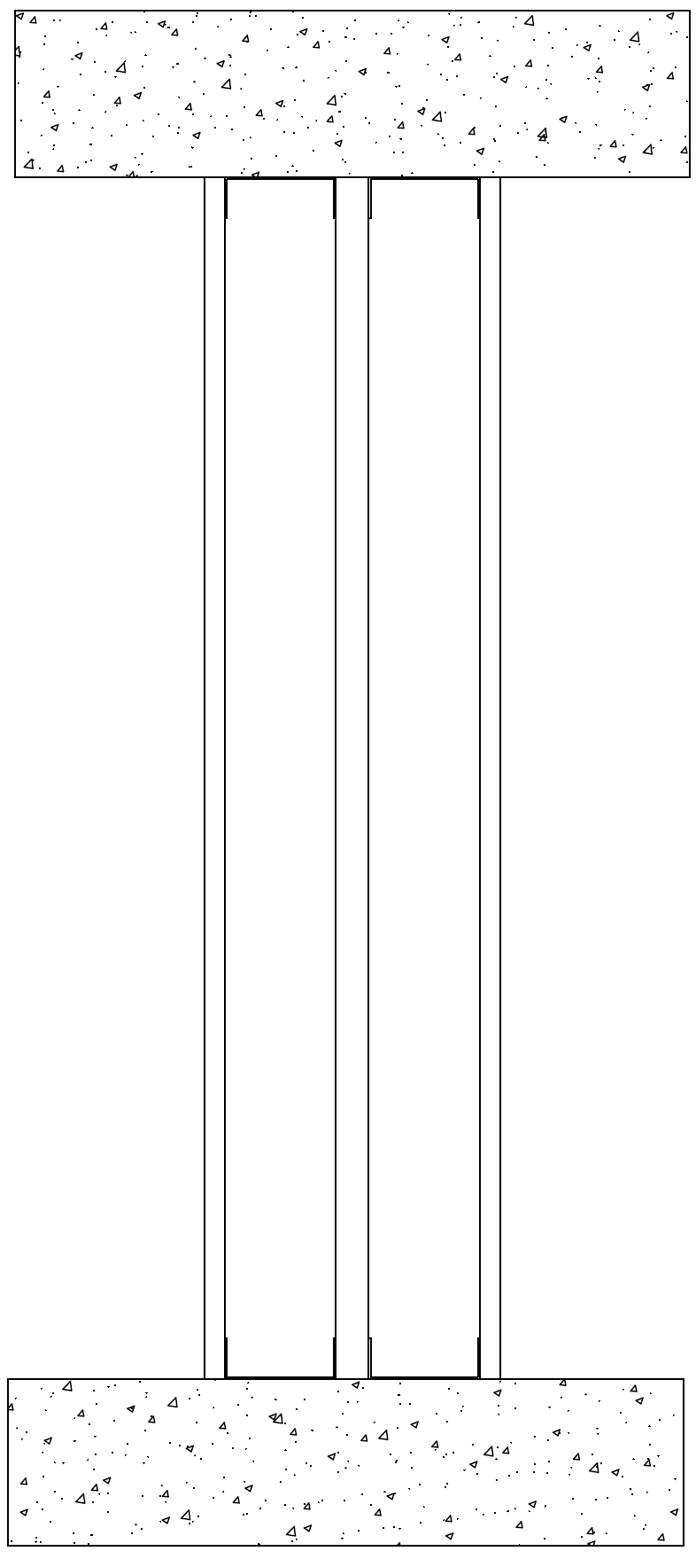
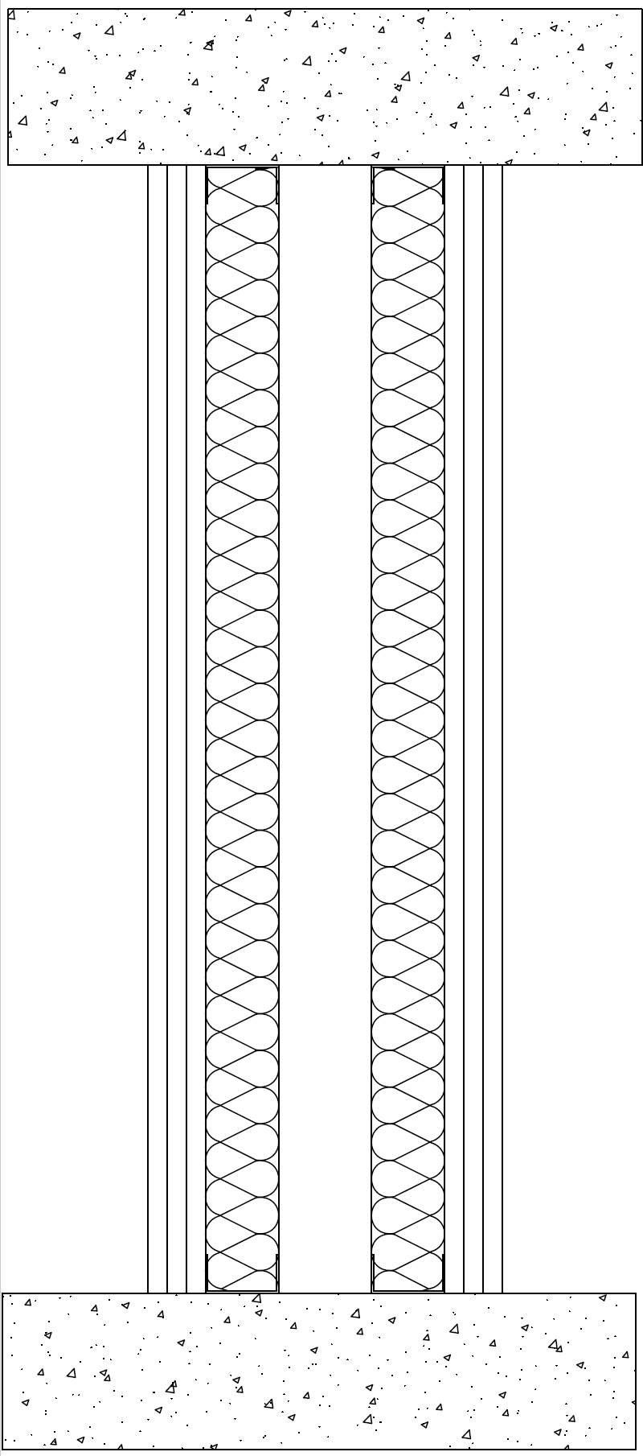
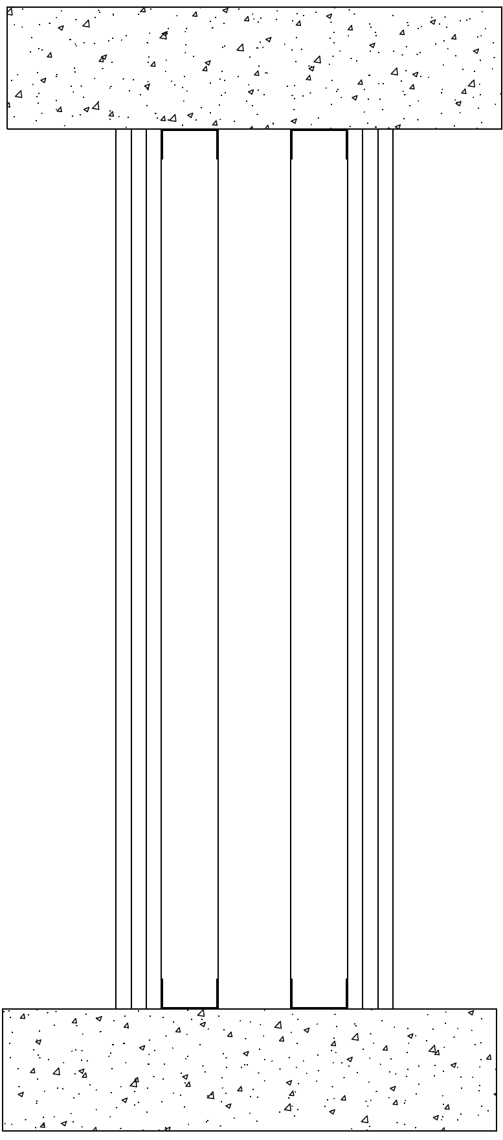
Construction Practices to Improve STC
About 35 – 39 STC - single
About 45 – 50 STC - insulated
About 50 – 55 STC - layered
About 55 – 60 STC – divided
About 60 – 65 STC – divided insulated
About 65 – 70 STC – narrowed and divided with layers
70+ STC – narrowed, divided, insulated, layered
Notes:
Here are some common construction practices in framed walls that can be implemented in design to improve STC.
A single stud cavity wall with a layer of 5/8 in. Type X gypsum on each side with provide an STC of about 35 to 39
If you insulated the cavity with fiberglass the STC will increase to around 45 or 50.
If you add layers of gypsum you can increase the STC up to around 50 to 55.
If you place a dividing space between the studs, effectively removing direct vibrational transfer through the structure, you can increase up to about STC 60.
If you insulate both stud cavities, you can increase STC up to about 65
If you reduce the stiffness of the studs by decreasing the stud width and increasing the space between studs and also add layers of wallboard, you can approach STC 70.
And if you do all of the above, you can achieve STC values above 70.

Slide 25
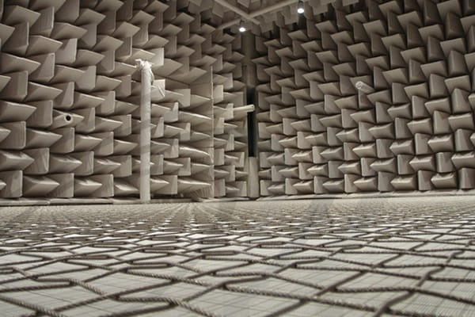
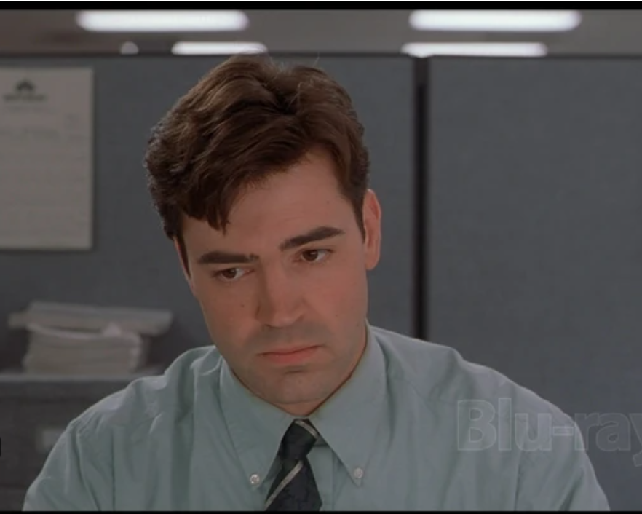


Masking Sound
Sound masking
Notes:
Another tactic that can be used to affect STC is a trick called sound masking. I call it a trick because you technically are not affecting the STC of the barrier at all. Follow along with me as this is illustrated.
Here’s a picture of Peter Gibbons enjoying his day in the office behind his cubicle wall.
Then Nina shows up and…
…Well you get the picture. Peter is not happy because now he can no longer concentrate on getting those TPS reports copied and sent to all the upper level managers. And now he is going to have to work on the weekend to get the work done. And I am sure Innitec installed cubicle walls with as high of an STC rating as possible, but it just didn’t work in this case.
But, if Innitec had installed sound masking in the office, which is a subtle background noise generator that sounds something like air flowing out of a vent, much of the noise coming into Peter’s space would’ve been masked by the background noise. Another way to look at this is to imagine yourself in a very quiet space and you have a timepiece that makes a ticking sound. If the room is quiet enough, you can easily hear that watch. If you turn on the radio and listen to some music, can you still hear the watch? Likely not, because the added noise in the room acts as sort of a filter by drowning out the watch sound. You’ve exchanged an annoying sound with something you prefer.
If you’ve never visited an anechoic chamber, you ought to try if you get the opportunity. In that environment, noise pollution can be almost completely nullified, well below the threshold of human perception. In fact, at one point in time an anechoic chamber I visited at the Owens Corning Science and Technology Center in Granville, Ohio was registered in the Guinness Book of World Records as being the quietest place on earth. While I don’t recall the exact sound level measurement, it registered in negative dB. Currently, the record holding anechoic chamber is at Microsoft in Redmond, Washington which measured a -20.35 dB. When you are in a room that quiet, it is actually possible to hear the blood pulsing though your veins which is inconceivable even if you are sitting in a quiet room in your house. This is essentially the way sound masking works, in that a subtle and comfortable noise is introduced that drowns out other sounds that may be annoying, keeping you from being able to concentrate.

Slide 26

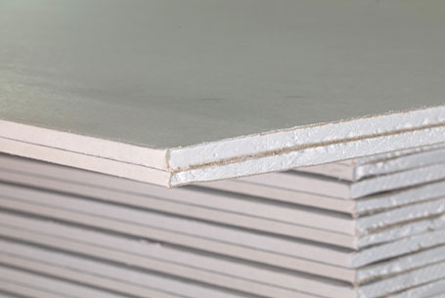
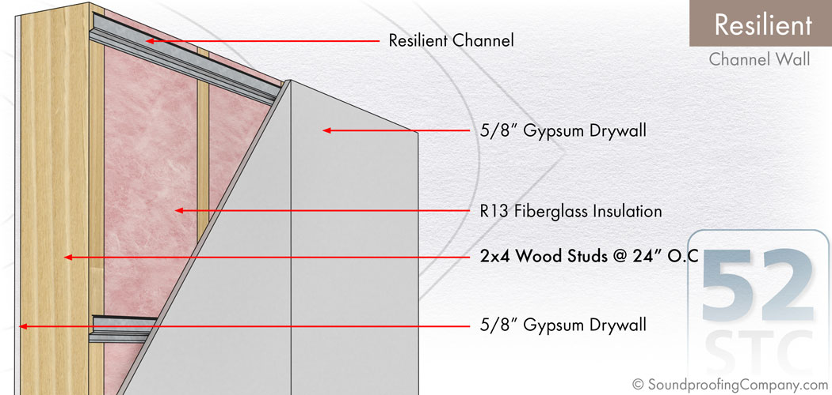
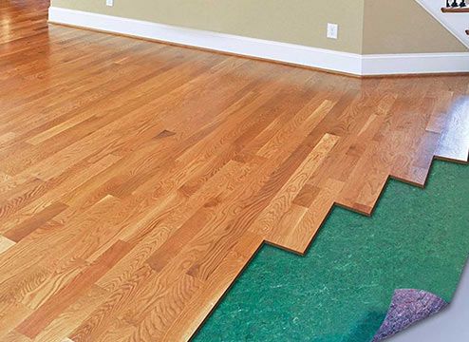

Other ways to improve STC
Resilient Channels
Materials that trap air in cavity spaces or on surfaces.
Sound attenuating underlayments
Absorbing materials in rooms, such as furniture, wall hangings, and rugs.
Acoustical ceiling panels
Sound attenuating gypsum panels
Notes:
While this is not an exhaustive list, there are many other typical construction methods that are used to improve STC for sound barriers.
Resilient channels offer additional flexibility to a wall system and also create a break in direct contact from the gypsum panel to the structure of the wall, reducing direct transfer of vibration the panel may be registering as sound waves make an impact.
Materials that trap air, such as fiberglass or fluid applied membranes such as paint or air barriers, are effective in providing assistance in reducing sound transfer.
Underlayments are commonly used under floor toppings, to reduce the impact noise made by moving furniture or someone walking around in on the floor above. This is not an STC related application, but it does improve impact noise ratings and prevents nuisance noises like footfall from floors above.
Furniture, wall hangings, and rugs absorb tremendous amounts of sound which helps to absorb sound within a room. While this also doesn’t exactly relate to STC, it does improve sound quality within a room by absorbing any reflective noises and cutting down on echos, preventing sound energy from reaching the wall or reflective energy from bouncing back into the room.
Acoustical ceiling panels can help reduce flanking noises by absorbing noise in the room, preventing sound from transferring into an adjacent space that may not be well protected.
One other item that can be used are gypsum panels with an sound absorbant layer within the core of the board is another effective way to reduce sound transmission.

Slide 27
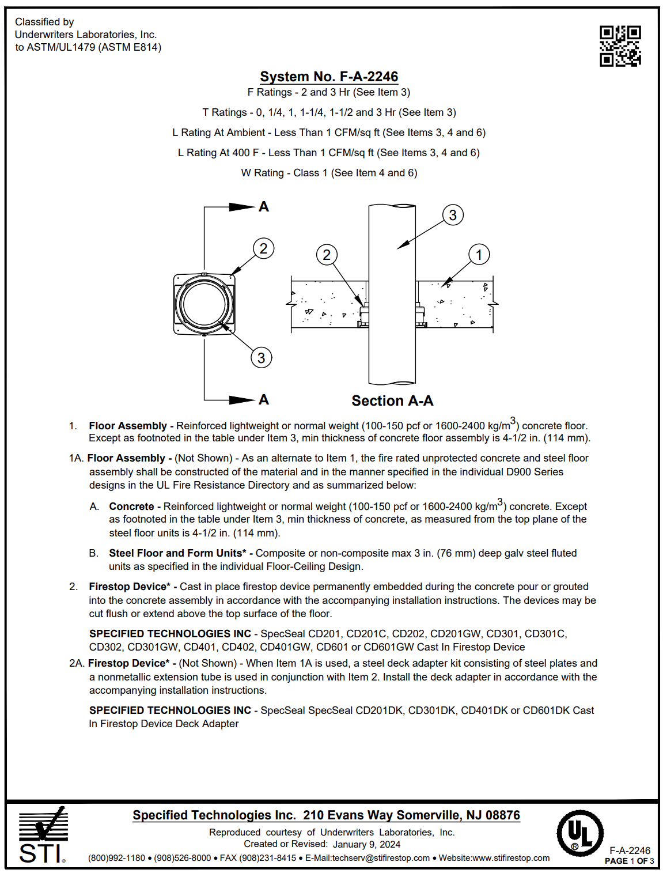
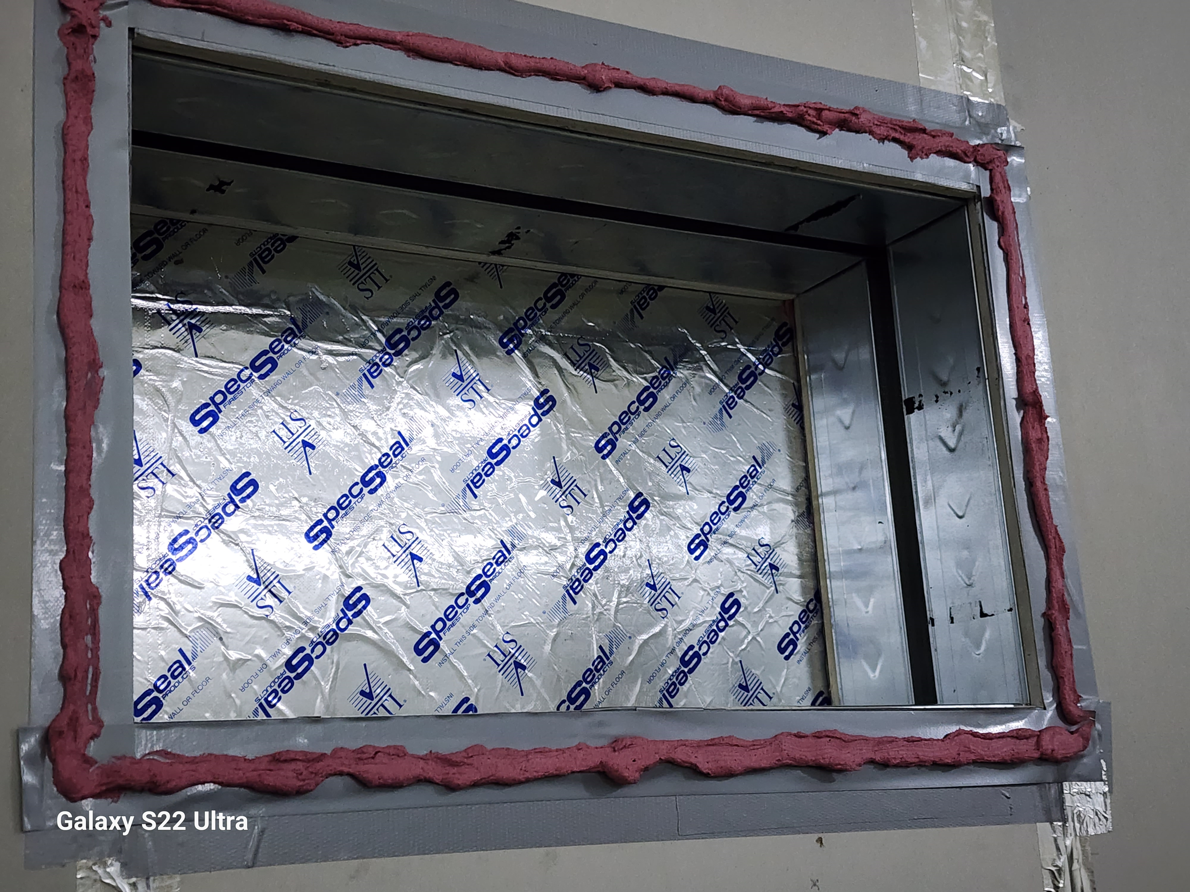
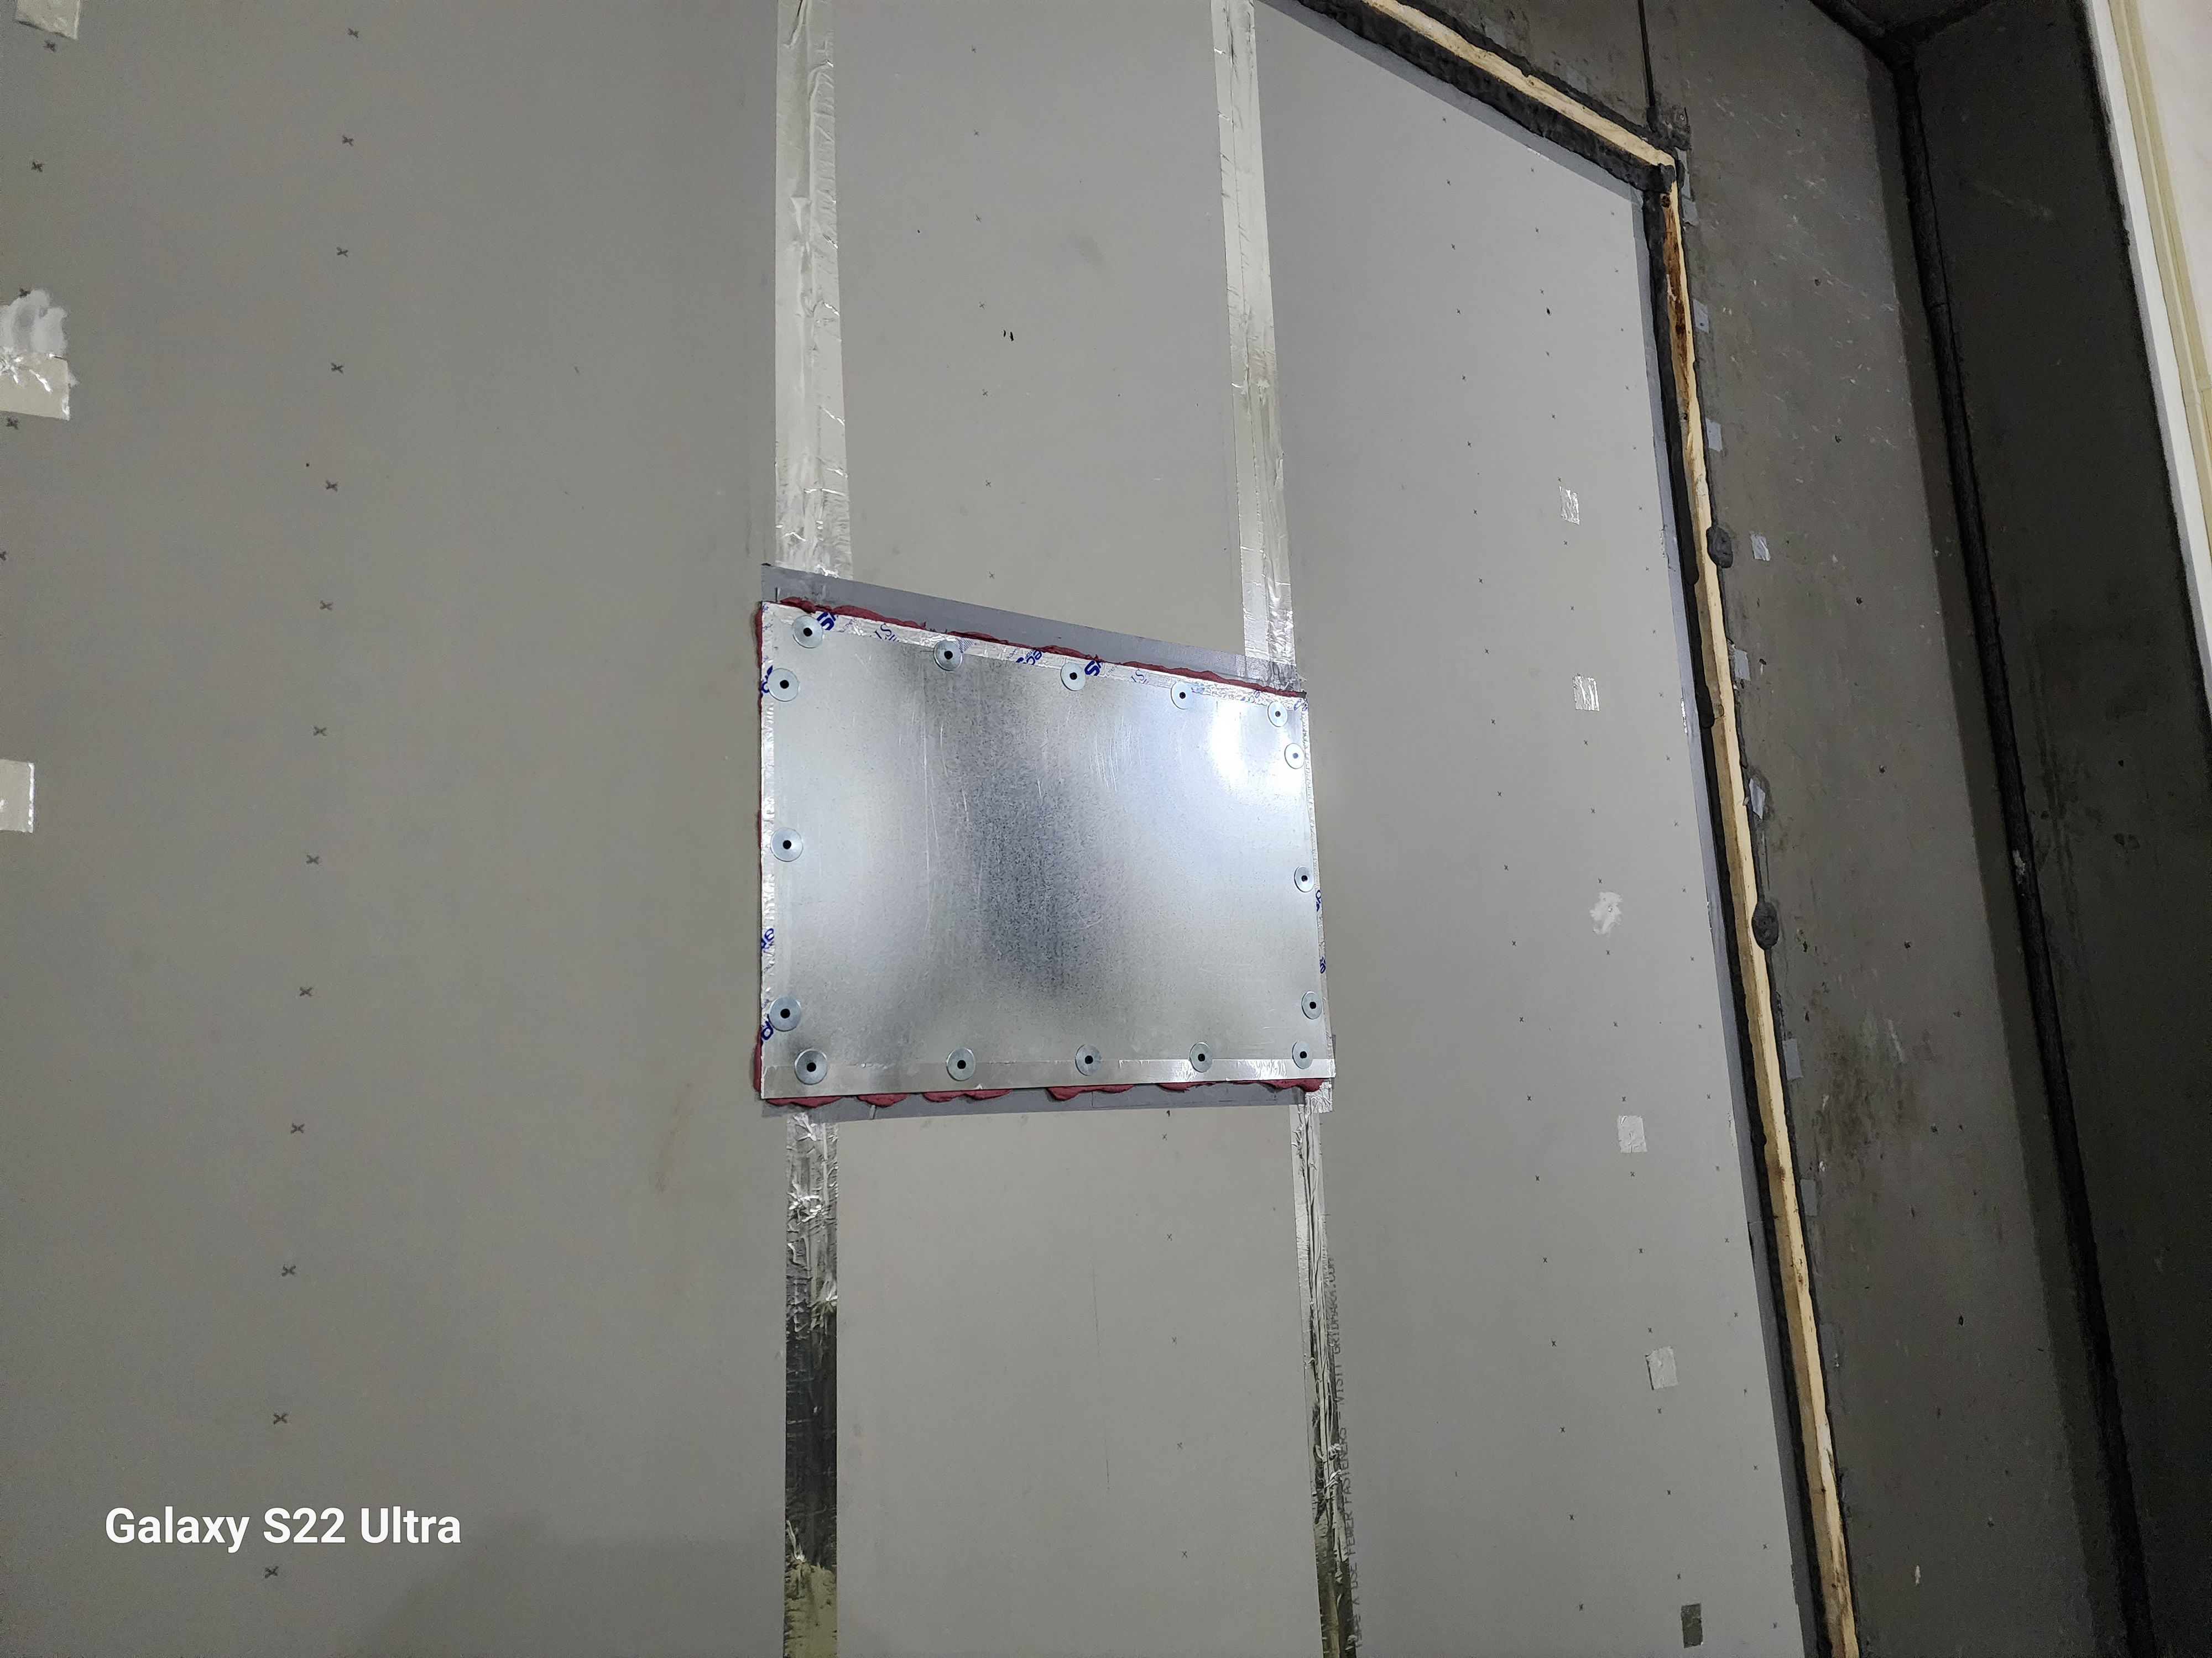
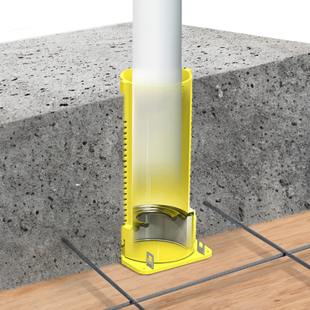
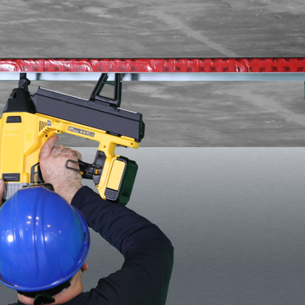
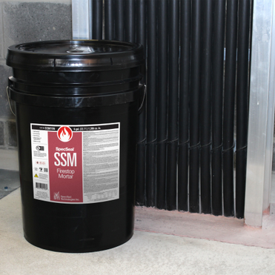
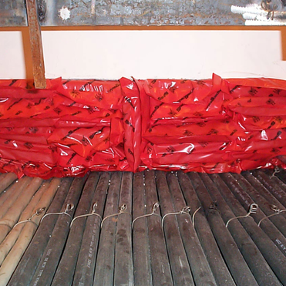
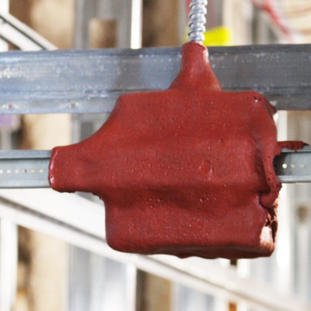
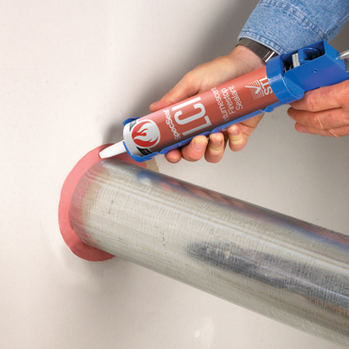
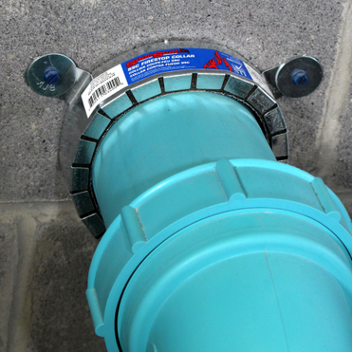
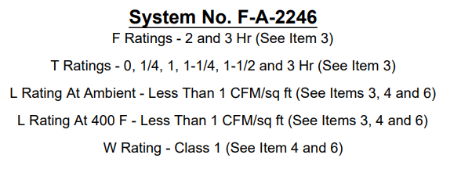
Firestopping materials that improve STC
Anything the seals against airflow (Look for systems with low leakage ratings)
Materials that have mass
Materials that absorb sound through density or malleability
Materials that absorb sound by trapping air
When using materials that are not inherently air leakage resistant, compliment with sealant.
Notes:
The most important thing to walk away from this presentation with is that these materials do their part for the sound performance of the entire system, but they do not improve STC ratings above the standard rating of what is built. If you build an STC 60 wall and poke holes in it, no firestop material, or any material for that matter short of adding more layers, is going to increase that rating to an STC 65, no matter what you may read in a product data sheet. That is why this session is called Restoring STC through Proper Firestopping, not Increasing or Improving STC through Proper Firestopping. But equally important to understand, if they are not installed properly or measures are not taken to seal properly, sound will pass through as will smoke. Here are some examples of firestop materials that can be used to make those restorations.
The first and most important feature to consider when dealing with sound transmission is to use materials designed to prevent air leakage, as we have illustrated.
Sealants, track gaskets, backer rods, tapes, cast-in devices with watertight ratings, all provide significant levels of sound transmission protection while serving as a passive fire control measure. Primarily, the sound attenuation feature is related to stopping airflow, but the material itself can provide a sound-deadening feature as well.
Look for firestop systems that have low L ratings, or leakage ratings. Remember what Job 1 is? You stop air flow and you stop or significantly reduce sound transmission while simultaneously saving lives through controlling smoke migration.
The use of materials that have mass, such as firestop mortars, will help in reflecting sound
Many materials are very effective at absorbing sound because they are reasonably dense and malleable, such as putties, foam bricks, and putty pads for outlet boxes. Not only will they work effectively at stopping airflow, the materials themselves will absorb sound and dampen vibrations to an extent that can help with some flanking sounds that may travel through the penetrating item itself.
Some materials and products help by absorbing sound through trapping air. Cable grommets, mineral wool, and fiberglass when approved to be used within firestop systems. Tightly packed pillows can do well by themselves, but may need some additional care around penetrating items, usually with putty which is effective since the putty is non-curing and the system is meant to be repenetrated when required.
Composite Sheets on both sides of a large opening work very well, and performance can be enhanced further with mineral wool or fiberglass placed in the void space between.
Wrapstrips and intumescent sleeves or collars are not inherently leak free in and of themselves, but are commonly paired with sealants or putties. Originally this was done to prevent free passage of cold smoke before the intumescent material activates. But now we also view this as an effective sound proofing measure as well. The bottom line is that any properly firestopped barrier will also be a well-performing acoustical barrier.

Slide 28
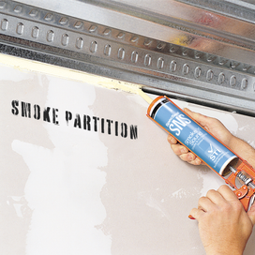
Conclusions
Don’t cut corners.
  Use the proper screw spacing
  Use the same gauge of framing as tested.
  Build to the design
Lighter framing helps STC, but hurts fire-resistance.
Seal against air leakage where practical
If the barrier is not fire rated, seal with materials designed for smoke and sound
When designing, consider flanking paths and try to mitigate
There is no such thing as an STC rating for a product.
The falling tree does indeed make a sound, but if no living creature is there to hear it, it does not make a noise.
Notes:
In conclusion, here are some final reminders of how to best mitigate sound transmission in construction practices, especially as it relates to fire protection.
First and foremost, build it correctly. Small differences and cut corners can significantly affect sound performance of the barrier. Details like screw spacing, using the same gauge of framing as was tested, and using the proper materials according to the design, such as the right type of fiberglass in the cavity space, making sure the fiberglass fits tight so as not to fall out of place due to gravity, all of these things can lead to poor sound performance.
One detail that you may not realize is that flexibility has a positive effect on STC, but a negative effect on fire performance. You may improve STC by using lighter gauge framing, but if the lighter gauges falls outside the acceptable scope of the wall design, it could reduce fire-resistance. For that reason, it is best to build with the lightest gauge permitted by the fire-rated design.
Once the construction is complete and done per the design, make sure and seal all openings. This step alone, when done improperly, will drastically reduce sound performance and could harm fire performance as well, and will definitely result in smoke migration.
If the barrier is fire-rated, the penetrations and joints must be protected per code with a firestop material as we all know. And as you will recall from the previous slide, look to find penetration and joint systems with low L ratings. What is a low L rating? Well, many firestop systems when tested produce L ratings lower than 1 cfm/ft^2, especially those with good air sealing characteristics. In actuality, this number is the lowest you will see from a listing agency because the way L ratings are tested is by measuring air flow difference from a system that is as installed, with the same system that has been artificially sealed with an impermeable air barrier such as a plastic sheet to reduce airflow as much as possible. But that number is never zero, so the difference between them is what is recorded as the L rating and the lab will always exercise caution, even if the measured difference approaches 0 cfm/ft^2.
If the barrier is not fire-rated, most firestop companies do provide materials that can be applied for sound and smoke resistance.
In addition to sealing, consider where flanking may be a problem and take steps to address the sources of sound transmission as best as possible.
And in closing, it is important to remember that no sound barrier will perform unless all parts of the sound attenuation system are working properly together. And with that, I will now turn it back over to John Zalepka who will finish up with a quiz and some giveaways. Take it away John.

