Slide 1

21st Century Building Science
Claudia Miller MD www.tiltresearch.org
Carl Grimes CIEC www.haywardscore.com
Westford Building Science Symposium
August 4-6, 2025

Slide 2


Modern Advances in Building Science
Should include not just the building.
Not just new technology.
Not just the emerging smart buildings.
Not even the brilliant hallucinations of Artificial Intelligence.
It’s Indoor Environmental Quality.
IF it will stop ignoring the historical blind spot of IEQ…
By excluding the missing variable
The individual humans who occupy the buildings
Buildings affect people, people affect buildings.
It’s the Interactions

Slide 3
But First
Neither Dr Miller nor I are Building Scientists. But…
As a Certified Indoor Environmental Consultant, I need what you know so I can improve my helping individuals who leave their home and experience feeling better.
As a former IH and now MD/Allergist Immunologist, Dr Miller needs what you know so she can better study the relationship between environmental exposures and health outcomes.
We hope this presentation will help us both better serve our clients and patients who are sick from the buildings they occupy.

Slide 4
Dr Miller’s brief CV
1996 journal Toxicology, proposed a unifying theory of disease Toxicant-Induced Loss of Tolerance (TILT).
1999 in Quick Environmental Exposure and Sensitivity Inventory (QEESI).
2021 Identified mast cell mechanism underlying TILT.
2023 Identified TILT initiators to include pesticides, indoor air VOCs, Gulf War exposures, implants and mold.
2024 Environmental house calls can reduce symptoms of chemical intolerance: a demonstration of personalized exposure medicine.
2024 Parents with high chemical intolerance score had 5.7 times an increased risk of having a child with autism/ADHD.

Slide 5
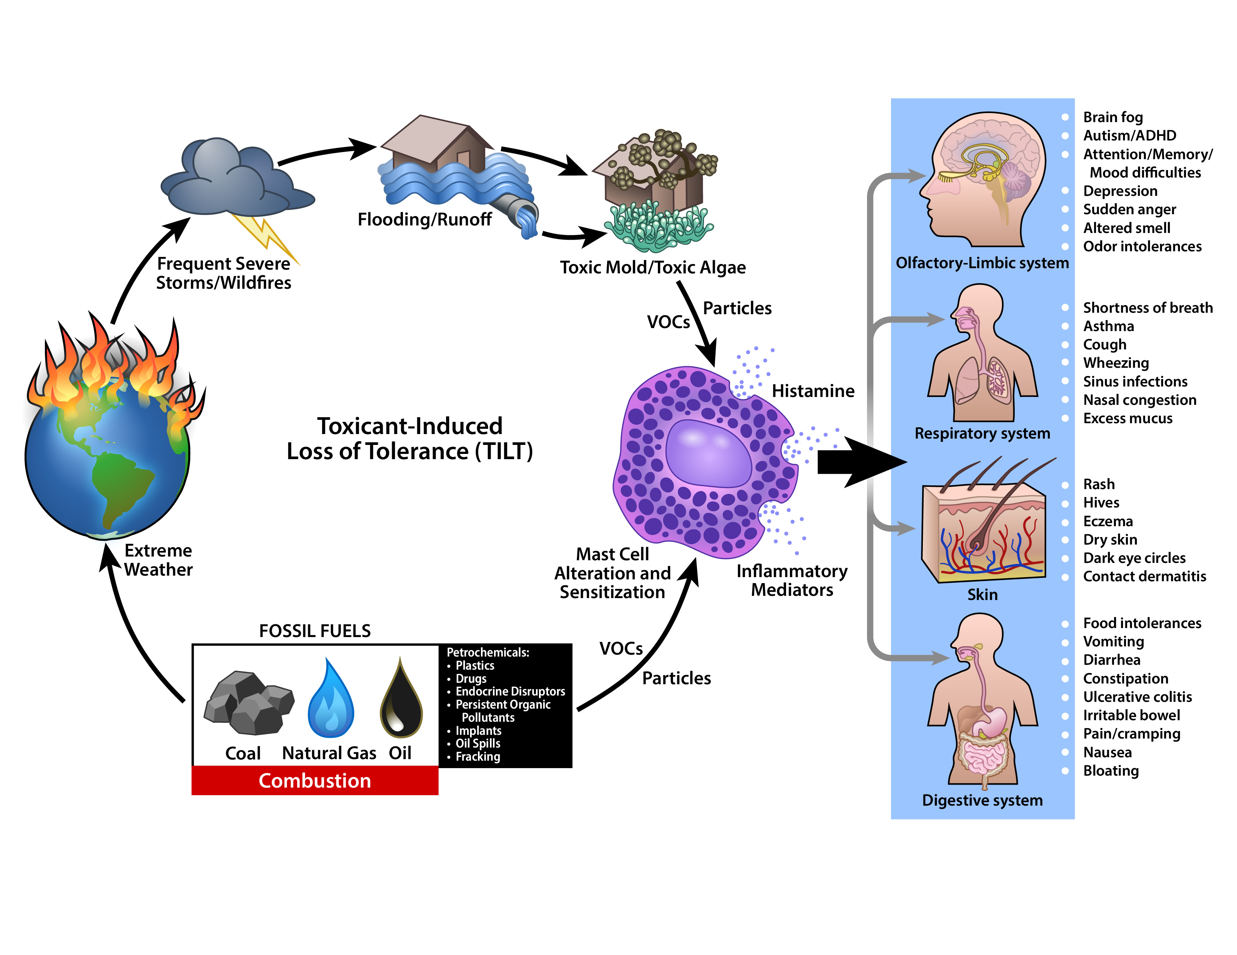

TILT Stage I: Initiation
TILT Stage II: Triggering
The
two stages of
TILT
Notes:
This is the graphical abstract from our paper titled “Assessing Chemical Intolerance in Parents Predicts the Risk of Autism and ADHD in Their Children” (2024). J Xenobiot 14(1), 350–367. https://www.mdpi.com/2039-4713/14/1/22 https://doi.org/10.3390/jox14010022. It summarizes the relationship between TILT and mast cells.
Toxicants are toxic foreign chemicals (xenobiotics) such as pesticides, solvents, or combustion products that can alter mast cells (TILT Stage I).
Toxic mold particles or mold VOCs also may initiate TILT. In Stage II, the initiating substance(s) and formerly tolerated chemicals including VOCs
arising from fragrances, cleaning products, new construction/remodeling, as well as foods/food additives, drugs and their excipients can
trigger mast cell degranulation resulting in inflammation and the multi-system symptoms that characterize TILT.

Slide 6
What is YOUR experience?
Not just the regulatory hazards, or even the fundamental factors of the indoor environment.
Thermal, IAQ contaminants, Noise, Illumination.
Let’s explore, as a group exercise, some of the common and ordinary exposures we all experience…
What if we could now explore this range and variability with a consistent set of questions with an observable outcome?

Slide 7
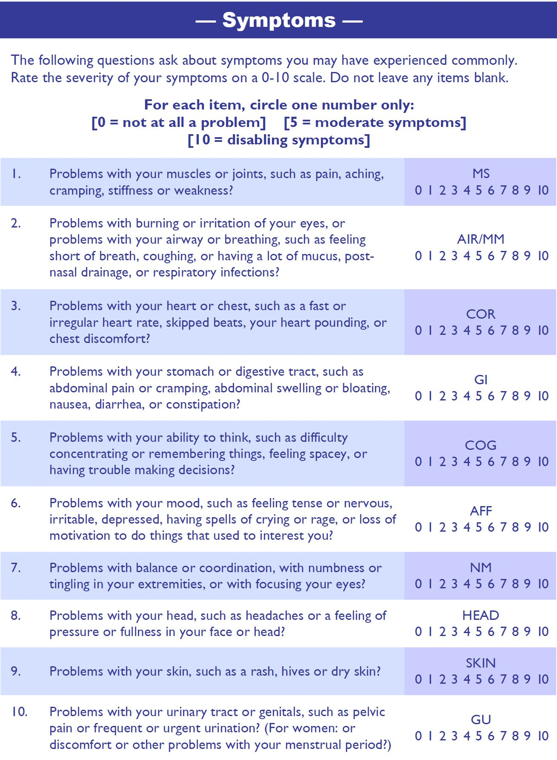
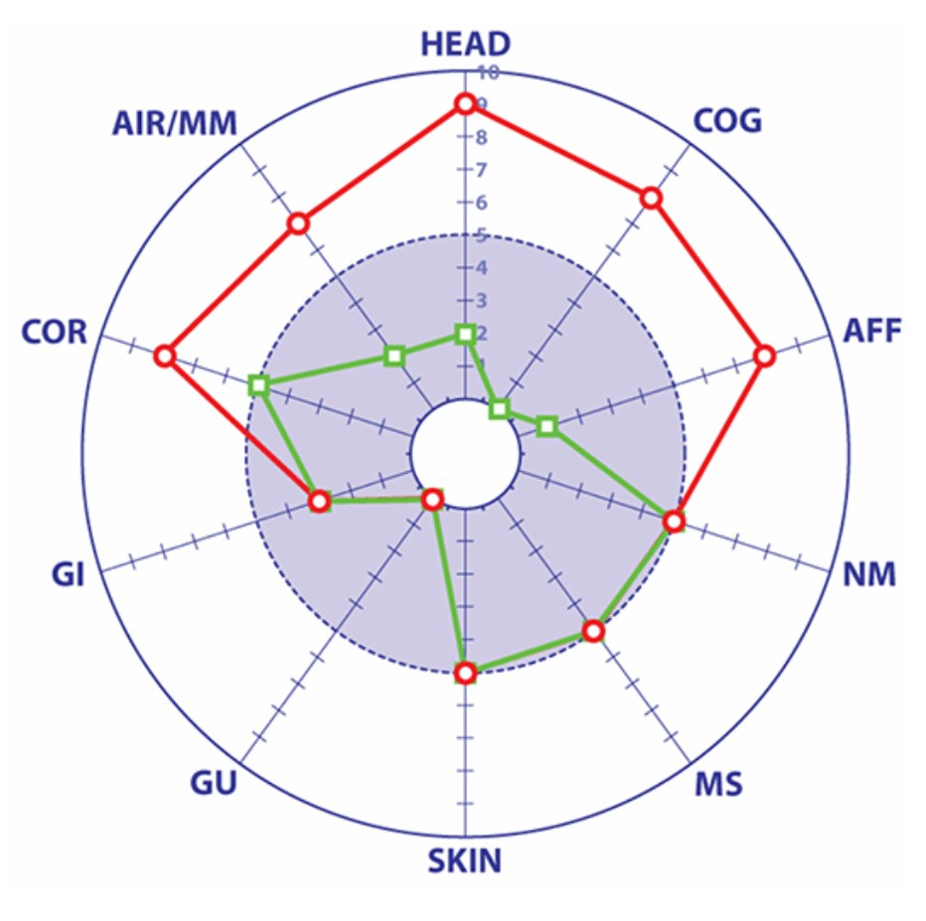
QEESI Symptom Star
Notes:
You can start at 12 o'clock and point at the severity of head-related symptoms as a 9 on a 0 to 10 scale. Then go clockwise to 1 o’clock “Cognitive symptoms” which are 8 on a 0 to 10 scale, etc.

Slide 8
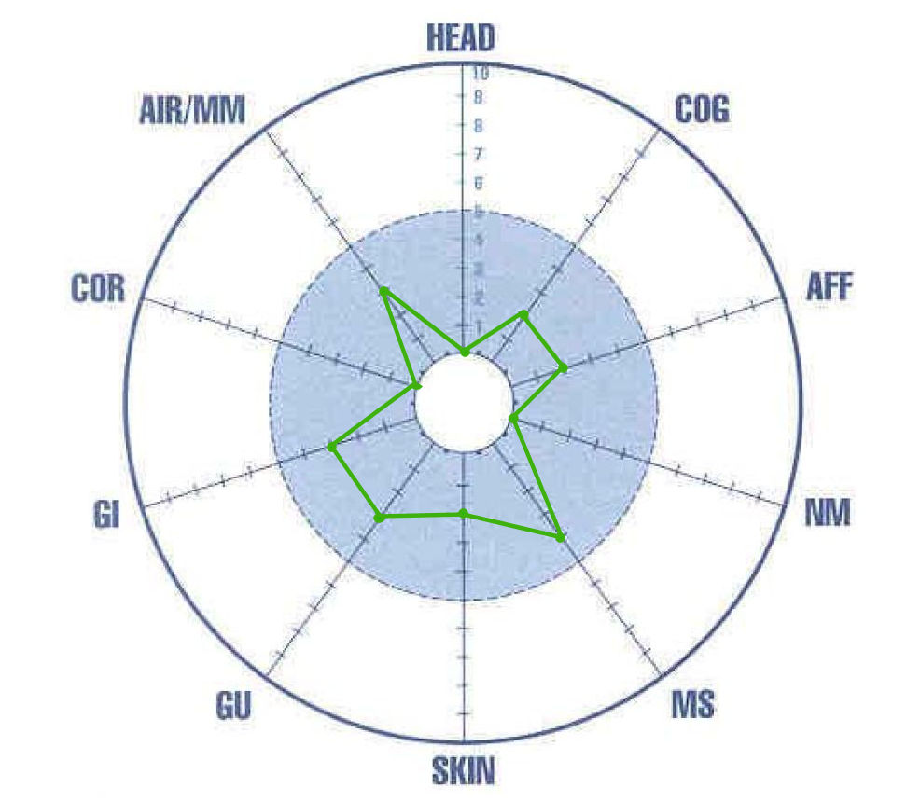
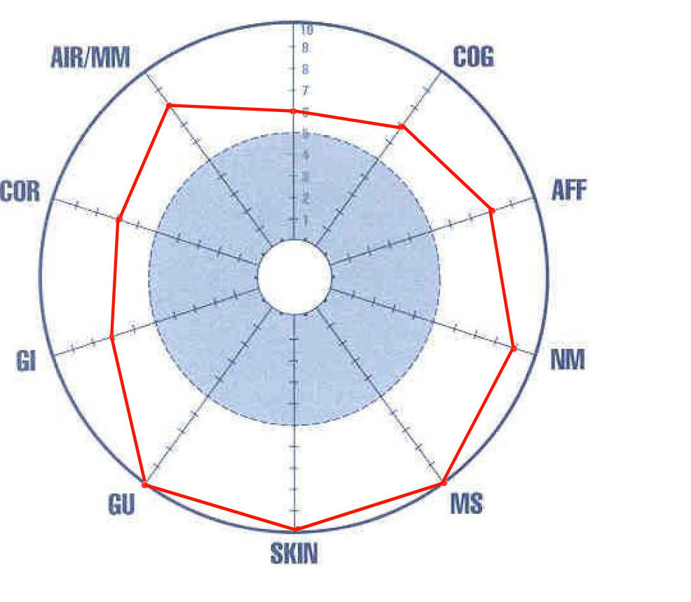
Before Exposure vs After Exposure
HEAD

Slide 9
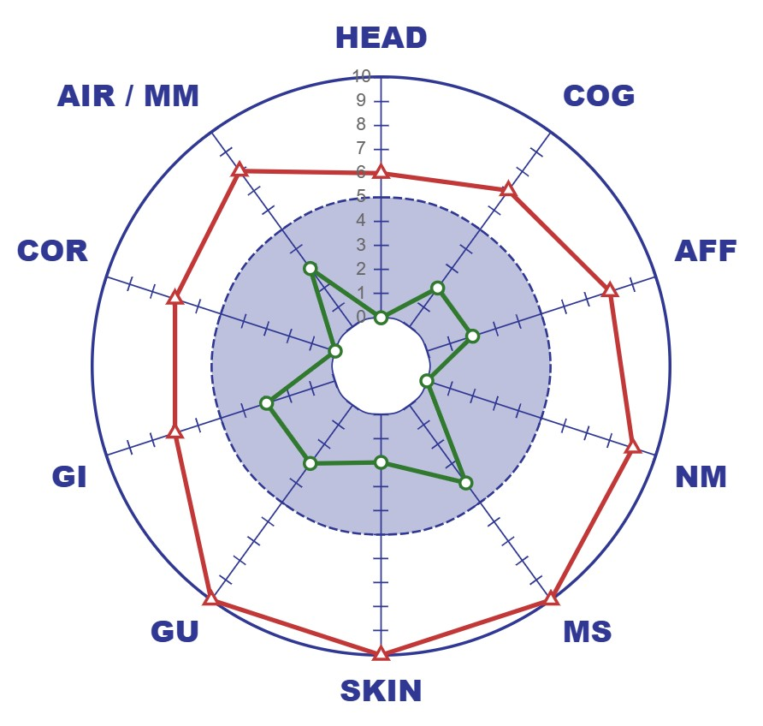

Slide 10
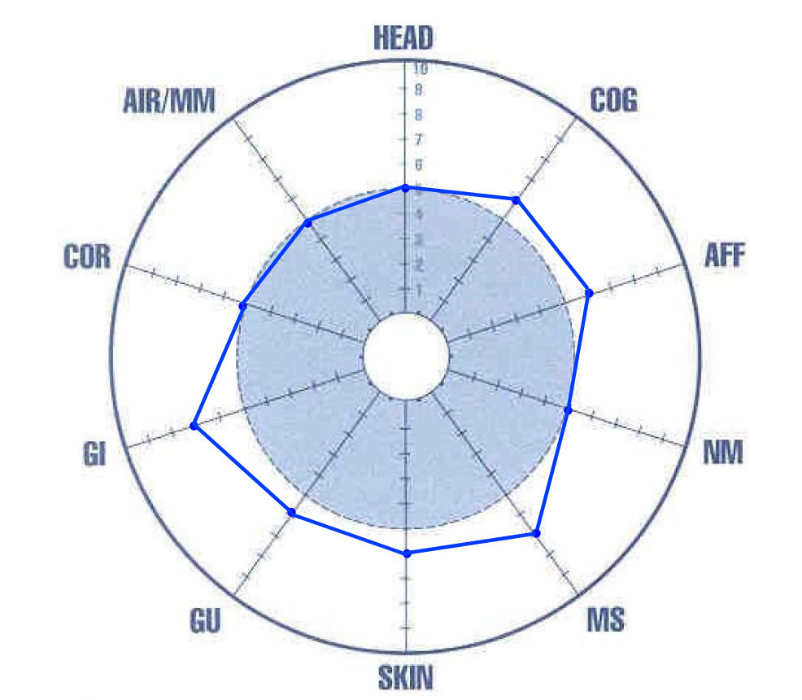
After Exposure vs After Intervention
HEAD

Slide 11
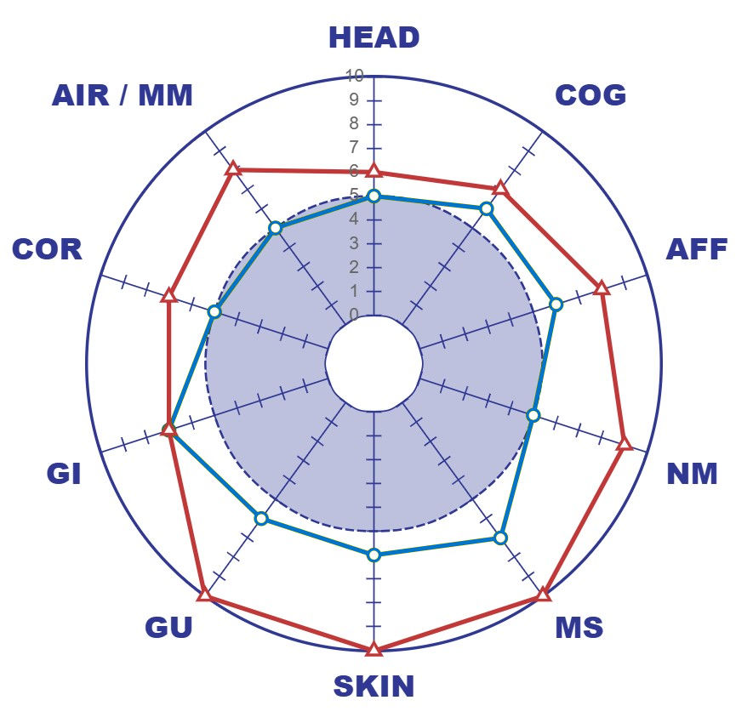

Slide 13
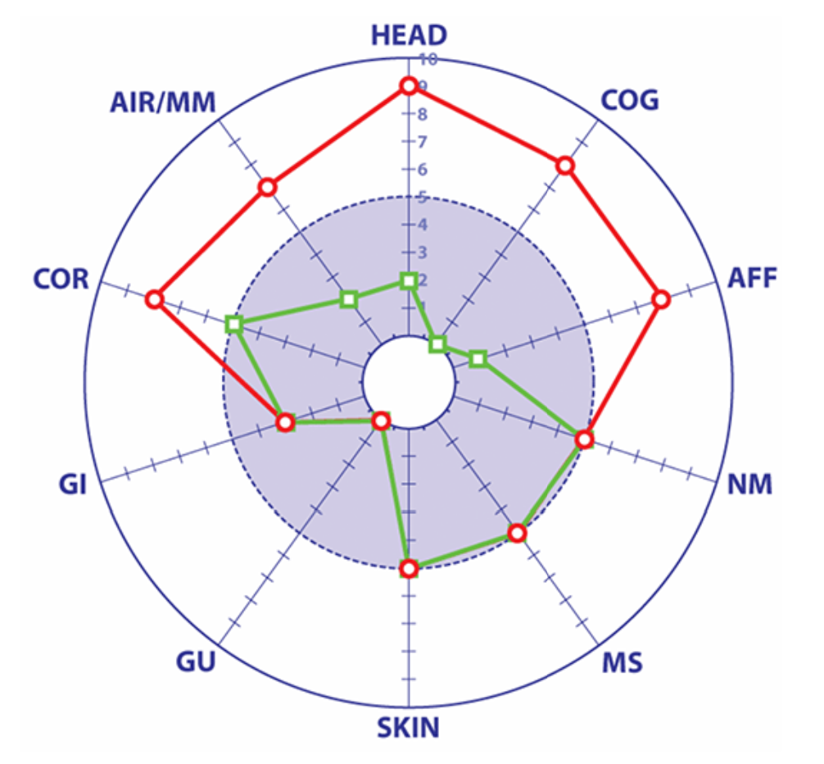
Some Symptoms May Not Change
In this case, certain symptom severities did not change: GI, GU, SKIN, MS, and NM before and after the exposure event or intervention.
This suggests that these symptoms were not affected by the house or the intervention.
Clients/patients feel better understood and can readily communicate this visual information to their families, doctors, and contractors.

Slide 14
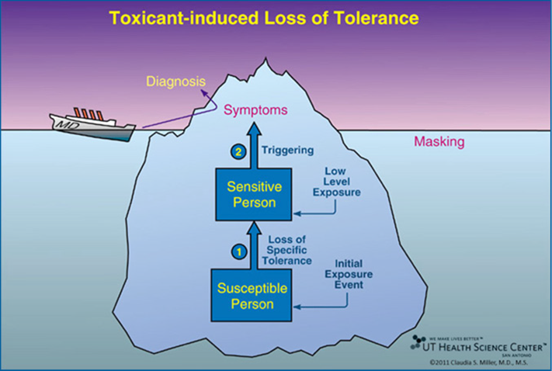
TILT = Toxicant-Induced Loss of Tolerance
TILT has two stages
Initiation by acute exposure or repeated lower-level exposures
Triggering by previously tolerated chemicals, foods, or drugs
“Masking” hides the relationship between exposures and symptoms
Notes:
Initiation is the first of two stages in the disease process Toxicant-Induced Loss of Tolerance or TILT. As shown here, Initiation (Stage 1 of TILT) involves a single major exposure or repeated, often lower level, exposures to toxicants such as pesticides, solvents, or a toxic mold. Stage 2 of TILT involves Triggering of multi-system symptoms by exposures to tiny quantities of previously tolerated substances that never bothered the person before and don’t bother most people, for example: diesel exhaust, cleaning products, fragrances, foods, drugs, or food/drug combinations such as red wine, beer, coffee or chocolate.
A physician sees only the tip of the iceberg—the patient’s symptoms—and formulates a diagnosis, based on them, e.g., asthma, ADHD, autism, or an autoimmune disorder. Background exposures “mask” or hide the relationship between symptoms and triggers. The initial exposure event that led to loss of tolerance may go unrecognized. Adults may not recall initiating exposures that occurred during their childhood, for example, riding their bikes behind a truck spraying DDT, living where pesticides were applied, or residing in homes where coal, oil, natural gas/propane, or wood was used for heating or cooking (Miller CS, 2000).
I first described TILT in leading journals in the late 1990s (Toxicology 1996, Environmental Health Perspectives 1997) and developed the QEESI soon after. The QEESI was based entirely on the symptoms and intolerances reported by groups of exposed individuals following well-characterized exposure events: Organophosphate pesticides (Miller and Mitzel 1995); VOCs associated with new construction/remodeling (Miller and Mitzel 1995); Gulf War exposures (Miller and Prihoda, 1999); and breast implants (Miller and Prihoda, 1999). Back then, I had no idea that mast cells were involved in TILT. Indeed, the QEESI preceded our publication showing the role of mast cells in chemical intolerance by a quarter of a century (Miller et al., 2021).

Slide 15
Next, Dr. Miller will discuss the biological mechanism underlying Toxicant-Induced Loss of Tolerance (TILT)

Slide 16
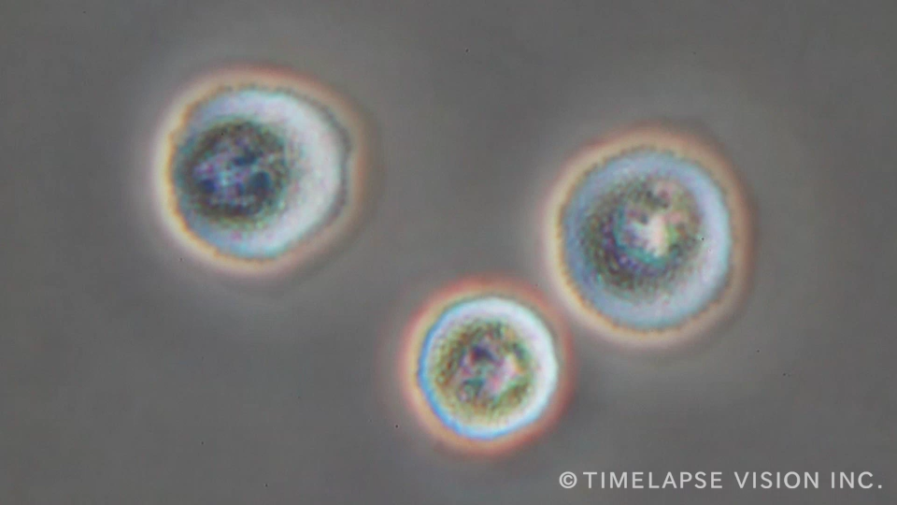
Mast Cell Degranulation

Slide 17
Paul Ehrlich
A couple of “mast cells” as described by Ehrlich
Notes:
In 1877 a Prussian medical student who later won the Nobel Prize identified mast cells under a light microscope using a special blue stain.
This is what he saw.
Paul Ehrlich and his sketch of the distribution of mast cells in various tissues (Paul-Ehrlich-Institut website).
Mast cells lie hidden at the interfaces between our tissues and the external environment. In contrast to immunoglobulins (antibodies), they do not do not circulate in the bloodstream except in small numbers. However, when sensitized and subsequently challenged by a xenobiotic (chemical, food, or drug) they release cascades containing histamine and inflammatory molecules to fight off the intruder.
In addition, the mediators mast cells release are difficult to measure because they are thermolabile, fragile, require special handling, refrigerated centrifuges, and special staining in order to identify them. Staining for mast cells is not routinely done by pathologists. For these historical reasons, and because mast cells are so fragile, it is only in the past 15 years that we have learned what mast cells do. Our 2021 paper was first to link toxicant exposures to mast cell alteration and sensitization (Miller et al. 2021). In 2024 we reported that U.S. adults whose QEESI chemical intolerance scores were in the top 10th percentile, versus the bottom 10th percentile, had more than 5 times the risk of having a child with autism and more than twice the risk of having a child with ADHD. These findings suggest that toxicants may alter mast cells epigenetically, that is by turning on or off mast cell genes.

Slide 18
Evolution of Mast Cells and TILT
Years Ago | Event
500,000,000 | Mast cells developed in vertebrate fish.
250,000,000 | Olfactory-limbic system evolved in first mammals.
300,000 | Homo sapiens appeared.
300 | Industrial Revolution (1760-1840) coal, natural gas, oil
150 | Freud diagnosed “hysteria.”
<100 | Synthetic organic chemical production began and grew exponentially after WWll (1939-1945): pesticides, plastics, synthetic drugs (including psychiatric medications), and food additives.
Notes:
Mast cells evolved more than five hundred million years ago in early vertebrate fish. They protect our internal milieu from the external chemical environment and are essential for the survival of humans and other vertebrates. Toxicants derived from fossil fuels or biological sources (mold, algae) can alter and sensitize mast cells. They guard our skin, nose-to-brain (olfactory-limbic) pathway, and respiratory, digestive, and genitourinary tracts. In the late 1800s, Freud diagnosed “hysteria” in wealthy women whose symptoms may have resulted from inhaling combustion products from coal gas which was used to light their homes.
Why haven’t doctors and public health authorities told us about TILT and mast cells?

Slide 19
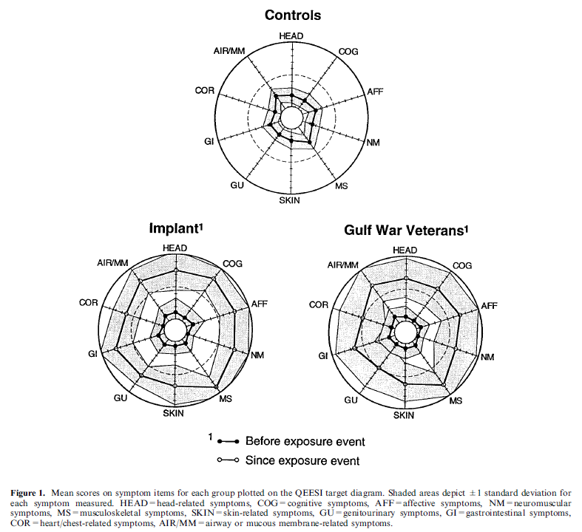
A controlled comparison of symptoms and chemical intolerances reported by Gulf War veterans, implant recipients and controls (After Miller & Prihoda, Tox Ind Health (1999b) 15:386-397)

Slide 20
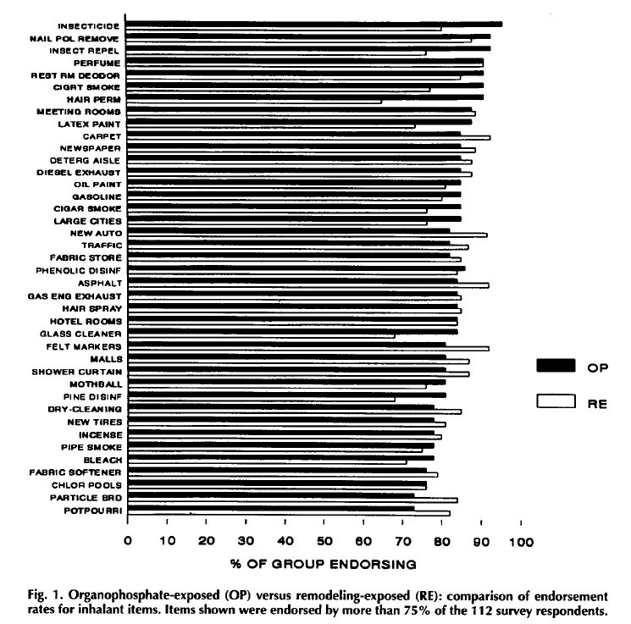
Chemical Intolerances Attributed to Pesticide Exposure Versus Remodeling (After Miller & Mitzel March/April 1995 Vol. 50 No.2)

Slide 21
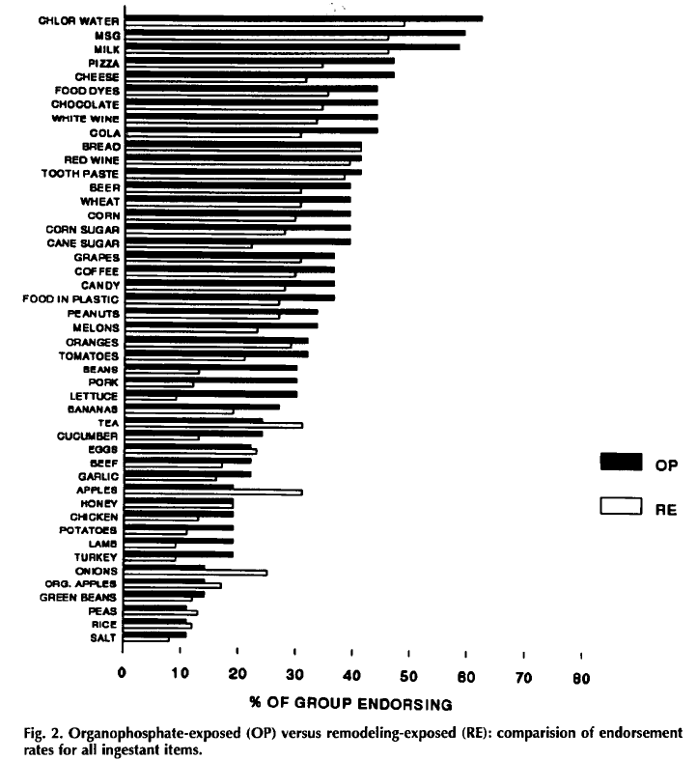
Food/Ingestant Intolerances Attributed to Pesticide Exposure Versus Remodeling (After Miller & Mitzel March/April 1995 Vol. 50 No.2)

Slide 22
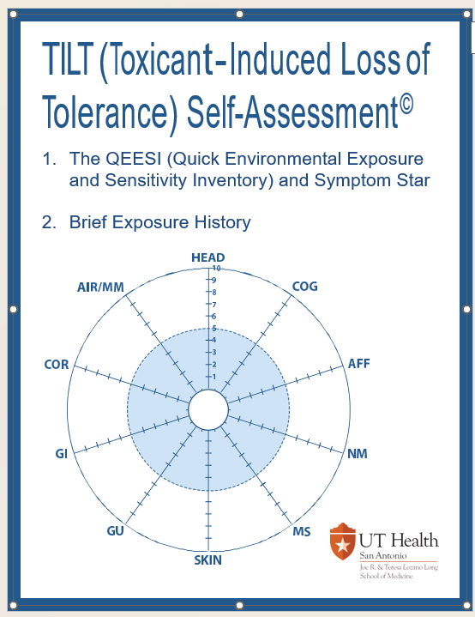
TILT Self-Assessment
For individual use, the TILT Self-Assessment is available at TILTResearch.org at no cost.
For commercial use, contact: Claudia S. Miller, MD, MS
President and Founder
The TILT Research Foundation MillerCS1212@gmail.com

Slide 23
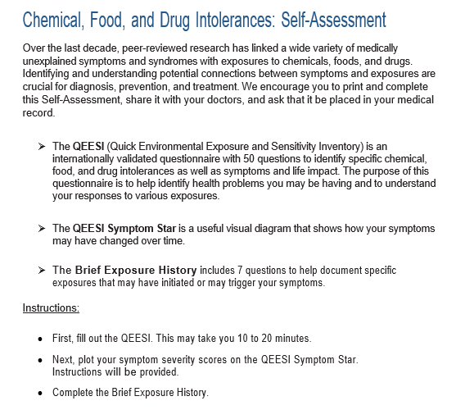

Slide 24
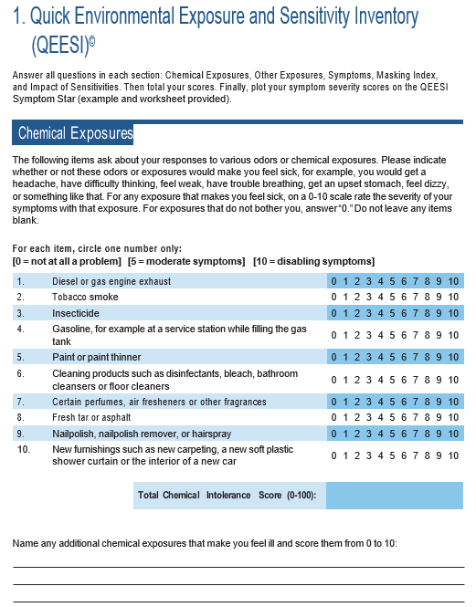
Notes:
The QEESI has emerged as the international reference standard for assessing chemical intolerance. To date, researchers in 18 countries have published more than 110 peer-reviewed studies using the QEESI.
The QEESI is available to anyone free online at TILTresearch.org.
The QEESI has 4 scales:
Chemical Exposures
Other Exposures
Symptoms
Life Impact
Each scale has 10 items derived by factor analysis. Each item is scored from 0 to 10 in terms of severity.

Slide 25
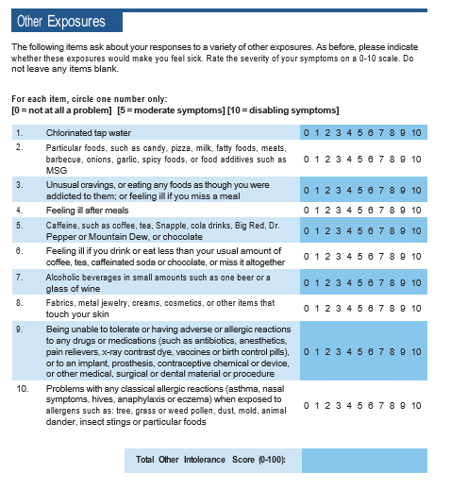
Notes:
Note that items 1 through 7 on the “Other Exposures” scale involve ingestants/foods. Often, food intolerances are the first symptom patients recognize.
The GI tract is heavily populated with mast cells, which ordinarily allow us to tolerate the biggest load of foreign substances we encounter—the pounds of food we eat in a week.

Slide 26
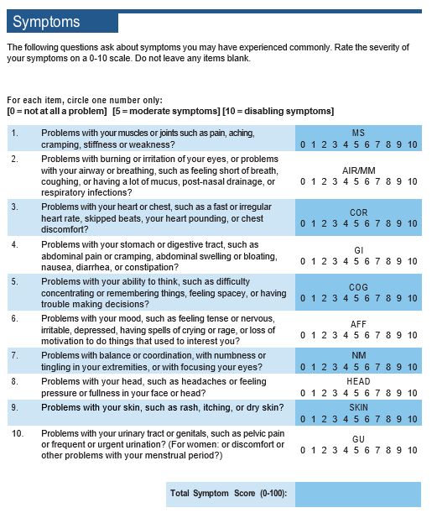
Notes:
People are asked to rate the severity of each group of symptoms on a 0-10 scale. A higher Total Symptom Score also suggests chemical intolerance.

Slide 27
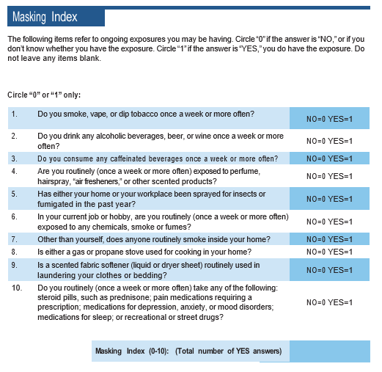
Notes:
The QEESI also has a Masking Index, which refers to common exposures that can hide the relationship between symptoms and exposures such as tobacco smoke, a gas stove or fragrances.

Slide 28
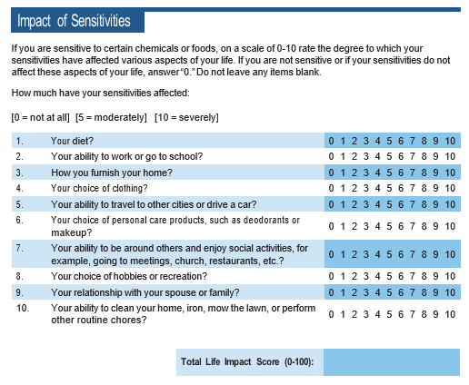
Notes:
The 10 items on this scale measures the impact of individuals’ intolerances on multiple aspects of their lives.

Slide 29
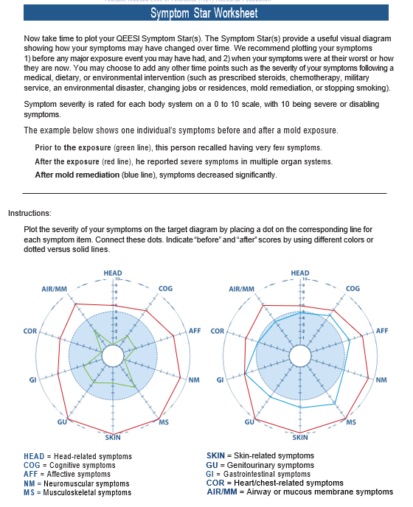

Slide 30
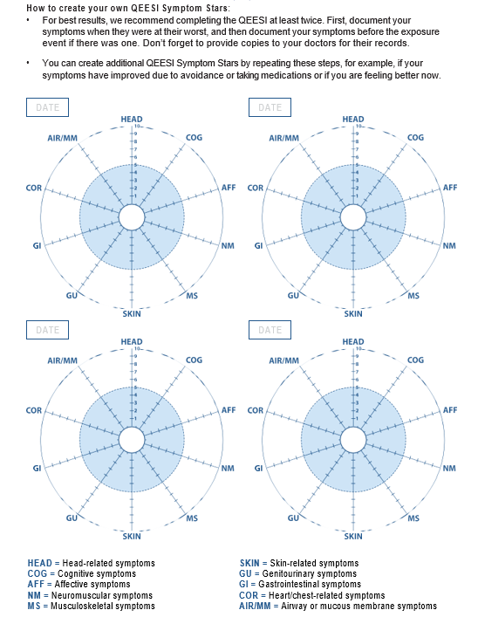

Slide 31
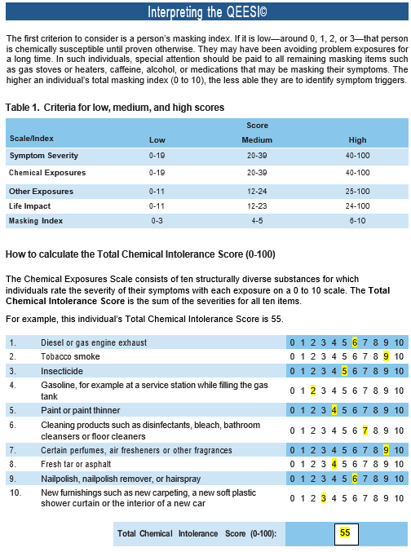

Slide 32
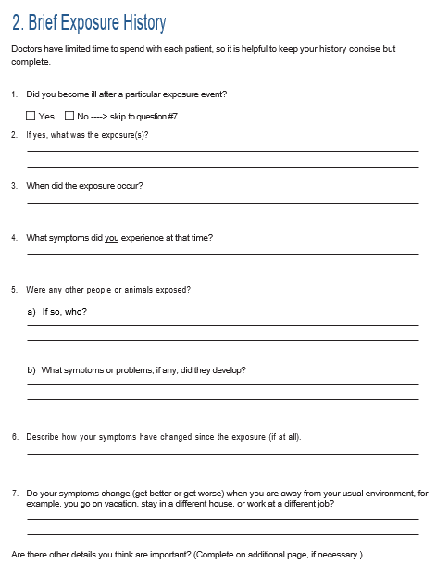

Slide 33
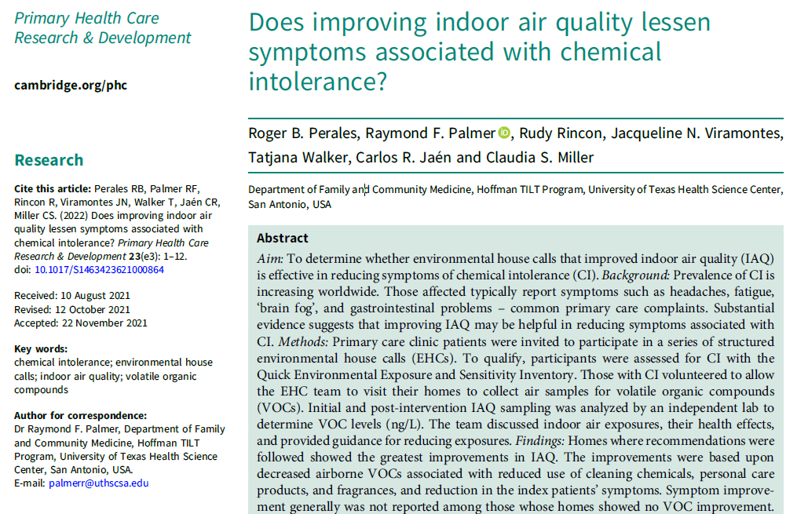

Slide 34
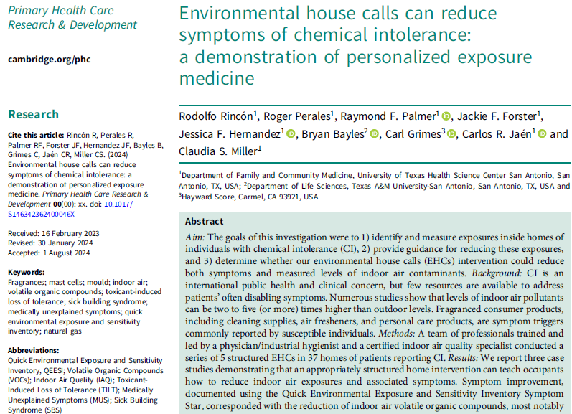

Slide 35
Case #1
A 68-year-old female who worked as a house cleaner for 16 years reported progressively worsening symptoms, including headaches, abdominal pain and cramping, memory difficulties, fatigue, coughing spells, throat irritation, watery eyes, and joint and muscle pains when exposed to multiple scented cleaners she used at work. She also developed intolerances for combustion products including smoke from cigarettes and from cooking and grilling. She said that her exposures led to depression, irritability, and worsening headaches, cognitive, and respiratory symptoms. Ultimately, her symptoms forced her to leave her job.
Pre-EHC observations
Multiple scented cleaning and personal care products were observed throughout the home. Candles were present in the bedrooms and living room. Mothballs were found in a closet.
Intervention
A detailed action plan was developed and discussed during the third visit, which included a targeted education session designed to help reduce sources of VOCs and eliminate mothballs. During the fourth visit, a second walkthrough and follow-up air sampling were conducted. The QEESI was also re-administered in order to document any changes in symptom severity.

Slide 36
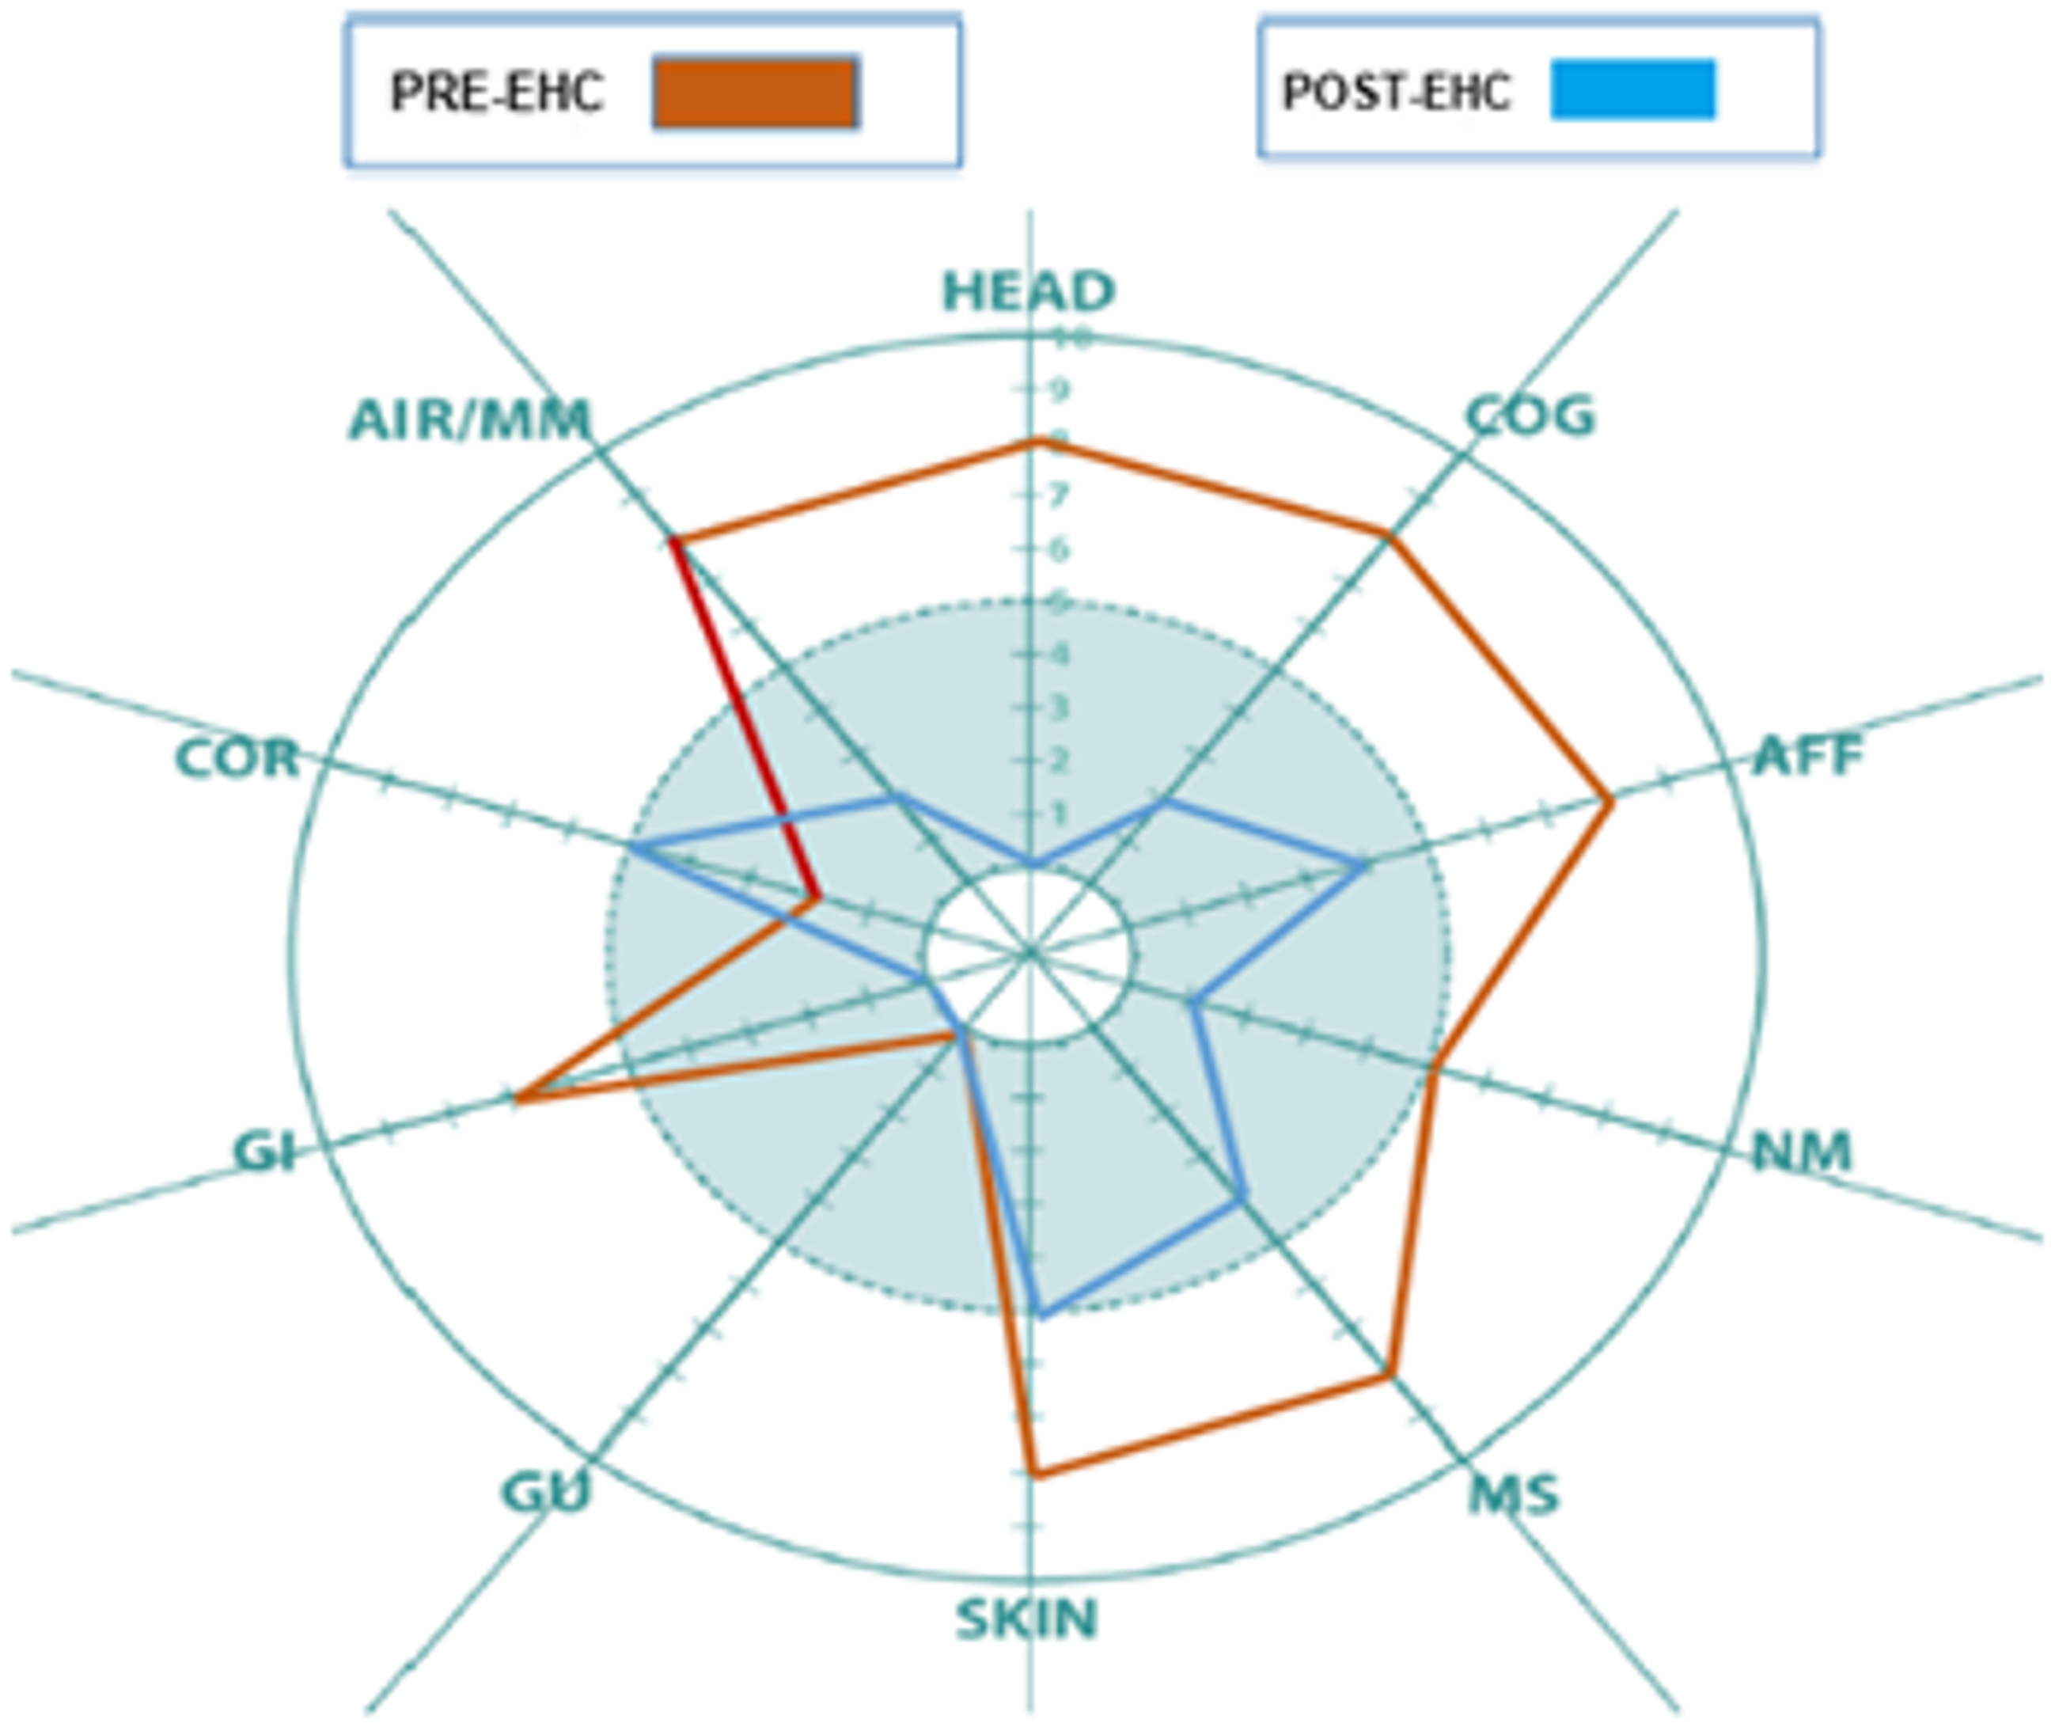

Slide 37
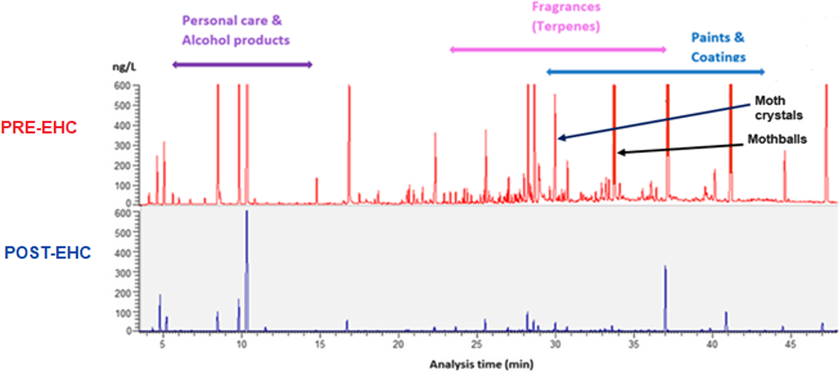

Slide 38
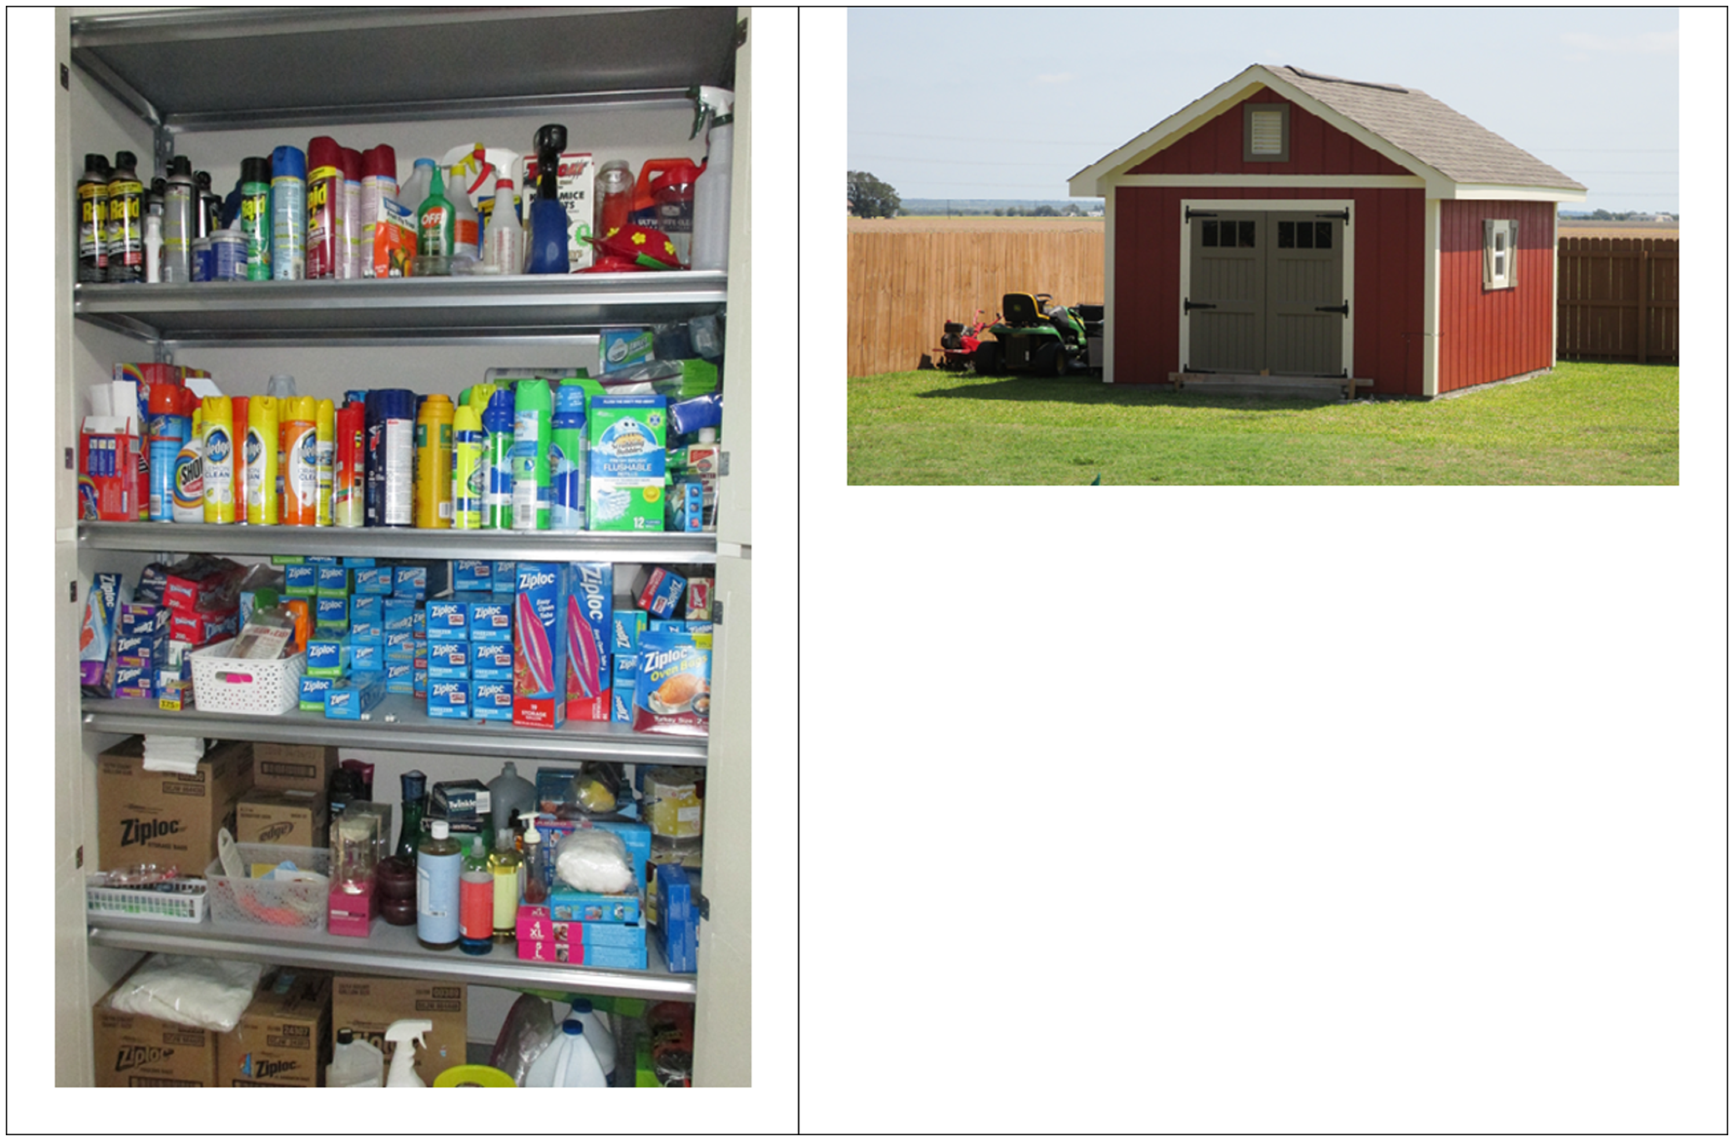

Slide 39
TILT Stage I: Initiation
TILT Stage II: Triggering
The
two stages of
TILT
Notes:
This is the graphical abstract from our paper titled “Assessing Chemical Intolerance in Parents Predicts the Risk of Autism and ADHD in Their Children” (2024). J Xenobiot 14(1), 350–367. https://www.mdpi.com/2039-4713/14/1/22 https://doi.org/10.3390/jox14010022. It summarizes the relationship between TILT and mast cells.
Toxicants are toxic foreign chemicals (xenobiotics) such as pesticides, solvents, or combustion products that can alter mast cells (TILT Stage I).
Toxic mold particles or mold VOCs also may initiate TILT. In Stage II, the initiating substance(s) and formerly tolerated chemicals including VOCs
arising from fragrances, cleaning products, new construction/remodeling, as well as foods/food additives, drugs and their excipients can
trigger mast cell degranulation resulting in inflammation and the multi-system symptoms that characterize TILT.

Slide 40
Why Are Autism & ADHD Increasing? The Potential Role of Fossil Fuels: Coal, Natural Gas, and Oil
Present
1973
Arab Oil Embargo
1950
Climate Change
Decreased fresh air, increased indoor VOCs
1939-1945
1859-Present
World War II
1760-1840
Industrial Revolution
Oil Production
Toxic mold
Algae
Synthetic chemical derivatives
Fossil fuels (coal, natural gas, oil, and their combustion products)
This illustration is copyrighted and available at: TILTResearch.org
Notes:
Our exposures to fossil fuels began less than 300 years ago during the Industrial Revolution when we began to burn coal to power engines, and subsequently coal and natural gas for lighting, heating, and cooking indoors. Oil production began around 1860 and has grown ever since. The production and use of synthetic chemicals, predominantly petrochemicals, began around WWII and have continued to increase exponentially. These include pesticides, persistent organic pollutants (POPs), endocrine disruptors (EDs), and volatile organic compounds (VOCs). Glyphosate (Roundup) is a broad-spectrum herbicide whose production began in 1974. It is now the world’s most widely used pesticide.
The combustion of fossil fuels has led to changes in weather and climate globally, resulting in more hurricanes, tornadoes, and flooding of homes and buildings leading to unparalleled mold growth indoors. Mold is now the most frequently reported initiator of Chemical Intolerance (Miller et al., 2023). Oil spills and “fracking” have become increasingly common and have the potential to initiate and/or trigger Chemical Intolerance/TILT.
The Arab Oil Embargo of 1973 led to increased efforts to reduce energy consumption so as to decrease U.S. dependence on foreign oil. One consequence has been more tightly sealed homes and buildings in order to reduce heat loss and energy use. The result has been indoor air contaminants accumulating to historically high levels. Heating and cooling homes and buildings require a great deal of energy. To reduce fuel use, requirements for fresh air in U.S. commercial buildings were drastically decreased and the use of insulation increased, resulting in unprecedented levels of indoor air pollution. Unbelievably, there was, and continues to be, no requirement for fresh air to dilute air contaminants inside homes. The result has been increased levels of all indoor air pollutants (xenobiotics) which can initiate TILT and trigger sensitized mast cells.

Slide 41
REFERENCES
SLIDE 11
Miller, C.S. (1996). Chemical sensitivity: symptom, syndrome or mechanism for disease? Toxicology 111, 69–86. https://doi.org/10.1016/0300-483X(96)03393-8
Miller, C.S. (1997). Toxicant-induced loss of tolerance–an emerging theory of disease? Environmental Health Perspectives 105, 445–453. https://doi.org/10.1289/ehp.97105s24
SLIDES 13
Miller, C.S., Palmer, R.F., Dempsey, T.T. et al. (2021). Mast cell activation may explain many cases of chemical intolerance. Environ Sci Eur 33, 129 https://doi.org/10.1186/s12302-021-00570-3
SLIDES 16-18 & 21-28
Miller, C.S. and Mitzel, H.C. (1995). Chemical sensitivity attributed to pesticide exposure versus remodeling. Archives of Environmental Health 50, 119–129. https://doi.org/10.1080/00039896.1995.9940889
Miller, C.S., & Prihoda, T.J. (1999a). The Environmental Exposure and Sensitivity Inventory (EESI): a standardized approach for measuring chemical intolerances for research and clinical applications. Toxicology and Industrial Health, 15(3-4), 370-385. https://doi.org/10.1177/074823379901500311
Miller, C.S., & Prihoda, T.J. (1999b). A controlled comparison of symptoms and chemical intolerances reported by Gulf War veterans, implant recipients and persons with multiple chemical sensitivity. Toxicology and Industrial Health, 15(3-4), 386-397. https://doi.org/10.1177/074823379901500312
SLIDE 30
Perales, R.B., Palmer, R.F., Rincon, R., Viramontes, J.N., Walker, T., Jaén, C.R., Miller, C.S. (2022). Does improving indoor air quality lessen symptoms associated with chemical intolerance? Primary Health Care Research & Development 23(e3): 1–12. doi: https://doi.org/10.1017/S1463423621000864
SLIDE 31
Rincón, R., Perales, R., Palmer, R.F., Forster, J.F., Hernandez, J.F., Bayles, B., Grimes, C., Jaén, C.R., Miller, C.S. (2024). Environmental house calls can reduce symptoms of chemical intolerance: a demonstration of personalized exposure medicine. Primary Health Care Research & Development doi: 10.1017/S146342362400046X

Slide 42


RESOURCES
Hayward Score QEESY & Symptom Star QR
Link: https://www.haywardscore.com/qeesi-symptom-star/landing-beta
TILT Self-Assessment QR
Link: https://tiltresearch.org/wp-content/uploads/sites/231/2025/07/TILT-Self-Assessment-12-4-2024.pdf
TILT Tutorial for Chemical Intolerance, Autism/ADHD:
https://tiltresearch.org/wp-content/uploads/sites/231/2024/10/TILT-Tutorial-Autism-ADHD-9-11-2024.pdf
TILT Tutorial for Exposed Communities and Individuals, Their Doctors, and Public Health Professionals:
https://tiltresearch.org/wp-content/uploads/sites/231/2024/10/Tutorial-for-Exposed-Communities-and-Individuals-9-11-2024.pdf

Slide 43
21st Century Building Science
Claudia Miller MD www.tiltresearch.org
Carl Grimes CIEC www.haywardscore.com
Westford Building Science Symposium
August 4-6, 2025

